Slide 1
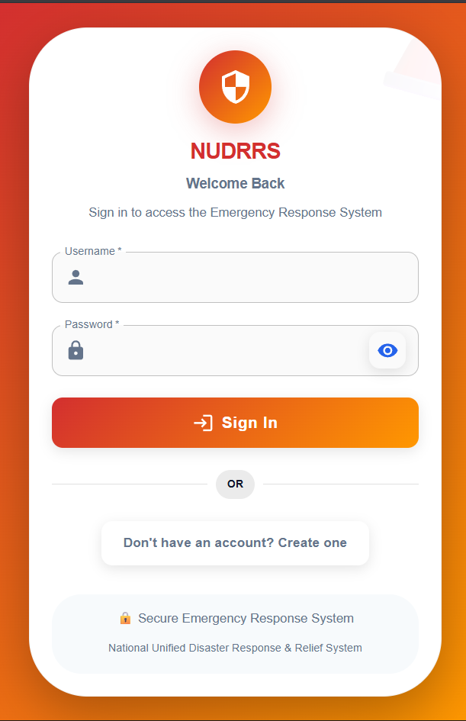
NUDRRS: National Unified Disaster Response & Relief System
India faces over 300 natural disasters annually, causing damages exceeding ₹50,000 Crores. Current emergency response systems suffer from slow response times, manual verification processes, and poor inter-agency coordination.
NUDRRS delivers an AI-powered emergency response platform with real-time intelligence capabilities, transforming how India responds to disasters.
Team HackerXHacker | Smart India Hackathon 2025

Slide 2





What is NUDRRS?
An intelligent disaster response platform that revolutionizes emergency management through cutting-edge AI technology and seamless government integration.
AI-Verified SOS Reporting
Real-Time Disaster Mapping
Multi-Channel Alerts
95% accuracy in emergency verification with fraud detection capabilities
Live visualization with predictive analytics and risk assessment
Instant SMS, WhatsApp, and email notifications to stakeholders
Government Integration
Crowdsourced Intelligence
Seamless API integration with existing government systems
Citizen reporting network with AI-powered fraud detection

Slide 3




How NUDRRS Works
Our streamlined emergency response process transforms disaster management through intelligent automation and real-time coordination.
Citizen Reports Emergency
AI Verifies & Analyzes
Automated Dispatch
Mobile app with GPS location tracking and AI-powered description analysis for accurate reporting
Advanced AI algorithms achieve 95% verification accuracy in under 3 seconds using multiple data sources
Real-time alerts sent to authorities with intelligent resource allocation and response coordination
Key Features: Voice-to-text emergency reporting, advanced image analysis for damage assessment, predictive risk modeling for proactive response planning

Slide 4
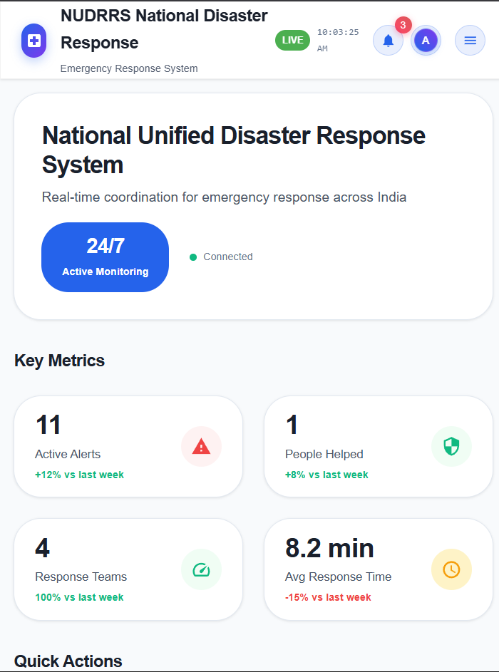
Technology Stack
Built on enterprise-grade infrastructure designed to handle India's scale and complexity with robust security and seamless integration capabilities.
Database Layer
AI/ML Engine
PostgreSQL for structured data with Redis for real-time processing and caching
Google Gemini API integration with YOLO v8 for advanced image recognition and analysis
Cloud Infrastructure
Security Framework
AWS/GCP deployment with auto-scaling to support 10,000+ concurrent users during peak disasters
AES-256 encryption, GDPR compliance, and government-grade security protocols
API Architecture
RESTful APIs designed for seamless integration with existing government systems and databases

Slide 5
Revenue Model
Scalable service-based pricing designed to deliver value while ensuring sustainable growth across government and enterprise sectors.
₹5-15
₹10K-50K
₹2-5L
₹2-20L
Per-Report Processing
Analytics Dashboard
State Government License
Custom AI Models
Cost per verified emergency report with AI analysis and verification
Monthly subscription for real-time analytics and insights per organization
Monthly unlimited access for state-level disaster management agencies
Specialized AI models tailored for specific disaster types or regional needs
₹1-10L
Integration Services
One-time setup plus ₹50K-2L monthly technical support and maintenance

Slide 6

Market Opportunity
Massive Growth Potential
India's disaster management market represents a ₹2,500 Crores annual opportunity with significant growth drivers accelerating adoption.
Target Market Size
28 states × ₹2-5 Lakhs monthly = ₹67-168 Crores potential ARR
Growth Drivers
Projected revenue growth from ₹50 Lakhs in Year 1 to ₹25 Crores by Year 3
Accelerating climate change impacts, government digitalization initiatives, and increasing AI adoption

Slide 7
Why NUDRRS ?
AI-First Approach
Lightning Speed
Cost-Effective Solution
95% accuracy in emergency verification compared to 60% with traditional manual processes
Under 3 seconds response time versus 15+ minutes with conventional emergency systems
70% reduction in emergency response operational costs through intelligent automation
Infinite Scalability
First-Mover Advantage
Auto-scaling infrastructure handles peak disaster loads without performance degradation
India's first comprehensive AI-powered disaster response platform with government integration

Slide 8





Use Cases & Impact
Real-world applications demonstrating NUDRRS's transformative impact across multiple disaster scenarios and government agencies.
Flood Response
Earthquake Relief
Fire Department
Government Agencies
Real-time flood monitoring with predictive analytics and automated evacuation alerts to at-risk communities
Immediate structural damage assessment using AI image analysis with intelligent resource allocation
AI-verified fire incident reports with automatic dispatch and optimal route planning for first responders
Centralized disaster management dashboard providing real-time situational awareness and coordination
Measurable Impact: 85% faster emergency response times, 70% cost reduction in disaster management operations, and most importantly—lives saved through intelligent early warning systems

Slide 9
Implementation Roadmap
Strategic three-phase deployment ensuring successful adoption, scalability, and sustainable growth across India's diverse disaster management landscape.
Phase 1: Pilot Program
Phase 3: National Deployment
6 months: Deploy in 3 pilot states with comprehensive testing and validation
18 months: Complete national coverage with international expansion opportunities
Investment: ₹2-5 Crores
Target: ₹25 Crores ARR
1
2
3
Phase 2: Regional Rollout
12 months: Expand to 10 states with enhanced features and proven scalability
Scaling: ₹10-20 Crores
Success Metrics: Maintain 95% AI accuracy, achieve 70% faster response times, and reach ₹25 Crores Annual Recurring Revenue by Year 3

Slide 10
Ready to Transform India's Disaster Response?
Immediate Impact
Revenue Potential
Market Leadership
Save countless lives through faster, more accurate emergency response and early warning systems
₹25 Crores ARR by Year 3 with scalable, sustainable business model
Secure first-mover advantage in India's AI-powered disaster management sector
Government Ready
Investment Opportunity
Purpose-built for compliance, security, and seamless integration with existing systems
Scalable, profitable, and socially impactful solution addressing critical national infrastructure needs
Questions & Discussion
Let's discuss how NUDRRS can revolutionize disaster response and save lives across India

