Slide 1

FRAUD DETECTION USING UNSUPERVISED ML MODELS
- Abhishek

Slide 2

Agenda:
Problem statement and Understanding Data set
Analyse data leveraging the EDA approach to balance and scale the data.
Proposing an unsupervised ml model to detect compromised merchant – K-Means, DBSCAN, Isolation forest.
Compromised and exploited dates.

Slide 3
Methodology
Step 1: Load and Preprocess the Data
Step 2: Exploratory Data Analysis
Step 3: Balancing the Target feature.
Step 4: Feature Engineering.
Step 5: Anomaly detection using unsupervised ML models.
Step 6: Model Evaluation and comparison.
Step 7: Finding the Compromised Merchant, Compromised dates and Exploited dates.
Data type, unique values for each feature, target class count, date range, merchant involvement in fraud.
Target class is highly imbalanced- using over-sampling
Merchant- transaction count and Standard scalar,LabelEncoder
K-means, DB Scan and Isolation forest
Silhouette Score
Frequency of transaction

Slide 4
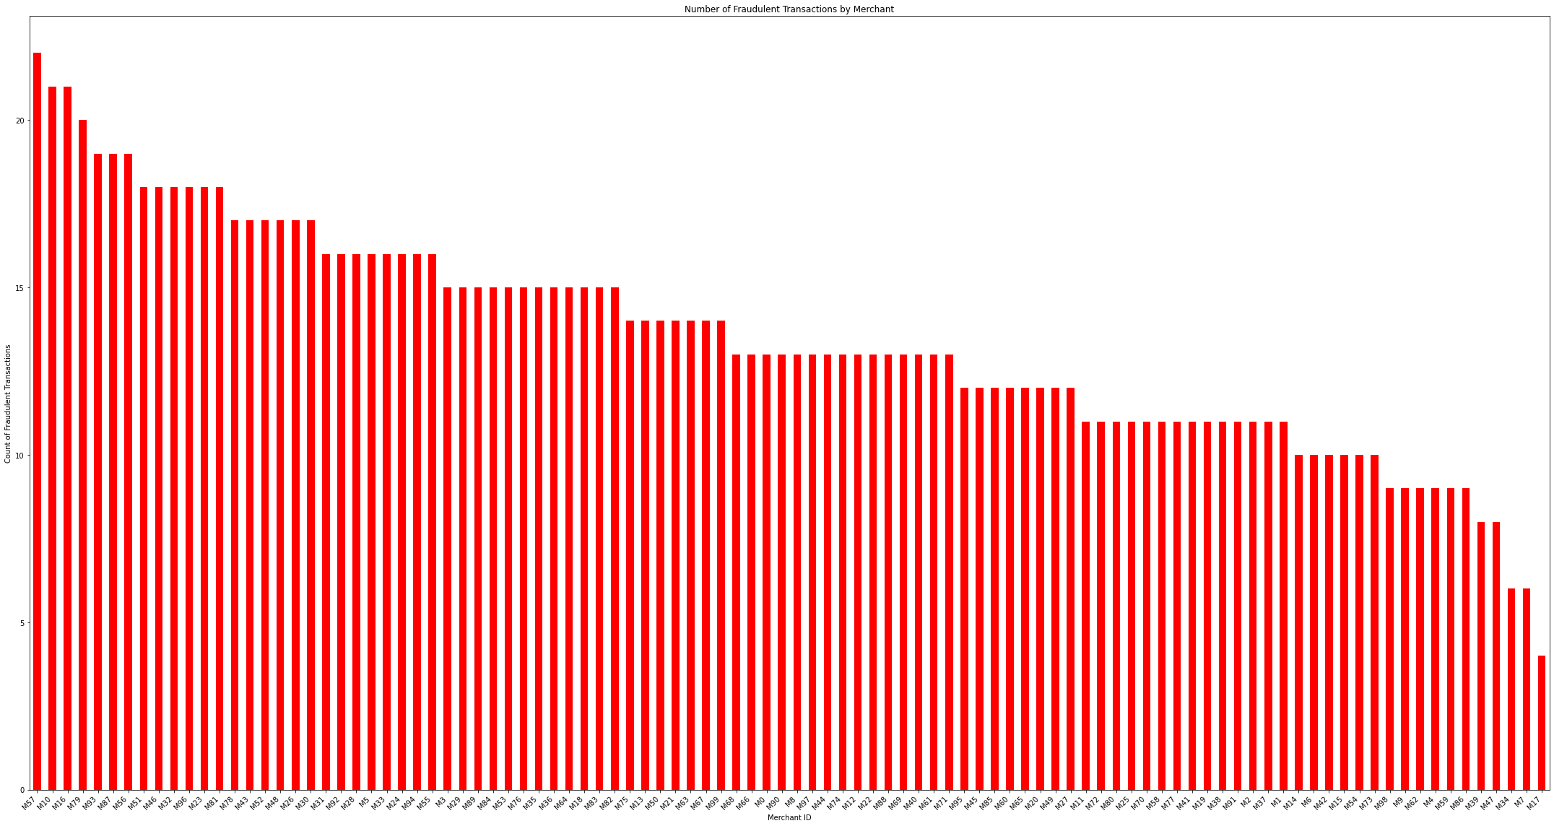
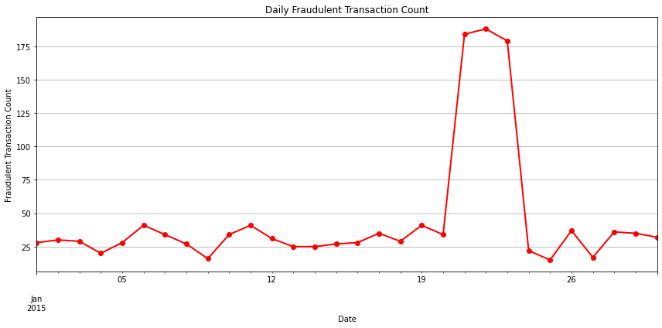
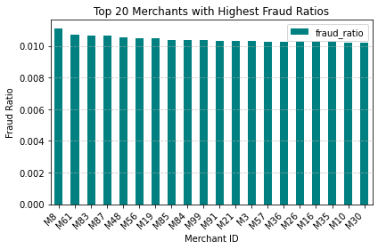
EDA of Transaction data with merchants
M57
1. The No. of transactions is similar for every merchant.
2. Highest Number of Fraud Transactions involves M57
3. M8 Has the highest Fraud Ratio.
4. 21st,22nd,23rd of Jan has seen the highest number of fraudulent transaction.

Slide 5
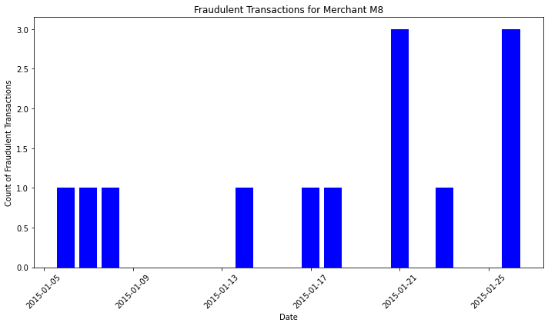
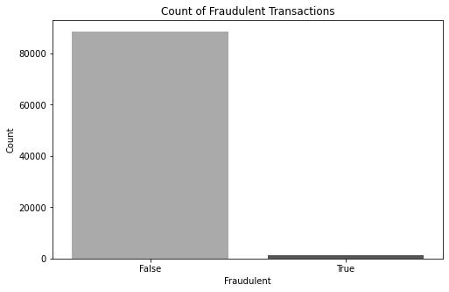
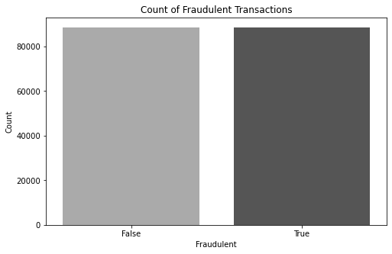

Merchant with the highest Fraud Ratio
M8
Step 1: Identify accounts with fraud
Step 2: Filter transactions of these accounts prior to the fraudulent transaction
Step 3: Count occurrences of each merchant in the compromised transactions
Step 4: Identify the merchant with the highest occurrence
88,503
88,503
88,503
1,348
Balanced Target class
(Using RandomOverSampler)
Imbalanced Target class

Slide 6
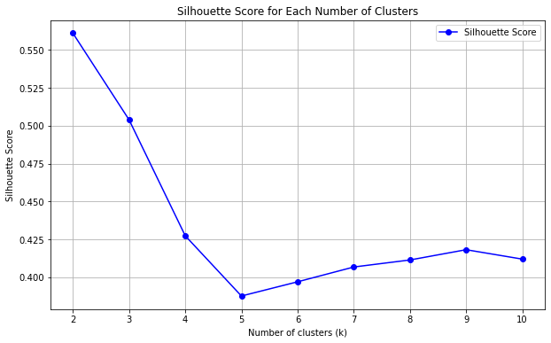
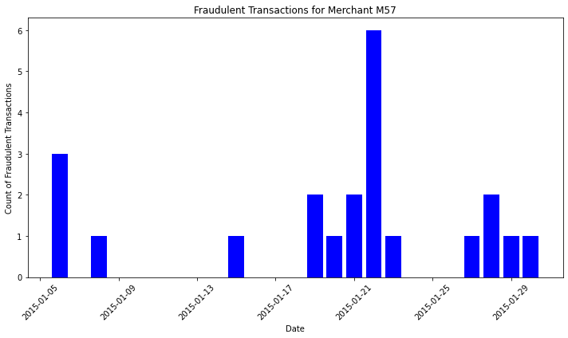

Unsupervised ML : K-Means
Methodology for implementing K-Means:
Filters the dataset to include only the transactions where fraud is true.
Grouping the 'merchant' and 'date' columns which are relevant for clustering.
Applies K-Means clustering to the prepared data with the specified number of clusters.
Adds the resulting cluster labels back to the data frame for further analysis.
Groups the data by clusters and identifies the largest cluster by size.
Identifies the most frequent merchant within the largest cluster, presumed to be compromised.
M57
KMeans(n_clusters = 9, random_state=42)
Dates of Compromise for Merchant M57:
2015-01-22
Dates of exploitation for Merchant M78:
2015-01-27, 2015-01-28,
2015-01-29, 2015-01-30
Notes:
First, we focused on fraudulent transactions from our dataset. The data preparation involved extracting the 'merchant' and 'date' columns from these transactions.
Since K-Means clustering requires numerical inputs, we used LabelEncoder to convert the categorical 'merchant' identifiers into numerical labels. This step ensures that each merchant is represented by a unique integer.
We applied the K-Means algorithm to the prepared dataset, specifying a certain number of clusters. For our analysis, we chose 9 clusters, though this number can be adjusted based on the data and the expected granularity of the results.The K-Means algorithm iteratively assigns each data point to one of the clusters based on the features and minimizes the variance within each cluster.

Slide 7
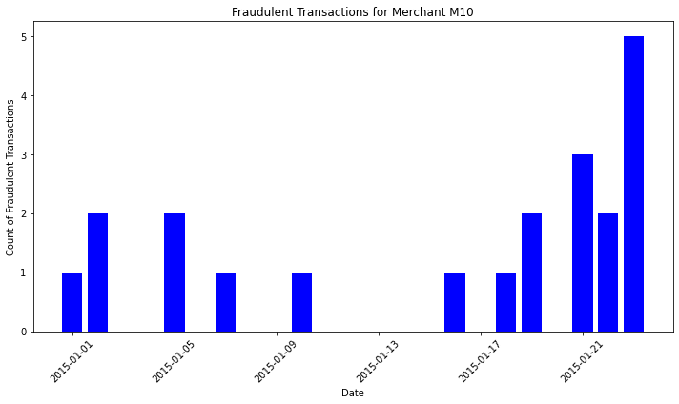
Unsupervised ML : DBSCAN
Track the best parameters:
If the current silhouette score is higher than the previously recorded best score, update the best parameters and clusters.
After exploring all combinations, the best eps, min_samples, and the highest silhouette score are printed.
Feature Extraction: Fraudulent_count feature
Data Scaling : StandardScaler
Applying DBSCAN Clustering:
We applied DBSCAN with specific values for eps (epsilon) and min_samples. In our case, eps was set to 0.3 and min_samples was set to 6
Analyzing Clusters:
The result of the DBSCAN clustering is stored in the 'cluster' column of our dataset.
Data points labeled with -1 are considered noise, which in the context of fraud detection, often correspond to anomalous activities.
We identified the cluster representing the compromised merchant by focusing on these noise points.
Best Parameters: eps = 0.03666666666666667,
min_samples = 6
Best Silhouette Score: 0.7380808274411298
dbscan = DBSCAN(eps=0.3, min_samples=6)
M10
Notes:
We applied DBSCAN with specific values for eps (epsilon) and min_samples. In our case, eps was set to 0.3 and min_samples was set to 6. These parameters can be adjusted based on the data characteristics.DBSCAN clusters data points based on density, identifying regions of high density as clusters and labeling points in low-density regions as noise (anomalies).
Data Preparation:
We started by filtering our dataset to focus on fraudulent transactions.
Next, we grouped these transactions by merchant and date, and counted the number of fraudulent transactions for each combination. This gave us a new dataset where each entry represents a merchant on a specific date along with the count of fraudulent transactions.
Feature Extraction:
From this grouped dataset, we extracted the 'fraudulent_count' feature, converting it into a floating-point numpy array for further processing.
Data Scaling:
Before applying DBSCAN, we scaled the data using StandardScaler. Scaling is crucial for DBSCAN as it relies on distance calculations, and features with larger scales can disproportionately influence these distances.
Applying DBSCAN Clustering:
We applied DBSCAN with specific values for eps (epsilon) and min_samples. In our case, eps was set to 0.3 and min_samples was set to 6. These parameters can be adjusted based on the data characteristics.
DBSCAN clusters data points based on density, identifying regions of high density as clusters and labeling points in low-density regions as noise (anomalies).
Analyzing Clusters:
The result of the DBSCAN clustering is stored in the 'cluster' column of our dataset. Data points labeled with -1 are considered noise, which in the context of fraud detection, often correspond to anomalous activities.
We identified the cluster representing the compromised merchant by focusing on these noise points.
Identifying the Compromised Merchant:
By examining the noise points (cluster label -1), we found the merchant with the highest count of fraudulent transactions, indicating a likely compromise.
The compromised merchant was identified and printed for further action.

Slide 8
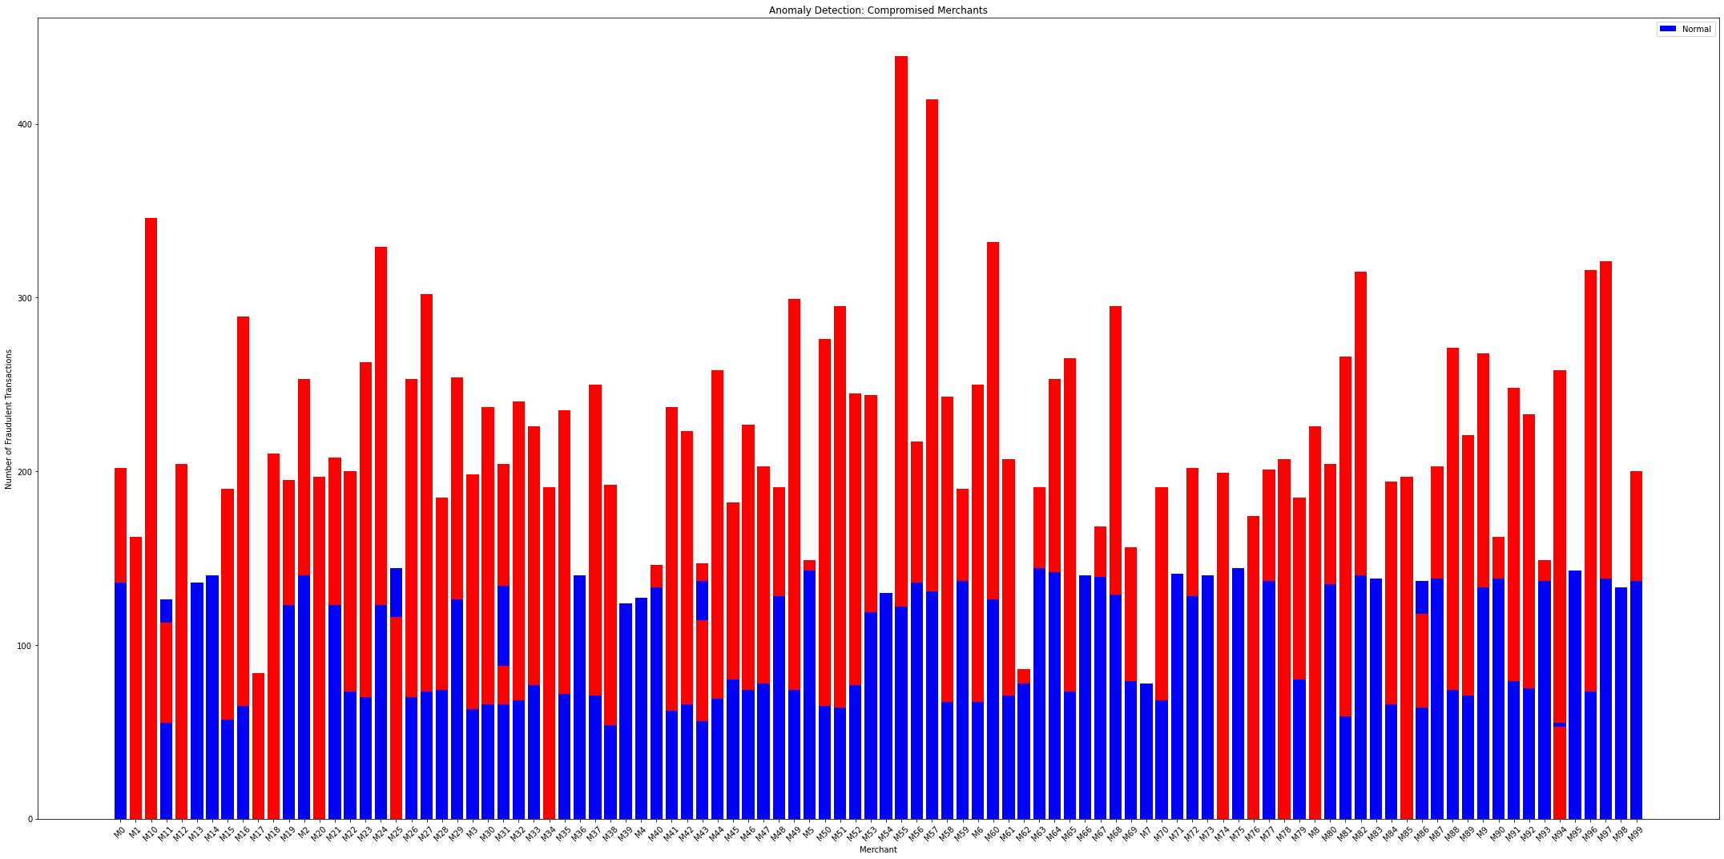
Unsupervised ML : Isolation forest
Filter for fraudulent transactions: Extract transactions marked as fraudulent from the dataset.
Group by merchant and date, count fraudulent transactions: Count the number of fraudulent transactions for each merchant on each date.
Prepare data for anomaly detection: Extract the count of fraudulent transactions as a feature for analysis.
Scale the data: Normalize the data to have zero mean and unit variance.
['M1', 'M10', 'M12', 'M17', 'M18', 'M20', 'M34', 'M74', 'M75', 'M78', 'M8']
M78
Apply Isolation Forest: Fit the Isolation Forest model to detect anomalies in the scaled data.
Predict outliers (anomalies): Identify anomalies in the data using the trained Isolation Forest model.
Find the compromised merchant (the most frequent anomaly): Identify the merchant with the highest frequency of anomalies (indicating compromise).

Slide 9
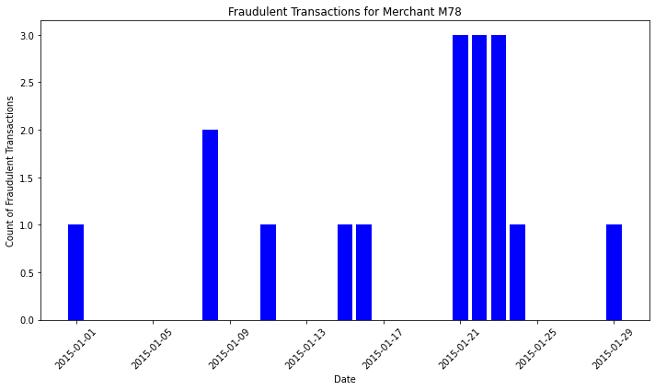
1 Std Dev is used as threshold for identifying unusually high activity periods
Dates of Compromise for Merchant M78:
2015-01-08
Dates of exploitation for Merchant M78:
2015-01-21,
2015-01-22,
2015-01-23

Slide 10
K-Means
Isolation Forest
M57
M78
Dates of Compromise for Merchant M57:
2015-01-22
Compromised Date
2015-01-08
Dates of exploitation for Merchant M78:
2015-01-27, 2015-01-28,
2015-01-29, 2015-01-30
Exploitation Dates:
2015-01-21, 2015-01-22,
2015-01-23
Notes:
How do you know?

Slide 11
Future Scope
Additional Data resources: Transaction Amounts, Geolocation Data, Merchant Categories, Transaction Frequency, Time of Day.
Account Behavior Analysis:
Analyze the behavior of compromised accounts before and after the fraud to identify any subtle changes or patterns.
DAG or Fraud Networks:
Investigate connections between different compromised accounts and merchants to identify potential fraud networks.
Neural Networks for Fraud detection:
Neural networks are a powerful tool in identifying complex patterns in large datasets
, making them ideal for detecting fraudulent transactions which often exhibit intricate patterns.

Slide 12

Thank you !

