Slide 1

Birdy
By Abhishek Singh

Slide 2
Mentor
Mr. Piyush Vashisth
(Asst. Professor)
Department of computer science & application.
Team
Abhishek Singh(181500028)
B.tech 3rd Year CSE
abhishek.singh2_cs18@gla.ac.in

Slide 3

1. Intro
Birdy is a scrolling based offline game based on flappy bird.
It is made using love gaming library and Lua.
It is a single player game in which you try to pass your bird through random pipepair by regularly jumping to score high.

Slide 4
Hardware & Software used
RAM- 4GB
Intel core i3 64-bit Processor (or higher)
Love 2D
Sublime text 3 (or any text editor that support language LUA)
Language
LUA

Slide 5


LOve 2D
LÖVE (or Love2D) is an open-source cross-platform engine for developing 2D video games. The engine is written in C++ and uses Lua as its scripting language.
Love is a cross platform.

Slide 6
LUA
Advantages
Lua is fast.
Lua is portable.
Lua is embeddable.
Lua is simple but powerful.
Lua is a powerful, efficient, lightweight, embeddable scripting language. It supports procedural programming, object-oriented programming, functional programming, data-driven programming, and data description.

Slide 7


Game Content
Background
pipe
medals
Bird

Slide 8
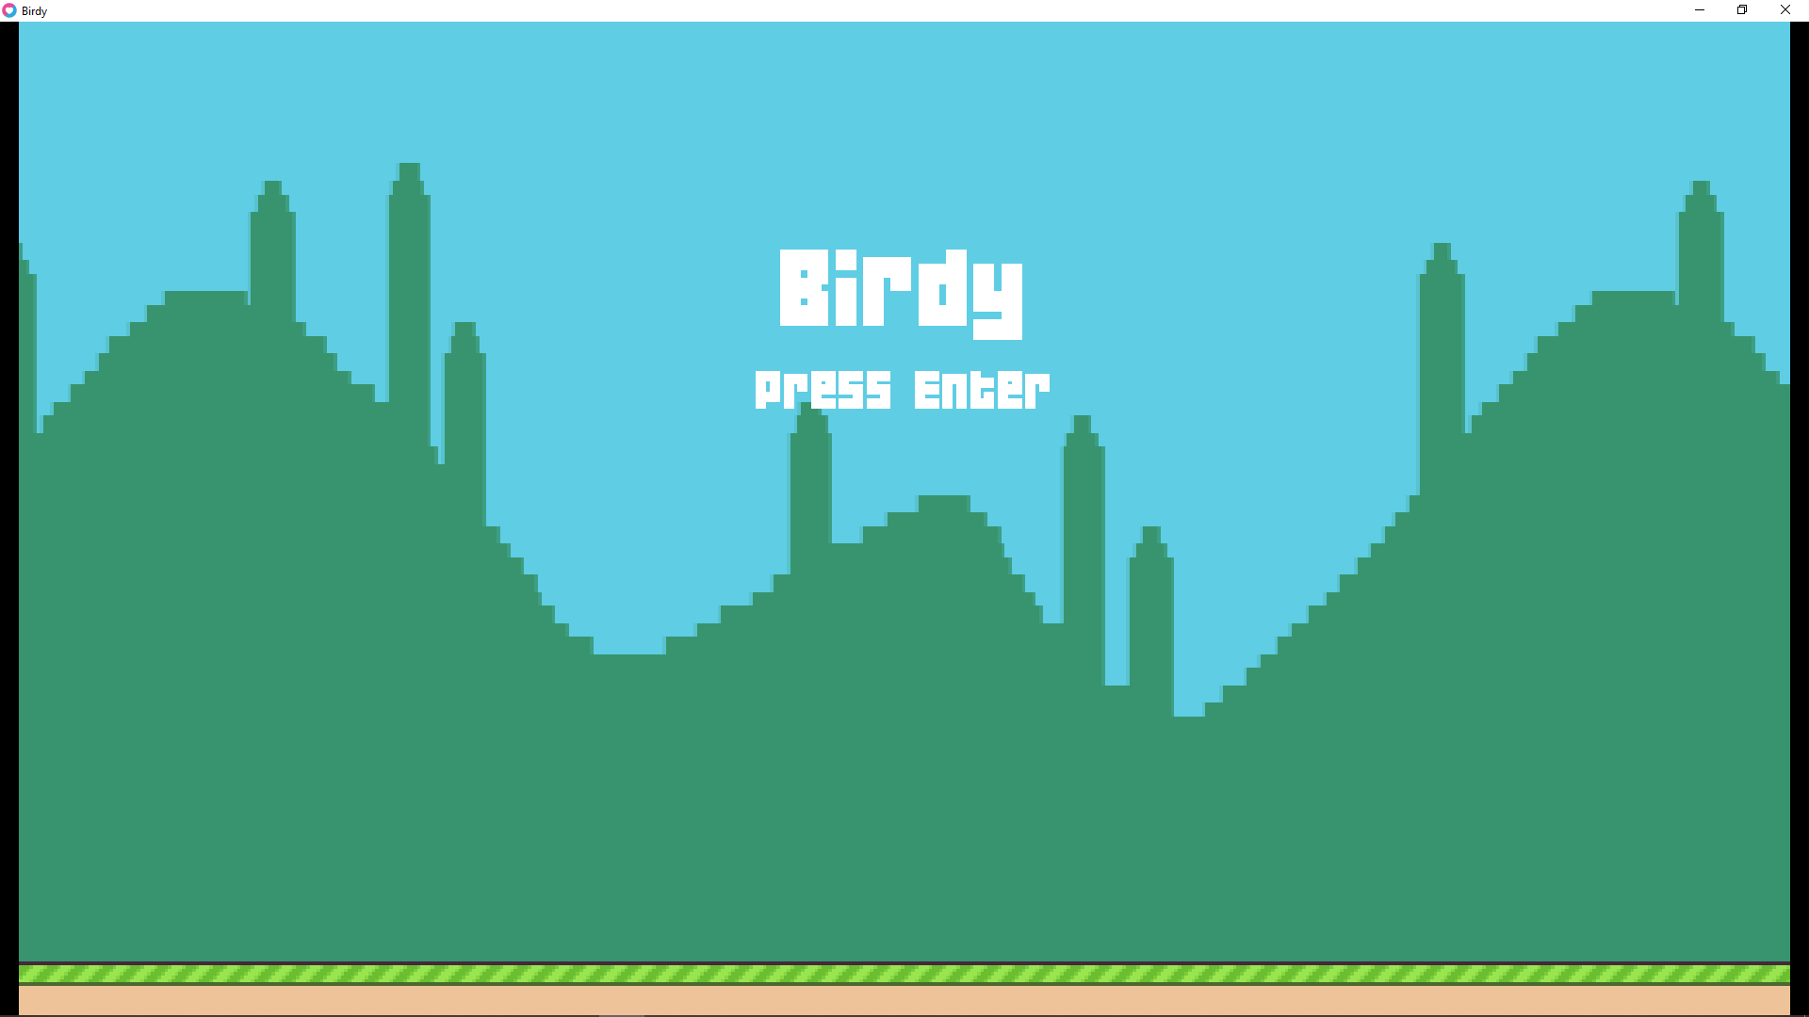
Gameplay
Title Screen
When you start the game this screen shows up.
To start the game you have to press enter key.
To jump the bird you have to press space-key or left-click on mouse.

Slide 9
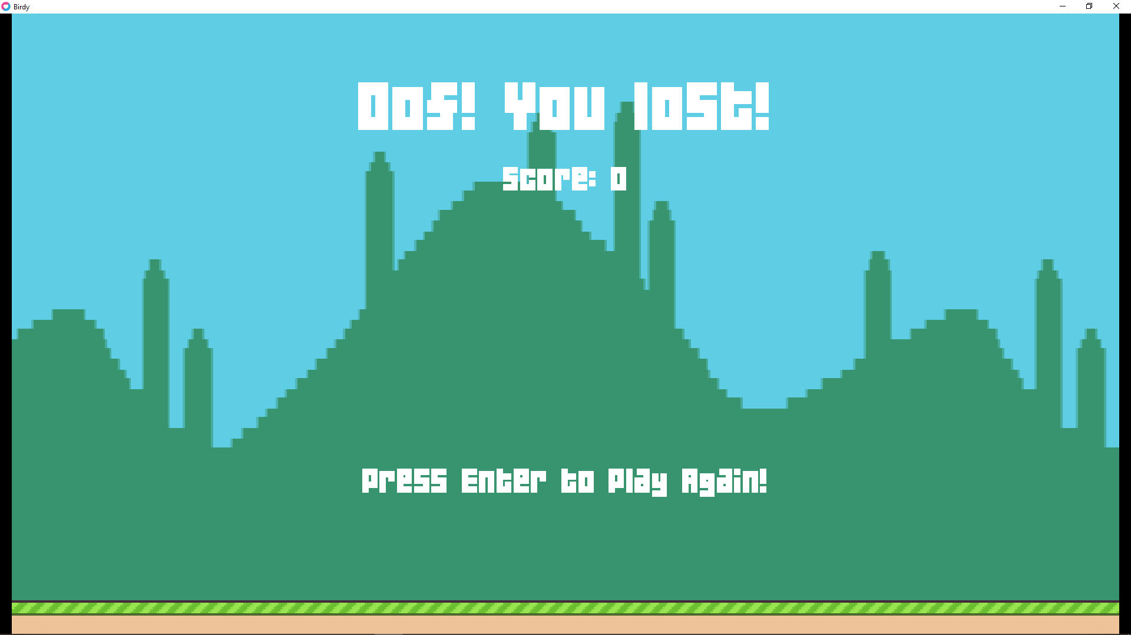
Lost screen

Slide 10
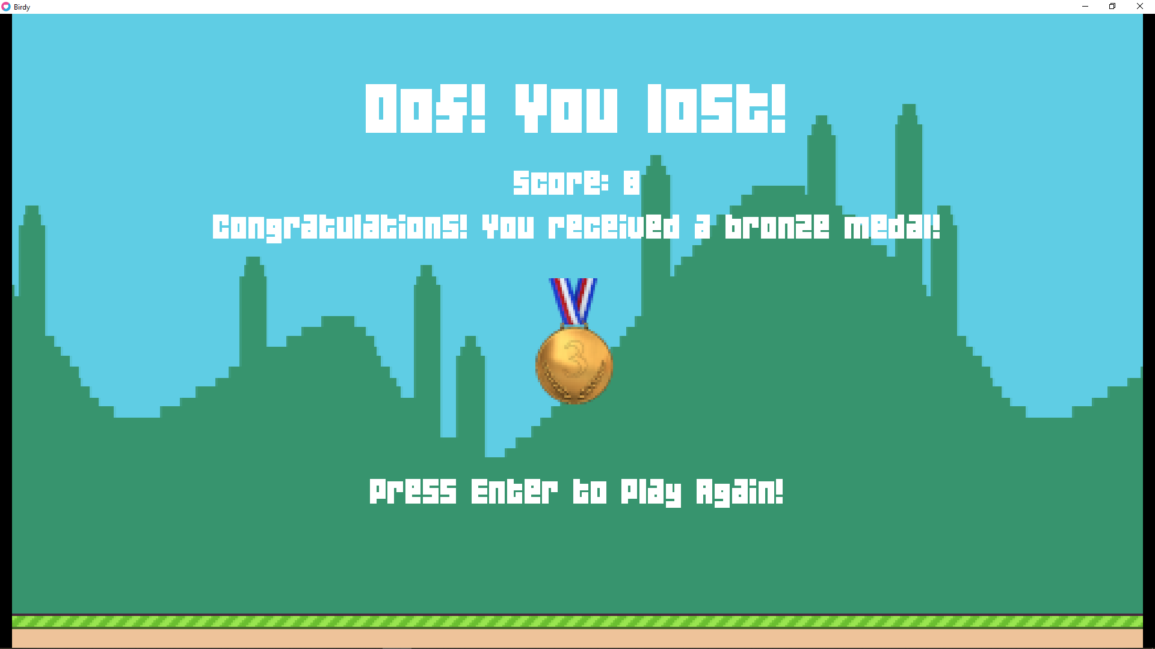
Score Screen

Slide 11
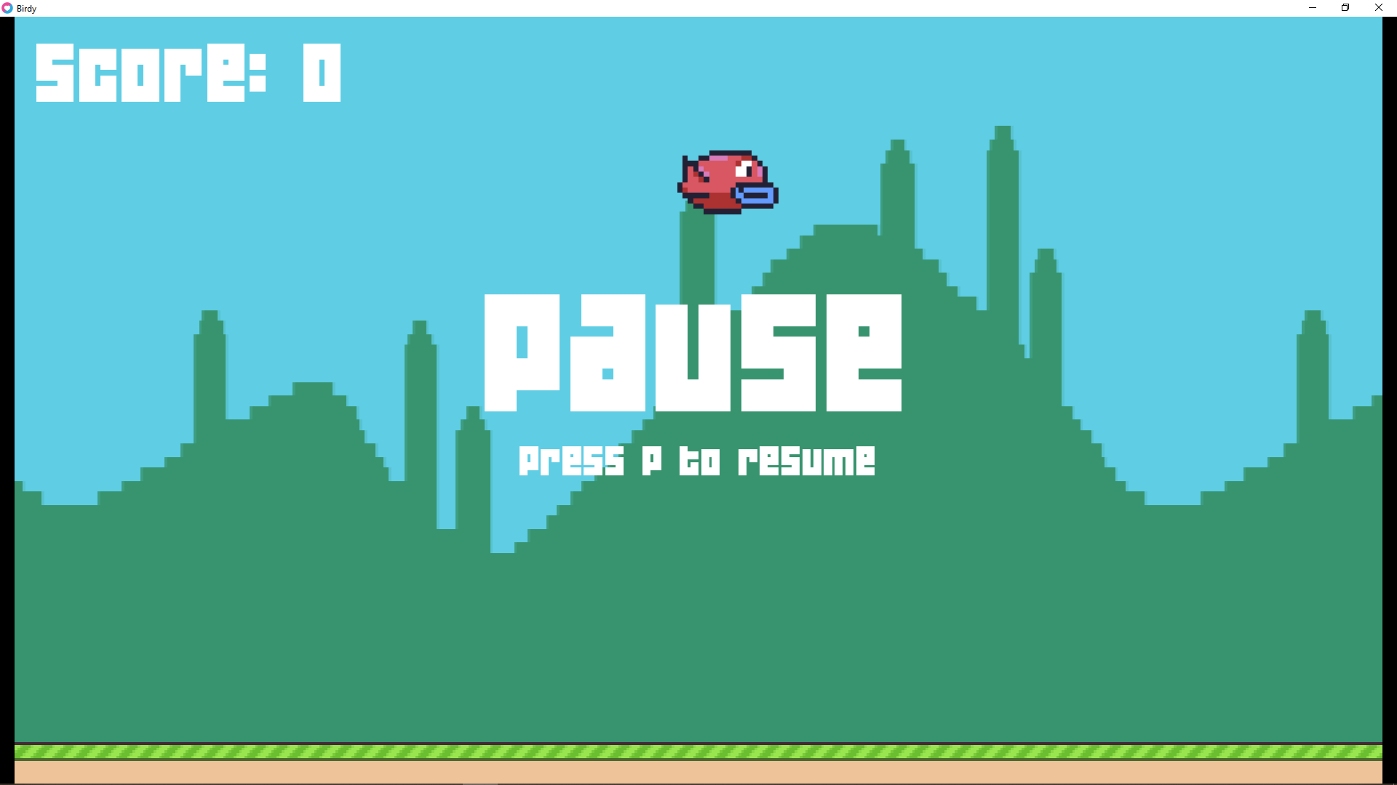
Pause & Resume Screen
Whenever player press key p the game will pause.
To resume the game the palyer has to again press the key p.

Slide 12
References
https://www.lua.org/
https://www.tutorialspoint.com/lua/index.htm
https://love2d.org/
https://www.sublimetext.com/3
https://www.wikipedia.org/

Slide 13
ThankYou

