Slide 1

Case Study 1
Analysis of Various complaints in Apollo Hospital
Master of Data Science

Slide 2
Agenda
Introduction
Problem statement and Data Source
Objective and Methodology
Solution Description

Slide 3
Introduction
This case study is about various complaints related to Apollo Hospital Services.
These complaints where collected through form filling by medical services beneficiaries.
As per the data there were total 845 complaints received from patients.
To analyze most frequent/significant problems Pareto charts has been used.
After analysis, we suggested to Apollo Hospital to prioritize the problem so that hospital services will be delivered smoothly.

Slide 4
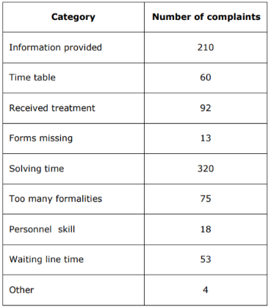
Problem Statement
The city Apollo hospital Must analyse and solve the various complaints of the patients, which are submitted to the Head Nurse Office. In order to analyse the complaints and claims we use the Pareto Diagram In our case, we consider 845 received complaints, starting from the complaint forms filled in by the medical service beneficiaries, which were grouped in the following categories:

Slide 5
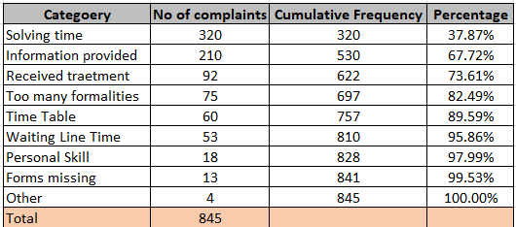
Objective And Methodology
Find out the most significant problems.
Prioritize the most frequent problems.
Resolve the problems according to priority to get the best results.
Analysis Done By Using Pareto Chart

Slide 6
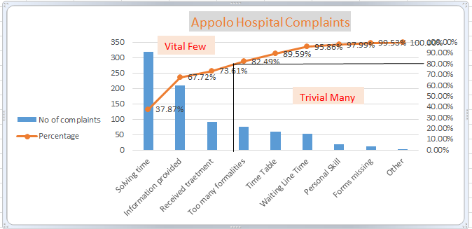
Objective And Methodology
Pareto Chart

Slide 7
Objective And Methodology
As per the rule of Pareto Chart problems are divided into 80:20
According to analysis below three problem categorized into ‘Vital Few’ : a. Solving Time
b. Information Provided
c. Received Treatment.
And below six problems are categorized in ‘Trivial Many’:
a. Too many formalities
b. Time Table
c. Waiting Line Time
d. Personal Skill
e. Forms missing
f. Other

Slide 8
Solution And Description
To get best results in terms of patients satisfaction we need to resolve problems in ‘Vital Few’ category first.
Reasons:
a. Frequency of Solving Time category is high (320)
b. Second most high frequency category is Information Provided (210)
c. Final high frequency category is Received Treatment (92)
‘Trivial Many’ would be second priority problems.
Reasons:
a. Frequency of rest category is less.

Slide 9
Solution And Description
To resolve problems in minimal time below action would be taken :
Reasons:
a. Automation is needs to be implemented to avoid manual intervention
ex. Medical staff and OPD doctor communication through internet for quick action.
The best solution for Information Provision as below :
a. Medicine and Operation theaters availability should be displayed on tablet to doctors.
To Improve Received Treatment best solutions as below :
a. Hospital should be equipped with advanced technology.

Slide 10


