Slide 1
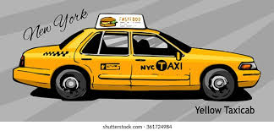
CAB FARE PREDICTIONS

Slide 2
Business problem
With this data we are tasked with predicting the fare amount for a taxi ride in New York City given the pickup and Dropoff locations.
Features
pickup-datetime
pickup-longitude
pickup-latitude
drop-off-longitude
drop-off-latitude
passenger-count Target
Fare-amount

Slide 3
ATTRIBUTES
Pickup-datetime : It indicates the date and time when the taxi ride started.
Pickup-longitude: Longitude coordinate of where the taxi ride started.
Pickup-latitude : Latitude coordinate of where the taxi ride started.
Dropoff-longitude : Longitude coordinate of where the taxi ride ended.
Dropoff-latitude : Latitude coordinate of where the taxi ride ended.
Passenger-count : Integer indicating the number of passengers in the taxi ride.

Slide 4
TARGET
Fare-amount - The cost of the taxi ride.
As our data is of New York so the values are in dollars.

Slide 5
RESOURCES
KAGGLE : Platform from where data is collected.
JUPYTER NOTEBOOK : To run all the libraries and codes.
Libraries used:
Pandas
Numpy
Seaborn
Matplotlib
Scipy
Sklearn

Slide 6
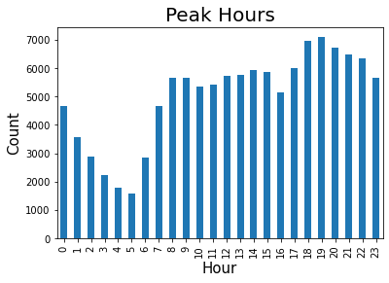
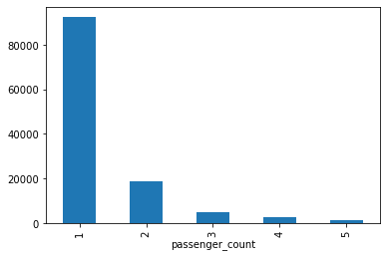
PEAK HOURS
NUMBER OF PASSENGERS
Number of cabs booked per hour.
Passengers in the cab at a time.
Here the peak hour is around 7 PM to 8PM which is office hour. And only one passenger uses a cab at a time

Slide 7
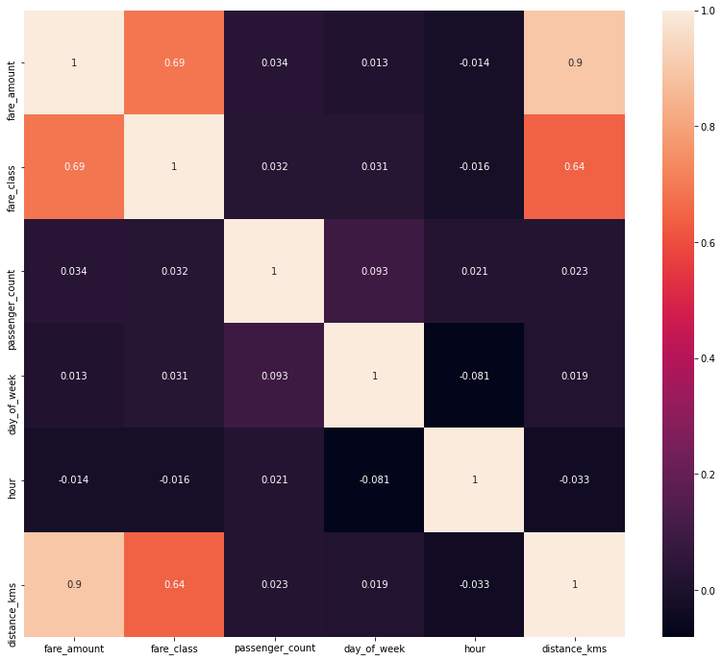
Correlation
As we can see fare amount is highly correlated with distance.

Slide 8
Machine learning
As we know that our target variable is fare amount charged by the cabs. And fare charges are continuous variable.
So we decided to do supervised machine learning. Wherein there are 3 algorithms which are:
Linear Regression
Decision tree Regressor
Random Forest Regressor
So, we used these three, one by one and check the accuracy of the same.
According to the accuracy we decided which model should be used to predict the fare charges of the cab.

Slide 9
Machine Learning models
Linear Regression = 82.13%
As the accuracy over here is around 82 %,so we changed the model to check the accuracy.
Decision Tree Regressor = 76.75%
In Decision Tree Regressor accuracy is lower than Linear Regression. So we move to Random Forest Regressor.
Random Forest Regressor = 85.53%
Random Forest Regressor is giving accuracy better than above all models, which is around 85%.
CONCLUSION:
So Random Forest is giving the best accuracy which is 85.53%.

Slide 10
THANKS FOR YOUR TIME ☺

