Slide 1

Personalized Session based Recommendation Systems
Team15: Abhinav Arun, Anshit Verma, Joseph Geibig, Mehul Soni

Slide 2
Contents
Introduction & Motivation
Approaches
Datasets
Comparative Study and Future Work
Experimentation and Evaluation
Results

Slide 3
The Problem
In many online applications, recommending relevant items to users is both important and an incredibly difficult task
One recent innovation is grouping interactions by ”sessions” – which are defined over a time window – and using them to create recommendations through utilizing both short and long term interest of users.
Why should we care?
Many Multi-Billion dollar industries rely on innovations in recommendation space to get the edge over others
Boost up user engagement on the platform by utilizing insightful session-level data.

Slide 4
Approach

Slide 5
Why these methods? - HG-GNN ISCON
HG-GNN - Graph based method –Focused on Global Graph construction and Graph Neural Network
ISCON - Context aware method – Focused on contextualizing Sessions and LSTMs
Limitations of Current Session Based Recommender systems :
Focus on item transition patterns neglecting user historical interactions (Non-Personalized Recommendations)
Limited to sessions of current user
Do not leverage implicit session contexts for next item recommendation
Our Selected Methods:

Slide 6
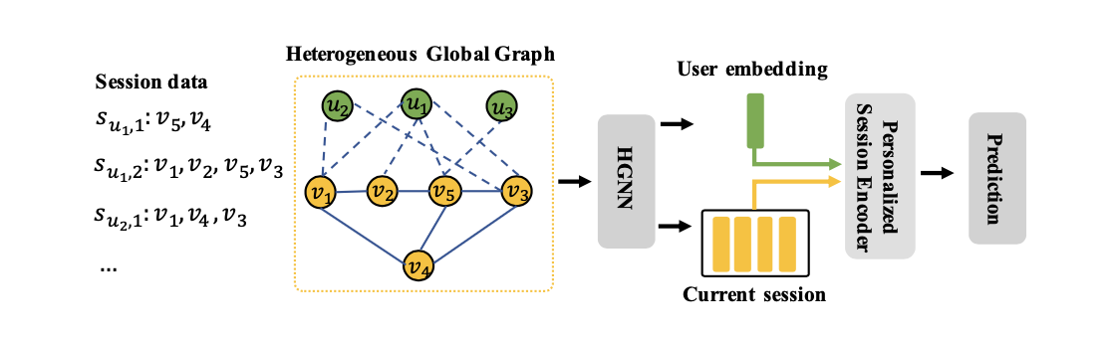
HG-GNN
Heterogenous Graph Neural Network
Item-Item graph: in-out adjacency and co-occurrence within a given session
Heterogenous Global Graph Construction
Graph Neural Network to learn user and item embeddings
User-Item graph: interactions between user-item over all historical sessions
Yields us long-term user preference and global-level item refined embeddings
https://dl.acm.org/doi/pdf/10.1145/3488560.3498505

Slide 7
HG-GNN
Gating Mechanism
Item-Level attention mechanism for the current session leveraging the item position information
Personalized Session Encoder
Final Session Preference Representation - linearly combining long-term and short-term embeddings
Captures current interest of the user
Learnable Contribution Parameter
https://dl.acm.org/doi/pdf/10.1145/3488560.3498505

Slide 8
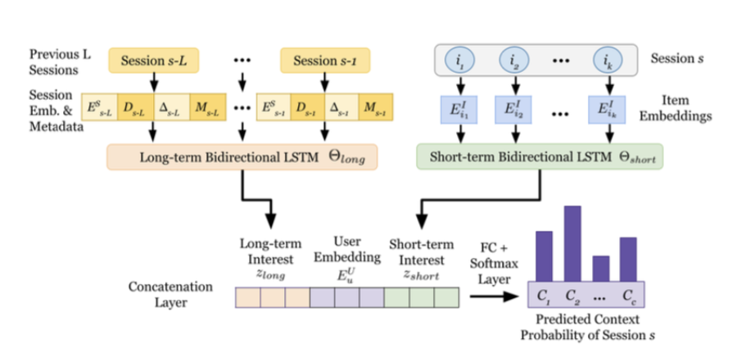
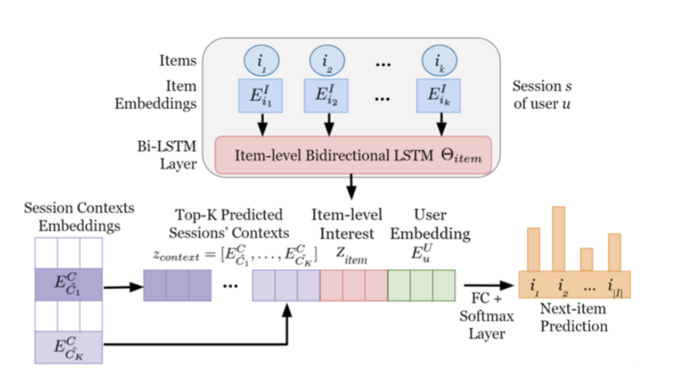
ISCON
Session Clustering Algorithm
GraphSAGE algorithm for session embedding
Session Generation/Embedding Algorithm
Embeddings clustered using K-means algorithm
LSTM used to predict next-item based on item embeddings and previously generated top-k session embeddings
LSTM Model – context prediction
Session Context Prediction
Next-Item Prediction
https://arxiv.org/pdf/2208.09076.pdf
Notes:
3. Session Context Prediction
LSTM model used to predict context (i.e. cluster of session)
Contexts are generated as a list of probabilities for each cluster
Top-k clusters are taken as an embedding. For both models, we used a top-k of 3 (top 3 clusters)
4. Next-Item Prediction
LSTM used to predict next-item based on item embeddings and previously generated top-k session embeddings.
Next-item predictions generated as list of probabilities, ordered from max to min

Slide 9
Datasets

Slide 10
The Reddit Dataset
The LastFM dataset
Shows user-subreddit interactions over time
Sessions were generated with a 60-minute threshold
Gathered directly from Kaggle
Objective: Subreddit recommendation
Contains music listening history and artists for ~1000 users.
Sessions were generated with an 8-hour threshold
Gathered directly from website
Objective: Artist (Item) Recommendation
Statistic | Reddit | LastFM
Number of Sessions | 1,337,594 | 702,941
Number of Users | 21,177 | 989
Number of items | 22,498 | 50,000
Avg Session length | 1.77 | 10.71
Avg # of Sessions | 65.05 | 708.61
All sessions with less than 3 interactions were removed
All users with less than 5 sessions was removed

Slide 11
Experiments and Evaluation

Slide 12
Experimental Setup
HG-GNN
Sampling Size : [8, 12, 16]
Top-K Similar Items : [10, 15, 20]
Number of GNN Layers : [1, 2, 3, 4]
Mini-Batch Size : 512
Adam Optimizer
Train-Test Split : ['By Time' , ‘By User-Interaction']
ISCON
Train-Test Split : ['By Session']
Max Sequence Length per user : 50
Batch Size : 1024
Learning Rate : 0.001
Number of Contexts : [10,20,30,40,50]
Top-K Contexts : [1, 2, 3, 4, 5]
Evaluation Metrics: HITS RATIO and MEAN RECIPROCAL RANK (@5, @10)

Slide 13
Results

Slide 14
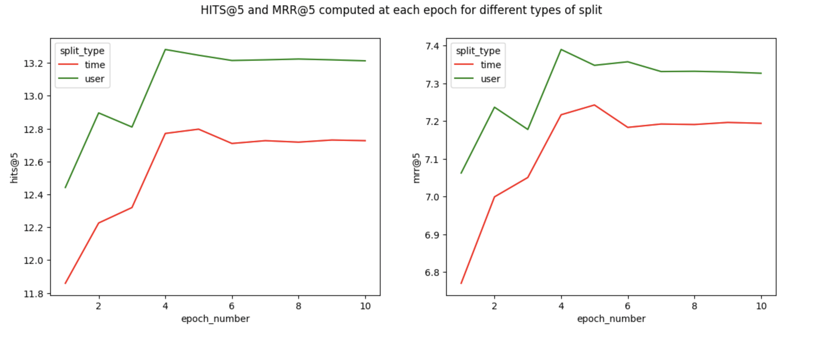
Split Type – Time vs User-Interaction
HG-GNN

Slide 15
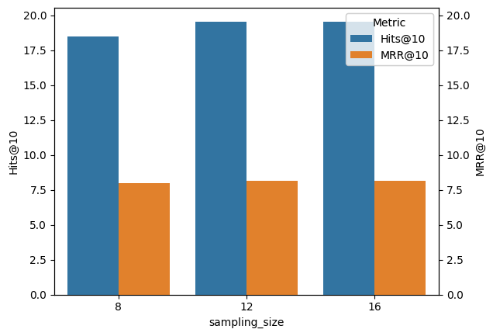
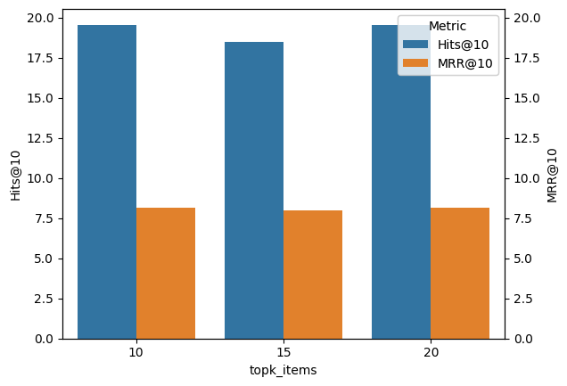
Hyperparameter Tuning
HG-GNN

Slide 16
Ablation Studies
HG-GNN
Evaluating the impact of Critical Components involved in the Model Architecture
(Evaluated for Best Set of Hyperparameters)
Model Setting | HR@5 | HR@10 | MRR@5 | MRR@10
w/o CPL Module | 12.64 | 18.92 | 7.01 | 7.83
w/o GPL Module | 13.23 | 19.56 | 7.34 | 8.17
HG-GNN | 13.25 | 19.54 | 7.34 | 8.17

Slide 17
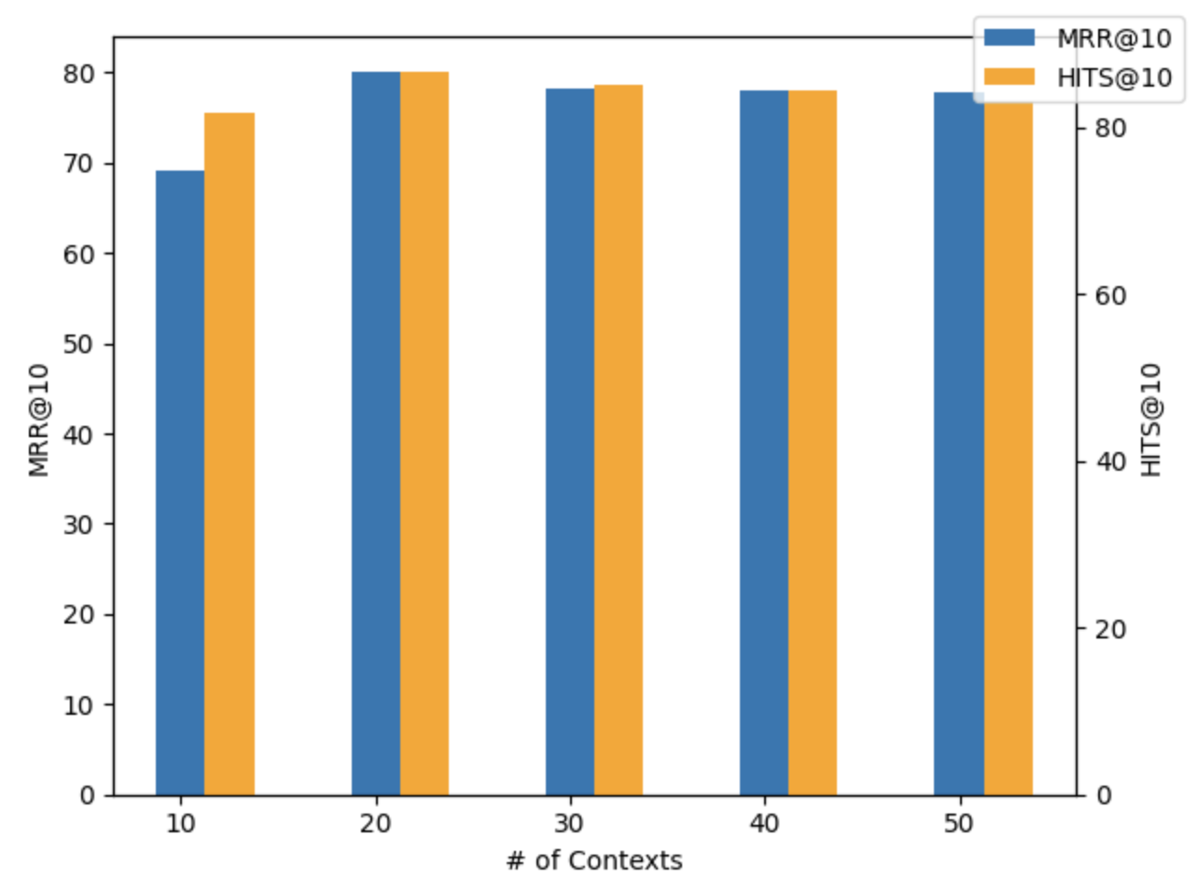
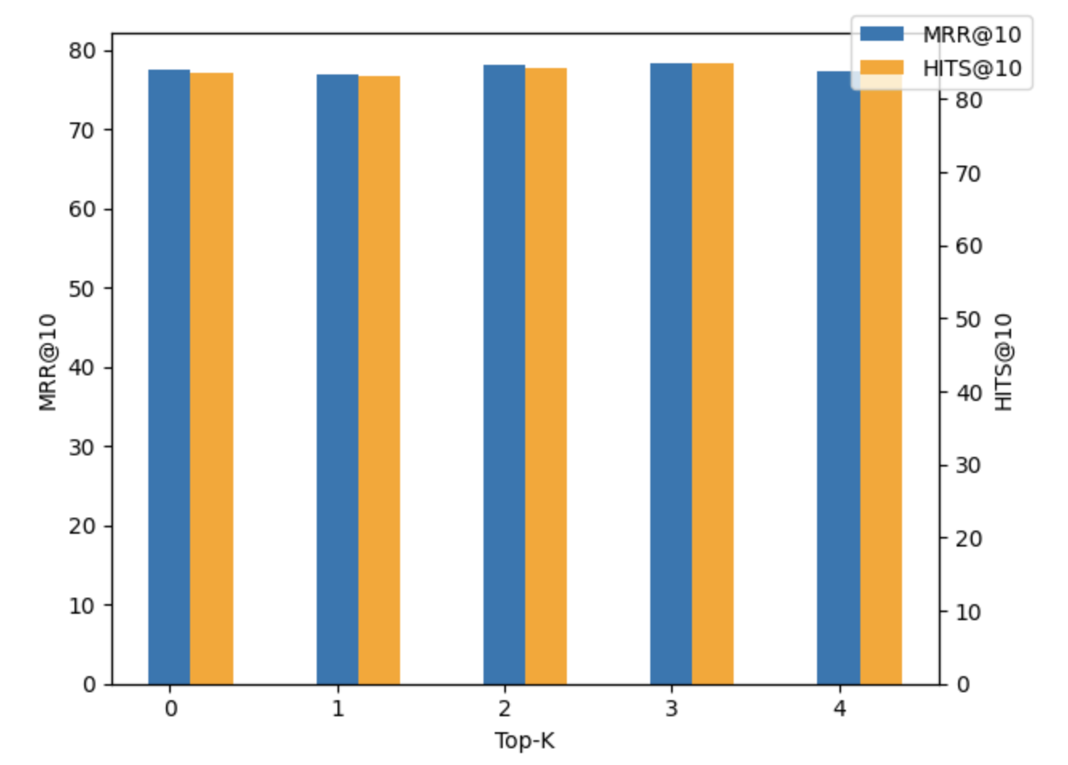
Hyperparameter Tuning
ISCON

Slide 18
Final Results
METHOD | Reddit |  |  |  | LastFM
 | Hits@5 | Hits@10 | MRR@5 | MRR@10 | Hits@5 | Hits@10 | MRR@5 | MRR@10
HG-GNN (Baseline) | 51.08 | 60.51 | 35.46 | 36.89 | 13.09 | 19.39 | 7.35 | 8.18
HG-GNN* | 27.3 | 43.7 | 15.85 | 18.35 | 13.25 | 19.54 | 7.34 | 8.17
ISCON* | 81.47 | 85.72 | 71.12 | 71.70 | 9.37 | 14.40 | 5.18 | 5.83
Note: All results presented in percentages
* Baseline – Results as taken from the original papers
* Our Implementation - Results presented of each algorithm are with the best set of hyperparameter setting

Slide 19
Comparative Study and Future Work

Slide 20

Comparative Analysis of Methods
Overall, the performance of each model was drastically different between each dataset, with the ISCON model performing better on the Reddit dataset, and the HG-GNN model performing better on the LastFM dataset.
LastFM dataset having a significant number of items per session can make specific context generation difficult. Thus, the ISCON model performs poorer on this data.
Since the Reddit dataset has very few average items per session, it can be difficult to generate item – item co-occurrence for an HG-GNN model, leading to poorer performance.
Notes:
Overall, HG-GNN models perform better on sparse data where the co-occurrence of items is important
Overall, the performance of each model was drastically different between each dataset, with the ISCON model performing better on the Reddit dataset, and the HG-GNN model performing better on the LastFM dataset.
Since the Reddit dataset has very few average items per session, it can be difficult to generate item – item co-occurrence for an HG-GNN model, leading to poorer performance
Conversely, the LastFM dataset having a significant number of items per session can make context generation difficult, especially with the computational power available to us. Thus, the ISCON model performs poorer on this data
Conversely

Slide 21

Future Work
Explore other State-of-the-art architectures like Transformers , fine tune the architecture for the explored methods
01
Develop models focused on scalability and interpretability
02
Focus more on creating robust domain-adaptive models.
03

