Slide 1

CL-643 PROJECT
Priyansh Sanjeev Shrivastav 210102118
Abhishek Gupta 210108065

Slide 2
INDEX
1
2
3
4
5
Introduction
Problem
Data
Formulation
Result

Slide 3

Task Allocation for Performance Optimization
In today’s academic landscape, every single student wants to achieve a good cumulative grade point average (CGPA) or every person wants to maximize his performance. But because different subjects need different amount of time and focus depending on the interest in the subject, it’s hard to figure out to study best for given time bounds.
Recognizing this challenge, our project delves into the realm of optimization modeling to assist students in maximizing their Performance by allocating their study hours effectively across tasks.

Slide 4
Problem
Task 1
X1 Hours
Task 2
X2 Hours
Task 3
X3 Hours
K Hours
Maximize Performance with Constraints
Task n-1
Xn-1 Hours
Task n
Xn Hours

Slide 5
Problem
In the previous slide, the flowchart of the problem can be seen which shows that K hours need to be distributed into several tasks (subjects) of Xi hours in such a way that the CGPA of a student is maximized.
Each task demands a specific time (time(i)) for its complete execution. Allocating Xi hours to each subject corresponds to completing a portion of the subjects, with each subject carrying a distinct weightage and completion time. The objective is to maximize the overall CGPA by strategically distributing time across subjects in a manner that optimally aligns with their individual weights and completion times.
Each task/subject i, has => 1. Credit ( credit(i) )
2. Efficiency ( efficiency(i) )
3. Completion Time ( time(i) )
Objectives:
Maximize Overall CGPA (Performance)
Constraints:
1. Σ(time allocated) <= Total Hours (k)
2. Grade in every subject should be greater than or equal to 4. (i.e. to pass the subject)

Slide 6

Primary Objective
‘’ Maximize Overall CGPA ’’

Slide 7
Data
 | Subjects | Credits (credit(i)) | Efficiency (efficiency(i)) | Completion time (time(i) in hrs)
 | 1 | 9 | 0.76 | 8
 | 2 | 9 | 0.68 | 7
 | 3 | 9 | 0.84 | 9
 | 4 | 8 | 0.73 | 6
 | 5 | 8 | 0.79 | 5
 | 6 | 6 | 0.77 | 6
 | 7 | 7 | 0.69 | 7
 | 8 | 7 | 0.63 | 4
 | 9 | 3 | 0.87 | 6
 | 10 | 6 | 0.75 | 4

Slide 8
Formulation
Decision Variables
Continuous Variables
Domain of Decision Variables: 0 ≤ xj ≤ time(j) , time(j) is the completion time for subject j
Time Allocated to Subject J
Now, these decision variables can be found by turning the constraints into mathematical equations and solving them using Metaheuristic Techniques.

Slide 9
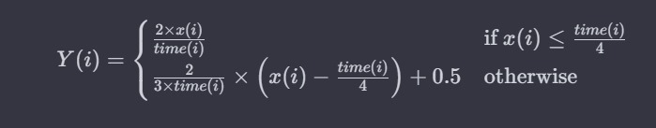
Formulation
Here,
Y(i) denotes the portion of the subject completed (normalized) between 0-1.
time(i) is the completion time for subject i, and
x(i) is the time spent on the subject i
So, Y(i) is calculated given by the formula, where we have assumed that, To complete half of the subject 1/4th of the completion time is required and to complete the remaining half 3/4th time is required,
Normalized Completed Subject

Slide 10
Formulation
Parameters :
We have the following Parameters.
Np → Number of Subjects.
x(i) → Time allocated to subject i
credit(i) → credit associated with subject i
efficiency(i) → efficiency factor for subject i
time(i) → maximum total time for completing subject i
Total_hour → total available hours
Y(i) → represent total part completed of subject i
S(i) → efficiency adjusted score for subject i
grade(i) → grade based on efficiency adjusted score for subject i
penalty(i) → penalty if you allocate hours less than the minimum hours required to pass the subject
domain_penalty → penalty for allocating hours greater than Total_hour
f → final CGPA

Slide 11
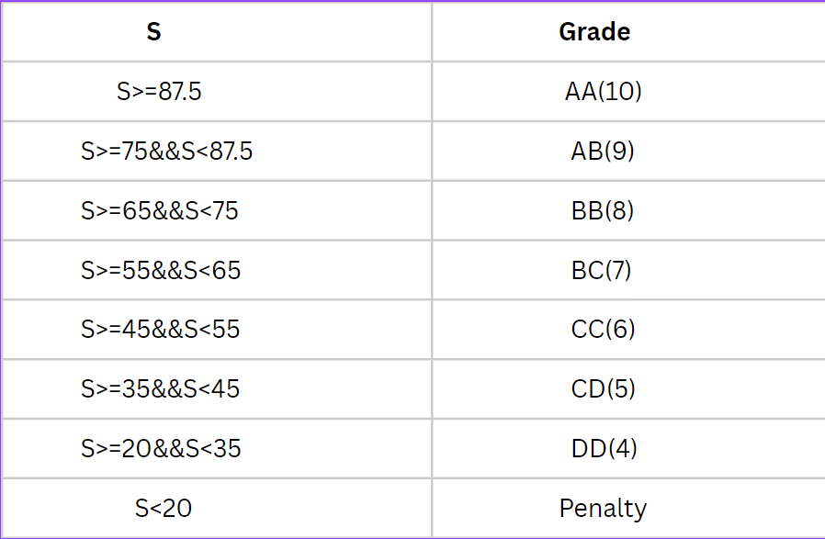
Formulation
Variable’s Values Determination :
Let x(i) be the time spent on subject i, and then normalized subject completion factor Y(i) can be calculated using the formula mentioned previously.
Efficiency Adjusted Score S(i) :
:
Grade Assignment :
S(i) = efficiency(i) * Y(i)
After the Calculation of S(i), the grade Assignment is done with the help of this table.
This grade in subject x(i) represents the performance in individual subject.

Slide 12
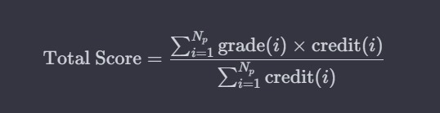
Formulation
Variable’s Values Determination :
CGPA Calculation (Performance Index) :

Slide 13
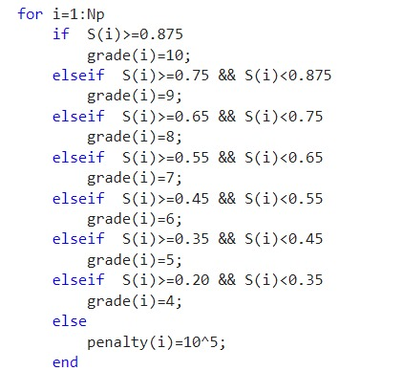
Formulation
Penalties :
Grade Penalty:
To ensure successful completion of each subject, students must attain a minimum grade of (4).
This requirement is in place to emphasize the importance of not only maximizing their Cumulative Grade Point Average (CGPA) for overall performance but also ensuring a satisfactory level of achievement in each individual subject.

Slide 14

Formulation
Penalties :
Domain Penalty :
We add up the time allocated for all subjects, called sum(x). This total time should not be more than the total available time (total_hour). To make sure of this, we use a penalty system.

Slide 15
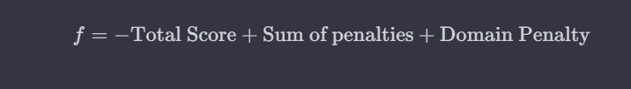
Formulation
Objective Function :
The objective function is currently defined as -CGPA (-Performance), and the negative sign is utilized because the Real Coded Genetic Algorithm aims to minimize the fitness function. However, our objective is to maximize the overall CGPA or performance.
Additionally, there are penalties applied, namely the Grade Penalty (Sum of Penalties) and Domain Penalty.

Slide 16
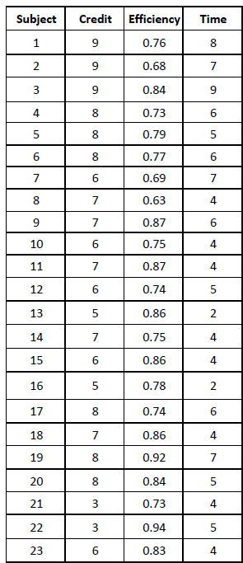
Result
We have used the following as data for our algorithm.
Here Credit column signifies the credits for each subject, efficiency signifies the efficiencies for subjects and time signifies the total time to complete the syllabus for a particular subject.

Slide 17
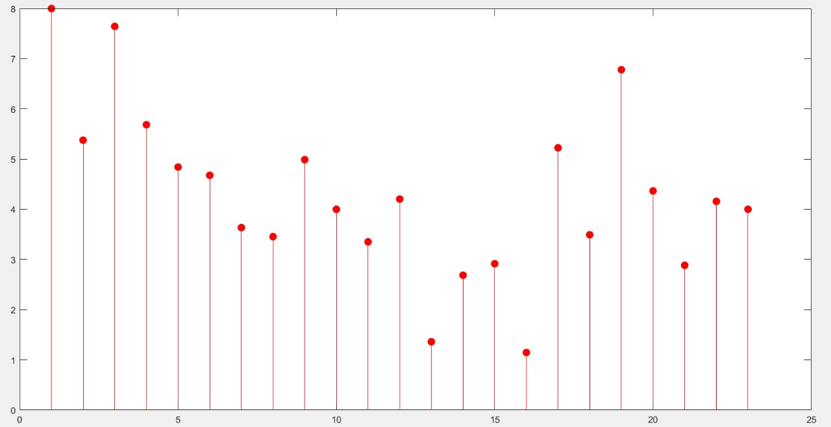
Result
Solution Vector (x) for the best solution out of NRuns

Slide 18
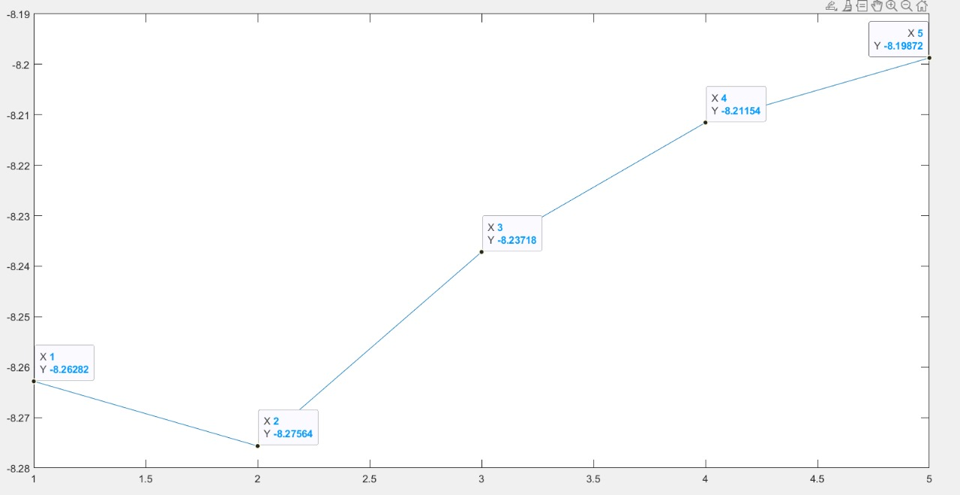
Result
Best Fitness Function Value for Each Run

Slide 19
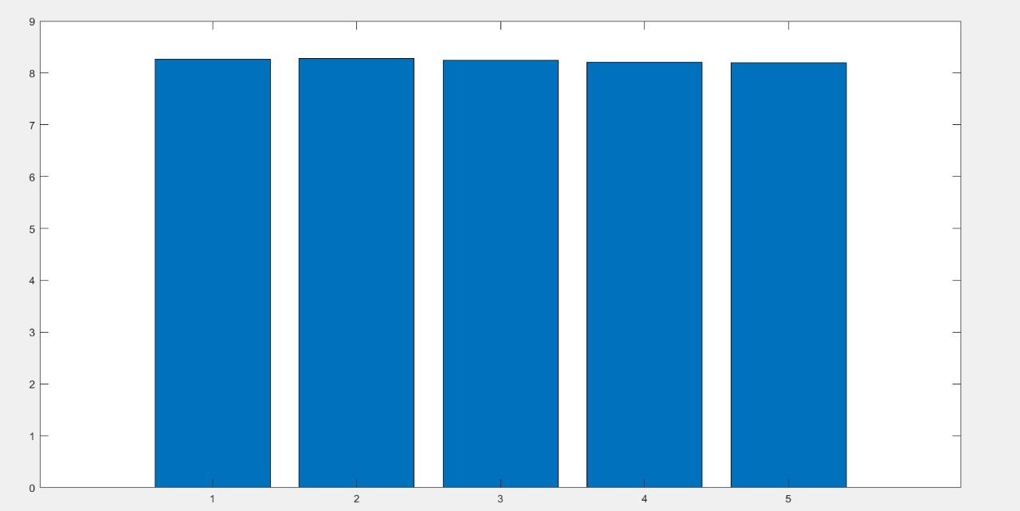
Result
Best CGPA (Performance) Value for Each Run

Slide 20
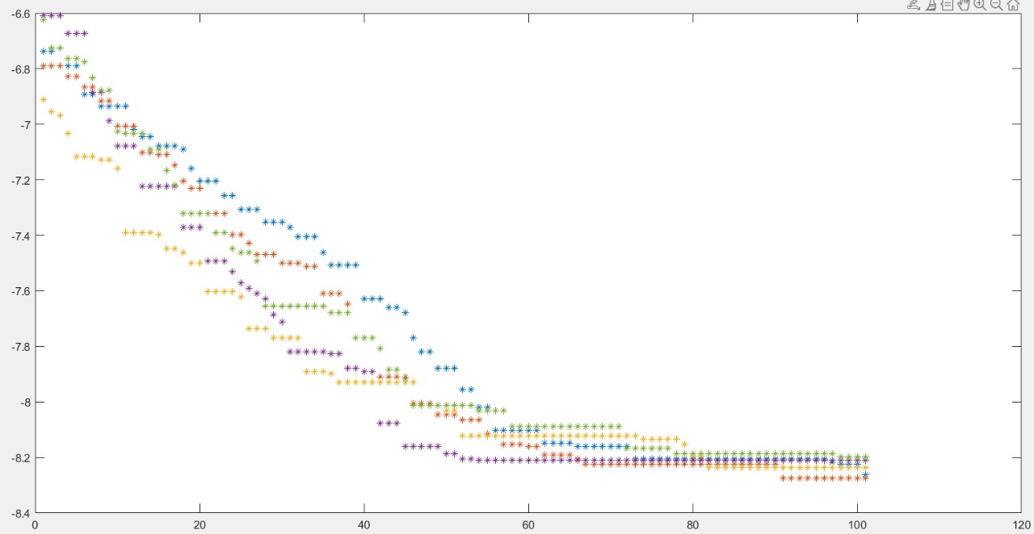
Result
Best Fitness Function Value for every Iteration for each Run

Slide 21

Conclusion
In conclusion, our project offers a valuable solution for students facing the challenge of juggling multiple subjects and limited study time. By employing optimization modeling, we've provided a tool to assist students in strategically allocating their study hours across various subjects.

Slide 22

Thank you

