Slide 1
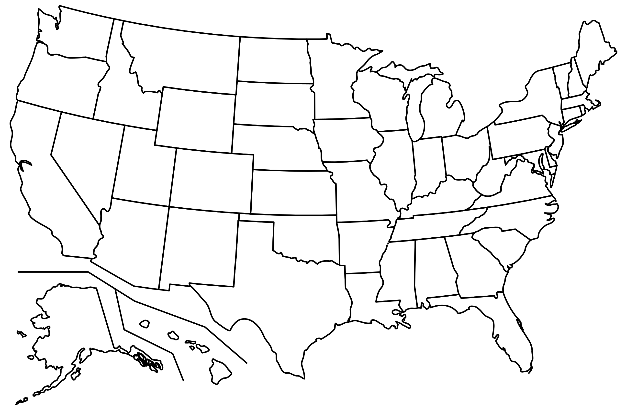
HATE CRIME STATS IN THE US

Slide 2
AGENDA
DATA DESCRIPTION
RESEARCH HYPOTHESIS
OUR APPROACH
KEY FINDINGS

Slide 3
CHOSEN DATASET
FBI HATE CRIME DATA
RACE, ETHNICITY, RELIGION, SEXUAL ORIENTATION, GENDER AND GENDER IDENTITY CRIMES
INFORMATION ON A STATE, CITY TYPE AND AGENCY LEVEL
2013 AND 2019

Slide 4
RESEARCH HYPOTHESES
ARE THERE ANY AGENCY TYPES REPORTING HIGHER HATE CRIME STATS THAN OTHERS?
IS THERE A CORRELATION BETWEEN THE STATE AND TIME OF THE YEAR?
IS THERE A CORRELATION BETWEEN THE AGENCY’S POPULATION AND THE VARIOUS HATE CRIME TYPES?
DID THE HATE CRIME STATS CHANGE OVER TIME? WAS THERE A CHANGE BETWEEN DIFFERENT TYPES OR BETWEEN THE STATES?

Slide 5
OUR APPROACH
DATA CLEANING: NAs REPLACED WITH 0
PARTLY GEOGRAPHIC DATA: USE OF CHOROPLETH MAP

Slide 6
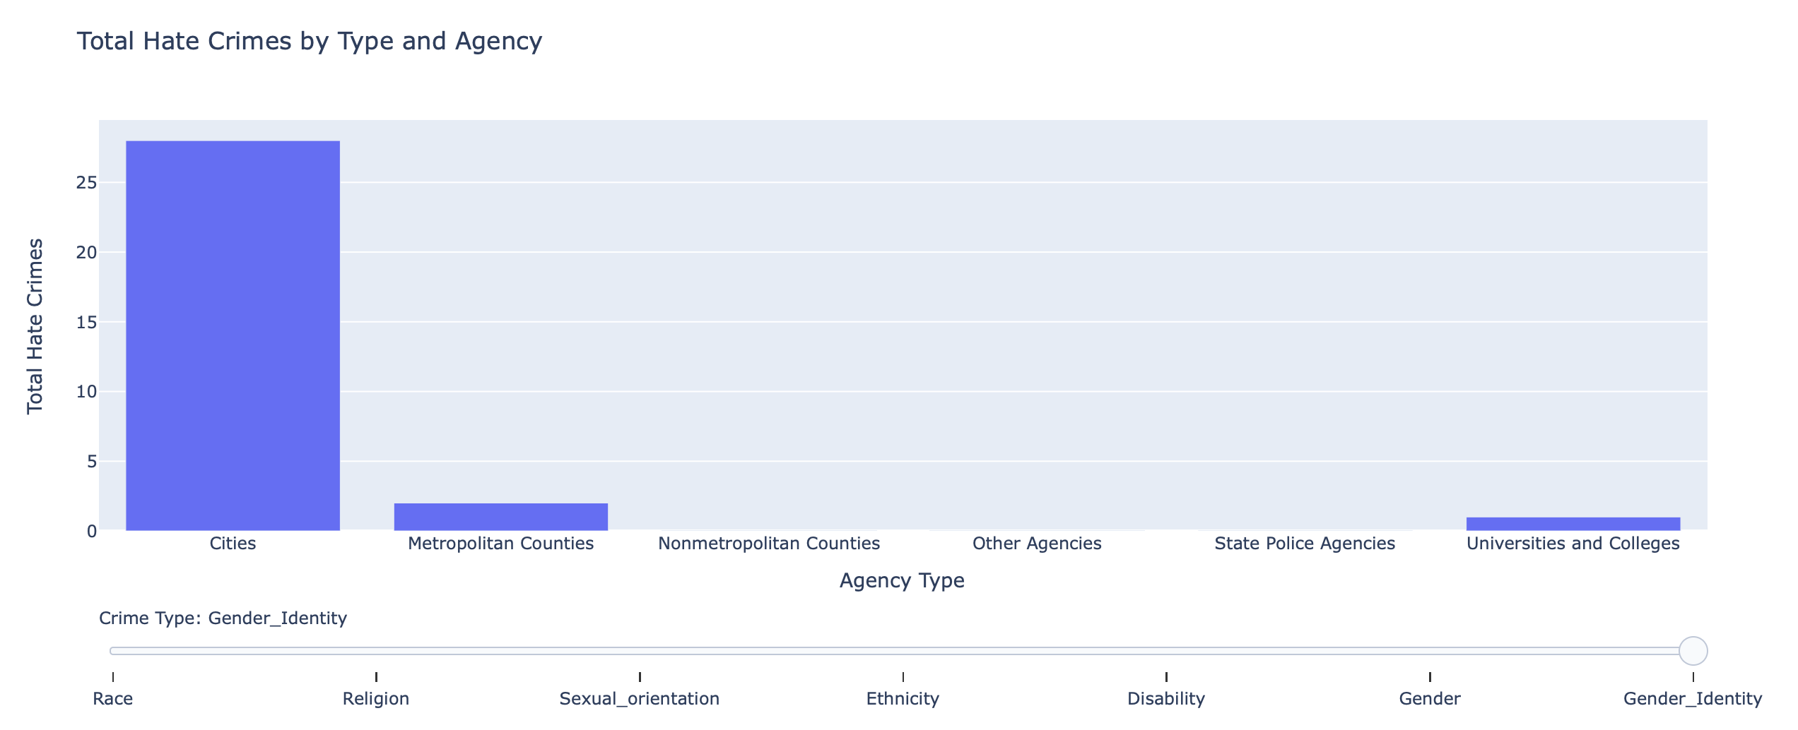
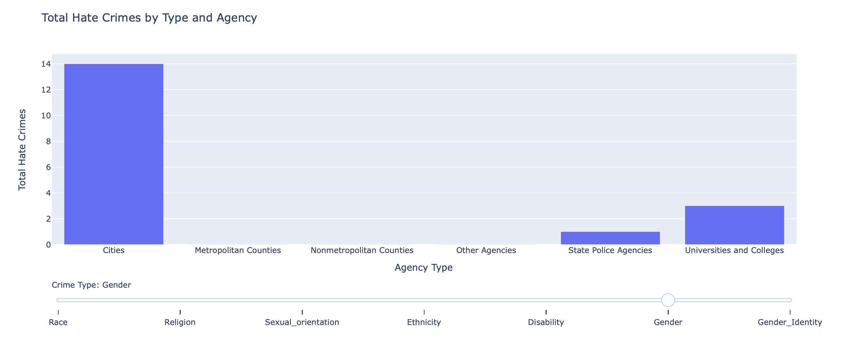
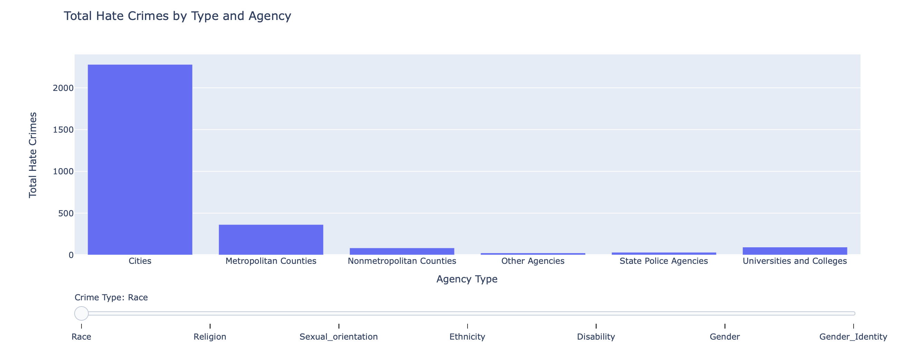
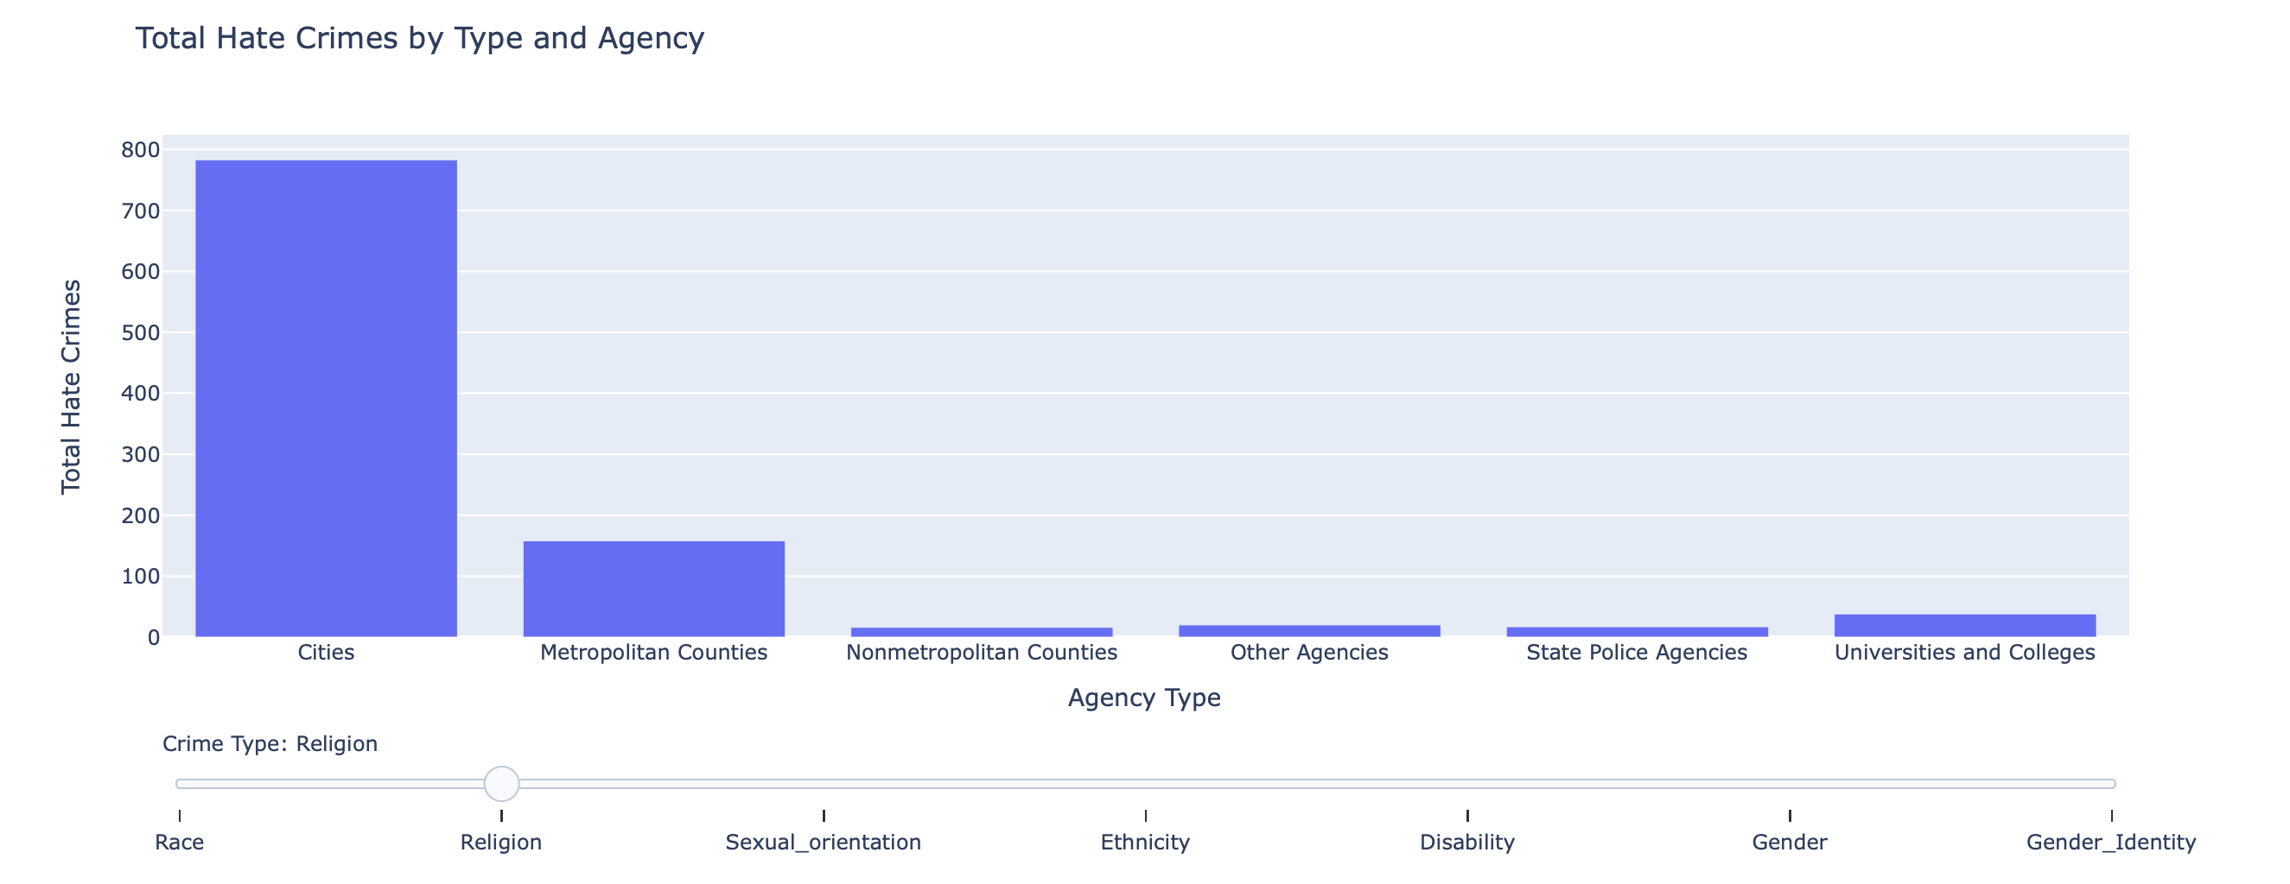
KEY FINDINGS 1

Slide 7
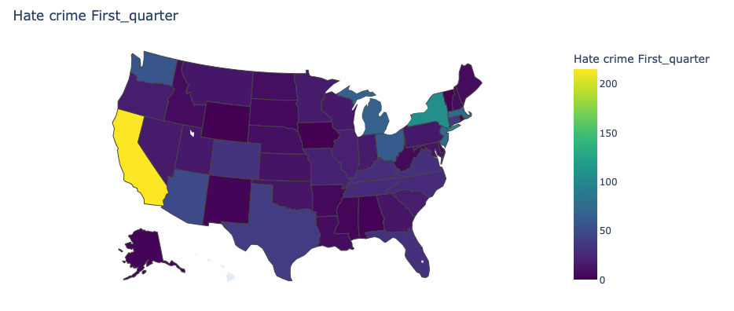
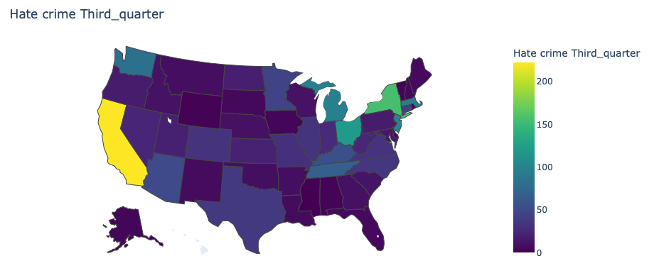
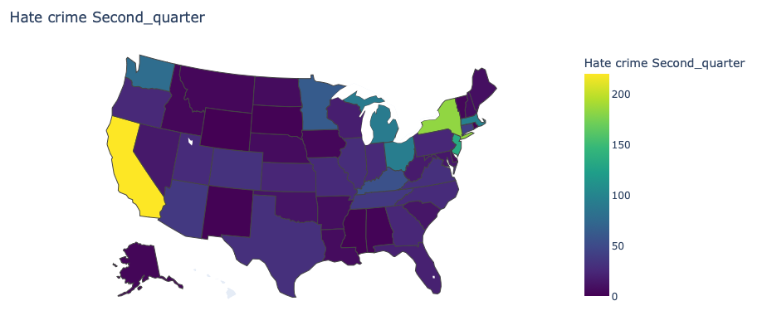
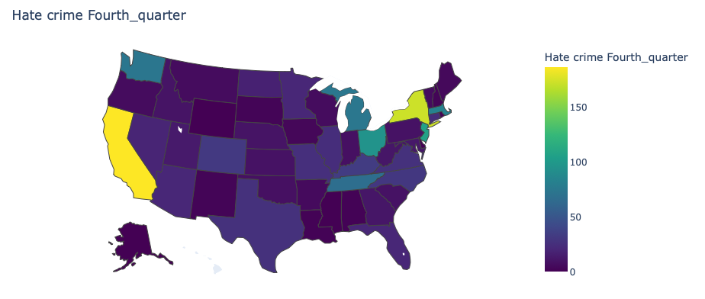
KEY FINDINGS 2

Slide 8
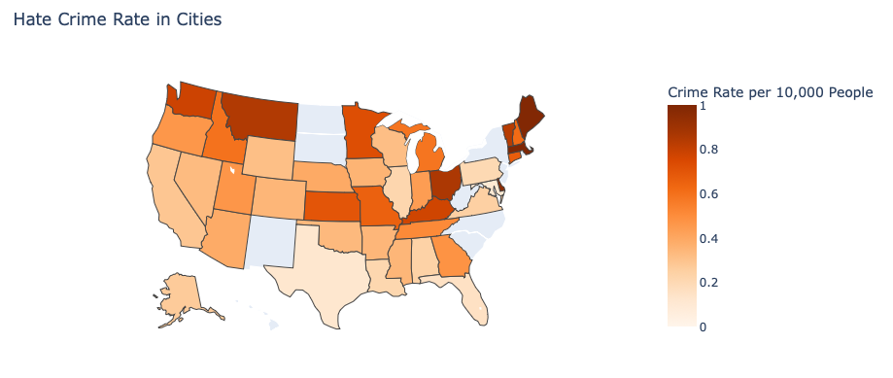
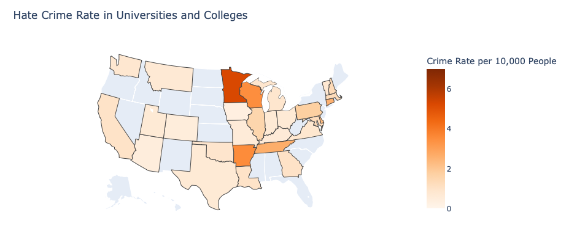
KEY FINDINGS 3

Slide 9
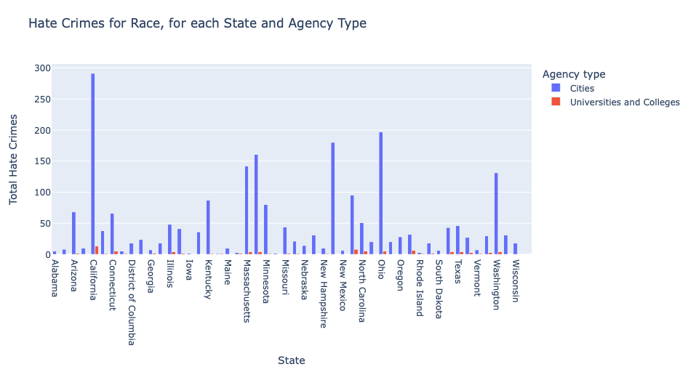
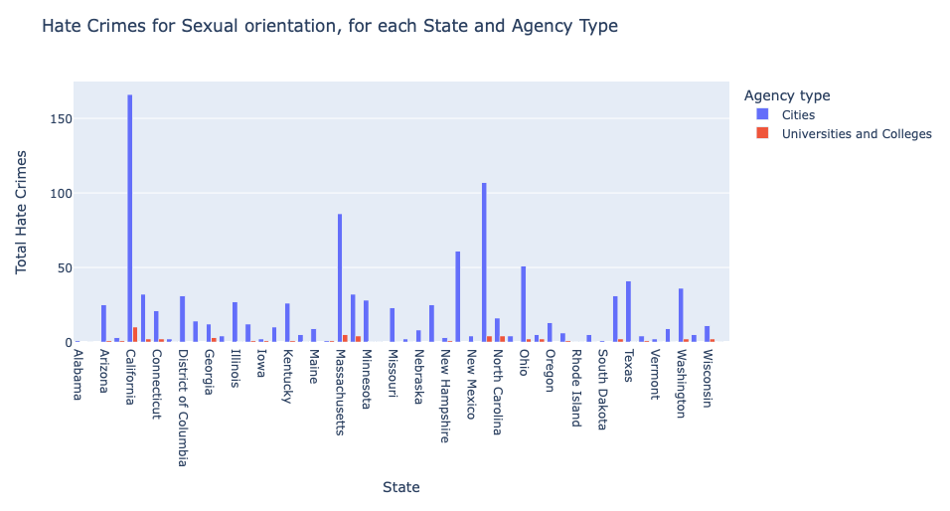
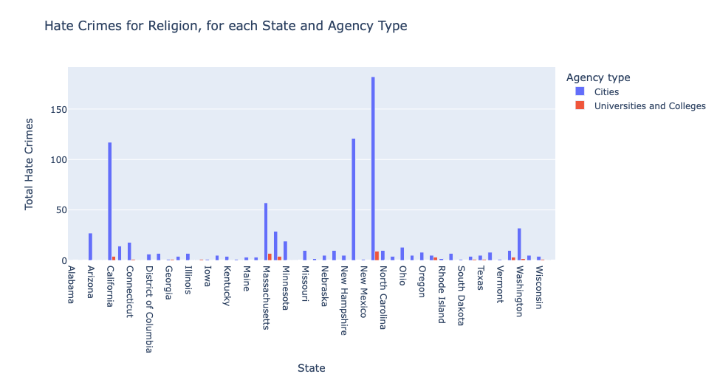
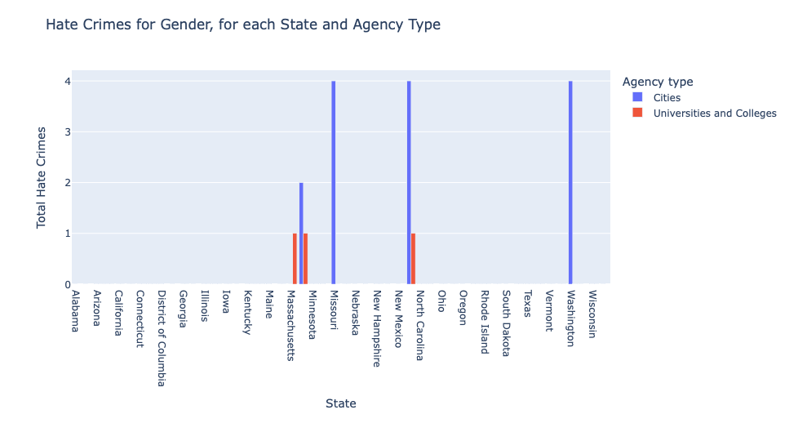
KEY FINDINGS 4

Slide 10
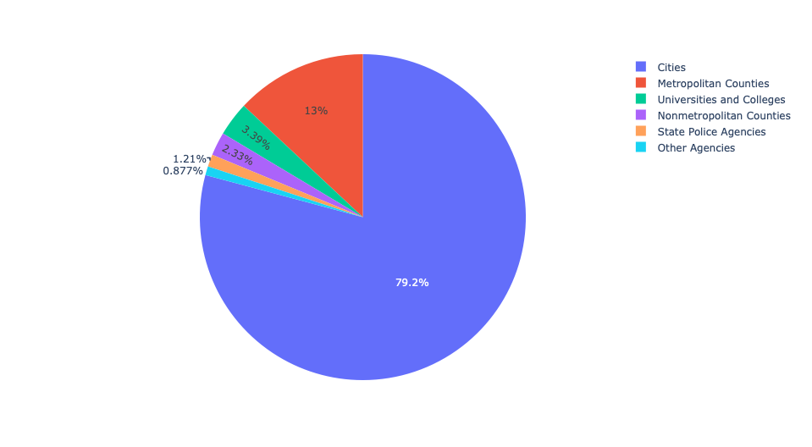
KEY FINDINGS 5

Slide 11
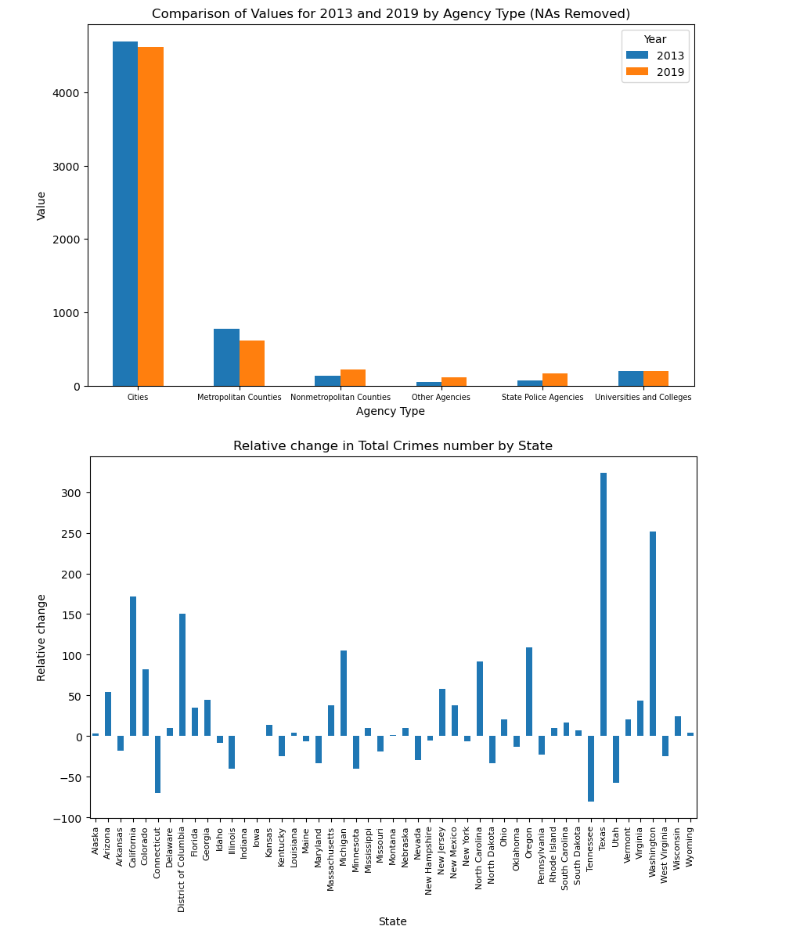
KEY FINDINGS 6

Slide 12
WE ARE MORE THAN HAPPY TO ANSWER ANY OF YOUR QUESTIONS

