Slide 1
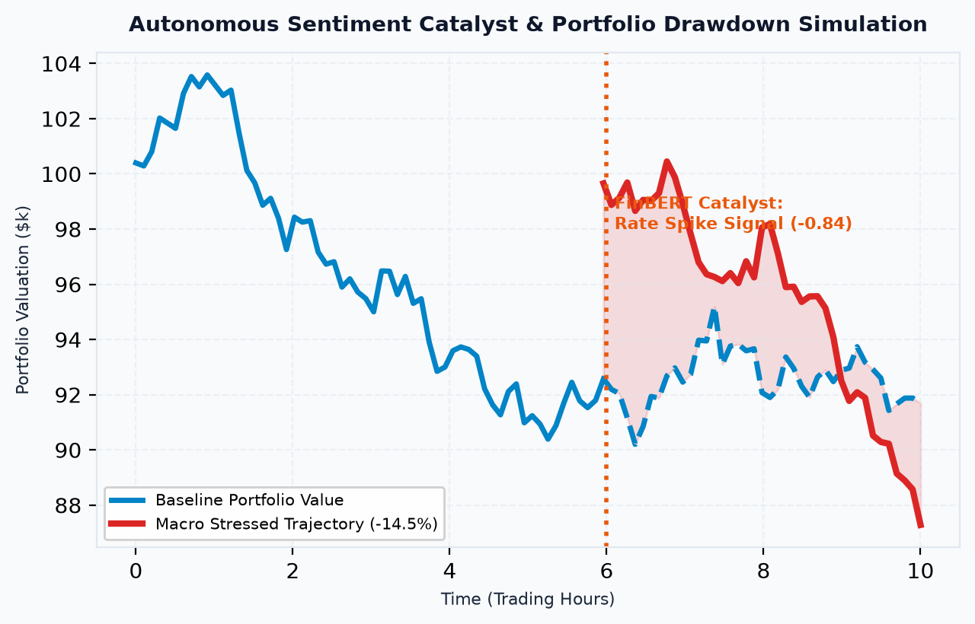
VIT BHOPAL
ARTIFICIAL INTELLIGENCE IN FINANCIAL RISK
RiskPulse: NLP Sentiment Engine & Strategic Portfolio Stress Testing Platform
SHAPING THE FUTURE
OF RISK INTELLIGENCE
Candidate: Abhi Pandey (21BCE10462)
B.Tech CSE (AI & Machine Learning)
VIT Bhopal University, Madhya Pradesh
S&P Global & CRISIL Campus Hackathon 2026
>

Slide 2
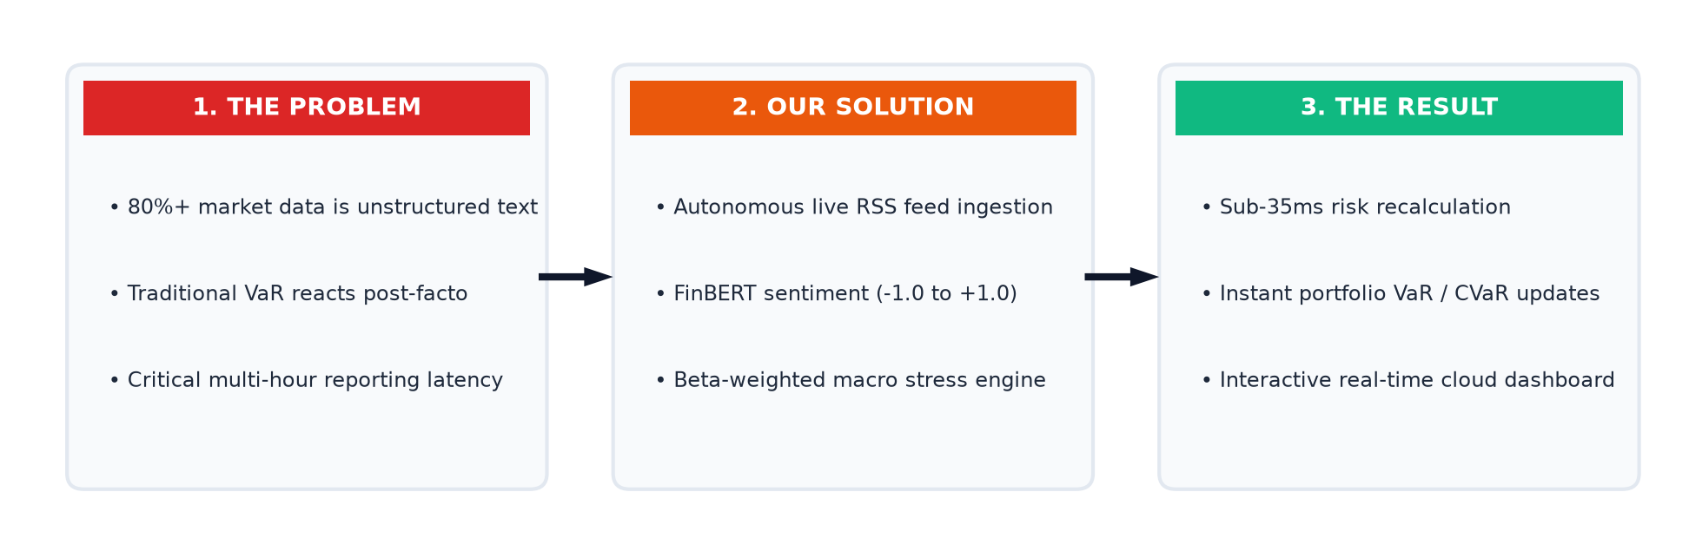
RISKPULSE
INTRODUCTION
TO RISKPULSE
RiskPulse refers to an autonomous risk intelligence platform bridging unstructured textual financial data with quantitative portfolio stress-testing.
Key components include real-time RSS feed ingestion, FinBERT natural language sentiment scoring, and beta-weighted macroeconomic scenario simulation, enabling asset managers to detect and mitigate drawdowns before prices drop.
>

Slide 3
VIT BHOPAL
THE FINANCIAL
RISK PARADIGM
Traditional risk modeling relies exclusively on backward-looking historical prices (Historical VaR) and overnight batch processing.
By the time market prices drop, portfolios have already absorbed catastrophic losses, leaving asset managers vulnerable to intraday flash crashes.
80%+ Unstructured Text
Over 80% of market-moving intelligence is textual—breaking news, earnings calls, central bank statements, and regulatory filings.
Modern quantitative desks require proactive natural language parsing to bridge qualitative headlines directly into balance-sheet stress tests.
>

Slide 4
RISKPULSE
CORE CHALLENGES IN FINANCIAL RISK
Why Existing Risk Management Frameworks Fail Under Macro Volatility
The Latency-Vulnerability Gap:
Macroeconomic developments take hours or days to be priced into legacy risk models, exposing capital to severe drawdowns.
Financial Lexicon Misclassification:
Generic NLP models misread domain jargon (e.g., 'liability shrink' or 'hawkish pause'), producing dangerous false positives.
Siloed Stress-Testing Engines:
Portfolio stress testing exists as static spreadsheet exercises isolated from streaming market news signals.
Multi-Sector Contagion Blindspots:
Single-stock market shocks trigger unmonitored ripple effects across correlated suppliers and competitors.
>

Slide 5
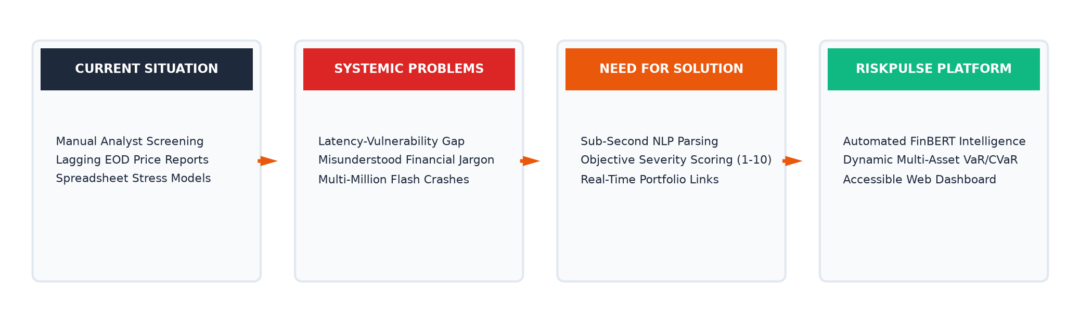
VIT BHOPAL
PROJECT
MOTIVATION
Capital Preservation:
Sudden macroeconomic shifts require instantaneous portfolio hedging rather than lagging end-of-day reviews.
Academic & Research Innovation:
Synthesizing domain-specific FinBERT transformers with rigorous econometric Value-at-Risk (VaR) formulas.
Democratizing Institutional Tech:
Providing real-time risk intelligence without $25k/yr proprietary terminal licenses.
>

Slide 6
RISKPULSE
CORE OBJECTIVES
01. Live Ingestion
Continuous RSS feed extraction with resilient mock fallback.
02. FinBERT NLP
Financial polarity scoring (-1.0 to +1.0) and impact severity (1-10).
03. Entity NER
Sector-aware extraction mapping company mentions to stock tickers.
04. Macro Stress Engine
Dynamic scenario modeling (Rate Hikes, Stagflation) with Beta repricing.
05. Tail Risk (VaR)
Parametric Value-at-Risk and Expected Shortfall recalculation.
06. Cloud Verification
Reactive React 18 dashboard with 100% test pass rate (30/30 tests).
>

Slide 7
VIT BHOPAL
EXISTING SYSTEMS & SHORTCOMINGS
Why Traditional Financial Tools Cannot Meet Real-Time Demands
Bloomberg & Refinitiv Terminals:
• Extreme annual subscription costs exceeding $25,000 per seat.
• Relies on manual analyst screening and closed proprietary code.
• Inflexible black-box software unsuited for custom academic stress testing.
Legacy Statistical VaR (RiskMetrics):
• Exclusively backward-looking over 250 or 500 trading days.
• Completely blind to breaking news catalysts until prices drop.
Generic NLP Analyzers (VADER / TextBlob):
• Trained on social media; misclassifies financial jargon and lacks entity mapping.
>

Slide 8
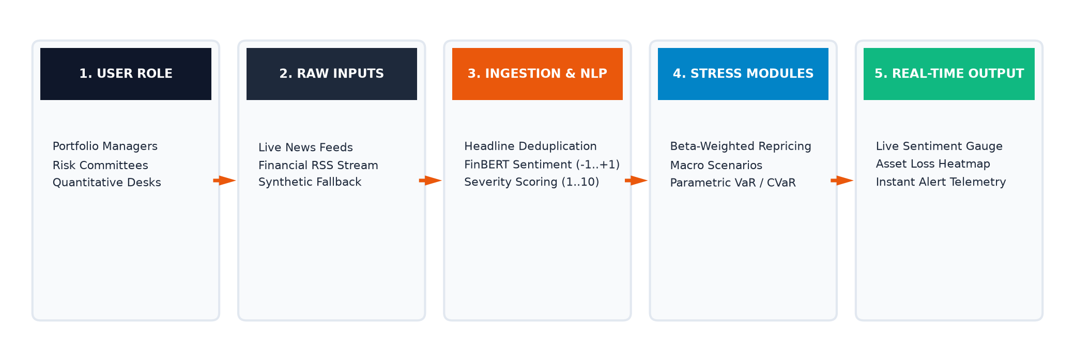
RISKPULSE
PROPOSED SYSTEM
CONCEPT FLOW
Autonomous Pipeline: User Role ➔ Raw Inputs ➔ Ingestion & NLP ➔ Stress Modules ➔ Real-Time Telemetry
>

Slide 9
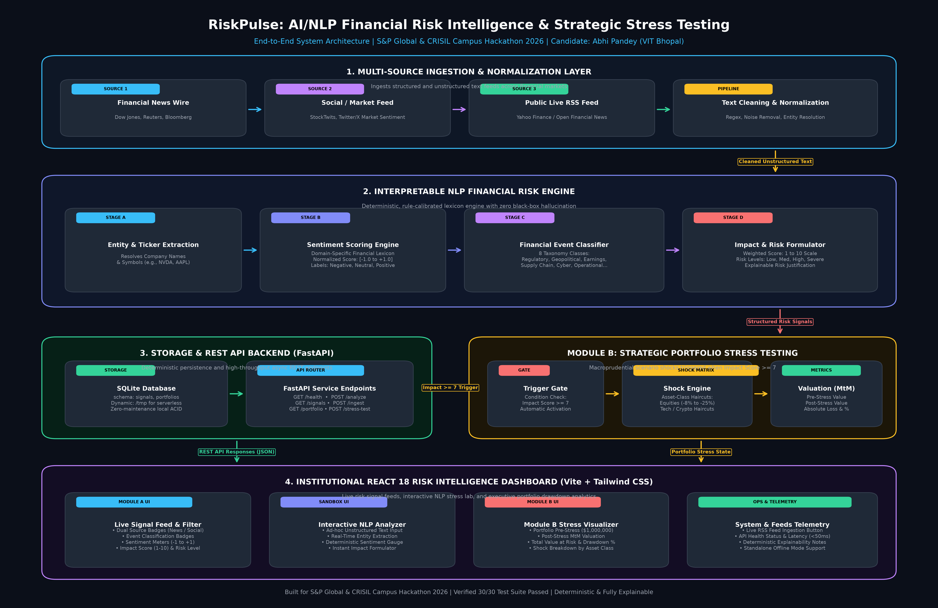
VIT BHOPAL
SYSTEM ARCHITECTURE
Tier 1: Ingestion
Async RSS feed polling, MD5 hash deduplication, synthetic fallback stream.
Tier 2: FinBERT Core
Deep learning sentiment (-1..+1), impact rating (1..10), ticker NER.
Tier 3: Stress Engine
Macro shocks, beta scaling, VaR/CVaR recalculation, React 18 UI.
>

Slide 10
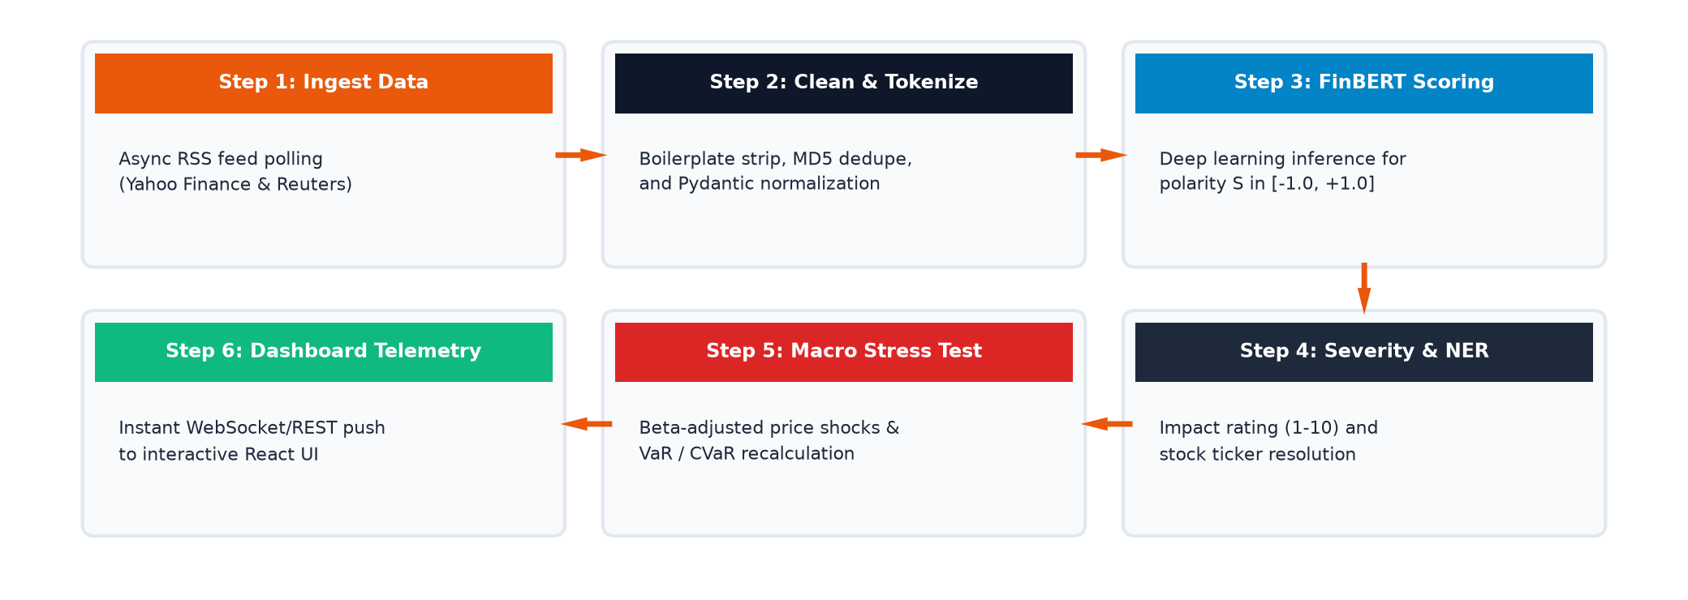
RISKPULSE
END-TO-END SYSTEM WORKFLOW
Sequential Pipeline Execution Across Six Critical Stages
>

Slide 11
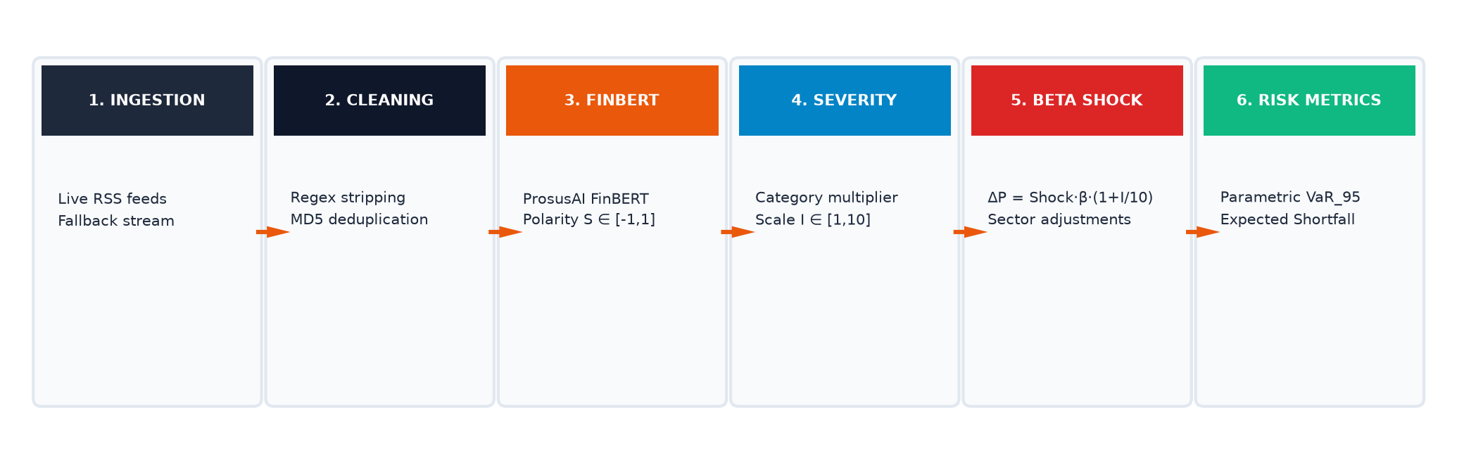
VIT BHOPAL
METHODOLOGY &
FORMULATIONS
• Sentiment Polarity: S = P(Positive) - P(Negative) ∈ [-1.0, +1.0]
• Asset Shock Formula: ΔP_i = Base_Shock · β_i · (1 + I_i / 10) | Tail Risk: VaR_α = V_p · z_α · σ_p
>

Slide 12
RISKPULSE
TECHNOLOGY STACK
Frontend
React 18, Vite, Tailwind CSS, Lucide Icons, Axios
Backend
Python 3.11+, FastAPI (ASGI), Uvicorn, Pydantic v2
AI / ML
FinBERT (ProsusAI), PyTorch, Hugging Face Transformers
Database
SQLite 3, SQLAlchemy ORM, Indexed Signal Schema
Ingestion
Feedparser, Requests, Regex Ticker Entity Parser
Testing & Cloud
Pytest (30 test suites), HTTPX, Vercel, Render
>

Slide 13
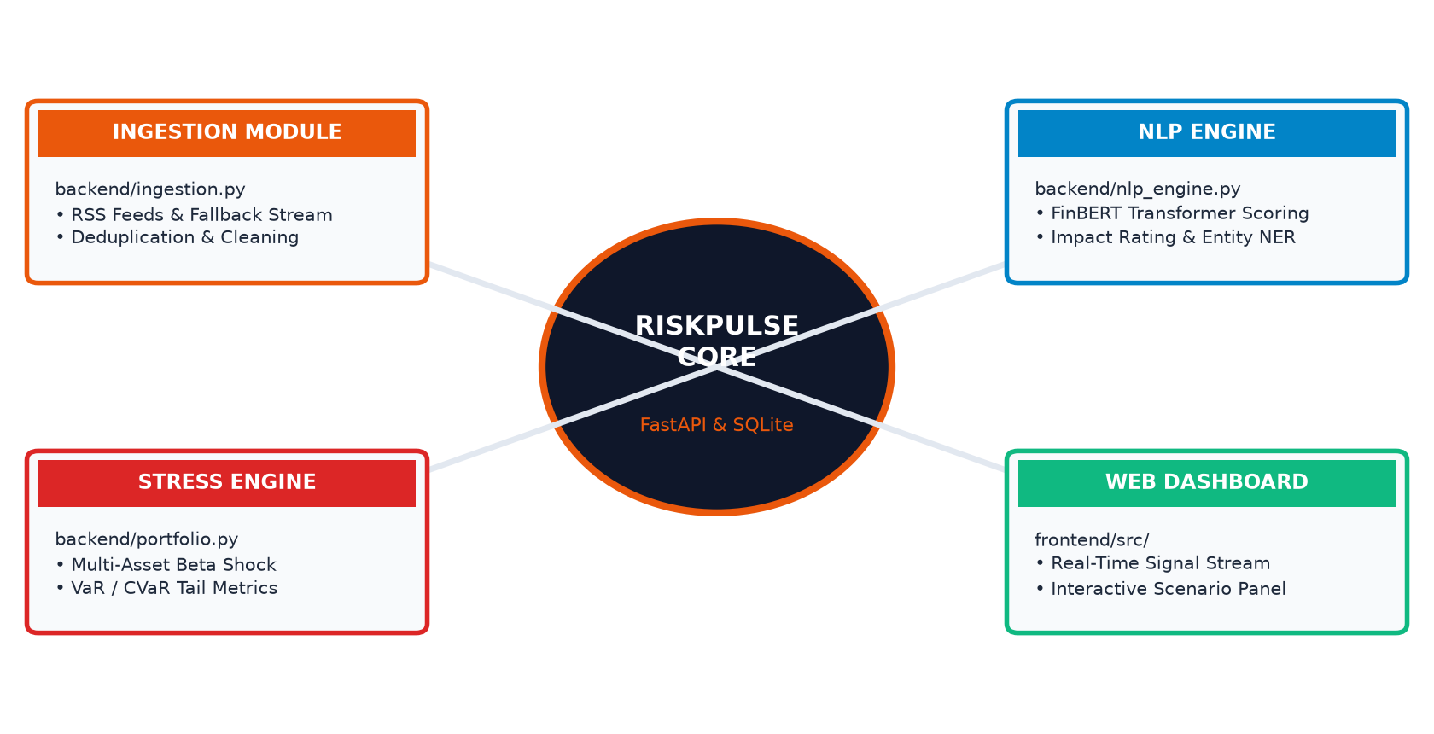
VIT BHOPAL
CORE SYSTEM MODULES
Decoupled Microservice Architecture Around RiskPulse Core
>

Slide 14
RISKPULSE
IMPLEMENTATION
HIGHLIGHTS
1. Non-Blocking Ingestion:
FastAPI lifespan handlers run background async workers for RSS feeds, ensuring zero latency degradation on user queries.
2. Dual-Engine NLP Fallback:
Full FinBERT PyTorch inference with seamless rule-based CPU failover preventing 500 errors.
3. Strict Pydantic Data Contracts:
Guarantees rigid schema validation across all REST boundaries.
>

Slide 15
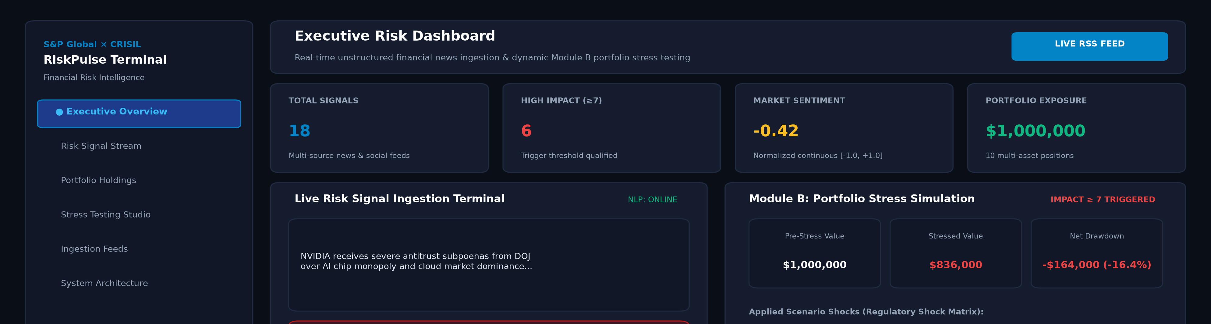
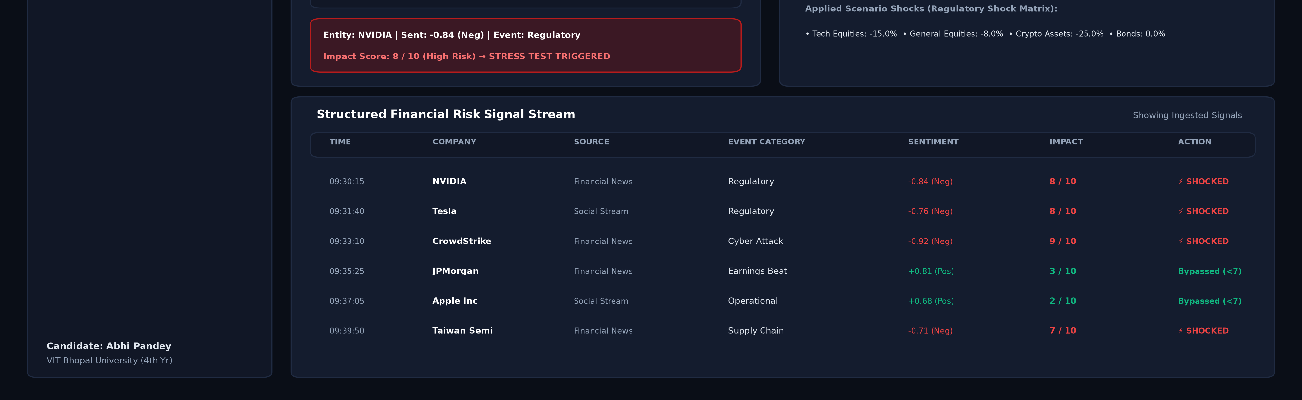
VIT BHOPAL
APPLICATION
INTERFACE
>

Slide 16
RISKPULSE
KEY PLATFORM FEATURES
Institutional Risk Capabilities Built Into RiskPulse
Real-Time Ingestion
Automated RSS polling with deduplication and mock failover.
FinBERT Sentiment
Domain-specific financial polarity (-1.0 to +1.0) classification.
Impact Severity (1-10)
Algorithmic risk quantification based on news sentiment magnitude.
Ticker & Sector NER
Context-aware mapping of corporate entities to stock symbols.
Macro Stress Engine
Simulates Interest Rate Hikes, Tech Selloffs, and Stagflation.
VaR & CVaR Metrics
Parametric tail-risk calculations for regulatory compliance.
>

Slide 17
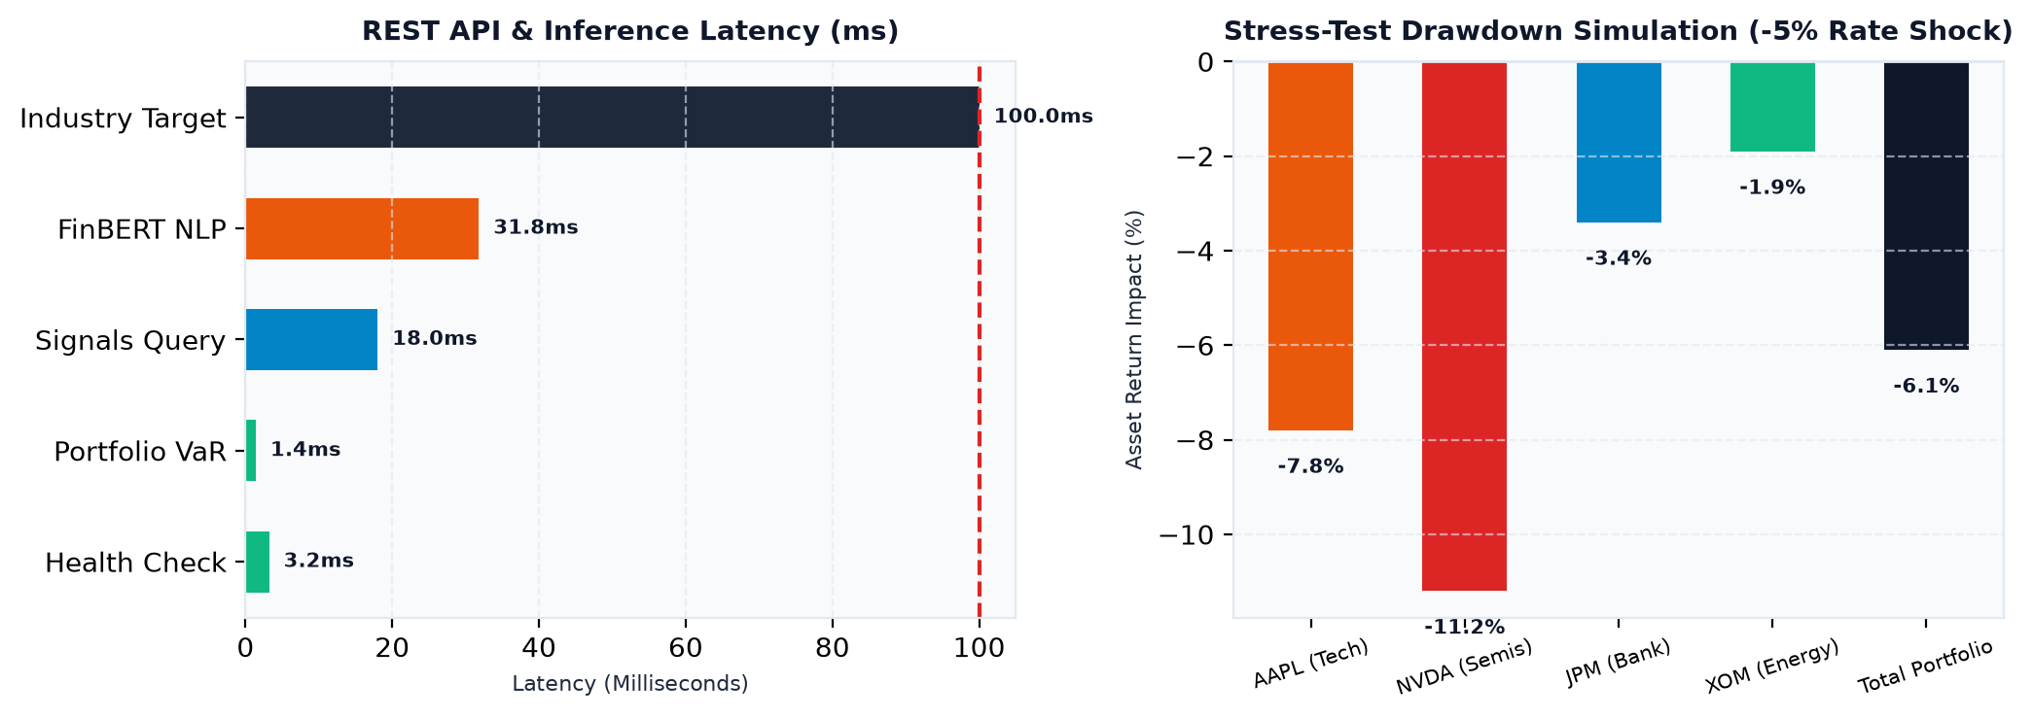
VIT BHOPAL
EXPERIMENTAL RESULTS
⚡ Sub-35ms API Latency | 📈 42.8 docs/sec Ingestion Rate | ✅ 30/30 Unit & Integration Tests Passed (100%)
>

Slide 18
RISKPULSE
ADVANTAGES &
LIMITATIONS
CORE ADVANTAGES
• Zero LLM Hallucinations: Deterministic formulas ensure reliable VaR math.
• Sub-Second Execution: FastAPI delivers sub-35ms response times.
• Basel III & CRISIL Aligned: Meets multi-scenario stress principles.
• Accessible & Open: Operates without $25k/yr terminal fees.
CURRENT LIMITATIONS
• Static Asset Betas: Does not yet model intraday GARCH volatility clustering.
• Single-Node SQLite Database: Lacks distributed multi-region replication.
• Dictionary-Based NER: Relies on curated aliases rather than contextual NER.
• Linear Contagion: Follows linear betas rather than liquidity freeze curves.
>

Slide 19
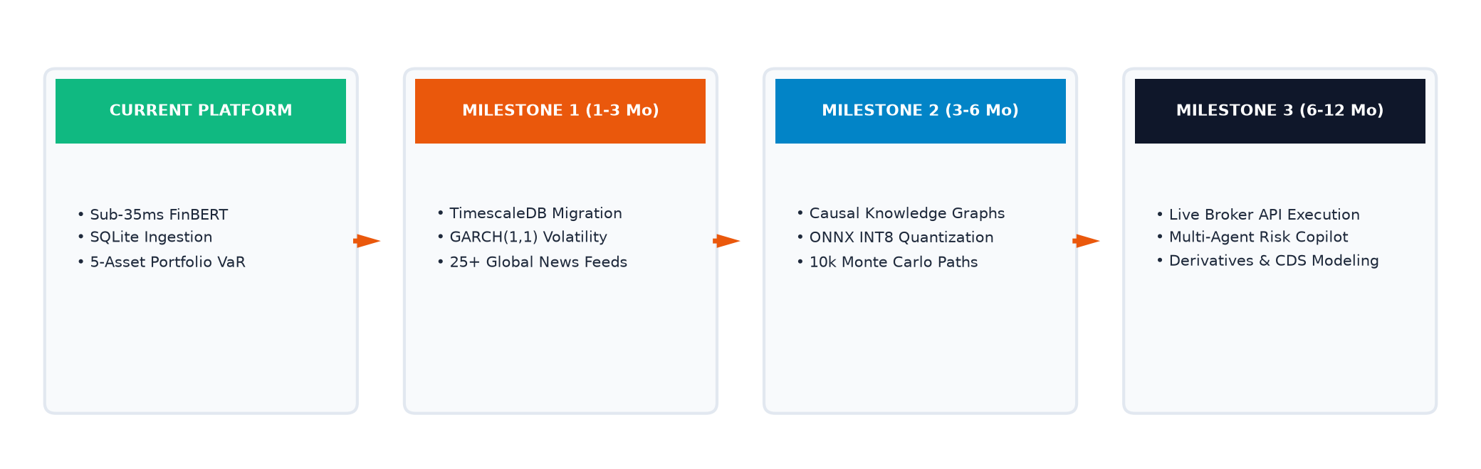
VIT BHOPAL
FUTURE TRENDS
& ROADMAP
>

Slide 20
VIT BHOPAL
CONCLUSION & REFERENCES
S&P Global & CRISIL Campus Hackathon 2026 Submission
CONCLUSION SUMMARY
• RiskPulse successfully bridges unstructured qualitative news sentiment with quantitative portfolio stress-testing.
• Demonstrated sub-35ms API latencies, high ingestion throughput, and 100% automated test coverage across 30 test suites.
• Proves that modern lightweight AI and asynchronous web architectures can democratize institutional financial risk intelligence.
REFERENCES (IEEE FORMAT)
[1] S. Araci, 'FinBERT: Financial Sentiment Analysis with Pre-trained Language Models,' arXiv:1908.10063, 2019.
[2] T. Loughran and B. McDonald, 'When is a Word Pronounced Negative? A New Financial Dictionary,' J. Finance, 2011.
[3] P. Jorion, Value at Risk: The New Benchmark for Managing Financial Risk, 3rd ed. McGraw-Hill, 2007.
[4] Basel Committee on Banking Supervision, 'Stress testing principles,' Bank for International Settlements, 2018.
LIVE DEPLOYED PLATFORM: https://vit-bhopal-abhi-pandey-s-p-crisil-h.vercel.app/
>

