Slide 1
S& P GLOBAL · CRISIL HACKATHON 2026
RiskPulse
From financial news to portfolio stress decisions.
ABHI PANDEY · VIT BHOPAL UNIVERSITY
B. TECH CSE ( AI & ML)

Slide 2
Financial risk moves faster than reporting cycles
THE GAP
Signals surface early
Critical clues appear in news, regulatory updates, and market commentary.
Teams work apart
Analysts read text while portfolio teams work in separate risk models.
Handoffs slow action
Manual transfer delays the choice to hedge, investigate, or stress-test.
RiskPulse reconnects them
The qualitative signal becomes a quantitative portfolio view.
The signal appears in text first. The decision arrives later.

Slide 3
1. Collect multi-source news and sentiment feeds.
THE SIGNAL CHAIN
RiskPulse turns unstructured text into an auditable risk signal
Clean text and normalize entities.
Score sentiment, classify the event, and calculate impact.
Trigger stress testing when impact reaches 7 or higher.
Surface the result in one risk dashboard.
DETERMINISTIC RULES KEEP THE REASONING TRANSPARENT AND REPEATABLE.

Slide 4
Six features built for a fast risk review
FAST REVIEW SURFACE
Multi-source intake
News, social sentiment, and optional public RSS.
Interpretable sentiment
Scores range from -1.00 to +1.00.
Eight event classes
Financial events are grouped into eight categories.
Impact tiers
Impact runs 1–10 across Low, Medium, High, and Severe.
Portfolio stress test
Module B turns a severe signal into portfolio impact.
Review modules
Signal feed, NLP sandbox, and dashboard results.

Slide 5
The decision path is one connected workflow
ONE CONNECTED WORKFLOW
News Input → Text Analysis → Event Classification → Risk Score → Stress Testing → Results Dashboard
High-impact gate
Impact Score ≥ 7.
Structured handoff
Each stage leaves a structured signal for the next.

Slide 6
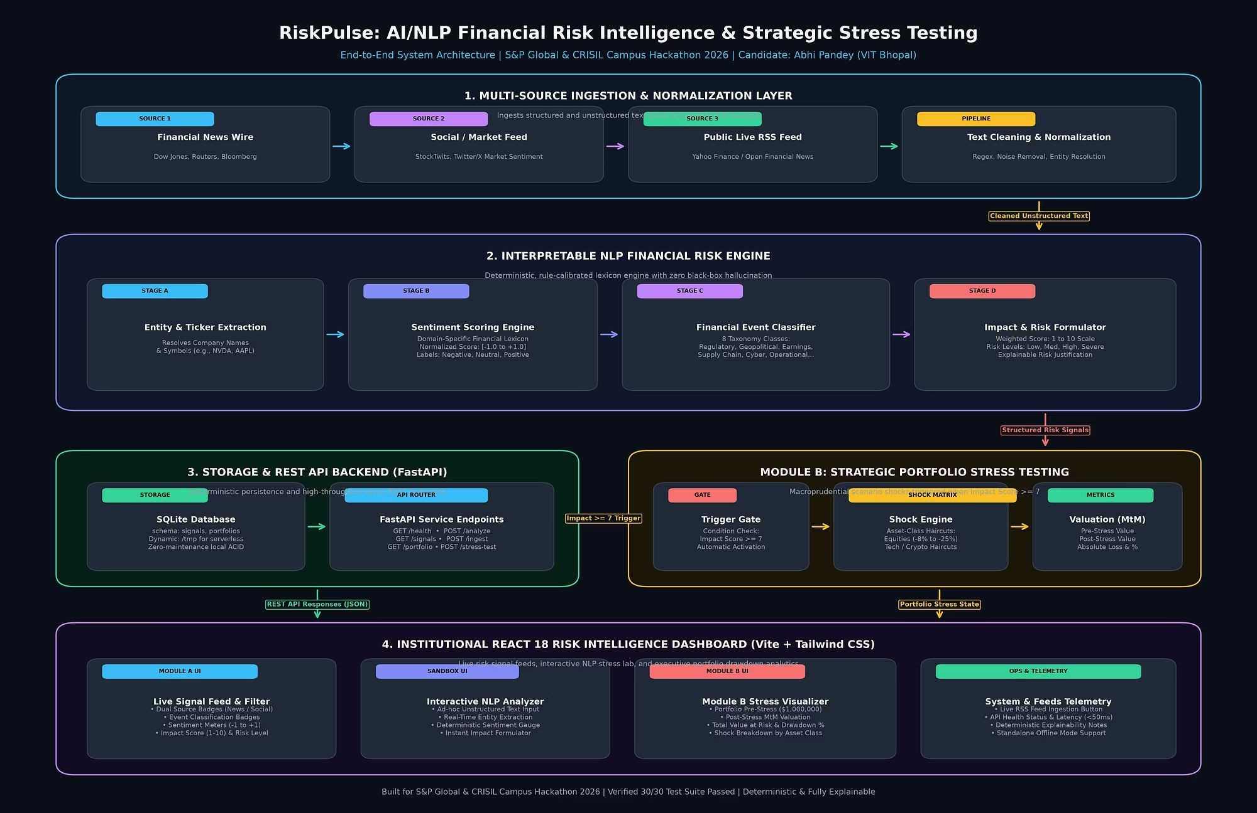
A lightweight stack keeps the prototype explainable
PROTOTYPE ARCHITECTURE
Feeds become structured signals through a small, inspectable path.

Slide 7

$164,000
SYNTHETIC STRESS SCENARIO
A severe signal makes the portfolio impact visible
PORTFOLIO VIEW
Simulated loss
Baseline: $1,000,000 Post-stress: $836,000 Drawdown: -16.4%
Regulatory event · Impact 8/10 · Module B activated
Portfolio value ($)
1m
ACADEMIC BENCHMARK, CLIENT POSITIONS OR ADVICE.
NOT LIVE
INVESTMENT
1m
836k
500k
0
Pre-stress
Post-stress
Stage

Slide 8
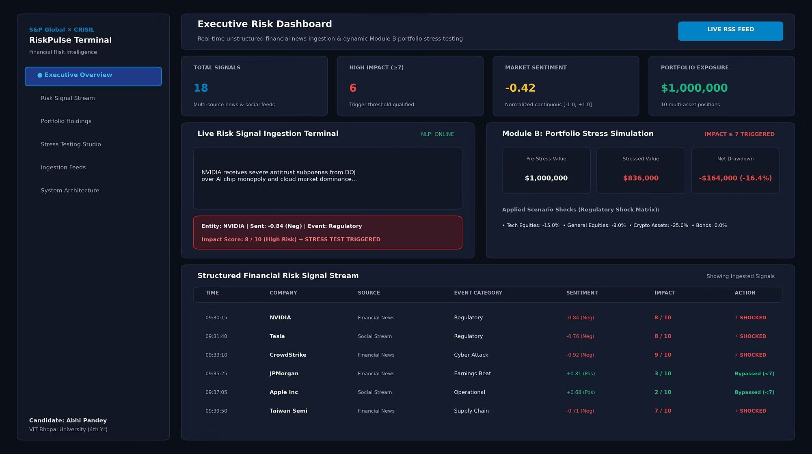
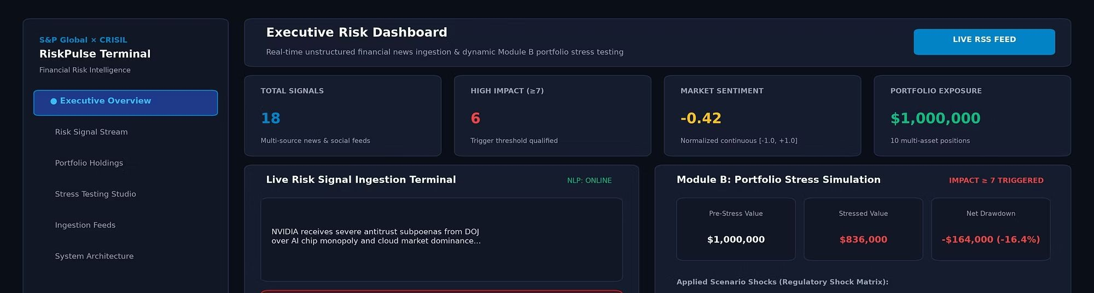
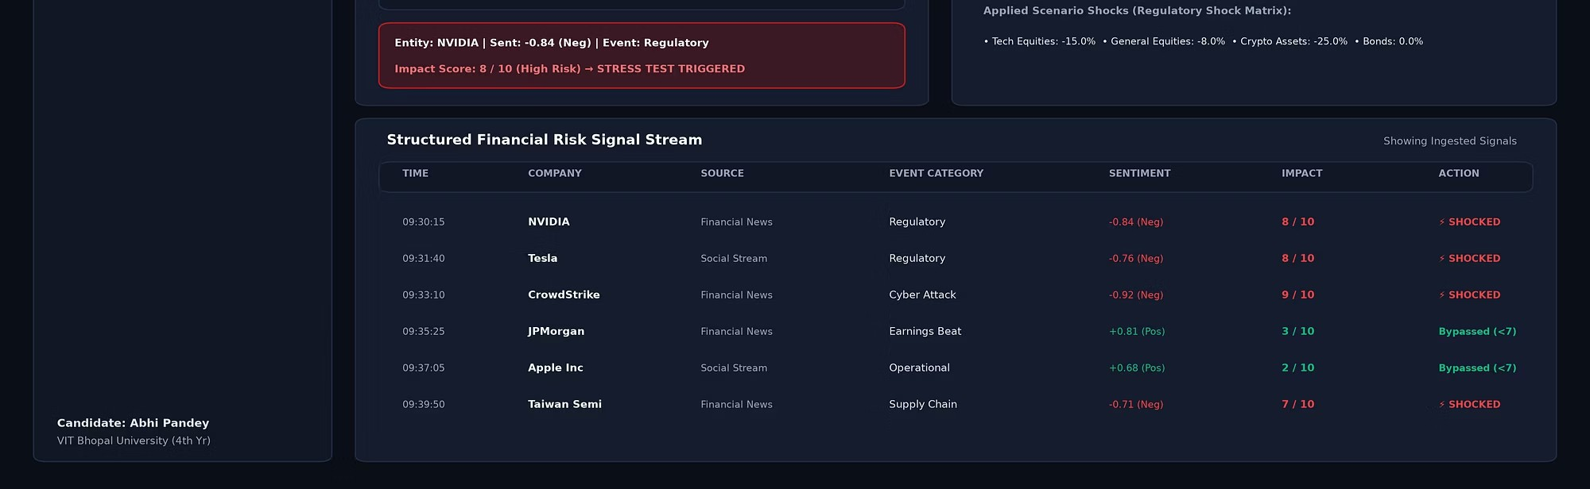
Repository evidence shows the dashboard in action
REPOSITORY EVIDENCE
EXECUTIVE DASHBOARD · SIGNALS, GATE, SENTIMENT, EXPOSURE
SENTIMENT GAUGE STRESS HEATMAP
Executive view
Signal count, high-impact gate, market sentiment, and exposure.
Signal stream
Company, source, event, sentiment, impact, and action.
Module B
Pre-stress, stressed value, drawdown, and applied shocks.

Slide 9
The prototype is tested, measured, and honest about its limits
VALIDATION AND LIMITS
30/30
Automated tests passed
In the repository test run. Coverage: API routes, ingestion and RSS fallback, NLP scoring, portfolio math, and Module B.
VERIFIED NOW
LIMITS
What remains bounded
Rule-based parsing, synthetic portfolio scope, fixed haircuts, and third-party RSS availability.
NEXT
Where it can grow
Hybrid FinBERT analysis, broker APIs, historical crisis backtesting, and VaR / Expected Shortfall.
MEASURED IN THE README
<15 ms
Average NLP inference latency
Synthetic maximum drawdown: -16.4%.

Slide 10

Detect. Analyse. Stress-Test. Decide.
THE TAKEAWAY
RiskPulse links breaking financial text to an interpretable risk signal, then carries high-impact events into a portfolio stress view.
TRANSPARENT, STUDENT- READY PROTOTYPE · S& P GLOBAL & CRISIL HACKATHON 2026
GitHub: https://github.com/Abhi4621/VIT-Bhopal-Abhi-Pandey-S-P-Crisil-hackathon Live demo: https://vit-bhopal-abhi-pandey-s-p-crisil-hack.vercel.app/
The supplied live-demo URL returned a Vercel 404 during verification; confirm the deployment before presenting it as live.

