Slide 1


MOSAIC PS-2
Image inpainting
BY team- three random
- saket kumar singh
-Abhishek kumar
- Ankur kumar

Slide 2
EDA(Exploratory Data Analysis)
In this approach, we train a neural network to predict missing parts of an image such that the predictions are both visually and semantically consistent.
But we sure can capture spatial context in an image using deep learning. A convolutional neural networks or CNN is a specialized neural network for processing data that has known grid like topology – for example an image can be thought of as 2D grid of pixels. It will be a learning based approach where we will train a deep CNN based architecture to predict missing pixels.

Slide 3
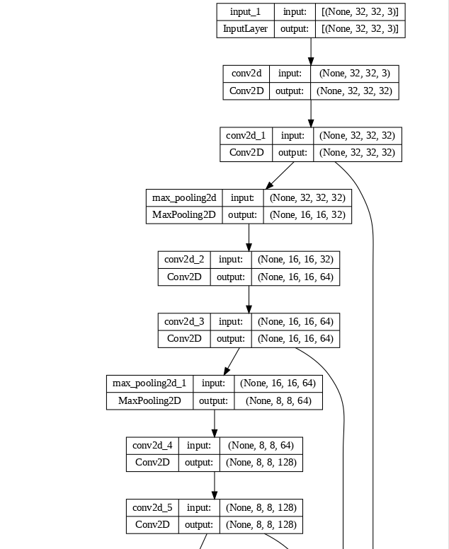
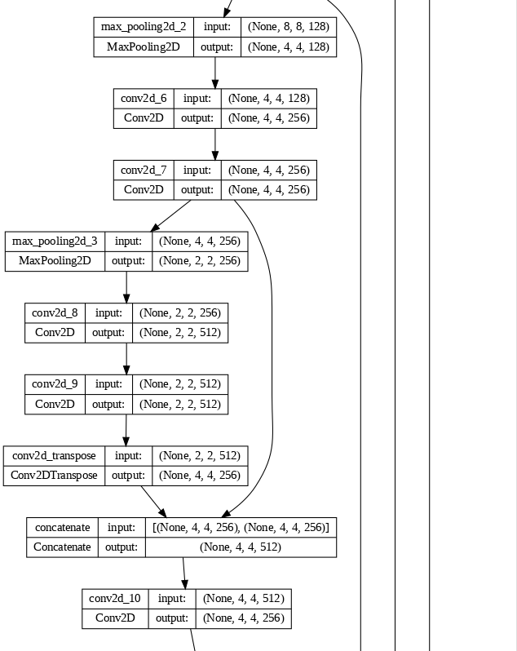
Model Implementation : Auto Encoder Decoder Model

Slide 4
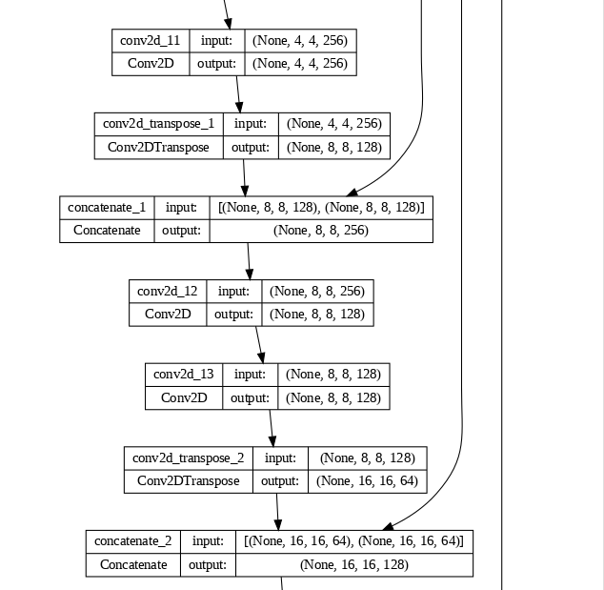
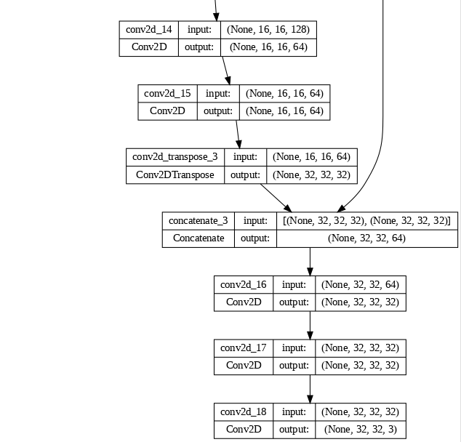
Model Implementation

Slide 5
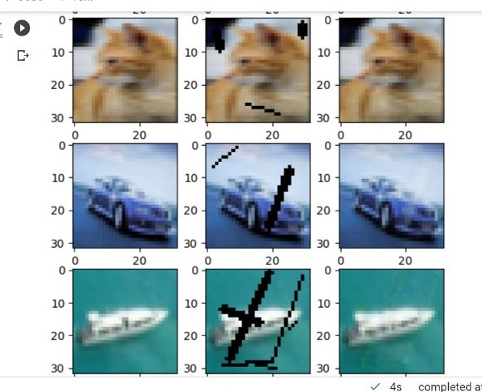
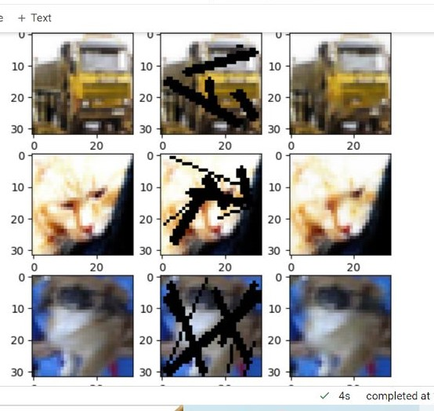
Image Inpainting: Left side contain generated image and right one contain inpainted image

Slide 6
Thankyou

