Slide 1
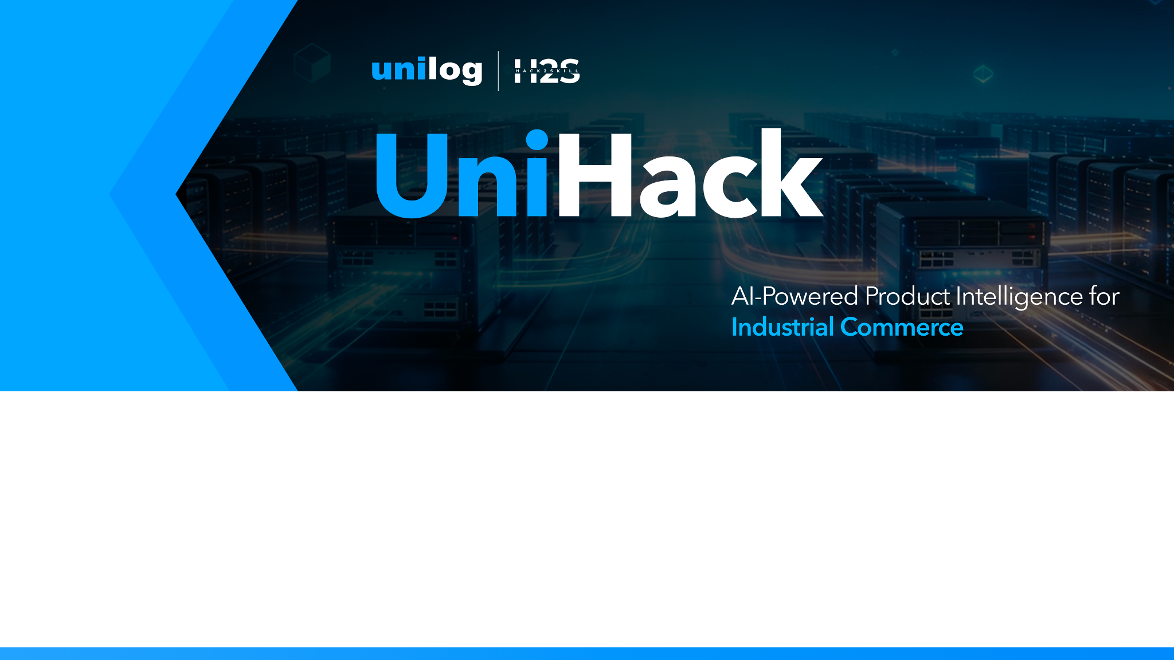
Team Details
Team name: KLassic
Team leader name: Abhijeet Kangane

Slide 2

Brief about your solution
OmniSpec is a comprehensive AI-powered intelligence pipeline that bulk processes unstructured supplier datasheets (PDFs) and URLs into perfectly validated, commerce-ready catalogs. It leverages advanced Large Language Models (LLMs) and deterministic fallback engines to generate structured Golden Records with extremely high accuracy, bypassing the need for manual data entry.

Slide 3
1. Enrichment: Ingests minimal inputs and fetches technical sheets, using a Hybrid AI extraction pipeline (Qwen-27B LLM + Deterministic Fallback). 2. Validation: Applies real-time Confidence Scoring. Anything below 95% is flagged for Human-in-the-Loop (HITL) review to ensure 100% integrity. 3. Scalability: Built on FastAPI and Next.js microservices for asynchronous bulk processing. Uses PyMuPDF/BS4 to dynamically normalize any unstructured document format.

Slide 4
Opportunities
Unlike rigid parsers, OmniSpec dynamically adapts to any manufacturer's layout automatically. Unlike pure API-dependent LLMs which crash frequently, our hybrid engine guarantees 100% reliable local fallback during network outages. USP: Zero-API-Dependency Fallback Mode for 100% uptime, Ultra-Fast asynchronous processing, and an automated UNSPSC taxonomy prediction engine natively integrated into a premium sci-fi dashboard.

Slide 5
List of features offered by the solution
• Multi-modal Ingestion (Drag-and-Drop PDFs, Direct URLs) • Hybrid AI Extraction Pipeline (Groq LLM + Local Deterministic Fallback) • Automated UNSPSC Taxonomy Categorization • Real-time Confidence Scoring and Data Triangulation • Human-in-the-Loop (HITL) Enrichment Dashboard • Fully Responsive Sci-Fi UI for industrial users

Slide 6
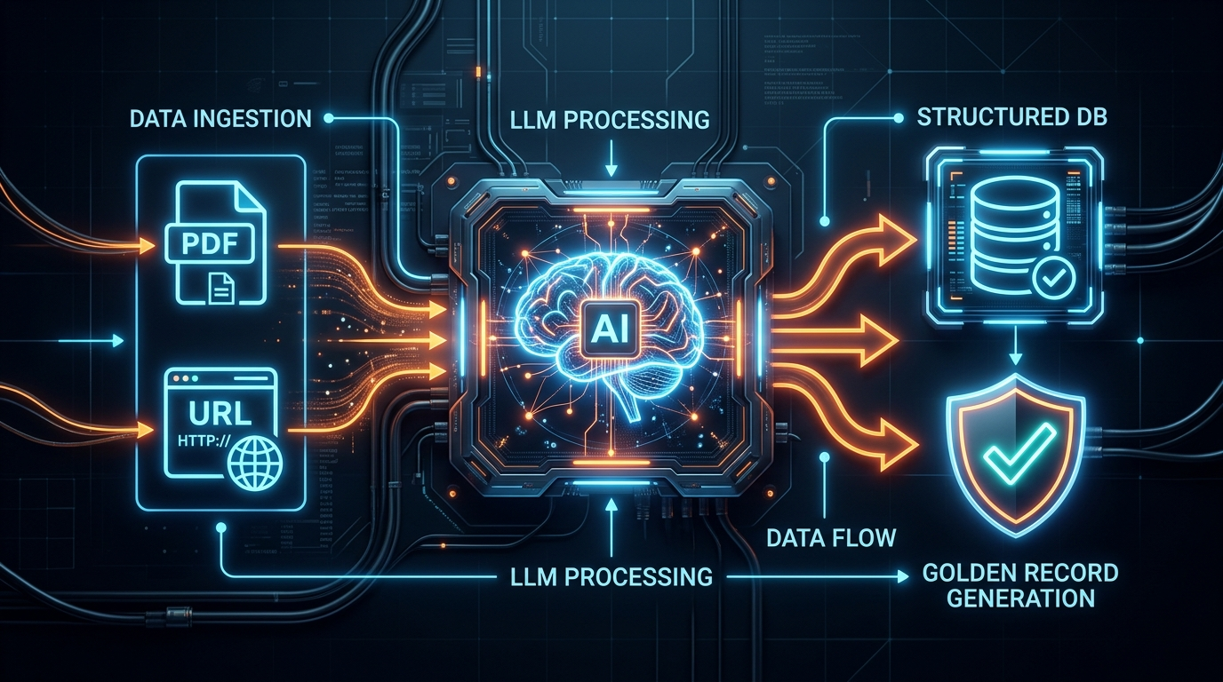
Process flow diagram or Use-case diagram

Slide 7
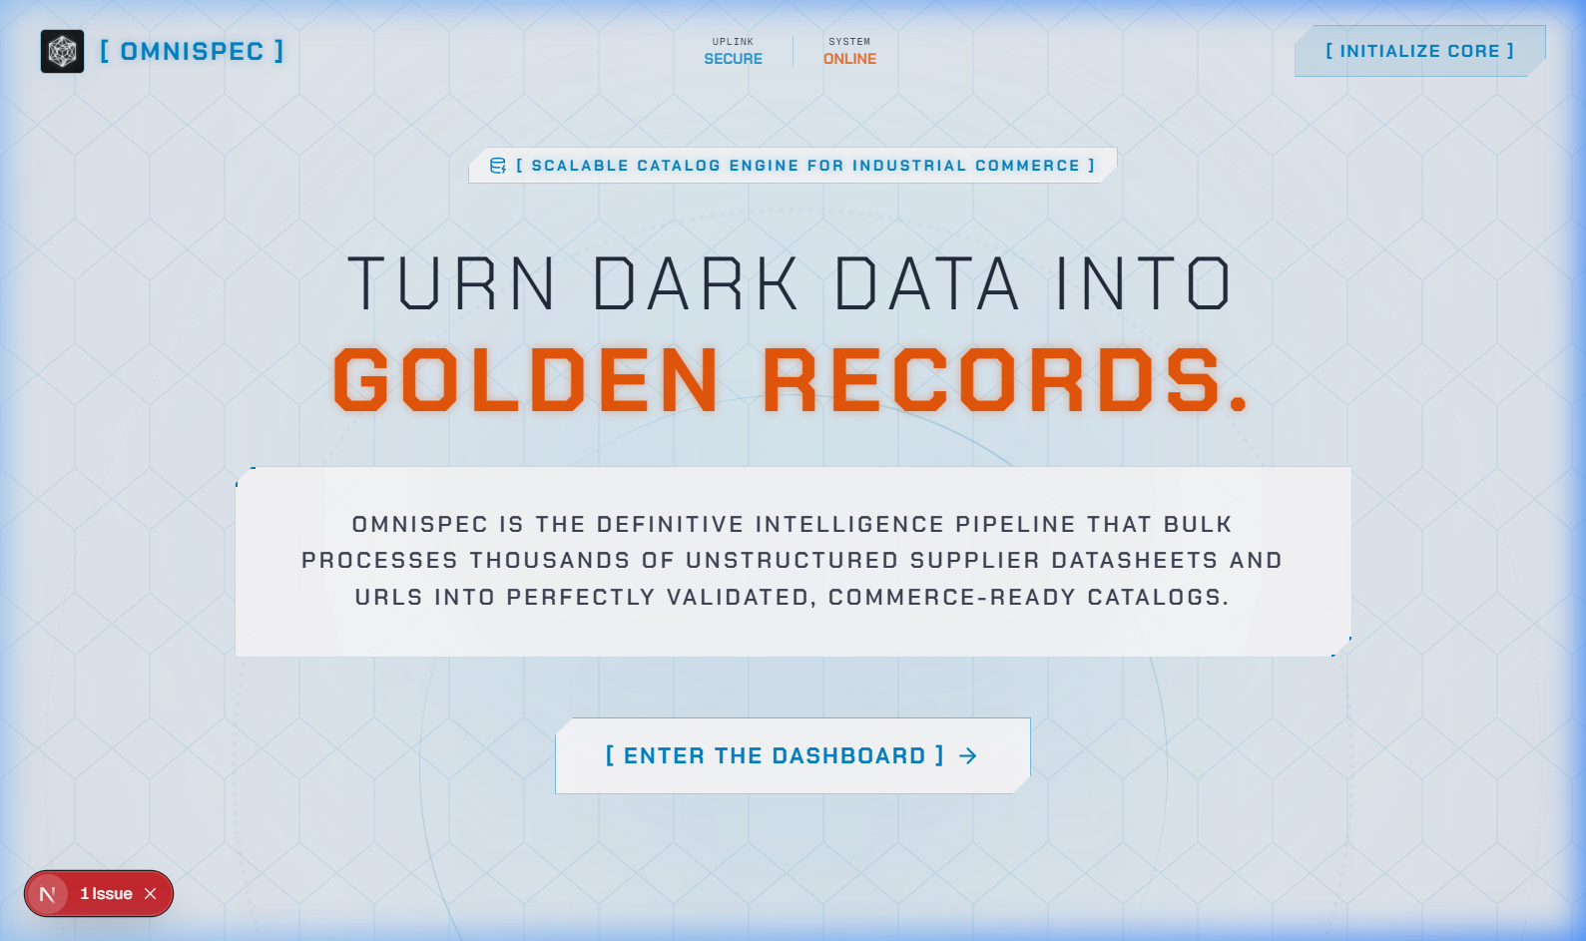
Wireframes/Mock diagrams of the proposed solution (optional)

Slide 8
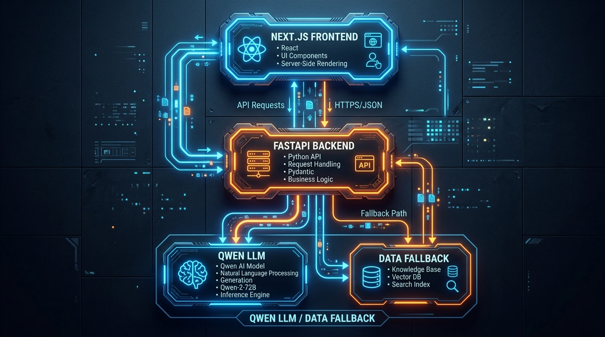
Architecture diagram of the proposed solution

Slide 9
Technologies used in the solution
Frontend: Next.js 16.3, React 19, Tailwind CSS, Framer Motion Backend: FastAPI, Uvicorn, Python 3.10+ AI/Parsing: Groq API (Qwen-27B), PyMuPDF, BeautifulSoup4 Deployment: Vercel (Frontend), Render (Backend) Tooling: Git, Eslint

Slide 10
Estimated implementation cost (optional)
Extremely Low / Near Zero. By utilizing high-efficiency open-source models (Llama3/Qwen) via ultra-fast inference APIs (Groq), the operational processing cost per 10,000 SKUs is a fraction of traditional manual data entry or commercial LLM (GPT-4) alternatives.

Slide 11
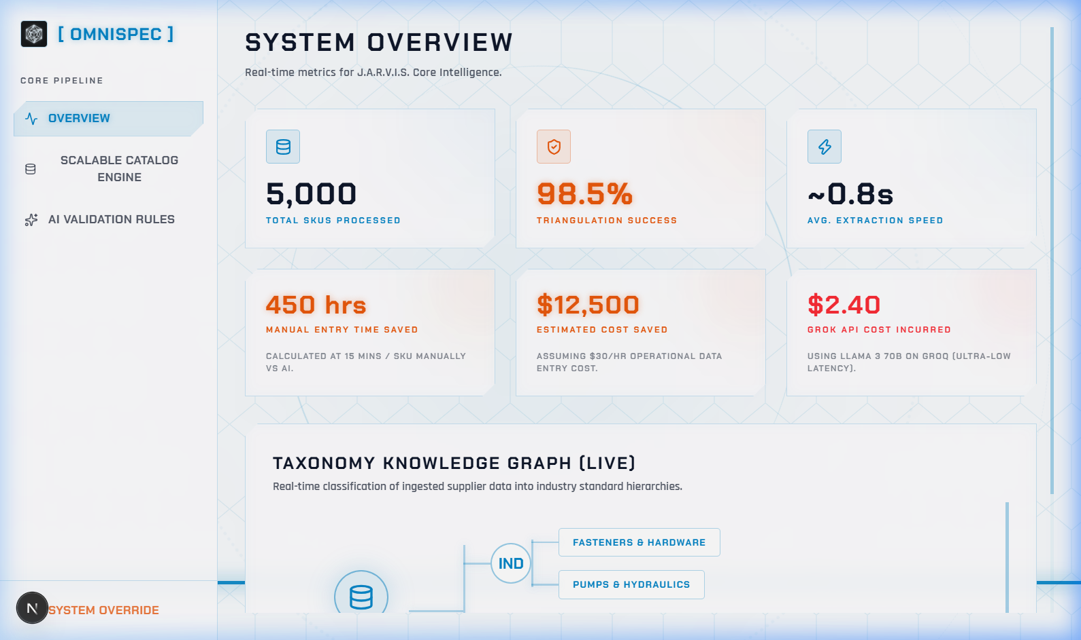
Snapshots of the MVP

Slide 12
Additional Details/Future Development (if any)
Our immediate future roadmap includes: 1. Direct eCommerce platform integrations (e.g., Shopify, Magento ERP plugins). 2. An automated web-crawler that actively monitors supplier websites for real-time datasheet updates and pushes delta changes directly to the Golden Records.

Slide 13
Provide links to your:
GitHub: https://github.com/Abhi666-max/OmniSpec Demo Video: https://youtu.be/775Z2EbCy8E Prototype Link: https://omni-spec-one.vercel.app/

Slide 14


