Slide 1

Deep Learning-Based Classification of Tomato Leaf Diseases Using CNN
Presented by
Abhijeet Tukaram Kangane
Roll No- 38
Under the guidance of
Prof. Suvarna Phule
REVIEW DATE PAGE NO
SHALAKA FOUNDATION’S
KEYSTONE SCHOOL OF ENGINEERING
DEPARTMENT OF COMPUTER ENGINEERING

Slide 2

ABSTRACT
INTRODUCTION
LITERATURE SURVEY
METHODOLOGY
RESULT ANALYSIS
CONCLUSION
FUTURE SCOPE
SHALAKA FOUNDATION’S
KEYSTONE SCHOOL OF ENGINEERING

Slide 3
ABSTRACT
SHALAKA FOUNDATION’S
KEYSTONE SCHOOL OF ENGINEERING
Tomato crops are often affected by leaf diseases, and manual diagnosis is slow and requires expert knowledge. This seminar presents an automatic system that classifies tomato leaf diseases from images using a Convolutional Neural Network (CNN). The model uses MobileNetV2, pre-trained on ImageNet, with transfer learning in two phases: first, only the new classification layers are trained, and then the last 40 layers of the network are fine-tuned. Because the dataset is imbalanced, class-weighted training is used so that rare diseases get more attention. The model is trained and tested on the PlantVillage dataset, which has 18,160 images in 10 classes (nine diseases and one healthy class), split 80:20 for training and validation. The model achieves 93.86% training accuracy and 92.15% validation accuracy. The small gap between the two shows that the model generalizes well without overfitting. Class weighting also improved recall on rare classes, such as Tomato Mosaic Virus (0.97). These results show that a lightweight CNN can support quick, low-cost disease detection in agriculture.
Keywords: CNN, Transfer Learning, Tomato Leaf Disease, Class Imbalance, PlantVillage Dataset

Slide 4
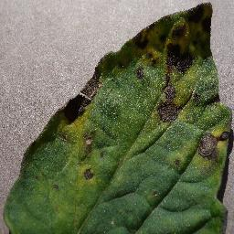
INTRODUCTION
SHALAKA FOUNDATION’S
KEYSTONE SCHOOL OF ENGINEERING
Tomato plants easily catch leaf diseases caused by fungus, bacteria, or viruses (for example: early blight, late blight, bacterial spot, yellow leaf curl virus)
Checking diseases by eye is slow and needs expert knowledge that many farmers do not have
Deep learning (CNN models) can detect diseases from leaf images automatically, fast and accurately
Goal: build a simple, efficient CNN model that can identify 9 tomato diseases plus healthy leaves
Method: use transfer learning and class-weighting to also handle uneven amounts of data for each disease

Slide 5
LITERATURE SURVEY
SHALAKA FOUNDATION’S
KEYSTONE SCHOOL OF ENGINEERING
Title, Author & Year | Methodology | Result | Research Gap
Advanced Neural Network Architectures for Tomato Leaf Disease Diagnosis in Precision Agriculture Ghosh et al., 2025 | Compares VGG19, ViT, EfficientNetV2, ConvNeXt for tomato disease diagnosis | Hybrid models give highest accuracy | No unified class-imbalance handling
Optimized Deep CNN Architectures for High-Precision Multiclass Detection of Tomato Leaf Diseases Das & Senapati, 2026 | Selectively unfreezes deep conv blocks for fine-tuning | 99.08% accuracy | No class-imbalance analysis
An Automated Approach Using Hybrid CNN to Recognize and Classify Tomato Leaf Diseases Saradha et al., 2026 | Combines ResNet50 feature extraction with SVM classifier | Reduced overfitting on skewed classes | Imbalance only partly solved
Classification of Foliar Diseases in Tomato Crops Using Convolutional Neural Networks Lopez-Velasco et al., 2026 | Benchmarks custom CNN vs. VGG16/19, InceptionV3, Xception | >95% train & test accuracy | No class-imbalance handling
Tomato Leaf Disease Detection Using Convolutional Neural Network Trisha et al., 2026 | Custom CNN trained on 5 major tomato disease categories | Effective healthy vs. diseased split | Limited to only 5 disease classes

Slide 6
LITERATURE SURVEY
SHALAKA FOUNDATION’S
KEYSTONE SCHOOL OF ENGINEERING
Title, Author & Year | Methodology | Result | Research Gap
Plant Leaf Disease Detection Using Convolutional Neural Networks Munaye et al., 2026 | CNN trained across tomato, pepper, and potato (15 classes) | 96.14% test accuracy | No class-weighting used
Generative AI-driven Hybrid Data Augmentation for Robust Tomato Leaf Disease Classification Nguyen et al., 2026 | Generative-AI augmentation + EfficientNet-B0 backbone | Improved robustness in low-data regime | High computational cost
Tomato Leaf Disease Detection Using EfficientNet-ViT Hybrid Model with Attention-Driven Feature Fusion Gadekar et al., 2026 | Proposes attention-based CNN + Transformer feature fusion | Conceptual design, no results yet | Empirical validation missing
Enhancing Tomato Leaf Disease Classification with Deep Transfer Learning on VGG16 Jain et al., 2026 | Deep transfer learning on VGG16 for texture-level features | 99.27% accuracy | No class-imbalance discussion
Deep Learning Based Multi-class Identification of Tomato Leaf Diseases Chaudhury et al., 2026 | DenseNet121 transfer learning model | Improved robustness to lighting variation | No class-weighting used

Slide 7
METHODOLOGY
SHALAKA FOUNDATION’S
KEYSTONE SCHOOL OF ENGINEERING
Dataset
PlantVillage dataset: 18,160 tomato leaf images across 10 classes (9 diseases + 1 healthy)
Significant class imbalance: 5,357 images (Yellow Leaf Curl Virus) vs. only 373 (Mosaic Virus)
Split into 80% training (14,528 images) and 20% validation (3,632 images)
Preprocessing & Augmentation
Images resized to 160×160 pixels, normalized using MobileNetV2 preprocessing
Augmentation: random horizontal flip, rotation, zoom, and contrast adjustment

Slide 8
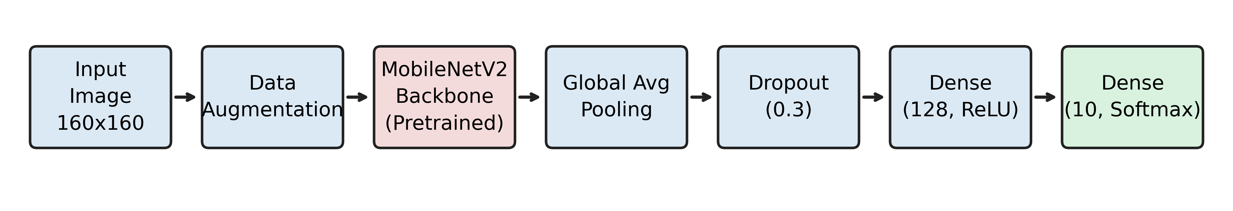
METHODOLOGY
SHALAKA FOUNDATION’S
KEYSTONE SCHOOL OF ENGINEERING
Proposed Architecture
MobileNetV2 (pretrained on ImageNet) as feature-extraction backbone
Custom head: Global Avg Pooling → Dropout(0.3) → Dense(128, ReLU) → Dense(10, Softmax)
Two-Phase Training Strategy
Phase 1: frozen backbone, train head only (10 epochs, lr=1e-4)
Phase 2: fine-tune last 40 layers (10 epochs, lr=1e-5) + class-weighted loss

Slide 9
RESULT ANALYSIS
SHALAKA FOUNDATION’S
KEYSTONE SCHOOL OF ENGINEERING
Final Training Accuracy: 93.86%
Final Validation Accuracy: 92.15%
The gap between training and validation accuracy is small (about 1.7%), which means the model works well on new images too
Training in two phases (first freezing the base model, then fine-tuning it) gave much better accuracy than training in just one phase
Giving more importance to rare disease classes during training helped the model detect them better, without reducing overall accuracy

Slide 10
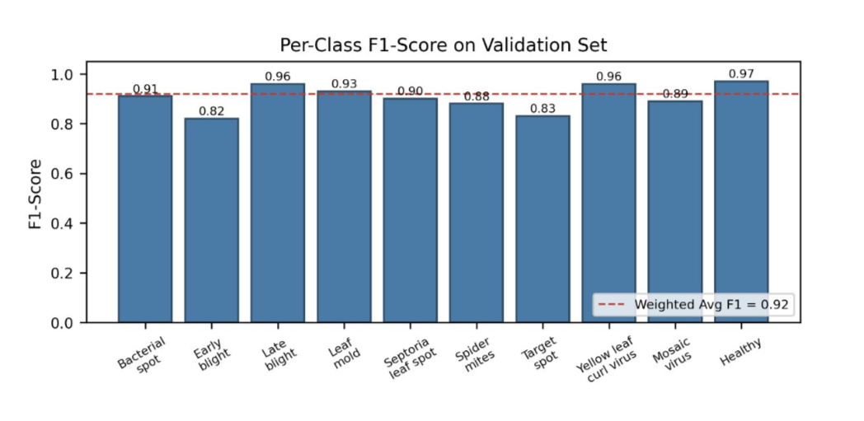
RESULT ANALYSIS
SHALAKA FOUNDATION’S
KEYSTONE SCHOOL OF ENGINEERING
Overall weighted-average F1-score: 0.92 across all 10 disease classes
Highest F1-scores: Healthy (0.97) and Late Blight (0.96) – excellent detection
Yellow Leaf Curl Virus and Tomato Mosaic Virus also score strongly (F1 = 0.96 and 0.89)
Lowest F1-score: Early Blight (0.82) – still acceptable

Slide 11
CONCLUSION
SHALAKA FOUNDATION’S
KEYSTONE SCHOOL OF ENGINEERING
Built a tomato leaf disease classifier using a CNN model (MobileNetV2) with transfer learning
Two-phase training gave 93.86% training accuracy and 92.15% validation accuracy
Giving extra weight to rare classes improved detection of Early Blight and Mosaic Virus
The small gap (about 1.7%) between training and validation accuracy shows the model works well on new, unseen images
This is a lightweight solution that can be used on real farms for quick, real-time disease detection

Slide 12
FUTURE SCOPE
SHALAKA FOUNDATION’S
KEYSTONE SCHOOL OF ENGINEERING
Try bigger and stronger deep learning models to push accuracy even higher than 92%
Test the model on real farm photos taken in sunlight, shadow, and different backgrounds – not just clean lab photos
Combine multiple models together (called ensemble learning) so their combined guess is more accurate than any single model
Turn this into a simple, easy-to-use mobile app so farmers can click a photo and get instant disease results in the field
Add support for other crops like potato, chilli, and grapes, so more farmers can benefit from this system

Slide 13
REFERENCES
SHALAKA FOUNDATION’S
KEYSTONE SCHOOL OF ENGINEERING
[1] H. Ghosh, I. S. Rahat, M. M. R. Emon et al., "Advanced neural network architectures for tomato leaf disease diagnosis," Discover Sustainability, vol. 6, art. 312, 2025.
https://doi.org/10.1007/s43621-025-01149-1
[2] S. Das and M. R. Senapati, "Optimized deep CNN architectures for multiclass detection of tomato leaf diseases," Intelligent Systems, ICMIB 2025, Springer, 2026.
https://doi.org/10.1007/978-3-032-05120-2_18
[3] M. Saradha et al., "An automated approach using hybrid CNN to recognize and classify tomato leaf diseases," Recent Trends in Intelligence Enabled Research, ISSIP 2025, Springer, 2026, pp. 49-61.
https://doi.org/10.1007/978-3-032-25038-4_5
[4] B. Lopez-Velasco, J. C. Olguin-Rojas, and A. Ruiz-Garcia, "Classification of foliar diseases in tomato crops using CNNs," MICAI 2025, Springer, 2026, pp. 260-271.
https://doi.org/10.1007/978-3-032-09044-7_19
[5] S. Trisha et al., "Tomato leaf disease detection using CNN," Applied Artificial Intelligence, 2AI 2024, Springer, 2026, pp. 315-328.
https://doi.org/10.1007/978-3-032-00793-3_25

Slide 14
REFERENCES
SHALAKA FOUNDATION’S
KEYSTONE SCHOOL OF ENGINEERING
[6] Y. Y. Munaye, Y. B. Checkol, T. A. Alemu, and A. K. Tegegne, "Plant leaf disease detection using CNNs," 12th EAI Int. Conf. (ICAST 2024), Springer, 2026, pp. 79-90.
https://doi.org/10.1007/978-3-032-04203-3_6
[7] T. T. Nguyen et al., "Generative AI-driven hybrid data augmentation for tomato leaf disease classification," Multimedia Tools and Applications, vol. 85, art. 728, 2026.
https://doi.org/10.1007/s11042-026-21895-2
[8] P. P. Gadekar, O. Pattnaik, and A. D. Potgantwar, "Tomato leaf disease detection using EfficientNet-ViT hybrid model," ICIVC 2025, Springer, 2026, pp. 187-198.
https://doi.org/10.1007/978-3-032-10667-4_16
[9] N. Jain, A. Singh, and S. Jain, "Enhancing tomato leaf disease classification with deep transfer learning on VGG16," DSAI 2025, Springer, 2026, pp. 183-195.
https://doi.org/10.1007/978-981-96-9083-1_15
[10] K. S. Chaudhury et al., "Deep learning based multi-class identification of tomato leaf diseases," HITA 2025, Springer, 2026, pp. 169-180.
https://doi.org/10.1007/978-3-032-19529-6_16

