Slide 1


ER. PERUMAL MANIMEKALAI COLLEGE OF ENGINEERING
AN AUTONOMOUS INSTITUTION • HOSUR – 635 117
DEPARTMENT OF INFORMATION TECHNOLOGY
PROJECT TITLE
Campus Circle
PRESENTED BY
PROJECT GUIDE
Abhilash R
Anbu Selvan K
Dileep Kumar A
Aanandha S
Sijal

Slide 2
Problem Statement & Proposed Solution
Bridging collegiate event communication gaps with an integrated academic registry
Existing Challenges & Bottlenecks
• Information Fragmentation: Circulars scattered across WhatsApp groups and paper boards lead to low student turnout and missed deadlines.
• Manual Attendance Rosters: Paper sign-in sheets cause delays, proxy attendance, lost records, and tedious data compilation.
• Administrative Burden: Faculty coordinators spend excessive hours drafting notices, tracking seat counts, and managing rosters.
• Unverified Credentials: Traditional printed certificates lack digital validation, centralized IDs, or QR verification.
The Campus Circle Solution
• Centralized Event Catalog: Real-time discovery across Workshop, Technical, Cultural, Placement, and Seminar categories.
• Automated 1-Click Ticketing: Instant student registration with automated Brevo transactional email passes.
• Registrar Control Suite: Live attendee rosters, 1-click CSV attendance export, and safe two-step student deletion.
• Verified Digital Credentials: Official certificates with authorized gold medallion, QR code, and landscape A4 print styling.
• Google Gemini AI Assistant: Automated event copywriting, schedule formatting, and category generation from coordinator prompts.
Department of Information Technology · Er. Perumal Manimekalai College of Engineering

Slide 3
System Architecture & Decoupled Dataflow
Decoupled client-server architecture with asynchronous cloud service integration
Student / Admin
Client Interface
(Mobile & Desktop)
React 18 + Vite
(SPA on Vercel Edge)
Python Flask Backend
(REST API Services)
Neon Cloud PostgreSQL
(Pooled DB Cluster)
▶
▶
▶
Google Gemini Generative AI
Brevo Transactional Email (v3)
GitHub Actions CI/CD Pipeline
Automated drafting pipeline: transforms brief coordinator prompts into structured titles, agendas, categories, and schedules with multi-model fallback.
Asynchronous background threading: delivers responsive HTML event tickets and welcome credentials directly to student inboxes without UI blocking.
Continuous integration & regression testing: runs automated frontend builds, Flask unit test suites (7 passing tests), and Docker validation.
Decoupled cloud design with background threading workers ensures sub-50ms API response latency.

Slide 4
Comprehensive Technology Stack
Enterprise-grade, modern open-source toolchain powering the platform
Frontend: React 18 + Vite
Backend: Python 3.12 + Flask
Database: Neon Serverless PostgreSQL
Single Page Application with fast HMR, responsive Tailwind CSS styling, custom monochrome SVG icons, and Newsreader collegiate typography.
Lightweight REST API backend utilizing connection pooling, parameter validation, modular route blueprints, and background threading.
Cloud-hosted relational database featuring pooled connection strings, foreign key constraints (ON DELETE CASCADE), and ACID transactions.
AI Integration: Google Gemini API
Email Service: Brevo REST API (v3)
DevOps & CI/CD: GitHub Actions
Intelligent event generation engine with resilient fallback across gemini-3.5-flash and gemini-flash-latest models.
Automated transactional email dispatching personalized welcome passes and event entry tickets with college credentials.
Automated continuous integration pipeline testing Vite builds, 7 Flask unit tests, Docker container validation, and Vercel edge deployment.

Slide 5
Platform Features: Student & Administrator Suites
Complete end-to-end functionality tailored for students and department faculty
Student Experience & Engagement
• Event Discovery & Live Category Filters: Browse workshops, technical symposiums, cultural sessions, placements, and seminars with live event counts.
• Real-Time Seat Capacity Meters: Live visual progress bars showing occupied and remaining spots with duplicate registration safeguards.
• 1-Click Registration & Email Passes: Immediate registration confirmation with automated Brevo transactional email tickets.
• Personal 'My Schedule' Dashboard: Track enrolled sessions, upcoming event dates, venues, and attendance confirmation status.
• Verified Digital Certificates: Access and print authorized participation credentials with official gold seal and QR verification.
• Interest-Based Recommendations: Tailored suggestions matching declared technical interests (AI, Web, Cloud, Placements).
Administrator & Registrar Suite
• Live Attendee Rosters: View registered students per event with full names, registration numbers (e.g. 610825BIT001), departments, and classes.
• 1-Click CSV Export: Instantly download complete attendee rosters for offline university records, attendance grading, and gate security check-ins.
• Student Directory & User Deletion: Complete visibility into registered accounts with individual removal and two-step safe bulk deletion safeguards.
• Real-Time Event Editor: Modify event schedules, venues, descriptions, and seat limits on the fly without losing student enrollment history.
• AI-Assisted Event Auto-Fill: Gemini AI automatically generates polished titles, agendas, and durations from rough coordinator prompts.
• Live Institutional Analytics: Real-time dashboard metrics tracking total events, enrolled students, and seat utilization rates.

Slide 6
Core Implementation: Production Code Showcase
Flask API atomic registration, connection pooling, and non-blocking asynchronous email threading
📄 backend/app.py — Atomic Registration Handler
📄 backend/brevo_service.py — Async Services & AI Fallback
# backend/app.py — Atomic Event Registration
@app.route('/api/events/<int:event_id>/register', methods=['POST'])
def register_for_event(event_id):
data = request.json or {}
user_id = data.get('user_id')
if not user_id:
return jsonify({'error': 'user_id required'}), 400
conn = get_db()
with conn.cursor() as cur:
# Atomic seat capacity check
cur.execute("SELECT seats FROM events WHERE id = %s", (event_id,))
ev = cur.fetchone()
cur.execute("SELECT COUNT(*) FROM registrations WHERE event_id = %s",
(event_id,))
count = cur.fetchone()[0]
if ev and count >= ev['seats']:
return jsonify({'error': 'Event is full'}), 400
# Enforce unique registration per student
cur.execute("""
INSERT INTO registrations (user_id, event_id, status)
VALUES (%s, %s, 'Confirmed')
ON CONFLICT (user_id, event_id) DO NOTHING
RETURNING id
""", (user_id, event_id))
reg = cur.fetchone()
conn.commit()
if not reg:
return jsonify({'error': 'Already registered'}), 409
# Trigger asynchronous Brevo email pass
trigger_confirmation_email(user_id, event_id)
return jsonify({'message': 'Registration confirmed', 'id': reg['id']})
# backend/brevo_service.py — Asynchronous Email & AI
def send_brevo_email_async(to_email, to_name, subject, html):
"""Non-blocking transactional email delivery."""
def worker():
api_key, sender_email, sender_name = get_brevo_config()
payload = {
"sender": {"name": sender_name, "email": sender_email},
"to": [{"email": to_email, "name": to_name}],
"subject": subject,
"htmlContent": html
}
requests.post(
"https://api.brevo.com/v3/smtp/email",
headers={"api-key": api_key, "Content-Type": "application/json"},
json=payload, timeout=10
)
threading.Thread(target=worker, daemon=True).start()
def generate_event_with_gemini(prompt):
"""Multi-model AI fallback pipeline."""
for model in ['gemini-3.5-flash', 'gemini-flash-latest']:
try:
m = genai.GenerativeModel(model)
resp = m.generate_content(SYSTEM_PROMPT + prompt)
return json.loads(clean_json(resp.text))
except Exception:
continue
return fallback_template(prompt)

Slide 7
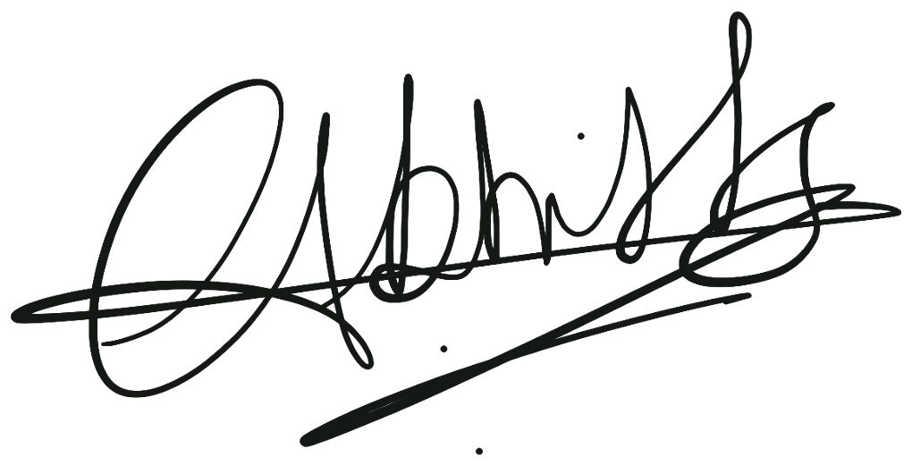
Official Certificate Verification Engine
Authorized distributor layout, gold medallion seal, QR verification, and real signatory signature
AUTHORIZED
★
2026
Credential Highlights
• Official Academic Layout: Clean distributor certificate format matching institutional standards
• Zero Bracket Placeholders: Pure typography rendering student recipient and event details without bracket symbols
• Authentic Signatory Integration: High-resolution authorized signature image for Abhilash R, Authorized Signatory
• Gold Medallion & QR Verification: Engraved 2026 authorized seal and digital QR verification code
• A4 Landscape Auto-Print: Custom CSS rules (@page size: landscape) formatted for 1-click PDF download
• Tamper-Resistant Validation: Credential records cross-referenced against PostgreSQL registration keys
DISTRIBUTOR CERTIFICATE
QR
This certifies that
Abhilash R
is an Authorized Participant for CodeCraft Hackathon under the Campus Circle event catalog.
This authorization applies exclusively to the technical sprint and workshops held on 2026-10-11 at C Block Auditorium, Er. Perumal Manimekalai College of Engineering.
Abhilash R
AUTHORIZED SIGNATORY
certificate.issued_on: 2026-10-11

Slide 8
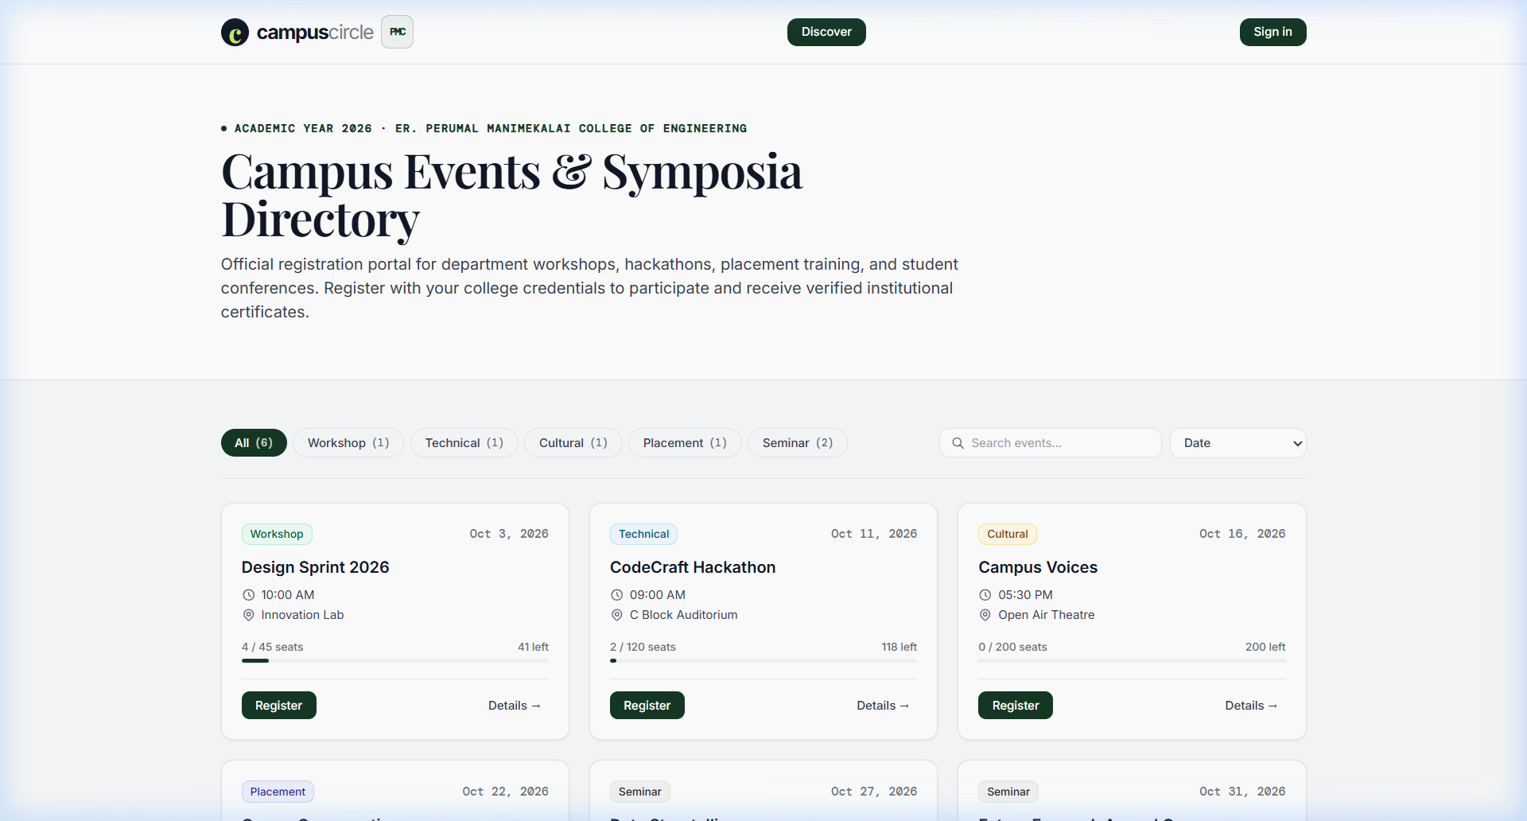
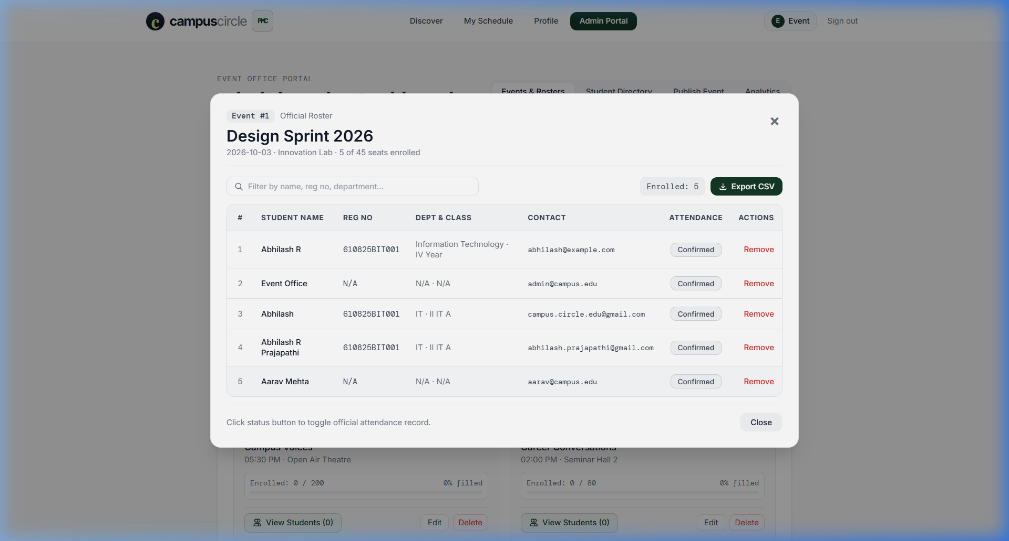
Live Platform Demonstration: Student & Admin Interfaces
Real production interface showing Student Discovery and Admin Attendee Roster management
Student View: Classic logo badge, category filter pills, real-time seat countdowns, and 1-click registration.
Admin View: Live attendee roster with register numbers (610825BIT001), department, and 1-click CSV Export.
Live production site: https://campuscirclepmc.vercel.app · Department of Information Technology

Slide 9
DevOps, Security Architecture & Conclusion
Continuous deployment, automated regression testing, security safeguards, and live demonstration
DevOps & Automated Testing
• GitHub Actions CI/CD Pipeline (.github/workflows/ci.yml): Automated validation on push and PR to main
• Frontend Build Verification: Installs npm dependencies and validates Vite production bundling (0 build errors)
• Flask Backend Unit Test Suite: All 7 unit test cases passing in 0.045s (API routes, email HTML, sanitization)
• Docker Containerization: Syntax-validated multi-stage container readiness for portable deployments
• Continuous Cloud Deployment: Zero-downtime automated deployment to Vercel production edge network
Security & Data Integrity Safeguards
• Two-Step Typed Confirmation Safeguard: Bulk user deletion requires typing 'DELETE ALL USERS' to unlock execution
• Role-Based Access Control (RBAC): Strict administrative route protection separating student and registrar permissions
• SQL Injection Defense: Parameterized SQL queries (%s tokens) executed via psycopg2 context managers
• Connection Pooling & Scalability: Neon serverless PostgreSQL connection pooling supporting concurrent traffic
• Referential Integrity: Foreign keys with ON DELETE CASCADE ensure clean automated registration cleanups
Campus Circle — Live Platform & Demonstration
🌐 Live Production URL: https://campuscirclepmc.vercel.app | 💻 GitHub: github.com/Abhi7Prajapathi/Events
Er. Perumal Manimekalai College of Engineering · Department of Information Technology · Thank You!

