Slide 1
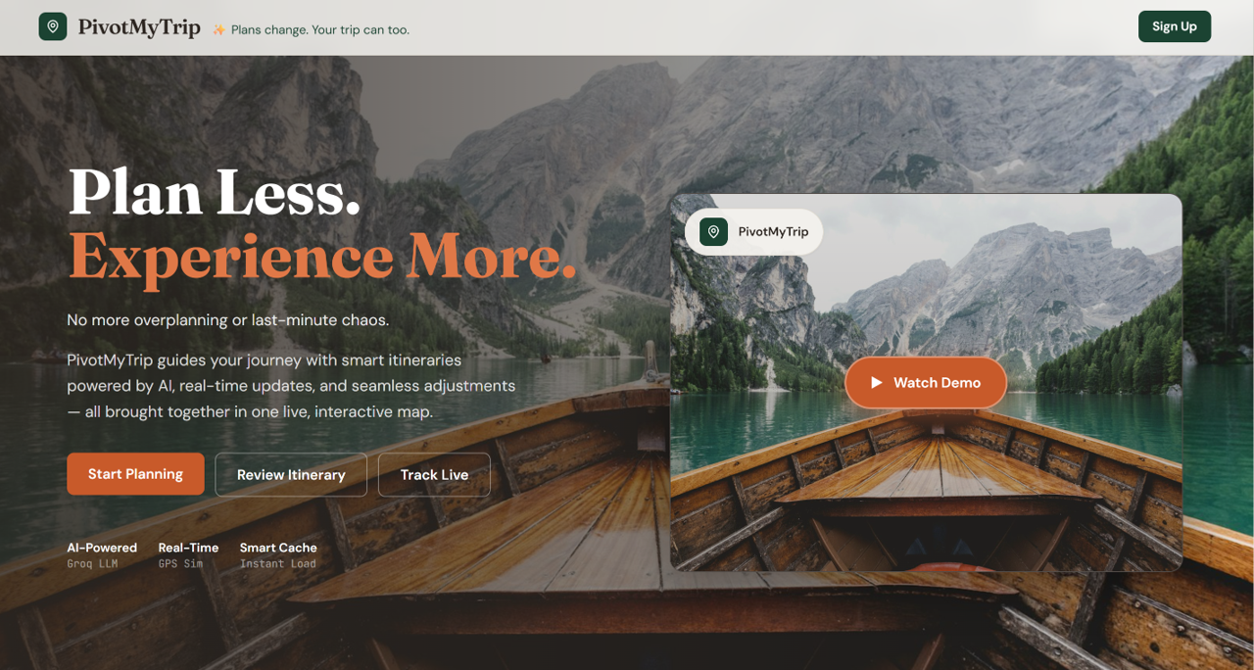

PivotMyTrip
Data Science Capstone
Guided by Prof. Yuxiao Huang
Group 4
Abhilasha Singh
Pranjal Wakpaijan
Problem Statement
Demo
Tech Stack
Solution

Slide 2
PROBLEM STATEMENT
Trip planning today is broken. Travelers face a fragmented landscape of disconnected tools, overwhelming choices, and zero intelligent assistance when plans inevitably change mid-journey.
Choosing which attractions to see, identifying hidden gems over tourist traps, and managing time efficiently
Travelers spend an average of nearly 18 hours planning, with roughly a quarter (22%) finding the process frustrating
No end-to-end journey connection tools.
100% manual effort for mid-trip changes.

Slide 3





SOLUTION
PivotMyTrip
Where to next
LLM ITINEARY GENERATION
REAL-TIME TRACKING
VOICE COMMAND
SMART ROUTE-OPTIMIZATION
MID-TRIP REPLANNING
FALLBACK

Slide 4




TECH STACK
Voice/LLM
Backend
Groq Whisper
Ollama Fallback
FastAPI + Python 3.11
Groq API LLM
Routing and Geo
OSRM + Nominatim
TSP Routing
Frontend
React 18 + TypeScript
Tailwind CSS + Vite
Leaflet Maps

Slide 5
PivotMyTrip
Let’s Explore the demo

