Slide 1
Tours And Travels Application
By:-
Abhijit Gaikwad
Dhanraj Nilakhe
Guided By:- Mrs. Sonali Mogal

Slide 2
CONTENTS
INTRODUCTION
PROBLEM STATEMENT
OBJECTIVE
PLAN OF METHODOLOGY
FEATURE SCOPE AND EVALUATION
FEATURE SCOPE

Slide 3
7. CONCLUSION
8. REFERENCES

Slide 4
INTRODUCTION
The sum of the phenomena and relationship arising from the travel and stay of non residents
Tours And Travels Application system provide reservation facility to there customer.
Maximize travel policy compliance all areas including best fares,allowances and approval.

Slide 5
PROBLEM STATEMENT
The purpose website is established fact that Internet users are increasing today Today One of the main purposes of the website is to facilitate the offline customer cannot spend their precious time in markets trying to find out the best deal.
Our priority will be our customers and their travels requirements .
There will be many users visiting the portal and hence we require a strong and reliable fronted which can withhold the users on our site.

Slide 6
OBJECTIVE
Our objective is to offer a variety of travel services that are sure to match all your priorities.
Our objective is to globalism, organize, standardize and goal of journey towards perfectionism
Our objective is to make strong relationship with customers so that they can enjoy holiday of their dreams.

Slide 7
PLAN OF OBJECT METHODOLOGY
Making of front end.
Creating various table in database as needed.
Connection of front end to back end (connection of forms to database).
Updating of candidates detail by admin.
Doing respective jobs.

Slide 8
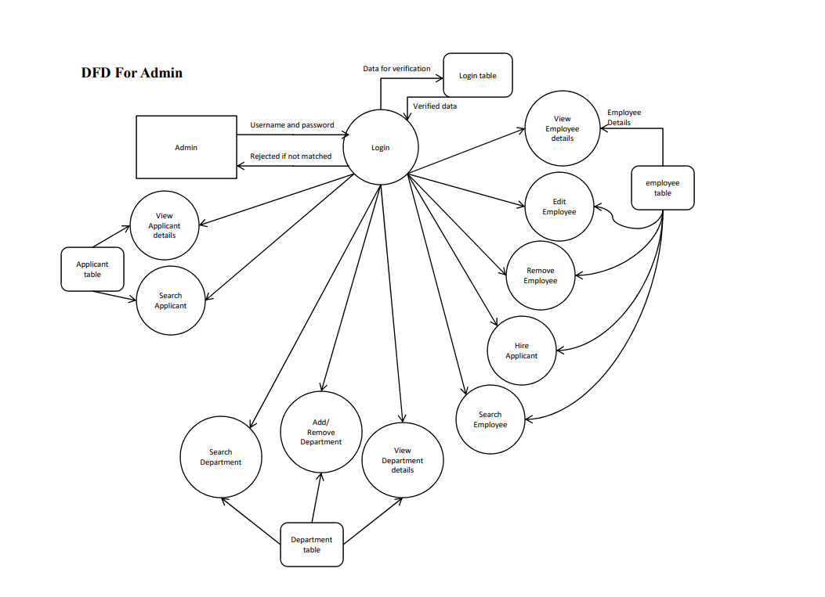

Slide 9
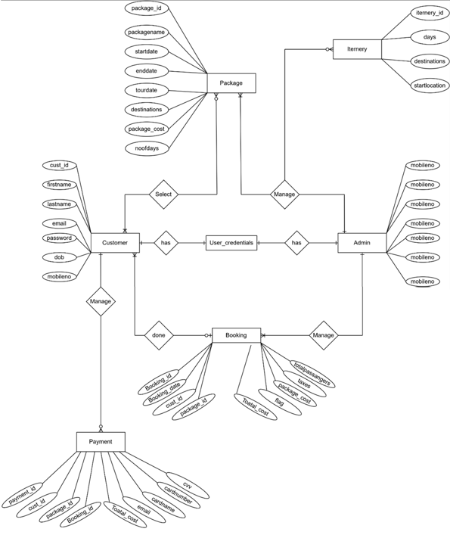
Fig-System Diagram

Slide 10
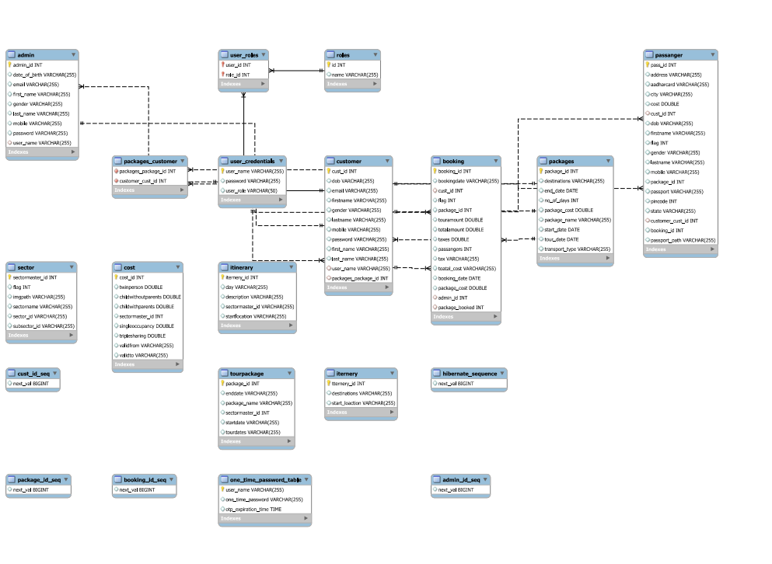
Figure:-E-R Diagram

Slide 11
MEASURES OF UNIQUENESS
It is very unique compared to other websites because in this we cover all the tourists hub. Other websites only select famous or limited tourist place.
This tourists we are providing best staffs who are very carrying and hospitable with the tourists And in the tourists also enjoy touring with them.
Apart from the available packages we let our customers choose the package which suits their need.

Slide 12
FUTURE SCOPE AND EVALUATION
Any tourist agency can make use of it for saving customer details in database.
Tourism group can use it for managing their location,hotel,vehicles details.
This application can easily implemented under various situations.
We can add new features as and when we require.

Slide 13
FETURE SCOPE
We will include more functionality as per the user requirements.
We want to improved our home page, as it is the main things which attracts all user
Not a single website is ever consider as complete forever firstly because there is always something new requirements also are growing day by day.

Slide 14
CONCLUSION
“Tours and Travels Application” simplifies the process in travelling .
Fast processing and immediate result with high security.
Minimizing human effort and cost efficient and cost efficient databases.
Navigation through the site is easy.

Slide 15
REFERENCES
https: //www.wikipedia.com
https: //www.indiaToursOnline.com
https: // www.realityToursandtravel.com

Slide 16
THANKYOU

