Slide 1
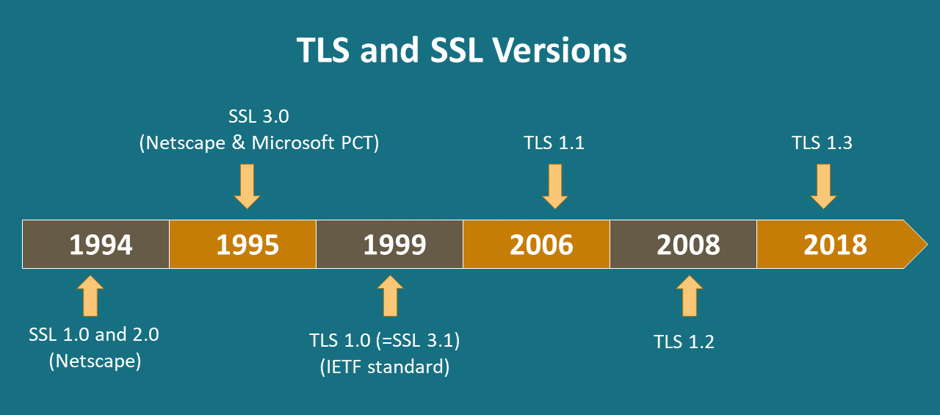
TLS 1.3
TLS : Transport Layer Security
SSL : Secure Sockets Layer
IETF : Internet Engineering Task Force
The important changes in version 1.3 are related to TLS handshaking and Cipher Suites.

Slide 2
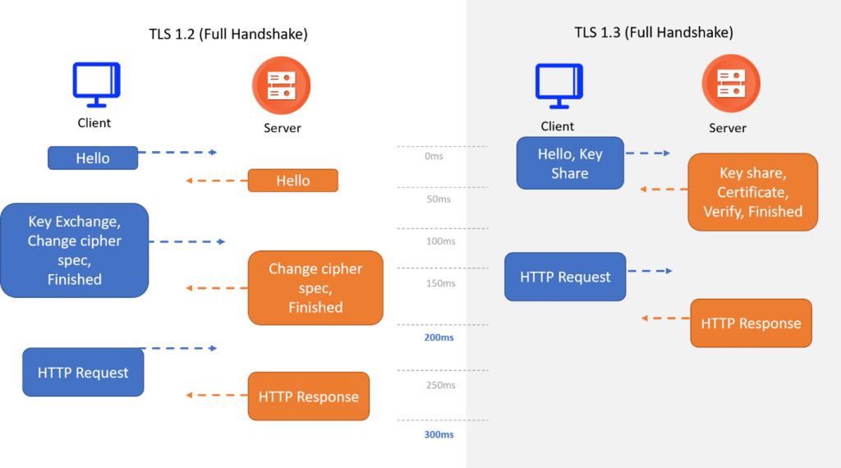

Slide 3
Total Round Trip Times (Pre TLS v1.3)
4 phases when a browser access a site for the first time
DNS lookup
TCP handshake 1 round trip
TLS handshake 2 round trips This is where the magic happens in TLS v1.3 0-RTT
HTTP 1 round trip
New Connection:4 RTT + DNS 3 RTT + DNS (1-RTT)
Resumed Connection:3 RTT + DNS 2 RTT + DNS (0-RTT)
Security
Performance
Old ciphers removed
Version negotiation removed
Faster and Shorter Handshake
Perfect Forward Secrecy - PFS
0-RTT
Every message after Server Hello is encrypted

Slide 4
Version negotiation removed: Up-to TLS 1.2 version , a connection can be established with a lower version. But in version 1.3 we are unable to establish a connection with lower version.
Perfect Forward Secrecy : In traditional key exchange methods, a single, long-term secret key is used to derive session keys for encrypting communications. If this long-term key is ever compromised, an attacker could decrypt all past communications that used that key. This vulnerability is removed using ephemeral key exchange algorithms. This often involves the use of Diffie-Hellman key exchange. With Perfect Forward Secrecy, a unique session key is generated for each individual session. Even if an attacker were to compromise the long-term key, they would not be able to decrypt past sessions because each session has its own unique key. But this created new problems i.e , the private key can’t be shared to other devices.
Client Hello
Server Hello
Certificate
Server Key Exchange Server Hello Done
Client Key Exchange Change Cipher Spec
Encrypted Handshake Message
Client Hello
Server Hello Change Cipher Spec
(Encrypted Extentions)
(Certificate)
(CERT verify)
(Finished)
Application Data

Slide 5
