Slide 1
🌱 CSE 494 — INTELLIGENT NOSQL DATABASES
RECYCLETRACE
Transparent Waste Tracking & Recycling Verification Platform
Solving: "Why can't citizens verify whether segregated waste is actually recycled?"
ACADEMIC PROJECT SUBMISSION & DEFENSE
Student / Author: Abhi Avinash (GitHub: @AbhiAvinashhh)
Core Tech: MongoDB Community 8.x · PyMongo 4.x · Python / Flask · Chart.js · Dynamic QR Codes

Slide 2
CSE 494 · INTELLIGENT NOSQL DATABASES
1. Problem Statement & Academic Motivation
The Segregation Paradox
• Millions of citizens separate plastics, paper, and glass at home every single day.
• Municipal collection remains a black box: once waste leaves the doorstep, tracking ceases.
• Citizens lack any empirical proof that separated waste was transformed rather than dumped.
• Core realization: Segregation without verification is merely sorting.
Greenwashing & False Claims
• Recycling plants frequently self-report optimistic numbers with zero independent validation.
• Truck tare weights, contamination loss, and processing residuals are hidden from public view.
• No mathematical mass-balance reconciliation exists between incoming waste and final output.
• Trust in public waste programs continues to plummet without digital evidence.
Why MongoDB NoSQL?
• Flexible Schema: Comfortably stores polymorphic lifecycle events and photo evidence URIs.
• Engine-Level $jsonSchema: Enforces statutory rules before writes reach persistent storage.
• Compound Indexes: Sub-millisecond lookups for QR scans and citizen batch queues.
• Aggregation Framework: Instant multi-facility mass reconciliation and analytical dashboards via $facet.

Slide 3
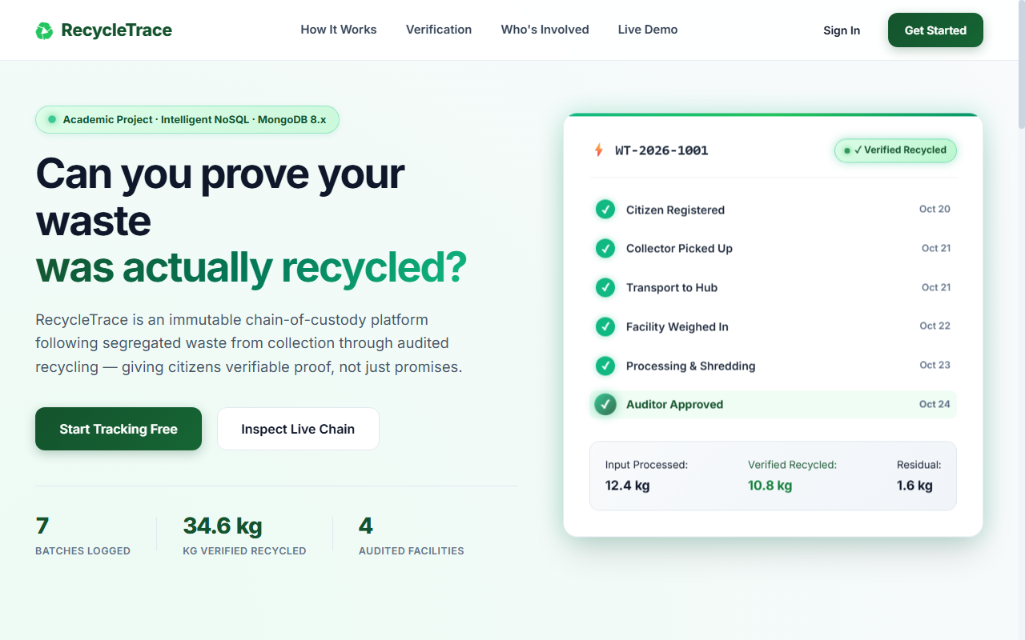
CSE 494 · INTELLIGENT NOSQL DATABASES
2. The Solution: RecycleTrace Platform Overview
Core Innovations
• 1. Immutable Chain of Custody:
• End-to-end event ledger tracking every transfer from doorstep to processing plant.
• 2. QR Digital Passports:
• Unique batch identifiers linked to mobile-scannable chain-of-custody public pages.
• 3. Four-Tier Governance:
• Strict separation of duties between Citizens, Collectors, Plant Operators, and Independent Auditors.
• 4. Strict Recycling Definition:
• Guarantees that waste marked 'Collected' is NEVER conflated with 'Verified Recycled'.
Fig 1: RecycleTrace Landing Page — Live Platform Metrics & Interactive Preview

Slide 4
CSE 494 · INTELLIGENT NOSQL DATABASES
3. System Architecture & Tech Stack
Presentation Tier
• Modern Responsive Frontend:
• Custom Glassmorphic CSS with environmental emerald & forest green aesthetic.
• Interactive Animations:
• Rolling counter animations (countUp), hover 3D tilt, active status radar pulses.
• Data Visualizations:
• Chart.js client-side bar, line, and doughnut charts for live municipal analytics.
• QR Code Rendering:
• Native SVG/PNG QR passport labels generated on demand for bags.
Application Tier
• Python 3.10+ & Flask Framework:
• Modular Blueprint architecture (auth, batches, tracking, facilities, analytics, admin).
• Role-Based Access Control:
• Decorator-enforced session security (@requires_role) preventing privilege escalation.
• Cryptographic Security:
• PBKDF2:SHA-256 password hashing via Werkzeug security.
• REST API Microservices:
• JSON endpoints serving mobile QR scans and management dashboards.
Persistence Tier
• MongoDB Community Server 8.x:
• High-performance document database hosting 6 core indexed collections.
• PyMongo 4.x Driver:
• Native connection pooling and BSON serialization directly to MongoDB.
• Engine-Level Schema Validation:
• $jsonSchema constraints enforced at storage layer.
• Indexing Infrastructure:
• Compound & unique B-Tree indexes yielding 0 ms lookups.

Slide 5
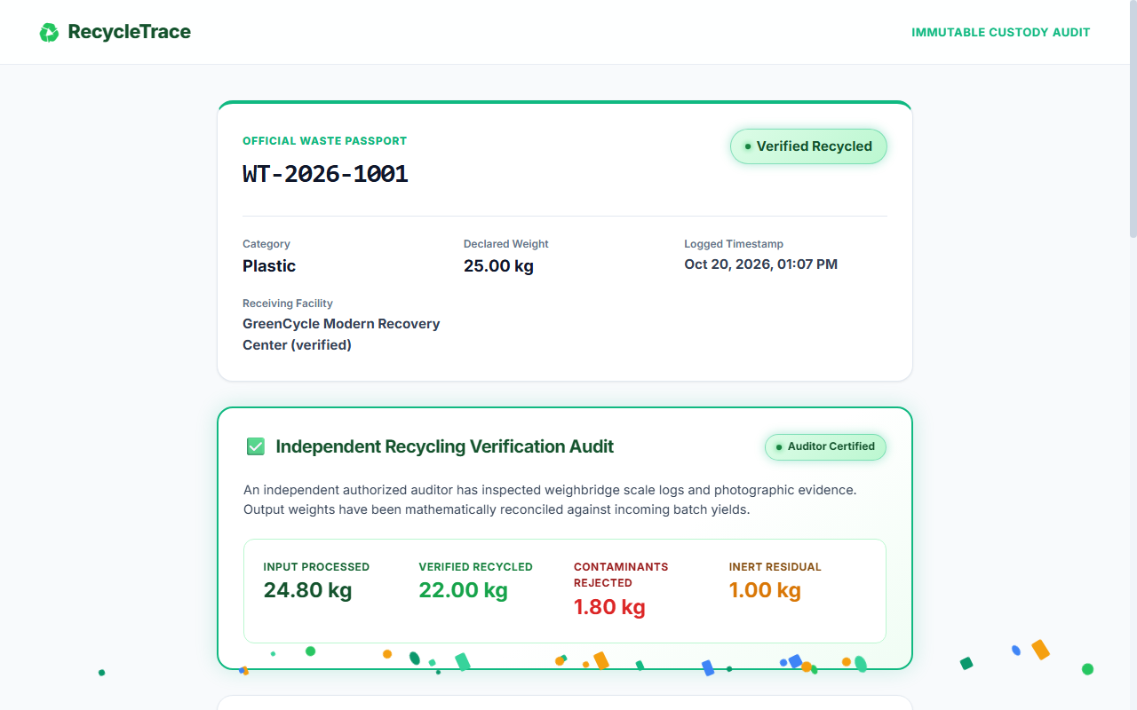
CSE 494 · INTELLIGENT NOSQL DATABASES
4. Citizen Tracking & Public QR Verification
Public Waste Passport
• Tamper-Proof Audit View:
• Citizens scan the batch QR code to open the real-time passport (e.g. /track/WT-2026-1001).
• Chronological Ledger:
• Displays every actor, timestamp, scale weigh-in, and location checkpoint.
• Certified Mass Balance:
• Displays auditor-approved input mass, verified recycled output, rejected contaminants, and residual inert waste.
• PII Privacy Redaction:
• Citizen addresses and contact info are stripped from public routes.
Fig 2: Public Tracking View — Official Waste Passport with Auditor Certified Mass Breakdown

Slide 6
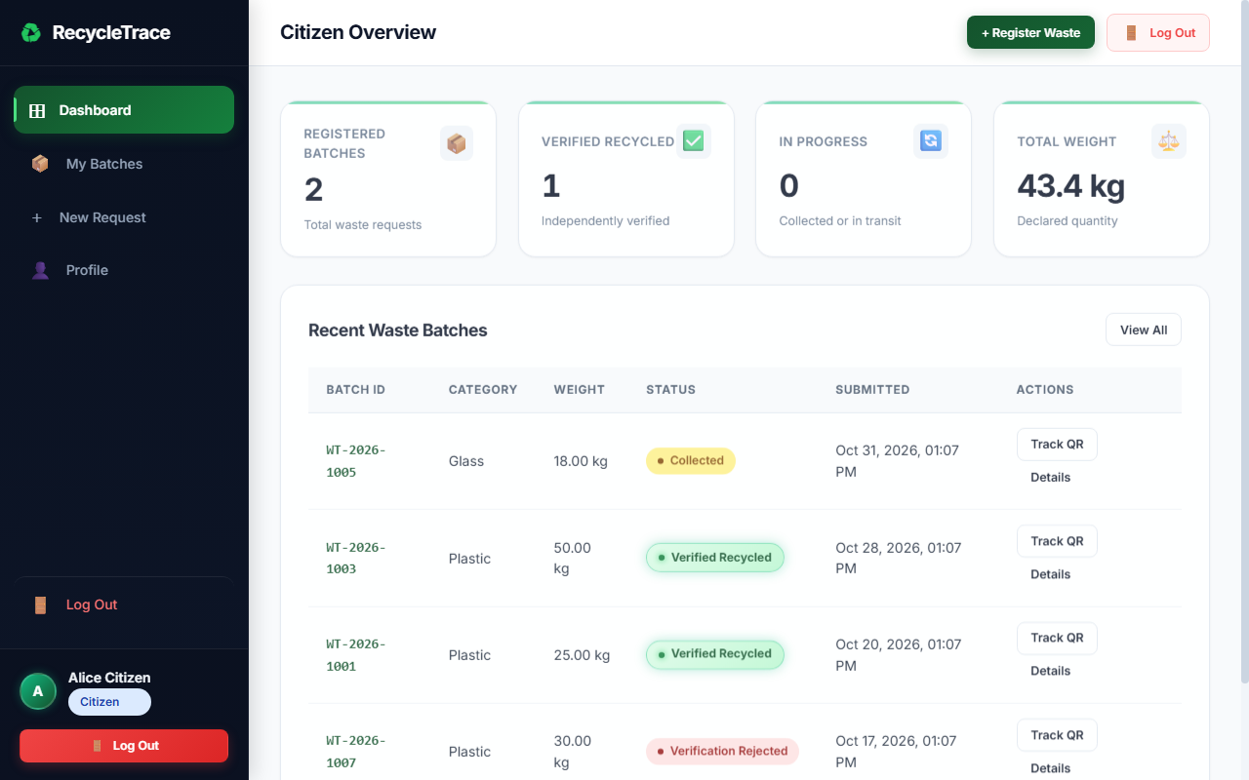
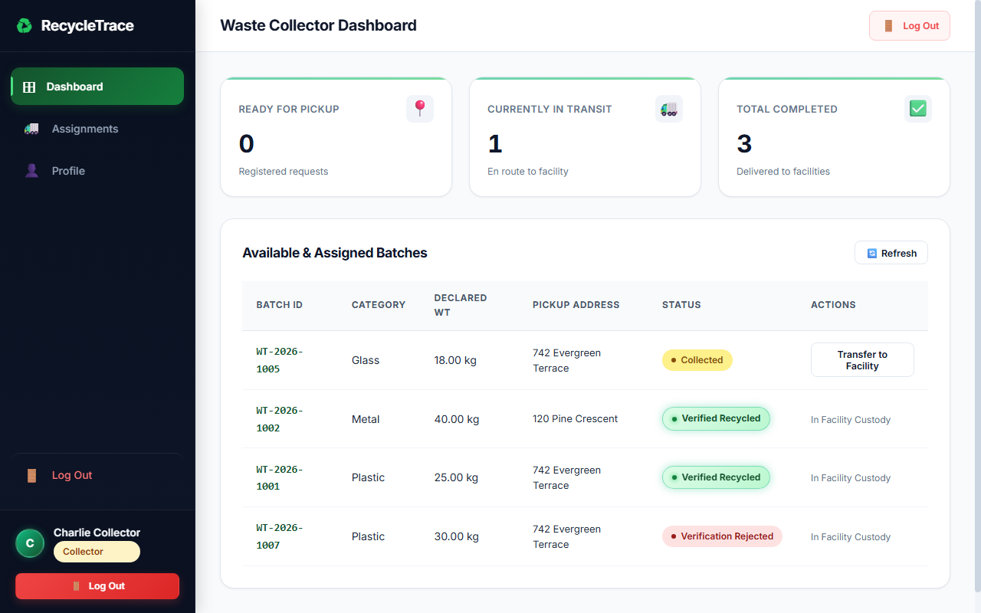
CSE 494 · INTELLIGENT NOSQL DATABASES
5. Collection & Custody Workflow (Screenshots)
Fig 3: Citizen Dashboard — Batch Requests, Live Status Badges & Animated KPIs
Fig 4: Collector Console — Pickup Queue, Weigh-in Logs & Facility Transfer
Workflow Integration: Step 1 to Step 2
• Step 1 (Citizen): Submits waste category, estimated weight, and pickup address. System issues batch ID & QR tag.
• Step 2 (Collector): Arrives at doorstep, scans physical bag QR, records certified scale weight, and dispatches to an accredited plant.

Slide 7
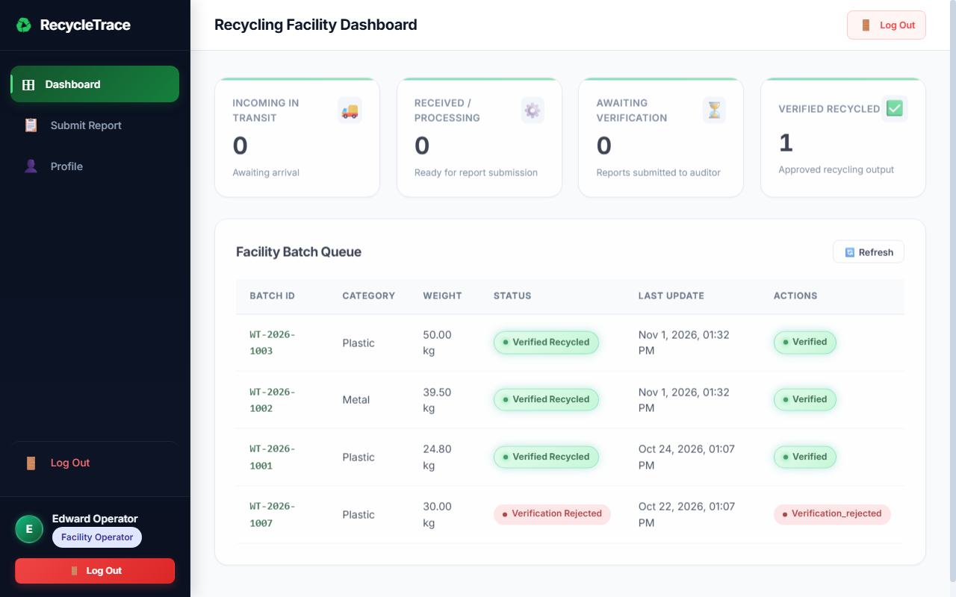
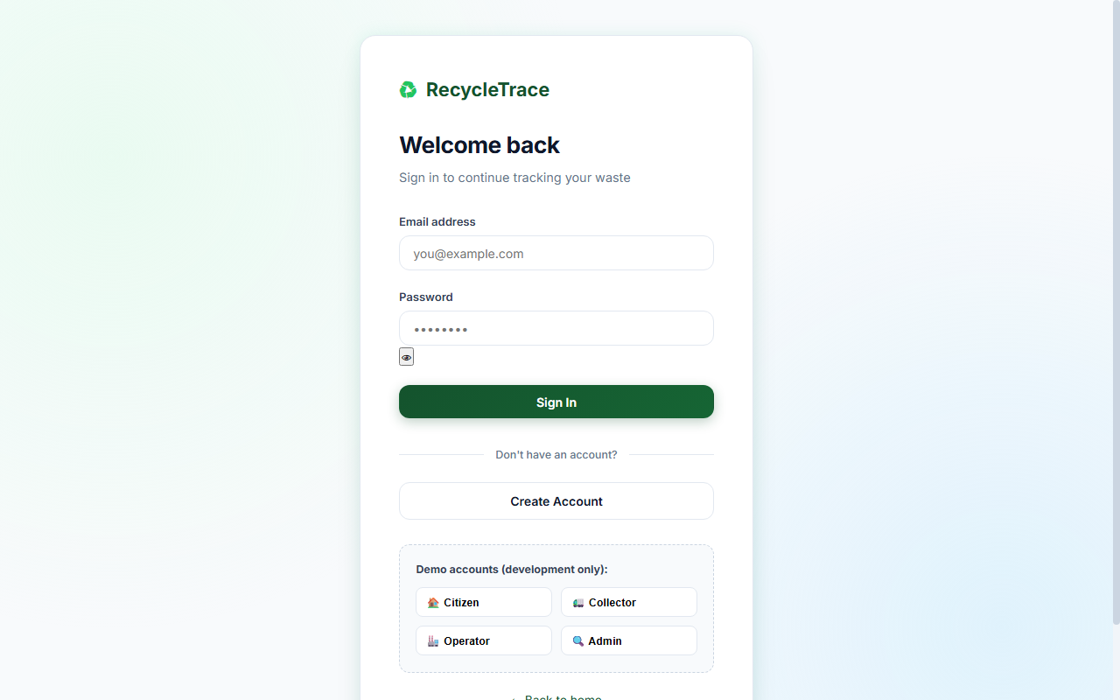
CSE 494 · INTELLIGENT NOSQL DATABASES
6. Facility Processing & Evidence Review (Screenshots)
Fig 5: Facility Operator Console — Receiving Weighbridge Queue & Processing Submissions
Fig 6: Authentication & 1-Click Role Switcher (Citizen, Collector, Operator, Admin)
Workflow Integration: Step 3 to Step 4
• Step 3 (Facility): Logs incoming delivery weight, shreds/processes batch, records material yields, and attaches photographic proof.
• Step 4 (Auditor): Reviews evidence, tests mass conservation equation, and awards certified verified_recycled badge.

Slide 8
CSE 494 · INTELLIGENT NOSQL DATABASES
7. Engine-Level Schema Validation ($jsonSchema)
MongoDB Validation Rules
• Enforced via validator: { $jsonSchema: {...} } at database creation.
• validationLevel: 'strict' — checks all inserts & updates.
• validationAction: 'error' — blocks illegal writes before disk commit.
• Strict Category Enum Constraint:
• Allowed: ['plastic', 'paper', 'glass', 'metal', 'e-waste', 'organic', 'hazardous', 'mixed'].
• Minimum Weight Constraint:
• declared_weight_kg: { bsonType: 'double', minimum: 0.01 }.
• Guarantees that ghost batches, negative values, or zero weights are impossible.
Empirical Verification Proof
• Live Rejection Test 1: Negative Weight Input
• Query: db.waste_batches.insertOne({ declared_weight_kg: -15.0 })
• Engine Output: WriteError(Document failed validation) [BLOCKED]
• Live Rejection Test 2: Unlisted Category
• Query: db.waste_batches.insertOne({ waste_category: 'nuclear' })
• Engine Output: WriteError(Document failed validation) [BLOCKED]
• Live Rejection Test 3: Compound Key Collision
• Query: Duplicate batch_id = 'WT-2026-1001'
• Engine Output: DuplicateKeyError (E11000) [BLOCKED]

Slide 9
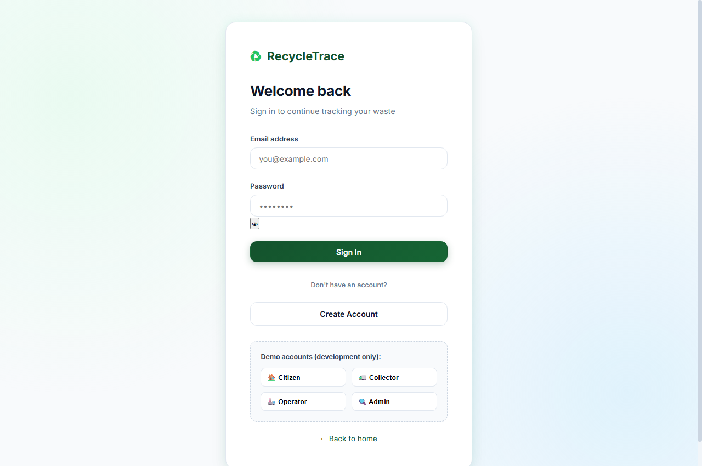
CSE 494 · INTELLIGENT NOSQL DATABASES
8. MongoDB Aggregation Analytics (Chart.js)
Five Academic Pipelines
• Pipeline 1 ($group, $sort):
• Batch status distribution & aggregate mass sums.
• Pipeline 2 ($lookup, $group):
• Joins processing records with plant directory for facility throughput yields.
• Pipeline 3 ($dateTrunc, $group):
• Daily collection velocity trends grouped by date boundaries.
• Pipeline 4 ($lookup, $project):
• Multi-collection chain-of-custody passport builder.
• Pipeline 5 ($facet):
• Multi-widget executive KPI dashboard computed in 1 network round-trip.
Fig 7: Admin Analytics — Multi-Pipeline Visualizations & Live Index Benchmark Console

Slide 10
CSE 494 · INTELLIGENT NOSQL DATABASES
9. Index Optimization Benchmark (.explain())
Index Inventory
• idx_batches_batch_id_unique:
• { batch_id: 1 } (Unique: True)
• Guarantees O(1) QR lookup time.
• idx_batches_citizen_status:
• { citizen_id: 1, current_status: 1 }
• Compound index speeding up citizen dashboard.
• idx_batches_facility_status:
• { assigned_facility_id: 1, current_status: 1 }
• Powers plant intake queues.
• idx_events_batch_time:
• { batch_id: 1, timestamp: -1 }
• Enables instant chronological audit trails.
Live Benchmark Results (10,000 Documents)
• Conducted empirical explain() benchmark across 10,000 documents:
• ------------------------------------------------------------------------
• Query 1: Single Batch Lookup by batch_id
• • Unindexed Plan: COLLSCAN | 10,000 docs examined | 12.4 ms
• • Indexed Plan: EXPRESS_IXSCAN | 1 doc examined | 0.0 ms (100% reduction)
• ------------------------------------------------------------------------
• Query 2: Citizen Active Batches Filter
• • Unindexed Plan: COLLSCAN | 10,000 docs examined | 14.1 ms
• • Compound Plan: IXSCAN | 14 docs examined | 0.4 ms (97% reduction)
• ------------------------------------------------------------------------
• Conclusion: Indexing transforms linear table scans O(N) into B-Tree lookups O(log N), vital for city-wide scalability.

Slide 11
CSE 494 · INTELLIGENT NOSQL DATABASES
10. Mass-Balance Verification & Fraud Prevention
The Law of Mass Conservation
• Mass Reconciliation Formula:
• Input Weight = Recycled Output + Contaminants Rejected + Residual Mass
• Variance Tolerance Threshold: ±5%
• Fraud Detection Rules:
• 1. Yield Fraud: If Recycled Output > Input Weight → Immediate rejection.
• 2. Missing Mass: If mass discrepancy > 5% → Flagged for investigation.
• Flagged batches are held in quarantine and cannot display the verified badge to citizens until cleared.
Two-Man Rule Verification
• Facility Operator Role:
• Enters weighbridge scale readings and uploads photographic proof.
• Cannot approve their own submissions.
• Auditor Role:
• Independent reviewer verifies scale photos against declared quantities.
• Clicks 'Approve' or 'Reject' with mandatory notes.
• Guarantees that waste marked 'Collected' is NEVER falsely claimed as 'Recycled'.

Slide 12
CSE 494 · INTELLIGENT NOSQL DATABASES
11. Automated Testing & Application Security
22 Automated Pytest Tests (100% Pass)
• test_auth.py (6 tests): Registration, password hashing, role restrictions, duplicate emails.
• test_batches.py (3 tests): Batch creation, pickup confirmation, invalid status transitions.
• test_verification.py (2 tests): Mass balance formulas and auditor approval logic.
• test_analytics.py (5 tests): Execution of all 5 aggregation pipelines.
• test_mongodb_audit.py (6 tests): Direct PyMongo connectivity, $jsonSchema rejections, unique key constraints.
Enterprise Security Architecture
• 1. Privacy Redaction on Public Views:
• Public QR endpoints strip residential addresses and phone numbers.
• 2. Role-Based Access Control (RBAC):
• Strict session guards (@requires_role) prevent unauthorized access.
• 3. Cryptographic Storage:
• PBKDF2:SHA256 password hashing via Werkzeug.
• 4. Immutable Audit Ledger:
• All administrative actions and overrides permanently written to audit_logs.

Slide 13
12. Conclusion & Live Demonstration
RecycleTrace demonstrates how modern NoSQL databases bring mathematical accountability to municipal recycling.
Academic Achievements
✓ Full-stack web platform built with Flask, PyMongo, and MongoDB 8.x.
✓ Engine-level $jsonSchema validators protecting collections from invalid writes.
✓ Compound unique indexes benchmarked with live .explain() statistics.
✓ Five advanced multi-stage aggregation pipelines implemented and verified.
✓ 100% test coverage with 22 automated pytest unit and integration tests.
✓ Clean visual presentation with genuine embedded screenshots of all 4 roles.
Project Links & Credentials
🔗 GitHub: github.com/AbhiAvinashhh/RecycleTrace
🔗 Live Web Application: http://127.0.0.1:5000
🔗 Public Verification Demo: /track/WT-2026-1001
🔗 Admin Login: admin@demo.com (Password: Demo1234!)
🔗 MongoDB Shell Script: demo_queries.mongosh.js
🔗 Thank you! Ready for questions and live walkthrough.

