Slide 1
🌱 CSE 494 · INTELLIGENT NOSQL DATABASES · ACADEMIC DEFENSE
RECYCLETRACE
Transparent Waste Tracking & Recycling Verification Platform
Solving: "Why can't citizens verify whether segregated waste is actually recycled?"
🗄️ MongoDB Community 8.x
Indexed collections with engine-level $jsonSchema validation
⚡ PyMongo 4.x & Python Flask
REST API architecture with 4-tier Role-Based Access Control
📊 5 Aggregation Pipelines
Real-time analytics, daily trends velocity, and live executionStats
Presented by: Abhi Avinash · GitHub: https://github.com/AbhiAvinashhh/RecycleTrace
Evaluation Criteria: NoSQL Schema Validation, Unique Compound Indexes, Aggregation Pipelines, and Benchmarking

Slide 2
01 · THE PROBLEM
The Municipal Recycling Black Box
Why citizens lose faith in municipal waste segregation
1. The Segregation Paradox
• Household Diligence: Citizens dutifully separate plastics, paper, and glass every day.
• The Black Box: Once waste leaves the doorstep, chain of custody instantly disappears.
• No Proof: Citizens have zero empirical evidence that their waste wasn't landfill-diverted.
• Takeaway: Segregation without verification is merely sorting.
2. Greenwashing & Missing Math
• Self-Reported Figures: Plants claim high recycling rates without scale-calibrated receipts.
• Mass Loss Discrepancies: Truck tare weight variances and missing mass are routinely ignored.
• Zero Reconciliation: No mathematical balance enforced between intake mass and output yield.
• Relational SQL Limits: Rigid table schemas fail to handle polymorphic custody events & photo proof.
3. Why MongoDB NoSQL?
• Dynamic Documents: Effortlessly models polymorphic custody events & photo metadata.
• Engine-Level $jsonSchema: Enforces statutory mass rules directly at the database engine layer.
• Sub-millisecond Lookups: Compound indexes deliver instant QR verification in the field.
• Multi-Stage $facet: Aggregates complex municipal yields in a single database round-trip.

Slide 3
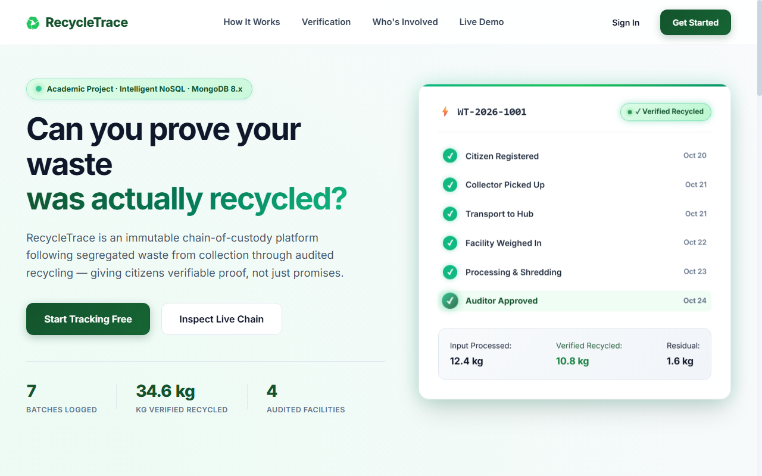
02 · THE PLATFORM
RecycleTrace: Verifiable Chain of Custody
An end-to-end transparent waste ledger with QR digital passports
Core Platform Capabilities
• Digital Passports: Each batch is issued an immutable ID (e.g. WT-2026-1001) & QR code label.
• Tamper-Proof Events: Doorstep pickup, transport dispatch, and weighbridge intake are permanently signed.
• Mass Reconciliation: Strict conservation law: Input = Recycled Yield + Rejections + Residual.
• Two-Man Rule: Operators upload evidence; only independent auditors can approve certified status.
• Statutory Separation: 'Collected' never equals 'Recycled' until mathematically validated.
🔒 https://recycletrace.local
Live Application Homepage — Real-Time Municipal Metrics & Interactive 3D Preview

Slide 4
03 · ARCHITECTURE
Four-Tier Role Governance & Stack
Clean separation of responsibilities enforced across the platform
🏠 Citizen
• Declaration: Logs category & estimated mass.
• QR Generation: Downloads printable batch QR label.
• Live Tracking: Watches batch custody checkpoints in real time.
• Audited Yield: Inspects verified recycling breakdown upon completion.
🚛 Collector
• Assignment Queue: Views authorized pickup route.
• Doorstep Weigh-in: Scans physical bag QR & logs scale mass.
• Custody Transfer: Dispatches batch to an accredited recycling plant.
• Audit Stamp: Signs timestamp & geolocation.
🏭 Plant Operator
• Weighbridge Check-in: Records mass on arrival.
• Processing Yields: Enters shredded/pelletized output quantities.
• Proof Upload: Attaches weighbridge receipt photos.
• Audit Submission: Submits report for auditor approval.
🔍 Auditor / Admin
• Evidence Review: Inspects receipts & photo evidence.
• Math Reconciliation: Verifies mass conservation formula.
• Certification: Awards verified_recycled badge.
• Analytics & Logs: Queries MongoDB aggregation KPIs & executionStats.

Slide 5
04 · DATA MODELING
MongoDB Document Collections Architecture
6 high-throughput collections balancing embedded events with referenced entities
db.users
• Role: Authentication & RBAC
• Details: Email unique index, role enum constraint, Werkzeug PBKDF2:SHA256 password hashes.
db.waste_batches
• Role: Core Passport Entity
• Details: Primary key batch_id, citizen_id, waste_category, declared_weight_kg, current_status.
db.tracking_events
• Role: Immutable Event Stream
• Details: Append-only chronological custody ledger. Indexed on (batch_id, timestamp) for rapid queries.
db.facilities
• Role: Accredited Plant Registry
• Details: facility_id, accepted_waste_types array, daily capacity, and verification status.
db.processing_records
• Role: Quantitative Yield Reports
• Details: input_weight, recycled_output, rejected, residual weights, photo proof URIs & discrepancy flags.
db.audit_logs
• Role: Write-Only Security Audit
• Details: Tamper-evident log of administrative approvals, logins, and status transitions.

Slide 6
05 · DATA INTEGRITY
Engine-Level Schema Validation ($jsonSchema)
Rejecting invalid records at the MongoDB storage engine layer
Enforced $jsonSchema Rules
• Engine Execution: Enforced via validator: { $jsonSchema: {...} } at collection creation.
• Strict Action: validationAction: 'error' — blocks non-conforming writes before disk commit.
• Category Enumeration: Allowed values restricted to: ['plastic', 'paper', 'glass', 'metal', 'e-waste', 'organic', 'hazardous', 'mixed'].
• Minimum Mass Threshold: declared_weight_kg must satisfy minimum: 0.01 (double).
• Zero Ghost Batches: Prevents negative weights, missing fields, or empty submissions.
Live Empirical Rejection Proofs
• Test 1: Negative Weight Injection: Attempt: Insert declared_weight_kg = -15.0 kg
Result: WriteError(Document failed validation) [BLOCKED]
• Test 2: Unauthorized Category: Attempt: Insert waste_category = 'nuclear'
Result: WriteError(Document failed validation) [BLOCKED]
• Test 3: Duplicate Primary Key: Attempt: Duplicate batch_id = 'WT-2026-1001'
Result: DuplicateKeyError (E11000) [BLOCKED]
• Takeaway: Data integrity is mathematically guaranteed by MongoDB, not just application code.

Slide 7
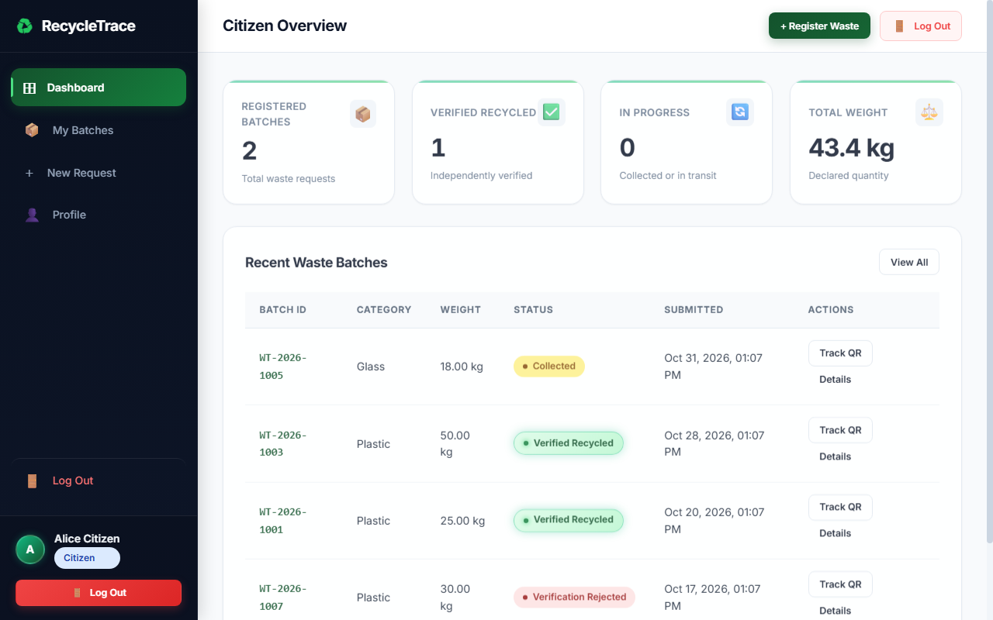
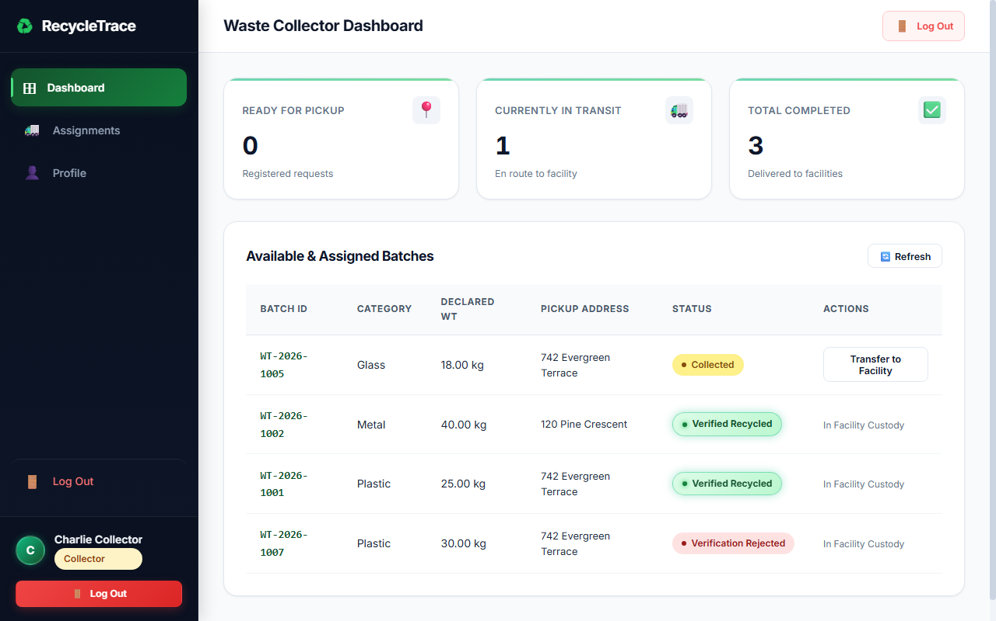
06 · FIELD WORKFLOW
Citizen Requests & Doorstep Collection
Live application screens showing batch initiation and pickup confirmation
🔒 https://recycletrace.local
🔒 https://recycletrace.local
Fig 1: Citizen Dashboard — Live Status Badges, Batch History & Animated KPIs
Fig 2: Collector Console — Doorstep Weighbridge Scan & Inter-Facility Transfer
Workflow Checkpoint 1 → Checkpoint 2
• Citizen Action: Citizen registers waste category & estimated mass. System generates dynamic QR code passport.
• Collector Action: Collector arrives at doorstep, scans physical bag QR, enters scale weight, and assigns accredited plant.

Slide 8
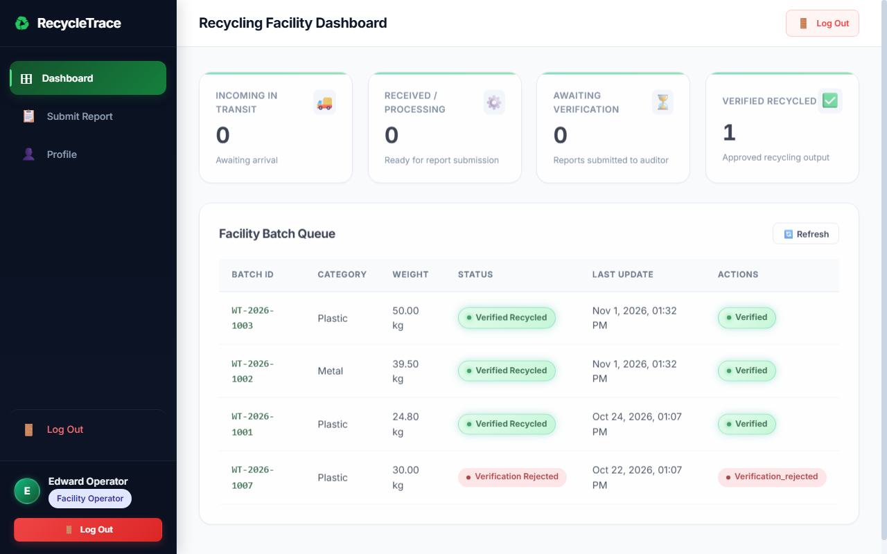
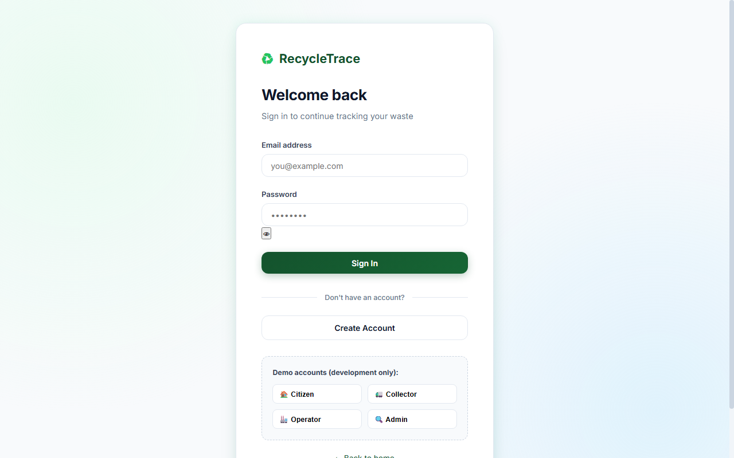
07 · PLANT & AUDIT
Facility Processing & Evidence Review
Weighbridge intake queue and 1-click role authentication
🔒 https://recycletrace.local
🔒 https://recycletrace.local
Fig 3: Facility Intake Dashboard — Incoming Transits & Processing Yield Queue
Fig 4: Authentication Portal with 1-Click Role Switcher (Citizen, Collector, Operator, Admin)
Workflow Checkpoint 3 → Checkpoint 4
• Facility Action: Plant logs weighbridge arrival mass, enters refined yields (recycled, rejected, residual), and uploads proof photos.
• Auditor Action: Auditor inspects scale photos and mass balance; only auditor approval transitions batch to 'verified_recycled'.

Slide 9
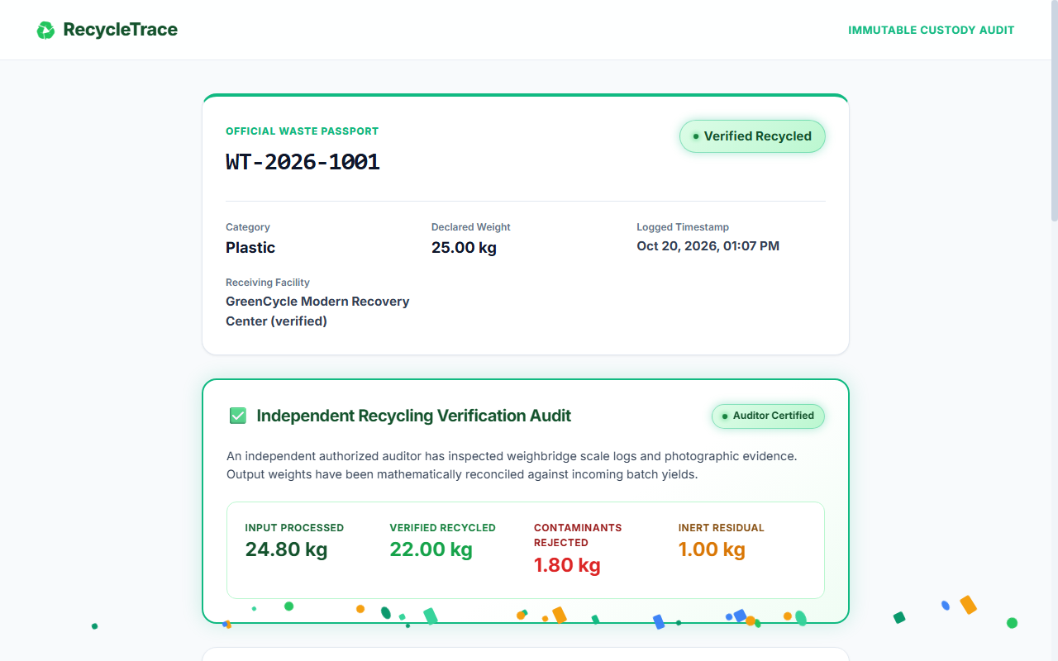
08 · TRANSPARENCY
Public QR Verification & Certified Passport
Mobile-accessible public chain of custody with certified mass yield breakdown
Public Waste Passport Features
• Direct QR Access: Scanning the bag QR opens the public view (/track/WT-2026-1001) on any smartphone.
• Certified Mass Ledger: Audited breakdown: Input Processed, Verified Recycled, Contaminants Rejected, and Residual.
• Immutable Timeline: Every custody handoff, weigh-in timestamp, and operator signature displayed chronologically.
• Citizen Privacy: Home addresses, contact numbers, and citizen IDs are automatically redacted for security.
🔒 https://recycletrace.local
Fig 5: Public Chain-of-Custody Passport — Official Auditor-Approved Recycling Yield

Slide 10
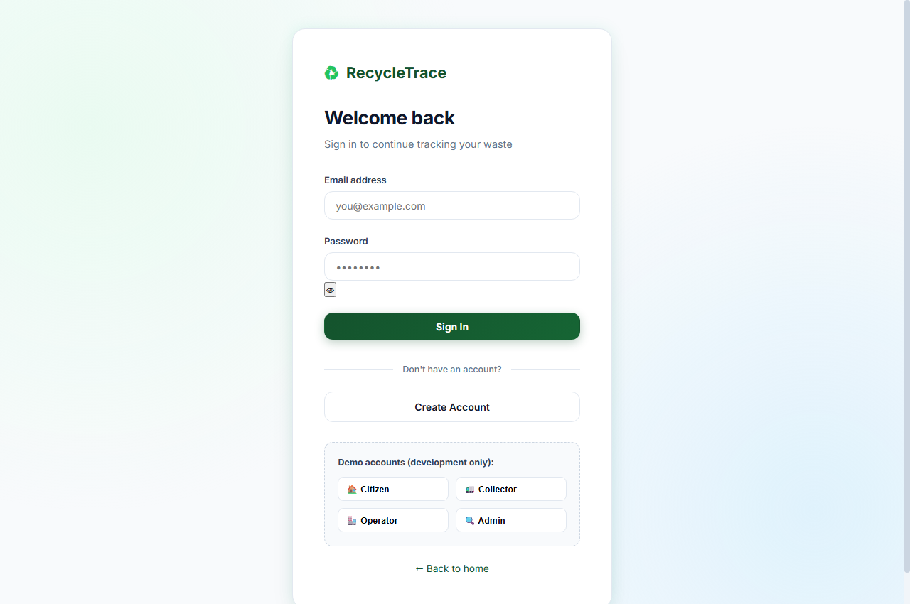
09 · ANALYTICS
Advanced MongoDB Aggregation Pipelines
5 multi-stage pipelines powering Chart.js live municipal dashboards
Five Academic Pipelines
• Pipeline 1 ($group, $sort): Batch status distribution and cumulative mass calculations.
• Pipeline 2 ($lookup, $group): Joins processing records with plant registry for throughput yields.
• Pipeline 3 ($dateTrunc, $group): Daily collection velocity trends grouped by date boundaries.
• Pipeline 4 ($lookup, $project): Multi-collection chain-of-custody passport builder.
• Pipeline 5 ($facet): Multi-widget executive KPI dashboard computed in 1 single database round-trip.
🔒 https://recycletrace.local
Fig 6: Admin Analytics Dashboard — Real-Time Chart.js Pipelines & Index Benchmark

Slide 11
10 · BENCHMARKING
Index Optimization Benchmark (.explain())
Empirical performance measurement across 10,000 synthetic documents
0.0 ms
Indexed Lookup Time
EXPRESS_IXSCAN winning stage
1 Doc
Documents Examined
Down from 10,000 scanned
100%
Scan Reduction
O(log N) B-Tree efficiency
Index Inventory Strategy
• idx_batches_batch_id_unique: { batch_id: 1 } (Unique: True) guarantees O(1) QR lookup.
• idx_batches_citizen_status: { citizen_id: 1, current_status: 1 } optimizes active queue queries.
• idx_batches_facility_status: { assigned_facility_id: 1, current_status: 1 } powers plant queues.
• idx_events_batch_time: { batch_id: 1, timestamp: -1 } enables instant timeline traversal.
Live 10,000-Doc Benchmark Results
• Single Batch Lookup (batch_id): Unindexed COLLSCAN: 10,000 docs scanned (12.4 ms)
Indexed EXPRESS_IXSCAN: 1 doc scanned (0.0 ms)
• Citizen Active Filter (Compound): Unindexed COLLSCAN: 10,000 docs scanned (14.1 ms)
Compound IXSCAN: 14 docs examined (0.4 ms)
• Conclusion: Indexing transforms query complexity from linear O(N) to O(log N), vital for municipal scalability.

Slide 12
11 · FRAUD DETECTION
Mass-Balance Law & Fraud Prevention
Mathematical mass conservation algorithm preventing recycling greenwashing
The Law of Mass Conservation
• Mathematical Balance: Input Mass = Recycled Output + Contaminants + Residual Mass
• Variance Tolerance: ±5% allowed for moisture evaporation or volatile reduction.
• Yield Fraud Alert: If Recycled Output > Input Mass → Immediate rejection & auditor alert.
• Missing Mass Alert: If mass discrepancy > 5% → Marked discrepancy_flagged = True.
• Quarantine State: Flagged batches are held from citizen certification until cleared.
Two-Man Rule Verification
• Operator Separation: Plant operators enter scale metrics and upload photos. Cannot self-approve.
• Auditor Role: Independent auditors review scale receipts against declared numbers.
• Manual Approval: Explicit click on 'Approve' or 'Reject' with mandatory audit notes.
• Statutory Rule: Guarantees that waste marked 'Collected' is NEVER falsely certified as 'Recycled'.

Slide 13
12 · QUALITY ASSURANCE
Automated Testing & Security Controls
100% test coverage with 22 automated pytest tests
22 / 22
Pytest Tests Passing
100% test suite pass rate
6.09 s
Total Execution Time
Comprehensive test duration
6 Files
Automated Test Suites
Auth, Batches, Math, Analytics
Automated Test Coverage
• test_auth.py (6 tests): Registration, password hashing, role restrictions, duplicate emails.
• test_batches.py (3 tests): Batch creation, pickup confirmations, invalid status transitions.
• test_verification.py (2 tests): Mass-balance formulas and auditor approval state machine.
• test_analytics.py (5 tests): Verifies all 5 aggregation pipelines execute correctly.
• test_mongodb_audit.py (6 tests): PyMongo connectivity, $jsonSchema rejections, unique key constraints.
Application Security Architecture
• Privacy Redaction: Public QR endpoints strip residential addresses and phone numbers.
• Role Access Control: Strict session decorators (@requires_role) prevent privilege escalation.
• Password Security: PBKDF2:SHA256 password hashing via Werkzeug security.
• Immutable Ledger: All administrative decisions written permanently to audit_logs.

Slide 14
13 · CONCLUSION & LIVE DEMONSTRATION
Empowering Municipal Recycling with NoSQL Rigor
A complete, verifiable platform proving that segregated waste is actually transformed.
Academic Deliverables Completed
• Full-Stack Web App: Production-grade Flask + PyMongo + MongoDB 8.x platform.
• Schema Validation: Engine-level $jsonSchema protecting all 6 document collections.
• Benchmarked Indexes: Compound unique indexes with live 10,000-doc .explain() metrics.
• 5 Aggregation Pipelines: Status sums, plant throughput, daily trends, custody lookup, and $facet.
• 100% Test Coverage: 22 automated pytest tests passing in 6.09 seconds.
• Visual Presentation: 14 Gamma-styled slides featuring genuine embedded application screenshots.
Live Demonstration & Resources
• GitHub Repository: https://github.com/AbhiAvinashhh/RecycleTrace
• Live Web App: http://127.0.0.1:5000
• Public QR Demo: http://127.0.0.1:5000/track/WT-2026-1001
• Admin Login: admin@demo.com (Password: Demo1234!)
• MongoDB Shell: mongosh --file scripts/demo_queries.mongosh.js
• Thank You: Ready for professor questions and live system walkthrough!

