Slide 1
POINT OF VIEW · SOLUTION OVERVIEW
A Knowledge-Graph Approach to
Oracle → PySpark Strategy
Parse the estate into an AST, build an Information Graph and a Knowledge Graph, and turn an opaque legacy codebase into explainable, decision-ready migration intelligence.
plsqlmig · Oracle PL/SQL · Neo4j · Databricks · PySpark

Slide 2
THE CHALLENGE
Why migrating a large PL/SQL estate is hard
1
Scale & entanglement
2
Mixed suitability
Procedures call procedures that read and write shared tables through views, synonyms and database links. The real dependency map is invisible in the files.
One procedure blends set-based transforms (ideal for Spark) with row-by-row cursors and transactional bookkeeping (not suited to Spark).
3
Semantic gaps
4
Orchestration
Sequences, autonomous transactions, savepoints, MERGE and CONNECT BY have no direct PySpark equivalent — they must be reasoned about, not blindly translated.
Once logic is split across two engines, the migrated job must run the right pieces in the right order with explicit cross-engine hand-offs.
plsqlmig · Migration Intelligence
2

Slide 3
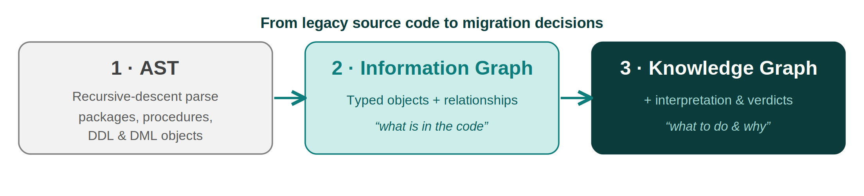
THE APPROACH
Three representations, each richer than the last
AST
Information Graph
Knowledge Graph
A recursive-descent parser reads every PL/SQL and DDL/DML object into a true nested tree — packages, nested procedures, blocks, loops, statements.
The trees are flattened into one corpus-wide graph of typed objects and relationships, stored in Neo4j. The factual decomposition of the estate.
An interpretation layer adds logic classification, Oracle→Spark mappings, and a migration verdict per routine — the graph now reasons.
plsqlmig · Migration Intelligence
3

Slide 4
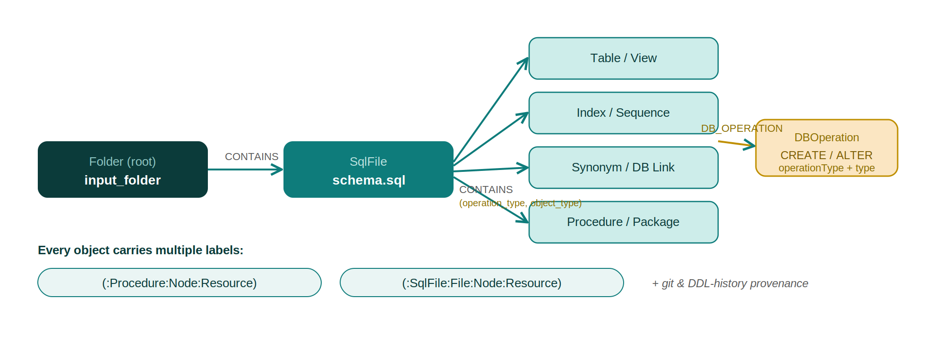
THE MODEL
A uniform, self-documenting graph model
Folder → SqlFile → object hierarchy (CONTAINS), every object also a :Resource, and each carries its DDL, git provenance and CREATE/ALTER operations.
plsqlmig · Migration Intelligence
4

Slide 5
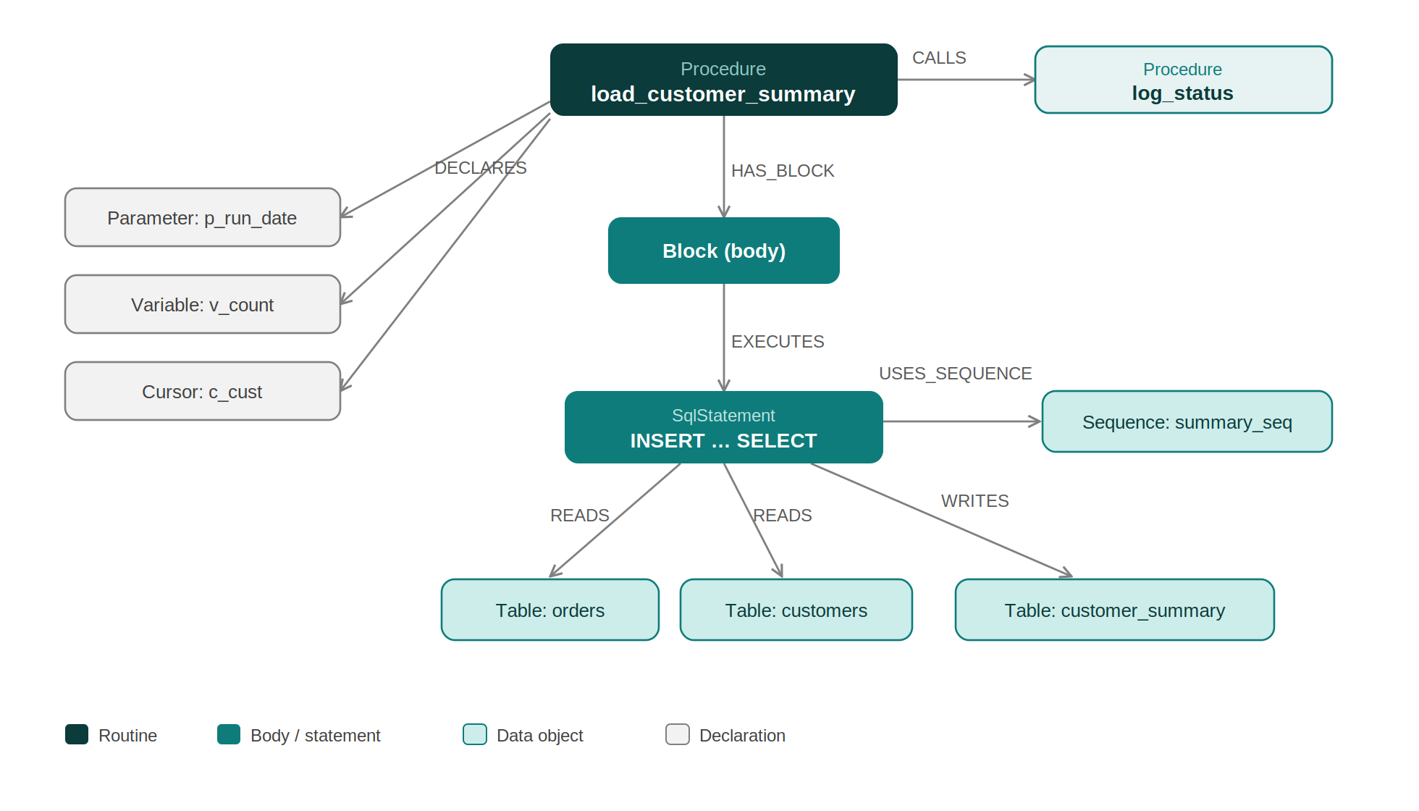
WORKED EXAMPLE
Information Graph: what is in the code
One procedure, fully decomposed
DECLARES its parameter, variable, cursor
body Block EXECUTES an INSERT…SELECT
READS orders & customers
WRITES customer_summary
USES the summary_seq sequence
CALLS log_status
Every edge is verifiable directly against the source.
plsqlmig · Migration Intelligence
5

Slide 6
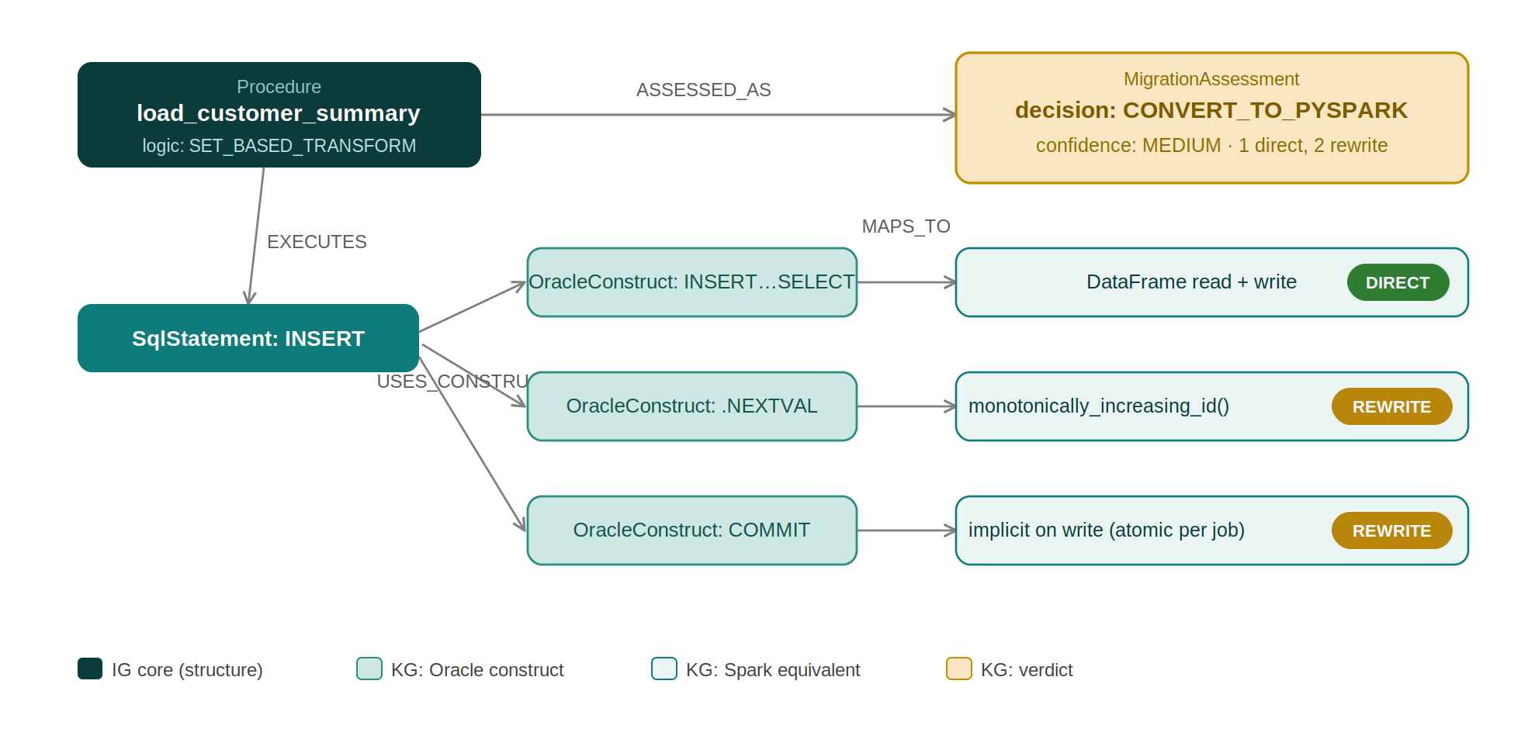
WORKED EXAMPLE
Knowledge Graph: what to do, and why
The same procedure, now with a logic pattern, Oracle→Spark construct mappings (DIRECT/REWRITE), and an explainable verdict — all stored on the graph.
plsqlmig · Migration Intelligence
6

Slide 7
TRIAGE RUBRIC
Migration decisions from the logic pattern
SET_BASED_TRANSFORM
Bulk INSERT…SELECT / MERGE / joins + aggregation
CONVERT_TO_PYSPARK
ROW_BY_ROW_CURSOR
Cursor loop with per-row DML or calls
REWRITE_FOR_PYSPARK
ORCHESTRATION
Mostly invokes other routines
SPARK DRIVER / WORKFLOW
OLTP_BOOKKEEPING
Single-row transactional writes
KEEP_IN_ORACLE
PROCEDURAL
Mixed — falls back to structural scores
SCORE-BASED
True blockers — autonomous transactions, savepoints — override any verdict to KEEP_IN_ORACLE. Weights are configurable; output is triage for human review, not autopilot.
plsqlmig · Migration Intelligence
7

Slide 8
HYBRID EXECUTION
Running a job that spans both engines
Deciding what runs first
Orchestrated as a DAG
Statements carry source order; READS/WRITES edges carry data dependencies.
Rule: a step that reads a table runs after the step that writes it.
Topologically sort the steps → execution order; tag each with its engine.
Shared tables at engine boundaries become explicit hand-off contracts.
Prep / truncate target
Oracle
Set-based transform → writes summary
Spark
Row-by-row post-processing
Oracle
Atomicity cannot span engines — steps are designed idempotent and re-runnable.
plsqlmig · Migration Intelligence
8

Slide 9
VALUE
One graph, three returns
Lineage
Migration
Governance
Trace forward from any source to see where data goes — table- and column-level, across procedures, views and database links.
The verdict says what to convert; dependency edges say in what order. Construct mappings jump-start the rewrite.
Trace backward for impact analysis. Surface data crossing database links and every DDL change via the operation history.
plsqlmig · Migration Intelligence
9

Slide 10
USE CASES
The same asset serves far more than migration
Information Graph
Knowledge Graph
Impact analysis — what breaks if this table/column changes
End-to-end data lineage across procedures, views, DB links
Build & deployment ordering from the dependency graph
Dead / orphan code detection
Automated documentation from the graph
Test-scope identification (the change’s dependency closure)
Effort & cost estimation weighted by construct difficulty
Risk & blocker scoring before any code is written
Automated PySpark skeleton generation
Hybrid pipeline planning with cross-engine hand-offs
Modernisation roadmap prioritisation
Target-platform flexibility (Snowflake, BigQuery via KB swap)
plsqlmig · Migration Intelligence
10

Slide 11
POSITIONING
Honest scope & where it goes next
What it is — and isn’t
Roadmap
Structural + pattern understanding, not semantic proof.
Verdicts are tunable triage for engineers, not autopilot.
Generated PySpark is a reviewed starting point.
A pragmatic parser today; ANTLR grammar swaps in for full coverage with no downstream change.
Deeper typed DDL (constraints, partitioning).
Statement-level engine tagging for finer splits.
Orchestrator-specific pipelines (Databricks Workflows, Airflow).
Volume-aware scoring from Oracle stats / AWR.
Second target platform via the mapping knowledge base.
plsqlmig · Migration Intelligence
11

Slide 12
THE BOTTOM LINE
The Information Graph tells us what exists.
The Knowledge Graph tells us what to do — and why.
A durable, queryable asset that turns a high-risk migration into a structured, explainable, and largely automatable program of work — and keeps delivering value for lineage, impact analysis and governance long after.
plsqlmig · Oracle PL/SQL → Databricks PySpark

