Slide 1
Practical Challenges of Machine Learning on the diagnosis of Cardiac Allograft Vasculopathy using Computed Tomography in pediatrics
Abhijit (Abhi) Bhattaru

Slide 2
Cardiac Allograft Vasculopathy (CAV)

Slide 3
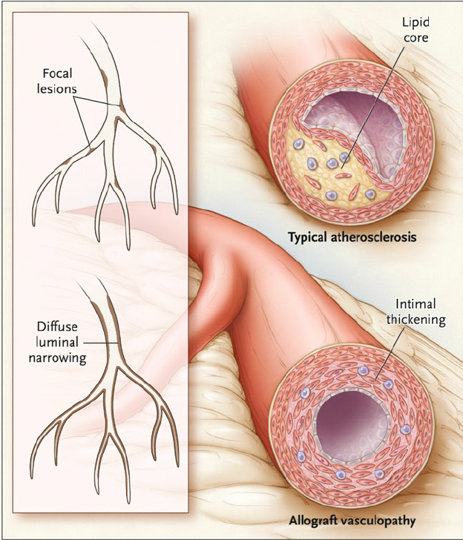
Pathophysiology
Immune and non-immune mediated endothelial injury
Luminal stenosis
Rapid development
Can be due to interactions between host and donor endothelium
Colvin-Adams, M., Harcourt, N. & Duprez, D. Endothelial Dysfunction and Cardiac Allograft Vasculopathy. J. of Cardiovasc. Trans. Res. 6, 263–277 (2013). https://doi.org/10.1007/s12265-012-9414-3
Notes:
Less frequent and less severe
Older recipients have lower survival
More erratic cardiac events
Lack of data

Slide 4
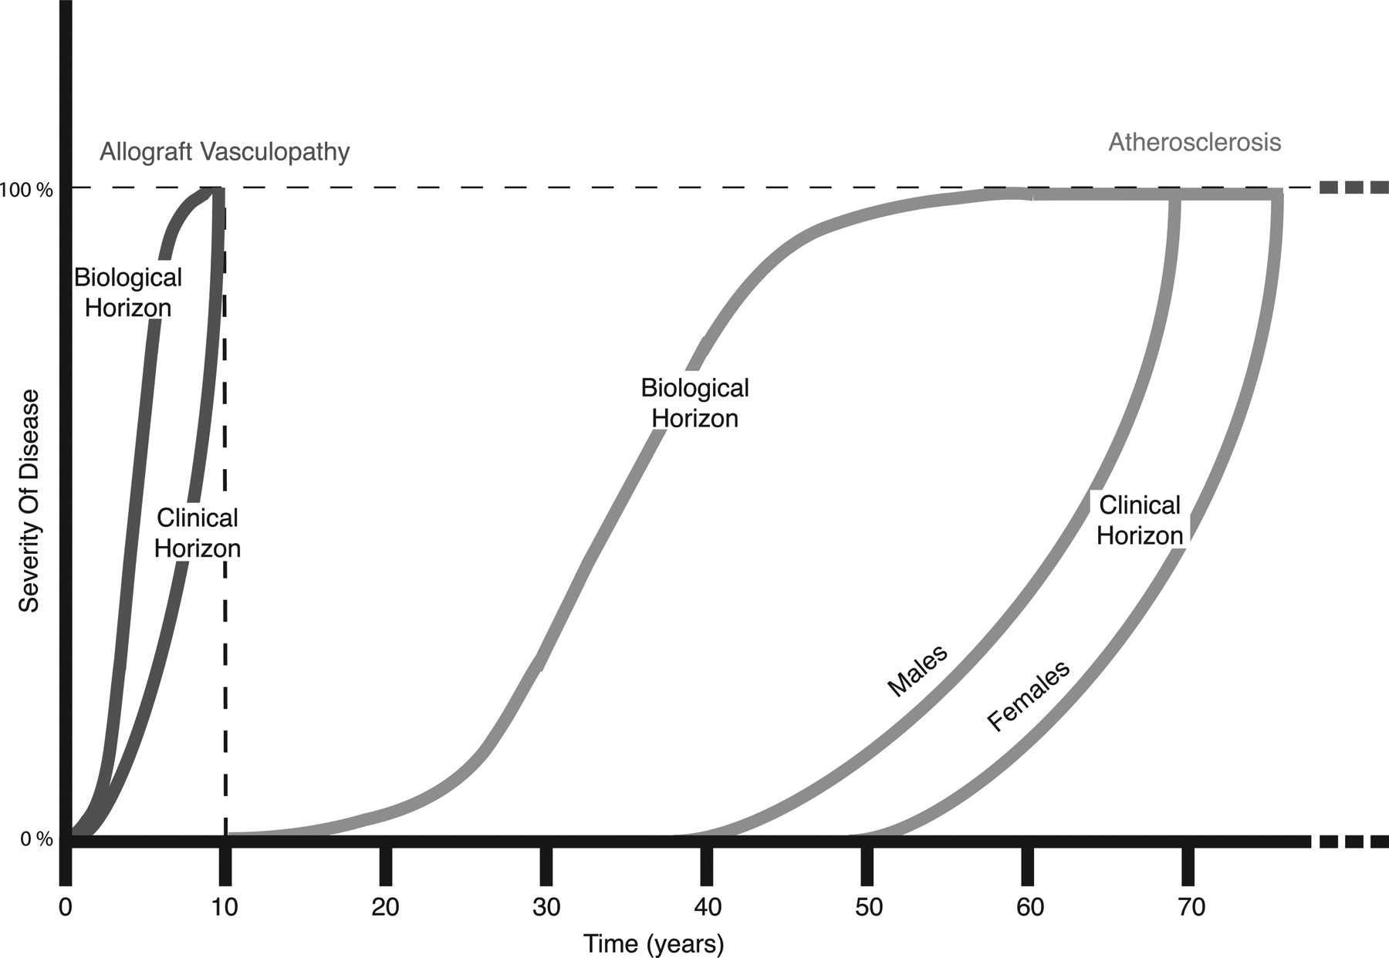
Prevalence and survival
Maziar Rahmani, Rani P. Cruz, David J. Granville, and Bruce M. McManus. Circ. Res. 2006;99:801–815. https://doi.org/10.1161/01.RES.0000246086.93555.f3
Notes:
https://www.sciencedirect.com/science/article/pii/S2213177917306388
https://www.ahajournals.org/doi/10.1161/01.res.0000246086.93555.f3

Slide 5
Invasive diagnostic methods
Gold Standard Angiography
Intravascular ultrasound

Slide 6
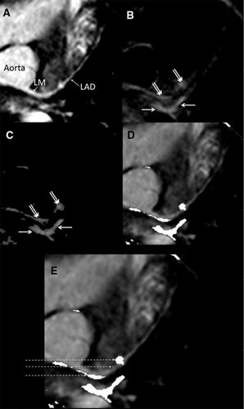
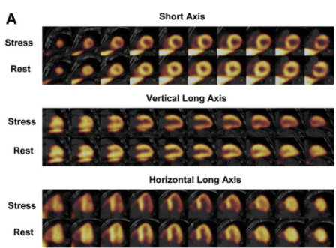
Non-invasive diagnosis
PET
MRI
CT
https://www.sciencedirect.com/science/article/pii/S0010865015001009
https://www.ahajournals.org/doi/full/10.1161/circimaging.112.975797
Notes:
https://www.sciencedirect.com/science/article/pii/S0010865015001009
https://www.ahajournals.org/doi/full/10.1161/circimaging.112.975797

Slide 7
Methodology
Notes:
Image problem, patient problem, machine learning problem

Slide 8
Patients Studied
40 Total datasets
22 Female 18 Male
Median age 14.8y (4.2-23.6y)
All underwent both CT and cardiac catheterization.
Disease severity based on invasive angiography

Slide 9
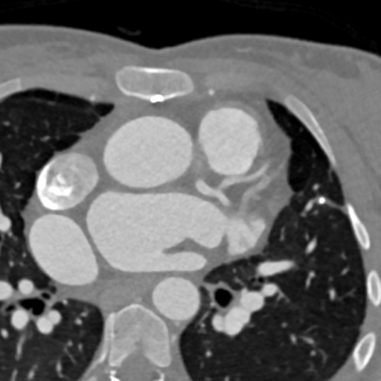

Slide 10
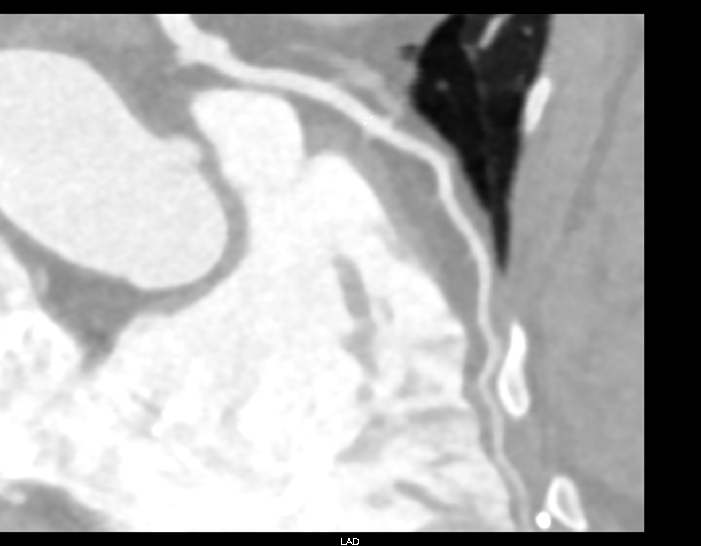

Slide 11
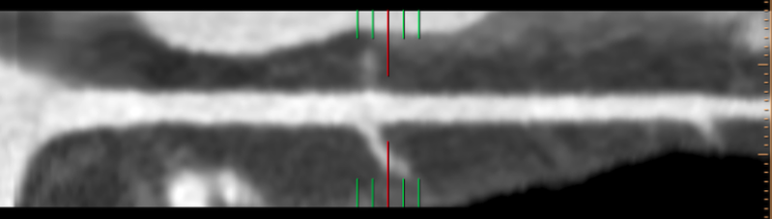
Notes:
Talk about FFT and thresholding here too

Slide 12

Convolution Neural Network
Supervised learning
Notes:
https://medium.com/@RaghavPrabhu/understanding-of-convolutional-neural-network-cnn-deep-learning-99760835f148

Slide 13
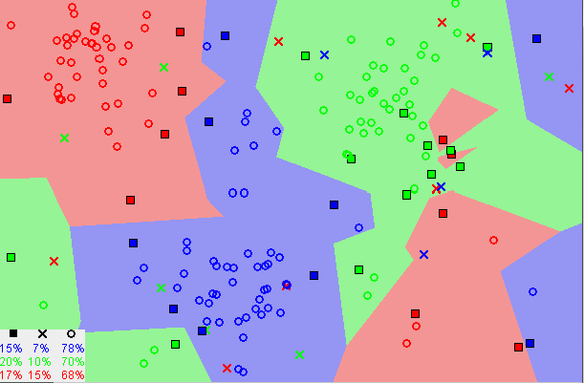
K-Nearest Neighbors
https://towardsdatascience.com/machine-learning-basics-with-the-k-nearest-neighbors-algorithm-6a6e71d01761
Notes:
https://towardsdatascience.com/machine-learning-basics-with-the-k-nearest-neighbors-algorithm-6a6e71d01761

Slide 14
Limitations
Notes:
hF values

Slide 15
Patient Limits
Image resolution
Motion artifact
Accuracy of clinical labeling
Notes:
Talk about the diffuse process

Slide 16
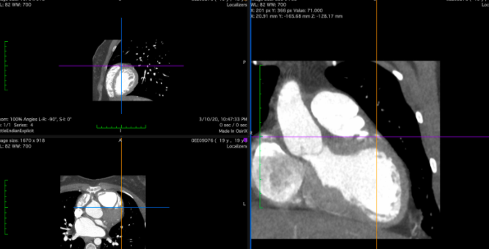
Image Limits
Image noise
Hounsfield unit (HU) extraction

Slide 17
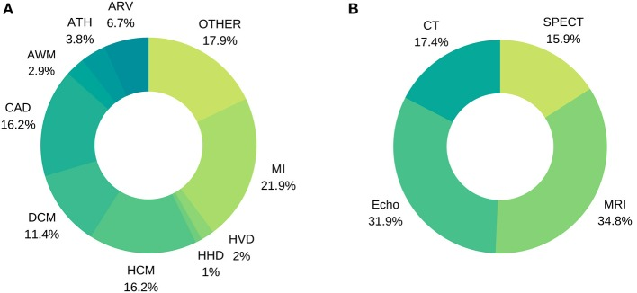
Algorithm Limits
Data availability
Data labeling
Ambiguity of results
https://www.ncbi.nlm.nih.gov/pmc/articles/PMC6992607/
Notes:
https://www.ncbi.nlm.nih.gov/pmc/articles/PMC6992607/

Slide 18
Concluding Thoughts
Great potential for KNN (and other unsupervised algorithms)
Need an increased amount of data
Finding a way to extract HU
Longitudinal study

