Slide 1

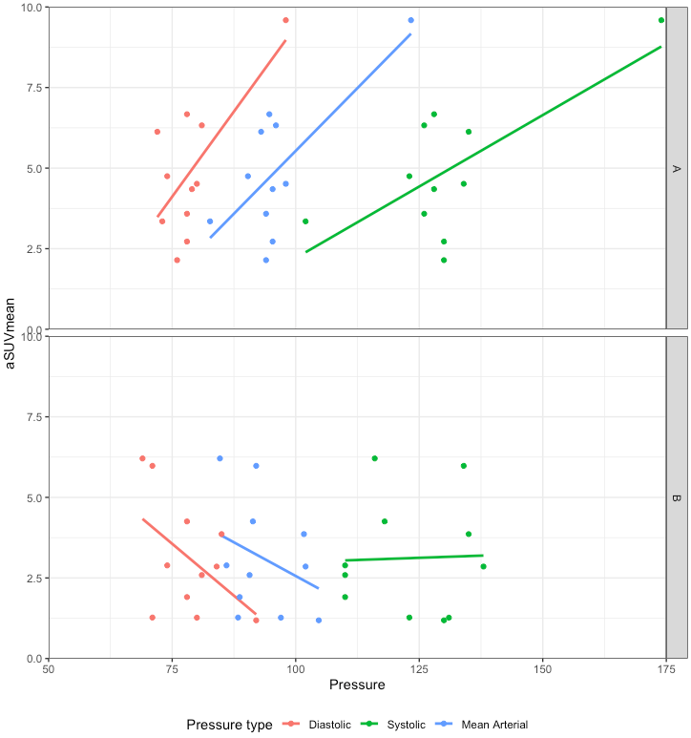
Correlation Between Blood Pressure And Left Ventricular Metabolism In HIV Individuals With And
Without Cocaine Use As Assessed By FDG-PET/CT
Abhijit Bhattaru^{1,2}, Rina Ghorpade¹, Chaitanya Rojulpote^{1,2,3}, Paco E Bravo^{1,2}, Shivaraj Patil^{1,4},
Karthik Gonuguntla^{1,4}, Pranav Karambelkar^{1,3}, Kiranmayi Vuthaluru¹, Vincent Zhang¹, Thomas J Werner¹, Abass Alavi¹
1 Radiology, University of Pennsylvania, Philadelphia, PA; 2 Cardiology, University of Pennsylvania, Philadelphia, PA; 3 Internal Medicine, The Wright Center for Graduate Medical Education, Scranton, PA; 4 Internal Medicine, University of Connecticut, Hartford, CT;
Objectives
Figure 1
Results
Elevated blood pressure from cocaine can increase left ventricular (LV) metabolic activity,
leading to structural changes such as hypertrophy. We aimed to assess the association between blood
pressure and LV myocardial uptake of FDG, hypothesizing that HIV individuals with raised blood pressure will have higher FDG uptake.
aSUVmean was higher in HIV patients with cocaine use (U(N cocaine = 11, N no cocaine=11) = 93, p=0.0336).
In patients with cocaine use, there was a positive correlation between blood pressure and aSUVmean (SBP: r=0.70, p=0.0164; DBP: r=0.69, p=0.0185; MAP: r=0.72, p=0.0120).
No significant correlations were found in HIV patients without cocaine use (SBP: r=0.03, p=0.9239; DBP: r=-0.50, p=0.1153; MAP: r=-0.32, p=0.3345).
Methodology
University of Pennsylvania enrolled patients with HIV on antiretroviral therapy with viral load <200 copy/ml. Cocaine usage in moderate to high amounts (cocaine disease score≥5) was subsequently documented. Full body PET scans were acquired 120 minutes post-injection of 18F-FDG(15 mCi) with lowdose CT scans for attenuation correction. Patients with imaging artifacts were excluded from the analysis. Regions of interest were drawn on axial slices using computer software (OsirixMD, v9.0.02) around LV myocardium. Average standard uptake value means (aSUVmean) were calculated for each patient. Systolic blood pressure (SBP) and diastolic blood pressure (DBP) were obtained prior to imaging; mean arterial pressure (MAP) was subsequently calculated. Linear regressions and Mann-Whitney U tests were employed for statistical analysis.
Clinical Implications
LV myocardial metabolism was more strongly positively correlated with blood pressure in HIV patients using cocaine compared to HIV patients without cocaine.
These data suggest FDG-PET/CT can be used to monitor LV metabolic activity and allow for timely assessment of structural changes caused by cocaine use and hypertension.
Results also highlight the implications of using cocaine when diagnosed with HIV and how this may impact both cardiomyopathy and hypertension.
Future studies are required to further validate the utility of using FDG-PET/CT with larger sample sizes.
Group A represents HIV patients with cocaine use and group B represents HIV patients without cocaine use. Each aSUVmean row of 3 represents a single patient. Colors indicate Blood pressure type. N=11, 11.

