Slide 1

Correlation Between Blood Pressure And Inflammation In The Thoracic Aorta Of HIV Patients With And Without Cocaine Use As Assessed By FDG-PET/CT
Abhijit Bhattaru, Chaitanya Rojulpote, Rina Ghorpade, Paco E Bravo, Shivaraj Patil, Karthik Gonuguntla, Pranav Karambelkar, Kiranmayi Vuthaluru, Vincent Zhang, Thomas Werner, Abass Alavi
Presented by: Abhi Bhattaru

Slide 2

Introduction

Slide 3
Inflammatory disorder
Increase Blood Pressure
Extenuates existing inflammation
Systemic changes
HIV Infection
Cocaine use

Slide 4
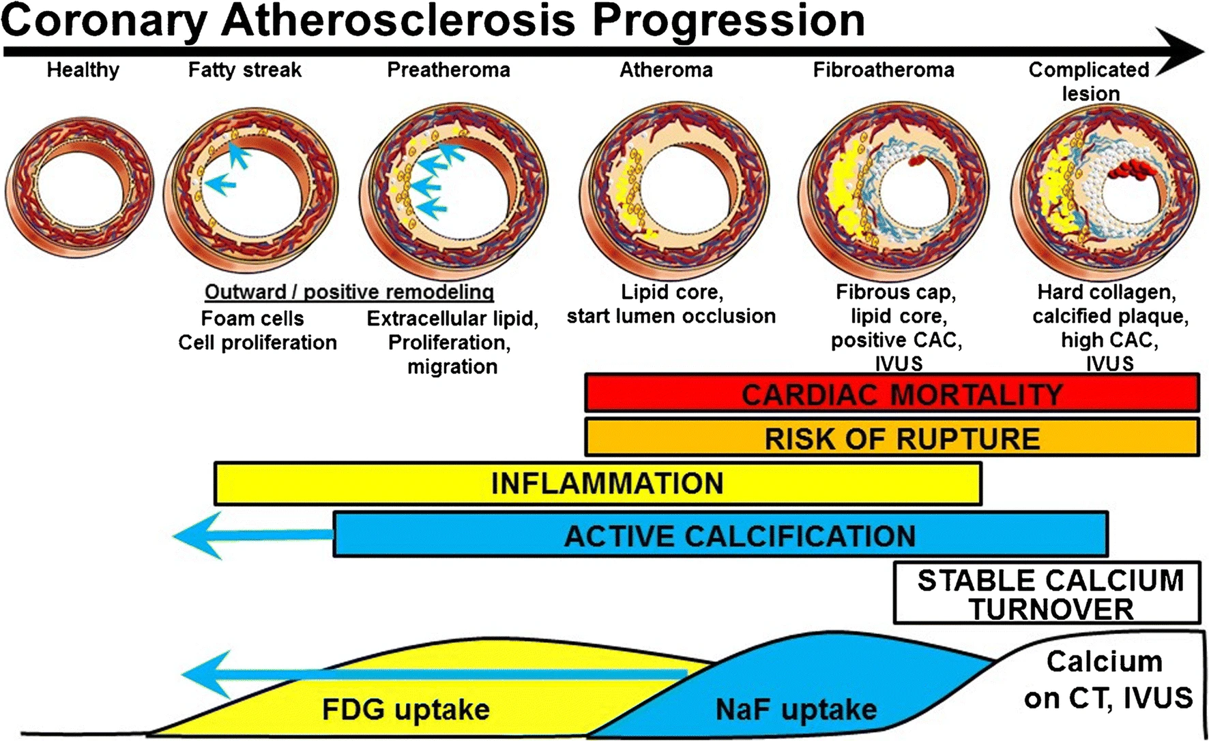
Raynor, WY, Borja, A.J., Rojulpote, C. et al. 18F-sodium fluoride: An emerging tracer to assess active vascular microcalcification. J Nucl Cardiol 2020

Slide 5
Methodology

Slide 6
Study participants
All patients had HIV and were on antiretroviral therapy at time of imaging
Viral load <200 copies/ml
BP measurements acquired pre-imaging
All injected with 15 mCi of 18-FDG and imaged after 120 minutes
Low dose CT for anatomical localization
Patients with imaging artifact excluded from analysis
Final study numbers: N_{cocaine}=11, N_{no cocaine}=18

Slide 7
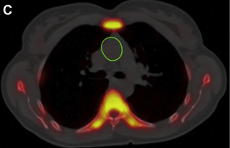
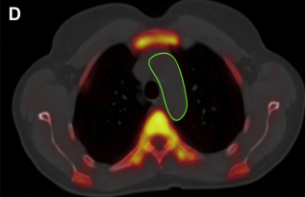
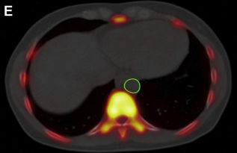
Ascending Aorta
Arch of Aorta
Descending Aorta
Note: this image reflects NaF uptake, not FDG
AJ Borja, C Rojulpote, EC Hancin, PF Hoilund-Carlsen, A Alavi. An Update on the Role of Total-Body PET Imaging in the Evaluation of Atherosclerosis. PET Clinics 2020

Slide 8
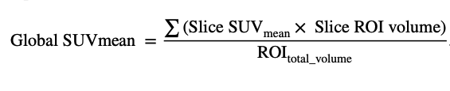
Ascending aorta + arch and descending aorta measured separately then summed.
All Global SUVmean (aSUVmean) values were determined and used for linear regression analysis
SM Seraj, WY Raynor, ME Revheim, A Al‑Zaghal, MZ Zadeh, LS Arani, C Rojulpote, TJ Werner, O Gerke, PF Hoiliund-Carlsen, JF Baker, A Alavi, SJ Hunt, Assessing the feasibility of NaF‑PET/CT versus FDG‑PET/CT to detect abdominal aortic calcifcation or infammation in rheumatoid arthritis patients. Annals of Nuclear Medicine 2020.

Slide 9
Results

Slide 10
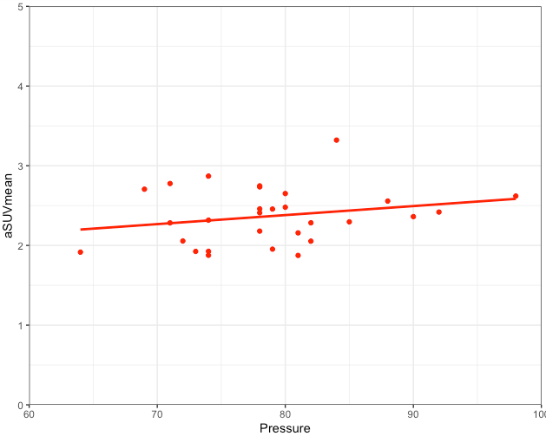
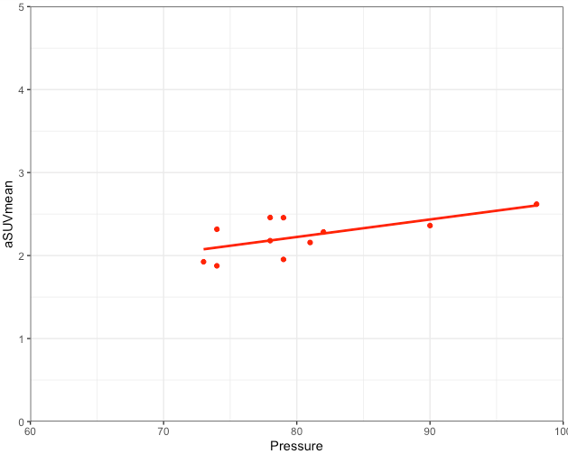
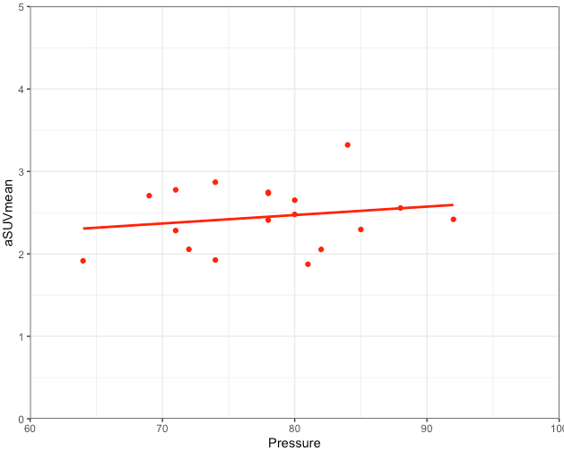
Diastolic Pressure
r=0.23
p=0.226
r=0.65
p=0.030*
r=0.19
p=0.459
Total cohort
Cocaine Use
No Cocaine use

Slide 11
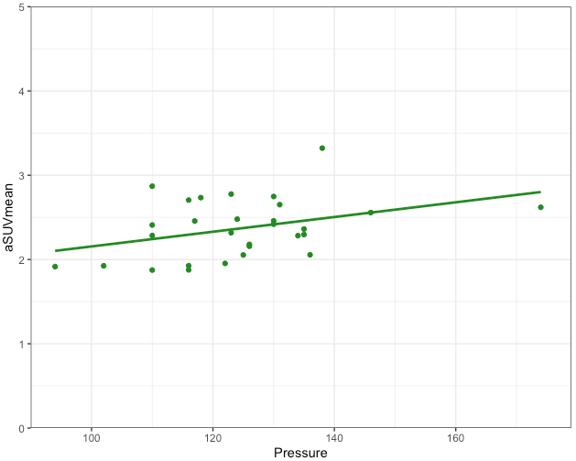
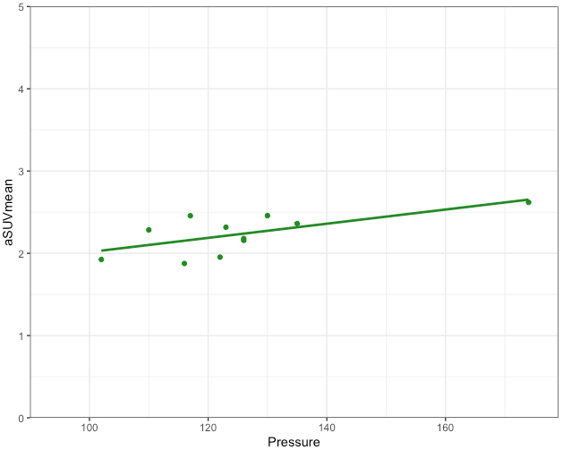
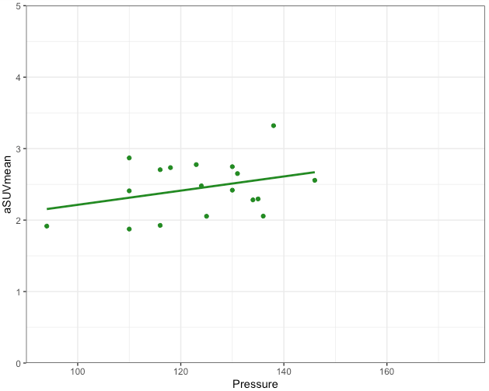
Systolic Pressure
r=0.37
p=0.048*
r=0.66
p=0.027*
r=0.33
p=0.185
Total cohort
Cocaine Use
No Cocaine use

Slide 12
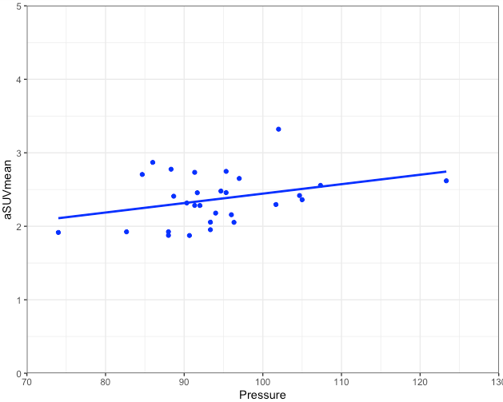
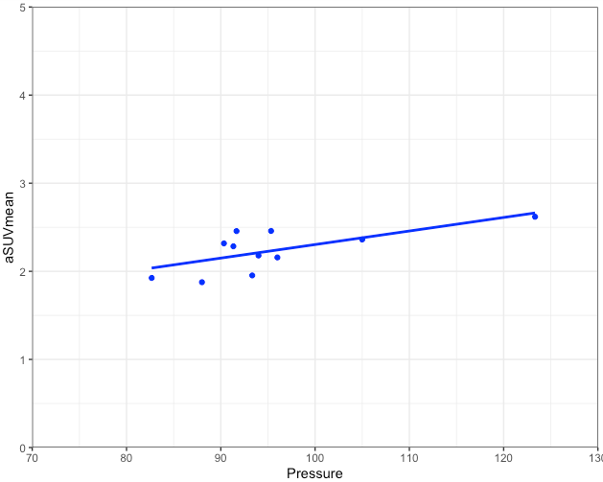
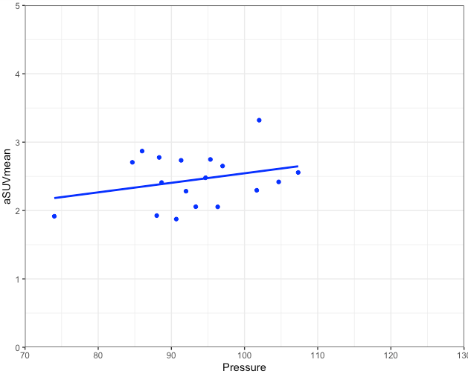
Mean Arterial Pressure
r=0.33
p=0.081
r=0.68
p=0.021*
r=0.29
p=0.250
Total cohort
Cocaine Use
No Cocaine use

Slide 13
Conclusion
HIV patients are prone to inflammation in the aorta
This effect is compounded by use of cocaine

