Slide 1




SMART INDIA HACKATHON 2026
  Problem Statement ID – 26068
  Problem Statement Title- WeatherGPT: Conventional AI for Weather Forecasting Alerts, and Climate information.
  Theme- Disaster Management
  PS Category- Software
  Team ID- 149059
  Team Name (Registered on portal)- VisionX123

Slide 2


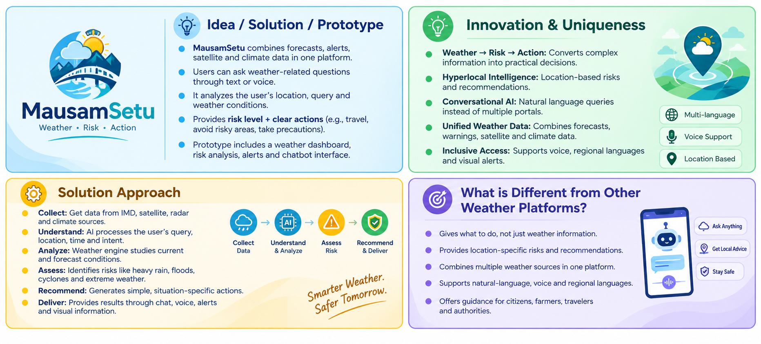
MausamSetu
VisionX123
  PROPOSED SOLUTION
PROTOTYPE
LINK
@SIH Idea submission- Template
2
Notes:
2

Slide 3
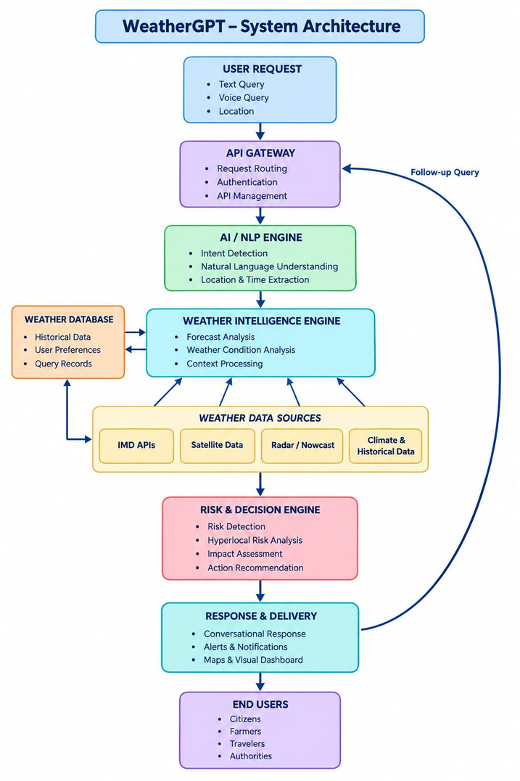
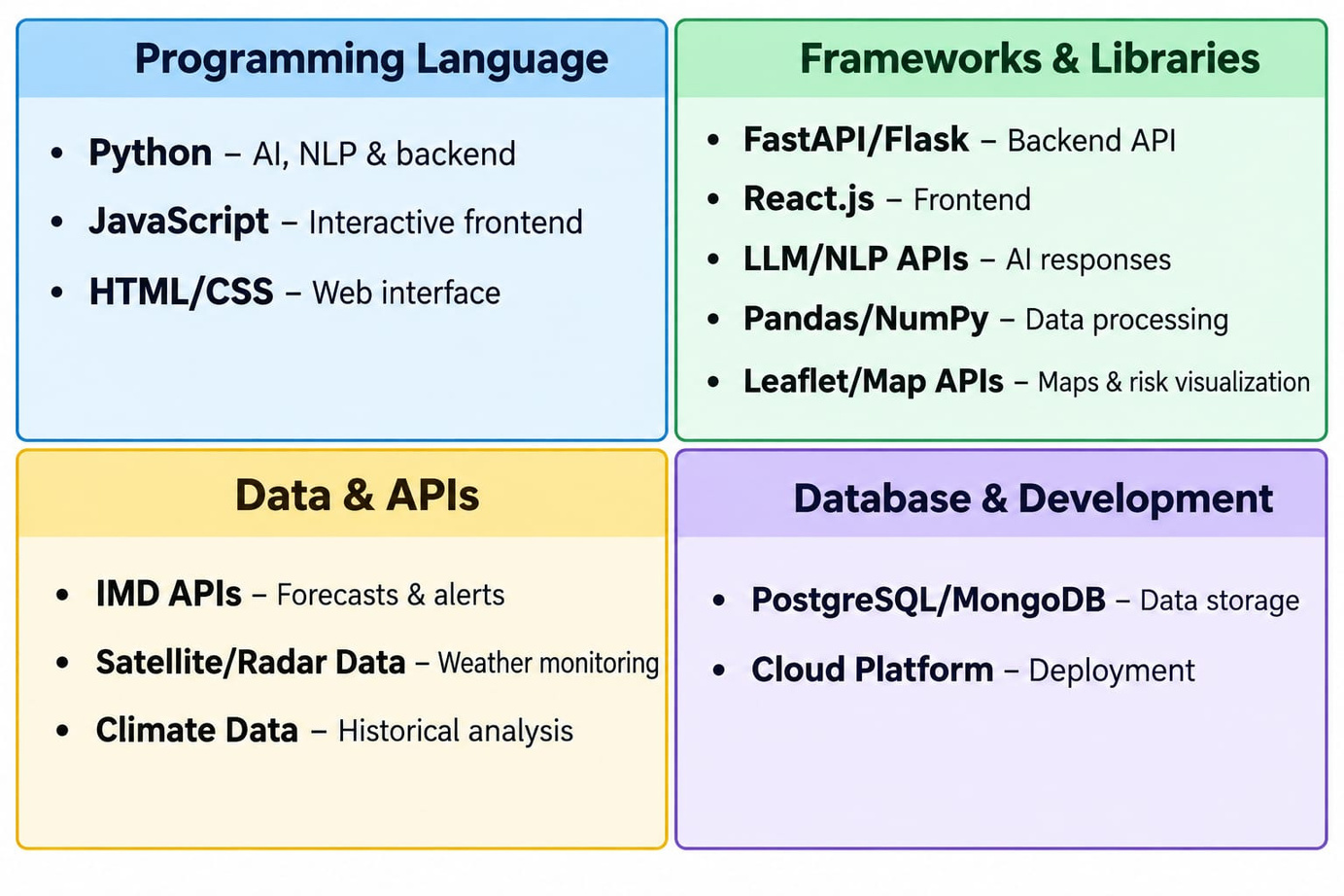
TECHNICAL APPROACH
VisionX123
Technology Used
SYSTEM ARCHITECTURE
@SIH Idea submission- Template
3
Notes:
3

Slide 4
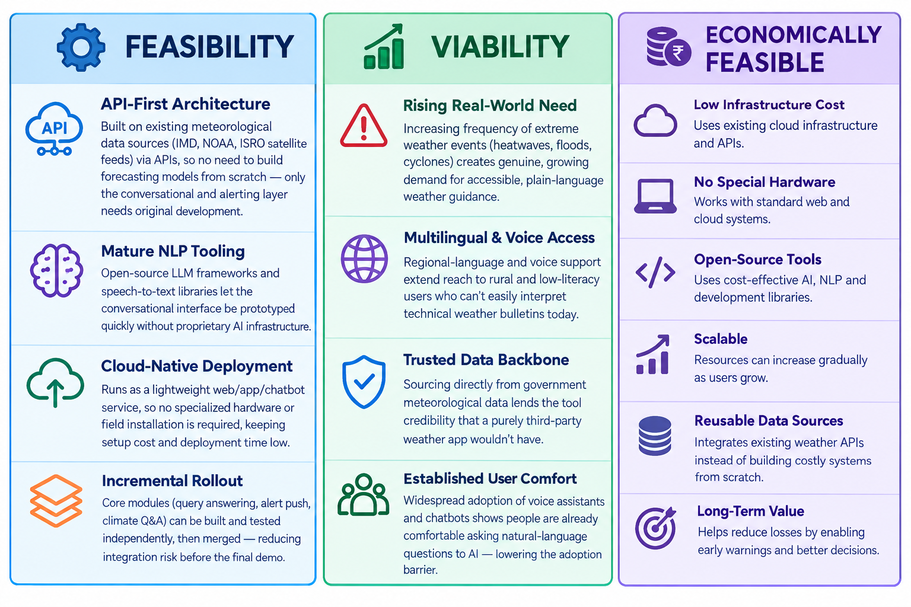
FEASIBILITY AND VIABILITY
VisionX123
@SIH Idea submission- Template
4
Notes:
4

Slide 5
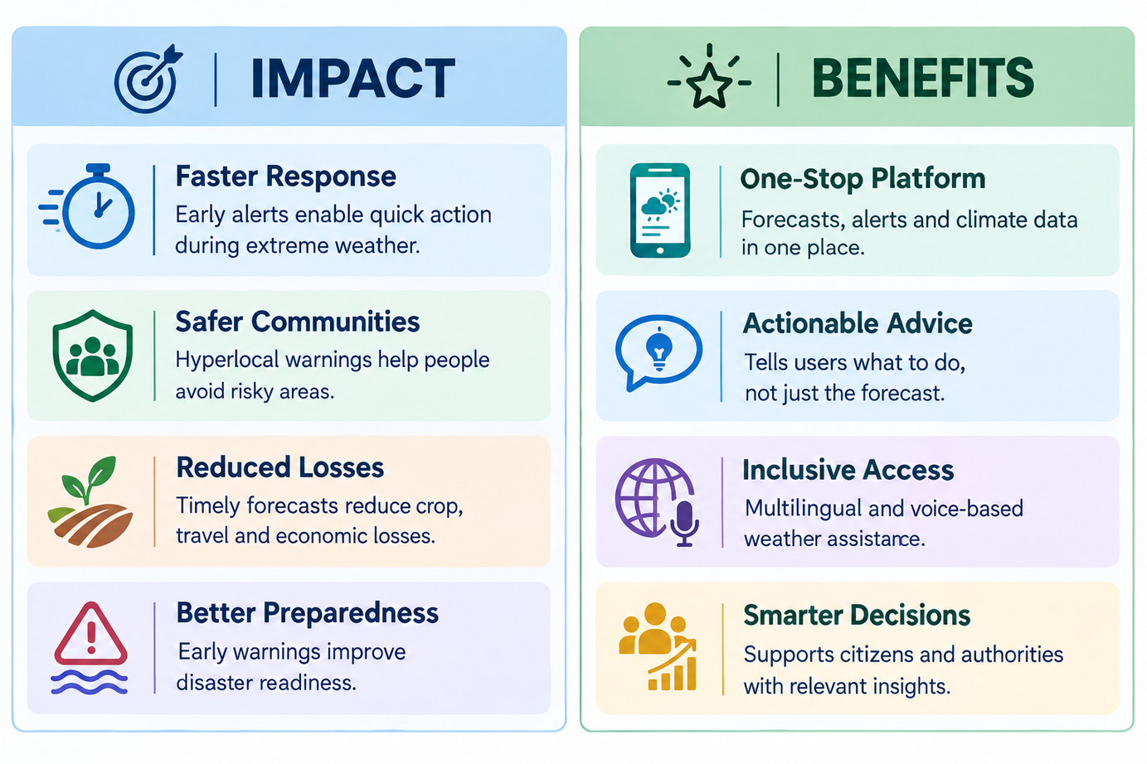
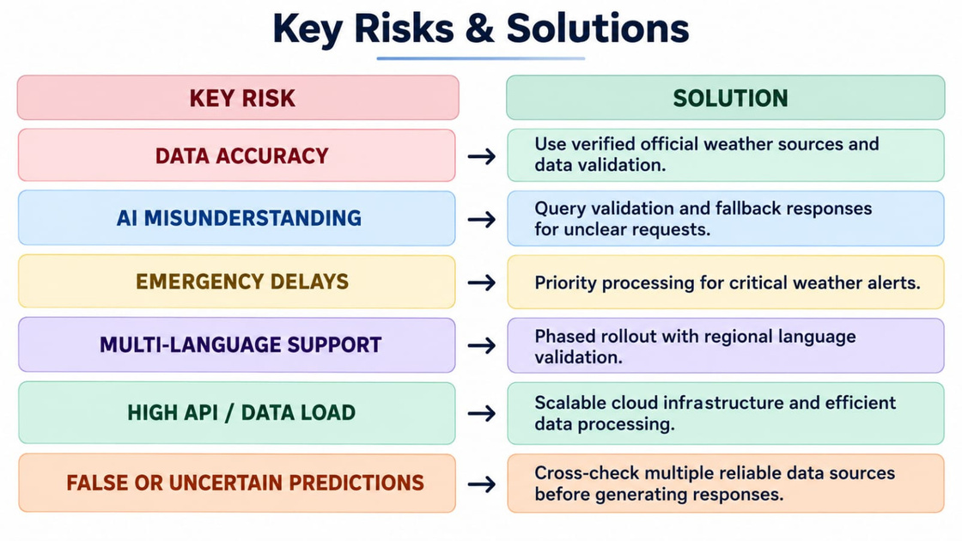
IMPACT AND BENEFITS
VisionX123
@SIH Idea submission- Template
5
Notes:
5

Slide 6
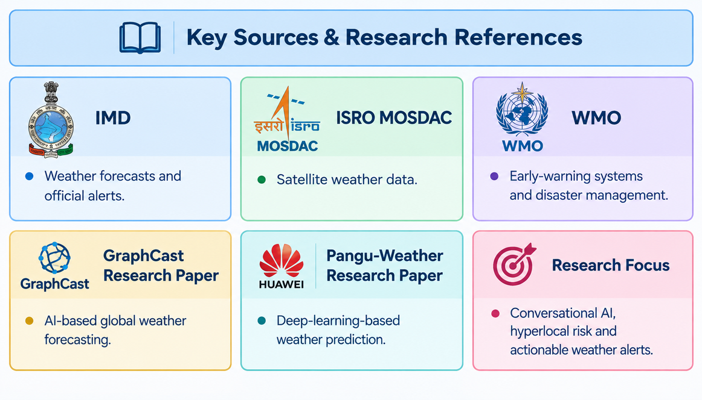
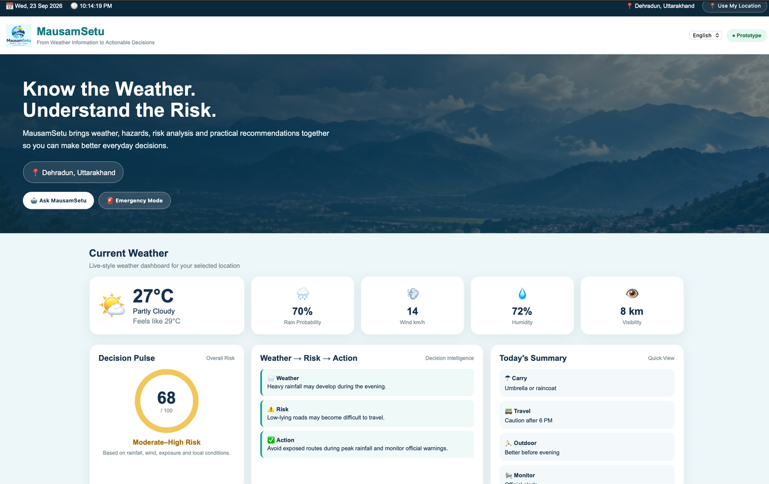
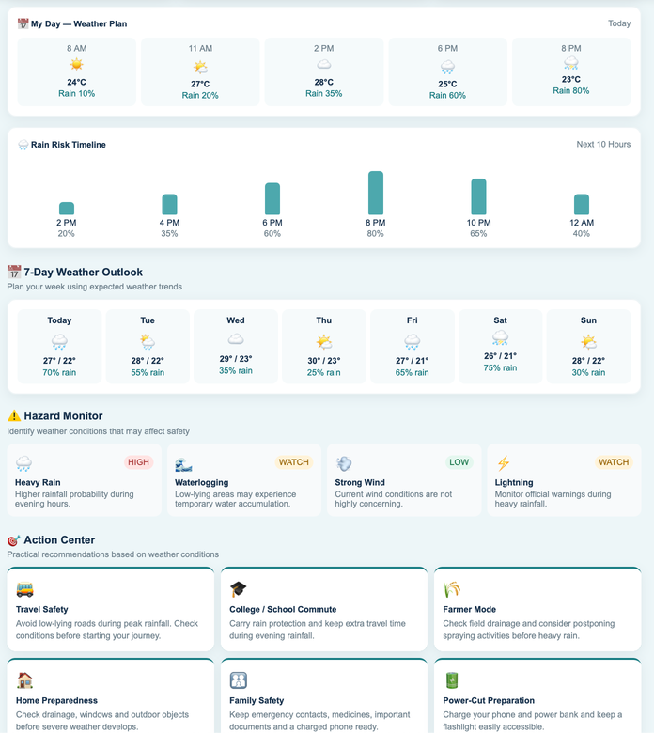
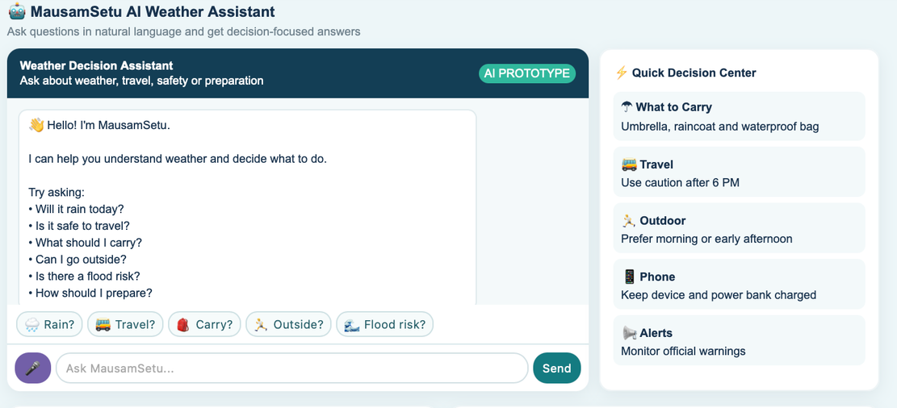
RESEARCH AND REFERENCES
VisionX123
UI/UX
@SIH Idea submission- Template
6
Notes:
6

