Slide 1

Int-213_Python Project
On
School of Computer Science and Engineering
Capstone Supervisor Allocation Portal For LPU Students Using Python
** Submitted To Navpreet Rupal (Faculty INT 213) On 10/Nov/2022**

Slide 2
Submitted By | Roll Number | Reg. Number
ABHISHEK KUMAR | 36 | 12115093
SANJAY KUMAR NAYAK | 11 | 12115352
SAKSHAM BAJPAI | 60 | 12115837
Name –> Abhishek Kumar
Reg. no. –> 12115093
Section -> K21QT Roll no. –> A36
Subject -> Python(project) Teacher -> Er. Navpreet Rupal
Topic -> Capstone Supervisor Allocation Portal for LPU Students
College -> Lovely Professional University

Slide 3
Acknowledgement
I Abhishek Kumar and my teammates _Sanjay Kumar Nayak _and _ SAKSHAM BAJPAI _have taken efforts to complete this project. However, it would not have been possible without the kind support and help of my professor _ Navpreet Rupal (Faculty INT-213).
I would like to extend my sincere thanks to all those who helped with the project & also for their support in completing the project. This project helped me and my team members hone our Python programming skills and learn how to use programming in real life. There were a lot of online resources that I referred to while preparing the project.
** Summary**
The project titled ‘Capstone supervisor allocation portal for LPU students using python’ is a GUI approach to create a software that helps in allocating supervisors to various registered students for their capstone project.

Slide 4
INTRODUCTION
In this project we have made a Capstone Supervisor Allocation Portal, the technology that we have used is solely Python Tkinter. _ Tkinter_ is the standard GUI (Graphical User Interface) library for Python. _Python
_when combined with _Tkinter _provides a fast and easy way to create GUI applications. _Tkinter _provides a powerful object-oriented interface to the Tk GUI toolkit. This project has been divided into two segments: -
**Student Segment **which helps new students register for the supervisor allocation and pre-registered students to login and check the name of their supervisor and their basic details.
**Supervisor Segment **which helps new supervisors to register for his availability and pre-registered supervisors to check the name of allocated students under them and their basic details.

Slide 5
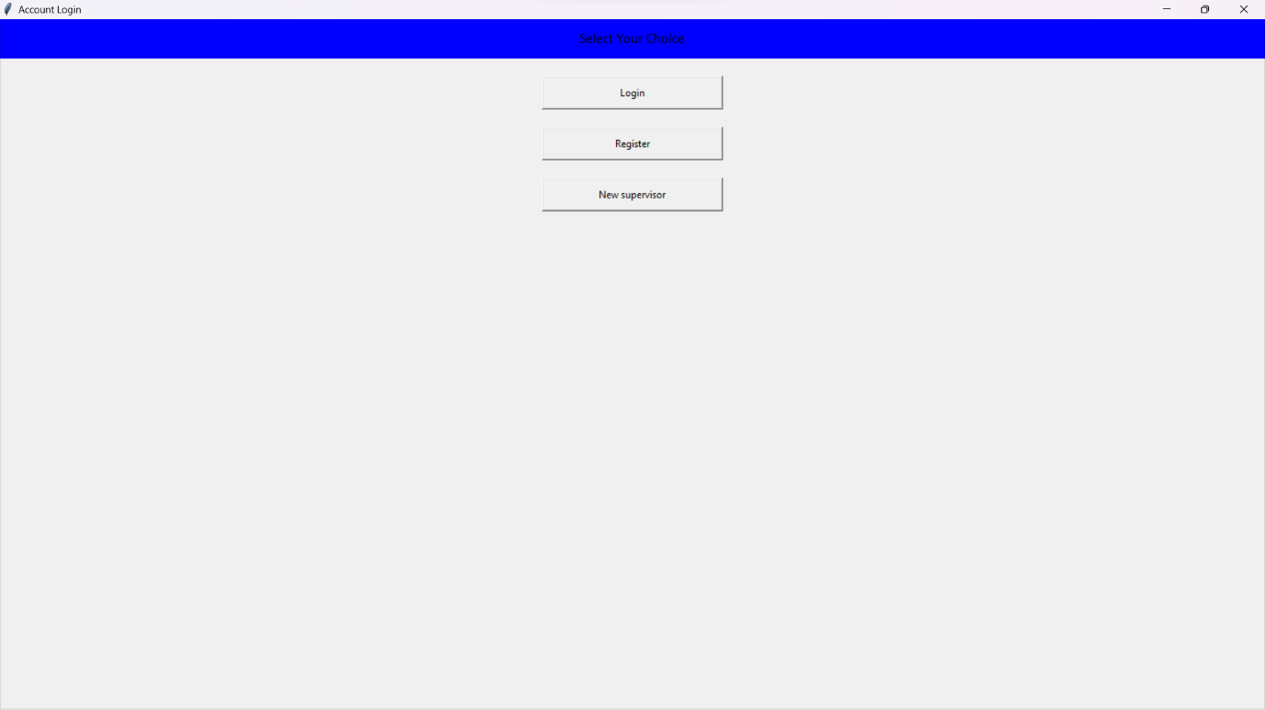
BASIC MODULE DIVISION
Opening Student Window
Fig 1
This is the first window that opens for the students. It has three buttons the first one is _the login
_button, when clicked it opens the login window. The second button is the Register button, when this button is clicked it opens a window for new registrations. The third is the _New Supervisor
_button, which takes the student to the _login
_window and when the student is logged in the student is taken to the form window which needs to be filled to the new supervisor.

Slide 6
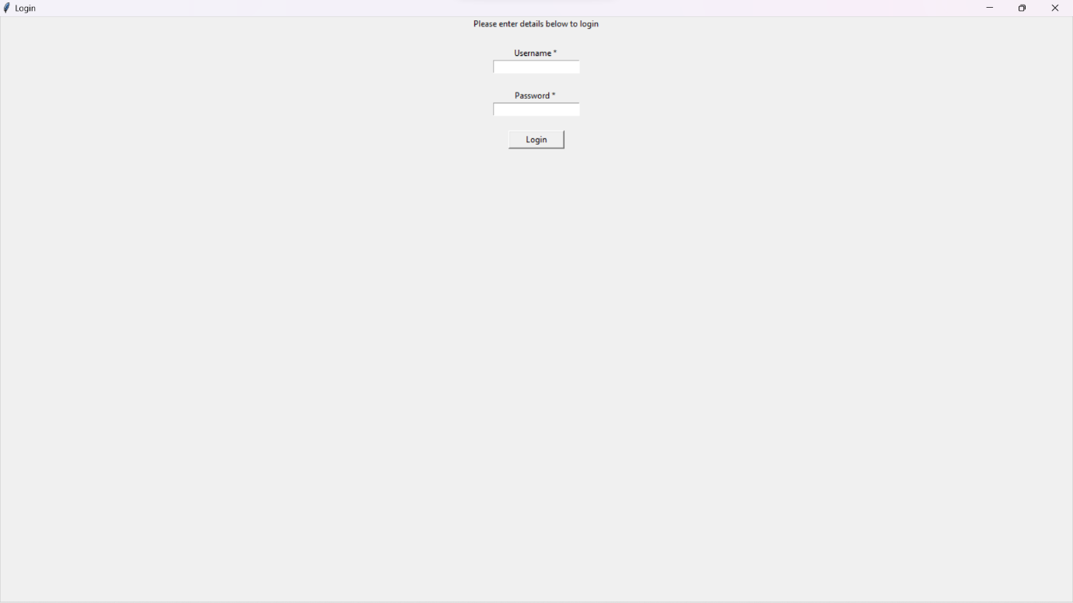
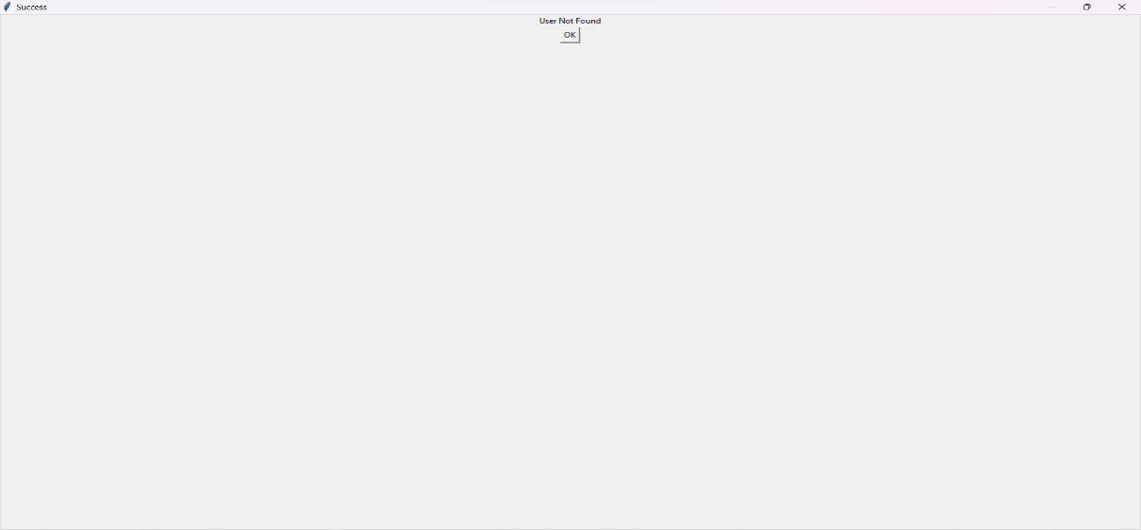
Student Login Window
Fig 2
Now, this is the login window where the student is taking is the _login _button is pressed. The _login
_form requires the _Username _and Password of the already registered student.
Fig 3

Slide 7
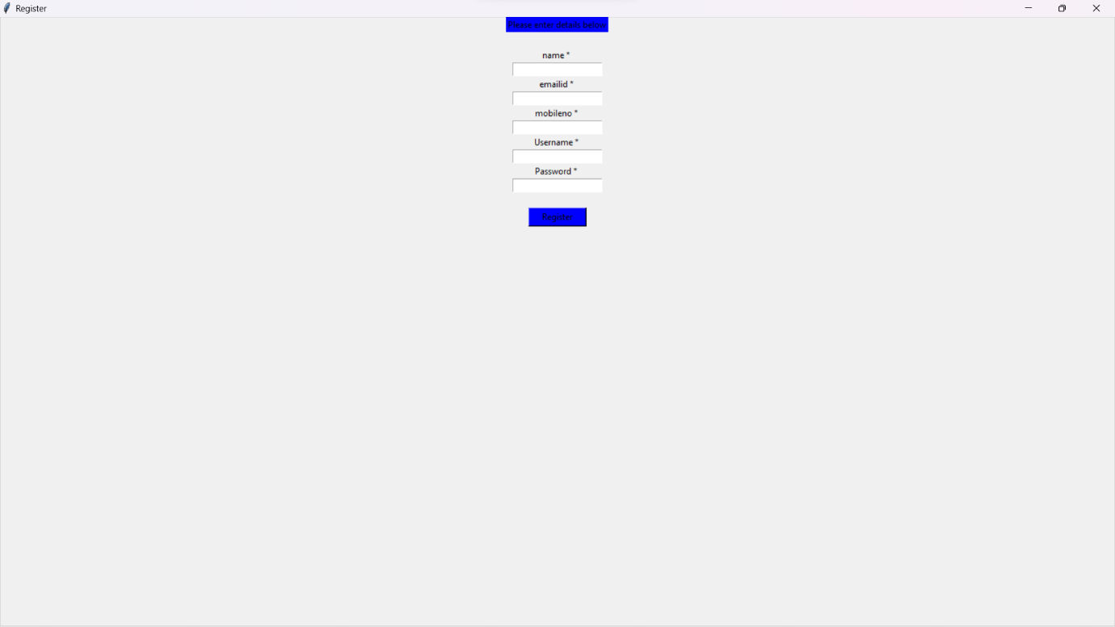
New Student’s Registration
Fig 4
This is the window that opens when the student presses the New User button in the opening window. This form contains five fields, so when a student fills this and press the Registered button he or she gets registered and the data is stored in the database.

Slide 8
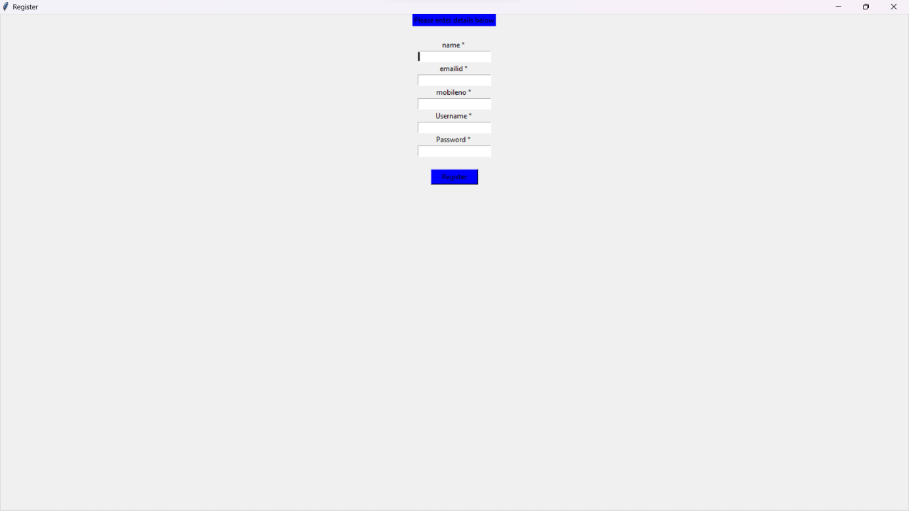
New Supervisor’s Login Window
Fig 5
This is the _ Login_ window which opens when a supervisor or user clicks the login button. It is the same as the login window for the students. An already registered uses need to fill in the
_Username _and the _Password _credentials to log in.
**Reference** 1.GeeksforGeeks.org
StackOverflow
TutorialsPoint

