Slide 1

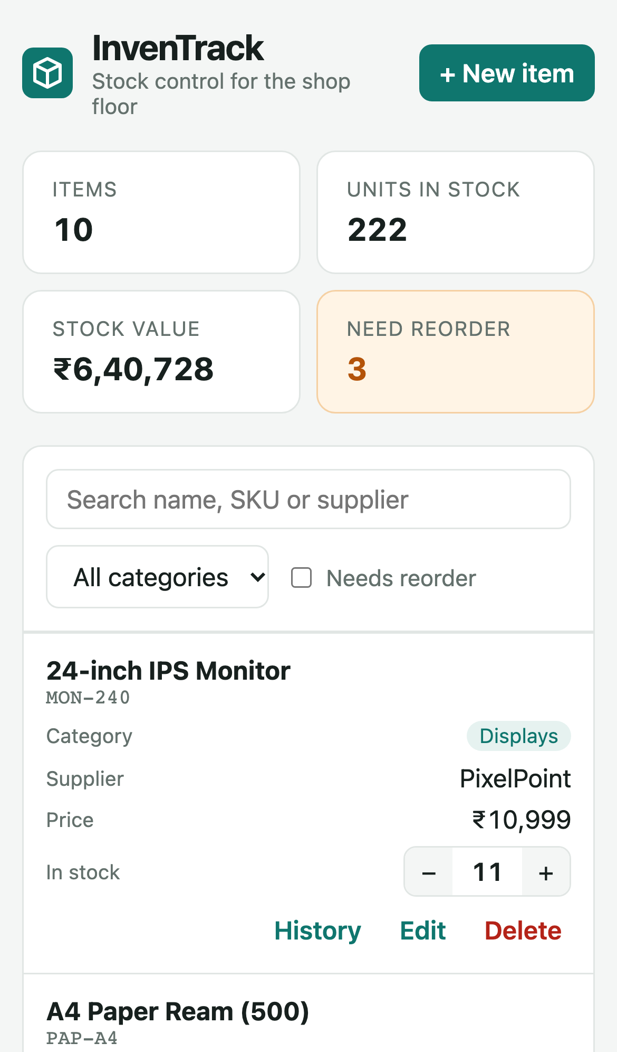
InvenTrack: End-to-End DevOps Project
From git push to a self-healing Kubernetes deployment
Abhi Gandhi
Roll No. 10397
Session 21 · Final DevOps Project and Troubleshooting
Notes:
Introduce yourself: Abhi Gandhi, roll number 10397. InvenTrack is a stock-control app for a small office-supplies shop, wrapped in the full DevOps toolchain from the course.

Slide 2
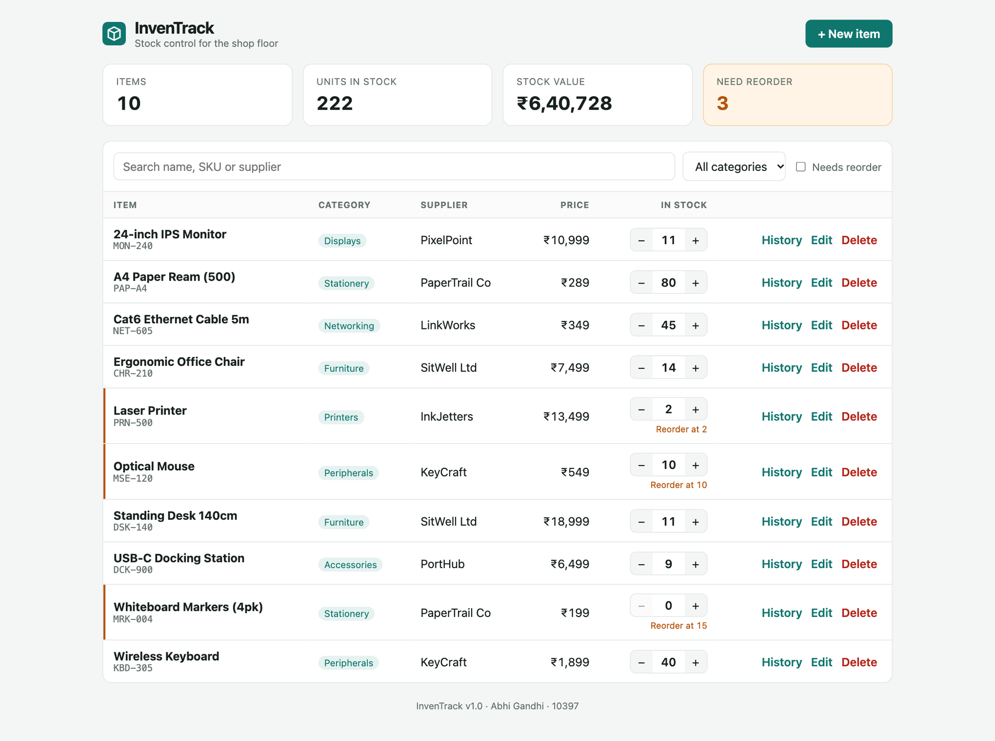
Project at a glance
A stock-control app for a small office-supplies shop, delivered through the full course toolchain. Every screenshot in this deck comes from a real run.
23
15
pytest tests,
100% coverage
GitHub Actions jobs,
all green
43 → 0
52
HIGH CVEs after
the Trivy fix
AWS resources applied
and destroyed
2 → 5
4
API pods scaled
by the HPA
break-and-fix
scenarios
Notes:
The headline numbers. Each one is backed by a screenshot later in the deck.

Slide 3
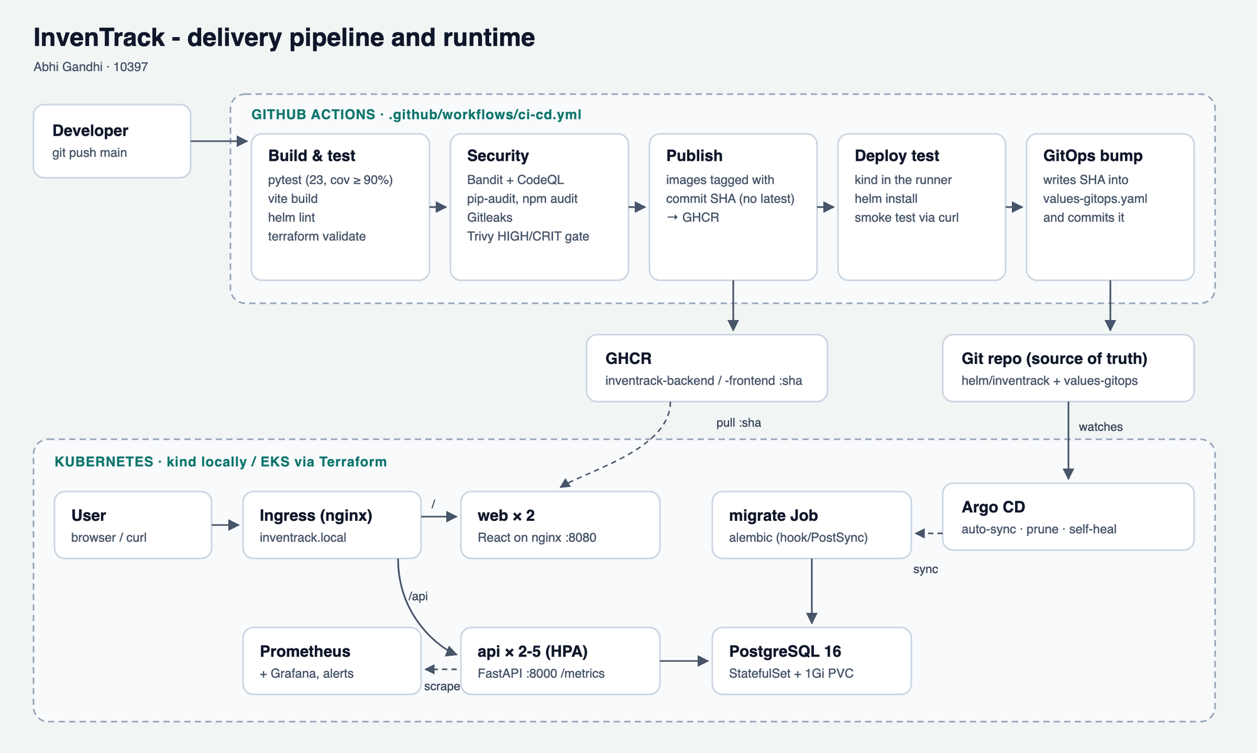
Architecture: pipeline and runtime
Notes:
Top half: GitHub Actions builds, tests, scans and publishes images tagged with the commit SHA, then commits that SHA to the GitOps values file. Bottom half: Argo CD syncs the Helm chart into Kubernetes; Ingress routes / to web and /api to the API; Prometheus scrapes the API.

Slide 4












Technology stack
Backend
Frontend
Database
Python 3.12, FastAPI, SQLAlchemy, Alembic, Pydantic v2
React 19 + Vite, served by unprivileged nginx
PostgreSQL 16, StatefulSet with a 1 Gi PVC
Testing
Containers
CI/CD
pytest + pytest-cov on a throwaway SQLite DB
Multi-stage, non-root images, Docker Compose
GitHub Actions, GitHub Container Registry
Security
Orchestration
Infrastructure
Bandit, CodeQL, pip-audit, npm audit, Gitleaks, Trivy
kind, Helm, ingress-nginx, HPA, restricted PSS
Terraform: AWS VPC + EKS, LocalStack for practice
Monitoring
GitOps
Source control
Prometheus, Alertmanager, Grafana
Argo CD: auto-sync, prune, self-heal
Git + public GitHub repository
Notes:
One tool per job; the slides that follow walk through each layer.

Slide 5
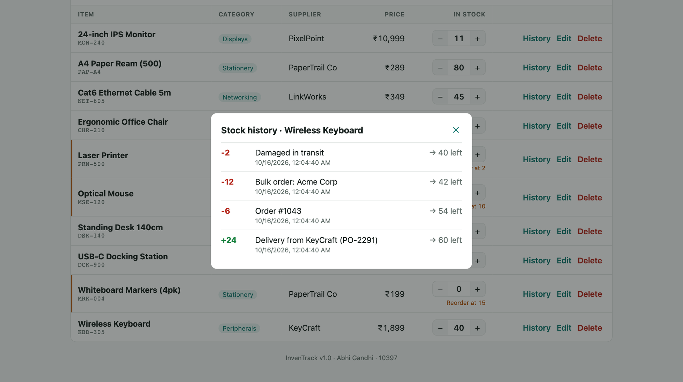
The application
Method | Path | Purpose
GET | /health · /ready | Liveness, and readiness with a DB check
GET | /metrics | Prometheus metrics
GET / POST | /api/items | List with search and filters, create
GET / PUT / DELETE | /api/items/{id} | Read, partial update, delete
POST / GET | /api/items/{id}/movements | Receive or ship stock, history
GET | /api/summary | Counts, stock value, reorder list
Per-item stock history: every change is a recorded movement
Two tables from Alembic migrations: items (unique SKU, quantity ≥ 0) and stock_movements
React UI: KPI cards, search, filters, +/− stock buttons, per-item history
Responsive: on phones, table rows turn into cards
12
2
3
API endpoints
Alembic migrations
services in Compose
Notes:
FastAPI backend with 12 endpoints. Every stock change is recorded as a movement, so there's a full audit trail. Migrations run once per release in a Helm hook Job.

Slide 6
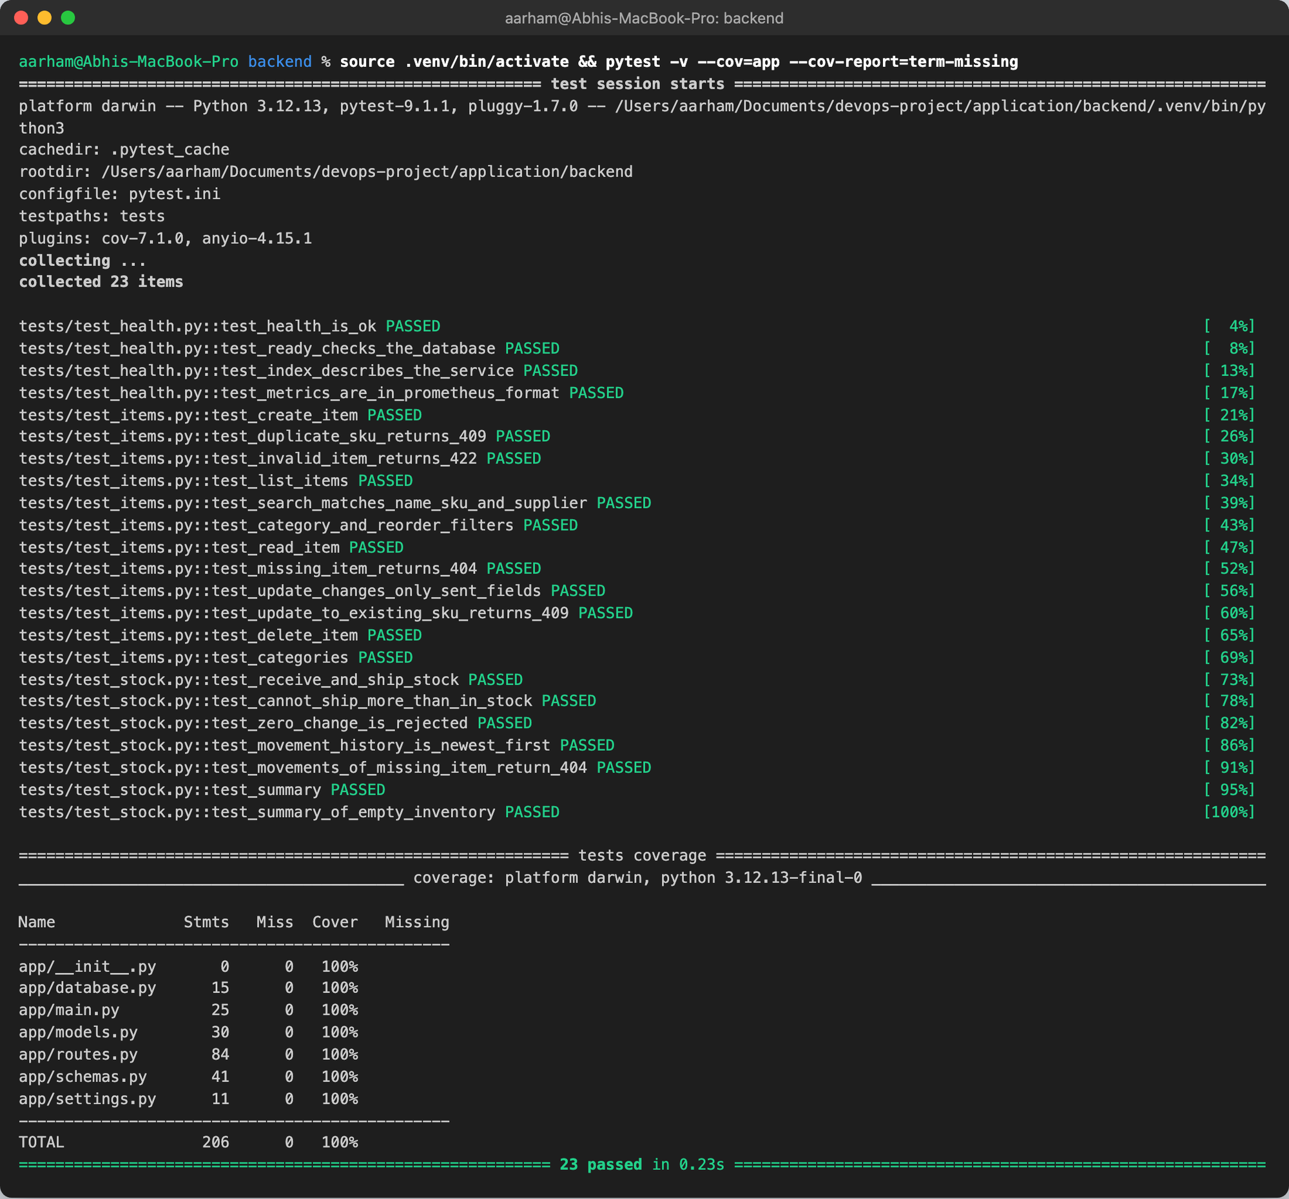
Testing with pytest
23
100%
tests in three files
line coverage (CI fails under 90%)
Covers every endpoint and its error paths: 404, 409, 422, overselling, zero-change movements
conftest.py points the app at a throwaway SQLite file, so PostgreSQL is never touched
Tables are created for each test and the file is deleted afterwards
The backend-tests job blocks the whole pipeline on any failure
Notes:
Tests run on SQLite so they're fast and need no database server.

Slide 7
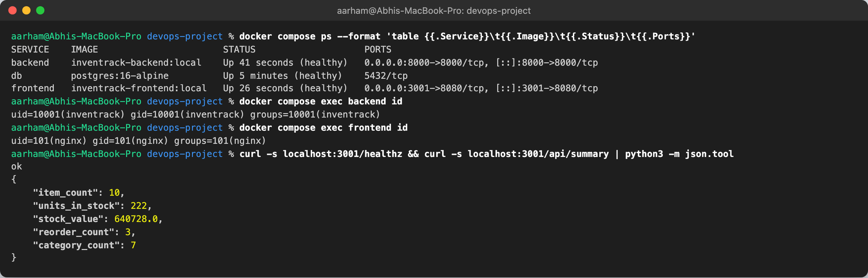
Containerisation with Docker
Backend image
Frontend image
python:3.12-slim, dependency layer cached separately, HEALTHCHECK. Runs as user inventrack, uid 10001.
Stage 1: node:22-alpine runs npm ci and vite build. Stage 2: nginx-unprivileged + apk upgrade. Runs as nginx, uid 101.
docker compose up --build: PostgreSQL, backend and frontend healthy, both app containers non-root
Notes:
Compose brings up all three services with health checks; migrations run before the API starts.

Slide 8







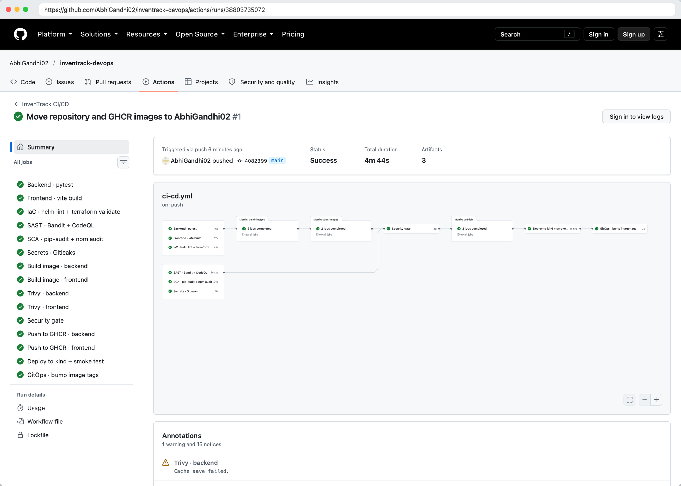
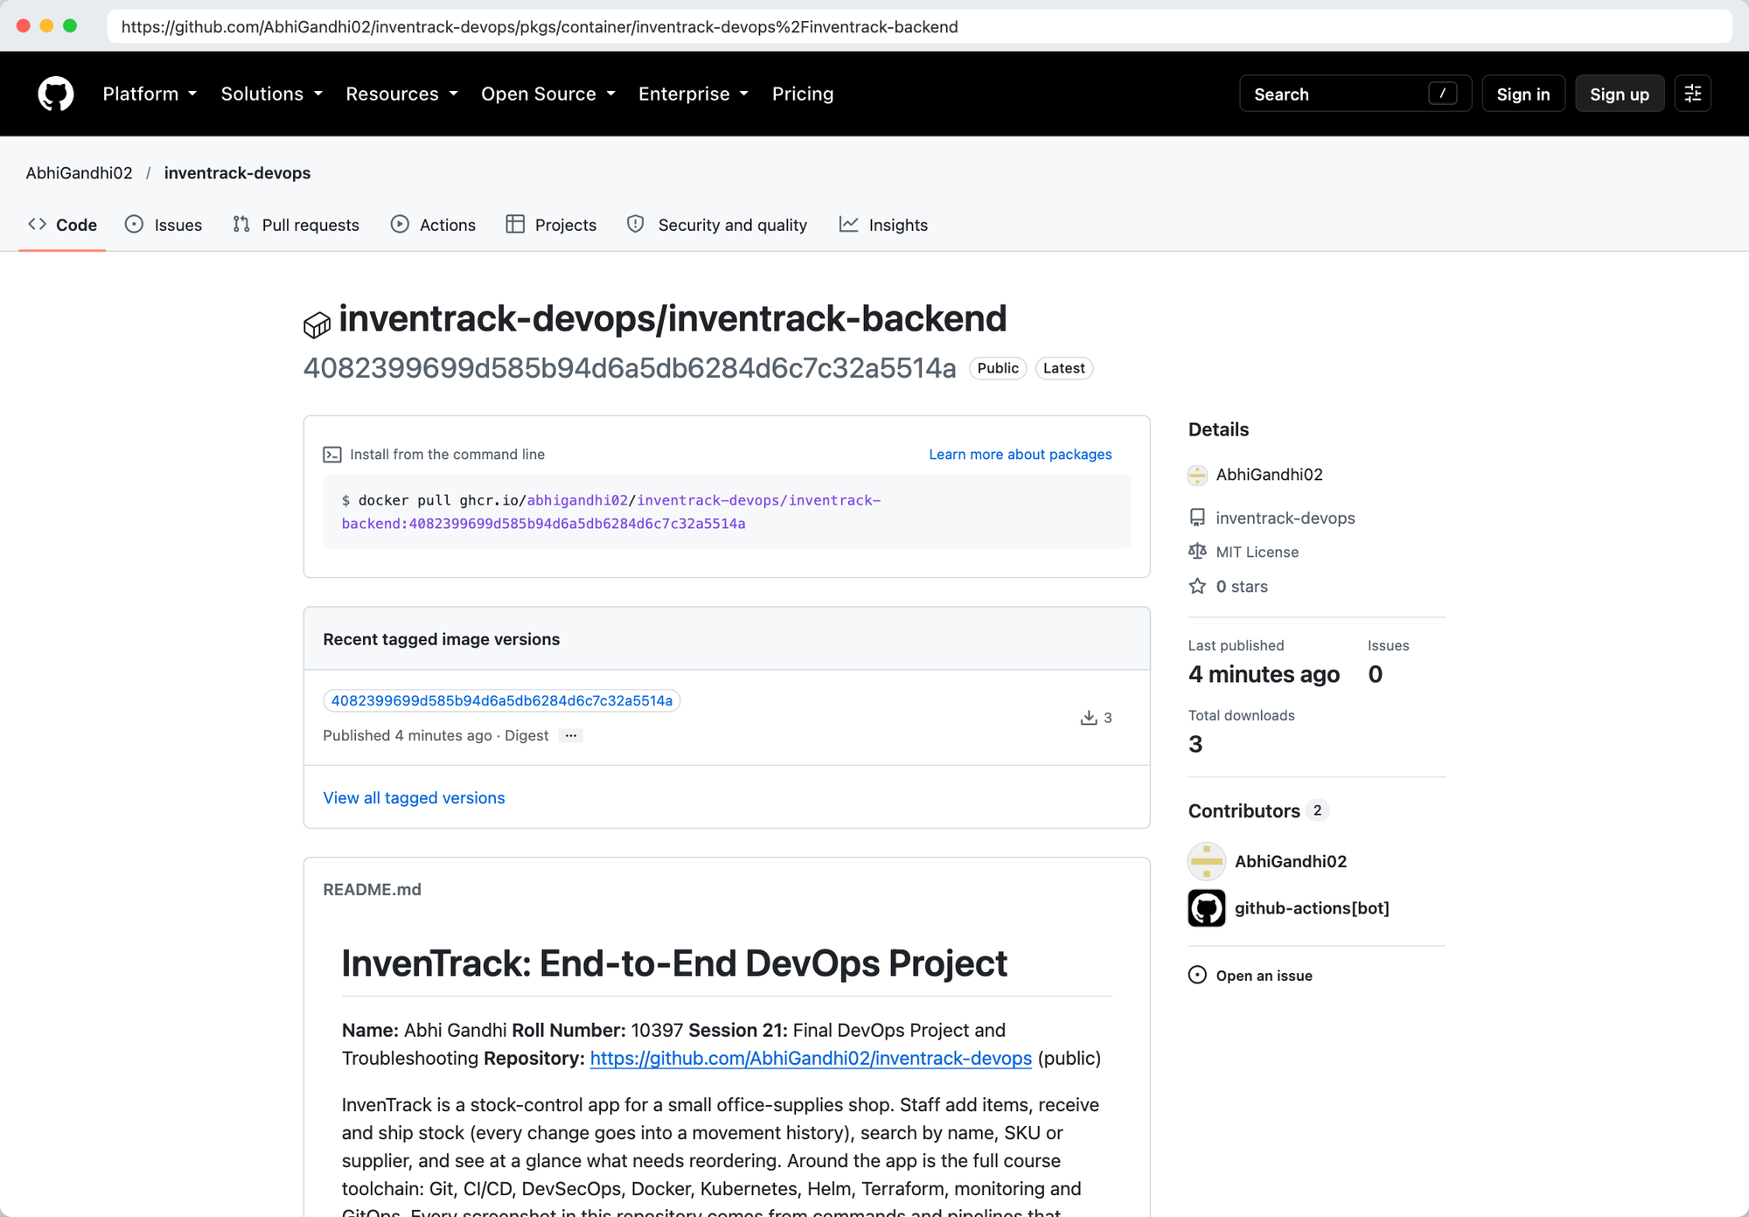
CI/CD pipeline: 15 jobs on every push
Test
Scan code
Build
Trivy gate
Publish
Deploy test
GitOps bump
pytest, vite build, helm lint, terraform validate
Bandit, CodeQL, pip-audit, npm audit, Gitleaks
Both images, tagged with the commit SHA
Fails on fixable HIGH/CRITICAL
Push to GHCR, never :latest
kind in the runner, Helm, smoke test
Commit the SHA to values-gitops.yaml
Notes:
Images are built once, scanned as a tarball, and pushed from that same tarball, so what was scanned is exactly what ships. Every image tag maps to one commit.

Slide 9
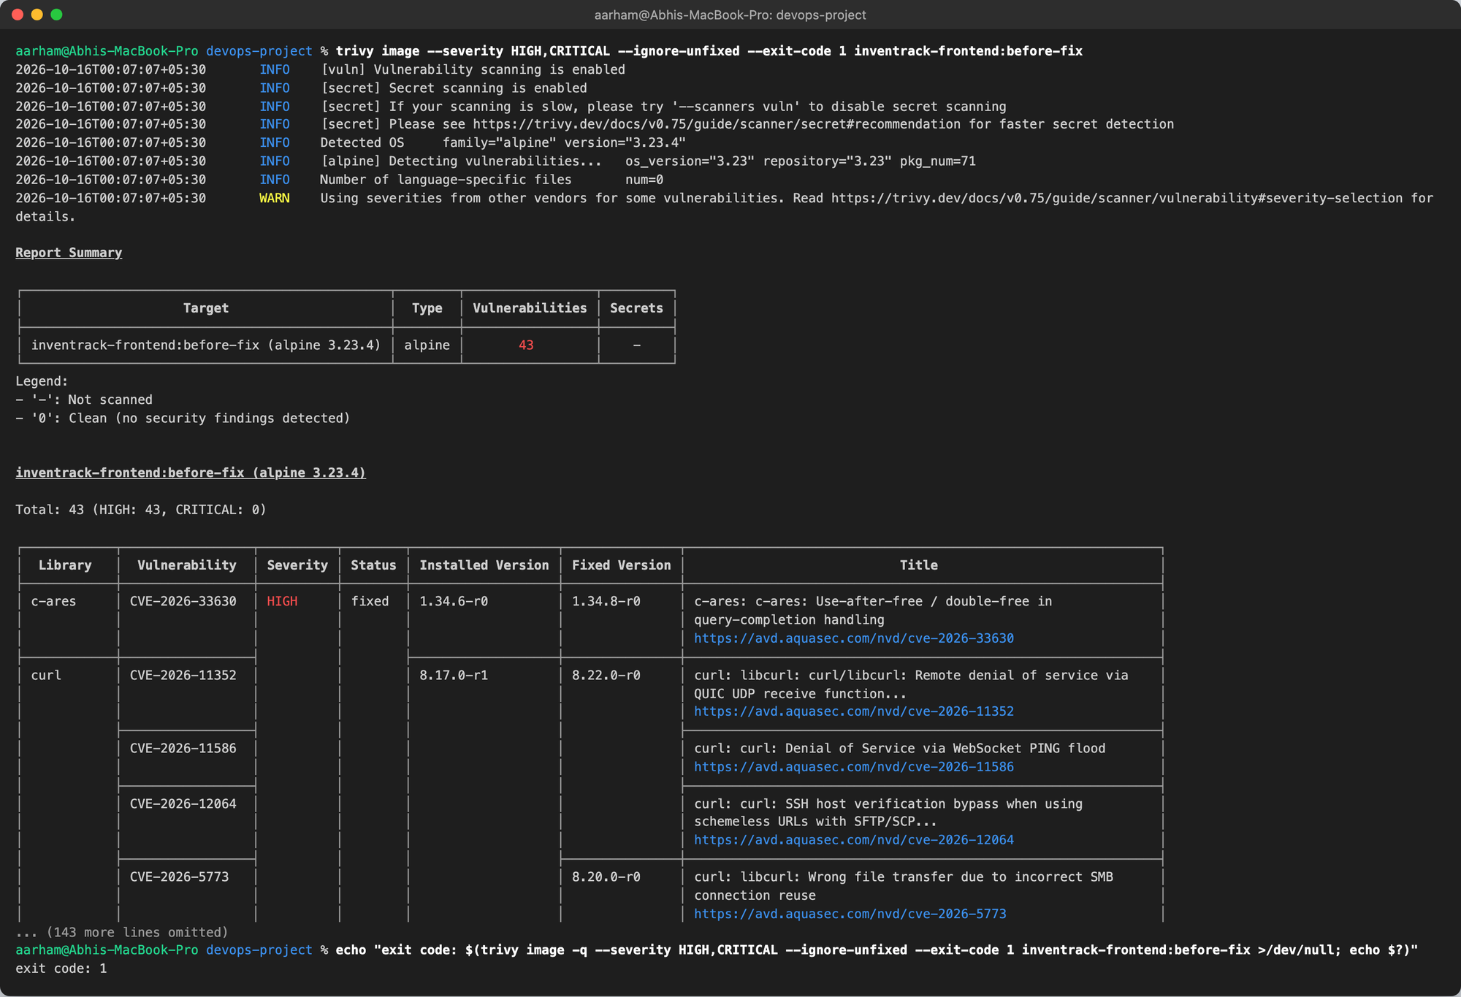
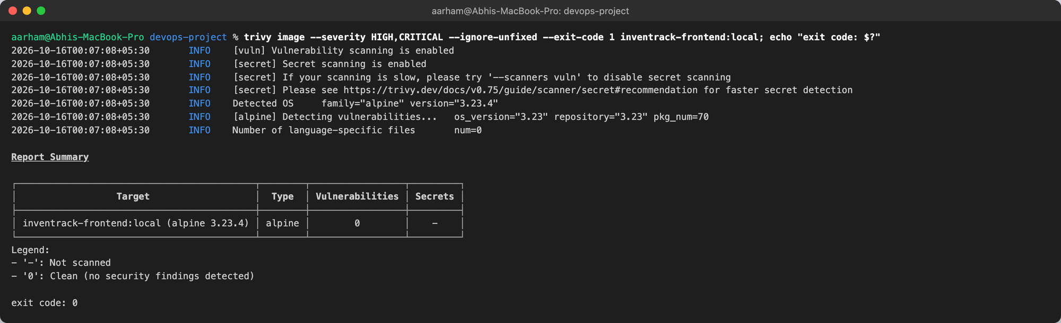
DevSecOps: Trivy found 43 HIGH CVEs
43 → 0
HIGH CVEs in the frontend image
All 43 came from Alpine packages in the nginx base image, not from my code
Example: CVE-2026-33630, a use-after-free in c-ares 1.34.6 (fixed in 1.34.8)
Fix: apk upgrade --no-cache in the runtime stage
The backend image was clean from the start
CI uses severity HIGH,CRITICAL, ignore-unfixed and exit-code 1
Notes:
Base images carry CVEs too. One line in the Dockerfile cleared every finding.

Slide 10
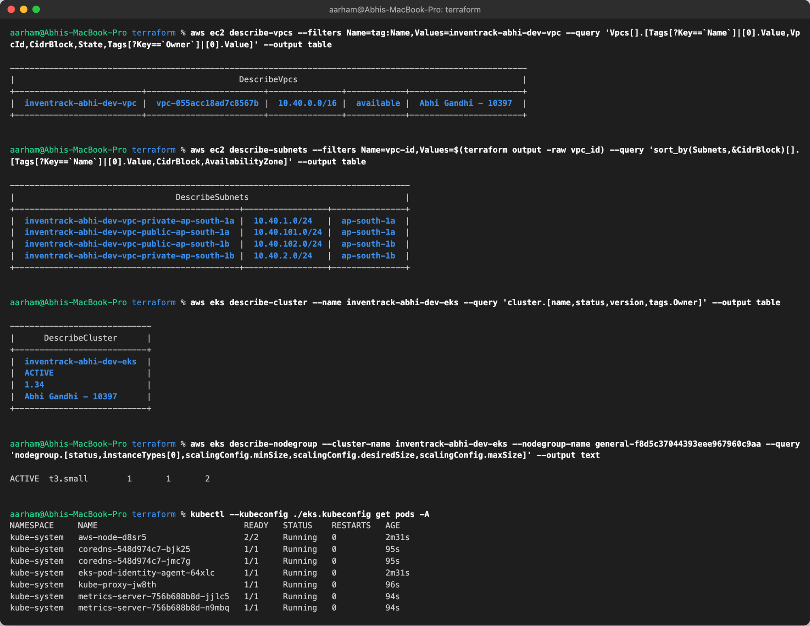
Infrastructure as Code: AWS VPC + EKS
Network module
VPC 10.40.0.0/16 · 2 public + 2 private subnets across 2 AZs · Internet gateway + NAT
EKS cluster
Kubernetes 1.34 · managed node group in private subnets
Applied on real AWS (ap-south-1)
Plan 52 → apply → node Ready → destroy. Smallest size: 1× t3.small, minimal_cost = true. Fixed an IAM tag error and untainted the cluster after a network drop. Practised first for free on LocalStack + kind.
Notes:
Credentials come only from aws configure; only terraform.tfvars.example is committed. Every resource is named and tagged with my name and roll number.

Slide 11
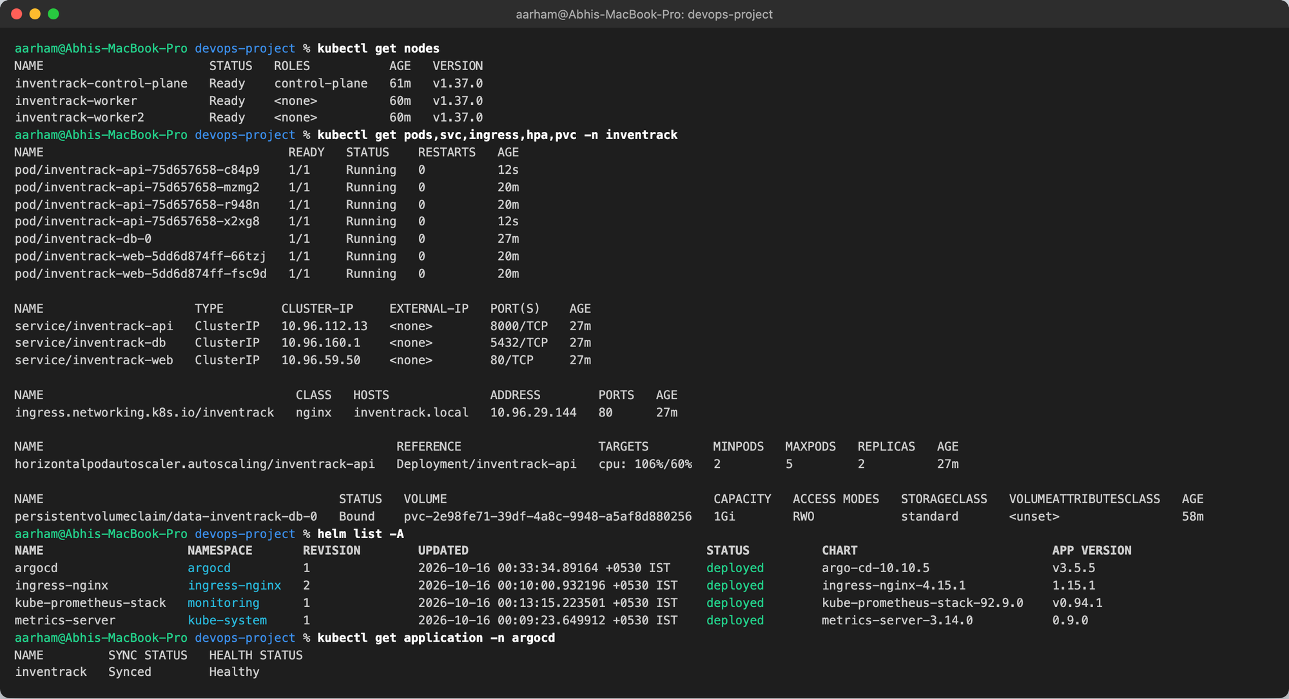
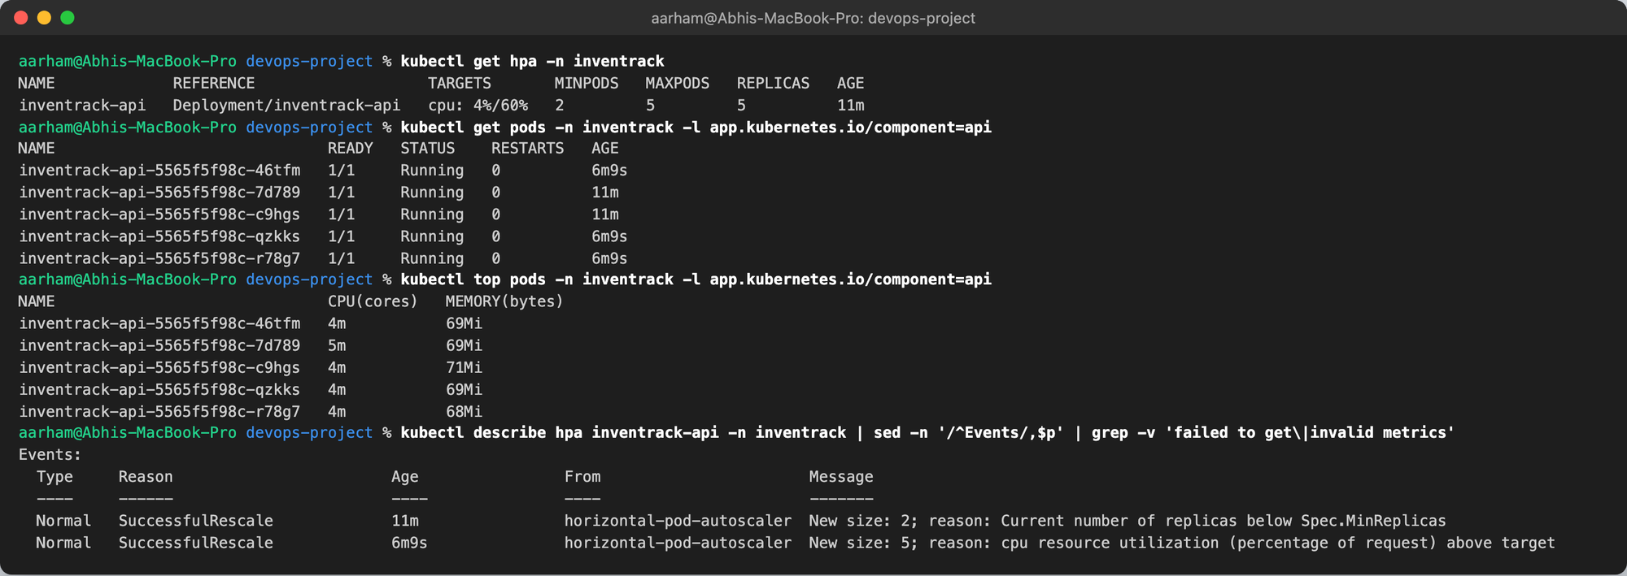
Kubernetes and Helm
API: 2 replicas, HPA up to 5
Web: 2 replicas
PostgreSQL StatefulSet, 1 Gi PVC
ClusterIP Services + Ingress: / → web, /api → API
PDB, ConfigMap, generated Secret, Alembic hook Job, ServiceMonitor
Non-root pods, capabilities dropped, restricted Pod Security
During a load test the HPA scaled the API from 2 to 5 pods
Notes:
The chart passes helm lint. Install, upgrade and rollback were all exercised in the troubleshooting challenge.

Slide 12
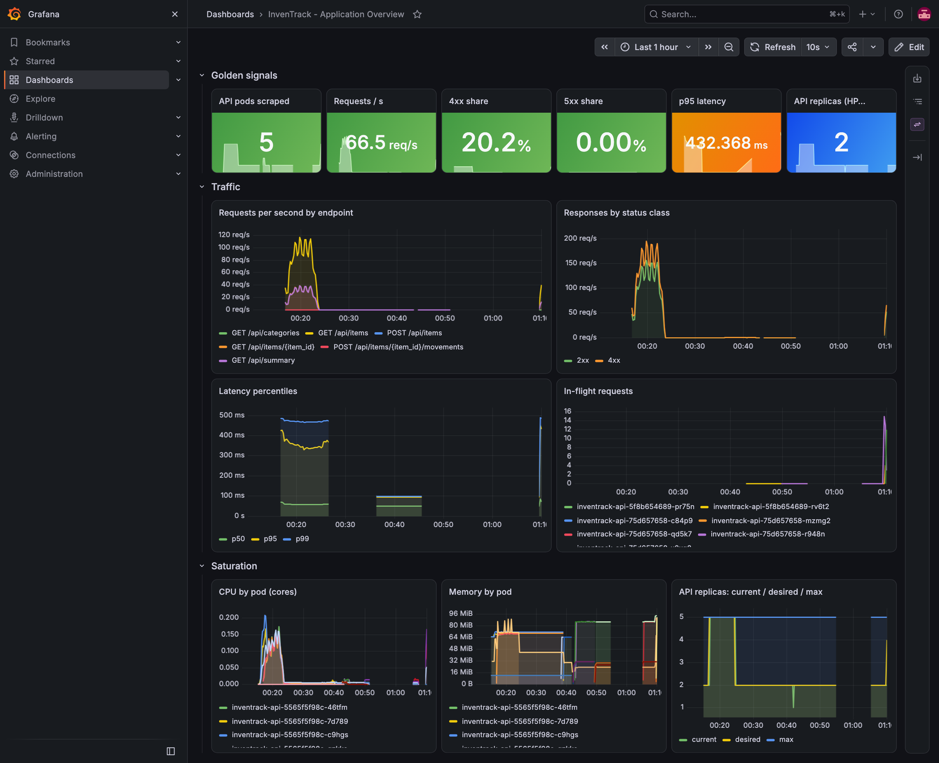




Observability: Prometheus and Grafana
Metrics
/metrics exposes request count, latency histogram and in-flight requests
Scraping
A ServiceMonitor lets kube-prometheus-stack find every API pod
Dashboard
15 Grafana panels: traffic, errors, latency, CPU, memory, replicas
Alerts
6 rules: availability, crash loops, 5xx rate, latency, HPA saturation
Notes:
The dashboard is imported automatically from a ConfigMap, so it survives a fresh install.

Slide 13
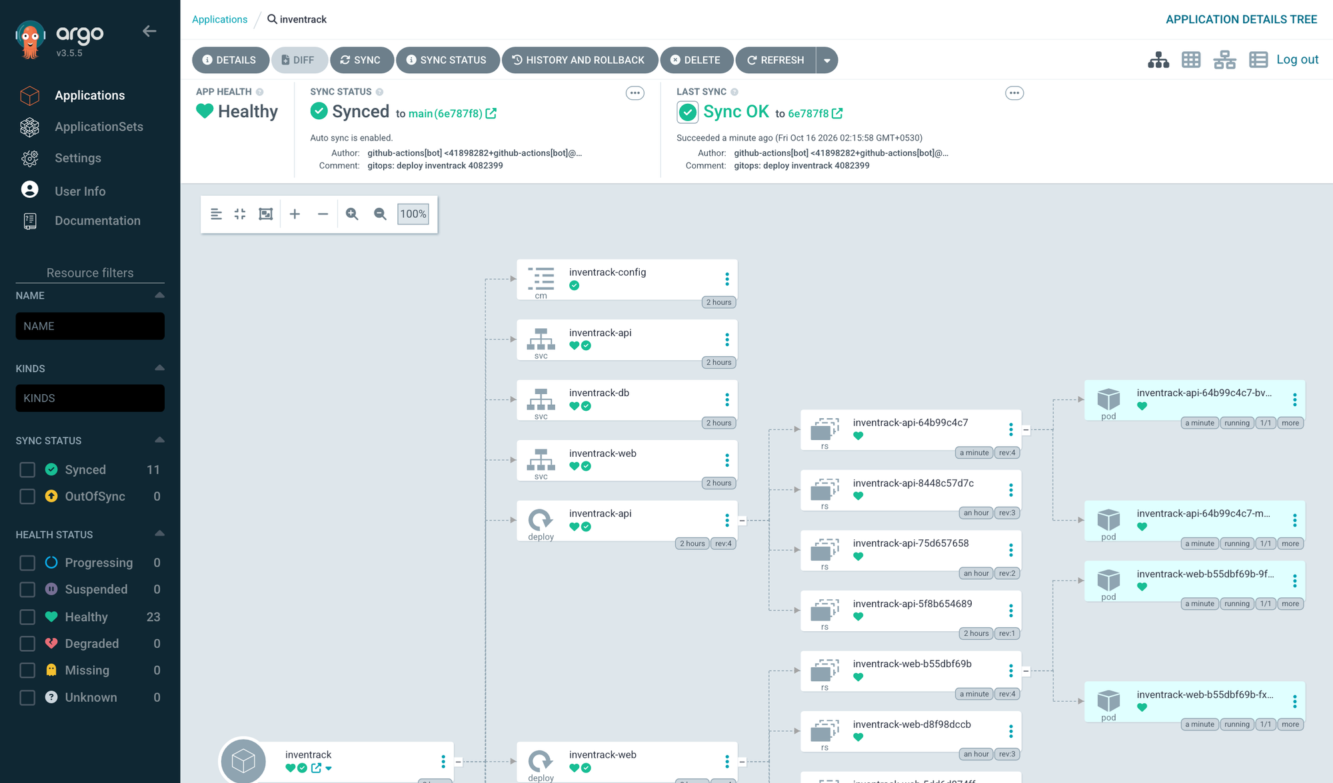
GitOps with Argo CD
git push
CI builds :sha
CI commits SHA to Git
Argo CD syncs
Rolling update
Argo CD watches helm/inventrack on main with values-gitops.yaml
Auto-sync, prune and self-heal: manual drift is reverted
Rollback = git revert of the bump commit
Live demo: changed the footer to v1.1, pushed, and watched it go live
Notes:
Git is the single source of truth. Nobody runs kubectl apply against the cluster.

Slide 14

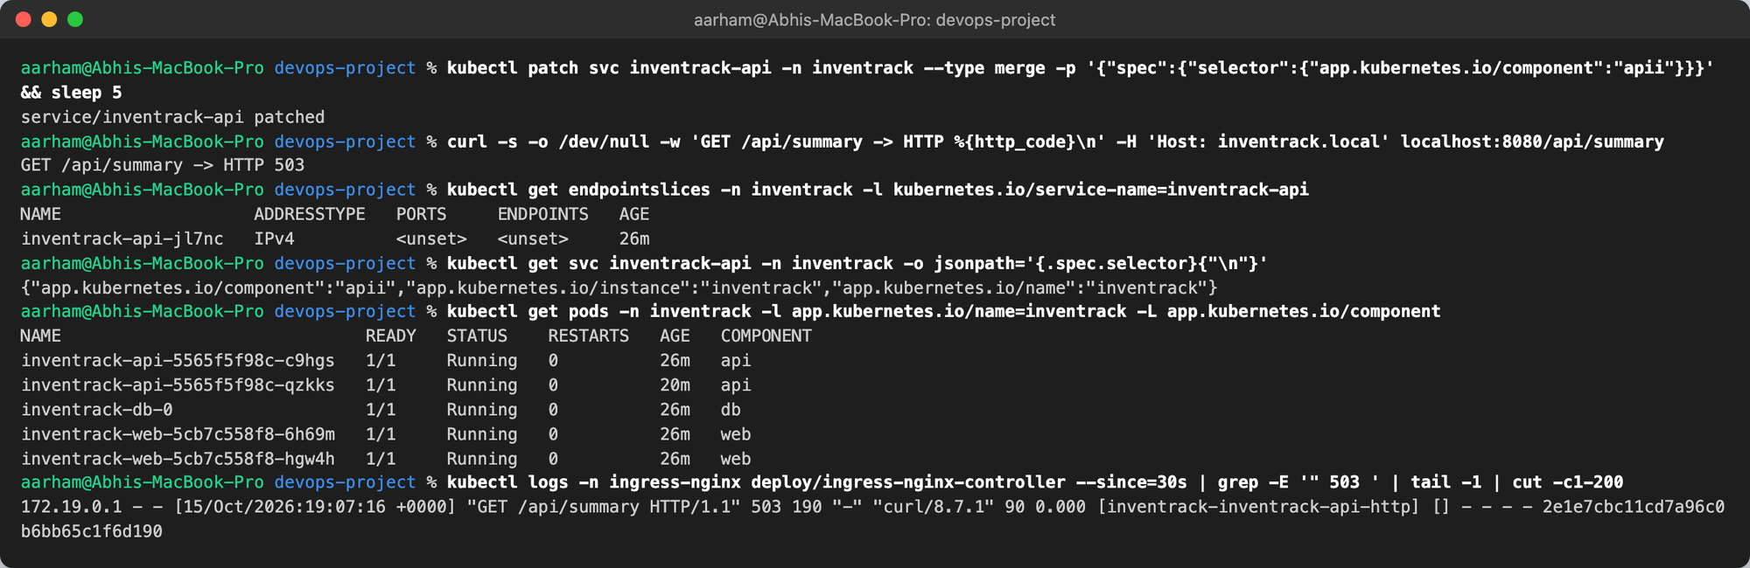
Troubleshooting: four break-and-fix scenarios
# | What I broke | Symptom | Fix
1 | Image tag that was never built | ImagePullBackOff, release failed | helm rollback
2 | Service selector typo (apii) | Ingress returns HTTP 503, no endpoints | Re-apply chart with --force-conflicts
3 | Wrong DB password in the Secret | Pod Running but 0/1 Ready, rollout stuck | Restore Secret, restart rollout
4 | Memory limit of 40 Mi | OOMKilled (exit 137), CrashLoopBackOff | helm rollback
Users only noticed scenario 2. In the other three the old pods kept serving HTTP 200, because the API uses maxUnavailable: 0 and a readiness probe that checks the database. A routing bug bypasses that protection.
Notes:
Scenario 2 also uncovered a Helm 4 server-side-apply conflict: kubectl patch had taken ownership of the selector field, so Helm refused until --force-conflicts.

Slide 15
What I learned
Readiness keeps users safe
Scan what you ship
Base images carry CVEs
Readiness probes plus maxUnavailable: 0 kept the old version serving in 3 of 4 failures.
Build once, scan the tarball, push that same tarball. Rebuilding after the scan voids it.
All 43 HIGH findings came from the base image; apk upgrade cleared them.
Migrations in one place
Don't edit live objects
Cloud APIs have rules
A Helm hook Job runs Alembic once per release instead of racing in every replica.
Helm 4 server-side apply refuses fields another manager owns.
IAM rejected parentheses in a tag; terraform untaint saved a full EKS rebuild.
Notes:
These are the lessons that came out of real failures during the project.

Slide 16
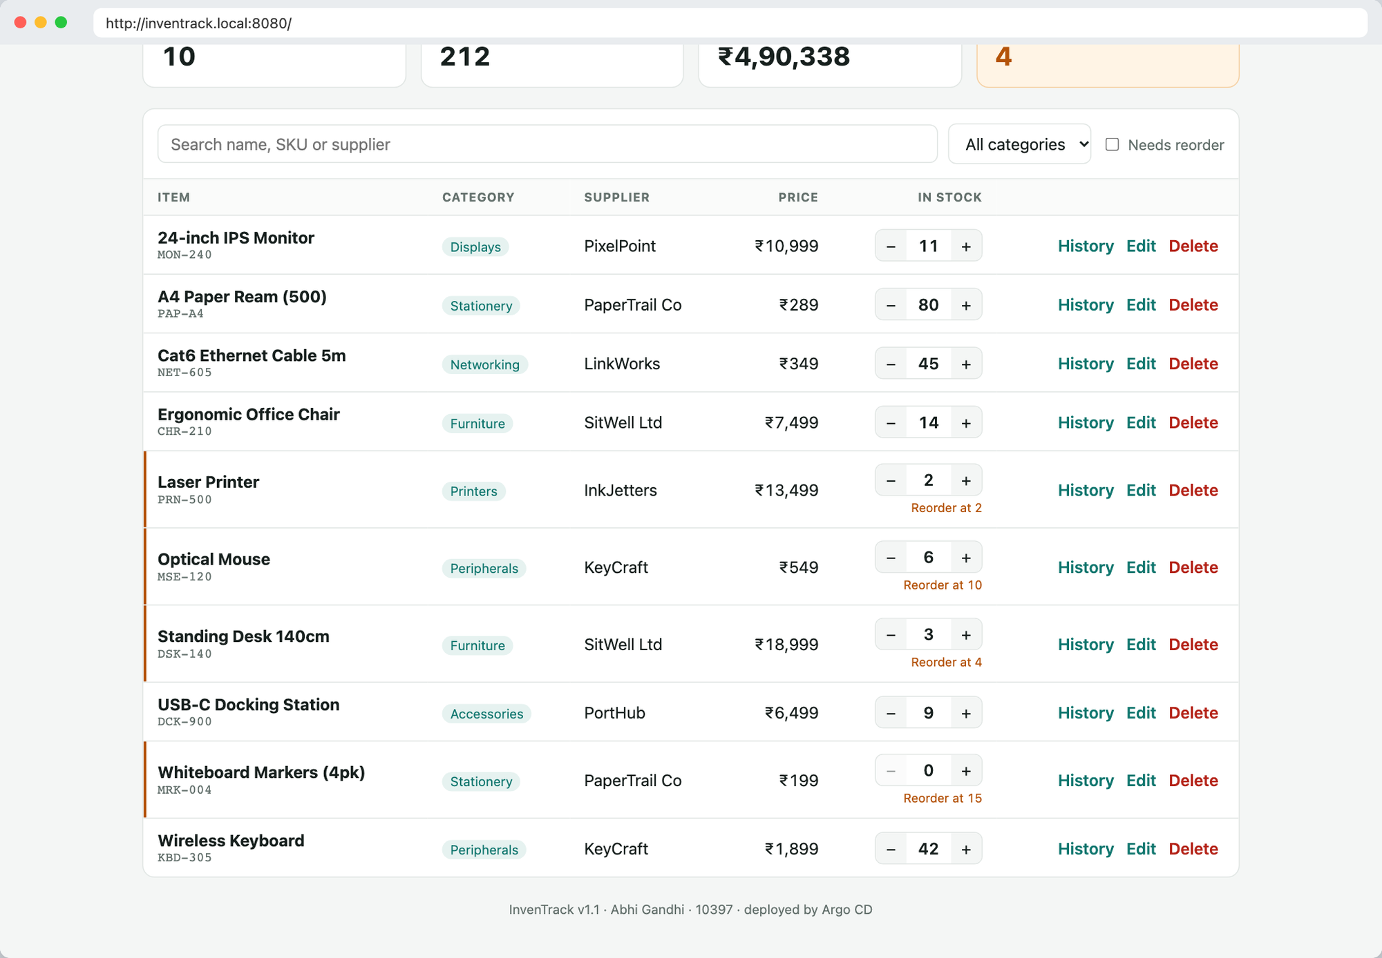
Thank you
Questions?
Abhi Gandhi · Roll No. 10397
github.com/AbhiGandhi02/inventrack-devops
Notes:
Close with the repository link and take questions.

