Slide 1

Spring MVC 3.0 using Annotations – Abhijeet R

Slide 2
Introduction to Spring MVC 3.0
The Spring web MVC framework provides model-view-controller architecture and ready components that can be used to develop flexible and loosely coupled web applications. The MVC pattern results in separating the different aspects of the application (input logic, business logic, and UI logic), while providing a loose coupling between these elements.
The Model encapsulates the application data and in general they will consist of POJO.
The View is responsible for rendering the model data and in general it generates HTML output that the client's browser can interpret.
The Controller is responsible for processing user requests and building appropriate model and passes it to the view for rendering.

Slide 3
Why Spring MVC (Comparison between Spring MVC and Struts)
Spring provides a very clean division between controllers, JavaBean models, and views.
Spring's MVC is very flexible. Unlike Struts, which forces your Action and Form objects into concrete inheritance (thus taking away your single shot at concrete inheritance in Java), Spring MVC is entirely based on interfaces. Furthermore, just about every part of the Spring MVC framework is configurable via plugging in your own interface. Of course we also provide convenience classes as an implementation option.
Spring, like WebWork, provides interceptors as well as controllers, making it easy to factor out behavior common to the handling of many requests.
Spring MVC is truly view-agnostic. You don't get pushed to use JSP if you don't want to; you can use Velocity, XLST or other view technologies. If you want to use a custom view mechanism - for example, your own templating language - you can easily implement the Spring View interface to integrate it.
Spring Controllers are configured via IoC like any other objects. This makes them easy to test, and beautifully integrated with other objects managed by Spring.
Spring MVC web tiers are typically easier to test than Struts web tiers, due to the avoidance of forced concrete inheritance and explicit dependence of controllers on the dispatcher servlet.
The web tier becomes a thin layer on top of a business object layer. This encourages good practice. Struts and other dedicated web frameworks leave you on your own in implementing your business objects; Spring provides an integrated framework for all tiers of your application

Slide 4
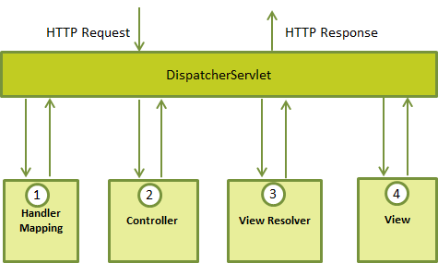
The Spring Web model-view-controller (MVC) framework is designed around a DispatcherServlet that handles all the HTTP requests and responses. The request processing workflow of the Spring Web MVC DispatcherServlet is illustrated in the following diagram:

Slide 5
1. After recieving an HTTP request, DispatcherServlet consults the HandlerMapping to call the appropriate Controller.
2. The Controller takes the request and calls the appropriate service methods based on used GET or POST method. The service method will set model data based on defined business logic and returns view name to the DispatcherServlet.
3. The DispatcherServlet will take help from ViewResolver to pickup the defined view for the request.
4. Once view is finalized, The DispatcherServlet passes the model data to the view which is finally rendered on the browser.
Note :- All the above mentioned components ie. HandlerMapping, Controller and ViewResolver are parts of WebApplicationContext which is an extension of the plain ApplicationContext with some extra features necessary for web applications.

Slide 6
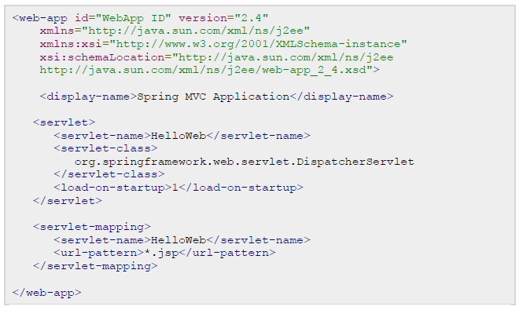
Web.xml configuration

Slide 7
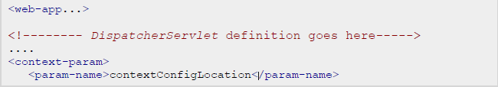
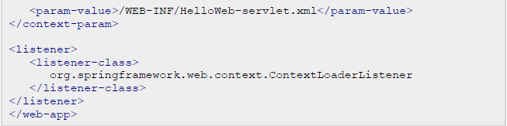
the framework will try to load the application context from a file named [servlet-name]-servlet.xml located in the application's WebContent/WEB-INF directory. In this case our file will be HelloWeb-servlet.xml.

Slide 8
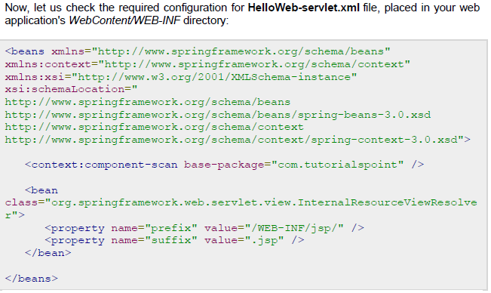

Slide 9
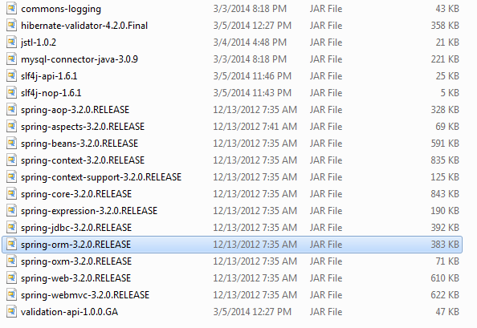
Dependencies you require

Slide 10
Case Study : Student Management

Slide 11
Case Study: Student Management
We are going to develop a small Spring MVC application using annotation.
We are going to Manage Student Entry by performing Insert , Update , Delete and Display Student Information using Spring JdbcTemplate.

Slide 12
Beginning with Project Setup in RAD Application Server 6.1

Slide 13
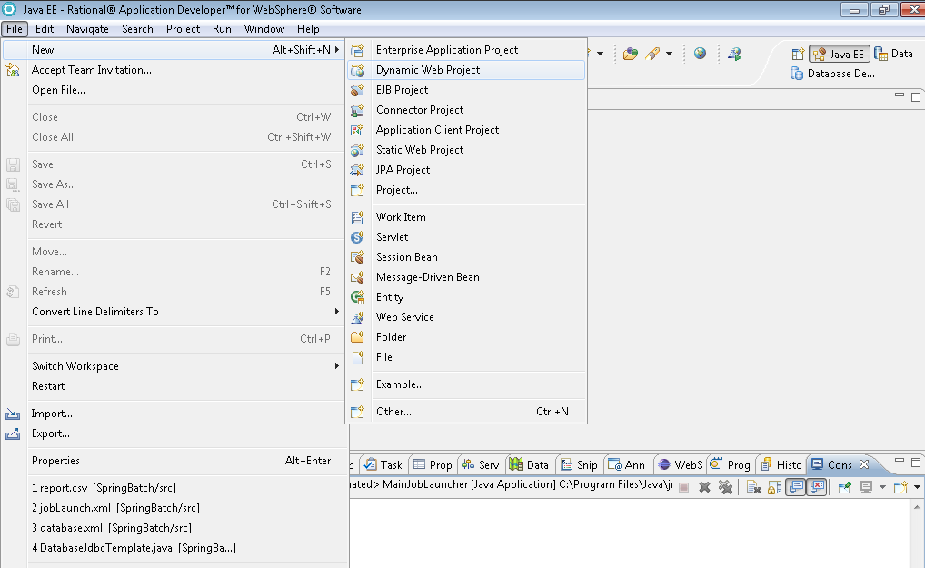

Slide 14
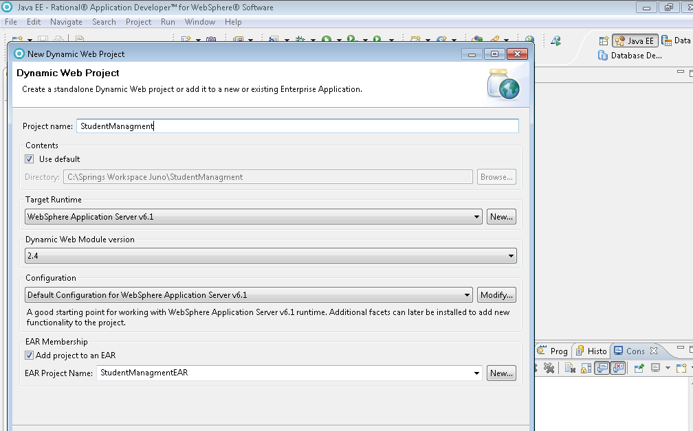
Project Name
App server version
Web module version
Optional keep unchecked if deploying war

Slide 15
Keep them as is and press finish

Slide 16
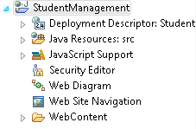
Folder structure view of project

Slide 17
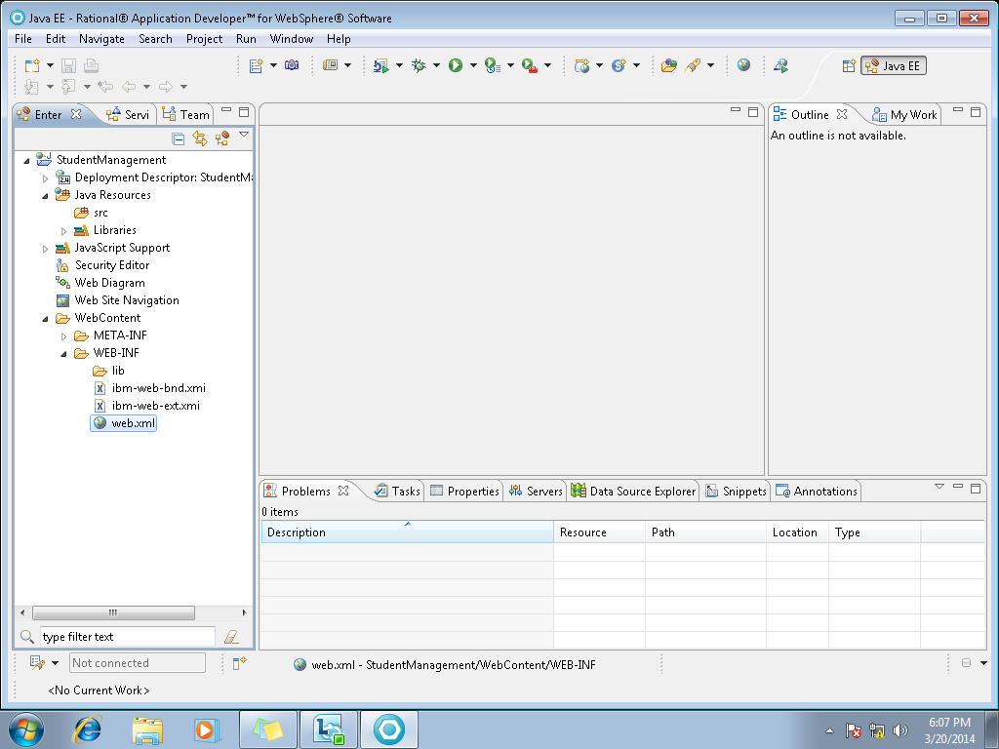
Open your web.xml

Slide 18
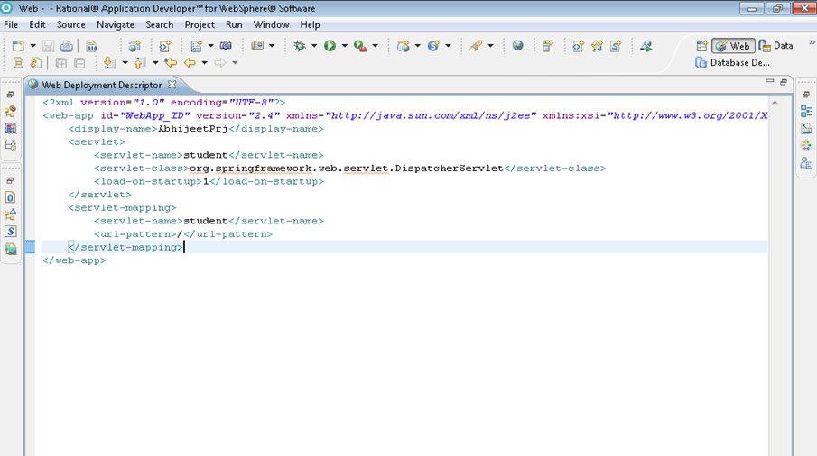
Configure web.xml
Servlet-name
url-pattern to match it can be any thing say *.jsp or *.htm
Front Controller that invokes when / pattern hit
This
Value is used to set priority for front controller
1 is to set the priority at startup

Slide 19
Spring Configuration File
Note that as shown in the previous slide we have servlet name as student so we create a file as student-servlet.xml
The reason behind doing so is Spring MVC searches the configuration file name as [servlet-name]-servlet.xml
Here we configure the namespaces url’s for XSD version that are picked from your jars and InternalResourceViewResolver class that searches files like .jsp , .html or any other type of file once you have configured.
We are also configuring database which would inject connection properties and other mandatory properties that will provide a dataSource of type DriverManagerDataSource class

Slide 20
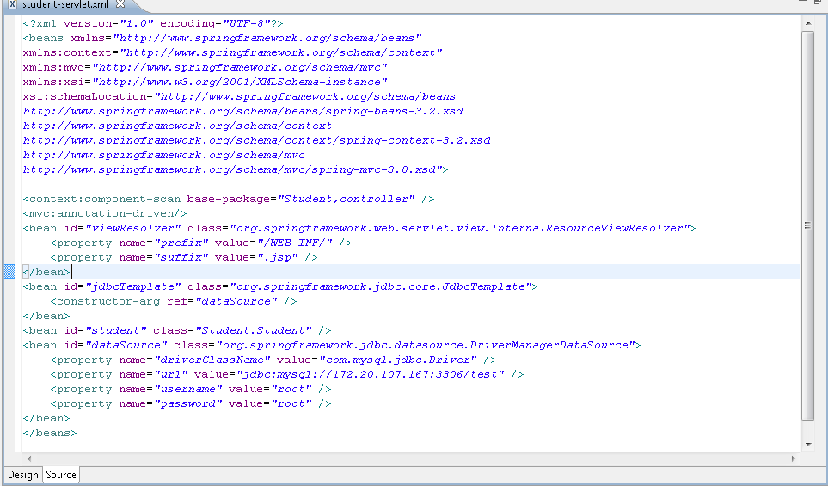
Spring Configuration
Mandatory Name spaces for bean, context, mvc -for mvc annotation.
xsd versions that are specific to your jars
For scanning annotations in the packages Student and controller and mvc:annotation to find mvc related annotation say @Valid
View resolver configured that searches the file returned by controller by appending .jsp. say login + .jsp = login.jsp in WEB-INF
The jdbcTemplate class instantiated with constructor injection of dataSource .
dataSource has properties that will inject driver,url and credential

Slide 21
Controller, Service and DAO layer
We are going to use Stereotype and MVC annotations that will be annotated to describe a class as Controller , Service and Dao Layer. we are going to access each layer through their interfaces.
The annotations used are @Controller , @Service and @Repository, @Autowired , @Valid
@Controller will be used with @RequestMapping for request mapping to a particular command(s) that would be annotated to a class or directly to a method(s) of that class.
@Autowired when applied to a class reference will inject that directly into class reducing xml dependency injection by searching its bean type into our student-servlet.xml provided its bean is declared in xml. @Service will declare a class as service and Dao layer by @Repository

Slide 22
Controllers
We have two controllers in our project that help us to navigate
through the project for every request mapping right from login to insert, update, delete and display information
We have controllers like FlowController , ValidateUser. When we try to login with the command /login the FlowController invokes as it has @RequestMapping(value = "/login") mapped to method loginUser() that returns
a new ModelAndView("login","student",student); which is red by DispatcherServlet that consults ViewResolver to find a jsp called login.jsp and when the jsp is fetched and is attached with the new instance of Pojo class Student whose variables are mapped to jsp input fields.

Slide 23
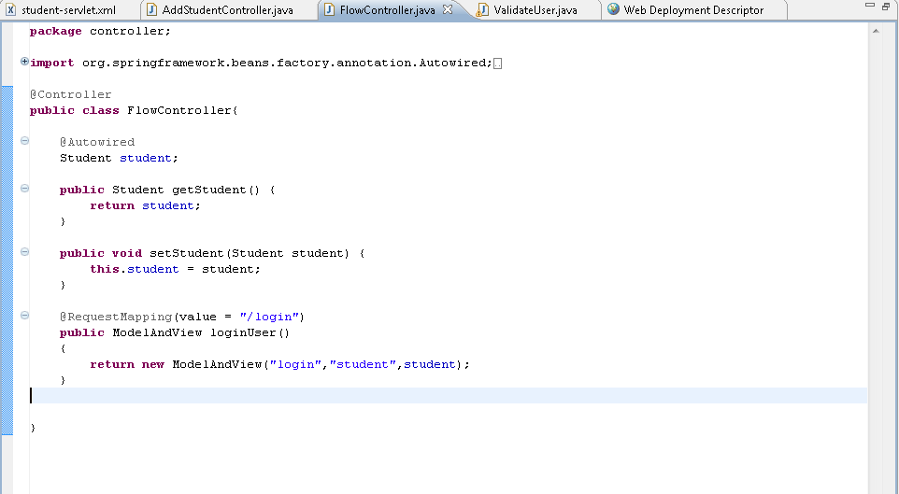
Autowired to student pojo that has bean definition in student-servlet.xml
Request mapped to method for command “/login“

Slide 24
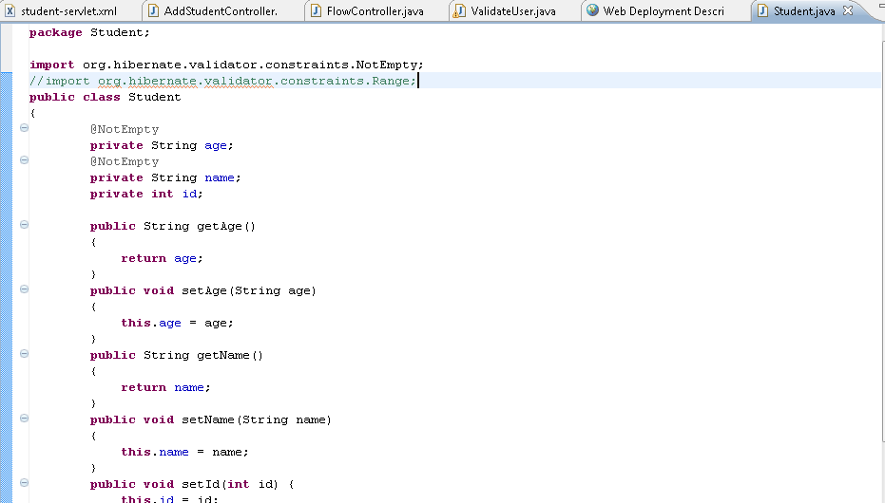
Pojo Class Student
Annotation to validate that fields are not empty
All these instance variables that are mapped in jsp and similar to database columns

Slide 25
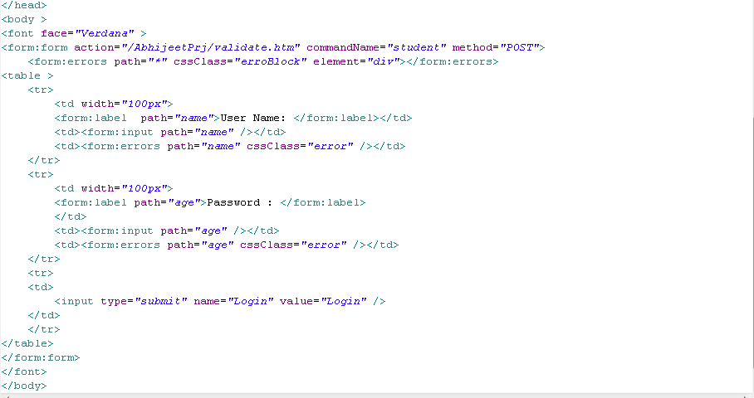
Login.jsp
Comand name is used to map to your pojo class student the mapped method should have Student as parameter and its mandatory
* In form errors Is a wild card that applies for all the fields that display message when validation fails for any field
Input mapped to student class variables
Used for validation

Slide 26
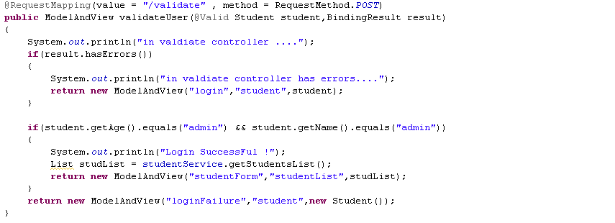
/Validate mapping
Method type to match post method / if method type is get method no need to describe method attribute
This is for validating if there are any validation error on the login page
@valid is used for applying validation on pojo Student as shown in previous slide for Student pojo
The list of student fetched will be pushed to sudentForm .jsp that will be iterated an displayed in tabular form
Navigating to next page that can be login.jsp , studentForm.jsp or loginFailure.jsp depending on errors , success or failure

Slide 27
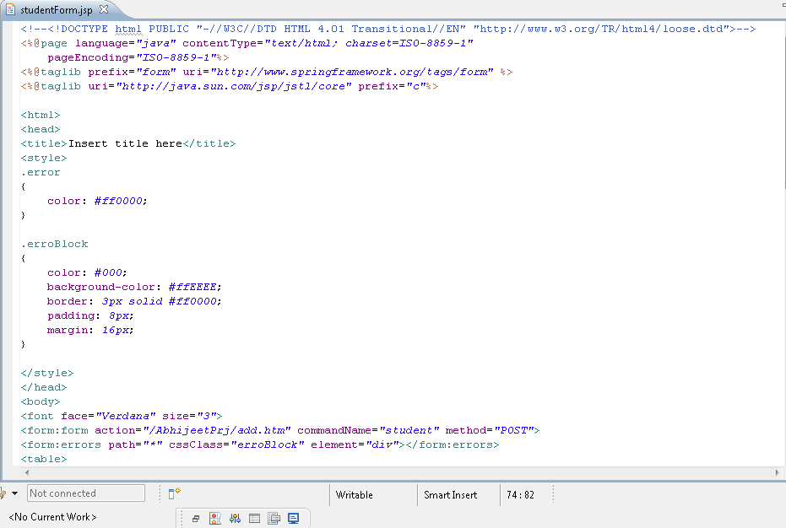
studentForm.jsp
Spring tag library form and jstl tag library for iterating list of data
The form errors to display message at the top of form/page

Slide 28
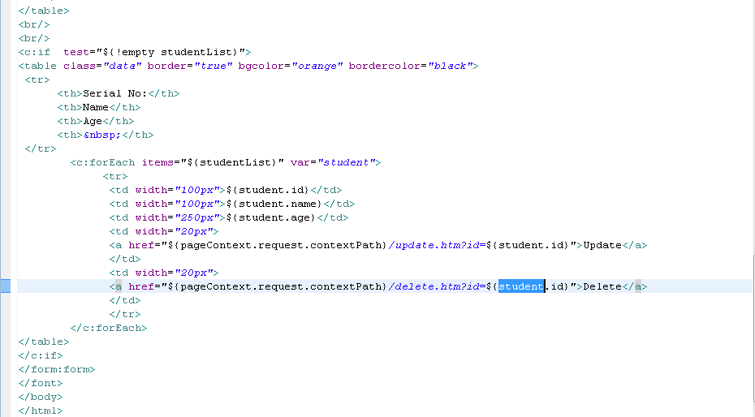
continued
the list is iterated that was previously sent from validate method
the pageContext gives you context path say in this case /AbhijeetPrj/update.htm?and the id that can be used to delete or update from the database

Slide 29
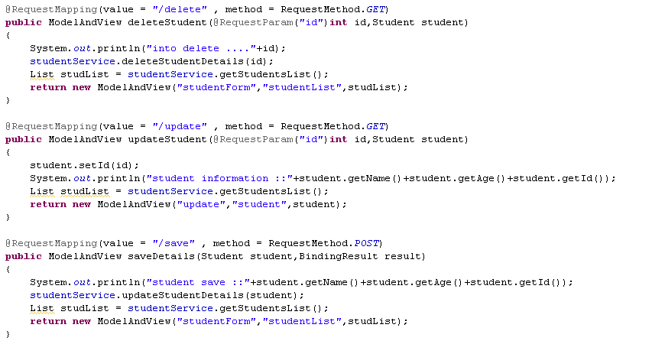
Request param is used to fetch a parameter in request say id in this case
Not mandatory works fine even if you do not declare by default mapping is for GET method

Slide 30
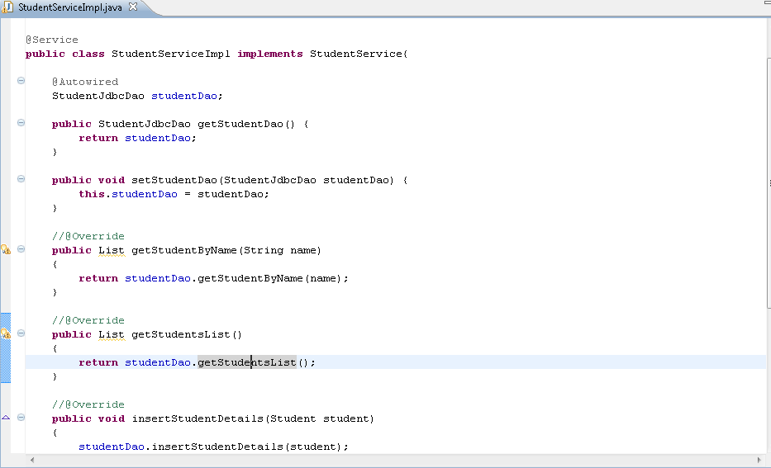
Service Layer (StudentServiceImpl)
StudentServiceImpl annoted as @Service which access all Dao layer methods to access data from database

Slide 31
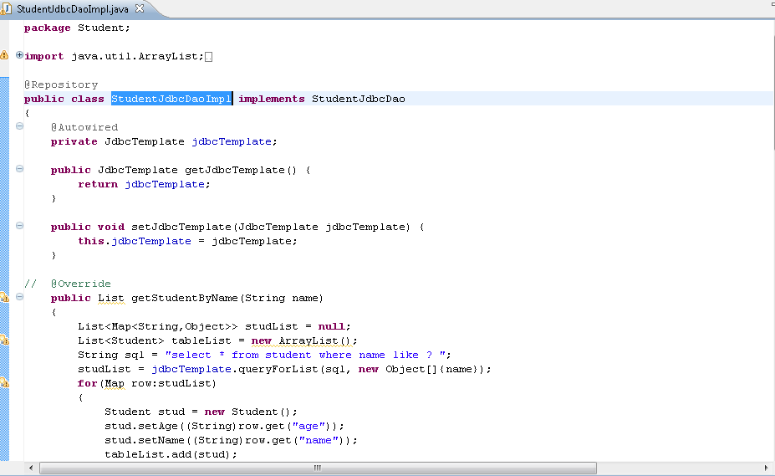
Dao Layer - StudentJdbcDaoImpl
The Dao layer annoted as @Repository

Slide 32
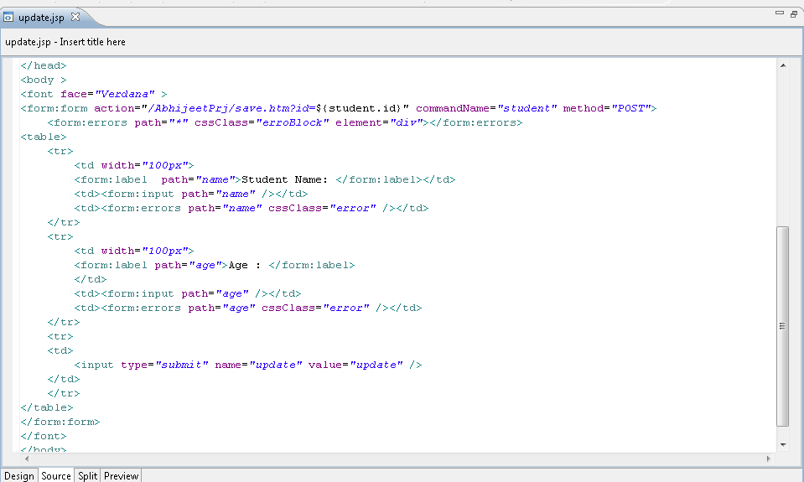
update.jsp
action is passed with id that needs to be updated by using expression
note * the /AbhjeetPrj is name of project , project specific it will be the same as name of new project

Slide 33
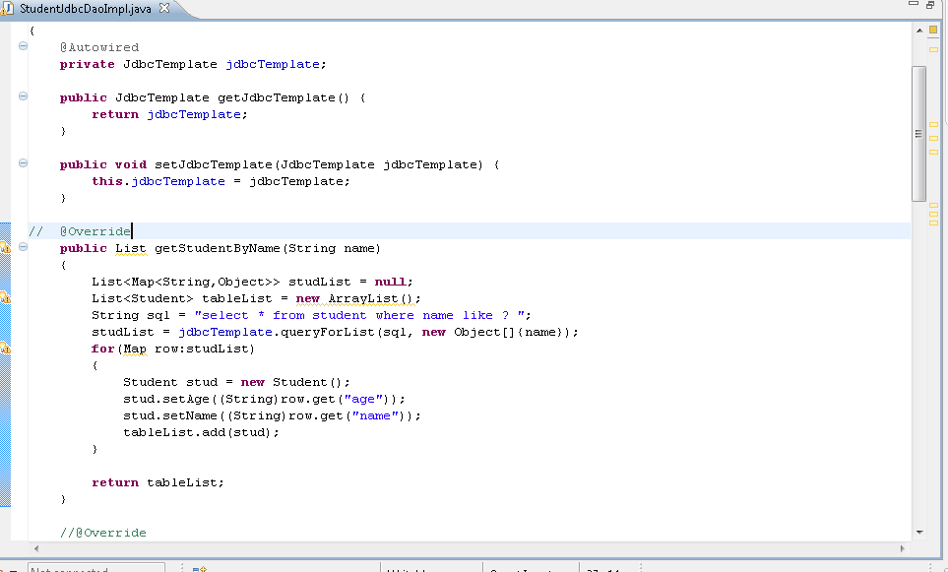
StudentJdbcDaoImpl Dao Layer
Way to write sql scripts using JdbcTemplate , here we are using queryForList method to pass query string and the parameter to be passed the ‘? ‘ is replaced runtime by the parameter passed say name in this case

Slide 34
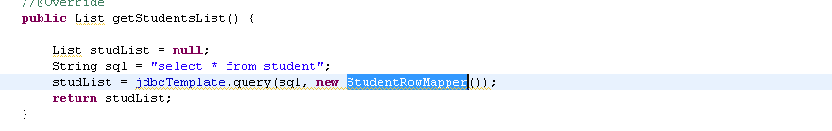
Here we fetching the list of all students in table note to receive the whole list we are using a class to fill data into pojo Student StudentRowMapper

Slide 35
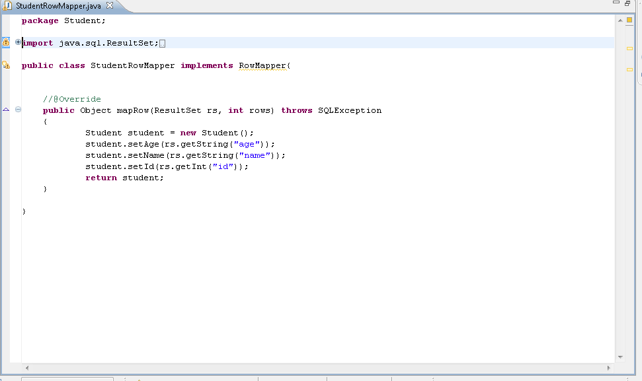
StudentRowMapper
The StudentRowMapper class that works as a mediator between the Student class and table , jdbcTemplate class asks us provide a class that implements RowMapper that has method mapRow(ResultSet rs, int rows) throws SQLException .
After implementing this method we get the ResultSet i.e the row wise data that can be filled into the pojo class Student

Slide 36
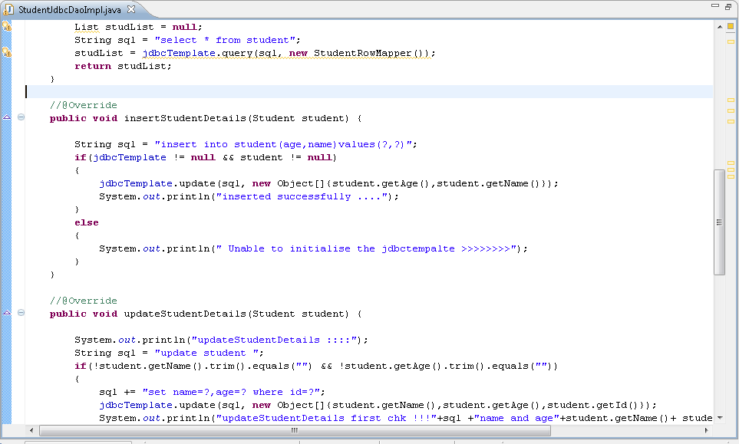
Insert function
Way to insert data into table using jdbcTemplate the runtime parameters will be filled by runtime parameters say name and age

Slide 37
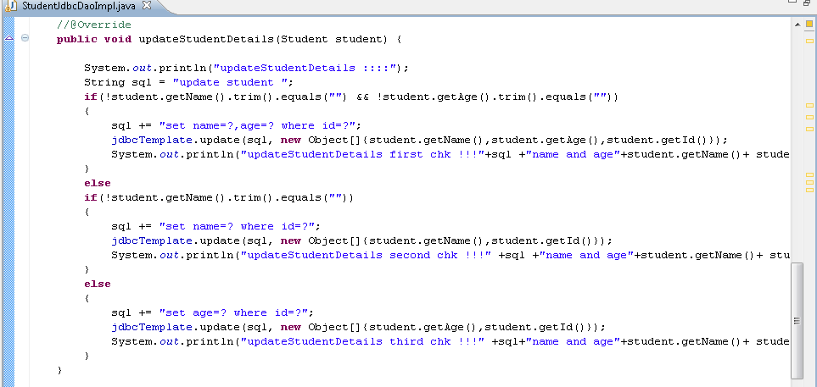
Update function
Update query dynamically created depending upon the fields the user wish to update

Slide 38
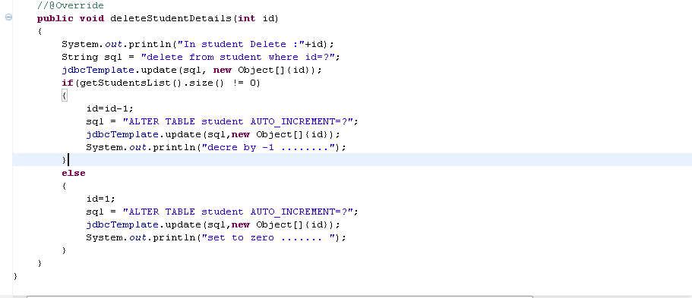
Delete function
To Delete student from database we pass a id which the user wish to delete
We have also written a query to reset the primary key as the auto increment in sql doesn’t maintain the order , this logic will every time decree the index by setting to 1 lesser so that new insert takes the appropriate id and when database is empty it will set the id back to zero so it again starts with 1

Slide 39
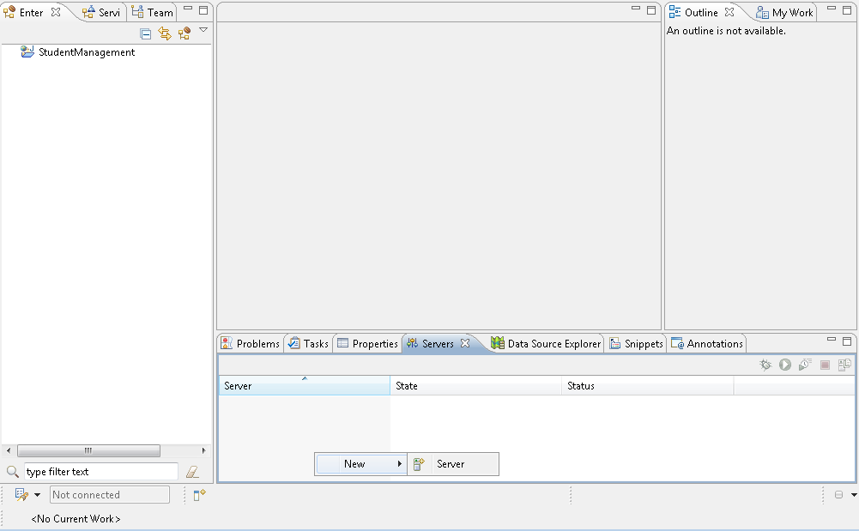
Create new Server
Right in server window and say New→ Server

Slide 40
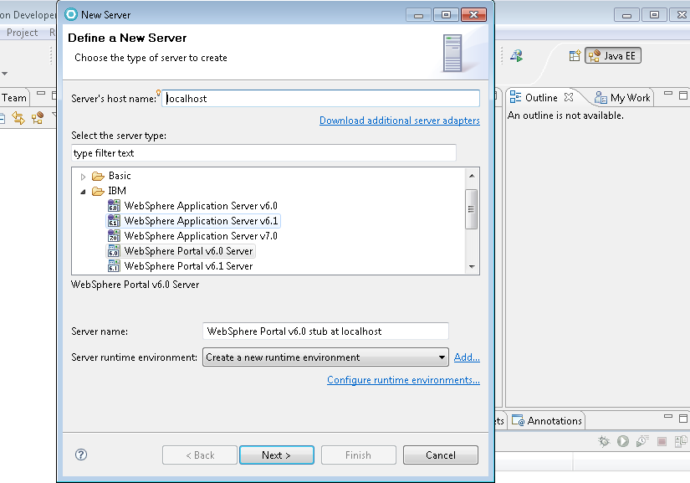
Select web app server v6.1

Slide 41
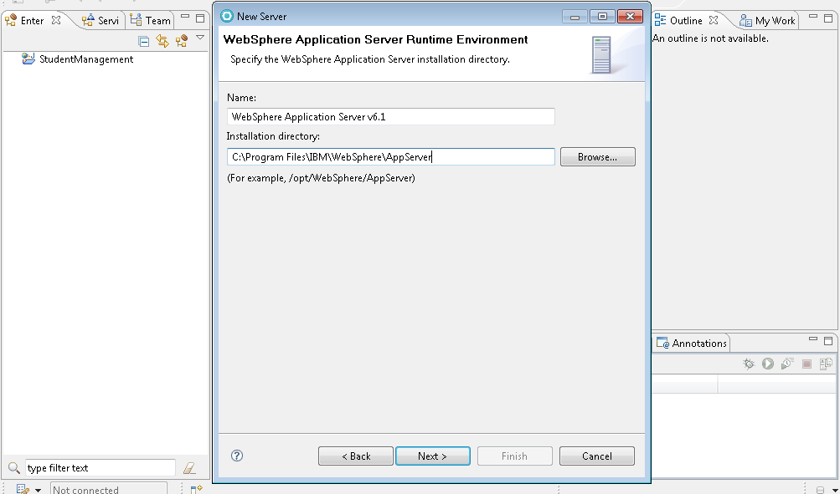
Select the App server path

Slide 42
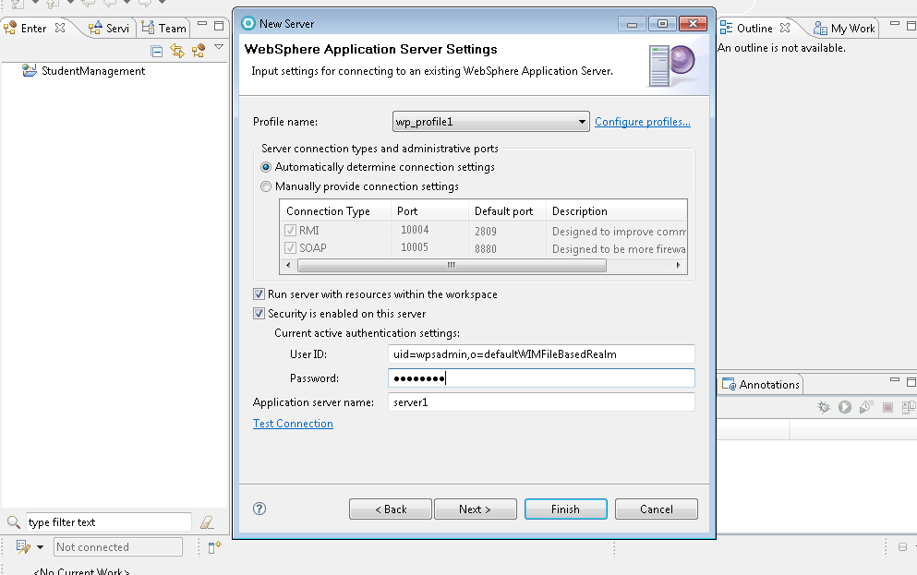
If you want can configure new profile by clicking this link
Enter pass word wpsadmin

Slide 43
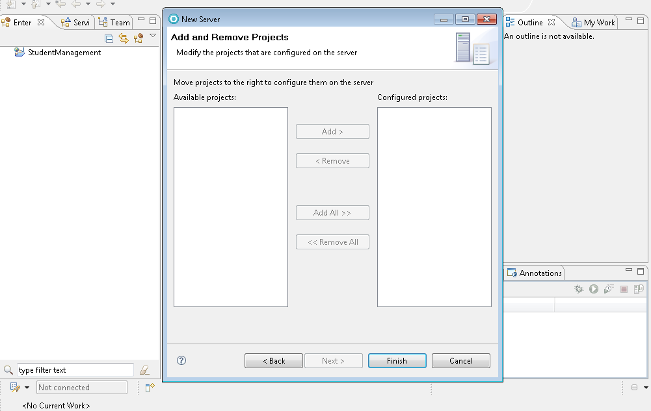
Will ask for ear to include into server before completing installation , if you have enabled the ear check box while creating project will show you a ear file of you project currently I don’t have any ear so we can straight way proceed to finish

Slide 44
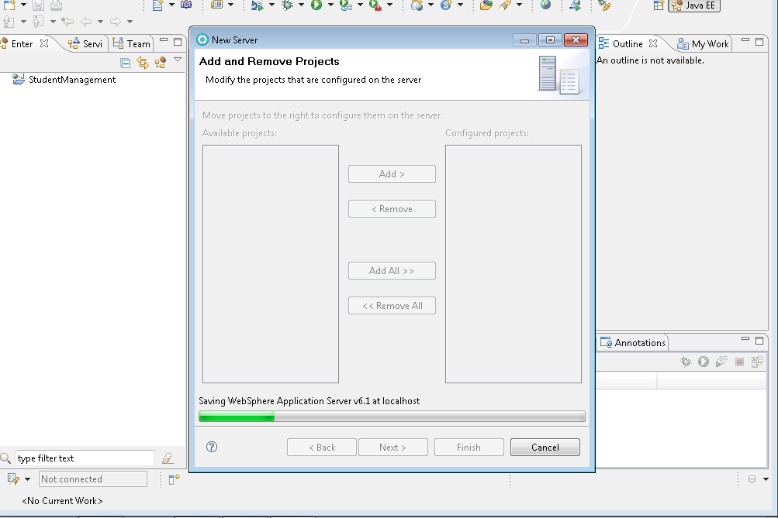

Slide 45
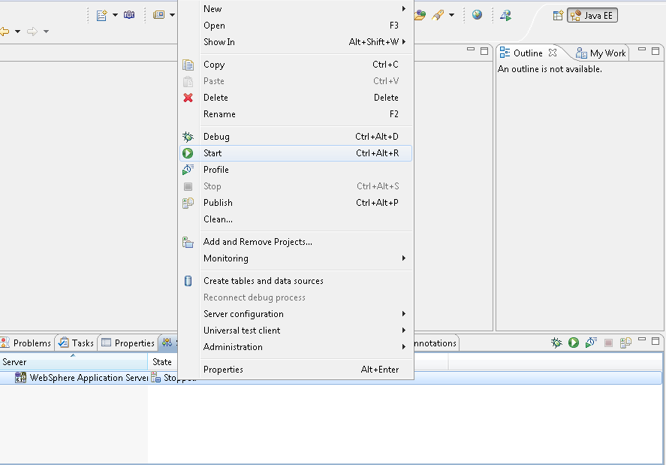
Start server

Slide 46
War Deployment
There are two ways you can deploy WAR one from application
Second through hitting the url

Slide 47
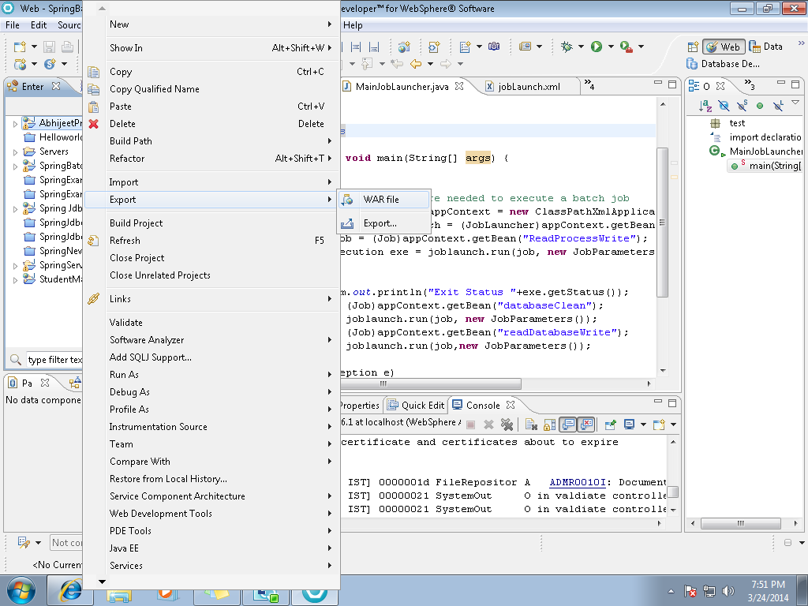
Create WAR of your project

Slide 48
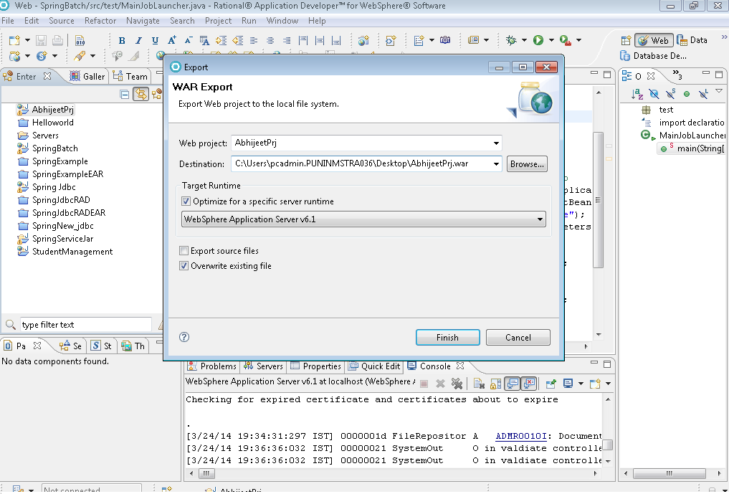
The project name by default taken by RAD
Select the location where you like to Store the WAR
Select if you are often storing in the same path the old war will be automatically replaced

Slide 49
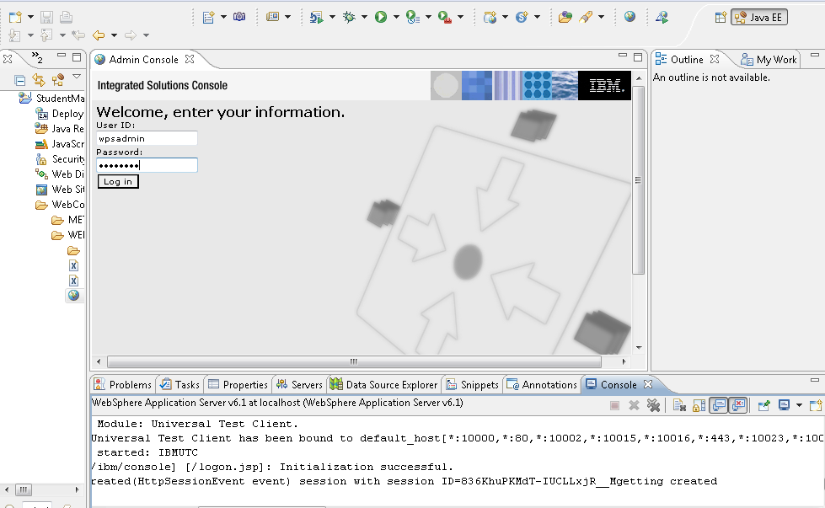
Enter the credentials

Slide 50
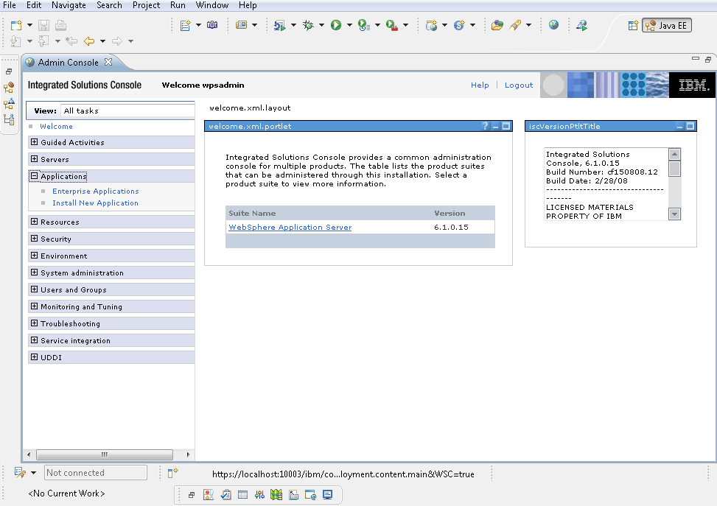
Select option Application→ install new Application

Slide 51
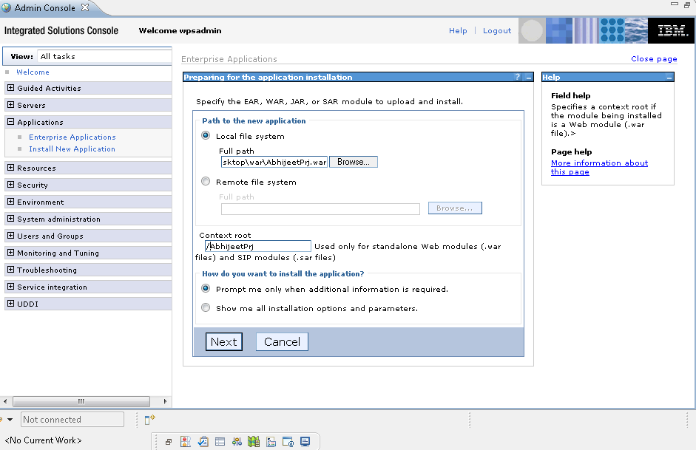
Locate the war file we created
Fill in the context root for the project keep it same as war name / or your project name
Click on Next

Slide 52
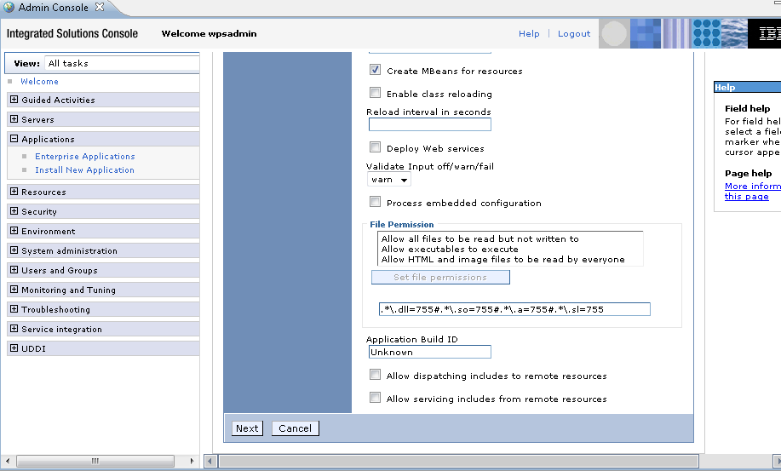
Do not make any changes keep them as is continue with Next

Slide 53
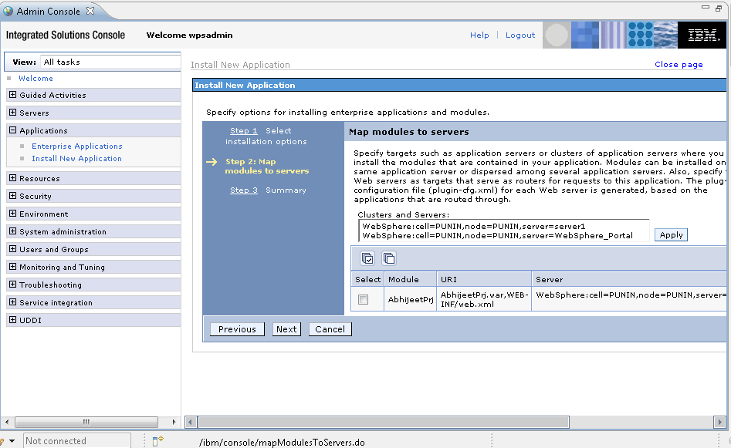
Click on next do not make any changes

Slide 54
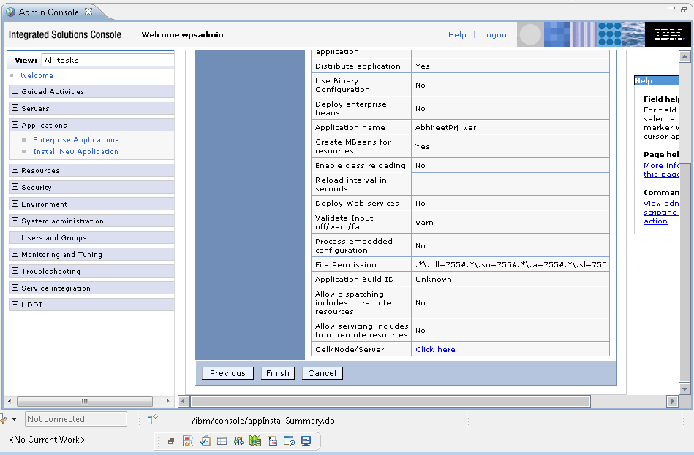
Click on finish

Slide 55
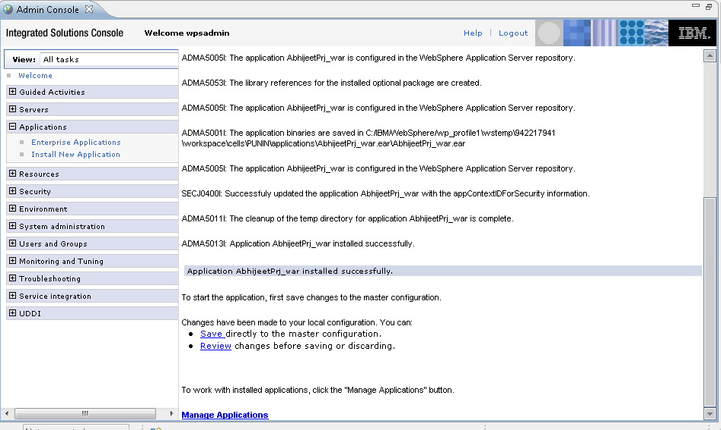
Scroll down the page and click on save to save the settings

Slide 56
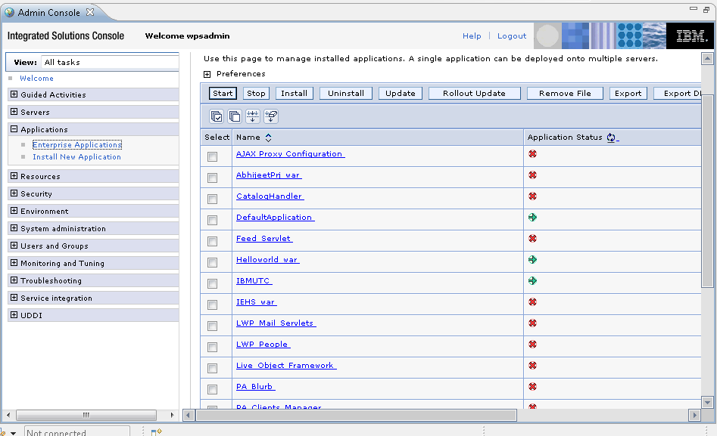
Click on option Enterprise Application option and search your war

Slide 57
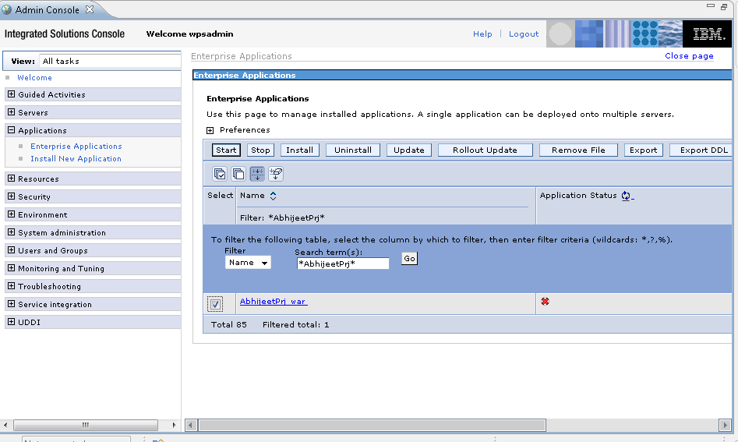
Select application and click on start button

Slide 58
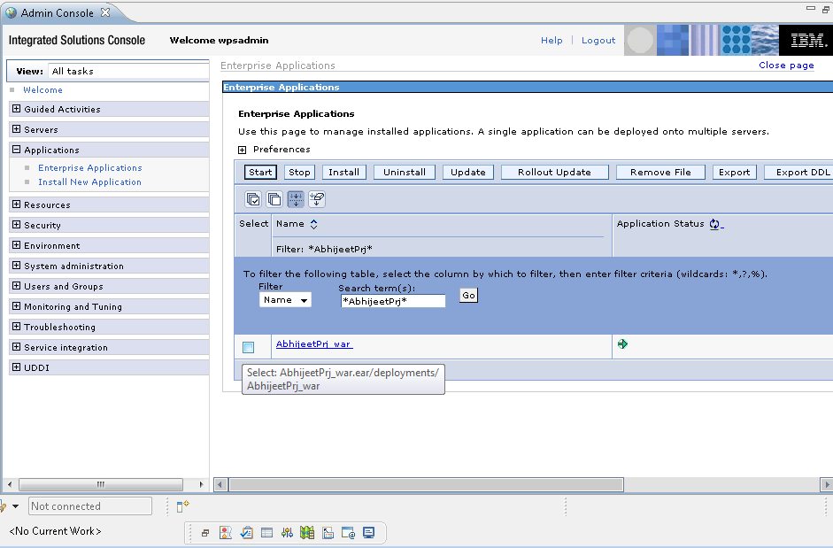
Now your application is started you can check the page by hitting it with respective port number

Slide 59
Lets Hit the Page and test its functionalities.

Slide 60
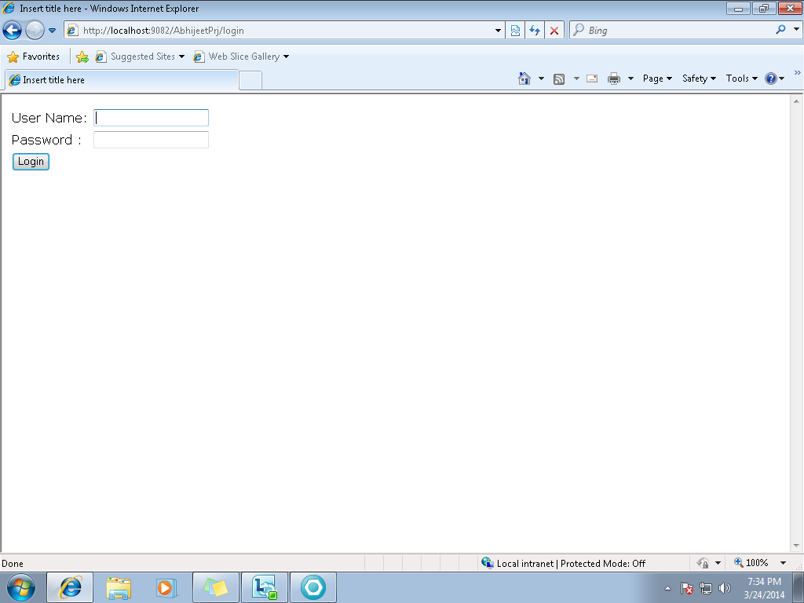
Login page

Slide 61
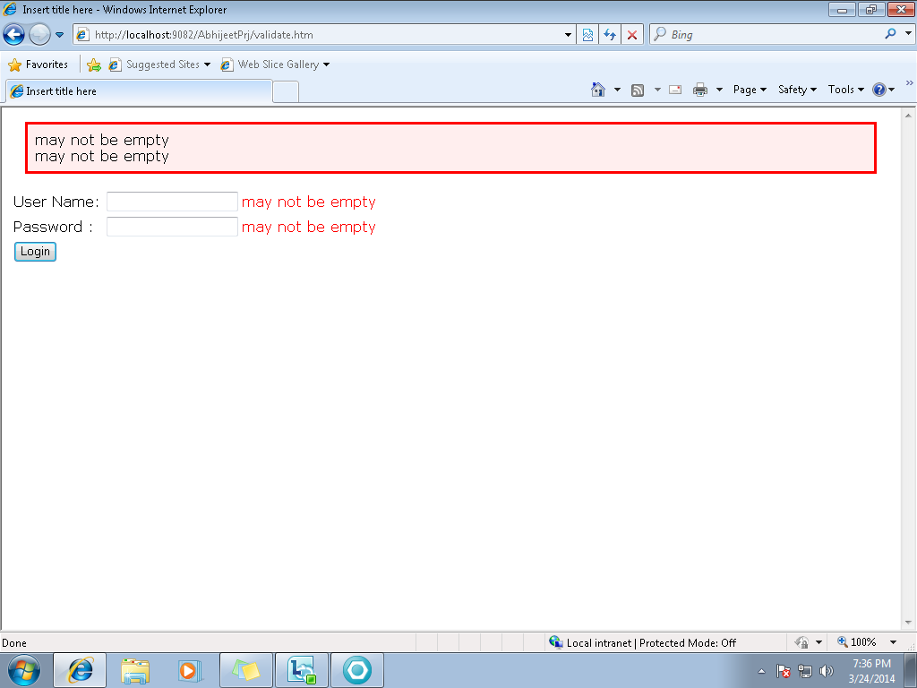
Test Validation

Slide 62
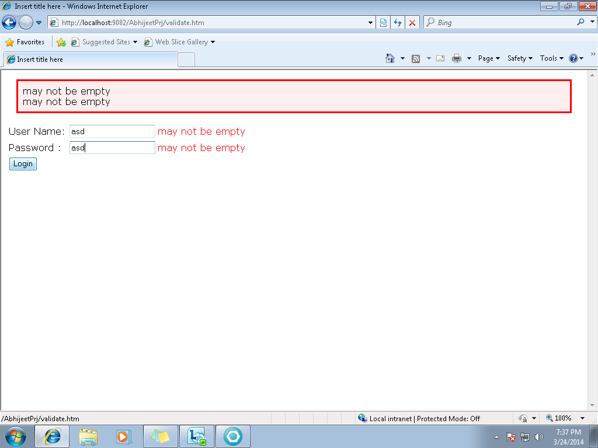
Wrong Credentials

Slide 63

Login failed page

Slide 64

Enter Correct Login

Slide 65

Add student Functionality

Slide 66

Display Student information

Slide 67

Add some more students

Slide 68

Delete Students

Slide 69

Update Student information

Slide 70

Student Information Updated

Slide 71
Danke

