Slide 1
Digital Diagnosis
AI-Based Symptom Analyzer Using ML & Large Language Models
Project Supervisor: Dr. Milind Penurkar
Team: Abhishek Godara (BT23CSA007) | Dayanand Swami (BT23CSA016) | Yashwant Chauhan (BT23CSA042)
Department of Computer Science & Engineering | IIIT Nagpur | Jan – May 2026

Slide 2
TABLE OF CONTENTS
01
Introduction & Motivation
11
Results — Overall Performance
02
Problem Statement & Scope
12
Results — Confusion Matrix
03
Literature Review (Part 1)
13
Results — Frontend UI
04
Literature Review (Part 2)
14
Results — Chatbot Interface
05
Dataset Description
15
ML Model Comparison
06
System Architecture
16
LLM Comparison — Symptom Parsing
07
System Workflow / Flow Diagram
17
LLM Comparison — Disease Prediction
08
Model Development
18
Conclusion
09
Conversational Agent & Symptom Parser
19
Future Work
10
Knowledge Base
20
References

Slide 3
INTRODUCTION & MOTIVATION
Background
Motivation
→ Millions lack timely access to healthcare, especially in rural areas. → WHO estimates a global shortage of 18 million healthcare workers. → Existing symptom checkers use rigid decision trees — they fail with natural language descriptions.
Healthcare Shortage
18M+ provider deficit globally; rural areas disproportionately affected.
LLM Advances
Modern LLMs make natural conversation possible — best of both worlds when combined with ML.
What is Digital Diagnosis?
Rural Access
→ A hybrid AI triage assistant named HealthPilot. → Accepts free-text symptom descriptions — no dropdowns. → Combines a LangChain conversational agent with a LightGBM classifier.
A reliable screening tool can help people decide when urgent care is needed.
Better Decisions
Filters non-urgent cases, relieving pressure on crowded hospitals.

Slide 4
PROBLEM STATEMENT & SCOPE
Problem Statement
There is a critical disconnect between how patients describe their symptoms and obtaining an accurate disease identification — particularly when healthcare access is limited. Traditional checkers are too rigid, don't understand context, and give generic advice. Pure LLM approaches are expensive, non-deterministic, and hard to audit.
Flaws in Current Tools
Our Approach
Target Users
▸ Rigid symptom dropdowns
▸ Free-text natural language input
▸ Everyday patients
▸ Cannot handle free-text
▸ LLM for semantic parsing
▸ Rural & remote communities
▸ No contextual reasoning
▸ LightGBM for fast classification
▸ Telemedicine services
▸ Generic advice only
▸ Knowledge base for advice
▸ Under-staffed rural hospitals
▸ No urgency detection
▸ Hybrid, auditable pipeline
▸ Health-conscious individuals

Slide 5
LITERATURE REVIEW — PART 1
Al Shafi Abdullah et al. (2025)
Disease-Symptom Dataset for AI Diagnostics | Medical Informatics
◆ Created a structured disease-symptom dataset using binary encoding.
◆ Sourced from medical literature and hospital records.
◆ Emphasized importance of standardized, multilingual healthcare datasets.
◆ Key takeaway: Dataset quality is critical for AI-based diagnosis.
Gupta et al. (2025)
Digital Diagnostics: LLMs in Recognizing Symptoms | AI & Medicine
◆ Evaluated GPT-4, GPT-4o, Gemini, o1 Preview, and GPT-3 on symptom-based disease diagnosis.
◆ GPT-4 showed the best overall accuracy for illness identification.
◆ Gemini excelled in high-risk scenarios requiring careful reasoning.
◆ Used precision, recall, and F1-score as evaluation metrics.
Research Gap: No single existing system combines LLM-based parsing, fast ML classification, and a clinical knowledge base in one auditable pipeline.

Slide 6
LITERATURE REVIEW — PART 2
Hassan et al. (2024)
Optimizing Classification of Diseases Through Language Model Analysis of Symptoms | Scientific Reports
◆ MCN-BERT + BiLSTM achieved 99.58% accuracy on symptom-based disease classification.
◆ Used contextualized embeddings for better symptom-disease relationship modeling.
◆ Hyperopt used for hyperparameter optimization to improve generalization.
◆ Showed transformer-based models outperform traditional ML on NLP-based medical tasks.
Devlin et al. (2019) & Lee et al. (2020)
BERT and BioBERT: Foundation Models for Biomedical NLP | NAACL / Bioinformatics
◆ BERT introduced deep bidirectional transformers for language understanding.
◆ BioBERT fine-tuned on biomedical corpora for medical text mining tasks.
◆ These form the foundation for modern LLM-based symptom parsing approaches.
◆ Our system uses Llama-3.3-70b — a successor to these foundational models.
Our Contribution: Hybrid LightGBM + LLM architecture outperforms pure-LLM approaches in speed, determinism, and top-1 accuracy.

Slide 7
DATASET DESCRIPTION
2,500
84
50
80/20
Total Samples
Symptom Features
Disease Classes
Train/Test Split
Data Source
Dataset Split
▸ Sourced from Columbia University's Disease-Symptom Knowledge Base (Government clinical dataset).
Split | Samples | Percentage
Train Set | 2,000 | 80%
Test Set | 500 | 20%
Total | 2,500 | 100%
▸ Original dataset contained 377 distinct symptom labels across 50+ disease categories.
▸ Real-world clinical records — not synthetically generated.
▸ Structured feature engineering reduced 377 → 84 clinically unambiguous symptom labels.
Class distribution preserved equally in both splits to ensure fair evaluation.
▸ Each disease received a unique consistent label for balanced training.

Slide 8
SYSTEM ARCHITECTURE
PRESENTATION LAYER
HTML/CSS/JS Frontend
AGENT LAYER
LangChain + Groq • Llama-3.3-70B • ConversationBufferMemory
DIAGNOSIS TOOL LAYER
Symptom Parser (LLM Call) • 84-dim Binary Vector Builder • get_diagnosis() Tool
CLASSIFICATION LAYER
LightGBM Classifier • 500 Decision Trees • Softmax → Top-3 Predictions
DATA / KNOWLEDGE LAYER
Serialized LightGBM Model • advice.json Knowledge Base • 50 Disease Records
Layered architecture cleanly separates UI, conversational AI, ML inference, and knowledge retrieval — enabling independent evaluation and replacement of each layer.

Slide 9
SYSTEM WORKFLOW — FLOW DIAGRAM
STEP 1
STEP 2
STEP 3
User Input
Intent Evaluation
Tool Execution
Types symptoms in natural language via UI
LangChain agent determines user intent
Sufficient symptoms → calls get_diagnosis()
STEP 4
STEP 5
STEP 6
Symptom Parsing
LightGBM Inference
Output Display
Llama-3.3-70b → JSON symptom list → 84-dim binary vector
Classifier predicts disease probabilities (<5ms)
Top-3 diseases with confidence + advice + specialist

Slide 10
MODEL DEVELOPMENT — LIGHTGBM CLASSIFIER
Why LightGBM?
Model Architecture
Accuracy
Input: 84-dimensional binary symptom vector Trees: 500 decision trees in sequence Output: Softmax over 50 disease classes → probability distribution Final output: Top-3 disease predictions with confidence scores
84% top-1, 99% top-3 across 50 diseases.
Speed
Inference under 5ms per prediction — real-time capable.
Leaf-wise growth
Grows decision trees leaf-wise (not depth-wise) for better accuracy with less data.
Compared alternatives
Comparison vs. Baselines
Outperformed SVM (RBF) and Random Forest (500 trees) on both metrics.
Model | Top-1 | Top-3
SVM (RBF) | 75% | 90%
Random Forest | 78% | 94%
LightGBM ★ | 84% | 99%
Deterministic
Unlike LLMs, produces identical results for identical inputs — auditable.
Efficient
Low memory footprint; serialized model loads instantly.

Slide 11
CONVERSATIONAL AGENT & SYMPTOM PARSER
Conversational Agent
Symptom Parser Design
Built with LangChain + Groq-hosted Llama-3.3-70b
Standalone LLM call using Llama-3.3-70b-versatile via Groq
▸ System prompt configures it as a compassionate, clinically-informed assistant.
Input
Raw natural-language symptom text from user.
▸ ConversationBufferMemory retains the full conversation history across turns.
LLM Call
Llama-3.3-70b maps text to controlled vocabulary of 84 symptom labels.
▸ get_diagnosis() registered as a LangChain tool with a docstring specifying when to call it.
JSON Output
Returns JSON list of matched symptom labels.
▸ Agent decides autonomously when sufficient symptoms have been collected.
Vectorization
84-dimensional binary vector constructed (1 = present, 0 = absent).
▸ Returns empathetic, plain-English summaries after diagnosis.
Passed To
LightGBM classifier for fast, deterministic prediction.

Slide 12
KNOWLEDGE BASE & ADVISORY SYSTEM
The knowledge base (advice.json) enriches every prediction with structured clinical guidance for 50 diseases.
🏷 Disease Name + UMLS Code
🚨 When to Seek Help
Standardized medical coding for interoperability.
Red-flag criteria indicating urgent or emergency care.
🩺 Primary Symptoms
📊 Severity Classification
Key clinical indicators associated with the disease.
Mild / Moderate / Serious / Critical rating.
⚡ Immediate Advice
👨‍⚕️ Specialist Recommendation
First-response guidance patients should act on now.
Appropriate medical specialty to consult.
💊 Quick Solutions
OTC and self-care recommendations for mild cases.
📁 Local JSON file — no external API needed; fast O(1) lookup by disease key.

Slide 13
RESULTS — OVERALL MODEL PERFORMANCE
86%
99%
0.859
<5ms
Top-1 Accuracy
Top-3 Accuracy
F1 Macro Score
Inference Time
Detailed Metrics
Analysis
Metric | Value
Top-1 Accuracy | 0.86
Top-3 Accuracy | 0.99
F1 Macro | 0.859
Precision | 0.87
Recall | 0.858
Inference Time | < 5 ms
✓ 86% top-1 accuracy across 50 disease categories is a strong result for symptom-based triage.
✓ 99% top-3 accuracy means the correct diagnosis appears in the top 3 in virtually every case.
✓ Sub-5ms inference makes real-time deployment practical without GPU infrastructure.
✓ F1 Macro of 0.859 confirms balanced performance even on less-common disease classes.

Slide 14
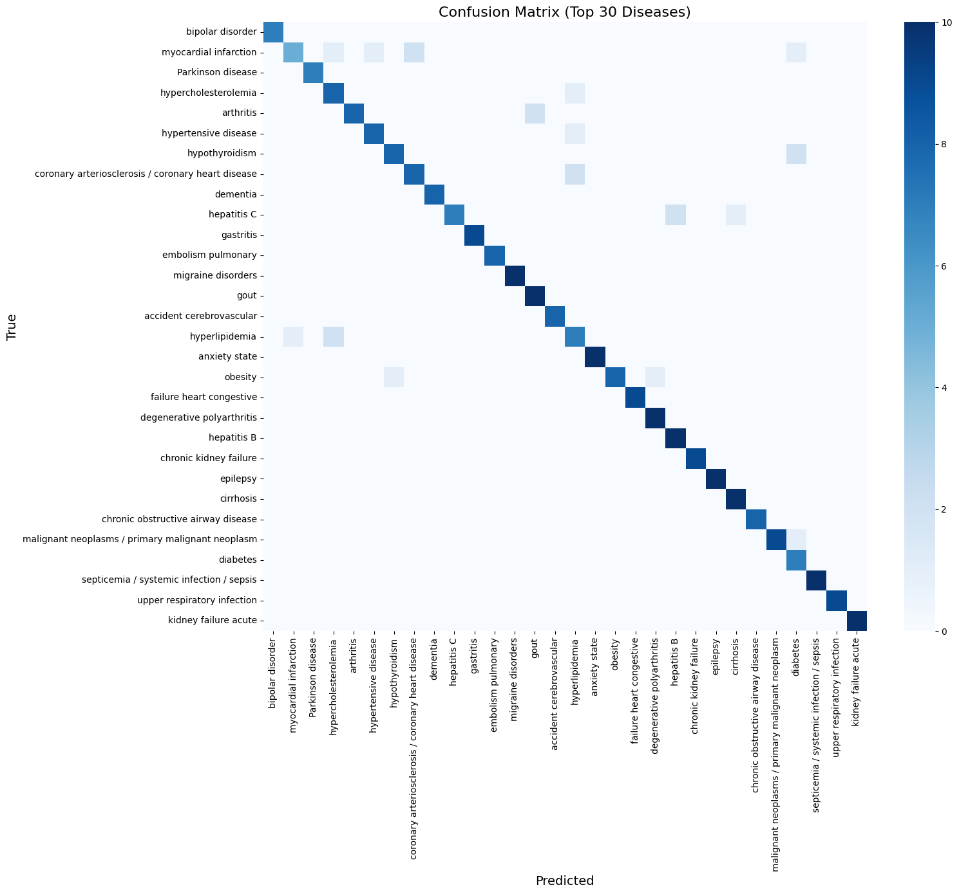
RESULTS — CONFUSION MATRIX (TOP 30 DISEASES)
The confusion matrix below shows model predictions vs. true labels on the test set. A strong diagonal indicates correct predictions.
[Confusion Matrix — Figure 4.1]
Key Observations
Strong Diagonal
Dark diagonal pattern confirms most predictions are correct.
Bronchitis vs. Asthma
(Insert Figure 4.1 from report)
Some confusion due to shared overlapping symptoms — clinically expected.
Hepatitis Variants
Mild confusion between Hepatitis B & C — consistent with medical literature.
Rare Classes
Low-frequency diseases show slightly higher error — addressed by top-3 output.

Slide 15
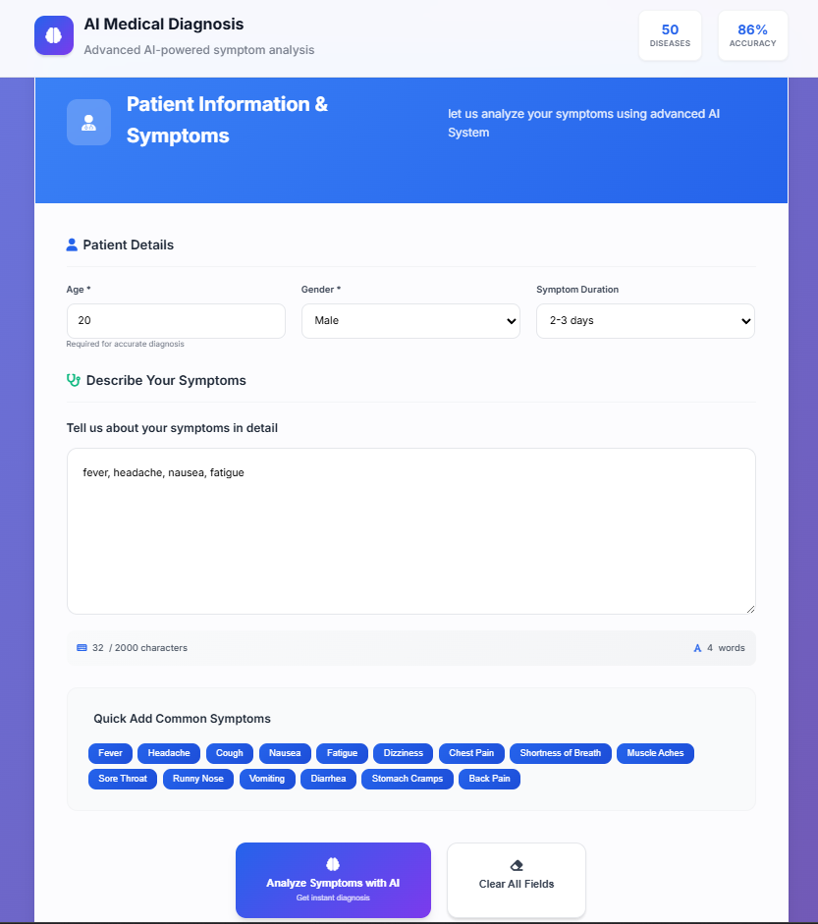
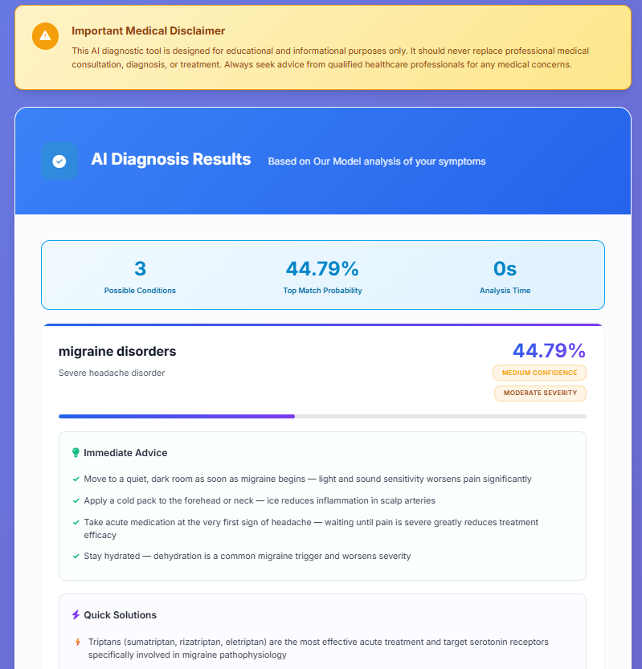
RESULTS — FRONTEND INTERFACE (HEALTHPILOT)
Symptom Input UI
(Figure 4.2)
Diagnosis Results Page
(Figure 4.3)
Input UI: Patient enters age, gender, symptom duration, and free-text symptoms. Quick-add buttons available for common symptoms.
Results Page: Top-3 diseases with confidence %, immediate advice, quick solutions, and specialist recommendation.

Slide 16
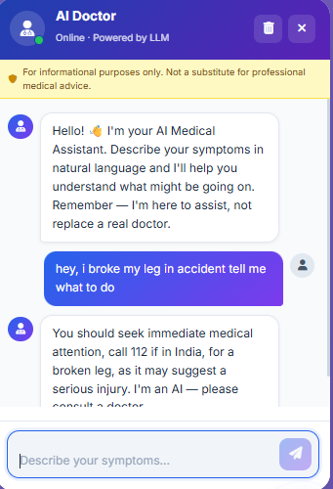
RESULTS — AI DOCTOR CHATBOT INTERFACE
Chatbot Screenshot
(Figure 4.4)
Chatbot Features
Natural Conversation
Users describe symptoms freely — no structured form needed.
LangChain Agent
Powered by Llama-3.3-70b via Groq; responds in under 2 seconds.
Auto Diagnosis
Agent autonomously triggers diagnosis when sufficient symptoms collected.
Safety Disclaimer
Every response includes a mandatory 'not a substitute for a doctor' notice.
Emergency Response
For serious conditions like fractures, directs user to call 112 immediately.
Conversation Memory
Remembers the full session context for multi-turn symptom discussions.

Slide 17
ML MODEL COMPARISON — DISEASE PREDICTION
Takeaways
LightGBM wins on both metrics
84% top-1 and 99% top-3 — the only model to clear 99% top-3.
SVM weakest overall
75% top-1; high-dimensional binary vectors don't suit SVM well.
Random Forest competitive
78% top-1, 94% top-3 — solid but outpaced by boosting.
Speed advantage
LightGBM inference <5ms; SVM and RF both slower on 84-dim input.

Slide 18
LLM COMPARISON — SYMPTOM PARSING (PRECISION / RECALL / F1)
Model | Precision | Recall | F1 Score
llama-3.1-8b-instant | 0.9333 | 0.8754 | 0.9034
llama-3.3-70b-versatile ★ | 0.9667 | 0.9334 | 0.9498
Llama-4-Scout-17B (Meta) | 0.9600 | 0.8144 | 0.8812
gpt-oss-safeguard-20b | 0.9433 | 0.9000 | 0.9211
gpt-oss-120b | 0.9367 | 0.8932 | 0.9144
★ llama-3.3-70b-versatile achieves the best F1 (0.9498) for symptom parsing — selected as the system's primary parser.
Why Parsing Accuracy Matters
Llama-4-Scout — Lower Recall
Symptom parsing is the first step — errors propagate to the classifier. High F1 ensures the 84-dim binary vector correctly reflects what the user described.
Despite newer architecture, Llama-4-Scout shows lower recall (0.8144) vs. 70b. Smaller model scale — not architecture — determines symptom extraction quality.

Slide 19
LLM COMPARISON — DISEASE PREDICTION ACCURACY
Model | Top-1 Accuracy | Top-3 Accuracy
LightGBM Hybrid (Ours) ★ | 84% | 99%
llama-3.1-8b-instant | 76% | 92%
llama-3.3-70b-versatile | 84% | 96%
Llama-4-Scout-17B (Meta) | 76% | 95%
gpt-oss-safeguard-20b | 80% | 94%
gpt-oss-120b | 76% | 89%
Our hybrid LightGBM matches llama-3.3-70b on top-1 (84%) but achieves 3% higher top-3 accuracy (99% vs 96%) — with far lower latency and deterministic output.
Equal top-1, better top-3: Our model ties 70b on top-1 but leads on top-3 — critical for triage safety.
Cost & Speed: LightGBM: <5ms; LLMs: 500–2000ms per API call. No API costs at inference time.
Best top-3 of all models: 99% means correct diagnosis appears in top 3 for virtually every patient.
Determinism: LightGBM produces identical output for identical input — auditable for medical use.

Slide 20
CONCLUSION
Digital Diagnosis demonstrates that a thoughtfully designed hybrid system outperforms both pure deep learning and pure LLM approaches for practical healthcare triage.
🏆 Strong Accuracy
⚡ Hybrid Architecture Wins
84% top-1 and 99% top-3 across 50 diseases — strong for a symptom-only triage tool.
Separating NLU (LLM) from classification (LightGBM) delivers the best of both worlds.
🔬 Validated Comparisons
🌍 Social Impact
Outperforms SVM & Random Forest; matches/exceeds 5 LLM baselines on key metrics.
Addresses the 18M healthcare provider gap — especially relevant for rural India.
🛡 Safe by Design
🔁 Modular
Every response includes safety disclaimers; never claims to replace a doctor.
Each layer (UI, agent, classifier, KB) can be independently updated or replaced.

Slide 21
FUTURE WORK
Planned extensions to Digital Diagnosis v2 and beyond:
🧬 Expand Disease Ontology
🌐 Multilingual Support
Scale from 50 → 150+ diseases, including rare diseases to improve clinical applicability.
Translate responses into Hindi and regional Indian languages for nationwide accessibility.
🎙 Speech Recognition
🚑 Urgency Scoring
Integrate Whisper (OpenAI) speech-to-text module for voice-based symptom input.
Add a numerical urgency score to improve triage recommendation precision.
🏥 EHR Integration
🔬 Clinical Trial Validation
Ingest existing Electronic Health Records to contextualize diagnosis with patient history.
Compare system recommendations to physician assessments via prospective clinical study.
📱 Mobile App
🎯 Improved Symptom Parser Recall
Deploy as a lightweight mobile app for offline-first rural usage with low data requirements.
Fine-tune a smaller model specifically for symptom extraction to boost recall above current 93%.

Slide 22
REFERENCES
[1] Hassan, E., Abd El-Hafeez, T., & Shams, M. Y. (2024). Optimizing classification of diseases through language model analysis of symptoms. Scientific Reports, 14, 1507.
[7] Gupta et al. (2025). Digital Diagnostics: The Potential of LLMs in Recognizing Symptoms. AI & Medicine.
[2] Devlin, J., Chang, M. W., Lee, K., & Toutanova, K. (2019). BERT: Pre-training of deep bidirectional transformers. Proceedings of NAACL-HLT 2019, 4171–4186.
[8] Hammoud, M., et al. (2024). Evaluating the diagnostic performance of symptom checkers. JMIR AI, 3, e46875.
[3] Lee, J., et al. (2020). BioBERT: A pre-trained biomedical language representation model. Bioinformatics, 36(4), 1234–1240.
[9] Koleck, T. A., et al. (2019). NLP of symptoms documented in free-text EHR narratives. JAMIA, 26(4), 364–379.
[4] Ke, G., et al. (2017). LightGBM: A highly efficient gradient boosting decision tree. NeurIPS 30, 3146–3154.
[10] Columbia University DBMI — Disease Symptom Knowledge Base. people.dbmi.columbia.edu
[5] Chase, H. (2022). LangChain: Building applications with LLMs through composability. GitHub.
[11] Groq API Documentation. console.groq.com/docs/overview
[6] Vaswani, A., et al. (2017). Attention is all you need. NeurIPS 30, 5998–6008.
[12] Streamlit Documentation. docs.streamlit.io

Slide 23
Thank You
Questions & Discussion

