Slide 1



Crop Production Analysis in India
This analysis delves into the complex dynamics of crop production in India, a nation where agriculture remains a cornerstone of the economy and livelihood for millions. Using a comprehensive dataset that spans several years, we aim to unveil crucial insights into trends, regional variations, and the interplay of factors influencing crop yields. Our objective is to not only understand past production patterns but also to identify opportunities and challenges for future agricultural development.
You can explore the interactive Tableau dashboard here.
by Abhi Pawar

Slide 2
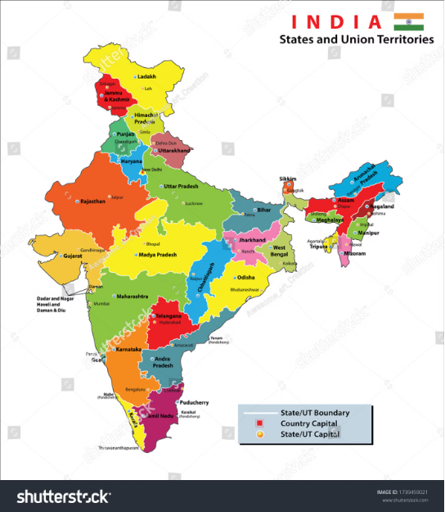
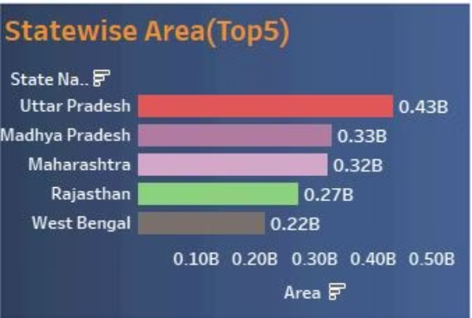
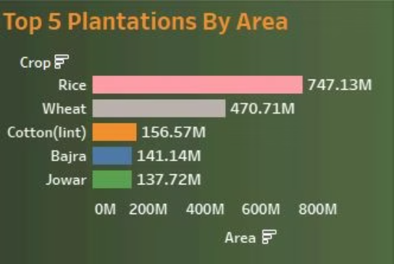
Regional Variations in Crop Production
Production Disparities
Crop Specificity
Uttar Pradesh has a large amount of agricultural land but not the highest production. Kerala has a smaller amount of agricultural land but higher production.
Rice is the most widely grown crop in India. Coconut production leads in overall yield. Several crops have large areas planted but low production.
State-Wise Land Allocation
Uttar Pradesh has the largest agricultural land area. Chandigarh has the smallest agricultural land area.

Slide 3

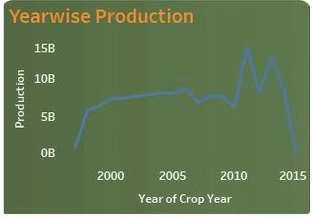
Temporal Trends in Crop Production
1
Peak Agricultural Land
The data indicates that the year 1997 witnessed the highest allocation of agricultural land in India. This observation suggests a potential trend of decreasing agricultural land over time, a phenomenon likely driven by factors such as urbanization, industrialization, and land fragmentation.
2
Declining Crop Area
Despite the peak in 1997, a general trend of decreasing agricultural land is evident as we move through the years. This underscores the need to optimize resource utilization and explore alternative agricultural practices to maintain production levels in the face of shrinking land availability.
3
Increasing Production
Despite the observed decline in agricultural land, overall crop production exhibits an upward trend, reaching its peak in 2011. This suggests a shift towards more efficient agricultural practices, technological advancements, and potentially, favorable climatic conditions during that period.
4
Seasonal Influences
The analysis reveals a clear seasonal influence on crop production. The Kharif season, characterized by monsoon rains, sees a larger area under plantation. In contrast, the Whole Year season, encompassing a longer cultivation period, witnesses the highest overall production, indicating the potential for multi-cropping and optimizing yields throughout the year.

Slide 4

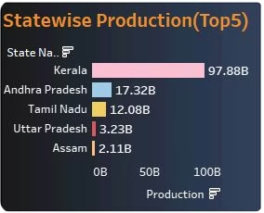
Impact of External Factors
1
Weather Dependency
Crop production in India is heavily influenced by rainfall patterns, particularly the monsoon season. States like Maharashtra and Karnataka, heavily dependent on rainfall, exhibit fluctuations in crop production closely aligned with monsoon variability. This highlights the vulnerability of Indian agriculture to climate variability and the need for robust water management strategies.
2
Technological Influence
Regions with access to irrigation and modern agricultural technologies, such as Kerala, Andhra Pradesh, and Tamil Nadu, demonstrate more stable and higher crop yields. This suggests a direct correlation between technological adoption and improved agricultural outcomes. Investments in research and development, along with promoting adoption of advanced farming practices, hold the key to enhancing overall productivity.
3
Shifting Consumer Preferences
Market demand is another significant factor influencing crop production. The rising preference for fruits and vegetables, driven by health consciousness and lifestyle changes, may lead to a gradual decline in the production of traditional staple crops in certain regions. Adapting to these changing market trends is essential for long-term sustainability.
4
Climate Change Impacts
The increasing unpredictability of weather patterns associated with climate change poses a significant risk to agricultural production, especially in regions reliant on monsoon rains. Mitigation strategies, such as drought-resistant crop varieties, improved water management practices, and climate-smart agriculture, are crucial to ensure food security in the face of climate change.

Slide 5


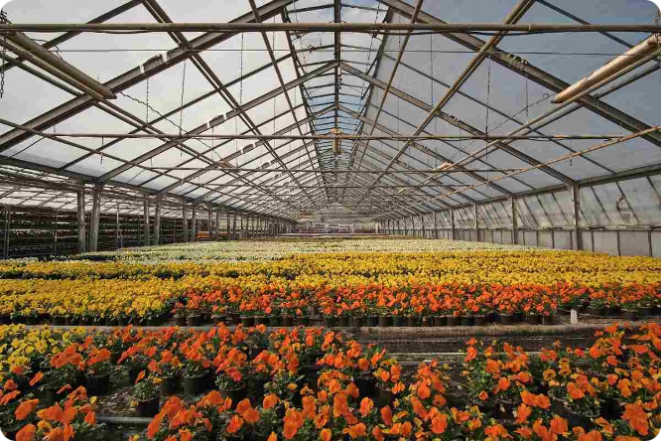


Future Projections and Opportunities
Potential Decline in Staple Crops
In certain regions, a decline in the production of traditional staple crops like wheat and rice is likely due to changing consumer preferences and increasing demand for fruits and vegetables. Adapting to these evolving market demands is crucial for maintaining a balanced agricultural system.
.
Risk of Climate Change
The impact of climate change, including erratic rainfall patterns, can significantly impact crop production in regions reliant on monsoon rains. Adapting to climate change through drought-resistant crops, improved irrigation infrastructure, and climate-smart agricultural practices is essential for mitigating risks and ensuring long-term food security.
Opportunities for Growth
Despite challenges, there exist significant opportunities for enhancing crop production in underperforming regions. Targeted investments in infrastructure, technology, and education can empower these regions to adopt modern farming techniques and improve their overall productivity. Initiatives focused on capacity building, knowledge sharing, and promoting innovation hold the key to unlocking untapped agricultural potential.

