Slide 1




Foreign Direct Investment in India: 2000-01 to 2016-17
This presentation analyzes Foreign Direct Investment (FDI) data for India from 2000-01 to 2016-17, providing insights into sector-wise and year-wise investment trends, key metrics, and relationships between attributes. We'll explore the overall FDI trend, identify top sectors, examine year-over-year growth rates, and discuss key factors influencing FDI in India.
by Abhi Pawar

Slide 2

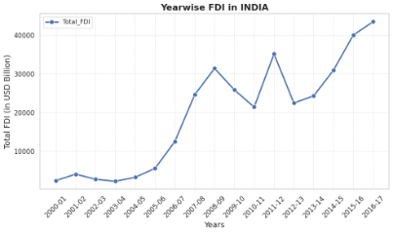
Overview of Total FDI Trends
1
2
3
4
Overall Upward Trend
Rapid Growth Phase
Global Financial Crisis Impact
Recovery and New Peak
FDI has generally increased over the 17-year period, indicating a positive investment climate in India.
A sharp increase in FDI was observed from 2005-06 to 2008-09, suggesting a period of significant economic expansion and investor confidence.
A dip in FDI is visible in 2009-10 and 2010-11, likely due to the global financial crisis, highlighting the sensitivity of FDI to global economic conditions.
FDI recovered and reached new heights in 2016-17, demonstrating India's resilience and continued attractiveness to foreign investors.

Slide 3
Sector-wise Investment Analysis
Services Sector Dominance
Technology Focus
Infrastructure Importance
Computer Software & Hardware and Telecommunications are in the top 3, highlighting the importance of India's tech industry to foreign investors.
Construction Development and Automobile Industry feature prominently, indicating a focus on infrastructure and manufacturing, essential for India's economic growth.
The services sector, including financial, banking, insurance, and outsourcing, has received the highest FDI, indicating a strong foreign interest in India's service industry.

Slide 4

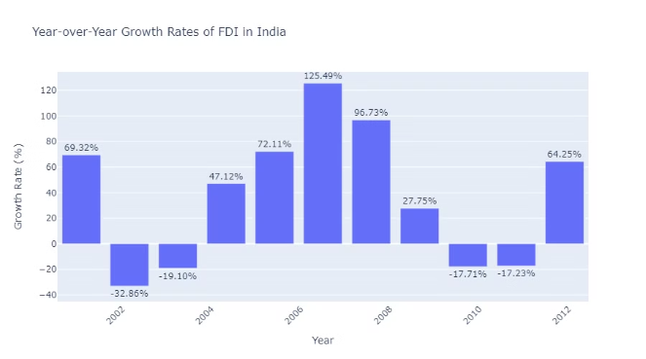
Year-wise Investment Analysis
1
Volatile Growth
FDI growth rates have been highly volatile, ranging from -36% to 125%, reflecting the dynamic nature of India's economy and the influence of external factors.
2
Peak Growth Periods
The highest growth rates were observed in 2005-06 (72%), 2006-07 (125%), and 2007-08 (97%), indicating periods of strong economic expansion and investor confidence.
3
Global Financial Crisis Impact
Negative growth rates in 2009-10 and 2010-11 coincide with the global financial crisis, demonstrating the impact of global economic events on FDI.
4
Recent Stabilization
Growth rates have been positive but more moderate in recent years (2013-14 to 2016-17), suggesting a more stable and sustainable investment environment.

Slide 5

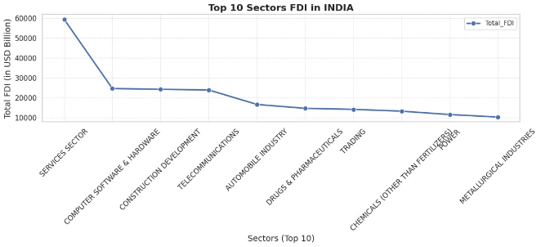
Key Metrics and Factors
Total Annual FDI Inflow
A key metric for measuring the overall attractiveness of India to foreign investors.
Sector-wise FDI Distribution
Provides insights into the specific industries attracting foreign investment and the focus of investor interest.
Year-over-Year Growth Rates
Indicates the dynamism and volatility of FDI flows, reflecting changes in investor sentiment and economic conditions.
Global Economic Conditions
Global economic events, such as the 2008 financial crisis, significantly impact FDI flows, highlighting the interconnectedness of global economies.

