Slide 1

ArangoMedica
ArangoDB powered Medical AI

Slide 2
Problem we are trying to Solve
ArangoDB-powered AI agent is solving a graph-based medical intelligence problem, where patients, diseases, symptoms, and treatments are interconnected.
Our AI can analyze these relationships to provide insights like:
✅ Finding the most critical symptom for a disease (e.g., Hypertension, Asthma)
✅ Predicting potential diseases for a patient based on symptoms
✅ Finding treatments that work best for certain diseases
✅ Identifying patients at high risk based on co-occurring symptoms
✅ Detecting hidden patterns in medical data using graph analysis (e.g., PageRank, centrality)

Slide 3
Why this Synthetic Data
synthetic data allows you to:
✅ Simulate real-world medical graphs (without dealing with actual patient data privacy issues)
✅ Test AI algorithms at scale (3M+ relationships = perfect for AI model training)
✅ Develop a working prototype that can later be integrated with real medical datasets

Slide 4
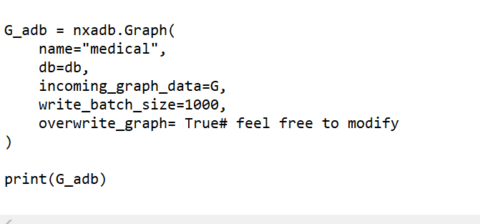
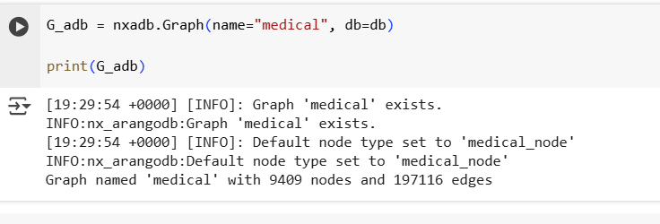
Persisting the data

Slide 5
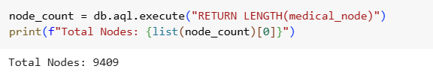

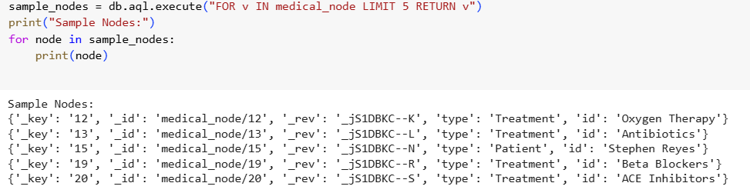
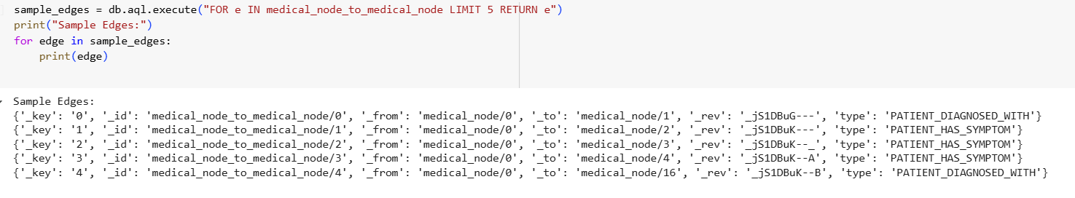
Some Simple AQL to validate Graph Parsing was successful!

Slide 6
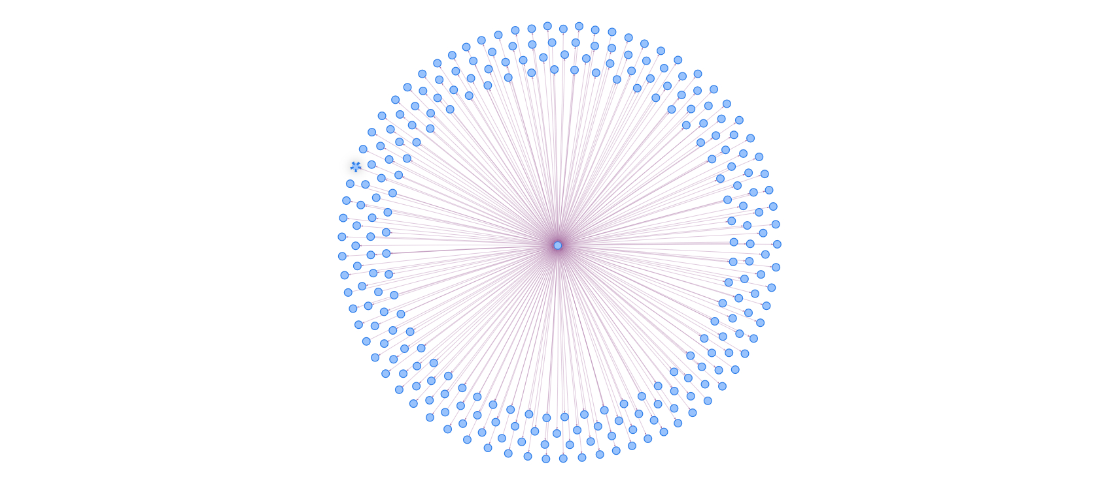
ArangoDB UI Graph Visual

Slide 7
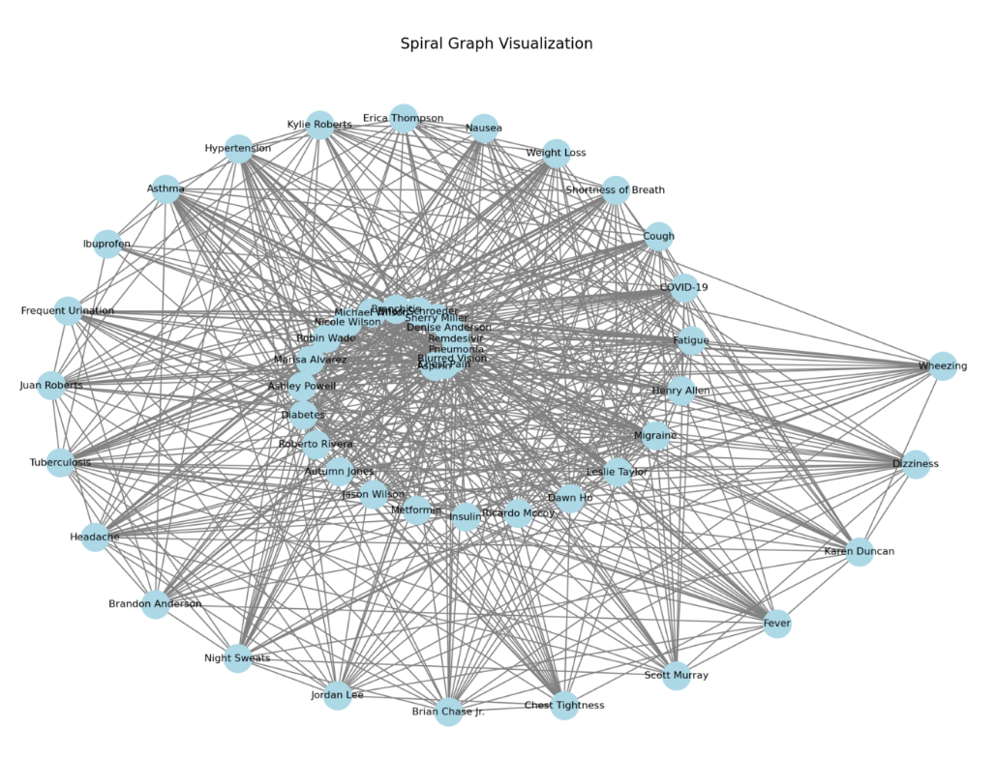
Visualization of the subgraph

Slide 8
Meet Our AI Agent
🔹 Summary (How the AI Agent Thinks)
1️⃣ Reads our question 🤔
2️⃣ Breaks it into smaller tasks 📌
3️⃣ Fetches data from the database 📚
4️⃣ Runs a smart algorithm to find the answer 🧠
5️⃣ Explains the result in simple terms 💡

Slide 9
Meet Our AI Agent
🔹 Why is this powerful?
✅ It automates complex graph analysis – No need for a human expert!
✅ It works dynamically – It figures out the best approach based on our question.
✅ It’s explainable – The AI tells you why the answer makes sense.

Slide 10
Our Solution
This System Prompt instructs GPT-4o on how to choose the correct tool for user queries. :
Simple data retrieval → text_to_aql_to_text
Example: "Find all patients diagnosed with Diabetes."
Uses ArangoDB queries.
Graph algorithm analysis → text_to_nx_algorithm_to_text
Example: "Find the most influential disease using PageRank."
Uses NetworkX algorithms.
Combining Database & Graph Analysis → execute_hybrid_query
Example: "Identify the most common co-occurring symptoms for heart disease."
Uses both AQL (filtering) + NetworkX (analysis).
Extracting a subgraph → extract_nx_subgraph
Example: "Extract a subgraph of diseases, symptoms, and treatments."
Filters and extracts relevant nodes & edges.
Subgraph + Visualization → visualize_metrics
Example: "Show the PageRank values for a subgraph of medical conditions."
Extracts a subgraph and plots metrics.

Slide 11
Hybrid Query Mode
Hybrid Graph Query Execution with ArangoDB & NetworkX
✅ Combining AQL (structured queries) and NetworkX (graph algorithms) allows for deeper insights.
✅ Hybrid execution enables both data retrieval and complex computations in a single workflow.
✅ LLMs can bridge the gap between traditional databases and computational graph analysis.

Slide 12
Demo Time
1)Open AI Agentic Integration with Langchain and Langraph
2)Microsoft’s Autogen Framework

Slide 13
Why did you think it was useful?
Our app uses ArangoDB’s multi-model architecture to manage complex relationships
with graphs while efficiently storing structured and unstructured data, enabling advanced queries and scalable AI workflows.
How do you plan on using it moving forward?
For scalable graph-based AI applications, knowledge graphs, and efficient document storage.
What was the most challenging part?
Learning AQL and optimizing performance for large-scale graph queries.
What was the thing you liked about ArangoDB?
Its seamless multi-model architecture and built-in graph analytics.

