Slide 1
Sales Prediction and Analysis Using Regression
Vikram Rao
Abhirami Nedunchezian

Slide 2
Sales Prediction and Analysis Using Regression

Slide 3
Problem Statement

Slide 4


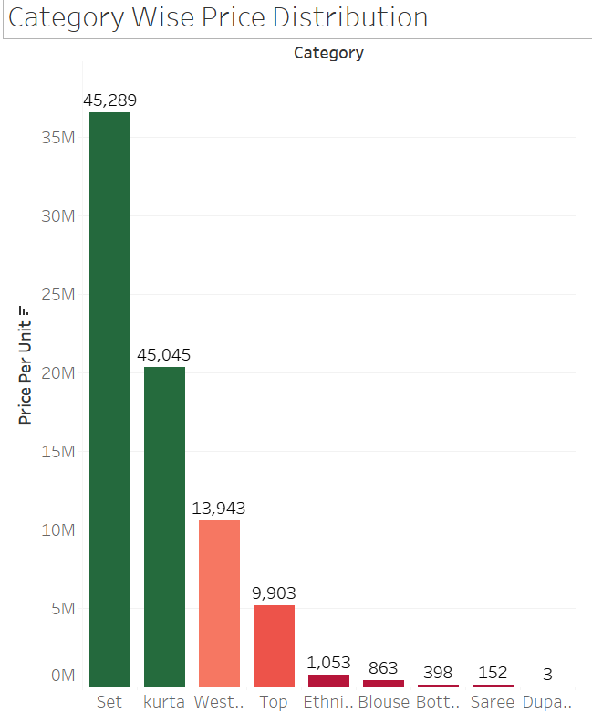
This project focuses on using machine learning regression techniques to analyze and predict sales amounts.
The analysis is based on a comprehensive dataset containing various factors influencing sales.
By leveraging these insights, businesses can make data-driven decisions to improve operations and maximize revenue.

Slide 5
Business Understanding

Slide 6
Objective:
Predict sales amounts using machine learning regression techniques.
Analyze key factors influencing sales to generate actionable insights.
Problem Statement:
Businesses struggle with unpredictable sales due to:
Dynamic market trends.
Pricing inefficiencies.
Inventory mismanagement.
This leads to missed revenue opportunities.
Why It Matters:
Optimize Operations: Improve pricing, inventory, and marketing decisions.
Maximize Revenue: Align strategies with sales predictions.
Enhance Efficiency: Avoid overstocking or understocking.
Outcome:
Data-driven decision-making for business growth.
Accurate sales prediction and optimized resource allocation.

Slide 7
Approach

Slide 8
The approach for this capstone project is centred on building, evaluating, and comparing various regression models to identify the most suitable model for the given problem. The process involves the following key steps:
Data Preparation and Exploration
Perform exploratory data analysis to understand underlying patterns, distributions & relationships in the dataset.
Preprocess the data, including handling missing values, encoding categorical variables, and splitting the dataset into training and testing data.
Model Development
Develop a variety of regression models and bagging techniques.
Model Evaluation
Identify the best suitable based on the various regression metrics such as
Mean Absolute Error
Mean Absolute Percentage Error
Mean Squared Error
Root Mean Squared Error
R square

Slide 9
Data Understanding

Slide 10
Source: Amazon sales data for 3 months with 128975 rows and 22 attribute columns
Type: Detailed sales transactional dataset with categorical and numerical attributes.
Target Variable: Amount (Sales value for each transaction).
Attributes:
-- Product details (Category, Size, Style, SKU, ASIN)
-- Transaction details (Date, Status, Quantity)
-- Logistics (Shipping Location, Courier Status)
-- Shipping location details (State, City, Pin Code)
-- Applicability of Promotion Codes
Observations: 85% of the features are categorical with high cardinality, requiring encoding and preprocessing.
Challenges: High number of categorical features with high cardinality.
Feature | Unique Counts
Style | 1377
SKU | 7195
Category | 9
Size | 11
ASIN | 7190
Ship City | 8955
Ship State | 69
Ship Postal Code | 9459
Promotion ID’s | 5787

Slide 11
Summary of the Dataset

Slide 12
The dataset comprises records of sales transactions with the following key attributes. Not all attributes may be important for our prediction of the Sale Amount.
Category: Type of product (e.g., electronics, clothing).
Size: Size specification of the product.
Date: Date on which the sale occurred.
Status: Status of the sale (e.g., completed, pending).
Fulfilment: Method of order fulfilment (e.g., delivery, in-store pickup).
Style: Product style or variation.
SKU (Stock Keeping Unit): Unique identifier for inventory tracking.
ASIN (Amazon Standard Identification Number): Identifier used for product listings on Amazon.
Courier Status: Status of the courier associated with the sale (e.g., dispatched, delivered).
Qty: Quantity of items sold in the transaction.
Amount: Monetary value of the sale (in the specified currency).
B2B: Indicator for business-to-business transactions (Boolean).
Shipping location - Shipping city, state, postal code and country.
Promotion ids: Promotion id's applied to the sale.
Currency: Currency used for the transaction.
Almost 85% of the features are Categorical. Most of these are Multiclass Categorical variable.

Slide 13
Exploratory Data Analysis

Slide 14
EDA was the most important step in the model building.
The below steps were undertaken as part of EDA
Remove Cancelled Orders as the model is for Sales Prediction.
Remove orders which had a null or 0 value for Sale Amount as this brought down the R2 score.
Missing values for state, city postal code and promotion id’s were replaced by the mode of those respective features as these are categorical features
The Size column had multiple class values hence they were grouped together to form high level groups to improve the R2 score.
Features like Promotion ID, Style, SKU, ASIN, Postal count are all Multiclass Categorical variables, hence after lot of trial and error, these were grouped using the frequency encoding method.
The Year column was dropped after it was found that the Variance Inflation Factor was around 200 indicating multicollinearity.
Outliers in Amount were not removed deliberately as we wanted to retain them.

Slide 15
Data Visualisation

Slide 16
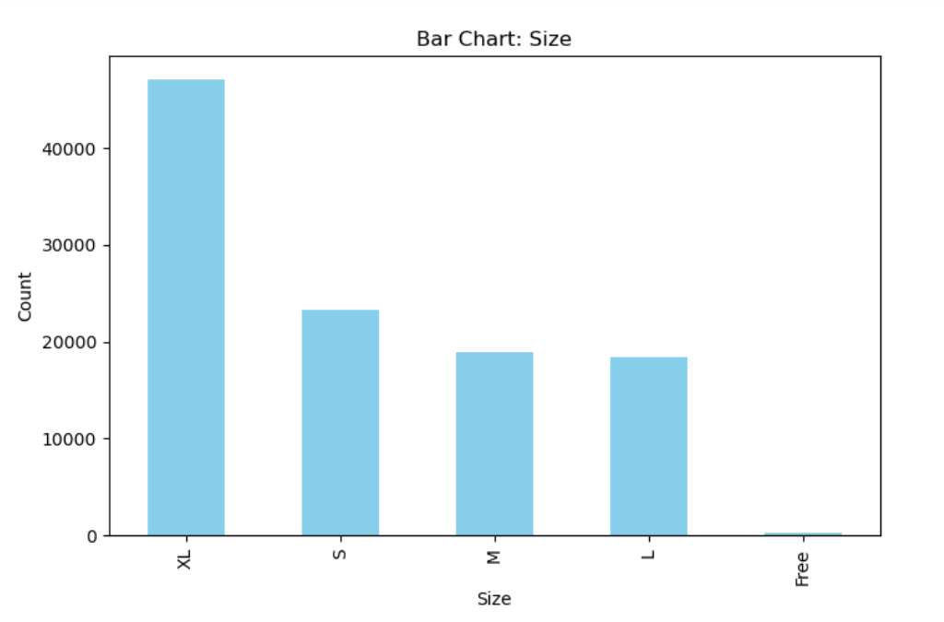
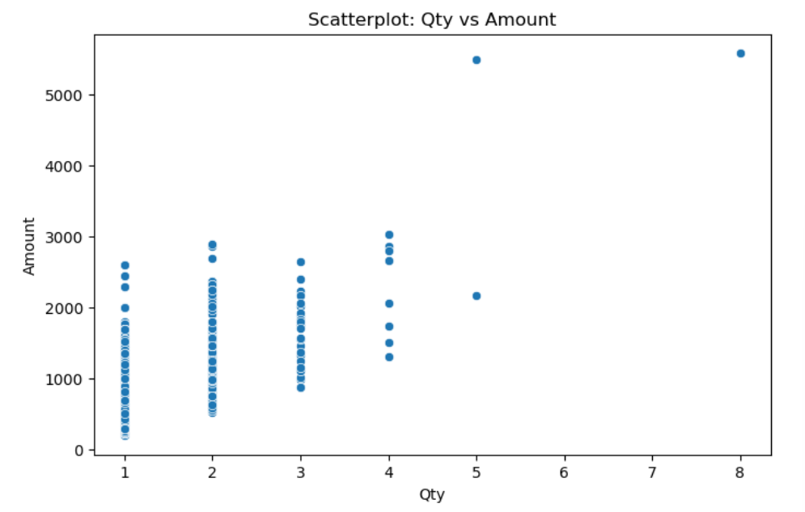
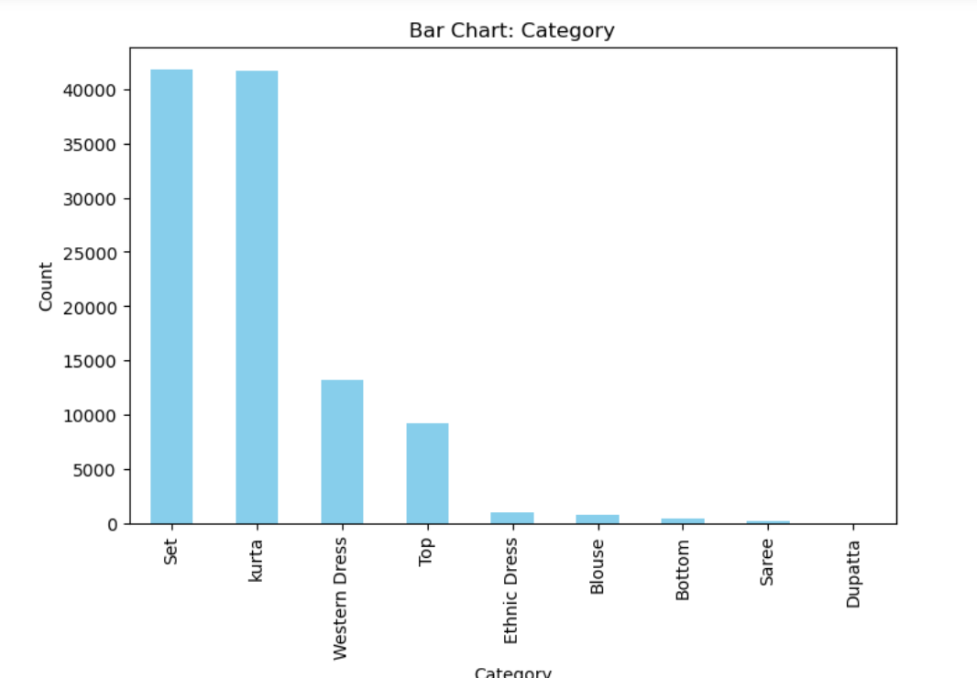
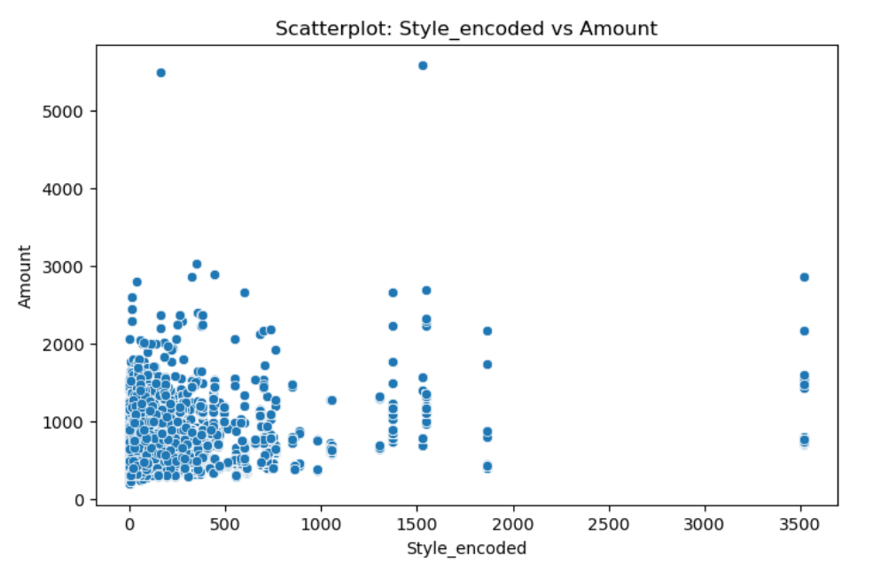

Slide 17
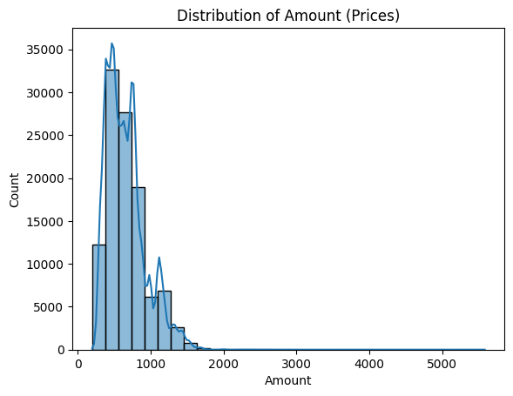

Slide 18
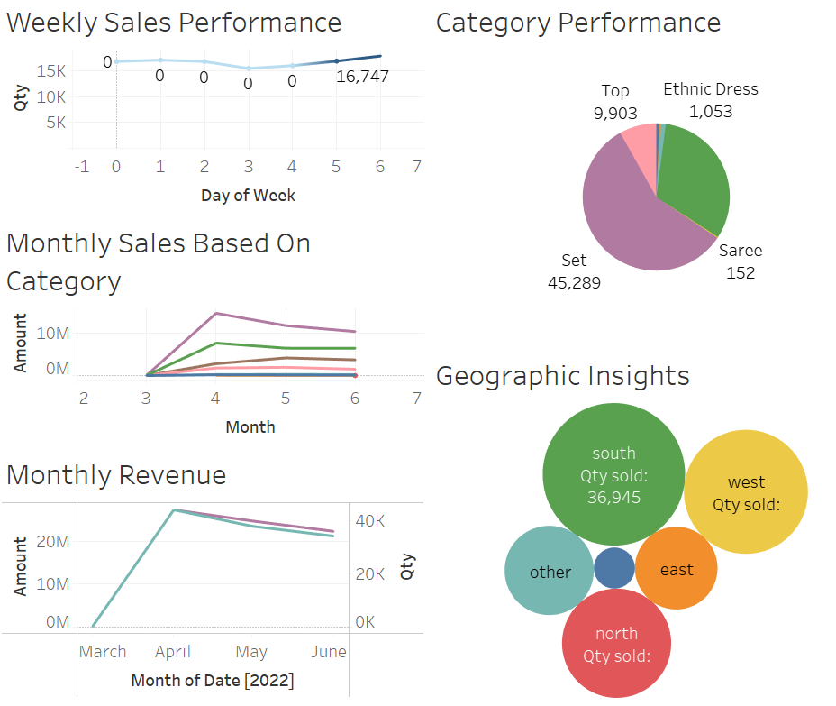

Slide 19
Data Preparation

Slide 20
Missing Values: Handled with mode imputation for categorical features.
Data Correction: Standardized states and grouped similar sizes.
Feature Engineering: Extracted day, month, and year from Date.
Encoding: Applied frequency encoding to categorical variables.
Data Quality: Removed invalid or zero Amount values.
Dataset Finalization: Selected key attributes for model training.

Slide 21
Data Modelling

Slide 22
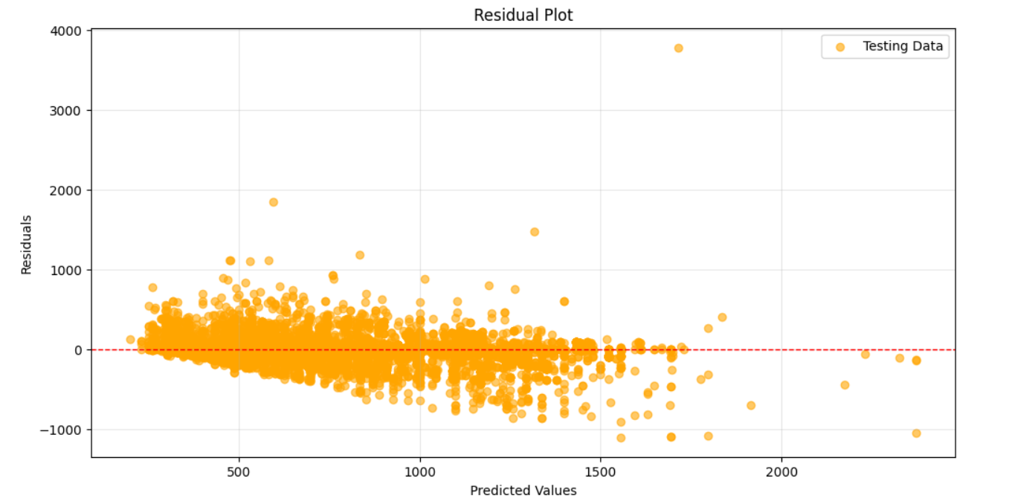
Decision Tree with default parmeters
--------------------------------- Training MAE: 1.055190694303075 Test MAE: 48.20721489706222 --------------------------------- Training MAPE: 0.0014398391091397281 Test MAPE: 0.07319439746445115 --------------------------------- Training MSE: 94.10078787668486 Test MSE: 12554.948455226568 --------------------------------- Training RMSE: 9.700556060179482 Test RMSE: 112.04886637189404 --------------------------------- Training R²: 0.9987017399756021 Test R²: 0.8283222972608135 ---------------------------------
High Difference between the results on train and test data shows overfitting. Hyper parameter tuning would be needed. Residuals are centred around 0.

Slide 23
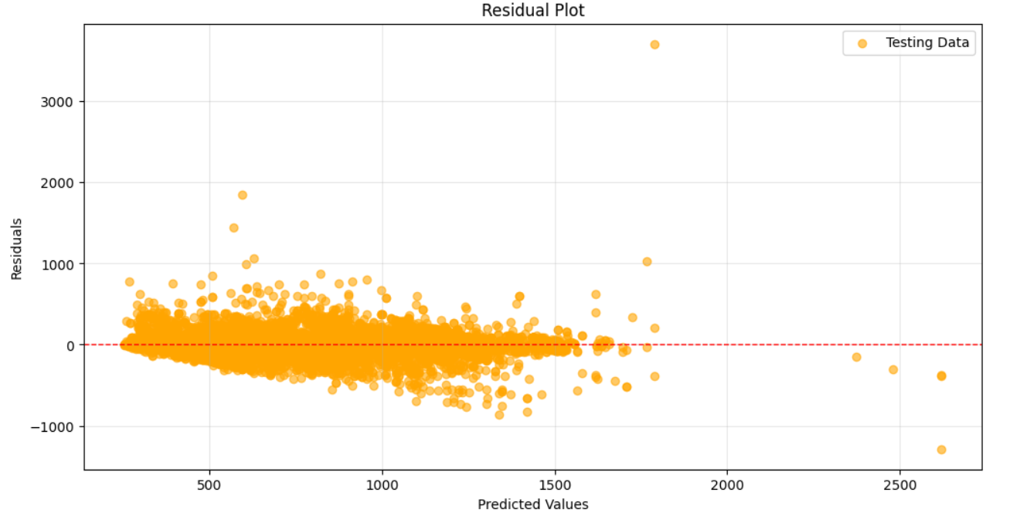
Decision Tree with Hyper Parameter tuning
--------------------------------- Training MAE: 29.62848231251696 Test MAE: 47.43808148902528 --------------------------------- Training MAPE: 0.04479494348211097 Test MAPE: 0.07219877892494685 --------------------------------- Training MSE: 3928.985018052039 Test MSE: 9597.282678365964 --------------------------------- Training RMSE: 62.681616268663966 Test RMSE: 97.9657219560289 --------------------------------- Training R²: 0.9457938206417603 Test R²: 0.8687657341934725 ---------------------------------
Improved performance with Hyperparameter tuning, but still considerable variation on train and test results. Residuals are centred around 0.

Slide 24
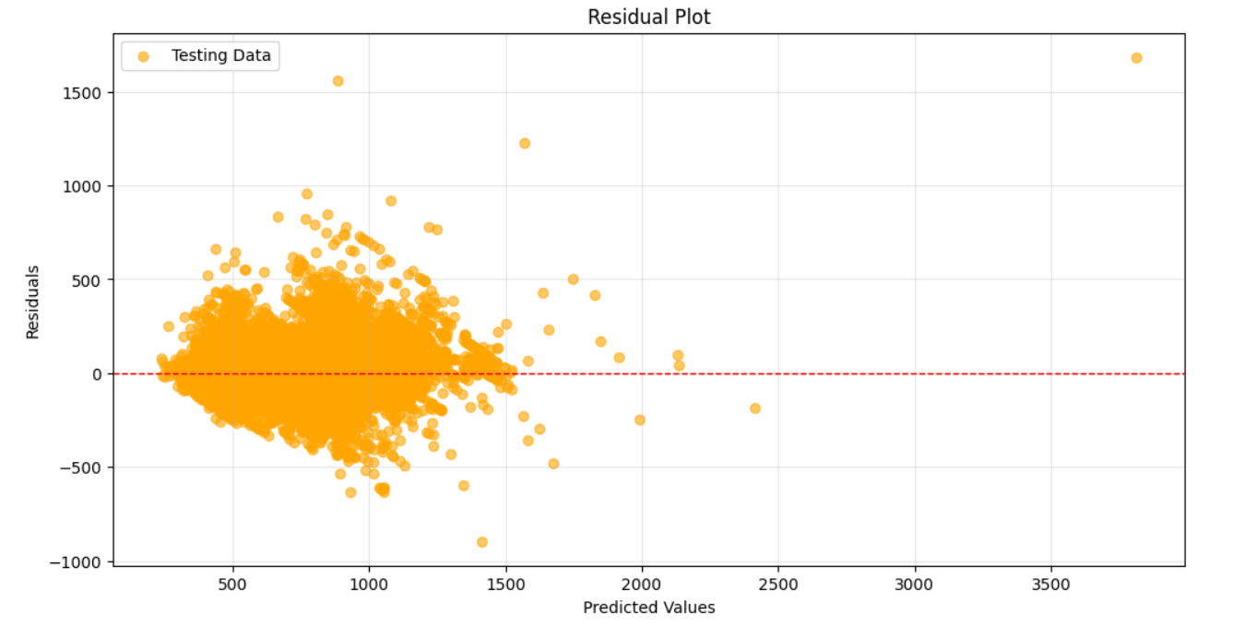
Final Model
XG Boost with default parameters
--------------------------------- Training MAE: 67.96826023798243 Test MAE: 71.98246423393495 --------------------------------- Training MAPE: 0.10832985328929612 Test MAPE: 0.11476144363837842 --------------------------------- Training MSE: 11110.694941779024 Test MSE: 12854.941884129323 --------------------------------- Training RMSE: 105.40728125598831 Test RMSE: 113.37963610864749 --------------------------------- Training R²: 0.8467114738178969 Test R²: 0.824220155153696 – --------------------------------
Best fitting model with consistency between train and test reading.
Hyper parameter tuning can enhance this further but it needs high computing resources

Slide 25
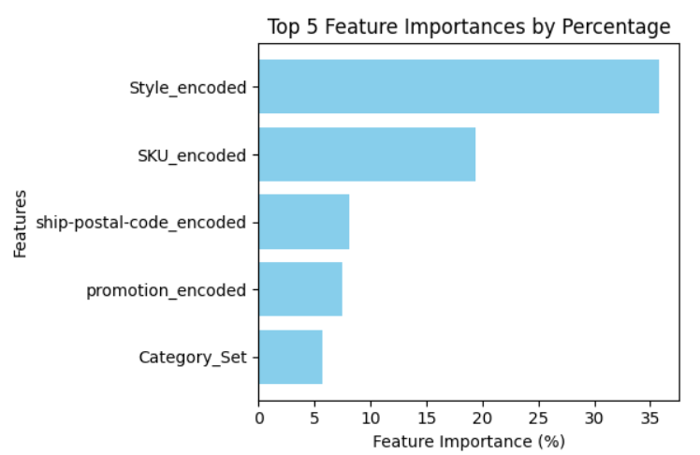
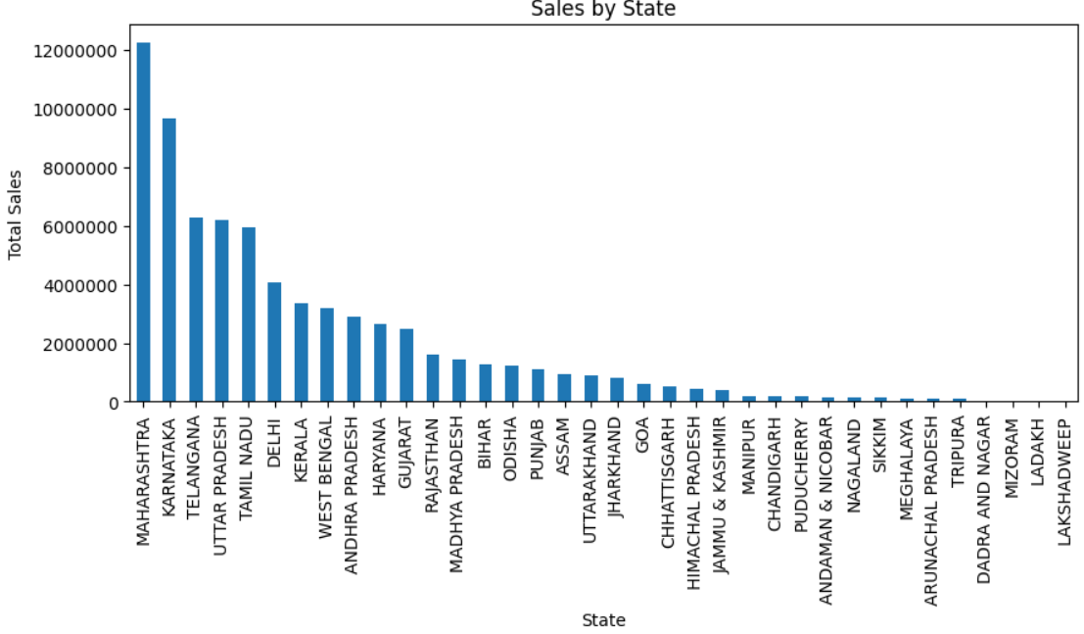
Inferences
Insight: Style being the top predictor suggests that product variations (e.g., color, design, or fit) strongly influence sales Action: Focus inventory and marketing on high-performing styles. Experiment with introducing new styles similar to top-performing ones. Offer targeted promotions for underperforming styles to clear inventory.
Insight: SKU's importance shows the individuality of products (specific models or variations) significantly impacts revenue. Action: Identify top-grossing SKUs and prioritize their stock availability. Perform SKU-level profitability analysis to discontinue low-performing items. Personalize marketing campaigns based on SKU-specific preferences.
Insight: Category being a key driver indicates product types significantly impact sales. Action: Identify high-margin categories and prioritize their growth. Diversify product offerings in underperforming categories or target different customer segments. Tailor promotions for specific categories based on customer demand.
Insight: Promotion being a key driver suggests that discounts or special offers are crucial for driving sales. Action: Evaluate the ROI of promotions to identify the most effective ones.
Insight: Some state score very less on the sales. Action: Increasing marketing campaigns in these states can improve the sales.

