Slide 1

Azure Functions
For Serverless computing
Abhishek Gupta
Abhishek.msft@outlook.com
@AbhiForTweeting
http://CloudAndMobileBlog.com

Slide 2
The “Evolution” of Application Platforms
On Premises
IaaS
PaaS
Serverless

Slide 3
What is Serverless?
$
Abstraction of servers
Event-driven/ instant scale
Micro-billing

Slide 4
Serverless is Great!
DevOps Productivity
Focus on business logic
Faster time to market

Slide 5


Serverless Application Platform Components
Development
Platform
IDE support
Functions
Logic apps
Developer tooling
Bindings and triggers
Open source
Visual designer
100+ connectors
Functions orchestration
Visual debug history
Local development
Data/storage
Messaging
Gateway Connectors
Intelligence
Bots
Verbose debugging

Slide 6
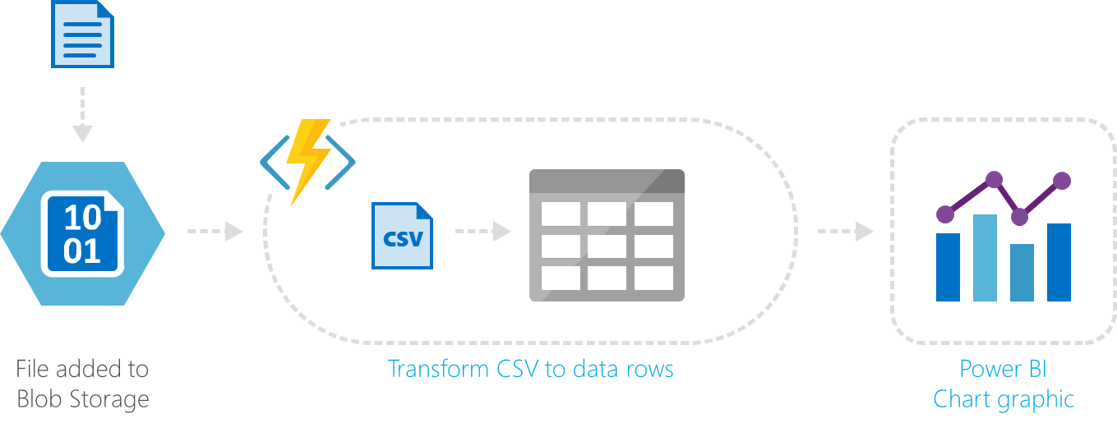
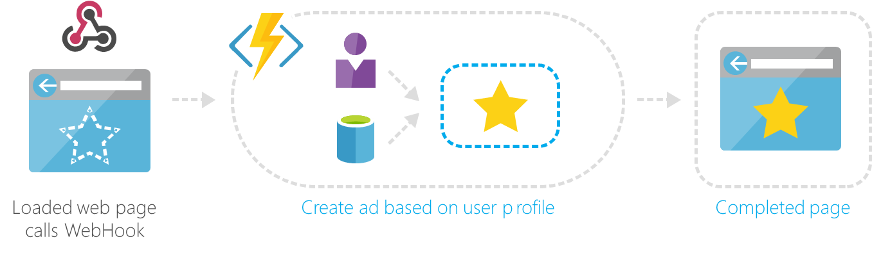
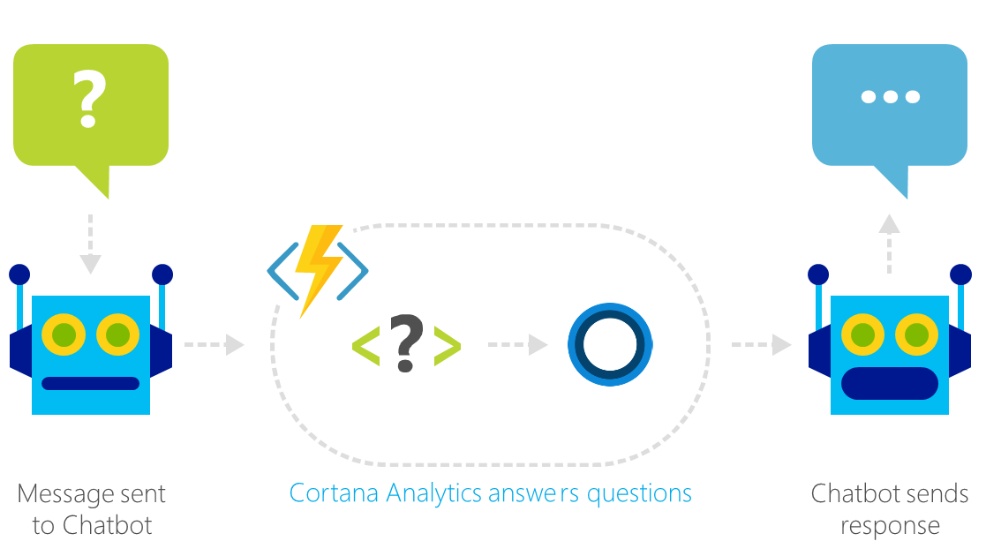
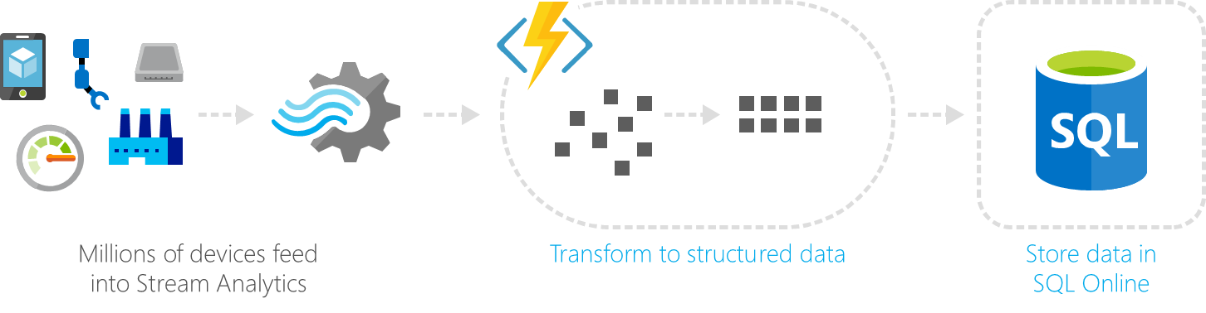
Common Scenarios
Web | Glue
Bots | IoT

Slide 7
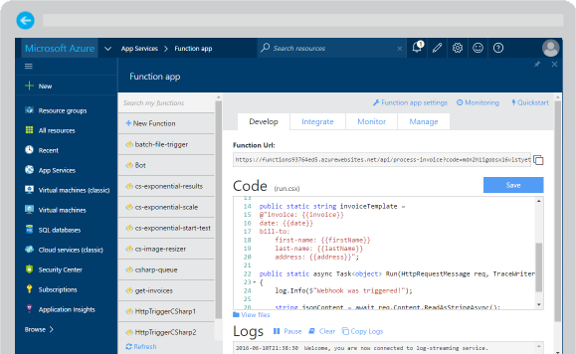
Azure Functions
Create a “serverless” event-driven experience that extends the existing Azure App Service platform by building “nanoservices” that can scale based on demand
Notes:
Azure Functions are part of the Azure Web + Mobile suite of App Services and are designed to enable the creation of small pieces of meaningful, reusable methods, easily shared across services. These serverless, event-driven methods are often referred to as “nanoservices” due to their small size. Although an Azure Function can contain quite a bit of code, they are typically designed to serve a single purpose, and respond to events in connected services.

Slide 8
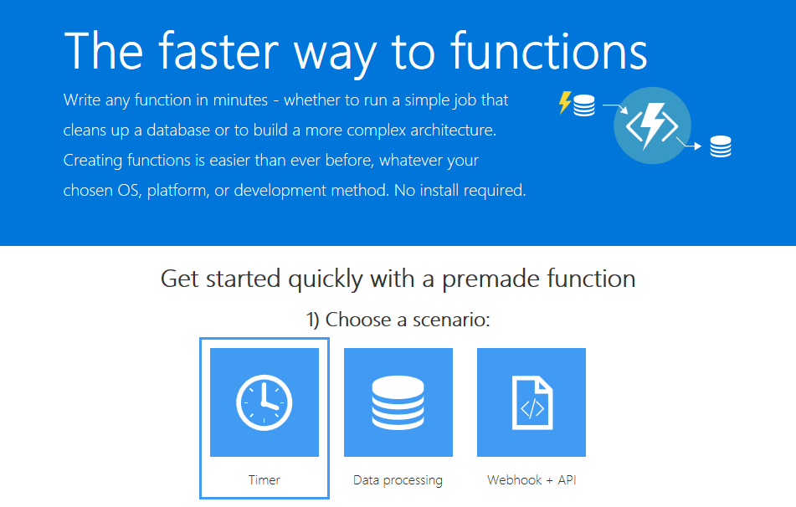
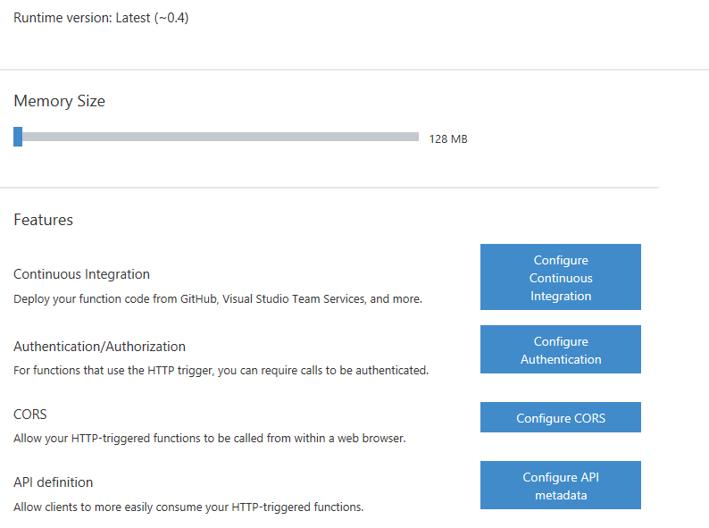
Supported Languages and Tools
Create functions in JavaScript, C#, Python, and PHP, as well as scripting options such as Bash, Batch, and PowerShell, that can be triggered by virtually any event in Azure, 3rd party services, or on premise systems
Notes:
Azure Functions can be created in most common development and scripting languages, and can be “triggered” by events in other Azure App Services, such as Web, Mobile, Logic, and API apps. Azure Functions can also be exposed via HTTP URL schemes for easy integration into legacy systems.

Slide 9

Common Scenarios
Timer-based processing
Azure service event processing
SaaS event processing
Serverless web application architectures
Serverless mobile backends
Real-time stream processing
Real-time bot messaging
Your App or Service
Office 365
Office Graph
Azure Storage
Legacy Systems
Web Services
Other Functions
Notes:
Azure Functions are “event-driven” meaning they run based on associated and configure events, or “triggers”. For example an Azure Function could be triggered by a simple timer, such as running a process once every 24-hours, or triggered by an event in a document management system, such as when a new document is uploaded to a SharePoint library. Azure Functions can also respond to Azure-specific events, such as an image added to a Storage Blob or a notification arriving in a Message Queue.

Slide 10
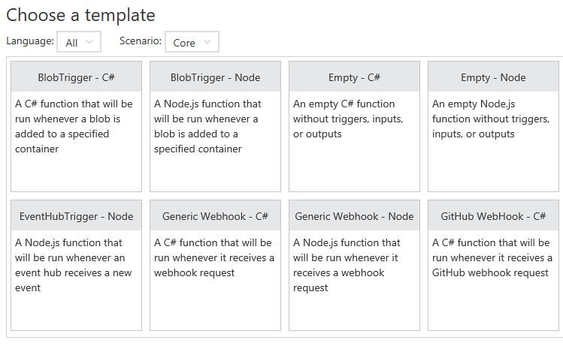
Function App Templates
Function App templates are categorized into general areas of Timer, Data Processing, and Webhook & API
BlobTrigger
EventHubTrigger
Generic webhook
GitHub webhook
HTTPTrigger
QueueTrigger
ServiceBusQueueTrigger
ServiceBusTopicTrigger
TimerTrigger
Blank & Experimental
Notes:
Although Azure Functions can be created from scratch”, the Azure Portal exposes a large number of ever-growing templates to help get developers started. These templates are typically designed with specific triggers in mind, such as a Blob Storage event, or a GitHub webhook event. Templates can easily form the basis for robust function creation, and are really designed just to get a developer started.

Slide 11
Timer Function Apps
Run at explicitly specified intervals, like every day at 2:00 am using CRON expressions, like “0 */5 * * * *“ (every 5 minutes)
Can send information to other systems, but typically don’t “return” information, only write to logs
Great for redundant cleanup and data management
Great for checking state of services
Can be combined with other functions
Notes:
Timer Functions are exactly what they sound like: Functions triggered by a specific time event. Timer Functions are perfect for clean up and maintenance processes and can easily be combined with other functions for more robust scenarios. Timer Functions us CRON expressions to configure schedules. It’s a good idea to get familiar with CRON syntax, but in the meantime there are a number of tools online to help you build CRON expressions.

Slide 12

Data Processing Function Apps
Run when triggered by a data event, such as an item being added to a queue or container
Typically have in and out parameters
Great for responding to CRUD events
Great for performing CRUD events
Great for moving content
Access data across services
Notes:
Data Processing Functions are triggered by activity in a datastore, such as a table, queue, or container. Data Processing Functions also typically have both “in” and “out” parameters, meaning they can accept an object as a parameter, and then process information and then return another object from within the function. This is not the same as a “return” value, as most Azure Functions either return void, or an HTTP response such as “created”, “accepted”, or “OK”.

Slide 13
Webhook & API Function Apps
Triggered by events in other services, like GitHub, Team Foundation Services, Office 365, OneDrive, Microsoft PowerApps
Takes in a request and sends back a response
Often mimic Web API and legacy web services flows
Typically need CORS settings managed
Best for exposing functionality to other apps and services
Great for building Logic Apps
Notes:
Webhook and API Functions are designed to easily integrate with 3rd party systems, like GitHub, Office 365, and especially Microsoft PowerApps. Since Webhook and API Functions are often exposed to external or legacy systems, they typically need CORS settings managed in order to “allow” external resources to “see” and execute the function. Most Azure Logic Apps leverage Webhook and API Functions directly.

Slide 14
Anatomy of a Function
A “Run” file that containing the function code
A “Function” file containing all service and trigger bindings and parameters
A “Project” file containing project assembly and NuGet package references
App Service settings, such as connection strings and API keys
code
Executable code
Function configuration
.NET Core and Project references
Notes:
An Azure Function is really a group of a few files that work in harmony. All actual function logic resides in a “Run” file written in a language of choice. A “Project” file is similar to a project file in other technologies such as .NET Core or Universal Windows Platform and contains “secondary” assembly references such as NuGet packages. Finally a “Function” file contains information about triggers and parameters, such as locations of Storage Queue connection strings and whether the parameter is design as an “in”, “out” or “bi-directional”. Optionally, additional configuration is also found in the Function App Settings such as an API Key or database connection string.

Slide 15
Function Bindings
Bindings serve as the basis for all connections to and from a function. Many bindings can be “bi-directional” as well.
Type | Service | Trigger | Input | Output
Schedule | Azure Functions | ✔
HTTP (REST or webhook) | Azure Functions | ✔ |  | ✔*
Blob Storage | Azure Storage | ✔ | ✔ | ✔
Events | Azure Event Hubs | ✔ |  | ✔
Queues | Azure Storage | ✔ |  | ✔
Tables | Azure Storage |  | ✔ | ✔
Tables | Azure Mobile Apps |  | ✔ | ✔
No-SQL DB | Azure DocumentDB |  | ✔ | ✔
Push Notifications | Azure Notification Hubs |  |  | ✔
Notes:
Without bindings, an Azure Function would just be a “disconnected” algorithm without any way to serve a purpose. Bindings server to connect functions and output to other services. Some of the most common binding types and features are listed in the table, however variations and adaptations can and do exist.

Slide 16
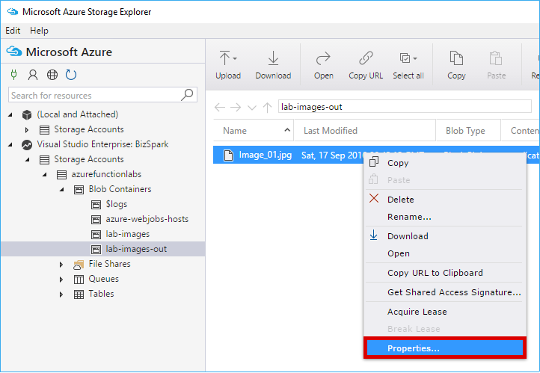
Testing Functions
Command-line tools
3rd party products such as Postman and Swagger
Direct web calls via cURL
Nested functions
Microsoft Azure Storage Explorer
Visual Studio Cloud Explorer
Notes:
Many Azure Functions are exposed via an actual URL that can be called directly from a web client or browser. When an Azure Function is not exposed via a URL its common practice to call the function from another function, such as a Timer-based Function for testing purposes only. Since Azure Functions can be nested, testing scenarios can be quite varied. For managing and testing Azure Functions that integrate with Storage Containers, Microsoft provides the Microsoft Azure Storage Explorer, as well as the Visual Studio Cloud Explorer. The Logs console in the Azure Function Designer is also a great way to view and trace function processing.

Slide 17
Demo Azure Functions: Calculator

Slide 18
References
https://azure.microsoft.com
https://azure.microsoft.com/en-in/services/functions/
https://info.microsoft.com/microsoft-serverless-approach-webinar-on-demand.html
https://docs.microsoft.com

Slide 19


Slide 20
Let’s connect
Abhishek.msft@outlook.com
@AbhiForTweeting
http://CloudAndMobileBlog.com

