Slide 1

Functional Spark
CUSTOMER SENTIMENT ANALYSIS
Team #7
Nadkar, Kailash
Patodi, Abhi

Slide 2
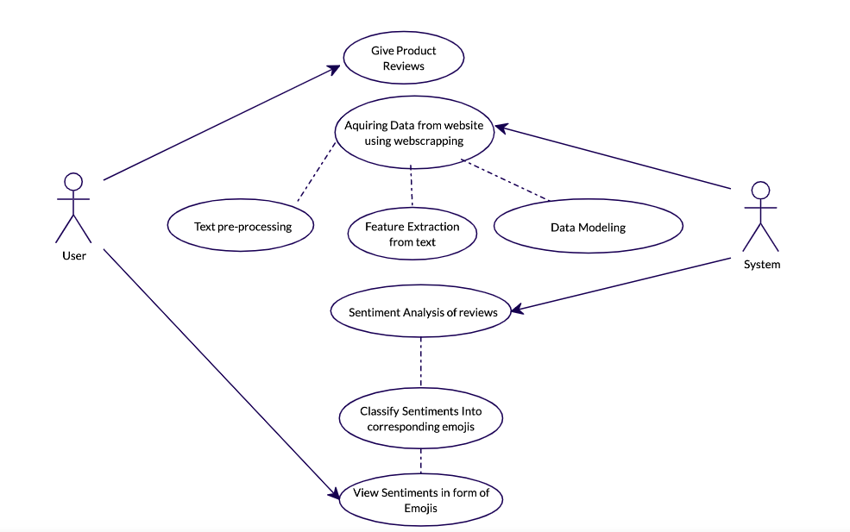

GENERAL USE CASE

Slide 3




SYSTEM FLOW
Customer Review
E-Commerce Businesses
Data Acquiring
Sentiment Analysis of Reviews
Easy Representation of Reviews
Customer Review
Customers feedback on product they purchased. Can be positive, Negative , Neutral etc.
Different E-commerce organization want to analyze the product based on customer reviews to improve on their products. They Put Request for easy sentiment analysis
Acquire Data from organization either directly or Using Web Scraping. Using AKKA and JSoup
Analyze the reviews given by user from scrapped data. Visualization of the Analysis and its categories
Represent Analyzed Sentiment in the form of easy emoji faces. It will simply avoid the need to read the review or sentiment analyzed text

Slide 4
Methodology - 1
1
Acquiring Data
Scrape the user reviews from the e-commerce websites using AKKA & JSOUP
2
Exporting Data
Exporting Data into CSV, JSON, Excel file format
3
Data Engineering
Data Cleaning and breakdown the reviews into words
Data Engineering to make data more suitable for analysis
Data preprocessing and Modeling

Slide 5
Methodology - 2
4
Sentiment Analysis
We will be doing data preprocessing using Scala and Apache Spark, and we will be classifying Reviews sentiment using a Gradient Boosting algorithm, Naïve Bayes Classifier.
Emoji Representation
Representing Sentiments of reviews into Emojis for Easier grasp of customer feedback. We will be using SVM to classify category of emoji to corresponding sentiment.
6
Visualization
Visualization using Apache Zeppelin to display chart and plots
5

Slide 6
Data Sources
For this project we will be scrapping data from Ecommerce Website
Examples:
Amazon
Walmart
Target

Slide 7
Project Milestones
Presentation
GitHub Repo Setup
Start
11/8
11/11
11/14
Designing AKKA & JSOUP
Cleaning & Filtering Data
Web Scrapping
11/22
11/18
11/24
Sentiment Analysis
Representation of Emojis
Visualization
Final Presentation
11/28
12/06
12/02

Slide 8



program in Scala and repository
Web Scrapping: AKKA and JSoup
Data Cleaning & Modelling Using Spark ML Libraries
Sentiment Analysis using: Naive Bayes and GBM
Validation & Visualization:
Zeppelin
Code repository:
https://github.com/KailashDN/FunctionalSpark

Slide 9
Acceptance Criteria
Verify Analysis result with test data : The Accuracy should be minimum 90%.
Scrapped data will be split into Test and Train to compute the accuracy of model
Able to show Sentiments on review in form of smileys: Accuracy should me minimum 90-95%.
We will be using SVM and other algorithms to classify emojis to corresponding group
We will be creating our own test set which has properly define sentiments with corresponding emoji
This Test set will be use for model evaluation
Example:
If review is Positive, then: 😄
If review is Negative, then: 😯
If review contain abusive word, then: 🤐, 🤬
If review is Positive, Helpful then: 😄, 🤗

Slide 10
Goals
Sentiment Analysis can uncover customer attitudes on products reviews and detect their tone on words and categorize them as either positive, negative or neutral
Our goal is to make this sentiments of customer toward product more easily readable, understandable to E-Commerce organization.
It will help shape the business more toward the customer interest and make improvement in business approaches,

Slide 11
Future Scope
Make Sentiment Representation in emoji Real time.
For example:
If customer writes a review, The sentiment of Review can be shown immediately below textbox
Can be use in Messenger, Chatting App to immediately see the sentiment of your text before sending to your peer.

Slide 12


