Slide 1



Optimizing Airbnb Listings:
A Data-Driven Approach with Power BI
Abhi Thaker

Slide 2


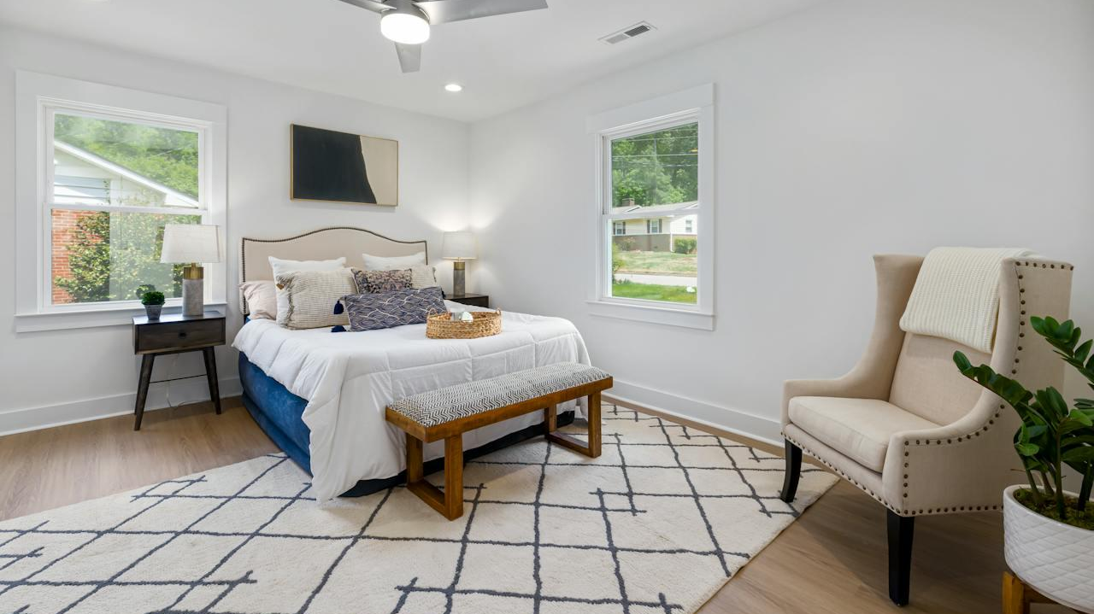
Business Problem
1
Optimal Pricing Strategies:
Difficulty in balancing competitive pricing with profitability.
Problem
2
Guest Satisfaction Drivers:
Lack of clarity on factors influencing reviews and repeat bookings.
Problem
3
Neighborhood Competition:
Struggling to differentiate in high-demand areas with similar offerings.
Problem

Slide 3
Analytical Question
What is the ideal price range to maintain a high occupancy rate and maximize revenue?
Decision: Use dynamic pricing based on demand and seasonality.
What factors influence guest satisfaction most and what elements—such as facilities, cleanliness, and communication—have the biggest effects on guest satisfaction rates?
Decision: Focus on amenities, cleanliness, and host communication.
Which neighborhoods bring in the most money and have the happiest visitors, and how do host behaviors—like response time—contribute to those neighborhoods' high performance?
Decision: Target high-performing areas for investments and strategy improvements.

Slide 4
1
Project Scope Analysis
Pricing Strategies:
2
Objective
Empower Airbnb hosts with actionable insights to optimize listing performance.
Guest Satisfaction:
Focus Areas
3
1
Identify optimal pricing ranges to balance revenue and occupancy.
Neighborhood Performance:
2
Discover key drivers like cleanliness, amenities, and communication.
3
Analyze local trends to strengthen competitiveness.

Slide 5
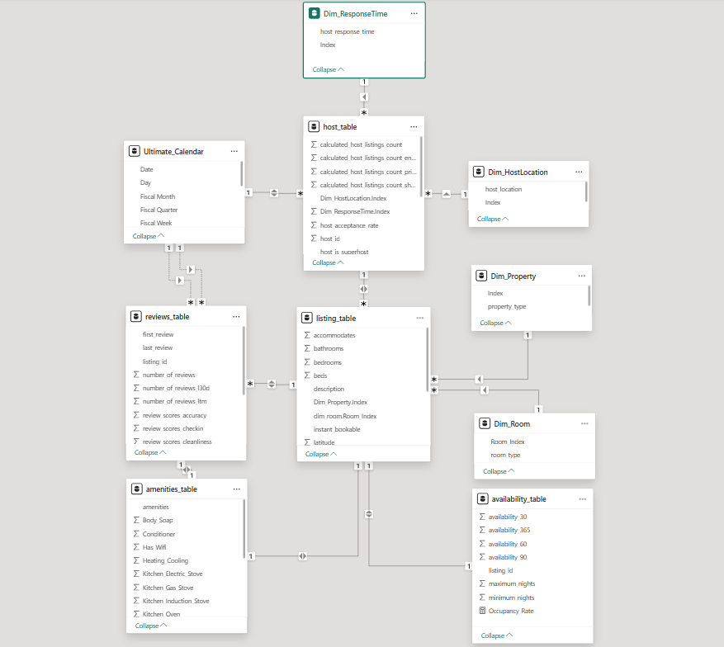
Solution’s Design
Snowflake Schema for Data Modeling:
Fact Table: Listing_Table acts as the Central table containing listing details.
Dimension Tables:
reviews_table: Tracks guest ratings and feedback.
host_table: Includes host response and Superhost status.
availability_table: Stores occupancy tracking data.
amenities_table: Lists available features for each listing.

Slide 6
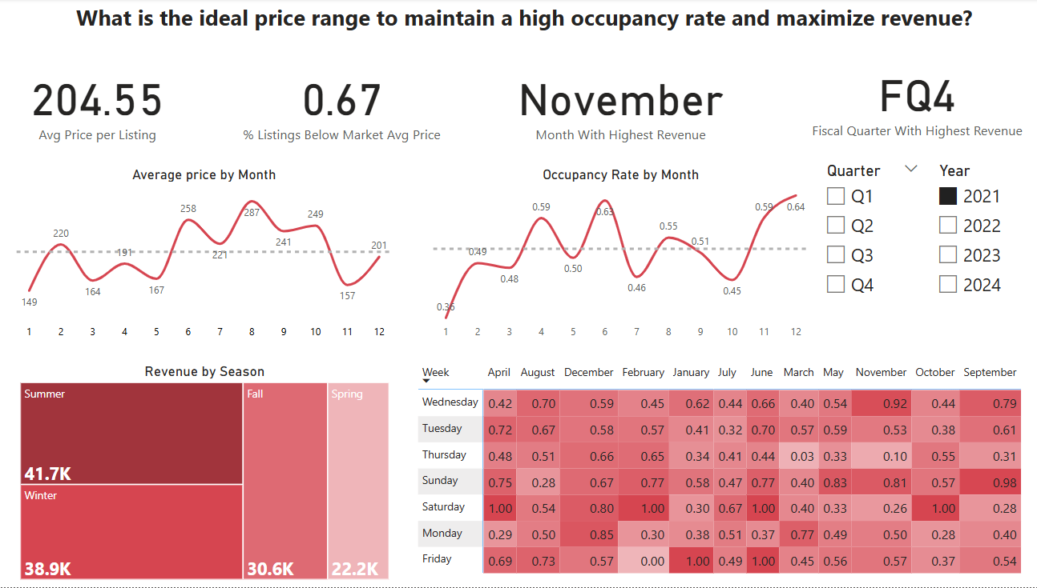

Slide 7
Dashboard 1
Target price band: $200–$230 → keeps occupancy ≥ 48 %.
Pricing headroom: 69 % of listings sit below market → raise rates.
Premium windows: Feb & Aug (+20 %) and Q4 weekends (+20 %) sustain higher prices.
Revenue peak: Q4, with November the #1 month; Dec occupancy hits 60 %.
Soft spots: Fall (‑10 %) and June 36 % occ. → run promos / bundles.
Day‑of‑week lift: Saturdays (Dec 0.87) & Sundays are hottest; Mondays strong in Dec.
Season parity: Winter ≈ Summer revenue (~$178 k each) → equal marketing focus.
Tactics:
Dynamic pricing anchored at $200–$230.
3‑night minimum stays over holidays.
Flash sales Mon–Wed during low periods to fill gaps.

Slide 8
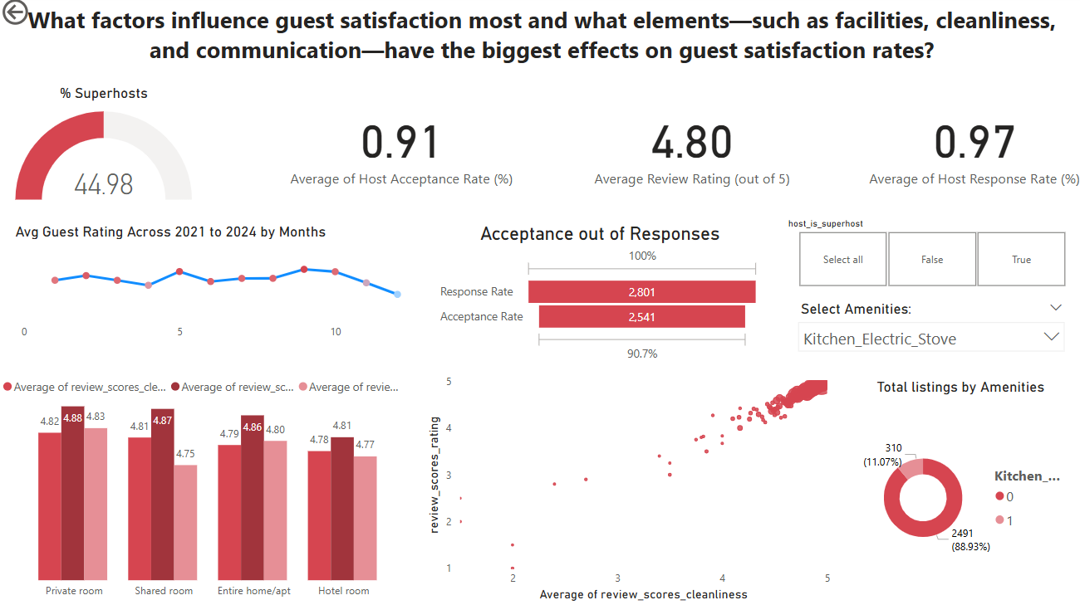

Slide 9
Dashboard 2
Top driver: Cleanliness ≥ 4.7 ⇒ overall ≥ 4.8 → double‑down on housekeeping & mid‑stay cleans.
Response vs. acceptance: 97 % reply rate but only 91 % acceptance → fix calendar gaps & minimum‑stay rules.
Superhost gap: Only 45 % meet Superhost status → coaching & perks can lift conversion and trust.
Rating trend: Stable 4.75–4.88 but dipping in last quarter → monitor for service slippage.
Amenity edge: Just 11 % offer an electric stove; in‑unit kitchens & workspaces boost satisfaction and length of stay.
Tactics:
Housekeeping audits → hit cleanliness 4.8+ every stay.
Auto‑accept / rapid approvals → raise acceptance to 95 %.
Superhost training & incentives for the 55 % non‑Superhosts.
Amenity upgrades → kitchen gear, desks, high‑speed Wi‑Fi.

Slide 10
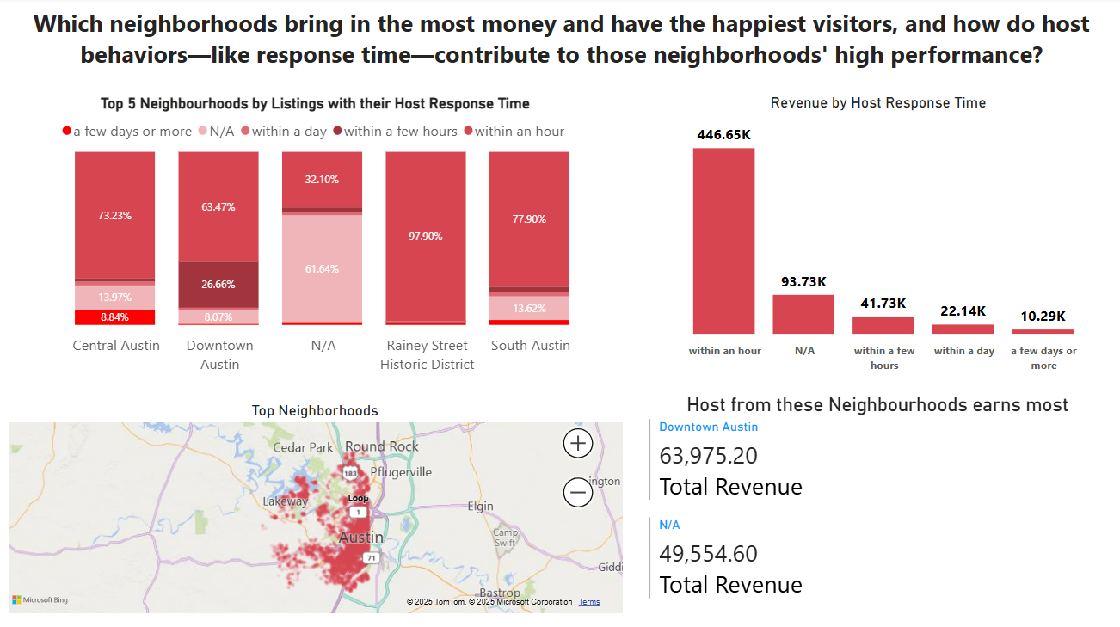

Slide 11
Dashboard 3
Slide‑ready pointers – Neighborhood Performance & Host Behaviour
Key Insights
Downtown & Central Austin = revenue leaders
Top host in Downtown earns ≈ $64 k.
63–73 % of listings answer in < 1 hour → fast replies = higher earnings.
Speed pays: < 1 hr replies → $446 k (≈ 5× next tier).
Revenue plummets as response time lengthens (few hrs $42 k → 1 day $22 k → 1days+ $10 k).
Rainey Street punches above its size: 98 % <1‑hour replies = best in dataset → model for new areas.
Action Checklist
Automate instant messaging → target ≥ 90 % replies within 1 hour.
Expand inventory in Downtown, Central, Rainey Street for best ROI.
Train outer‑suburb hosts on rapid‑reply best practices.
Build a host dashboard: show response‑time percentile vs. revenue to motivate speed.

Slide 12
Recommendations & Challenges
Recommendations
Challenges & Future Enhancements
Avg. price: $204.55. 67% underpriced. August peak: $287. November occupancy: 0.64.
Use dynamic pricing by season and weekends (e.g., Dec–Jan Fri/Sat >0.9).
Avg. rating: 4.8. Superhosts: 45%. Kitchen boosts ratings (88%).
Improve amenities, cleanliness,communication, and Super Host Culture.
Downtown: $63.9K. Fast replies (<1hr): $446.65K vs. >1 day: $10.29K.
Prioritize fast response in top areas.
Summer: $41.7K. Lows: June, Jan.
Adjust pricing by season and events.
Data quality issues: Inconsistencies and missing values required deep preprocessing.
Manual data import: Slowed updates and increased error risk.
Complex DAX metrics: Needed repeated validation and refinement.
Future improvements:
Add external datasets (e.g., events, weather)
Automate data flow & refreshes
Implement ML models for predictive pricing & demand forecasting

Slide 13
Thank You

