Slide 1


Uni-Track Project Management
COMPUTER SCIENCE & ENGINEERING
SAL INSTITUTE OF TECHNOLOGY AND ENGINEERING RESEARCH
Prepared by
Name – VADADORIYA ABHI
Enrollment No – 220670131051
Guided By – Prof. BIRENDRASINH ZALA

Slide 2
Table of Content
Abstract
Project Overview & Objectives
Software Requirements Specification
Company Profile
Tools & Technologies Used
Key Functionalities/Features
Progress Overview
Implementation screen shots
Results & Outcomes
Timeline of Project
Conclusion & Future Scope
References

Slide 3
ABSTRACT
The Uni-Track Project Management System is a web-based application developed using the MERN stack (MongoDB, Express.js, React.js, and Node.js). It allows students to submit projects, professors to review them, and administrators to manage users through secure role-based access control. The system implements authentication, CRUD operations, and RESTful APIs to ensure efficient and organized academic project management.

Slide 4
Project Overview & Objectives
Overview
Uni-Track is a platform that allows users to manage projects submission, approval, assign-guide, update, report file manage, deadline indicate, student page , professor page and admin page, status to work efficiently.
Objectives
• Specific focus on Student, Professors and Admin role logic and individual authentication.
• Enable users to Create, Read, Update, and Delete academic project entries through the
frontend interface connected with backend APIs.
• Integrate React UI with RESTful APIs in Express/Node.js so that data flows correctly and
securely between the user interface and the database.
• Make a mobile, tablet and desktop responsive to everyone easily use this.
• Easy to handle errors and and feedback loops.

Slide 5
Software Requirements Specification
Introduction
The system is a web-based application designed to manage projects for students, professors, and administrators using the MERN stack (MongoDB, Express.js, React.js & Node.js). It provides role-based access control, project submission, review, and management functionalities.
Functional Requirements:
User Roles & Features:
Admin: Manage projects, student and professor.
Student: Create project, request to send professor and submit project.
Professor: Accept and reject project and request and give deadline and approval.
Key Features:
Authentication: Pages authentication login and sign-up with forgot and reset password with email authentication.
Technology Stack: MERN stack and file management using multer, security with JWT authentication.

Slide 6
Software Requirements Specification
Non-Functional Requirements:
Security:
The system shall use JWT authentication and role-based access control for secure sessions.
Passwords must be securely hashed with bcrypt.
Performance
APIs should respond within acceptable time limits under 200ms for requests.
The system should support multiple concurrent users.
Usability
The application shall be responsive and accessible on desktops, laptops, tablets, and mobiles.
User interfaces should be intuitive and user-friendly.

Slide 7
Software Requirements Specification
Software Constraints:
MongoDB as the database.
Express.js and Node.js for backend.
React.js for frontend development.
Security Requirements:
Data must be transmitted via HTTPS for encryption.

Slide 8
Company Profile
Company Name:- Innocreek Solution
Official Website:- https://innocreeksolution.tech
Address:- C2-610, Pragati IT Park, Mota Varachha, Surat, Gujarat - 394101
Contact No:- 91578 93772
Industry:- IT Services & Software Development
Overview:-
Innocreek solution is an IT services company based in Surat that focuses on developing modern digital solutions for startups and small businesses like Web Application Development, Mobile App Development, UI/UX Design, Backend & API Development and Software Maintenance and support.

Slide 9
Tools & Technologies Used
Tools:
Technologies
Development Tools:-
Visual Studio Code
Git & GitHub
Deployment:-
Vercel
File management system:-
multer
Frontend:-
React.js, Tailwind css, Vite.
Backend:-
Node.js, Express.js
• Database:-
MongoDB

Slide 10
Tools & Technologies Used
Key Functionalities:
User Module:-
➢User registration and login.
➢ Create and submit final year project details,
Project title, description, Technology stack
➢ View project status (Pending / Approved /
Rejected)
➢ View feedback or remarks given by
professor/admin
Admin Module:-
➢Admin authentication and dashboard access
➢Assign professors to student projects
➢Manage all project records in the system
➢Control roles and permissions
➢Maintain system data and ensure security
• Manage users (students and professors)
Add, update, delete user accounts

Slide 11
Tools & Technologies Used
Professors Module:-
➢Secure login with professor credentials
➢View list of assigned student projects
➢Review project details submitted by students
➢Approve or reject project proposals
➢Provide feedback, comments
➢Monitor project progress and updates
➢View reports or ppt
Features:-
Create new project submissions
Track project status (Pending / Approved / Rejected)
Approve or reject proposals
RESTful API integration
Secure data storage
Responsive UI design
Role-based access (Student, Professor, Admin)

Slide 12
Progress Overview
Brief description about Completed Phases:
Phase 1: Requirements gathering and design.
Phase 2: Frontend and backend setup.
Phase 3: Authentication created.
Phase 4: Admin page to create manage students and manage professor.

Slide 13
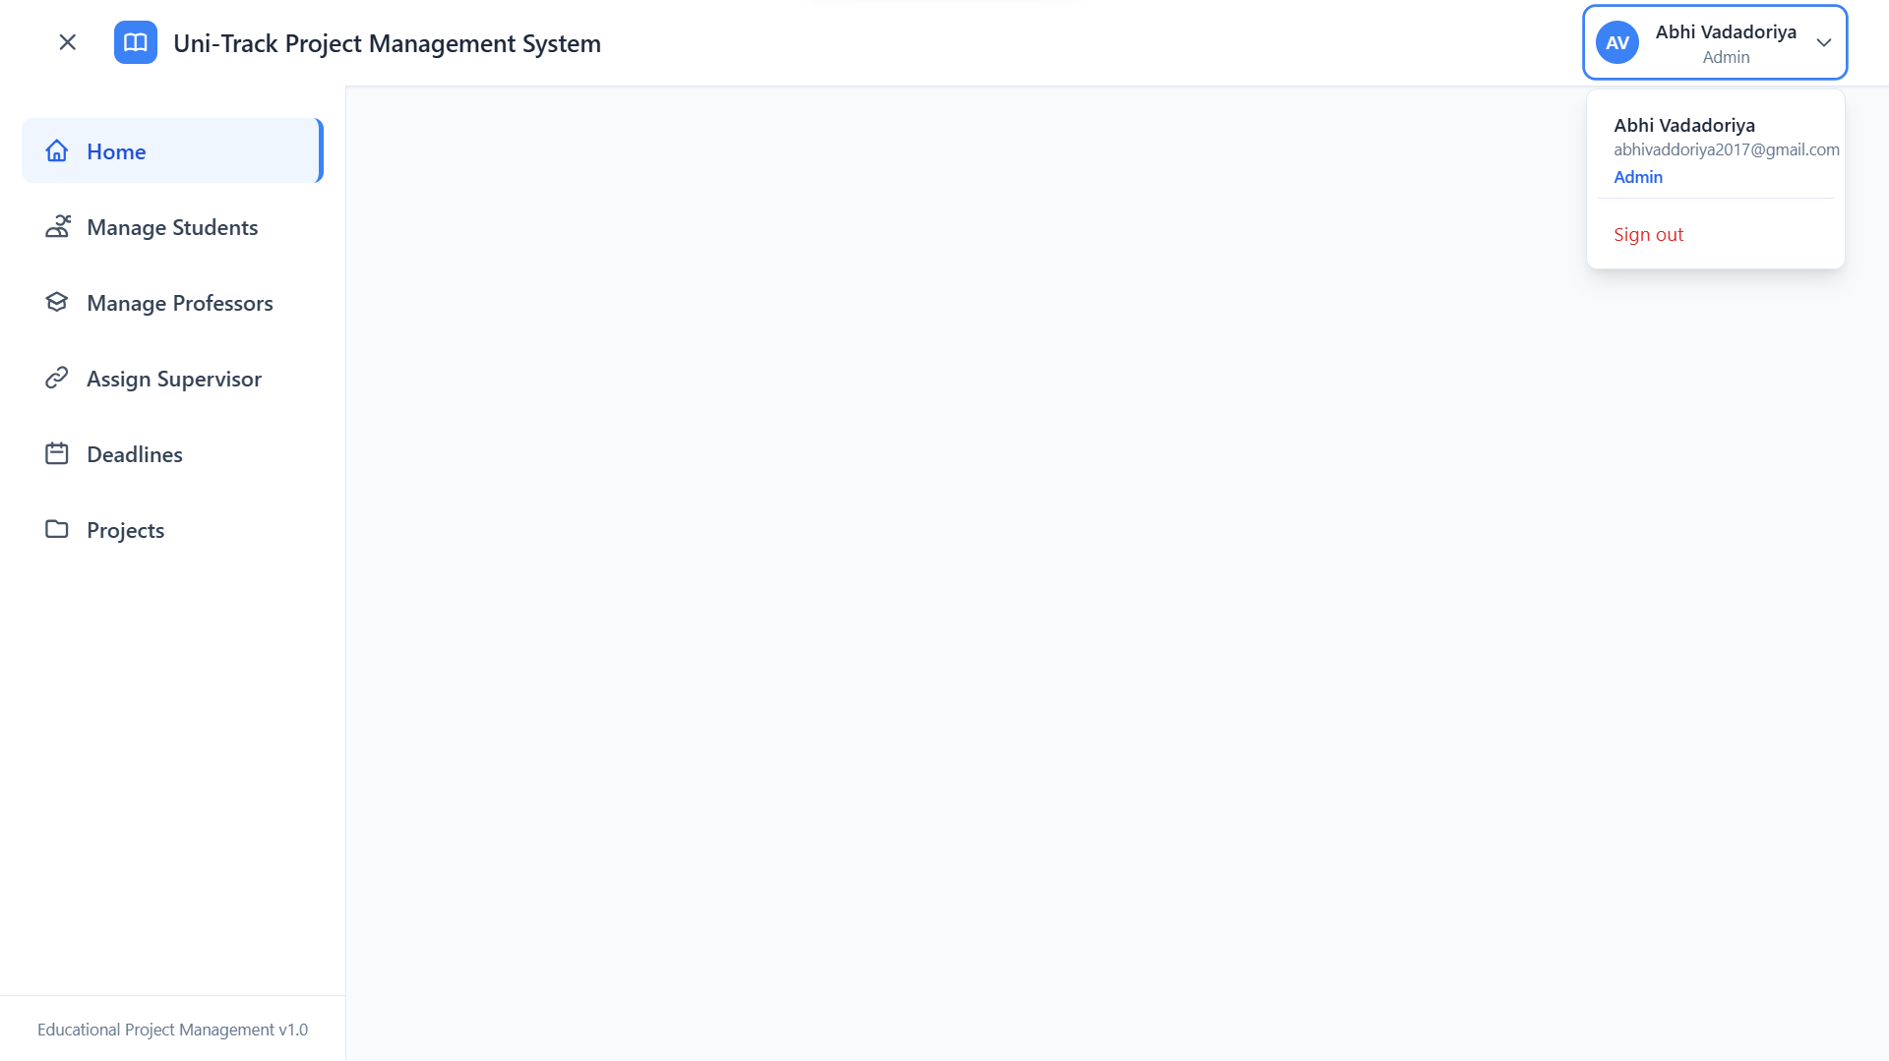
Implementation screen shots
Home page:-
That is the landing page of the website that provides an overview of the admin page, including logout, profile, manage student, manage professor, assign supervisor, deadline and projects

Slide 14
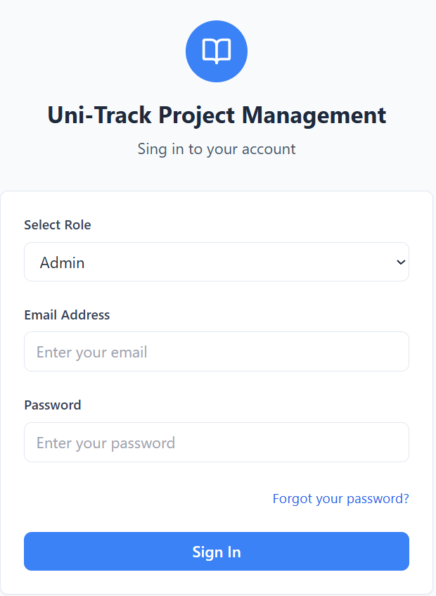
Implementation screen shots
Login page :-
This screen allows users to log in with according to their role including email and password and secure authentication.

Slide 15
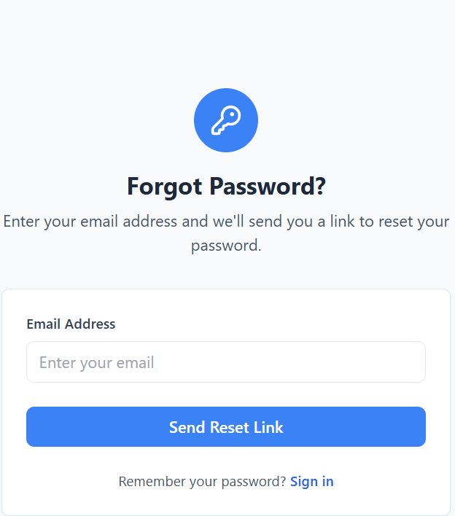
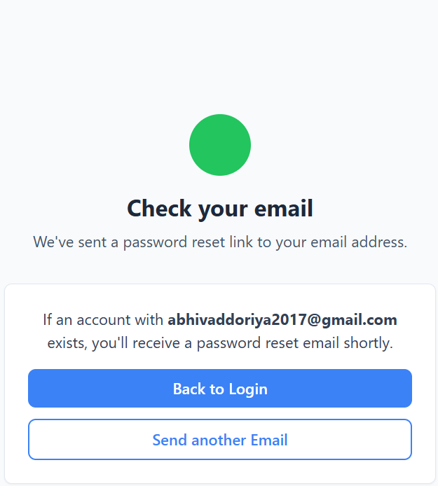
Implementation screen shots
Forgot and Reset Password:
Users who forgot their password can use this page to request a reset link. It ensures security by verifying the registered email and link share via mail.

Slide 16
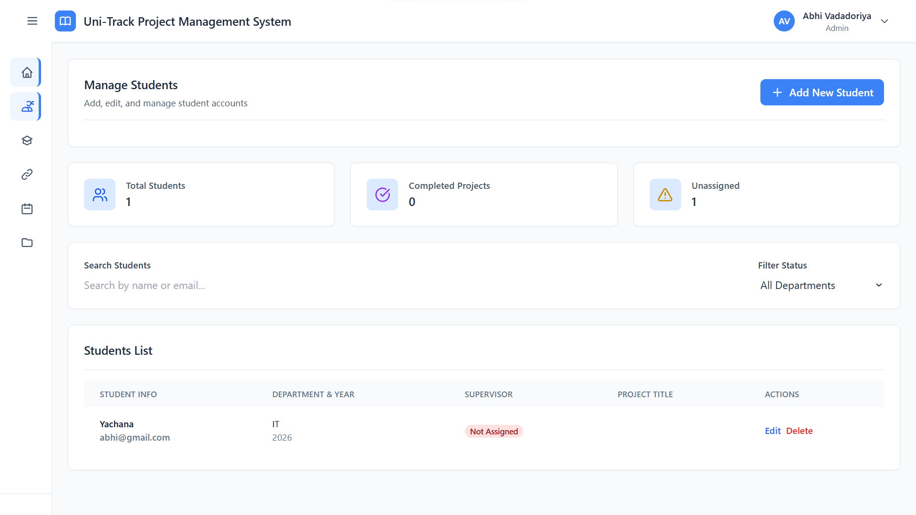
Implementation screen shots
Manage students:-
This section used to manage total student, completed projects, unassign student, filter option, departments, student list, status, action edit and delete.

Slide 17
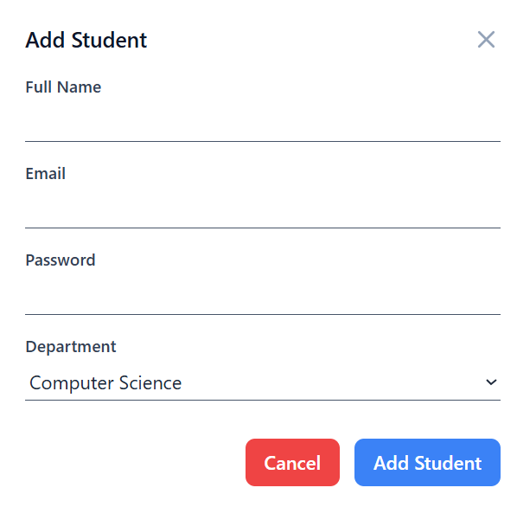
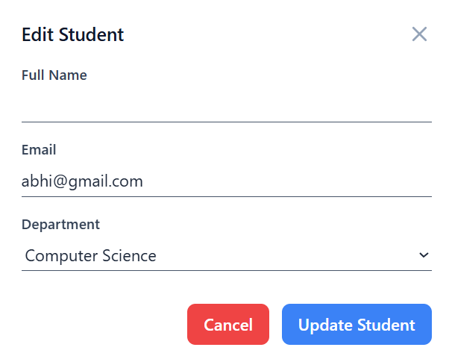
Implementation screen shots
Add student and Edit student:
This section to we add new student with their name, email, password, and department.
In edit student we update student with their full name , email and department.

Slide 18
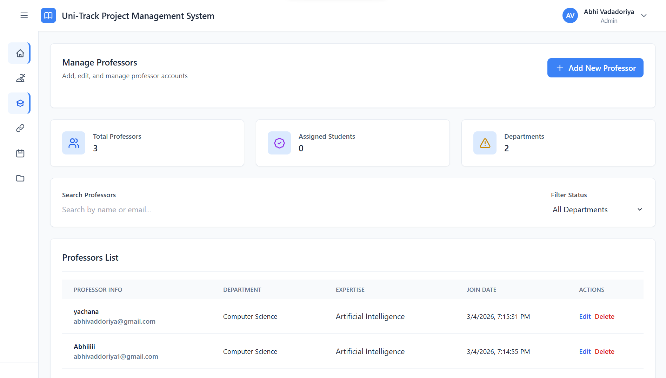
Implementation screen shots
Manage Professor:
In this section we manage professor with total professor count, assign students, department, filter, show professor list, edit and delete option is their to modify.

Slide 19
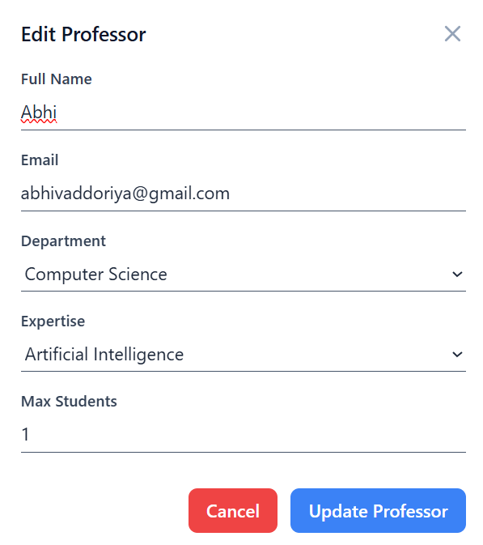
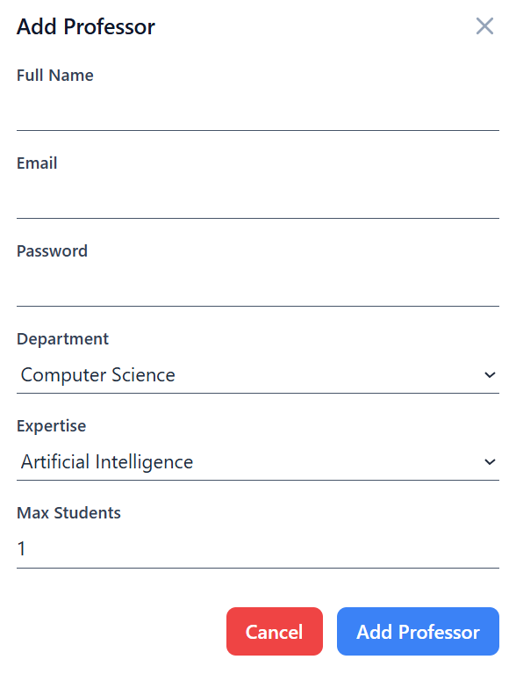
Implementation screen shots
Add Professor and Edit Professor:
This section to we add new professor with their name, email, password, and department, expertise and max students.
In edit professor we update professor with their full name , email and department, expertise and max students length.

Slide 20
Results & Outcomes
Results:
The system was successfully developed using the MERN stack (MongoDB, Express.js, React.js, Node.js)
CRUD operations for project management were implemented and tested successfully.
The application provided a responsive and user-friendly interface.
Backend APIs successfully communicated with the frontend and database without errors.
Outcome:
Learned secure authentication and authorization using JWT and password hashing.
Enhanced problem-solving and debugging skills during development.
Improved knowledge of database schema design using MongoDB

Slide 21
Timeline of Project
Timeline of project:
Week 1-2: Revise and understand the programming fundamental.
Week 3-4: Got project definition and create abstract and overview.
Week 5-6: Create frontend part with authentication.
Week 7-8: Setup backend and revise the concept of node and express and start backend coding with frontend.
Week 9-10: Complete fronted with 80% backend.
Week 11: Complete backend and testing and debugging.
Week 12: Deployment

Slide 22
Conclusion & Future Scope
Future Scope:
Deploy the system on cloud platforms like AWS or Azure for real-world institutional use.
Integrate a messaging feature for communication between students and professors.
Develop an Android/iOS mobile app for easier access.
Conclusion:
The Uni-Track Project Management was successfully developed using the MERN stack. The system provides secure authentication, role-based access control, and efficient project management features for students, professors, and administrators. It simplifies academic project handling by replacing manual processes with a structured digital platform. The project demonstrates practical implementation.

Slide 23
References
References:
MongoDB Official Documentation:- https://www.mongodb.com/docs/
React.js Official Documentation:- https://react.dev
JSON Web Token (JWT) Introduction:- https://jwt.io/
Tailwind Documentation:- https://tailwindcss.com/docs/
Pmms:- https://pmms.gtu.ac.in/GTULoginPage
Design Engineering:- https://de.gtu.ac.in/

