Slide 1

SEM 4
PYTHON MINI PROJECT
VOICE ASSISTANT
Under the guidance of –
Prof. Suchita Dange
Group 23 Members –
Siddhant Gunjal 5019167
Tini Tomy 5019169
Abhishek Yadav 5019173

Slide 2
CONTENTS
Acknowledgment
Abstract
Problem Statement
Introduction
Aim and Objectives
Literature Survey
System Requirement
Project Walkthrough
Future Scope
Conclusion
References

Slide 3
ACKNOWLEDGEMENT
We would like to express a deep sense of thanks and gratitude to our Project guide Prof. Suchita Dange for constantly guiding us throughout this project. Her constructive advice and constant motivation have been responsible for the successful completion of this project.
We have been greatly benefitted from the valuable guidance, encouragement and kind supervision given to us throughout this project which help us to develop the project successfully.
With sincere regards,
Project Group 23

Slide 4
ABSTRACT
Voice control is a major growing feature that change the way people can live.
The voice assistant is commonly being used in smartphones and laptops.
AI-based Voice assistants are the operating systems that can recognize human voice and respond via integrated voices.
This voice assistant will gather the audio from the microphone and then convert that into text, later it is sent through GTTS (Google text to speech).
GTTS engine will convert text into audio file in English language, then that audio is played using play sound package of python programming Language.

Slide 5
PROBLEM STATEMENT
We are all well aware about Cortana, Siri, Google Assistant and many other virtual assistants which are designed to aid the tasks of users in Windows, iOS and Android and their respective platforms. But they are specific to their Operating System only. We can’t use them on different systems.
Also they are not editable i.e. Open Source, so user can’t add their additional functionality into it.
Solution: -
As our Voice Assistant is a Python Script and we all know Python is a Portable language, so it can run on any platform, just we need is a python interpreter.
And as it is open source, users can alter and modify the script according to their need.

Slide 6
INTRODUCTION
A virtual assistant is a technology based on artificial intelligence. The software uses a device’s microphone to receive voice requests while the voice output takes place at the speaker.
You can –
Open various applications, also it can translate sentences into different languages.
Can search anything and give you the result, also guide to reach a destination.
Can play any song, tells a joke, also tells you date and time.
Can set alarm, reminders.
You can send emails and messages.
Also it can perform speed test and tells you the weather report, current news.
It can also solve maths problems.

Slide 7
AIM AND OBJECTIVES
Aim: - The aim of the software is to perform the tasks of the user at certain commands, provided through speech.
Objectives: -
To ease most of the works of user through speech.
To provide hands free experience to the user.
To develop cross platform software.
To develop open source software.
To understand different aspects of Python programming.

Slide 8
LITERATURE SURVEY
Sr. No | Title of Paper | Authors | Description | Year
1 | Personal Assistant with Voice Recognition Intelligence | Dr. Kshama V. Kulhalli Dr. M.S.Sheshagiri Mr. Abhijit J. Patankar | The Most famous application of iPhone is “SIRI” which helps the end user to communicate end user mobile with voice and it also responds to the voice commands of the user. Same kind of application is also developed by the Google that is “Google Voice Search” which is used for in Android Phones. | 2020
2 | A Review on Voice Assistance using Python | Subhash Mani Kaushal, Megha Mishra | Artificial Intelligent has been in great use when it comes to day to day life. Computer science defines AI research as the study of brilliant agents. Every In almost any direction one turns today, some form of computer-based information processing technology intrudes, whether to the individual knowingly or not. | 2020
3 | Smart Voice Based Virtual Personal Assistants with Artificial Intelligence | Ankit Pandey, Vaibhav Vashist, Prateek Tiwari, Sunil Sikka, Priyanka Makkar | Communication and Technology has a long history but still constantly and actively growing and changing. The technology changes so fast that today everybody has an AI Personal assistant. | 2020
4 | AI Based Voice Assistant Using Python | Deepak Shende, Ria Umahiya, Monika Raghorte, Aishwarya Bhisikar, Anup Bhange | Artificial intelligence technologies are beginning to be actively used in human life, this is facilitated by the appearance and wide dissemination of the Internet of Things (IOT). Autonomous devices are becoming smarter in their way to interact with both a human and themselves. | 2019

Slide 9
LITERATURE SURVEY: EXISTING SYSTEM
We are still far away from understanding the genuine capability of speech recognition technology. This applies both to the refinement of the innovation itself and to its coordination into our lives.
Limitations : -
Usage statistics and user data are sent to the developer
Installation required
User cannot edit or change the modules
Not a free Software

Slide 10
LITERATURE SURVEY: PROPOSED SYSTEM
Does not collect any user data
Installation required
User can edit and add new modules
Free Software
lightweight
Simple User interface

Slide 11
SYSTEM REQUIREMENT
Software Requirement –
Operating System: Windows 7/8/8.1/10 64 bits
Linux Ubuntu/Debian/Kali Linux/Fedora
Mac OS X 10.11/10.12/10.13/10.14/10.15/11
Python 3.7 or higher
IDE: PyCharm/Visual Studio Code
Hardware Requirement –
Memory (RAM): 1 GB or higher
Processor: Pentium IV or higher
Hard Disk: 500 MB required
Microphone

Slide 12

PROJECT WALKTHROUGH: USE CASE DIAGRAM
Open Application
Sends Mail, Messages
Antonyms,
Synonyms
Wikipedia
Weather Report
Search
Joke
Input Voice
News, Headlines
User
Screenshot
Math Problems
Reminders,
Alarms
Play Songs
Translation
Speed Test
Map

Slide 13
PROJECT WALKTHROUGH: FLOWCHART
Start
Say that again
No
No
User said anything within 1 sec?
Able to Recognize?
Wish the User
Listen to User through Microphone
Take Input
Yes
Yes
Convert speech to Text
Bye or Exit?
Is query available?
Stop
Display and Speak Result
Yes
Yes
No
No
Sorry I can’t do that

Slide 14
PROJECT WALKTHROUGH: MODULES, PACKAGES AND APIs
Modules –
pyttsx3: pyttsx3 is a text-to-speech conversion library in Python.
speech_recognition: Library for performing speech recognition, with support for several engines and APIs, online and offline.
pywhatkit: PyWhatKit is a Python library for Sending WhatsApp message at certain time, it has several other features too.
googletrans: Google Translate API for Python.
Packages –
smtplib: The smtplib module defines an SMTP client session object that can be used to send mail to any Internet machine with an SMTP or ESMTP listener daemon.
selenium: The selenium package is used to automate web browser interaction from Python.
APIs –
Wolframalpha API: Python Client built against the Wolfram|Alpha v2.0 API.
News API: News API is a simple JSON-based REST API for searching and retrieving news articles
OpenWeatherMap API: openweathermap is a service that provides weather data.

Slide 15
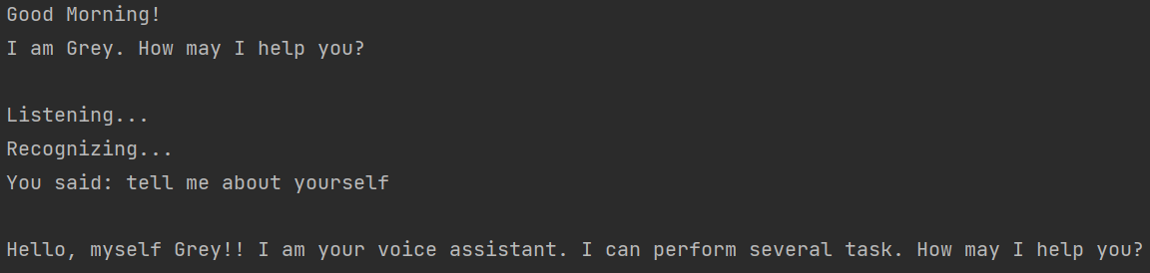
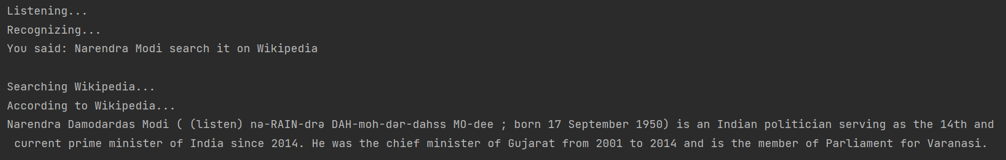
PROJECT WALKTHROUGH: SNAPSHOTS

Slide 16
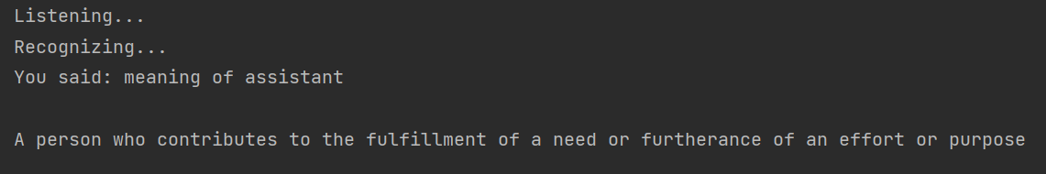
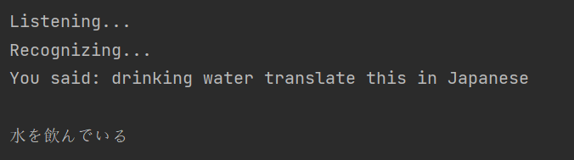
PROJECT WALKTHROUGH: SNAPSHOTS

Slide 17
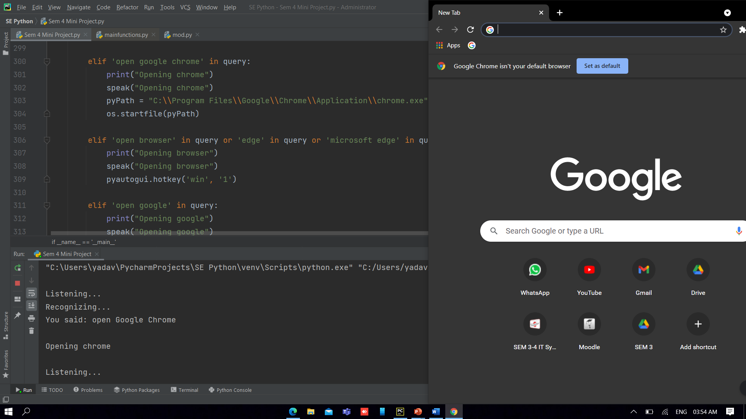
PROJECT WALKTHROUGH: SNAPSHOTS

Slide 18
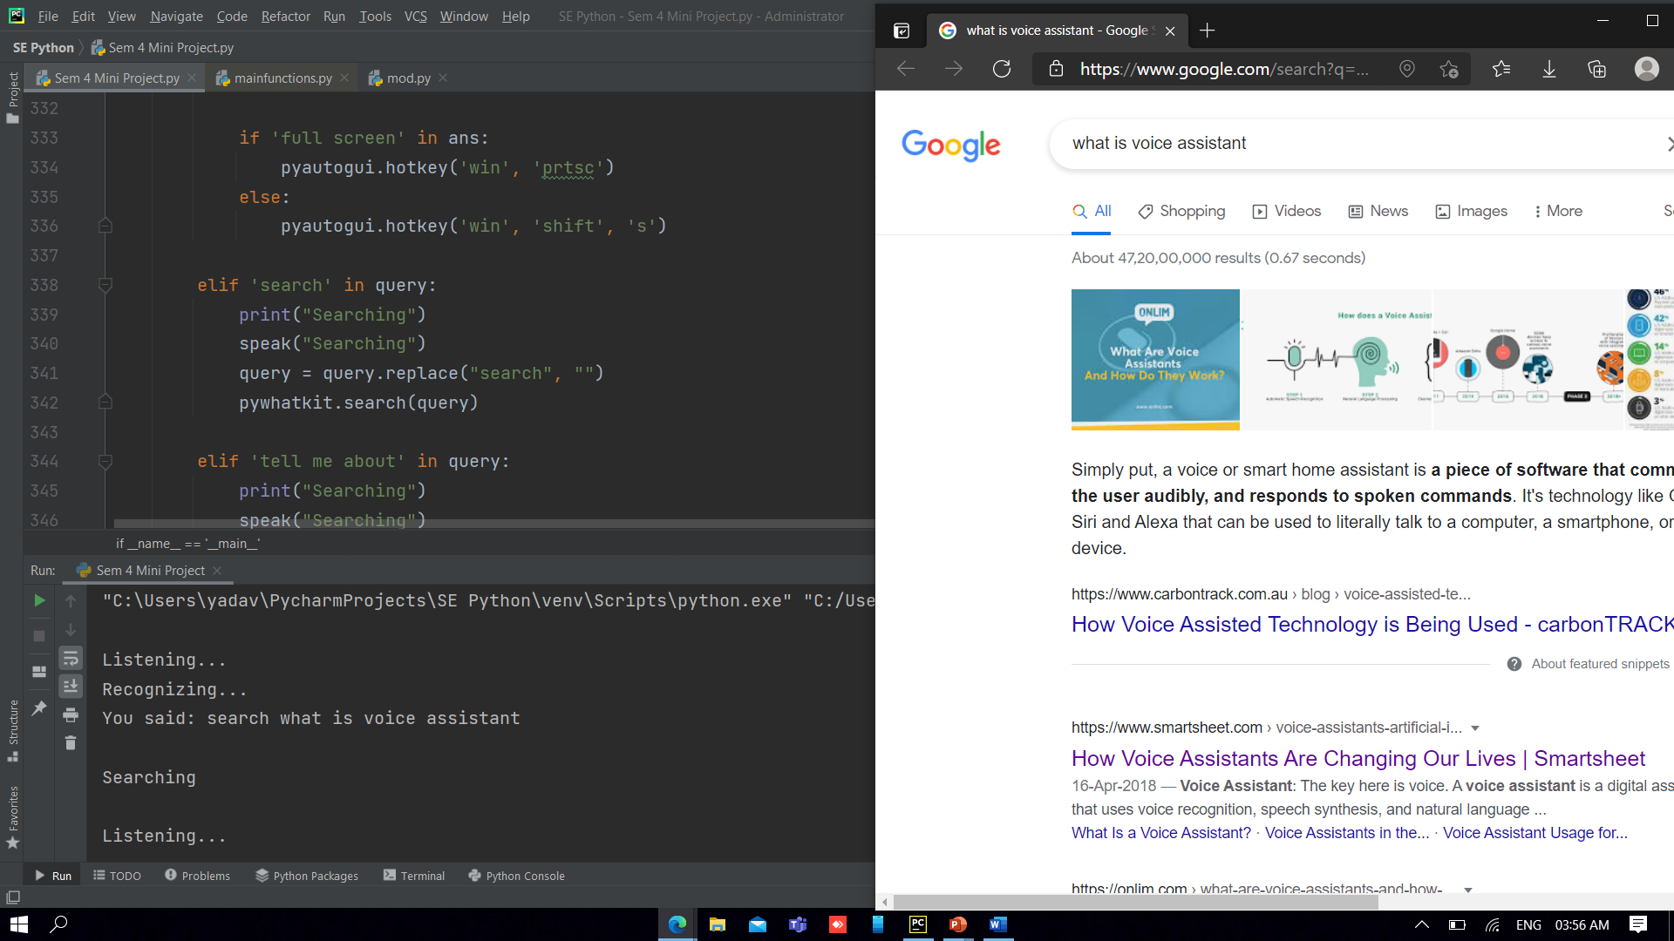
PROJECT WALKTHROUGH: SNAPSHOTS

Slide 19
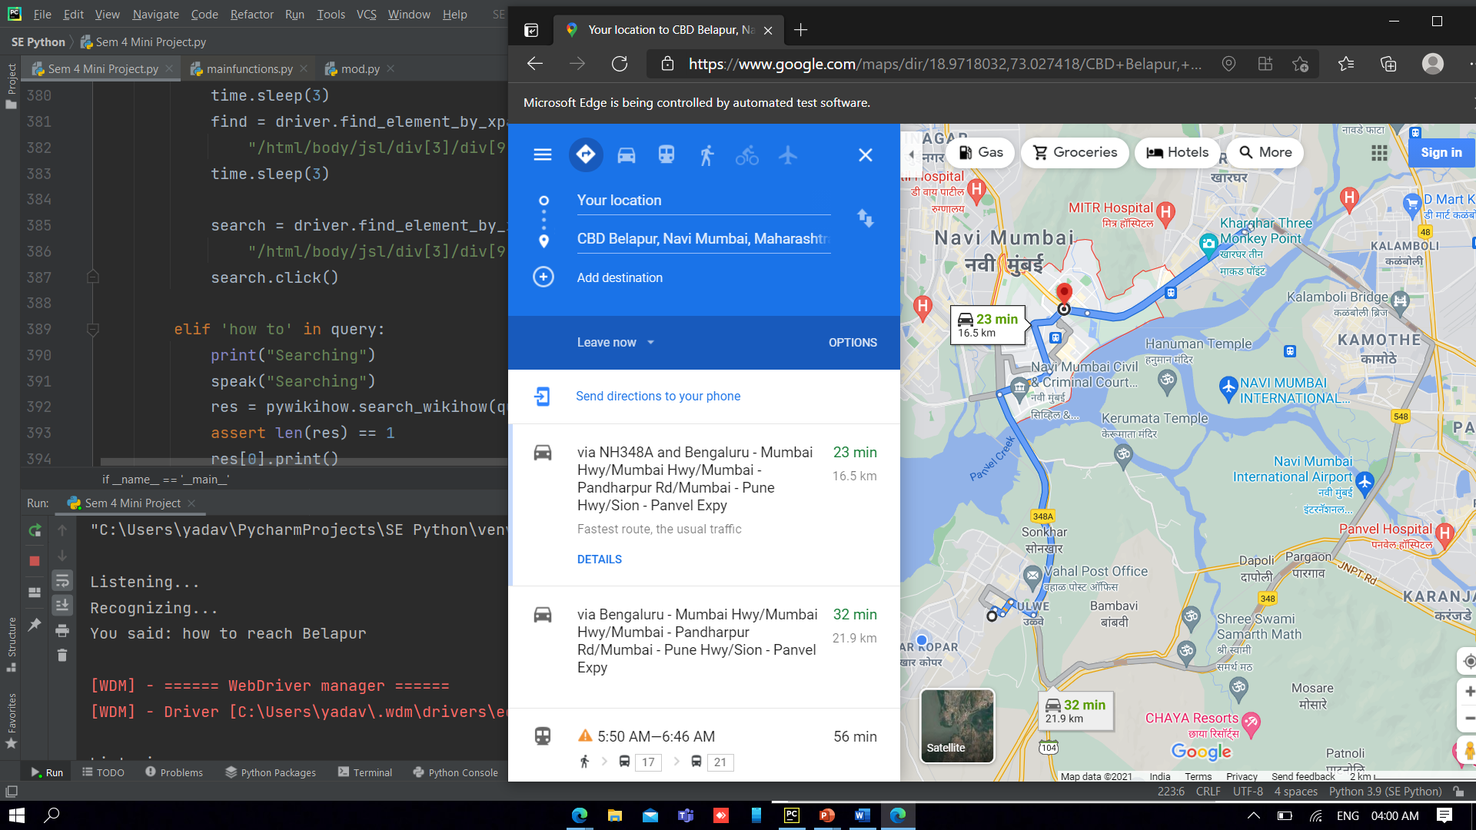
PROJECT WALKTHROUGH: SNAPSHOTS

Slide 20
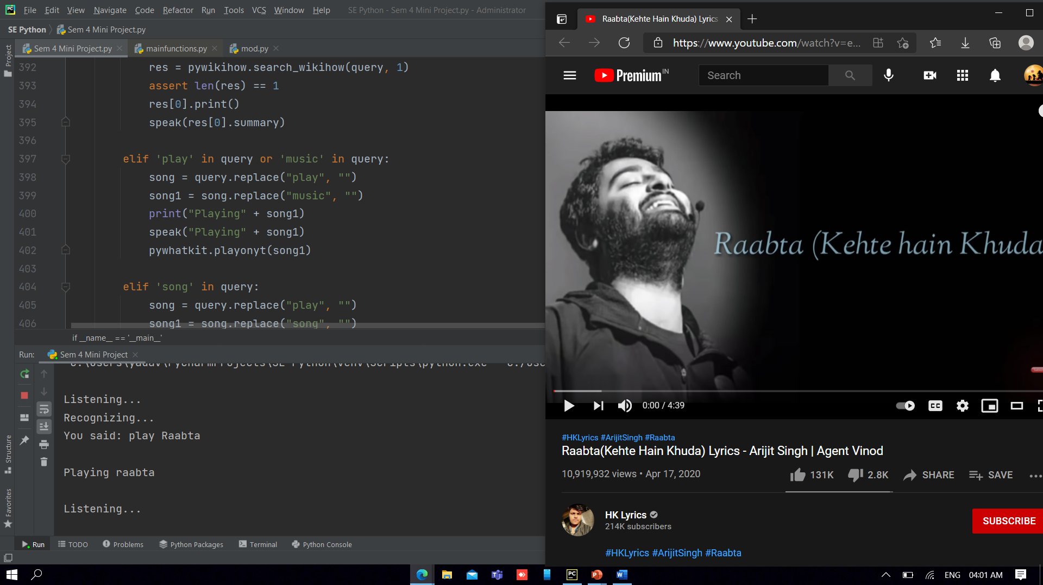
PROJECT WALKTHROUGH: SNAPSHOTS

Slide 21
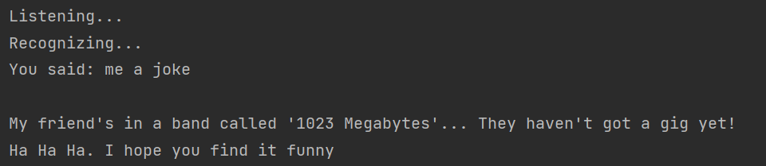
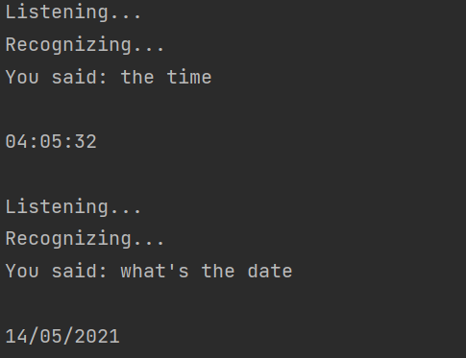
PROJECT WALKTHROUGH: SNAPSHOTS

Slide 22
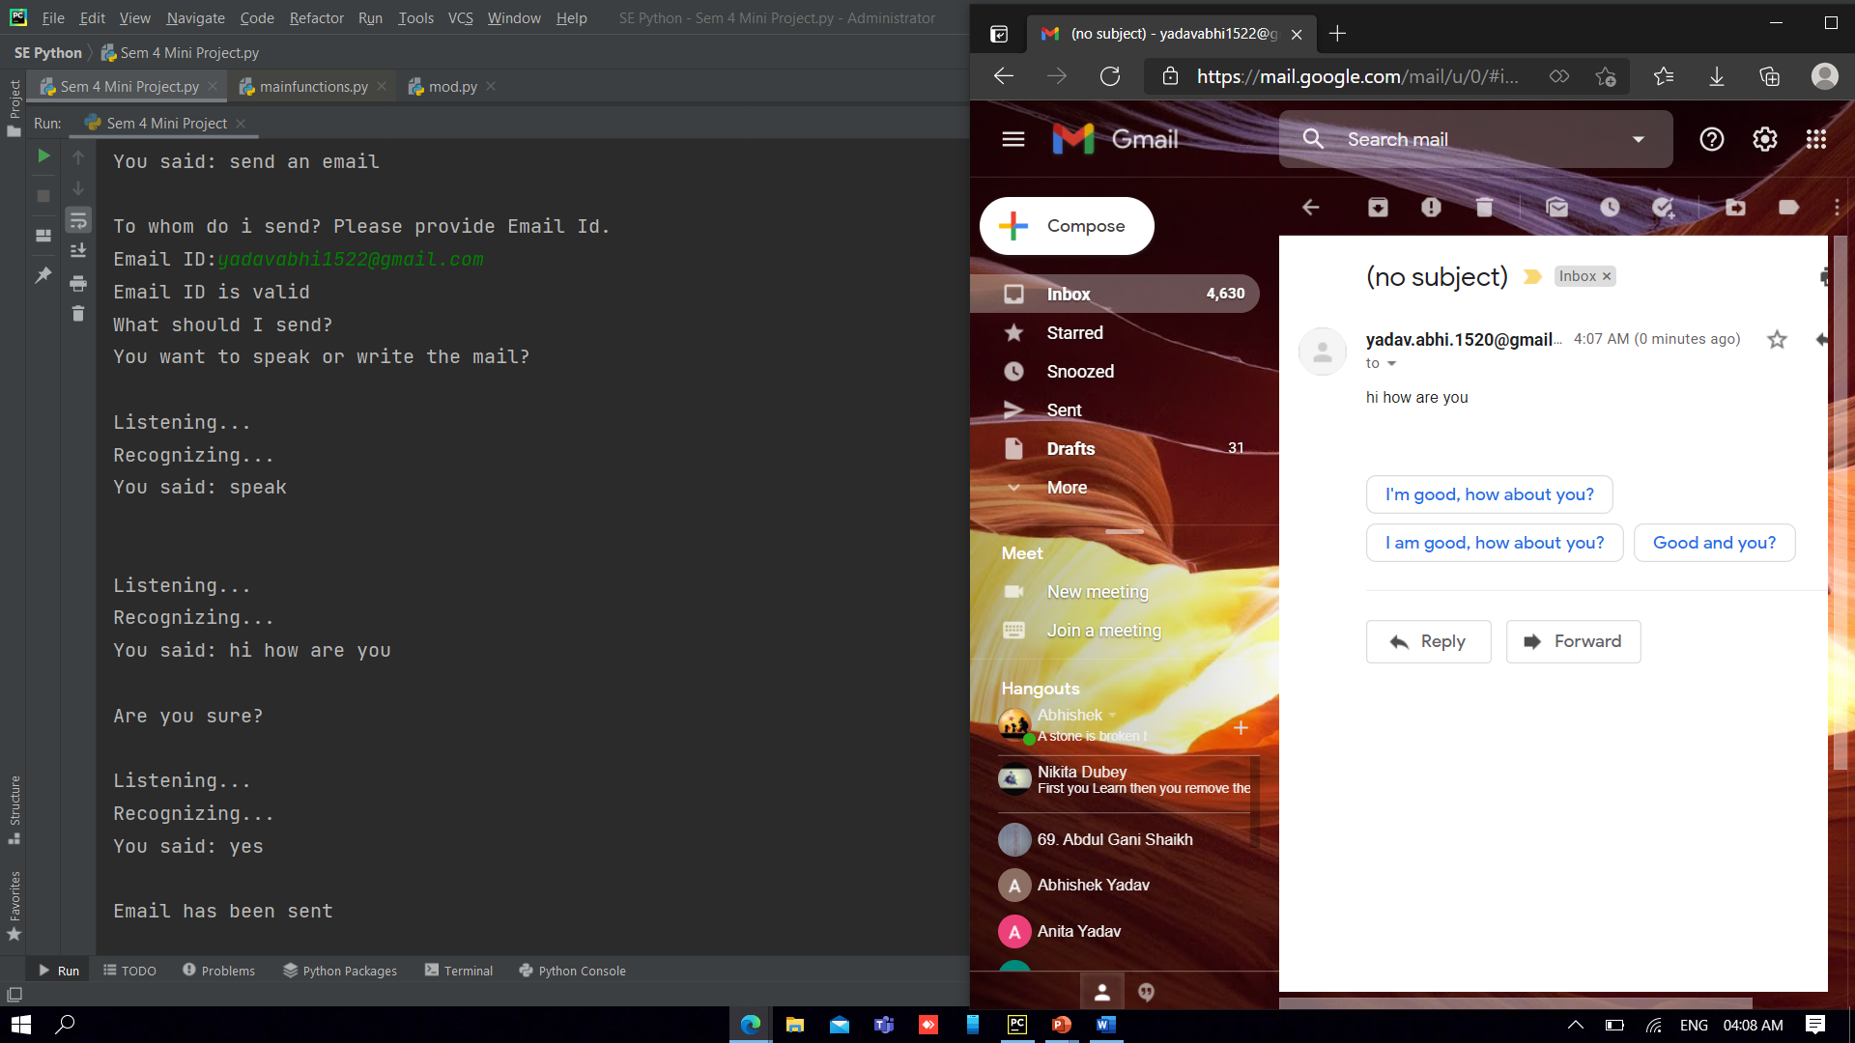
PROJECT WALKTHROUGH: SNAPSHOTS

Slide 23
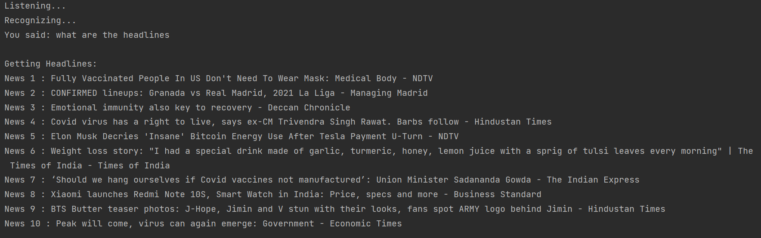
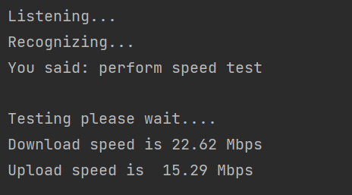
PROJECT WALKTHROUGH: SNAPSHOTS

Slide 24
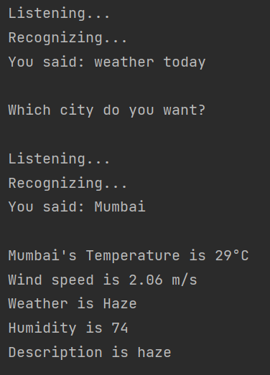
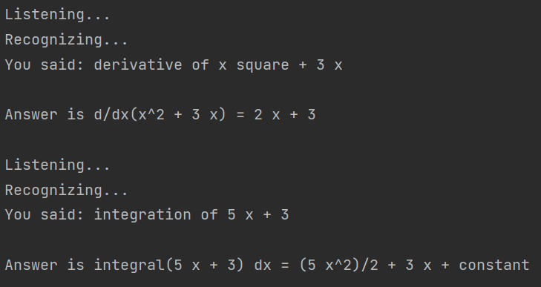
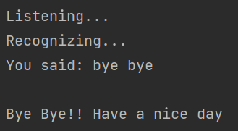
PROJECT WALKTHROUGH: SNAPSHOTS

Slide 25
FUTURE SCOPE
Controlling Smart Home appliances.
Chatbot, talking to user.
GUI based interface.
Play Games.
Controlling Device.
Read notification or messages for you.
AI based Knowledgebase.
Storing queries for future references.

Slide 26
CONCLUSION
Voice Controlled Personal Assistant System will use the Natural language processing and can be integrated with artificial intelligence techniques to achieve a smart assistant that can control the computer and applications and even solve user queries using web searches.
It can be designed to minimize the human efforts to interact with many other subsystems, which would otherwise have to be performed manually.
By achieving this, the system will make human life comfortable.
This project helped us to understand different aspects of Python Programming through different packages, modules and APIs.

Slide 27
REFERENCES
Books Referred –
Learning Python, 5th Edition, Marks Lutz.
Core Python Programming, Dr. R. Nageswara Rao.
E Balagurusamy, “Introduction to computing and problem-solving using python”, McGraw Hill Publication.
Websites Referred –
https://ieeexplore.ieee.org/document/9210344/figures#figures
https://ieeexplore.ieee.org/document/8993344
https://pypi.org/
https://docs.python.org/
https://www.geeksforgeeks.org/

Slide 28
THANK YOU

