Slide 1
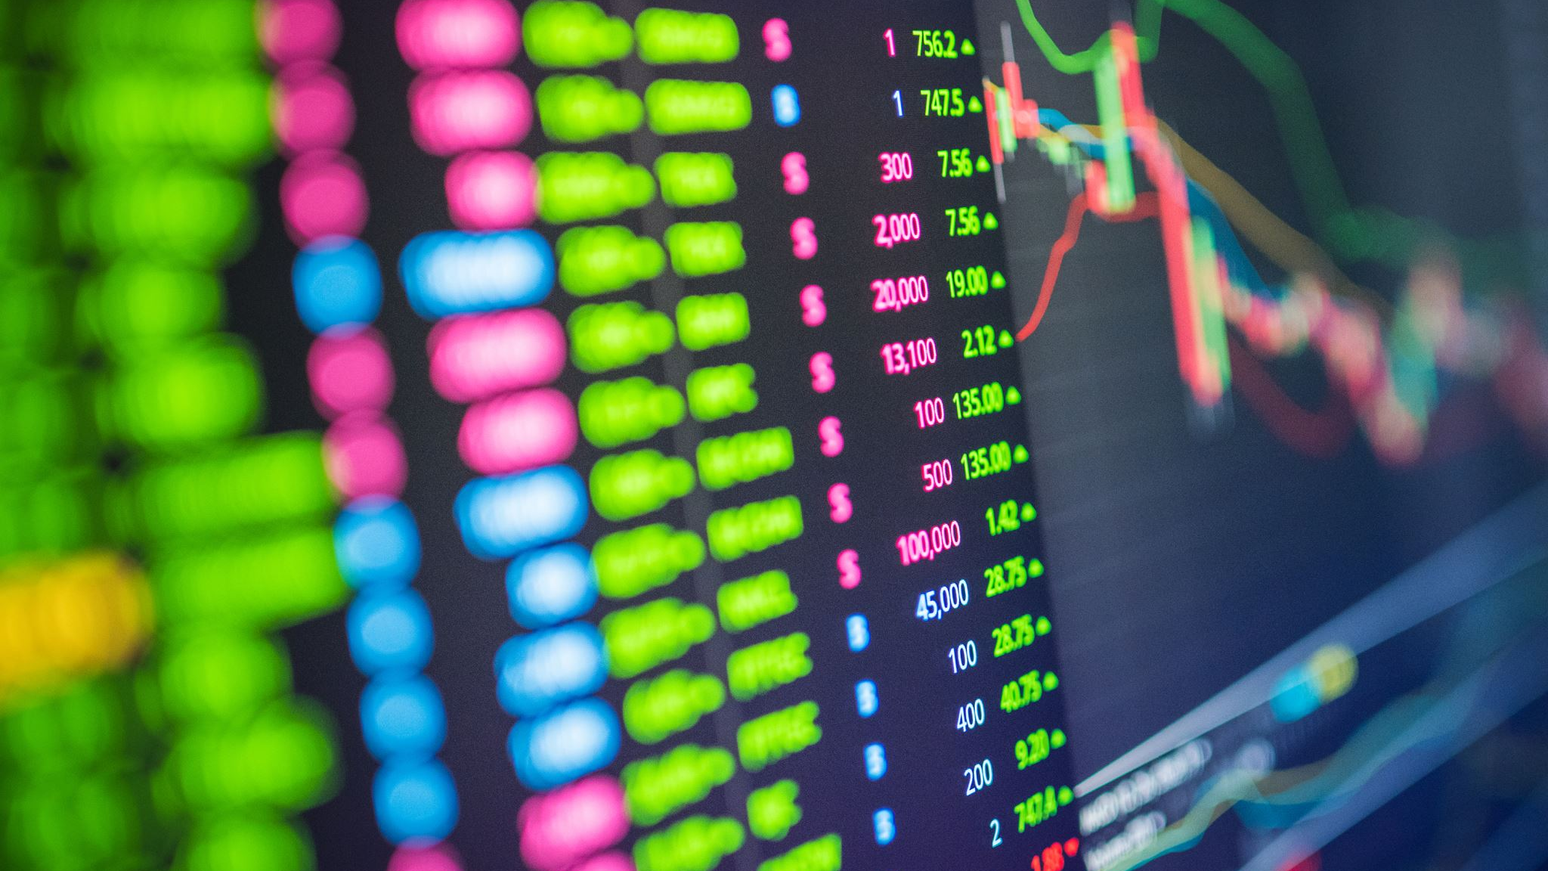
BTC/USDT Market Predictive Model Report
SARIMA-based and lstm-based Predictive Models

Slide 2

SARIMA REPORT

Slide 3
Data Preprocessing
We were given Open, High, Low, Close (OHLC) table of BTC/USDT Trading Pair which had data from 2018-01-01 05:30:00 till 2022-01-31 05:30:00 with an interval of 6 hours.
We selected the Close column to analyze and predict, as the closing price is often considered a crucial feature in time series analysis and prediction. It is the last price at which a trade occurred during a given period, and many trading strategies and technical indicators are based on it.
The Dickey Fuller test was used to check for stationarity. Initially, it had a p-value of .779, but after taking the first difference, it came down to 0. Based on STL Decomposition, a seasonal differencing having a period of 24 which is equivalent to 6 days in 6 hours' time scale was done. The ACF PACF plots with lag of 60(equivalent to 15 days in the given time scale), were also plotted which will helped in deciding the parameters (p, q, P, Q) for the SARIMA model. A finite difference was taken once and seasonal difference was too taken once, having an interval of 24. So, the parameters s = 24, D = 1, d = 1. From the Time Series plot we saw that we had a problem of increasing variance which hindered stationarity.
To enhance model stability, a Box Cox transformation was used. This preprocessing step ensures that the time series variance is stabilized and it adheres to the model assumptions, leading to more accurate predictions.
SEE THE NEXT PAGE FOR RELEVANT GRAPHS

Slide 4
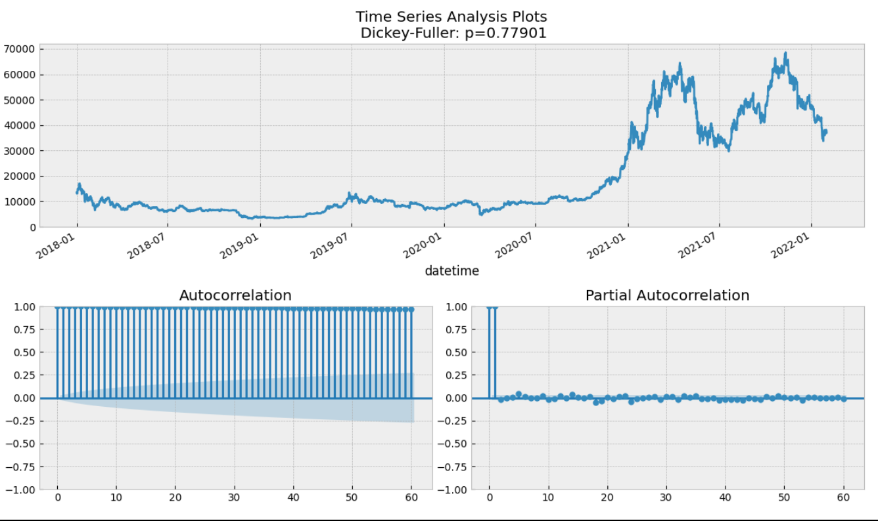
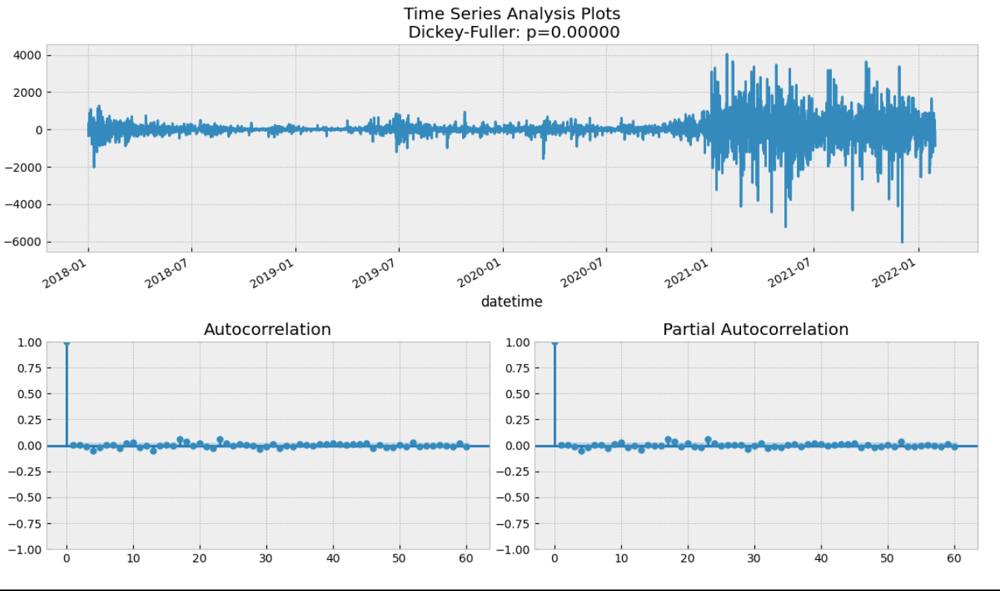
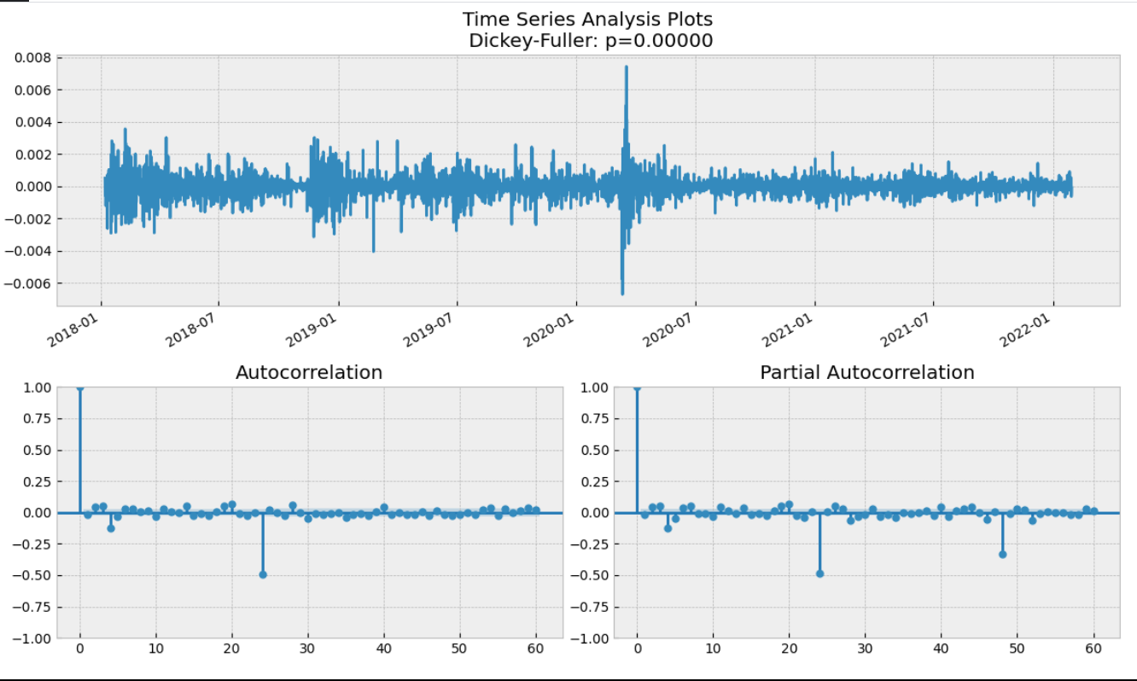
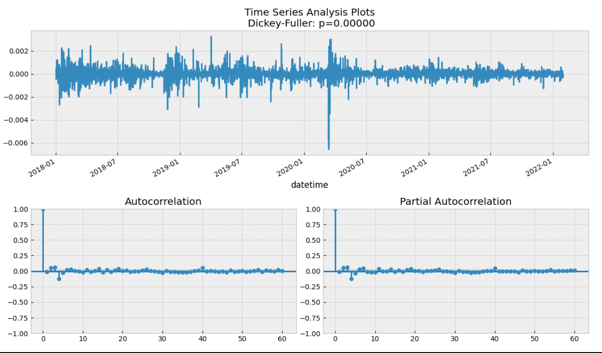
Original Plot of Close Prices
After taking first differences
After taking seasonal differences(s = 24)
After applying Box Cox Transformation

Slide 5
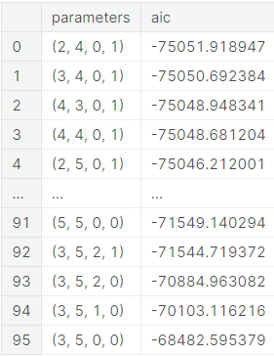
Model Parameters
The SARIMA (Seasonal AutoRegressive Integrated Moving Average) model leverages the power of both autoregressive and moving average components to capture temporal dependencies in the BTC/USDT time series data.
From the ACF, PACF plots, we chose estimated parameters (p=4, d=1, q=4, P=2, D=1, Q=1, s=24). So a grid search was run taking p to be in range(2,6), q in range(2,6), P in range(0,3) and Q in range(0,2)
AIC was used as the metric, the lower, the better. The results table is given on the right which is sorted in ascending order. The best combination was (p=2, d=1, q=4, P=0, D=1, Q=1, s=24).
The autoregressive component (p) accounts for the influence of past values, the differencing component (d) addresses non-stationarity, and the moving average component (q) captures the impact of past forecast errors.
The seasonal parameters (P, D, Q, s) handle seasonality in the data, considering the 24-hour cycle in the BTC/USDT market.

Slide 6
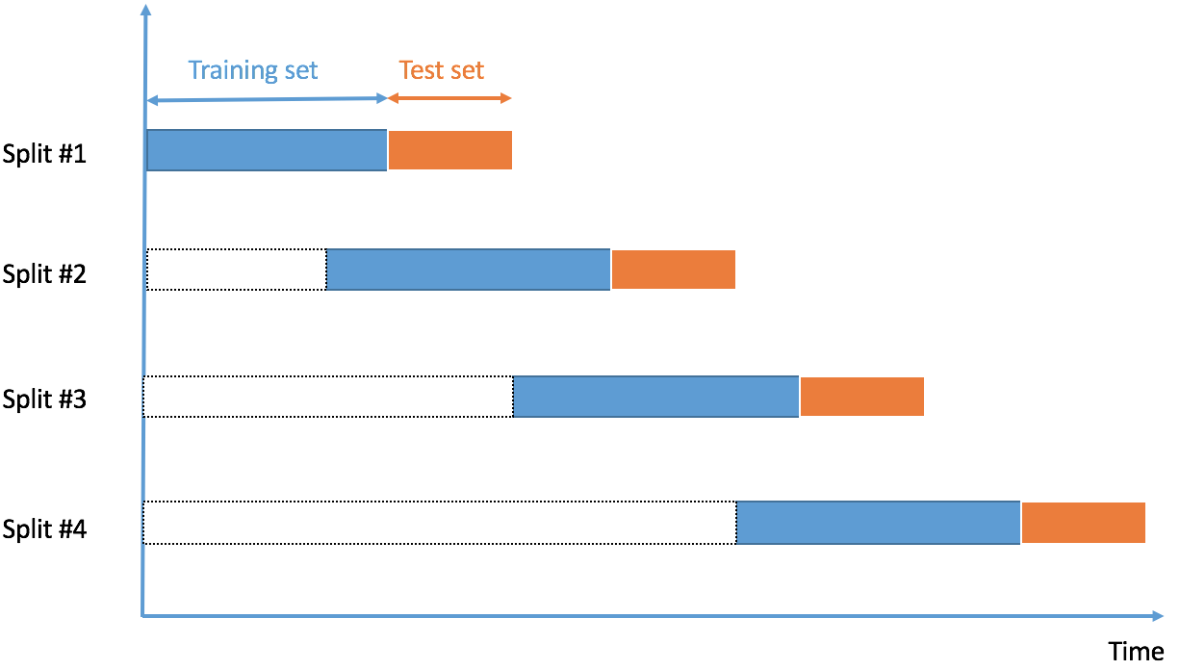
Forecasting and Cross Validation
As the model was fed with Box Cox Transformed data, the predictions are also transformed, in order to invert this transformation a inverse_boxcox function was implemented. A parameter n_steps was used to determine how many time steps in future do we have to predict.
Time Aware Cross Validation Scheme with 20 folds was used to check robustness of our model
Mean Absolute Percentage Error(MAPE) was used as our metric for CV
The mean of the 20 errors came out to be 22.38%, which is acceptable as in financial markets, predicting precise price movements is challenging due to the inherent volatility and randomness. Cryptocurrencies, including Bitcoin, are known for their price volatility.
This Photo by Unknown author is licensed under CC BY.

Slide 7
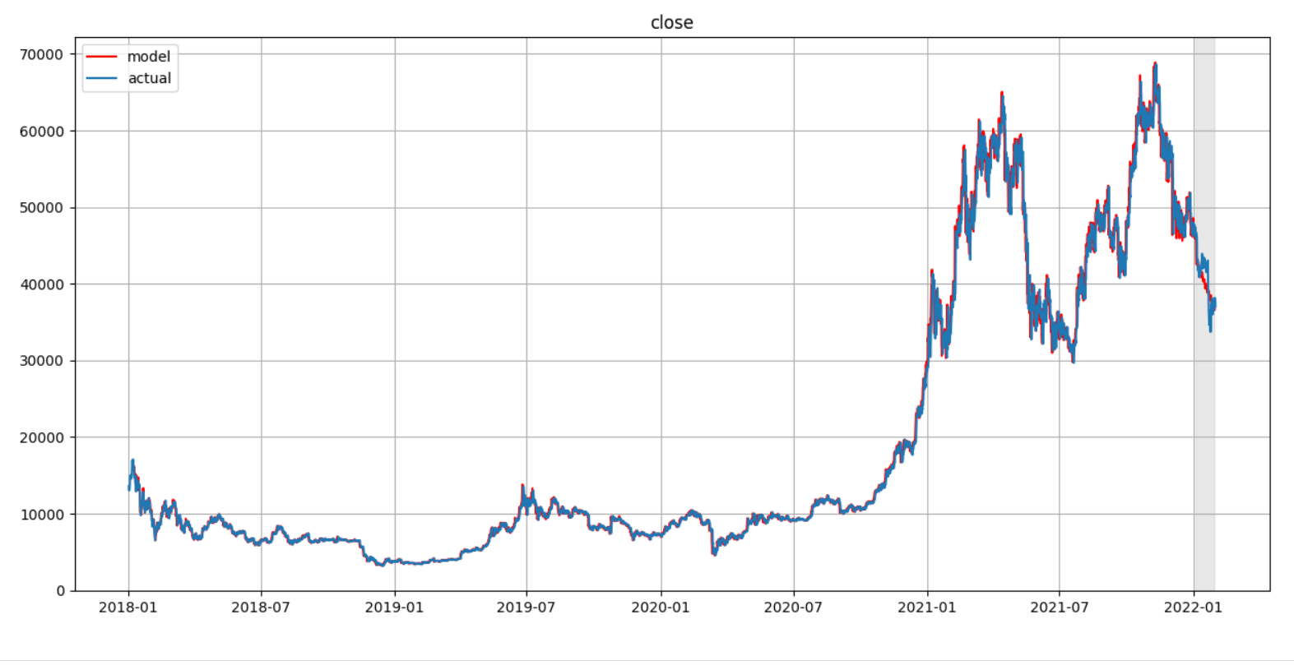
SARIMA Prediction (shaded)

Slide 8

Trading Strategy
Buy shares if 78-hour moving average > 144-hour moving average
Sell shares if 78-hour moving average < 144-hour moving average
The trading signals were generated on the basis of predicted series and were applied to the original series
According to it daily returns, cummulative returns, equity curve, sharpe ratio etc were calculated

Slide 9
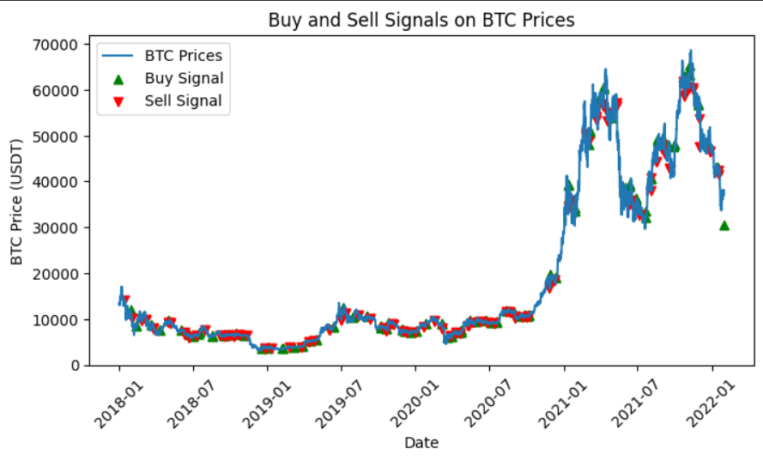
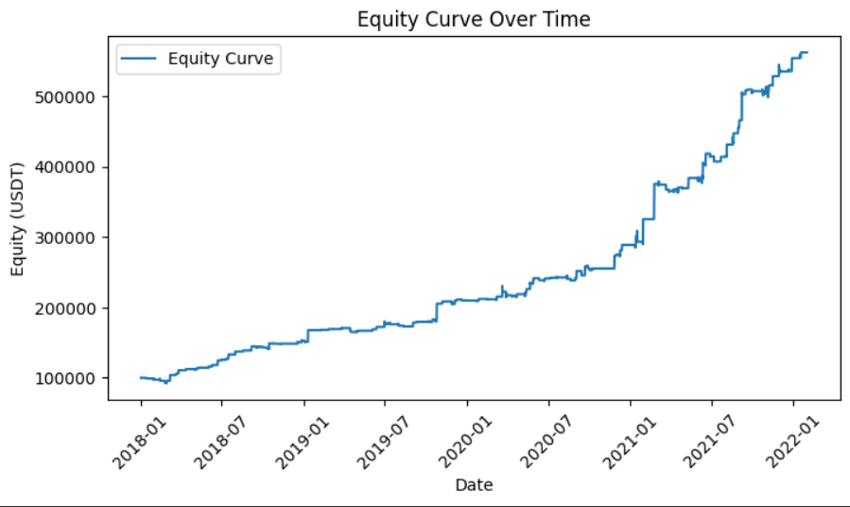
Backtesting Results
Equity Curve Analysis:
•Observation: The SARIMA model generates signals based on the dynamics of the equity curve.
•Characteristic: The equity curve demonstrates a rise, triggering sell signals during dips and buy signals during upward movements.
Buy/Sell Signals:
•Strategic Indicators: Signals are strategically generated to capitalize on the observed patterns in the equity curve.
•Pattern Recognition: Buy signals coincide with upward movements, while sell signals align with dip points
Performance Metrics:
•Sharpe Ratio: 1.1299
•Annualized Returns: 10.16%
•Maximum Drawdown: 7.92%

Slide 10
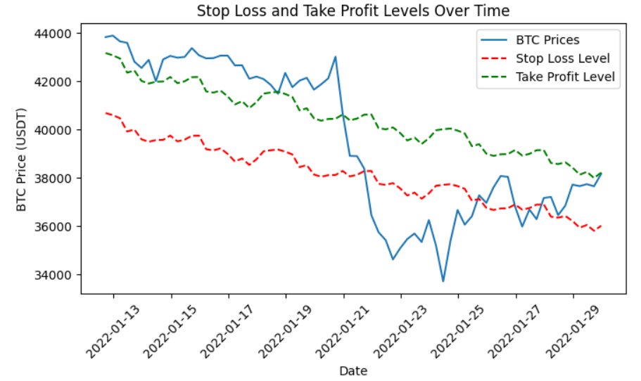
Risk Management Strategy
Risk-management policies like stop loss and take profit were plotted.
The stop loss percentage was kept at 0.02 and a fairly standard reward-risk ratio of 2:1 was used. This can be modified according to the trading policies of the user.
Performance metrics like sharp ratio, annualized returns and maximum drawdown were also provided alongside with this.

Slide 11

LSTM REPORT

Slide 12

Data Preprocessing
The features in the LSTM layer first consisted of only the ones in the csv file i.e., Open, High, Low, Close and Volume. However, on training the model, it led to significant overfitting after 4 epochs and hence additional features like High-Low ratio, Daily Returns, Moving Averages and RSI were added. To ensure that the overfitting problem does not persist, the correlation heatmap was plotted. There we see that many features have close to 0 correlation which is exactly what we need to solve the overfitting problem.
The Moving Averages were calculated on a 30-minute and 150-minute window. It is also the basis of how the buy and sell signals are generated. RSI was calculated on a 42-minute window.
Plots of volume analysis, moving averages and return analysis were plotted on the input data to have a better understanding of the trends in the market.
SEE THE NEXT PAGE FOR RELEVANT PLOTS

Slide 13
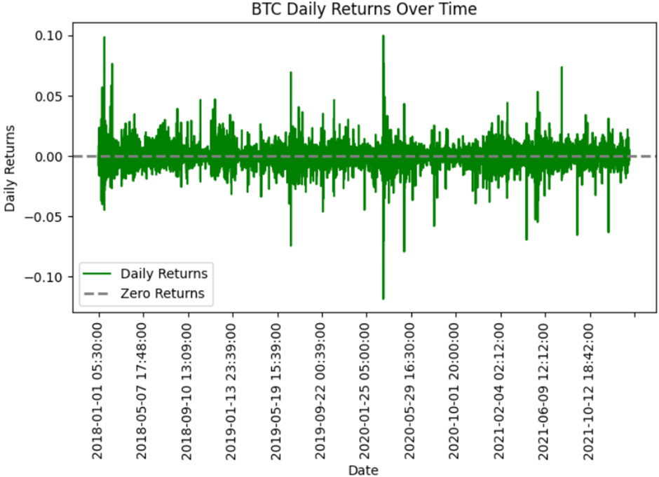
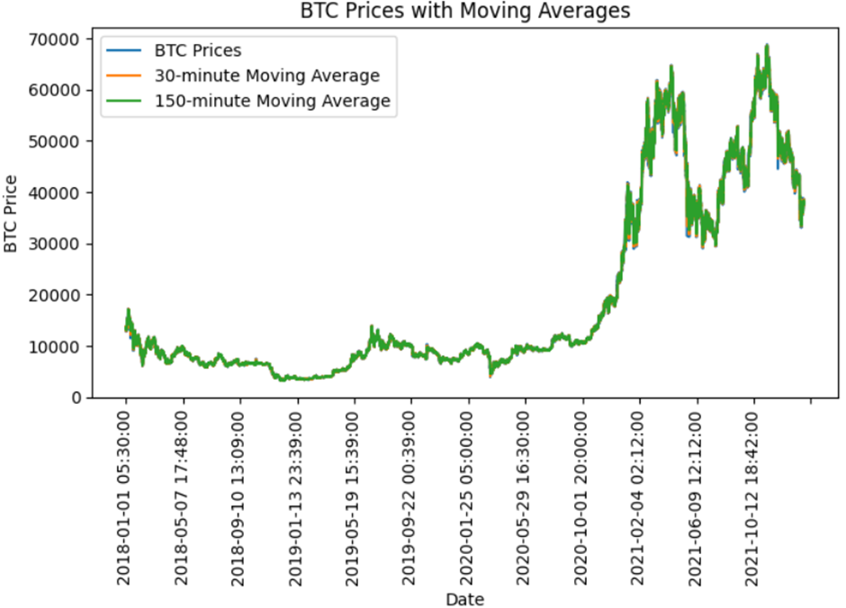
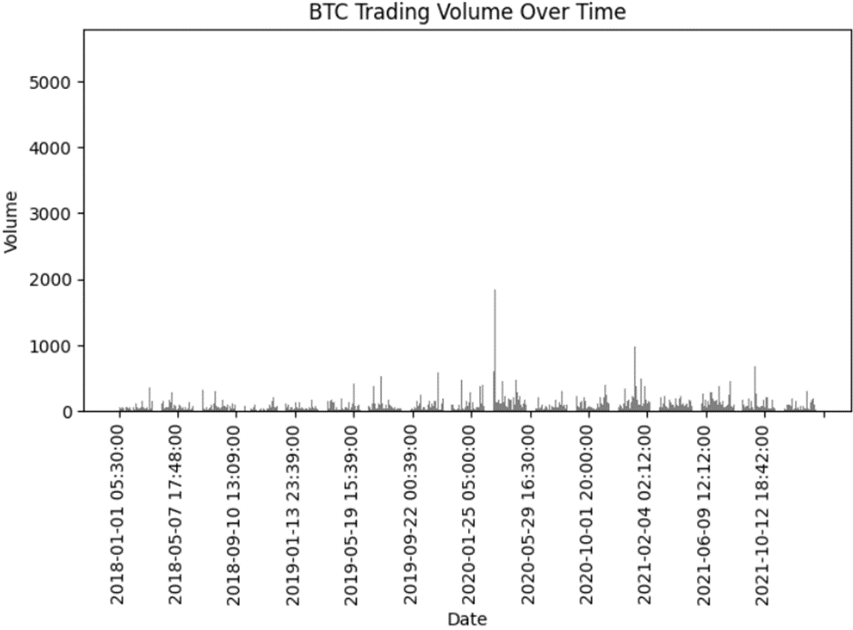
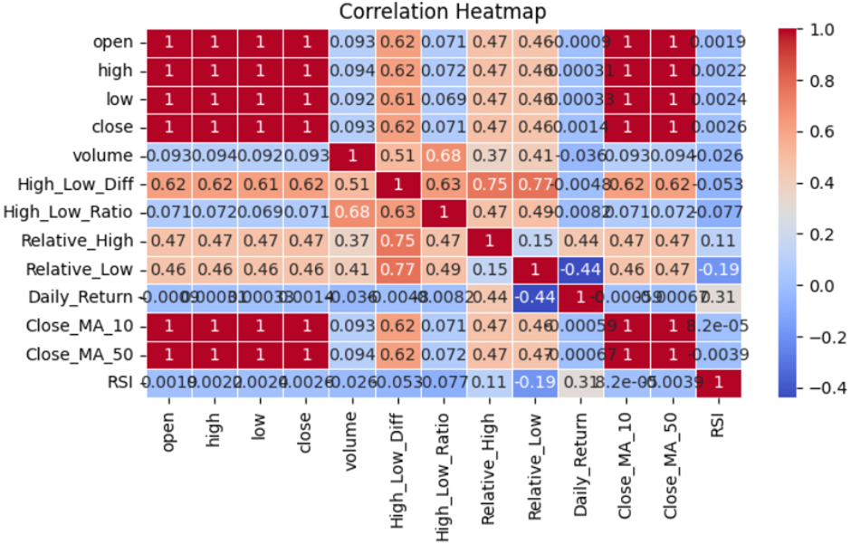
RELEVANT PLOTS

Slide 14

MODEL PARAMETERS
Batch size was kept at 32 throughout the testing. The number of epochs however was varied and it was ultimately found that 10 epochs is a good stopping point since the loss did not reduce significantly however the hyper-parameters were adjusted after 10 epochs.
The model consists of 2 Bidirectional LSTM layers since anything more than 2 did not produce any meaningful improvement of our result. The number of units was first kept at 50 units per layer as anything less than that produced underfitting. The final number was adjusted at 128 and 64 with recurrent dropouts of 0.4 and 0.25 to decrease the loss as well as keep overfitting in check. Finally, a Dense layer was added to the model. For further optimization RMSProp and Adam produced similar results. The loss used was mean squared error since the data is of continuous time series format.
The model takes the last 30-minute time series data as input and so sliding windows of a sequence length of 10 was used. This can be adjusted by the user according to his trading policy.

Slide 15
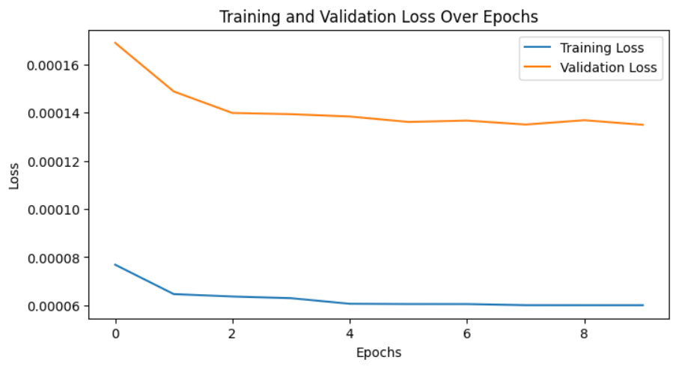
MODEL FITTING
Additionally, early stopping was implemented initially to adjust for overfitting but it did not prove to be much helpful since after increasing the features, both the training and validation loss tend to saturate after about 5 epochs.
While increasing features did solve the overfitting problem, it also increased the validation loss. To solve this, Reduce LR on plateau was implemented and the parameters adjusted so that the training and validation loss have acceptable values.
An 80:20 train-test split was made and after significant testing the Mean Absolute Percentage Error (MAPE) on the test Closing Prices comes out to be around 0.18%-0.20%.
The training and testing were mostly done on the ‘btc_3m.csv’ dataset since it contains the most information and additional stripping of data can be done as and when required

Slide 16
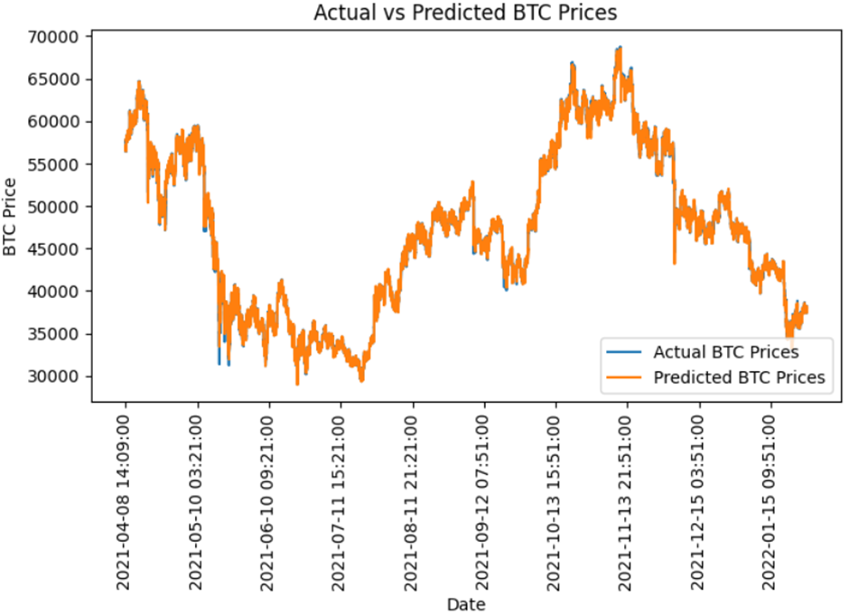
MODEL PREDICTION

Slide 17
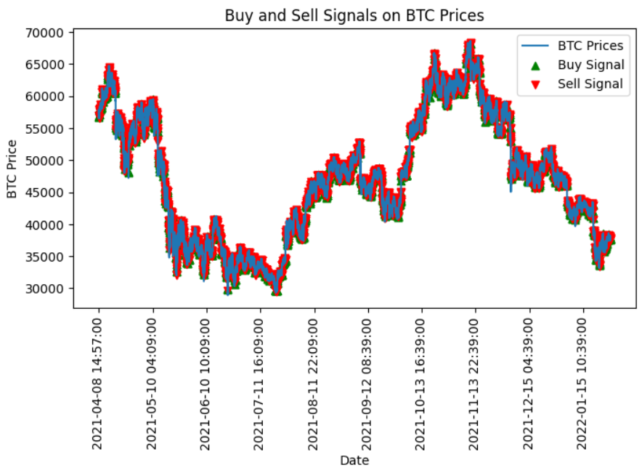
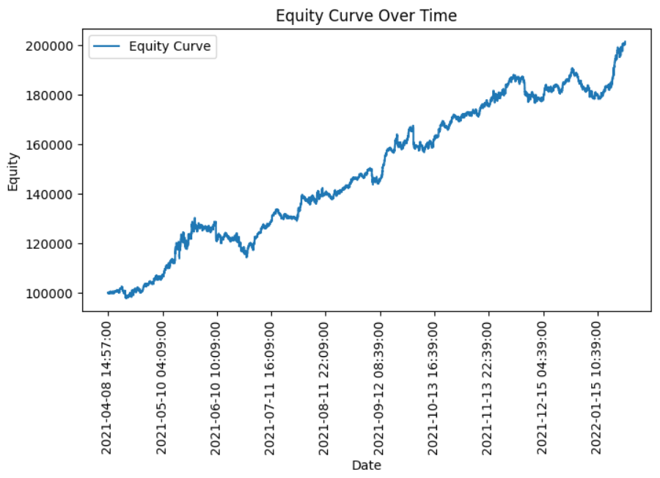
BACKTESTING
Trading Strategy is the same
For back testing, parameters like daily returns, cumulative return were calculated and equity curve was plotted. The buy and sell signals generated on the basis of moving averages was also plotted and it showed a fairly accurate prediction of when to buy or sell stocks. This policy can be made more modular and user-defined if required.

Slide 18
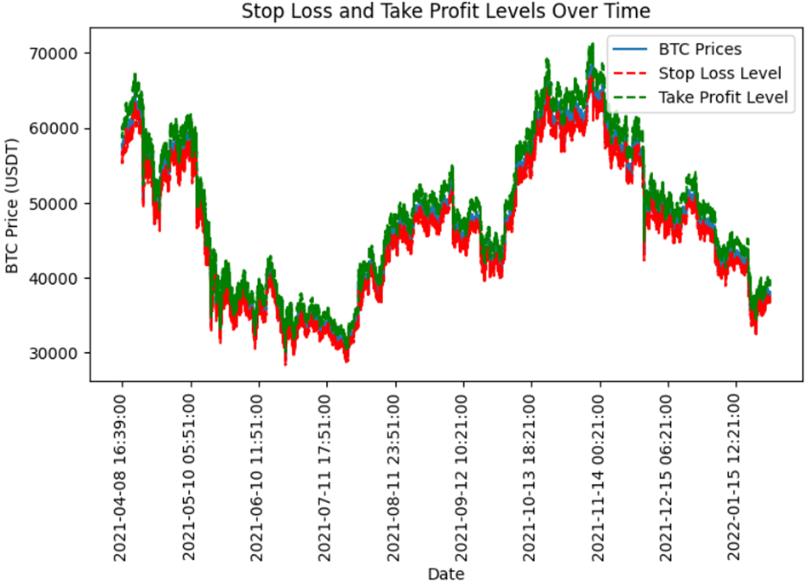
RISK MANAGEMENT SYSTEM
Risk-management policies like stop loss and take profit were plotted.
The stop loss percentage was kept at 0.02 and a fairly standard reward-risk ratio of 2:1 was used. This can be modified according to the trading policies of the user.
Performance metrics like sharp ratio, annualized returns and maximum drawdown were also provided alongside with this.

