Slide 1

AMCAT Exploratory Data Analysis
(AMCAT dataset)

Slide 2
About me
Hello!! My name is Abhishek Alwandi, a Data enthusiast. I completed my Bachelor of Engineering in Computer Science . Currently I’m working as an intern at Innomatics Research Labs on Data Science with Gen AI. The enthusiasm and the passion for Data Analysis motivated me to explore the world of Data Science.
Previously I did an internship on Java Full Stack, where I had to deal with a large data and do analysis on it. From there my passion to get into Data Science increased and it landed me today in this Data Science internship.
Here are my LinkedIn and GitHub links to reach me out and to see my works :
- https://www.linkedin.com/in/abhishekalwandi01/
- https://github.com/Abhialwandi

Slide 3
Objective of the Project
This Exploratory Data Analysis (EDA) analyze AMCAT scores and identify the trends that impacts employability based on demographic and domain-related factors. It also gets the correlation between verbal, logical and quantitative domain scopes and overall employability.
It provides companies and educational institutions with insights to improve to improve recruitment process and curriculum development.

Slide 4
Summary of the Data
Dataset contains 3998 rows and 39 columns.
The dataset contains the employment outcomes of engineering graduates as dependent variables (Salary, Job Titles, and Job Locations)
Along with the standardized scores from three different areas – cognitive skills, technical skills and personality skills.
The independent variables are both continuous and categorical in nature.
The dataset contains a unique identifier for each candidate.

Slide 5
Exploratory Data Analysis:
Imported Libraries: Pandas, NumPy, Matplotlib, and Seaborn for data manipulation and visualization.
Load Dataset: Read the dataset into a Pandas DataFrame for exploration.
Initial Exploration: Use functions like .shape, describe(), and .info() to understand the dataset size, data types, and summary statistics.
Data Cleaning Steps:
Handling Missing Data: Identify and address any missing values.
Remove Duplicates: Eliminate any duplicate entries in the dataset.
Correct Inconsistent Values: Fix any inconsistencies in the data. Data cleaning involves rectifying or removing incorrect, corrupted, improperly formatted, duplicate, or incomplete data.
Data Manipulation Steps:
Map Categorical Values: Mapped Categorical values to proper streams
Removed Unnecessary Columns: Dropped unnecessary columns i.e Unnamed
Filtering: filtered the data as per the requirement for analysis

Slide 6
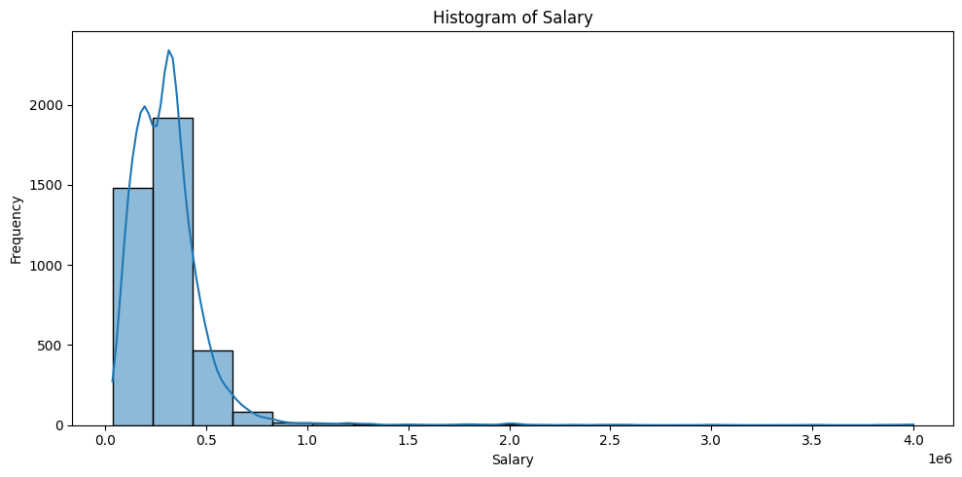
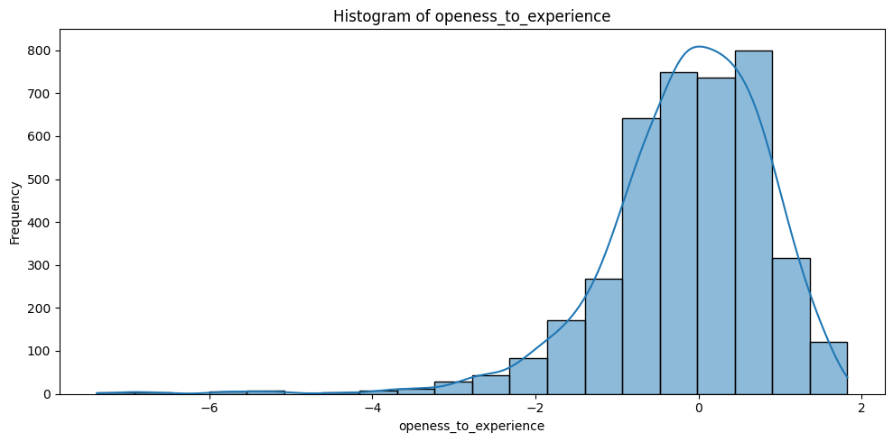
Univariate Data Analysis:
The first histogram figure shows the range of salary people getting.
The second histogram figure shows us the count of years of experience people having in the dataset.

Slide 7
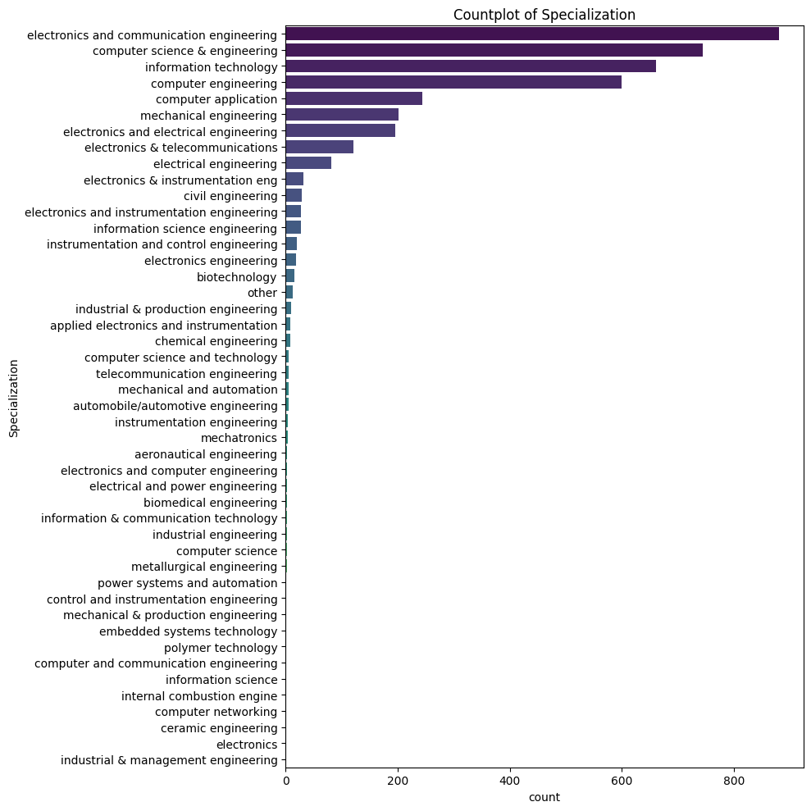
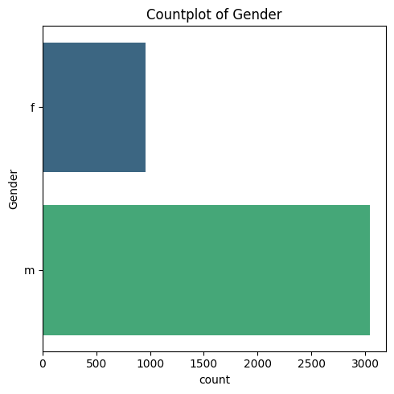
Univariate Data Analysis:
We can observe that female graduates are working less in number compared to male.
The other countplot shows us the Specialization done by the graduates.

Slide 8
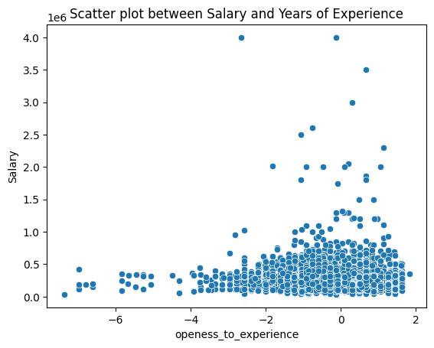
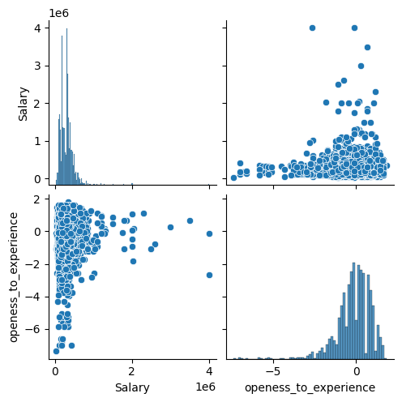
Bivariate Data Analysis:
We can observe in the pairplot that the pairwise relationships between Salary and openness to experience and vice versa.
We may notice the scatter plot between the Salary and openess to Experience.

Slide 9
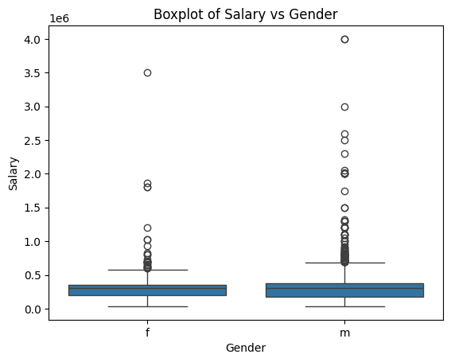
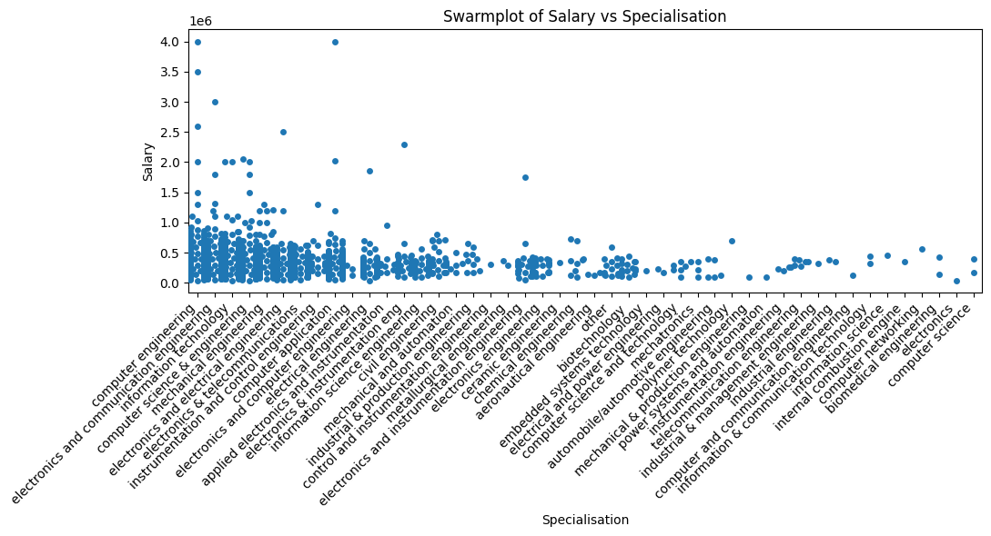
Bivariate Data Analysis:
The above swarmplot of Salary vs Specialization shows the salary range of the graduates of different specialization.
The Boxplot of Salary vs Gender tells that the males are getting paid more than females.

Slide 10
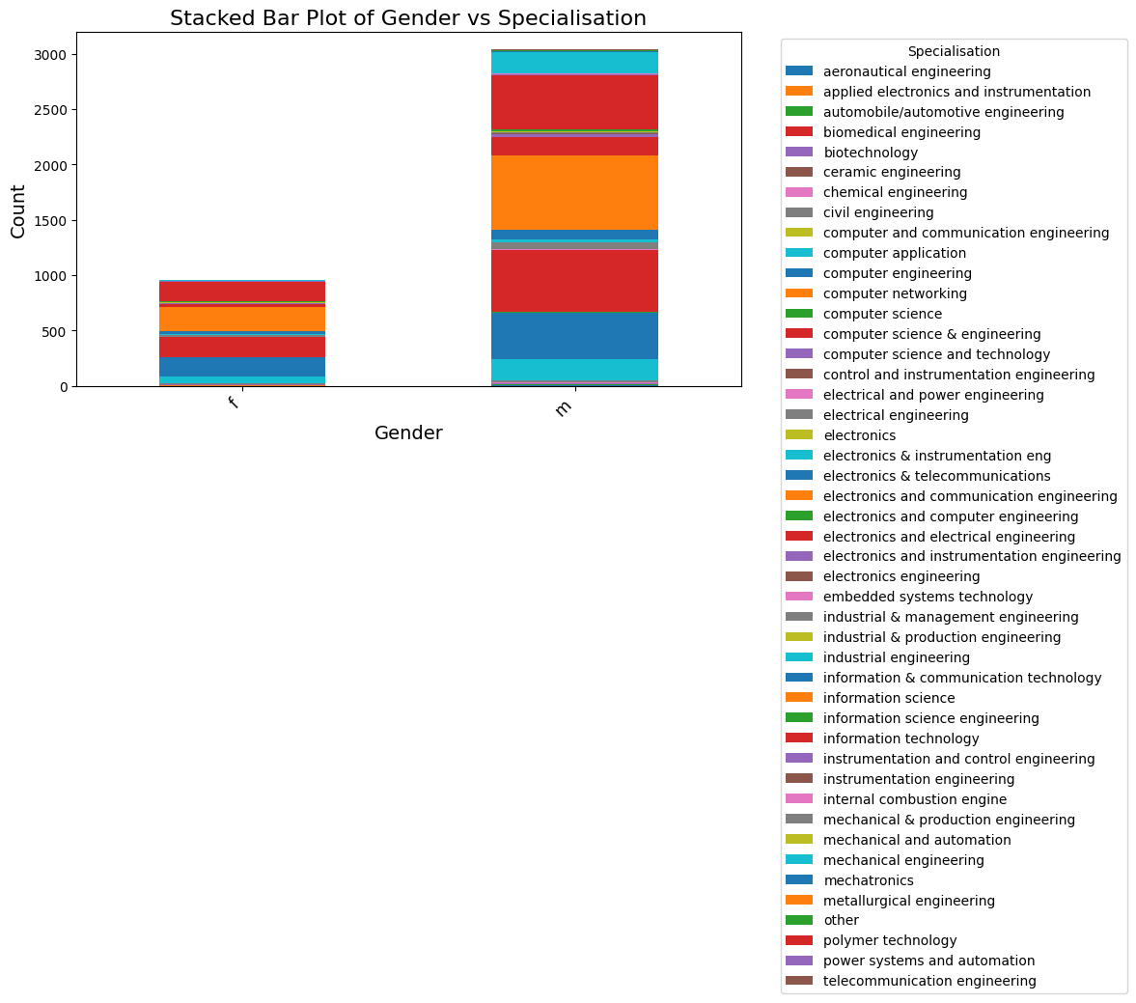
Bivariate Data Analysis:
The above Stacked Bar Plot shows us the analysis between Gender and Specialization of people.
It tells that the number of people from both male and female with a specialization.
Also, we can observe the employability is less in females compared to males according to the dataset .

Slide 11
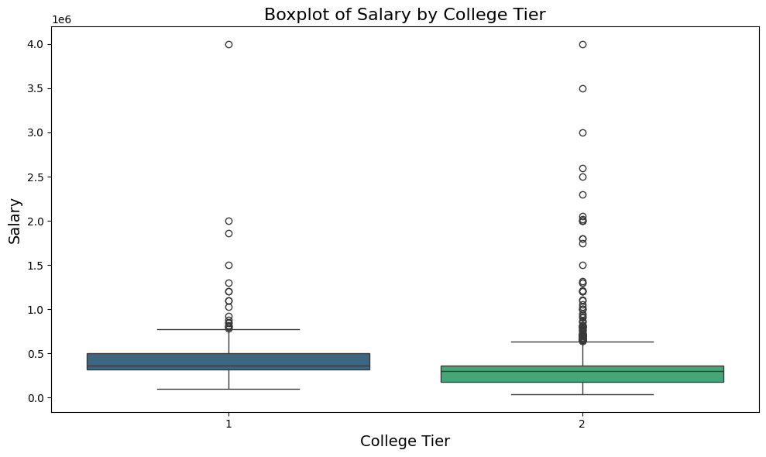
Question : Does college tier affects the salary?
The Boxplot shows the plotting between the Salary and College Tier, which says tier 2 students are earning more than tier 1.
So this states that the college tier does not affects the salary based on the dataset.

Slide 12
Conclusion
The analysis made on the AMCAT dataset provides with insightful conclusions regarding the salary trends, specialization and designation of the candidates. Here are some final conclusions made based on the analysis:
There is an uneven Distribution of male and female graduates across different job roles, indicating potential gender biases in certain specialization and job roles.
The graduates of Computer Science and IT related have higher salaries compared to others. This indicates the strong demand for the skills in tech industry.
Technical skills like programming , computer science and other related fields are strongly correlated with higher salaries, shows the significance in securing well-paying jobs.

Slide 13

Q&A

Slide 14

THANK YOU

