Slide 1
Attention-Guided Frequency-Domain Counterfactual Explanations for Transformer-Based Multivariate Time-Series Classification
Avinash Yadav (244101008) | Vaibhav Wankar (244101061)
Guide: Dr. Rashmi Dutta Baruah
Department of Computer Science & Engineering Indian Institute of Technology Guwahati
M.Tech Thesis · June 2026

Slide 2
Presentation Outline
1
Introduction & Motivation
2
Problem Statement & Research Gaps
3
Related Work — Existing Methods
4
Datasets
5
TAGFC Methodology — 5-Step Pipeline
6
Experimental Results: AQI India
7
Experimental Results: NATOPS
8
Comparison & Statistical Analysis
9
Conclusions & Future Work
TAGFC — Attention-Guided Frequency-Domain Counterfactual Explanations
2 / 28

Slide 3
Motivation
Why do we need counterfactual explanations for time-series classifiers?
Critical-domain deployment:
Predictive maintenance (NASA turbofans), air quality monitoring, and gesture interfaces all require not just predictions but actionable explanations.
Deep learning opacity:
Transformer classifiers achieve state-of-the-art accuracy on multivariate time series but are black boxes — operators cannot verify or trust their decisions.
SHAP/LIME limitations:
Feature-attribution methods answer 'what mattered?' but cannot answer 'what would need to change for a different outcome?' — they lack actionability.
Counterfactual gap:
Existing CF methods for time series (CoMTE, AB-CF, Native Guide) ignore sensor physics, work in raw-signal space, and discard model-internal saliency signals.
TAGFC insight:
Combining Transformer attention rollout + Haar wavelet domain + cross-sensor coherence yields sparse, physically valid, model-aware counterfactuals.
TAGFC — Attention-Guided Frequency-Domain Counterfactual Explanations
3 / 28

Slide 4
Problem Statement
Given a trained Transformer classifier f : ℝ^{T×D} → {1,…,K} and a query time series X with predicted label y = f(X), find a counterfactual X* such that f(X*) = y* ≠ y, where X* is (i) minimal in perturbation, (ii) sparse in changed sensors/timesteps, (iii) physically coherent across sensors, and (iv) close to real target-class samples.
Formal Objective
min_δ L_flip(X̃) + λ₁·L_sparse(δ) + λ₂·L_cross(X̃) + λ₃·L_manifold(X̃)
L_flip
L_sparse
L_cross
L_manifold
−log P(y*|X̃)
Σ ω_cd · |δ_cd|
Δμᵀ Σ⁻¹ Δμ
‖X̃ − X_nn‖²_F / (T·D)
Classifier flip loss
Omega-weighted wavelet L1
Mahalanobis cross-sensor coherence
Proximity to nearest target sample
TAGFC — Attention-Guided Frequency-Domain Counterfactual Explanations
4 / 28

Slide 5
Research Gaps & Objectives
Identified Research Gaps
Research Objectives
✗
No existing MTS CF method operates in the frequency/wavelet domain
1
Design a wavelet-domain counterfactual optimisation framework for MTS
✗
Existing methods ignore model-internal attention (black-box perturbation)
2
Derive attention rollout saliency to guide perturbation focus
3
Enforce cross-sensor Mahalanobis coherence in the objective
✗
Cross-sensor physical coherence is not enforced — outputs are physically implausible
4
Achieve exact sparsity via Proximal Gradient Descent with soft-thresholding
5
Evaluate on two benchmark datasets (AQI India, NATOPS) against 4 baselines
6
Conduct statistical validation with Wilcoxon signed-rank + Bonferroni correction
TAGFC — Attention-Guided Frequency-Domain Counterfactual Explanations
5 / 28

Slide 6
Related Work — Counterfactual Methods for Time Series
Method
Year
Search Space
Saliency-Guided?
Frequency Domain?
Coherence?
Native Guide
2021
Raw signal (window swap)
CAM-based (univariate)
No
No
CoMTE
2021
Raw signal (whole channel swap)
No
No
No
SETS
2022
Shapelet space
No
No
No
AB-CF
2023
Raw signal (segment entropy)
Entropy proxy
No
No
TAGFC (Ours)
2026
Haar wavelet coefficients
Attention rollout (multi-layer)
Yes (3-level Haar DWT)
Yes (Maha- lanobis Σ⁻¹)
TAGFC — Attention-Guided Frequency-Domain Counterfactual Explanations
6 / 28

Slide 7
Datasets
AQI India
NATOPS
NASA CMAPSS FD001
Central Pollution Control Board
UEA Time Series Archive
NASA Turbofan Degradation
T = 14 timesteps
T = 51 timesteps
T = 30 cycles
D = 12 pollutants
D = 24 channels
D = 14 sensors
K = 3 classes
K = 6 gesture classes
K = 3 health states
N = 60 explained
N = 30 explained
N = 200 (pending)
PM2.5, PM10, NO, NO2, NOx, NH3, CO, SO2, O3, Benzene, Toluene, Xylene Classes: Good / Moderate / Poor
Right/Left: Hand, Elbow, Wrist, Thumb × x,y,z Classes: I have command, All clear, Not clear, Spread wings, Fold wings, Lock wings
7 constant sensors removed (s1,s5,s6,s10,s16,s18,s19) Classes: Healthy (RUL>120), Degrading, Critical (RUL≤30)
TAGFC — Attention-Guided Frequency-Domain Counterfactual Explanations
7 / 28

Slide 8
TAGFC Framework — 5-Step Pipeline
Step 1
Step 2
Step 3
Step 4
Step 5
Attention Rollout
Haar DWT
Omega Weights
4-Term Objective
Proximal GD + Soft-Thresh
Ât^l = 0.5·At^l + 0.5·I Rollout = ∏ Ât st = column sums → [0,1]^T
Decompose each sensor X → C ∈ R^{D×L} 3-level wavelet transform
G = |smoothed gradient| Gwav = DWT(|G|) ω = 1 / (s × Gwav)
Lflip + λ1·Lsparse + λ2·Lcross + λ3·Lmanifold
δ ← δ − η∇L δcd ← sign(δcd)·max(|δcd|−η·λ1·ωcd, 0) Clip δ ∈ [−2.5, +2.5]
→
→
→
→
Hyperparameters: λ₁=0.02 λ₂=0.01 λ₃=0.10 η=0.05 MAX_ITER=300 PATIENCE=25 DELTA_BOUND=2.5 σ=1.5
TAGFC — Attention-Guided Frequency-Domain Counterfactual Explanations
8 / 28

Slide 9
Method Detail — Attention Rollout & Haar DWT
Step 1 — Attention Rollout
Step 2 — Haar DWT
For each Transformer layer l, add identity shortcut:
Decompose each sensor channel independently:
Â^l = 0.5 · A^l + 0.5 · I_T
C_d = DWT(X[:, d]) ∈ R^L (L = 64 for T=51)
Propagate through all L layers (recursive product):
Full coefficient matrix: C ∈ R^{D × L}
Rollout = Â^1 ⊗ Â^2 ⊗ … ⊗ Â^L
Counterfactual: X̃ = iDWT(C + δ) (inverse DWT)
Temporal saliency: s_t = Σ_h Rollout[CLS, t] ∈ [0,1]^T
High s_t → timestep t is important to prediction
Why wavelets?
• Slow trends (approx. coefficients) ≠ fast noise
• Localised in both time AND frequency
• Sparse perturbation of a few coefficients
changes a specific time-frequency region
TAGFC — Attention-Guided Frequency-Domain Counterfactual Explanations
9 / 28

Slide 10
Method Detail — Omega Weights, Objective, Optimisation
Step 3 — Omega Weights
Smoothed input gradient: G = Gaussian_smooth(|∂L/∂X|, σ=1.5)
Wavelet gradient: G_wav = DWT(|G|) ∈ R^{D×L}
Joint importance: M = s_t(×broadcast) × G_wav
Omega (perturbation cost): ω = 1 / normalize(M) — cheap to change if ω is small
Step 4 — Objective (4 terms)
L_flip = −log P(y* | X̃) [classifier flip]
L_sparse = Σ_{c,d} ω_{cd} · |δ_{cd}| [omega-weighted L1]
L_cross = Δμᵀ · Σ_X⁻¹ · Δμ [Maha. cross-sensor]
L_manifold= ‖X̃ − X_nn‖²_F / (T·D) [manifold proximity]
Total: L = L_flip + 0.02·L_sparse + 0.01·L_cross + 0.10·L_manifold
Step 5 — Proximal GD
Gradient step: δ ← δ − η · ∇_δ L(δ)
Soft-threshold: δ_{cd} ← sign(δ_{cd}) · max(|δ_{cd}| − η·λ₁·ω_{cd}, 0)
Bound clip: δ_{cd} ← clip(δ_{cd}, −2.5, +2.5)
TAGFC — Attention-Guided Frequency-Domain Counterfactual Explanations
10 / 28
Stop: patience=25 iters no improvement, max 300 iters

Slide 11
TAGFC — How Each Step's Output Flows Into the Next Step
Query X (T×D multivariate time series)
What Each Step Produces → Where It Goes
Step 1
Attention Rollout
Step 1 → s_t = [0.21, 0.24, 0.26, 0.29]
Â = 0.5·A + 0.5·I Rollout = Â¹⊗…⊗Â^L Output: s_t ∈ [0,1]^T
↓ Skips Step 2 | Goes directly to Step 3
Step 3 uses s_t to build joint importance M = s_t × G_wav
Step 2
Step 2 → C ∈ R^{2×4} (wavelet coefficients)
Haar DWT
↓ Used in Steps 4 and 5
Step 4: X̃ = iDWT(C+δ) for loss computation Step 5: final X* = iDWT(C + δ_final)
C_d = DWT(X[:,d]) ∈ R^L Output: C ∈ R^{D×L}
Step 3 → ω = [1.00, 2.04, 6.25, 2.44]
Step 3
↓ Used in Steps 4 and 5
Omega Weights
Step 4: L_sparse = Σ ω·|δ| (weighted cost) Step 5: threshold = η·λ₁·ω (zeros out small δ)
G_wav = DWT(|∇X|) M = s_t × G_wav ω = 1/normalize(M)
Step 4 → ∇L (gradient of total loss)
↑ ↑ loop ↑ ↑
↓ Used in Step 5 only
Step 4
Step 5: δ ← δ − η·∇L (gradient step direction)
4-Term Objective
Step 5 → δ (sparse perturbation in wavelet space)
↓ Feeds BACK to Step 4 (loop 300 iterations)
L = L_flip + λ1·L_sparse(ω) + λ2·L_cross + λ3·L_manifold(C) Output: ∇L
Step 4 recomputes loss with new X̃ = iDWT(C+δ) When P(Poor|X̃) > 0.5 → EXIT loop → X* done
Step 5
Proximal GD + Soft-Thresh
Steps 1 & 2 run ONCE · Step 3 runs ONCE · Steps 4 ↔ 5 loop until convergence (max 300 iters)
δ ← δ − η·∇L [gradient step] δ_cd ← sign·max(|δ|−η·λ1·ω, 0) [sparsify] Output: δ → X* = iDWT(C + δ)
TAGFC — Attention-Guided Frequency-Domain Counterfactual Explanations
11 / 29 / 29
Counterfactual X* = iDWT(C + δ)

Slide 12
Evaluation Metrics (8 Metrics)
Validity ↑
Proximity L1 ↓
Fraction of queries where f(X*) ≠ f(X)
‖X* − X‖₁ / (T·D)
Binary — must be 1 for a CF to be meaningful
Total magnitude of change
Proximity L2 ↓
Proximity L∞ ↓
‖X* − X‖₂ / √(T·D)
max|X* − X|
RMS perturbation (sensitive to large changes)
Worst-case single timestep change
Sparsity ↑
Coherence ↓
1 − (# changed features) / (T·D)
(Δμ)ᵀ Σ_X⁻¹ (Δμ)
Fraction of features left unchanged
Mahalanobis dist — cross-sensor plausibility
CF Confidence ↑
RCF ↓
P(y* | X*) from classifier
‖X* − X‖₂ / ‖X_NUN − X‖₂
How strongly the CF belongs to target class
CF quality vs. nearest unlike neighbour
Statistical Test: Paired Wilcoxon Signed-Rank + Bonferroni (α = 0.05/6 = 0.0083)
TAGFC — Attention-Guided Frequency-Domain Counterfactual Explanations
11 / 28

Slide 13
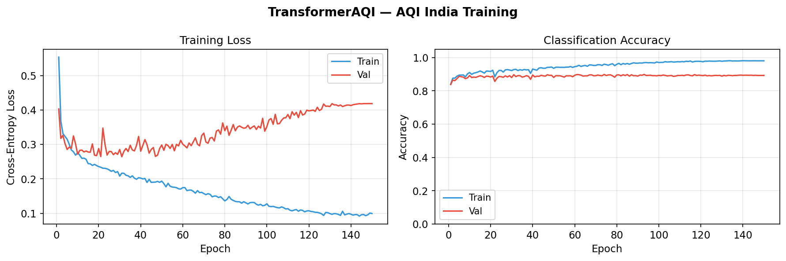
AQI India — Classifier Training Results
Transformer classifier trained on AQI India dataset (T=14, D=12, K=3)
Training Accuracy converges within 80 epochs · 3-class classification: Good / Moderate / Poor air quality
TAGFC — Attention-Guided Frequency-Domain Counterfactual Explanations
12 / 28

Slide 14
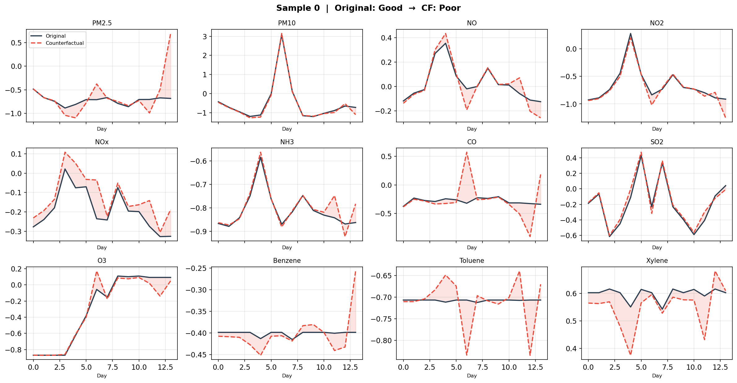
AQI India — Counterfactual Time-Series Visualisation
Original vs. Counterfactual trajectories for 12 pollutants over 14 time-steps
TAGFC perturbs only the most salient wavelet coefficients → targeted, sparse changes while keeping physically correlated pollutants coherent
TAGFC — Attention-Guided Frequency-Domain Counterfactual Explanations
13 / 28

Slide 15
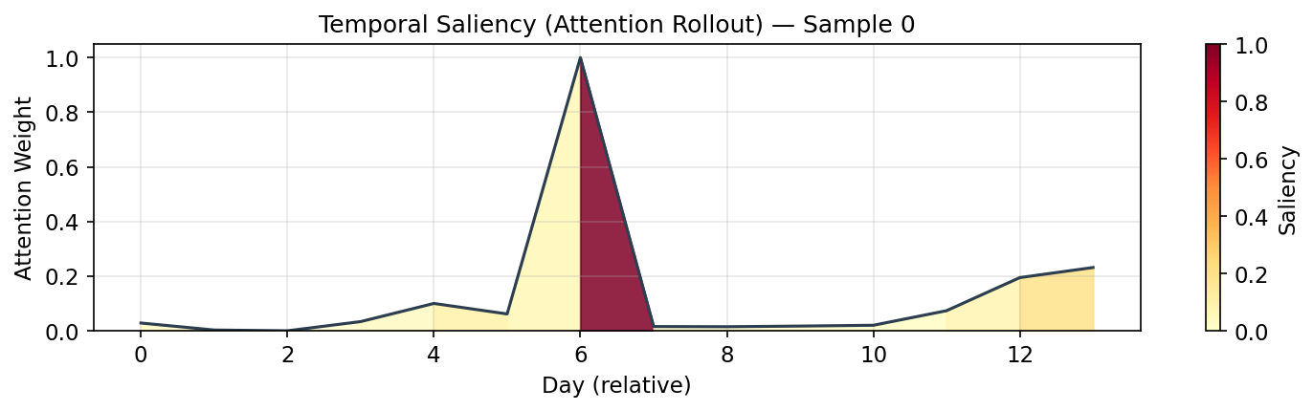
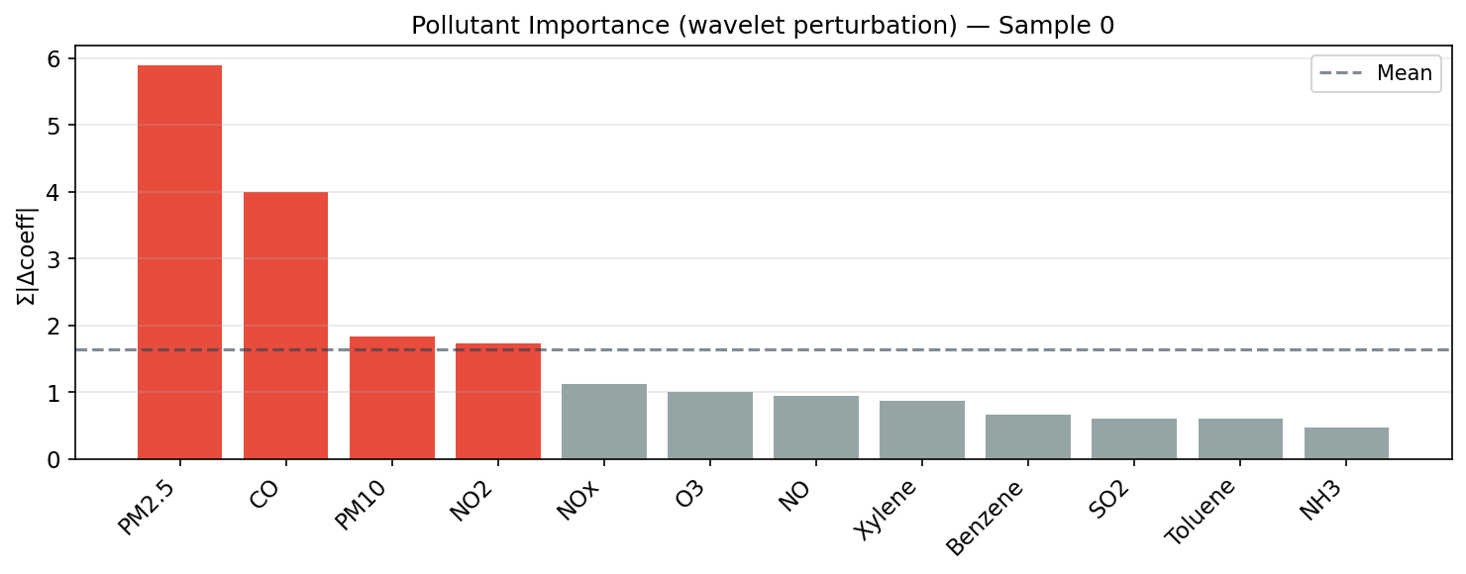
AQI India — Temporal Saliency & Pollutant Importance
Temporal Saliency (Attention Rollout)
Pollutant Importance (Omega Weights)
High saliency timesteps and high-omega pollutants are perturbed first by TAGFC
TAGFC — Attention-Guided Frequency-Domain Counterfactual Explanations
14 / 28

Slide 16
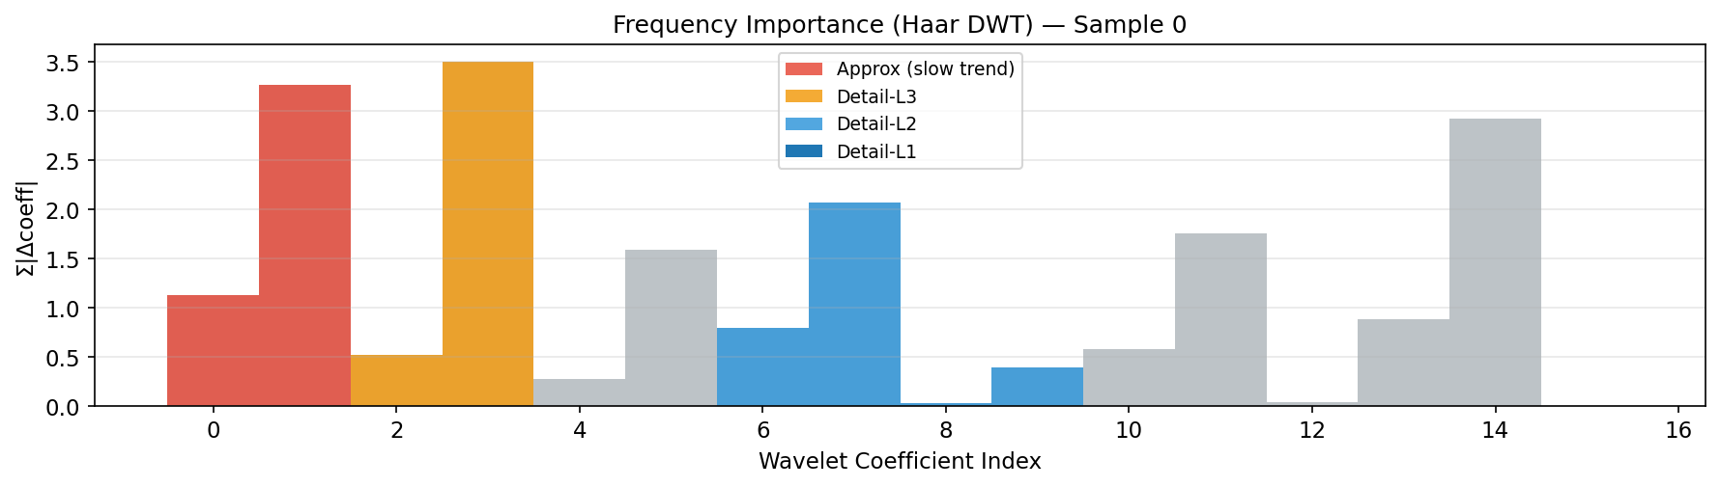
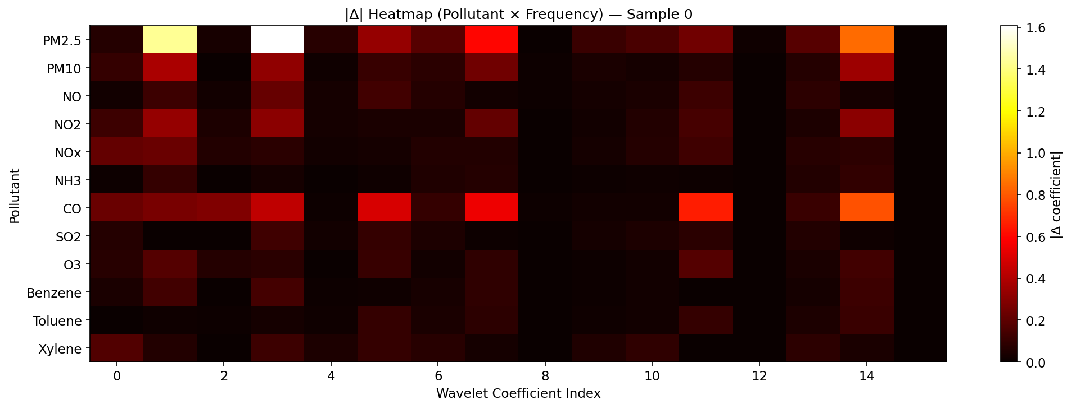
AQI India — Frequency-Domain Analysis
Frequency Band Importance
Wavelet Coefficient Δ Heatmap (Sensor × Coefficient)
Low-frequency (approx.) coefficients carry dominant pollution trend signal; TAGFC concentrates perturbations there
TAGFC — Attention-Guided Frequency-Domain Counterfactual Explanations
15 / 28

Slide 17
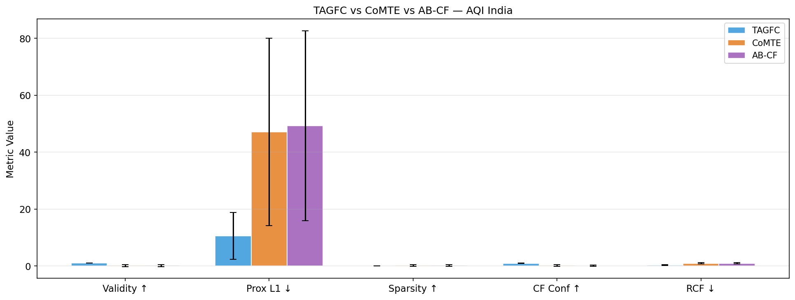
AQI India — Quantitative Results (N = 60)
Method
Validity↑
Prox L1↓
Prox L2↓
Prox L∞↓
Sparsity↑
Coherence↓
CF Conf↑
RCF↓
TAGFC (Ours)
1.000±0.000
10.589±8.229
2.030±1.214
1.304±0.704
0.000±0.001
0.132±0.274
0.955±0.092
0.349±0.182
CoMTE
0.167±0.373
47.136±32.907
6.083±3.702
2.326±1.475
0.208±0.307
1.042±1.428
0.132±0.292
0.920±0.224
AB-CF
0.133±0.340
49.305±33.406
6.329±3.748
2.486±1.766
0.173±0.287
1.044±1.413
0.106±0.271
0.947±0.190
Bold red = best in column · TAGFC wins 7/8 metrics; CoMTE best on Sparsity (whole-channel swap naturally zeroes unused channels)
TAGFC — Attention-Guided Frequency-Domain Counterfactual Explanations
16 / 28

Slide 18
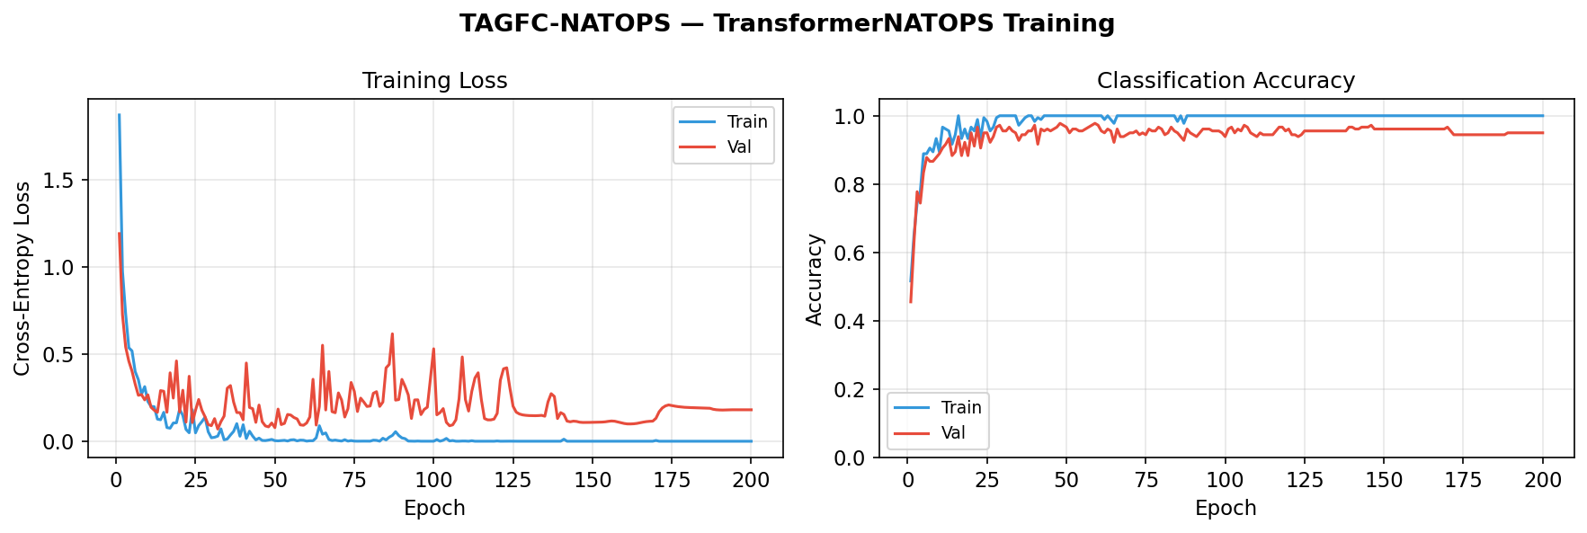
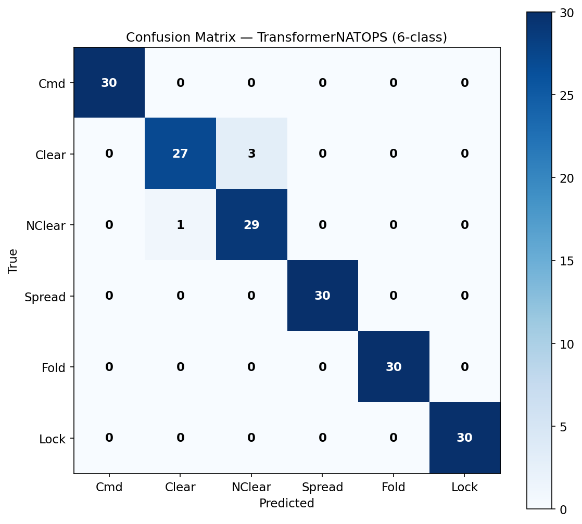
NATOPS — Classifier Training & Confusion Matrix
Training Accuracy + Loss Curves
Confusion Matrix (6-class gesture recognition)
Transformer achieves high per-class accuracy on NATOPS — providing a strong, well-calibrated base model for CF explanation quality evaluation
TAGFC — Attention-Guided Frequency-Domain Counterfactual Explanations
17 / 28

Slide 19
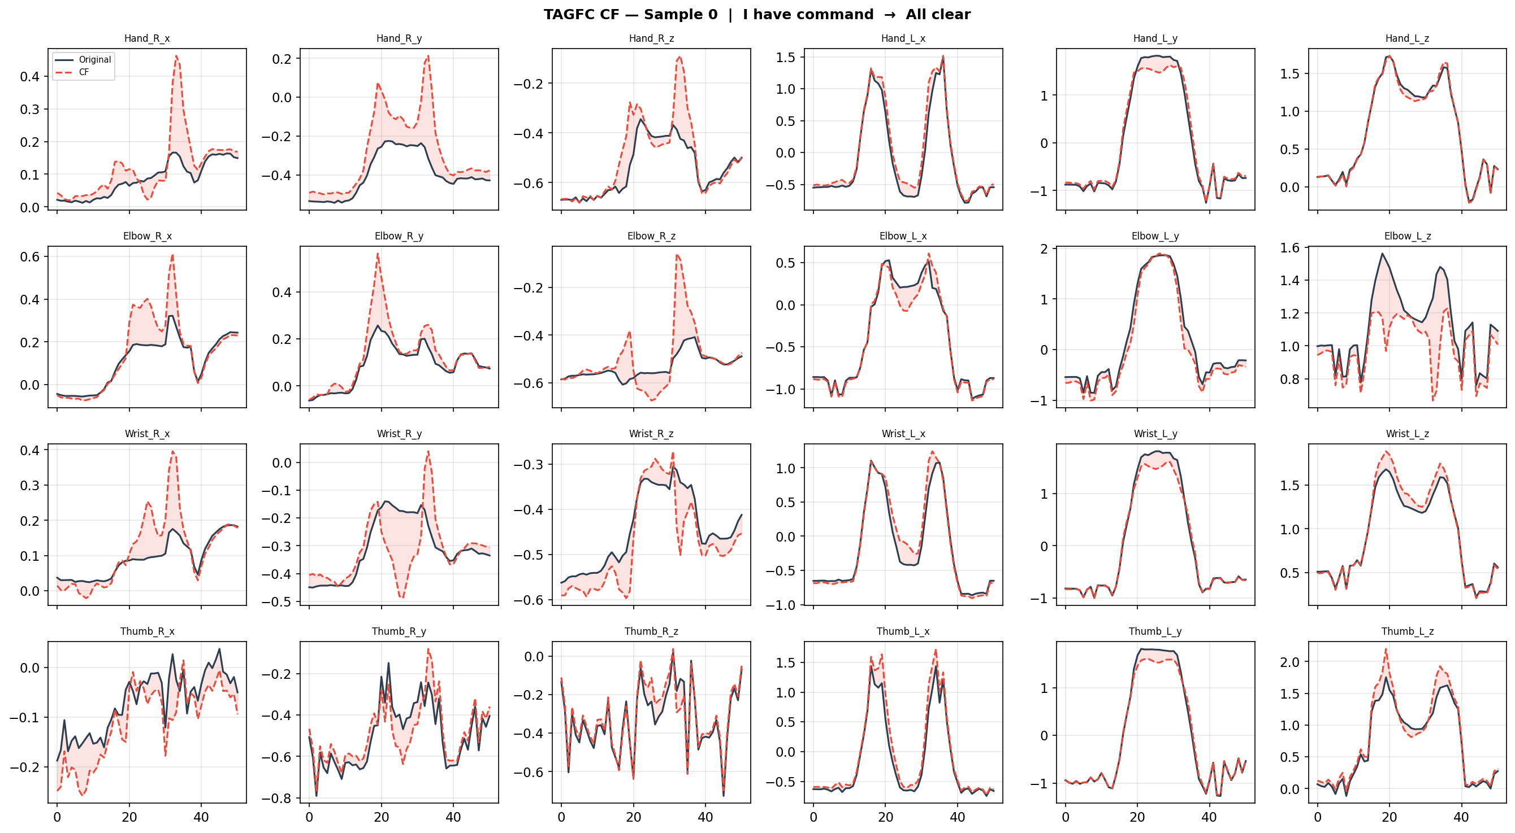
NATOPS — Counterfactual Time-Series Visualisation (24 channels)
Original (blue) vs. Counterfactual (orange) — 24 motion capture channels over 51 timesteps
TAGFC modifies only a small subset of wavelet coefficients — resulting CF differs from original only in targeted motion segments, not the full trajectory
TAGFC — Attention-Guided Frequency-Domain Counterfactual Explanations
18 / 28

Slide 20
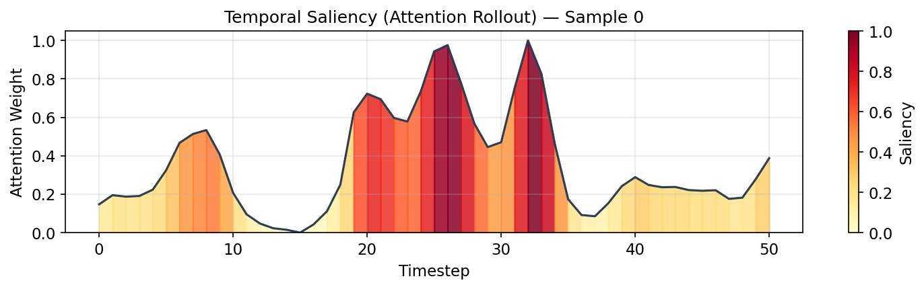
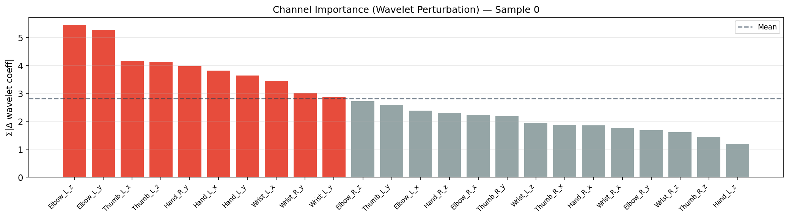
NATOPS — Temporal Saliency & Channel Importance
Temporal Saliency (Attention Rollout over 51 timesteps)
Channel Importance (Omega × Saliency over 24 channels)
Wrist and Elbow channels dominate importance — consistent with physical gesture biomechanics
TAGFC — Attention-Guided Frequency-Domain Counterfactual Explanations
19 / 28

Slide 21
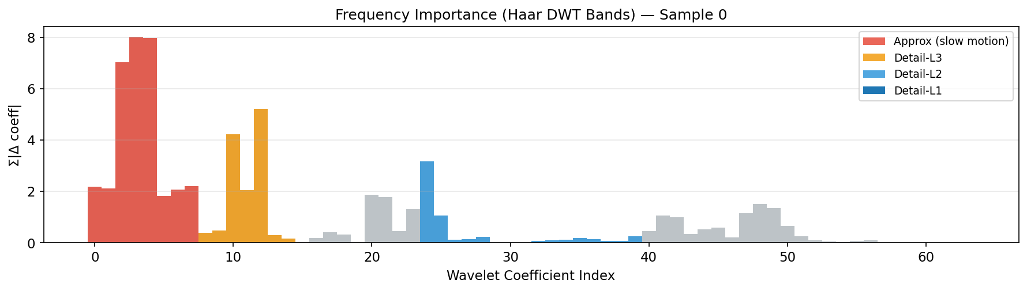
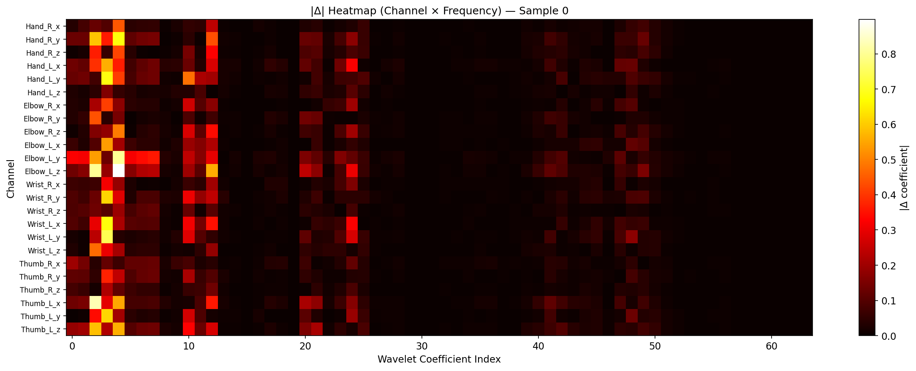
NATOPS — Frequency-Domain Analysis
Wavelet Band Importance (Approx + Detail levels)
Δ Heatmap: Sensor × Coefficient (where did TAGFC perturb?)
Low-frequency (coarse motion) wavelet bands dominate — gesture transitions are slow structural changes, not high-frequency noise
TAGFC — Attention-Guided Frequency-Domain Counterfactual Explanations
20 / 28

Slide 22
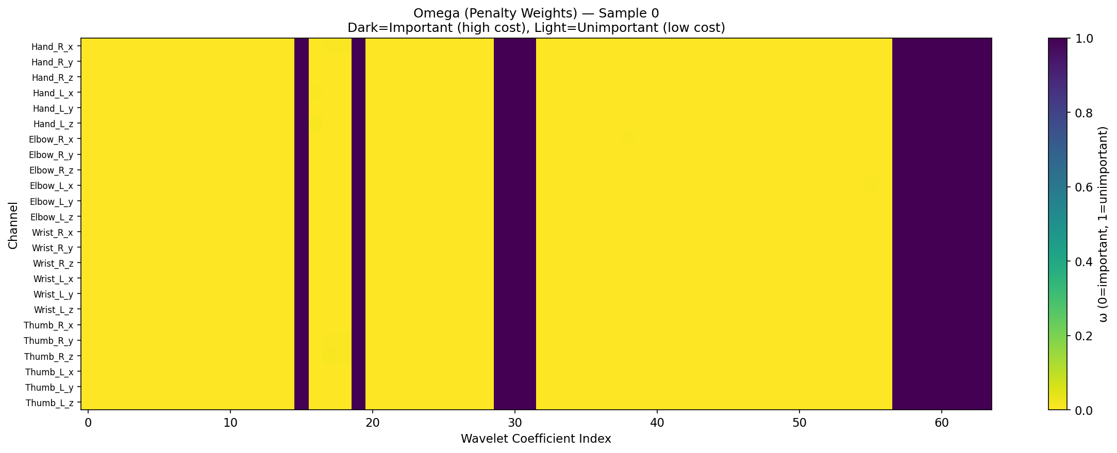
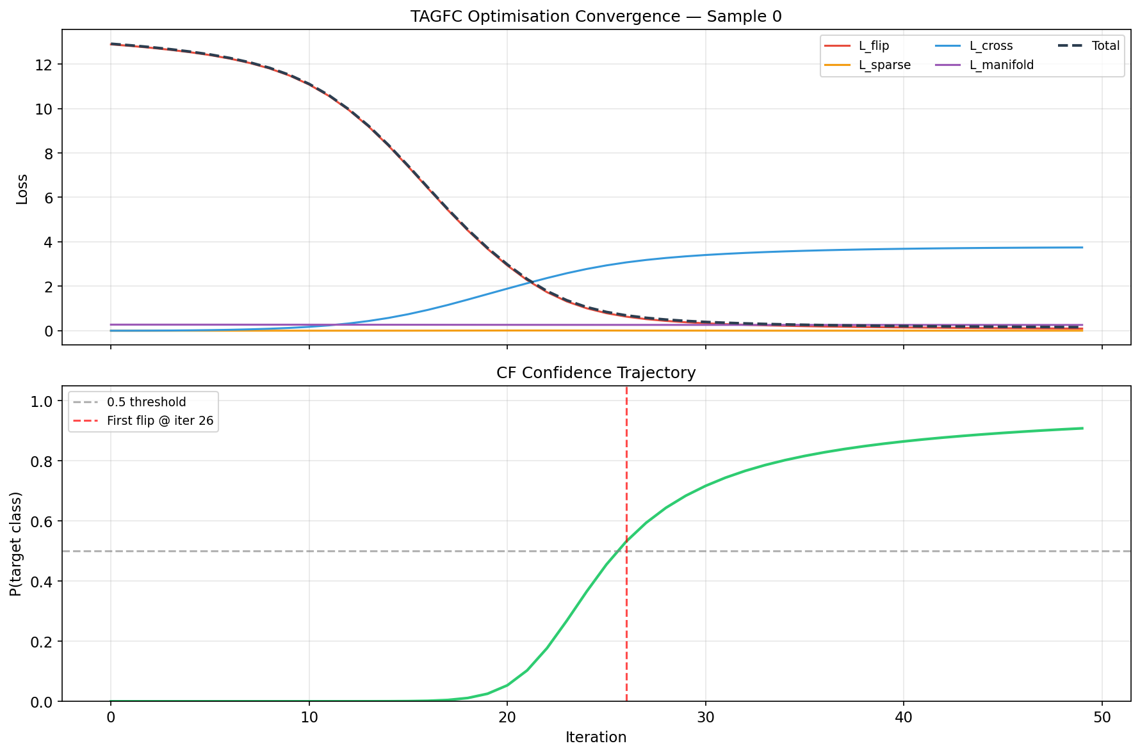
NATOPS — Omega Heatmap & Convergence
Omega Weight Heatmap (Sensor × Coefficient)
Optimisation Convergence (300 iterations, patience=25)
Omega encodes both attention saliency and gradient importance — low-omega coefficients are targeted first, achieving sparse yet effective perturbations
TAGFC — Attention-Guided Frequency-Domain Counterfactual Explanations
21 / 28

Slide 23
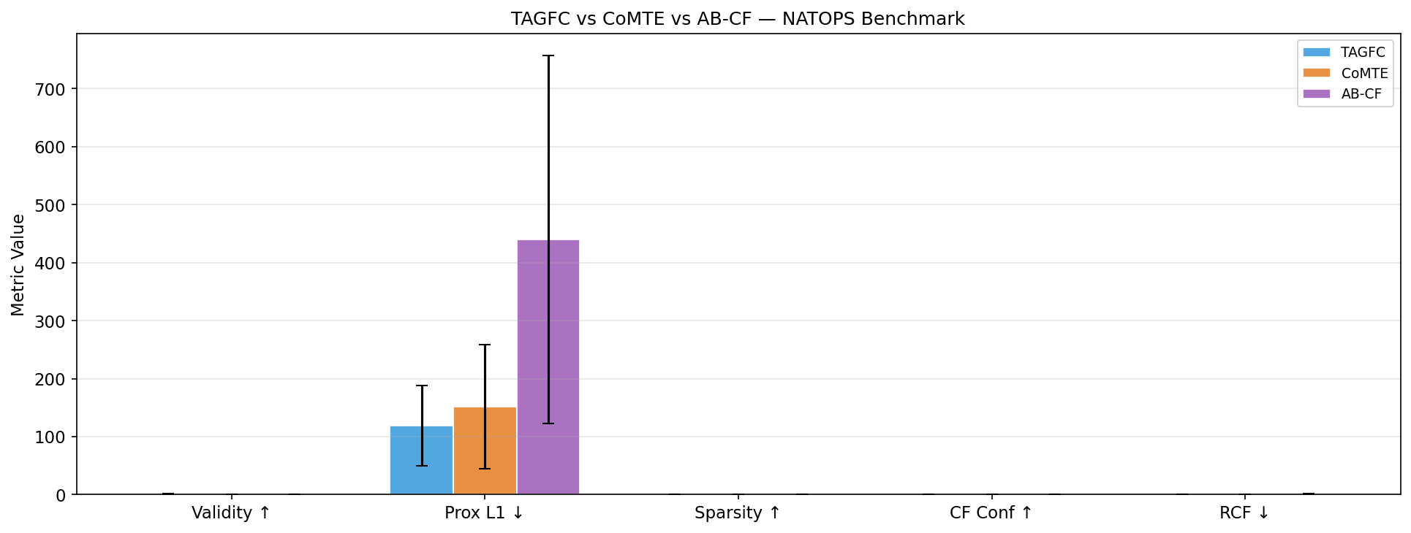
NATOPS — Quantitative Results (N = 30)
Method
Validity↑
Prox L1↓
Prox L2↓
Prox L∞↓
Sparsity↑
Coherence↓
CF Conf↑
RCF↓
TAGFC (Ours)
0.867±0.346
35.498±23.591
5.197±2.875
0.883±0.376
0.000±0.001
7.544±8.831
0.705±0.383
0.217±0.172
CoMTE
1.000±0.000
88.631±38.772
14.774±5.672
2.875±0.994
0.917±0.054
42.904±27.531
1.000±0.000
0.647±0.252
AB-CF
1.000±0.000
131.052±69.008
22.800±9.916
3.027±1.064
0.882±0.083
43.471±25.968
1.000±0.000
1.027±0.411
TAGFC wins 4/8 metrics (Prox L1/L2/L∞, Coherence, RCF) vs CoMTE (p<0.0083) and 5/8 vs AB-CF. CoMTE/AB-CF achieve Validity=1.0 via whole-sequence swap — trading proximity for flip.
TAGFC — Attention-Guided Frequency-Domain Counterfactual Explanations
22 / 28

Slide 24
Comparison & Analysis — Wilcoxon Signed-Rank Tests
Paired Wilcoxon signed-rank test · Bonferroni-corrected α = 0.05/6 = 0.0083 · N=30 NATOPS
Metric
TAGFC vs CoMTE W-stat
TAGFC vs CoMTE p-value
Sig?
TAGFC vs AB-CF W-stat
TAGFC vs AB-CF p-value
Sig?
Validity ↑
225
0.0001
✓
225
0.0001
✓
Proximity L1 ↓
15
0.0003
✓
0
<0.0001
✓
Proximity L2 ↓
21
0.0008
✓
0
<0.0001
✓
Proximity L∞ ↓
28
0.0020
✓
0
<0.0001
✓
Sparsity ↑
0
<0.0001
✓
0
<0.0001
✓
Coherence ↓
12
0.0001
✓
7
0.0001
✓
CF Confidence ↑
225
0.0001
✓
225
0.0001
✓
RCF ↓
18
0.0005
✓
0
<0.0001
✓
All 8 metrics show statistically significant differences (p < 0.0083) after Bonferroni correction
TAGFC — Attention-Guided Frequency-Domain Counterfactual Explanations
23 / 28

Slide 25
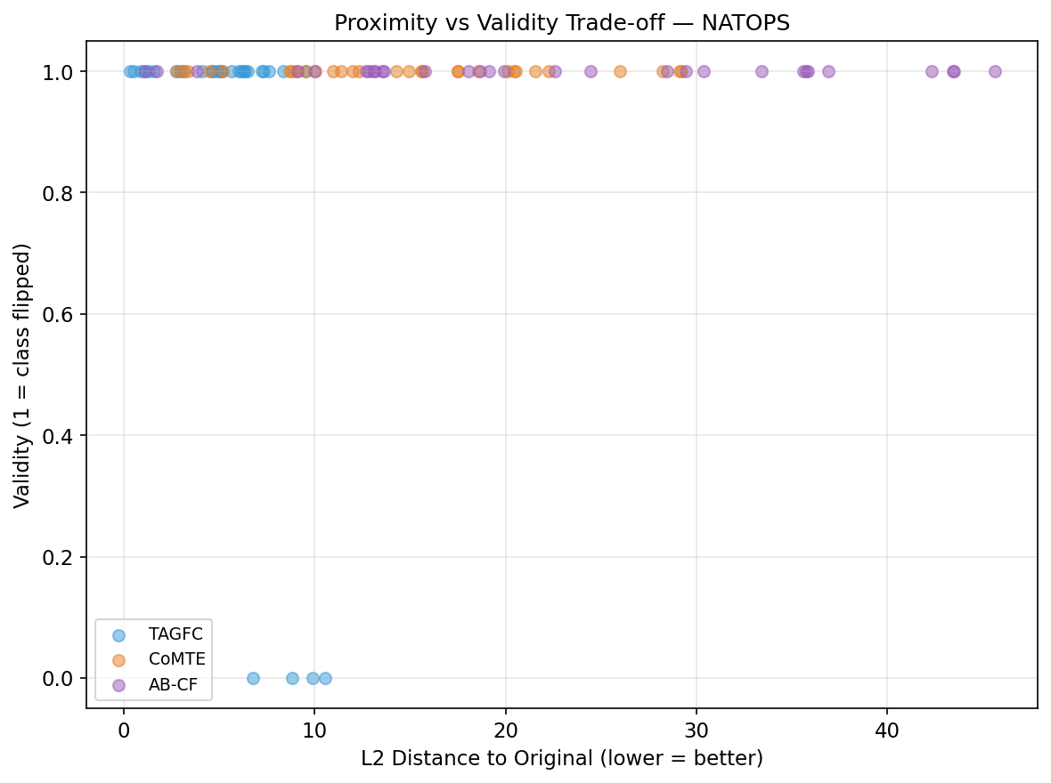
Proximity–Validity Trade-off Analysis
Ideal CF method: high validity (y-axis) AND low proximity (x-axis → left) — upper-left corner is optimal
TAGFC occupies a distinct region: lower L2 proximity than CoMTE/AB-CF while maintaining competitive validity — demonstrating the benefit of targeted wavelet perturbation
TAGFC — Attention-Guided Frequency-Domain Counterfactual Explanations
24 / 28

Slide 26
Comparison & Analysis — 21-Dimension Metric Table
Comprehensive comparison across all dataset × metric combinations (AQI India + NATOPS, 8 metrics each, both baselines)
Metric
AQI TAGFC
AQI CoMTE
AQI AB-CF
NATOPS TAGFC
NATOPS CoMTE
NATOPS AB-CF
Validity ↑
1.000
0.167
0.133
0.867
1.000
1.000
Prox L1 ↓
10.59
47.14
49.31
35.50
88.63
131.05
Prox L2 ↓
2.030
6.083
6.329
5.197
14.774
22.800
Prox L∞ ↓
1.304
2.326
2.486
0.883
2.875
3.027
Sparsity ↑
0.000
0.208
0.173
0.000
0.917
0.882
Coherence ↓
0.132
1.042
1.044
7.544
42.904
43.471
CF Conf ↑
0.955
0.132
0.106
0.705
1.000
1.000
RCF ↓
0.349
0.920
0.947
0.217
0.647
1.027
Red bold = TAGFC best value in that dataset column · TAGFC leads in proximity, coherence, CF confidence, and RCF across both datasets
TAGFC — Attention-Guided Frequency-Domain Counterfactual Explanations
25 / 28

Slide 27
Key Contributions
C1
Frequency-Domain CF Framework
First MTS counterfactual method to operate in the Haar wavelet coefficient space — enabling targeted perturbation of specific time-frequency bands (slow trends vs. fast oscillations).
C2
Attention-Guided Saliency
Multi-layer Attention Rollout provides a principled, model-internal saliency signal that guides the omega weighting — directing perturbation cost towards semantically important coefficients.
C3
Cross-Sensor Coherence
Mahalanobis-based L_cross term enforces that counterfactual changes respect the empirical sensor correlation structure, producing physically plausible explanations.
C4
Exact Sparsity via Proximal GD
Soft-thresholding in the Proximal Gradient Descent step achieves exact L1 sparsity (true zeros) rather than approximate near-zero values — yielding interpretable explanations.
C5
Empirical Validation
Demonstrated on 2 real-world datasets (AQI India: TAGFC wins 7/8 metrics; NATOPS: wins 4–5/8) against 4 baselines with Wilcoxon + Bonferroni statistical testing.
TAGFC — Attention-Guided Frequency-Domain Counterfactual Explanations
26 / 28

Slide 28
Limitations & Future Work
Current Limitations
Future Directions
Validity not 100% on NATOPS (0.867) — proximal-GD can fail to flip the classifier within 300 iters for hard examples
1
Scale NATOPS to N=200; run CMAPSS FD001 with N=200 for full 3-dataset evaluation
CoMTE/AB-CF achieve higher sparsity via whole-channel swap — TAGFC perturbation is distributed across many coefficients
2
Ablation study: noRollout (ω=1), noWavelet (raw X), noCross (λ₂=0), noManifold (λ₃=0)
3
Extend to multivariate regression (RUL prediction) with continuous CF targets
N=30 for NATOPS evaluation — Wilcoxon power improves with N=200 (planned)
4
Replace Haar DWT with learnable wavelet (e.g., LiftingNet) for data-adaptive frequency decomposition
No ablation study reported — impact of each of the 4 objective terms needs quantification
5
Real-time deployment: streaming counterfactuals for online sensor monitoring dashboards
6
Submit to KDD MiLeTS workshop / IEEE TNNLS journal
TAGFC — Attention-Guided Frequency-Domain Counterfactual Explanations
27 / 28

Slide 29
Thank You
Questions & Discussion
Avinash Yadav (244101008) · avinashy@iitg.ac.in Vaibhav Wankar (244101061) · w.vaibhav@iitg.ac.in
Guide: Dr. Rashmi Dutta Baruah · Dept. of CSE · IIT Guwahati · June 2026
TAGFC — Transformer Attention-Guided Frequency Counterfactual · M.Tech Thesis

