Slide 1


SMART INDIA HACKATHON 2026
TITLE PAGE
Problem Statement ID – SIH26068
Problem Statement Title- WeatherGPT: Conversational AI for Weather Forecasting, Alerts, and Climate Information
Theme- Disaster Management
PS Category- Software
Team ID- 118709
Team Name- Void Pointers
WeatherGPT: ask the sky, trust the answer.
IMD's forecasts in every Indian language, answered from servers in India.

Slide 2



















WEATHERGPT
Void Pointers
IMD's forecasts, in your language. Every number comes with a receipt.
How it addresses the problem
Weather data is scattered across portals, bulletins, satellite products & forecast systems
One conversational interface: actionable insight in seconds
Generic AI chatbots invent forecasts, even warnings
Accurate: every value verified against IMD & NWP records
English-only, text-heavy portals shut out rural India
Voice-enabled & multilingual via Sarvam AI: 22 Indian languages
How every answer is made
IMD first: warnings · nowcast · Mausamgram · stations · bulletins
WeatherGPT
ગુજરાતી
empty? re-plan once
fails? re-compose
You ask
voice or text · 22 languages · Sarvam AI
Answer + Pramaan Receipt
App · Web · Push · SMS / IVR
Surat, Gujarat
કાલે સવારે સુરતમાં વરસાદ પડશે?
1 · PLAN
2 · RETRIEVE
3 · WEIGH
4 · COMPOSE
5 · VERIFY
FORECAST RAINFALL
Contextual plan: intent, place, time, who asks
IMD first, then global models
sources compared, never averaged
LLM writes from the evidence
Satya Gate checks every number
0.4 mm
સુરત · કાલે 09:30–12:30
Proposed Solution: seven modules, one conversation
09:30
evidence covers window
12:30
IMD · Green: no warning
Mausam Setu
Satya Gate
Pramaan Receipt
Vaani
Chetavani Relay
Krishi Salah
Jalvayu Lens
PRAMAAN · GFS 12Z · f+18–21 h
cell 21.25N 72.75E · 23:03 IST
IMD-first real-time data
zero-hallucination verifier
proof on every answer
Sarvam AI: 22 languages, voice
early warning dissemination
location-based advisory
climate trend & historical analysis
સાંજે?
કોઈ ચેતવણી?
PS SIH26068 · 8 / 8 KEY FEATURES COVERED
INNOVATION & UNIQUENESS
SEE IT LIVE
તમારો પ્રશ્ન પૂછો…
Real-time
NL querying
GFS / WRF
Early warning
Zero invented values: Satya Gate checks every number first.
Location
22 languages
Climate trend
Voice
IMD first: IMD's warnings, nowcasts & Mausamgram, beside global models.
Concept screen · Gujarati in, Gujarati out
Sovereign by design: open models, Indian servers; no question leaves India.
Scan or click QR

Slide 3




























TECHNICAL APPROACH
Void Pointers
Technologies to be used · Methodology and process for implementation
Zone 1 · Users & Channels
Zone 2 · Mobile & Web · React PWA
Zone 3 · LLM Query-Understanding Engine
Zone 4 · Mausam Setu · IMD First
Chat · Vaani
Alert inbox
1
2
3
4
IMD warnings
CAP · 756 districts
IMD nowcast
764 districts
Gateway
WebSocket · SSE
PLAN
LLM, re-plans once
RETRIEVE
governed tools
WEIGH
never averaged
Farmer
Officer
Pilot
Warning map
Krishi Salah
plan → retrieve → weigh → compose → verify
Mausamgram
IMD multi-model
IMD stations
2,071 AWS / ARG
Fisher
Researcher
Citizen
Chetavani Relay
alert lane
7
Vaani
Sarvam AI voice
6
SATYA GATE
verify every value
5
COMPOSE
LLM, from evidence
Jalvayu Lens
Offline cache
IMD sat · radar
INSAT-3DS · DWR
Global second
GFS · WRF · WIS 2.0
App
Web
Voice
Push
SMS
THE RULE THAT NEVER BENDS: the LLM plans and speaks; it never supplies a number, unit, place, time-window or warning level. Tools own every value.
Satya Gate: how a number earns its place on screen
Mausam Setu: real-time data ingestion & alerts
Model composes
Check each claim
Restore safety clauses
Show, or keep floor
WIS 2.0 MQTT
push
IMD CAP
every 60 s
IMD nowcast
every 5 min
Mausamgram
each run
INSAT · DWR
each scan
CLAIM from the draft
value 5.6 mm, window total
place Pune
window 23 Sep · 8 × 3 h
EVIDENCE IMD Mausamgram
grid 0.125° · 3.0 km away
cell 18.5N 73.875E
init 22 Sep 00Z · summed
Normalise · CAP 1.2
PostgreSQL · PostGIS
Change detector
Chetavani Relay: push · SMS · IVR, < 60 s
=
match → shown with receipt · no match → withheld, never guessed
11,721 bulletin passages
Place → 1 of 756 districts
Verified: POD · FAR · CSI
Technology
stack to
be used
TARGET
Service
Levels
< 1 s
first frame
≥ 95 %
grounded accuracy
< 60 s
change → alert
React
Android
Python
FastAPI
PostgreSQL
Redis
MQTT
Docker
Kubernetes
LLMs: Sarvam-30B · Llama, self-hosted in India (OpenAI · Gemini adapters, off by default)
Voice & language: Sarvam Saaras (22) · Bulbul (11) · Sarvam-Translate · Bhashini
Web: Node.js · Vite · Capacitor GIS & weather APIs: GDAL · IMD · Open-Meteo
22
languages + voice
99.5 %
uptime, failover
10 lakh+
users, autoscale

Slide 4









FEASIBILITY AND VIABILITY
Void Pointers
Feasibility analysis · Potential challenges & risks · Strategies to overcome them
Feasibility
Viability
Practical Implementation
90 %
Proven, available tech: open-weight Indian LLMs, IMD's own feeds, GFS / WRF, Sarvam speech.
Working prototype today: 1,630 + 596 automated checks, a 21-step gate, 0 failed.
100 %
Sovereign & sustainable: open-weight Indian models (Sarvam-30B) on IndiaAI / NIC compute, IMD-owned.
Serves Mission Mausam; a chat widget for IMD's website, apps, UMANG & EOC portals.
90 days
Scalable: 1 state → every State / UT; 4.3 crore farmers already get IMD agromet SMS.
Low-end phones and 2G; day-one owner IMD Met Centre + State EOC.
of 306 live scenarios
answered from evidence
hosted, processed &
stored in India
to a Gujarat pilot:
every district, gu / hi / en
01
AI hallucination: an LLM may invent a number, or even a warning.
Satya Gate binds every value to a source record; unverified output is never shown.
01
02
Data access: IMD's APIs need credentials and approvals.
Public routes to IMD's own data: Mausamgram, 764-district nowcast, 2,071 stations; API adapters switch on with a key.
02
Potential
Challenges
& Risks
03
Connectivity: patchy rural networks and feature phones.
Offline + SMS / IVR: last-answer cache, tiny PWA payloads, voice call-back.
03
Strategies for
Overcoming
Challenges
04
Language fidelity: translation can distort values and negations.
Value-safe translation: Sarvam-Translate output re-checked for numbers, units & dates, else it stays in source.
04
05
Foreign AI dependence: outages, price shifts, questions sent abroad.
Sovereign stack: self-hosted Indian models, a rule-planner floor, zero foreign data egress.
05
SOVEREIGN
Deployment
NATIONAL CORE
IMD / NIC MeghRaj: models, data, audit logs
STATE NODE
State Data Centre + SEOC: languages, alert relay
DISTRICT EDGE
offline node at the DEOC: answers when links fail
CITIZEN DEVICE
PWA cache · SMS · IVR, no data plan needed
STATE-SCALE COST
≈ ₹26 lakh / yr
Biggest line: 2 × H100 inference on IndiaAI compute at ₹150 / GPU-hr, 24 × 7. No per-question foreign API fees.
DATA STAYS
in India
DPDP Act 2023
district-level location only
CERT-In 2022
logs kept 180 days in India
MeitY cloud
empanelled, India region
Open standards
CAP 1.2 · WIS 2.0 · WFS
NOW
IMD-first answers · installable PWA · streaming
BEFORE FINALE
Live push on a phone · WIS 2.0 lane · WRF
36-HOUR FINALE
SMS / IVR · cyclone-bulletin OCR · IMD API adapters
90-DAY PILOT
Gujarat · all districts · 3 languages
FUTURE SCOPE
WhatsApp bot · panchayat-level forecasts · AI nowcasting · impact-based warnings

Slide 5




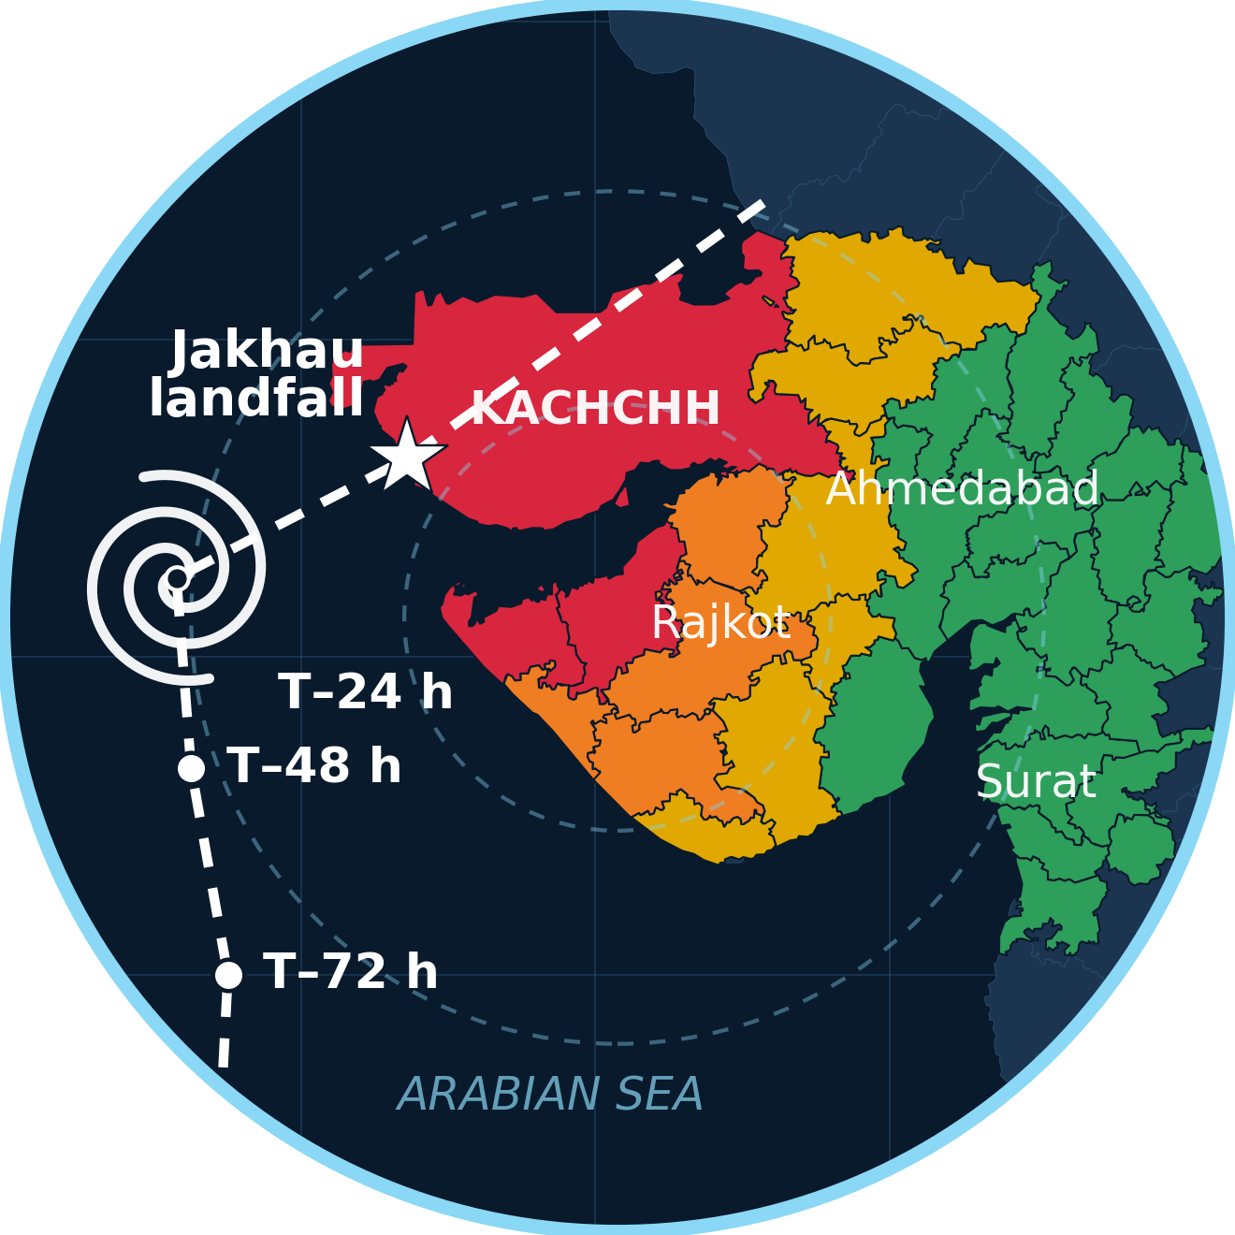


IMPACT AND BENEFITS
Void Pointers
Potential impact on the target audience · Social, economic & environmental benefits
99 %
of days in Jan–Sep 2025 saw extreme weather in India
Source: CSE 2025 ›
4,064
lives lost in those nine months, up 48 % in four years
Source: CSE 2025 ›
9.47 M ha
of crops hit, four times the 2022 figure
Source: CSE 2025 ›
₹12,500
yearly gain per rain-fed farm household using advisories
Source: NCAER 2020 ›
PS OUTCOMES
Faster dissemination of weather information
Improved public accessibility to forecasts
Better disaster preparedness & response
Decision support for agriculture, aviation, marine & urban planning
Farmers: crop-weather advisories at the right hour to spray, sow and irrigate, spoken in their language.
Benefits of the Solution
Social
IMD's forecasts reach the last mile in 22 languages through Sarvam AI voice, SMS & IVR. Trust grows when every alert traces to IMD.
Disaster Managers: flood & cyclone warning dissemination by district: what changed, plus a forwardable brief.
Aviation & Marine: aviation weather briefing (METAR / TAF); RSMC sea-area & coastal warnings for fishers.
Impact on
Target
Audience
Economic
Advisories are worth ₹12,500 a year to a rain-fed farm household; run on Indian government compute, no foreign fees.
Smart Cities & Urban Planners: smart city weather monitoring: heat, flood risk and air quality.
Researchers & IMD: climate analytics for researchers: a century of records, plus what India asks.
Environmental
Weather-timed spraying & irrigation cut wash-off and water waste; open records power local adaptation (SDG 13 · 2 · 11).
DISASTER-DAY STORYBOARD: 72 hours of a cyclone
Illustrative, modelled on Cyclone Biparjoy (Kutch, June 2023): IMD's warnings moved 1 lakh+ people to safety
no warning
watch
alert
warning
T – 72 h
T – 48 h
T – 24 h
T – 0
T + 24 h
Yellow watch
IMD raises Orange
Red warning
Landfall
Recovery
A farmer asks by voice and hears the rain window plus IMD's own advice: harvest early.
The change reaches every subscribed phone in the district within a minute by push, SMS and IVR.
The district officer pulls a what-changed brief with its source and forwards it to every taluka.
Networks choke: the cached last answer and the IVR line keep working; fishers hear the RSMC sea-area warning.
Relief teams ask for rainfall totals and river discharge; every figure comes with its source and time.
Sarvam voice · Krishi Salah
Chetavani Relay
Pramaan Receipt
Offline cache · IVR
Mausam Setu · Jalvayu Lens

Slide 6


RESEARCH AND REFERENCES
Void Pointers
Details and links of the reference and research work
PS decoded
MoES · IMD needs
70 sources
live-probed
5 systems
benchmarked
Architecture
designed
Prototype
306 scenarios run
Now building
live push · WIS 2.0
See it · Run it · Verify it
Existing systems benchmarked
✓ yes · ~ partial · × no
Field & Applied Research
IMD apps
Weather apps
AI chatbots
WeatherGPT
70 official sources live-probed; public routes to IMD's own products found (Mausamgram, nowcast, stations).
306-scenario live atlas: 90 % answered from evidence, every refusal classified by cause.
8 multi-turn probes: 7 held end to end.
Aligned with Mission Mausam, the IndiaAI Mission, Bhashini and the UN Early Warnings for All.
Data stays in India
Ask in natural language
Official IMD warnings
Scan or click for the demo
Source code: github.com/Abhichandani-Yash-Manish/WeatherGPT_
No invented numbers
Source shown on every answer
~
22 languages + voice
~
~
~
SMS / IVR reach
~
WHAT THE RESEARCH CHANGED
IMD's evaluation parameters → our answer
Forecast · advice · climate in one
Hallucination surveys → Satya Gate
RAG literature → cited bulletin answers
NCAER advisory value → Krishi Salah
CAP 1.2 · WIS 2.0 → Chetavani Relay
Accuracy & relevance
Satya Gate · 90 % of 306 live scenarios answered
IMD + global models, compared
IMD apps studied: Mausam app · Meghdoot · Mausamgram
Response latency
first frame streamed in 0.4 s, measured
Official Data, Standards & Research Sources
Multilingual capability
Sarvam AI: 22 languages in, 11 spoken back
SIH26068: Ministry of Earth Sciences · India Meteorological Department. sih.gov.in/sih2026PS
IMD Mausam: forecasts, warnings, bulletins. mausam.imd.gov.in
IMD GeoServer: district-warning layers. reactjs.imd.gov.in/geoserver
Mission Mausam: Cabinet note, 2024. pib.gov.in
WMO WIS 2.0 · OASIS CAP 1.2: community.wmo.int
NDMA SACHET: national CAP alert portal. sachet.ndma.gov.in
IMD Pune open data: rainfall & temperature since 1901. dsp.imdpune.gov.in
data.gov.in · CERT-In: open IMD datasets · log directions. data.gov.in
NOAA GFS · Open-Meteo: numerical weather prediction. open-meteo.com
Lewis et al., 2020: Retrieval-Augmented Generation. arXiv:2005.11401
Ji et al., 2023: hallucination in NLG, ACM CSUR. arXiv:2202.03629
NCAER, 2020: value of weather advisories. NCAER2020.pdf
CSE · Down To Earth: Climate India 2025. cseindia.org
Sarvam AI: sovereign LLM, IndiaAI Mission; Saaras, Bulbul, Translate. sarvam.ai/models
IndiaAI compute: sovereign GPUs for Indian models. indiaai.gov.in
UI & accessibility
voice-first, WCAG 2.1 AA, low-end phones
Scalability & innovation
stateless API on Kubernetes · Pramaan Receipt
Real-time integration
IMD warnings, nowcast, Mausamgram · WIS 2.0
Voice for rural access
Sarvam Saaras + Bulbul voice, IVR call-back

