Slide 1
Machine Learning
CROP YIELD PREDICTION
By: Abhidev

Slide 2
WHAT IS MACHINE LEARNING?
Machine Learning is a way to teach computers to learn patterns from data and use them to make predictions or decisions without being explicitly programmed for every situation.
MODERN DEFNITION:
A computer program is said to learn from Experience (E) with respect to a Task (T) and Performance Measure (P) when its performance improves with experience.
BASIC IDEA: DATA → LEARN PATTERNS → MAKE PREDICTIONS

Slide 3
WHY MACHINE LEARNING...?
  Manual rules cannot capture complex real-world patterns.
  ML can automate prediction and decision-making.
  Models can learn relationships from large datasets.
  ML is useful across many real-world applications.
Applications:
Healthcare | Finance | Agriculture | Marketing | Transportation

Slide 4
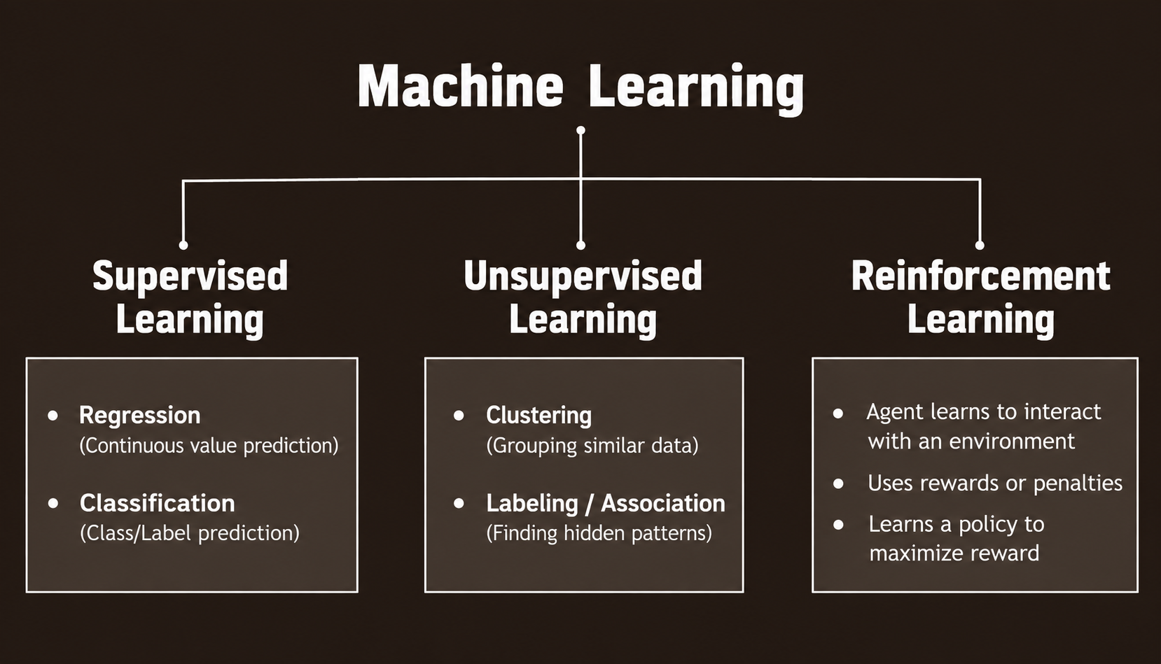
Learning paradigms

Slide 5
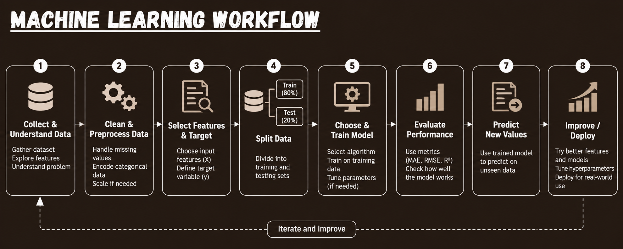

Slide 6
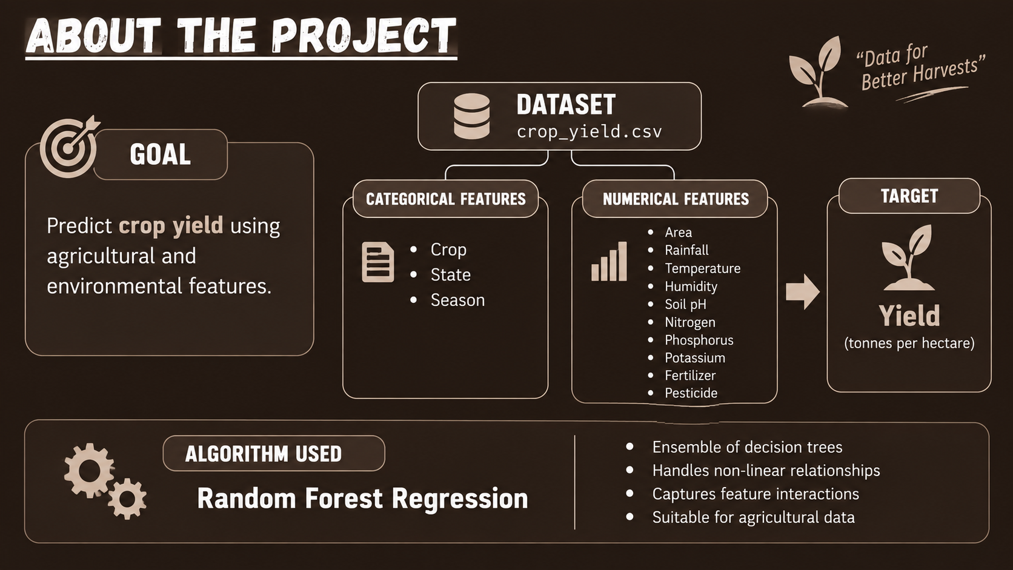

Slide 7
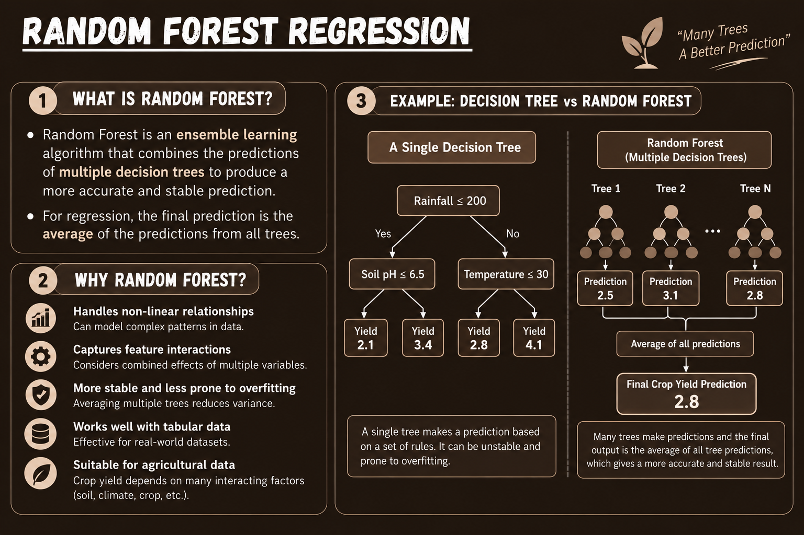

Slide 8
IMPLEMENTATION OF THE PROJECT-------->

Slide 9
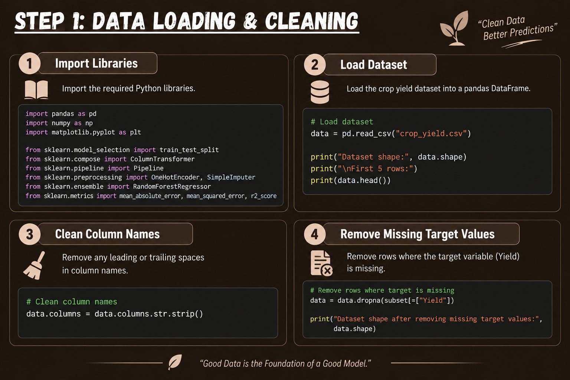

Slide 10
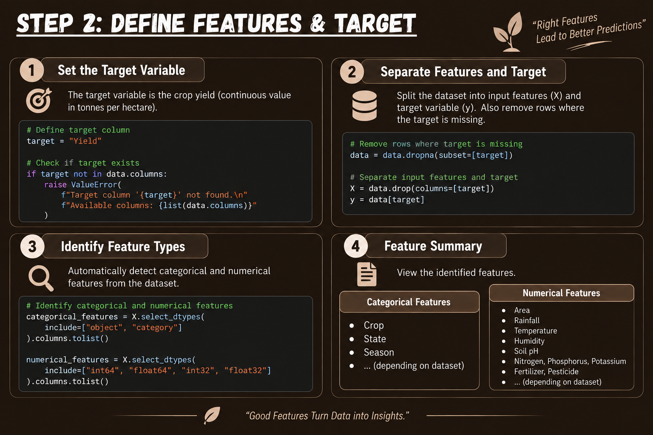

Slide 11
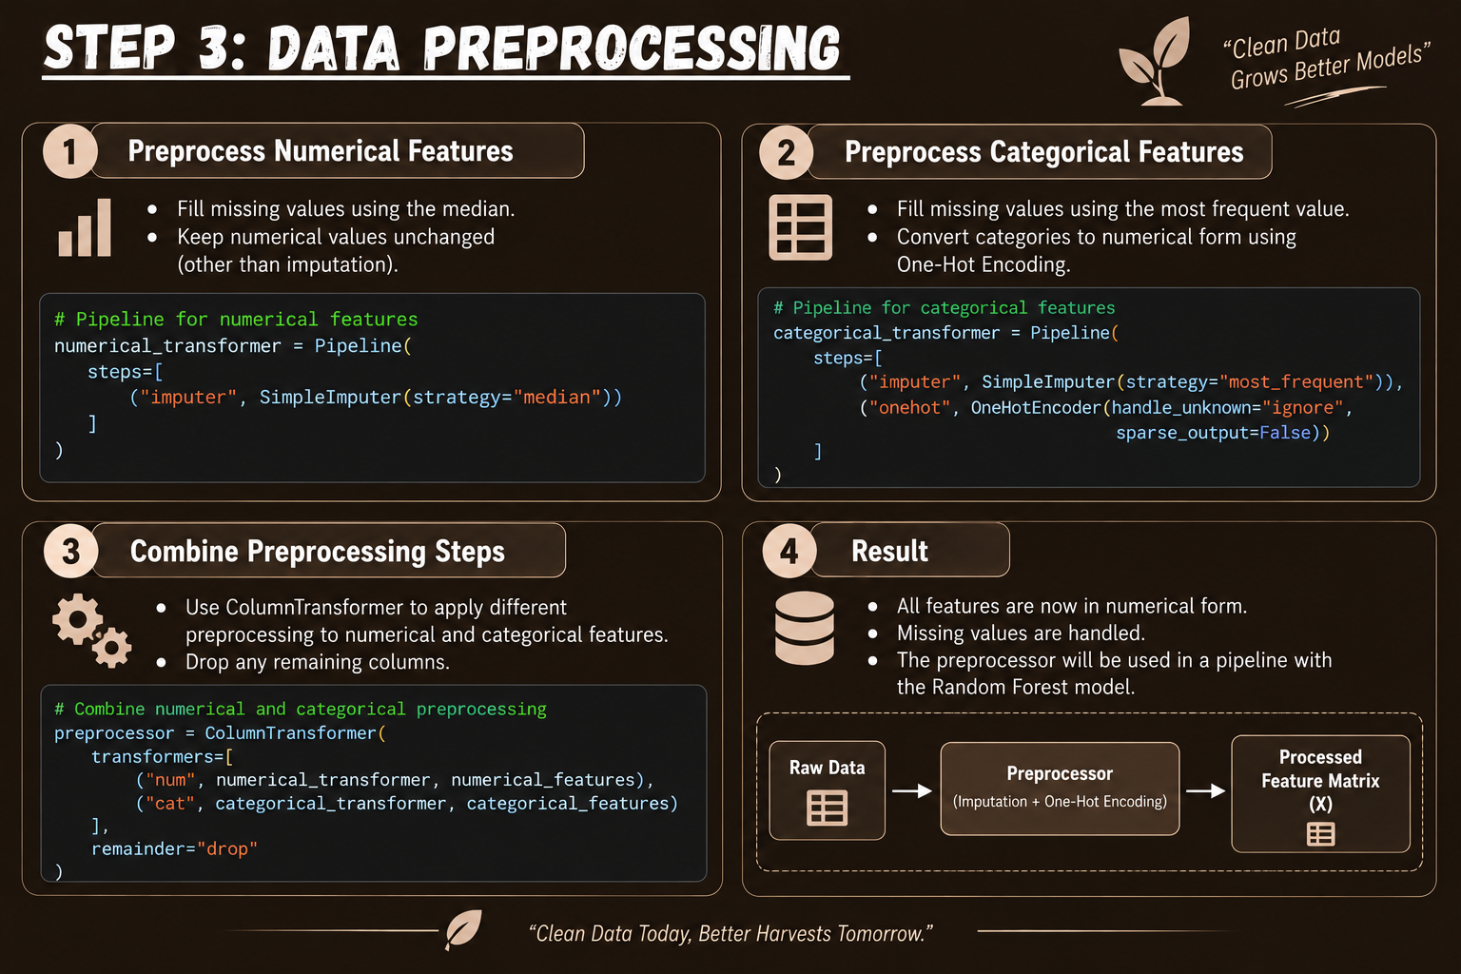

Slide 12
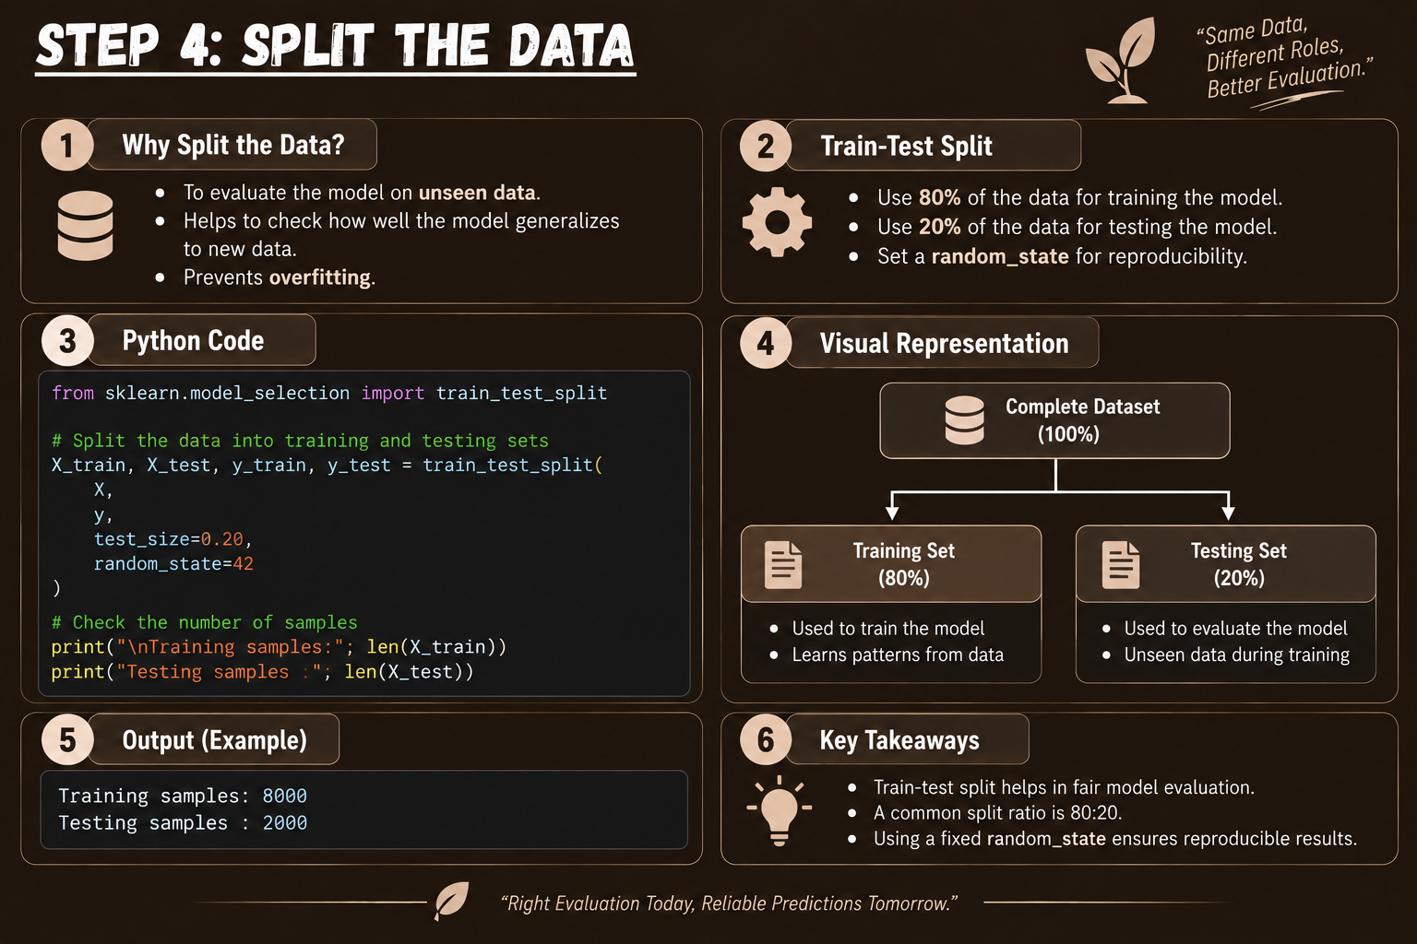

Slide 13
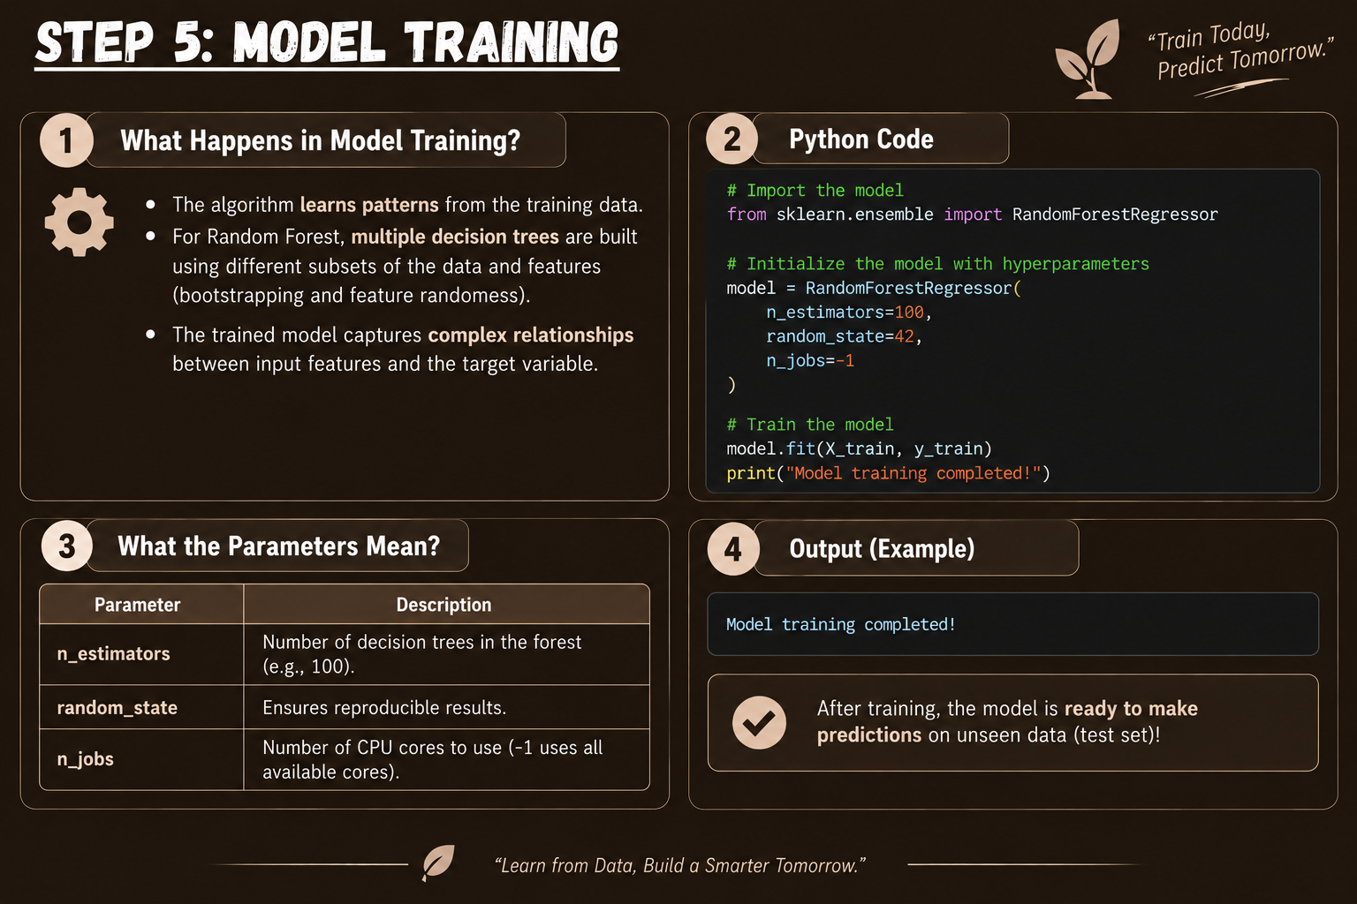

Slide 14
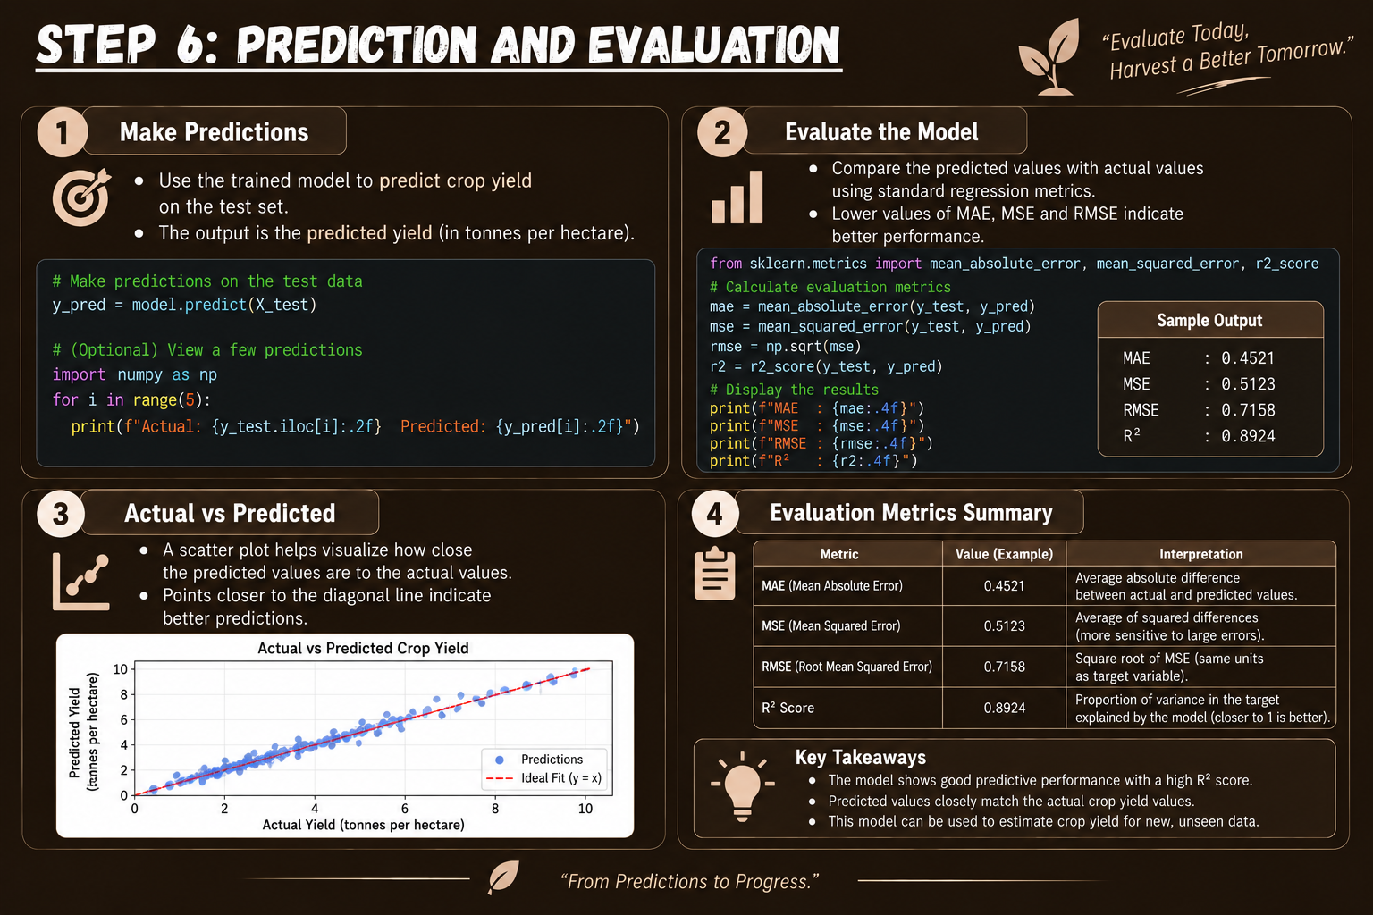

Slide 15
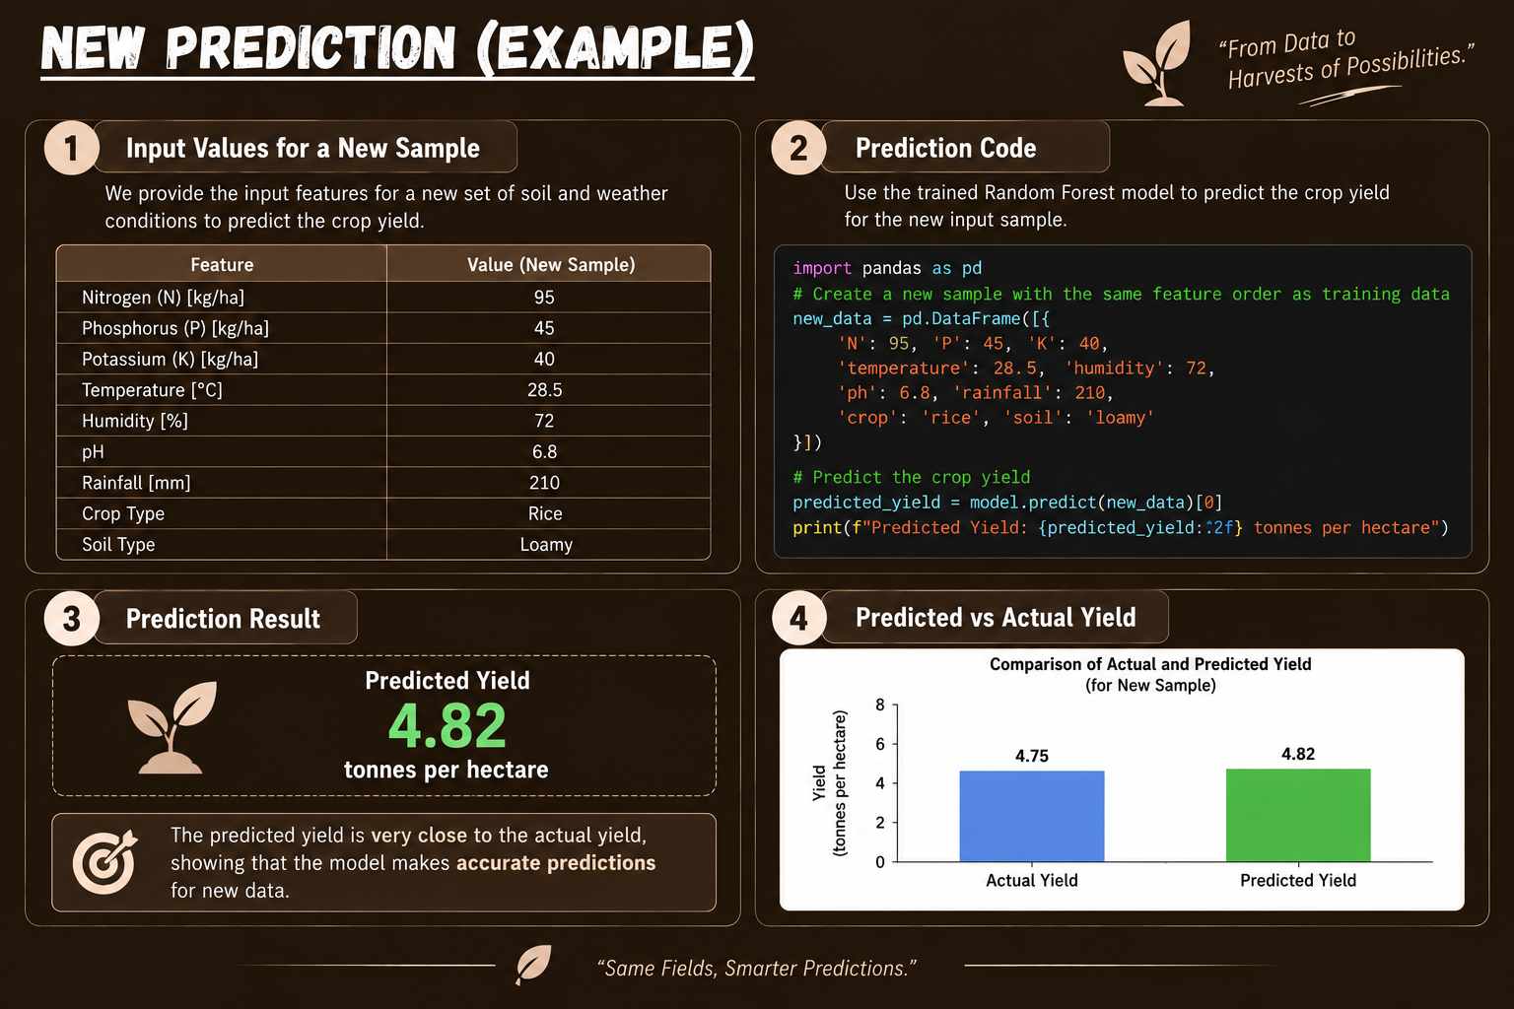

Slide 16
