Slide 1

NEOLOGIC Google AdWords and Facebook Ads
By-
Abhidha Arya

Slide 2
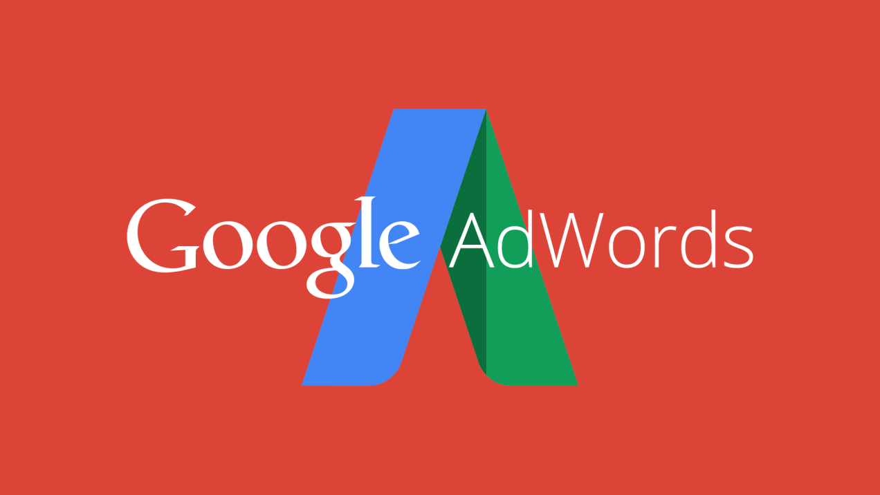

Slide 3
Company Overview
Neologic is an IT Consulting/Staffing Company
Founded in 2015, based in McKinney, Texas
Provides IT services to clients
IT services includes all domains of SAP
SAP –Portfolio and Project Management
SAP – Project Life Cycle Management
SAP – Document Management System
Training Talent Acquisition

Slide 4
Account Structure Google AdWords
Account Structure
Brand Awareness
Client Services
Onshore Offshore Delivery Model
Careers
Consulting
Outsourcing
Product Development
Project Management Services
Center of Excellence
Talent/Training Acquisition
Neologic Careers
Search and Display Network

Slide 5
Target Market
Educational institutions
Startups
IT industries
Medical institutions

Slide 6
Initial Mistakes
Not so appropriate keywords
Low quality score
Failed to reach a wide range of audience.

Slide 7
Remedy
Used more Refined Keywords.
Added a wide variety of audience that included local, National and International audience.
Using refined Keywords also helped us to increase our impression.

Slide 8
Major Impact on our campaign
By doing all these modifications I was able to:
Obtain a better quality score
Made our adds more appealing
Relevant adds were displayed more number of times.

Slide 9
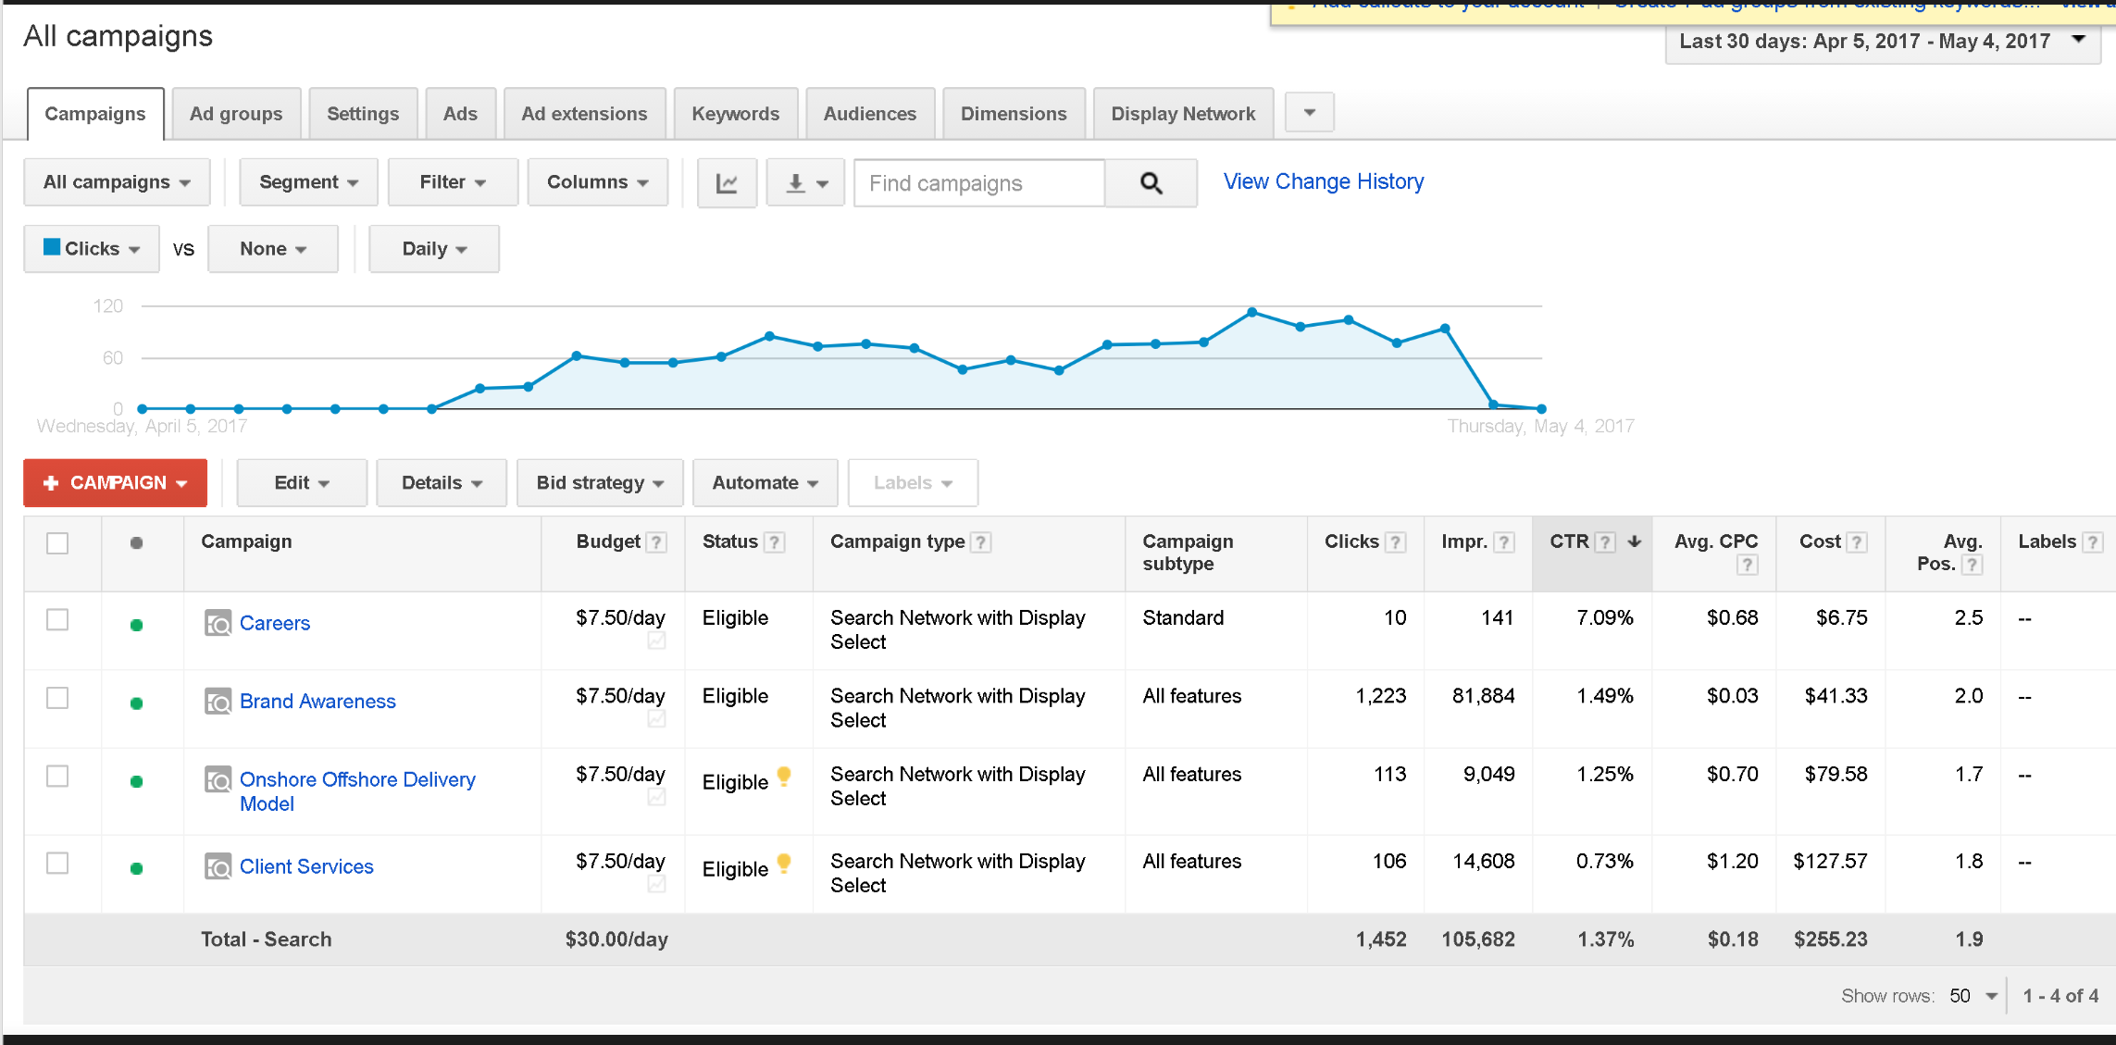
Campaign Overview

Slide 10
Campaign Overview(contd..)
Total Budget - $250
Was able to obtain decent CTR with the max being 7.09 %.
And eventually able to meet and at times, exceed the initial goals.

Slide 11
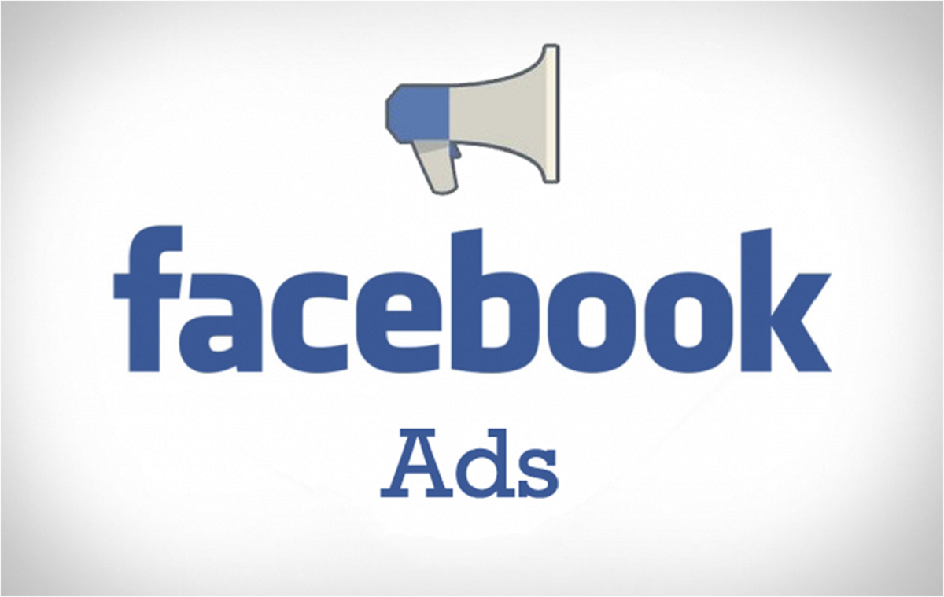

Slide 12
Facebook Structure
Facebook Account/Advertiser Account
Budget | $126.66
Audience | 22 – 55+
Bid | CPC
Delivery | Standard
Schedule | All Type
Campaign Objective
BA1
BA2
Brand Awareness
BA3
BA4
Texas-22+
Ad1

Slide 13

Facebook Account Overview and Ads
Facebook Objective- Brand awareness
Ad Set - Texas - 22+
Targeting – In the news feed
Locations- Texas
Type of Ads – Single Image Ads
Optimized According to –Link Clicks, Reach

Slide 14
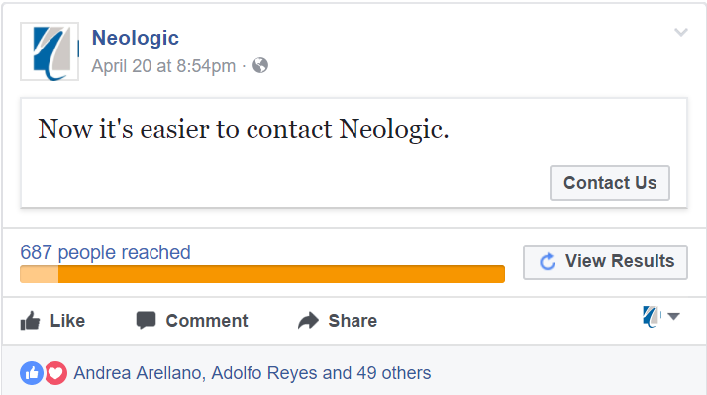
Improvements and Boosting
After the suggestions provided by Facebook Ad Manager, chose the Boost Post option
Improvements were made with regards to the Ad and the “contact us “ feature was added
Because of this the reach increased to 687 people

Slide 15
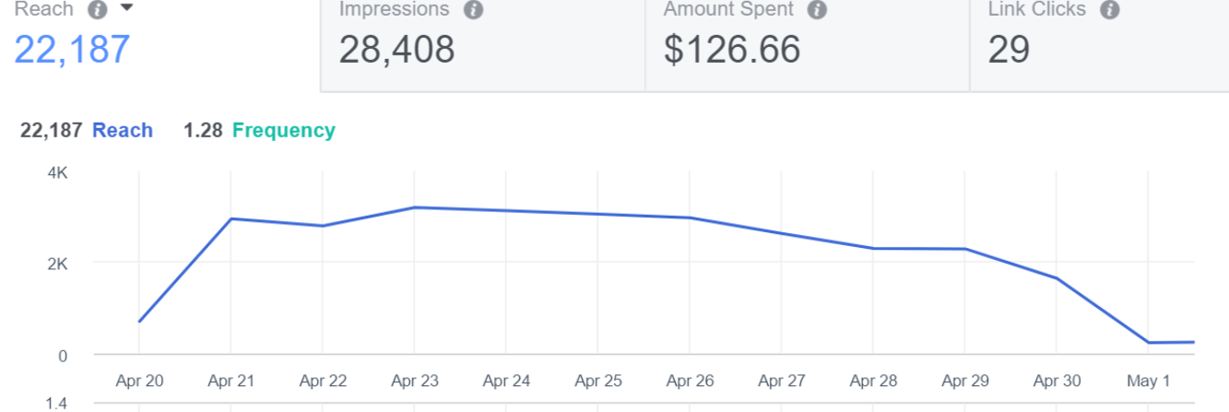
Reach Statistics

Slide 16
Facebook Results
Reporting Starts – 04-20-2017
Reporting Ends – 05-01-2017
Campaign – Brand Awareness
Reach – 22,187
Link Clicks – 29
Impressions – 28,408
Frequency – 1.28
CTR ( Link)- 0.42%
Clicks(all)-118

Slide 17
Results & Conclusions
As the objective was Brand awareness, I focused on the reach & link clicks which was accomplished in the 11 days span.
As per the data in the engagement on post and post shares, the client should focus on Engagement.
Also, There were 5 Campaigns when it came to Facebook . But the max CTR was 7.60% for campaign BA1 as compared to the overall CTR of 0.42%.

Slide 18


