Slide 1
Public Transport & Housing Sale Trends
in Metropolitan Melbourne
Project 1 – Group 1
Team Members
Abhidnya
Talieh
Peter
Yared

Slide 2
Aim :
To analyse the share of the different public transport modes and study the correlation between the passenger footfall for the metro & the housing sale data for the year 2018-23 in Melbourne Metropolitan
Data :
Passenger footfall data -
by Public Transport Victoria (PTV)
Housing sale data –
Victorian Integrated Survey of Travel and Activity (VISTA) –
by department of Transport & Planning

Slide 3

Data Sources
The project will draw its main data from the Department of Transport and Planning under the Government of Victoria and Property sales statistics. The team will also utilize insights from the VISTA survey to enrich the analysis.

Slide 4
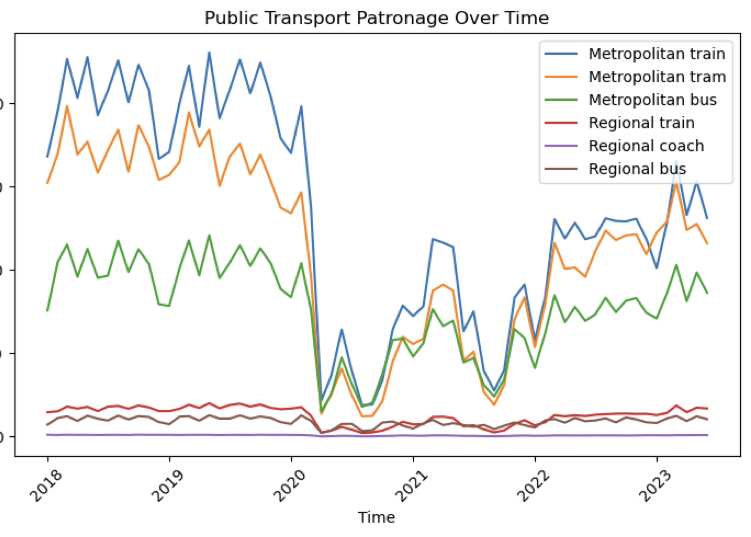
Share of different modes of Public Transport in Melbourne

Slide 5
Melbourne Metro Station Map by total footfall 18-23

Slide 6
Metro footfall distribution by City Councils

Slide 7
Housing sell – Apartments/Units by City Councils

Slide 8
Housing sell – House
by City Councils

Slide 9
Housing sell – Plots
by City Councils

Slide 10
Housing sell – Total
by City Councils

Slide 11
Summary
The passenger footfall is significantly higher for CBD and surrounding councils due to presence of offices.
The transit/tourist hubs and last stations of the metro lines generally witness higher footfall.
The apartments/units sell is higher for councils closer to CBD while plot sell is higher for councils away from CBD and vice versa.
Above analysis is in line with VISTA survey councted
Future prospects :
A similar research can be conducted for each suburb with/without census data for more detailed understanding the city growth.
The passenger footfall data along with PTV timetable can be studied to analyze trend for each metro line which can be helpful to improve timetable in future.
Thank You !

