Slide 1
Street Vendor Digitalization Agent
CAPSTONE PROJECT
Presented By:
Student name : Abhigna Vedururu
College Name : Vishwa Vishwani Institute of Systems and Management
Department : Computer Science

Slide 2
OUTLINE
Problem Statement
Proposed Solution
Technology used
Wow factor
End users
Result
Conclusion
Git-hub Link
Future scope
References
IBM Certifications

Slide 3
Problem Statement
Local Hawkers, Street Vendors and Micro Entrepreneurs often remain digitally invisible while struggling with new technologies like UPI. They are also unaware of government’s MSME schemes and guidance to apply for these advantages. Many struggle with understanding the guidelines due to language barriers.

Slide 4
Proposed Solution
A street vendor digitalization Agent that uses Natural Language Processing (NLP), Retrieval-Augmented Generation (RAG), to assist users in generating user profiles, guiding UPI and QR setup, recommending market strategies, explaining MSME and Udyam registration steps with document checklists in local languages by seamless switching between requested languages.

Slide 5
Technology used
IBM cloud lite services
Natural Language Processing (NLP)
RAG pipeline with internal vector index for direct queries (MSME guides, UPI PDFs)
IBM Granite model with local language support

Slide 6
IBM cloud services used
IBM Cloud Watsonx AI Studio
IBM Cloud Watsonx AI runtime
IBM Cloud Agent Lab
IBM Granite foundation model

Slide 7
Wow factors
Hyperlocal Intelligence: Utilizes geolocation to offer government programs, location-specific advice, and pricing benchmarks specific to the vendor's region.
Multilingual Support: Allows non-English speakers to access digital onboarding by supporting regional languages like Telugu, Hindi, and Marathi.
RAG-Powered Personalization: For precise, current answers, Retrieval-Augmented Generation is used with grounded documents such as MSME registration checklists and UPI guidelines.
NDC & Fintech Ready: Provides vendors with guidance on how to list their goods on Meesho, WhatsApp Business, and ONDC, allowing them to fully participate in digital commerce platforms.
Language understanding: Responds to queries based on user’s input and can switch between languages in the same chat window based on requirements.

Slide 8
End users
Street Vendors
Local Hawkers
Small business owners
Micro-entrepreneurs

Slide 9
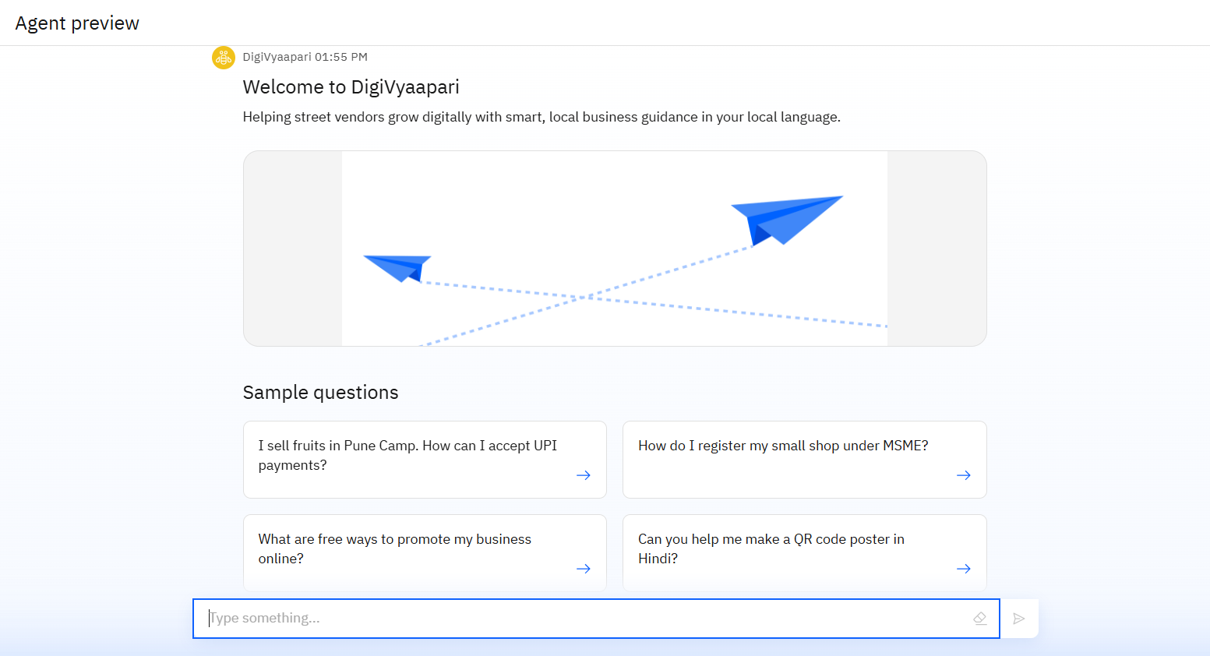
Results

Slide 10
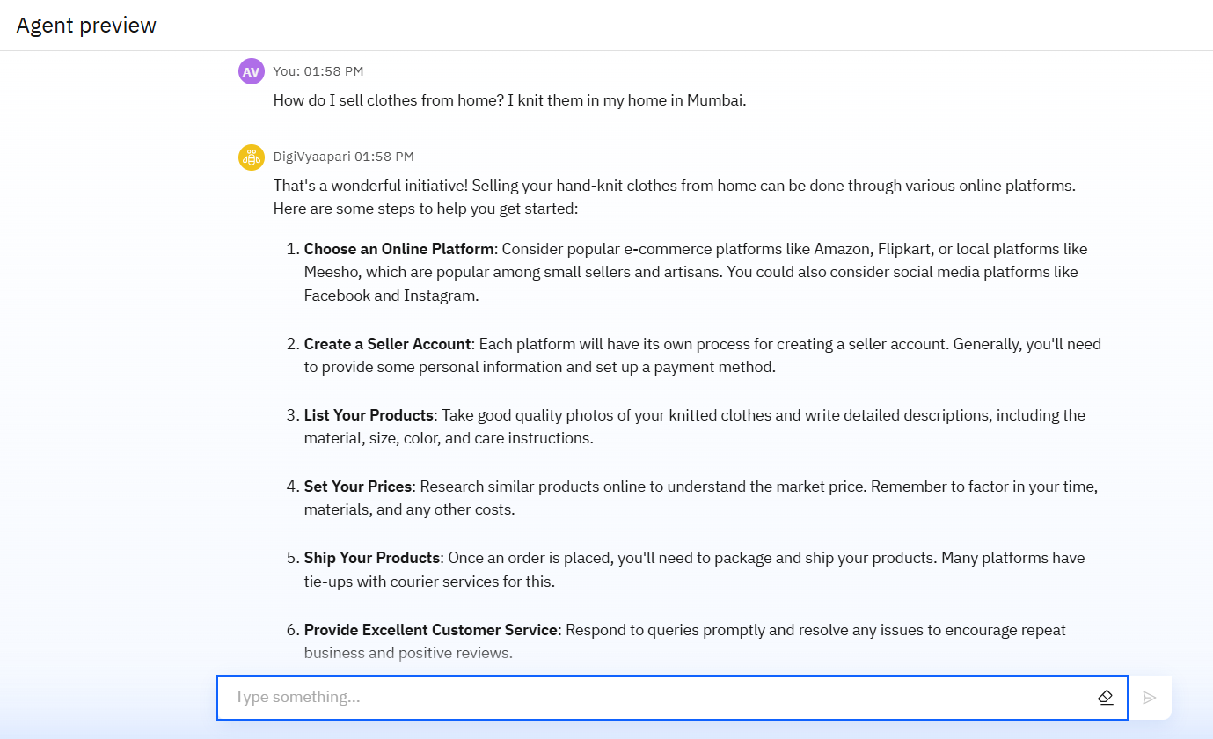
Results

Slide 11
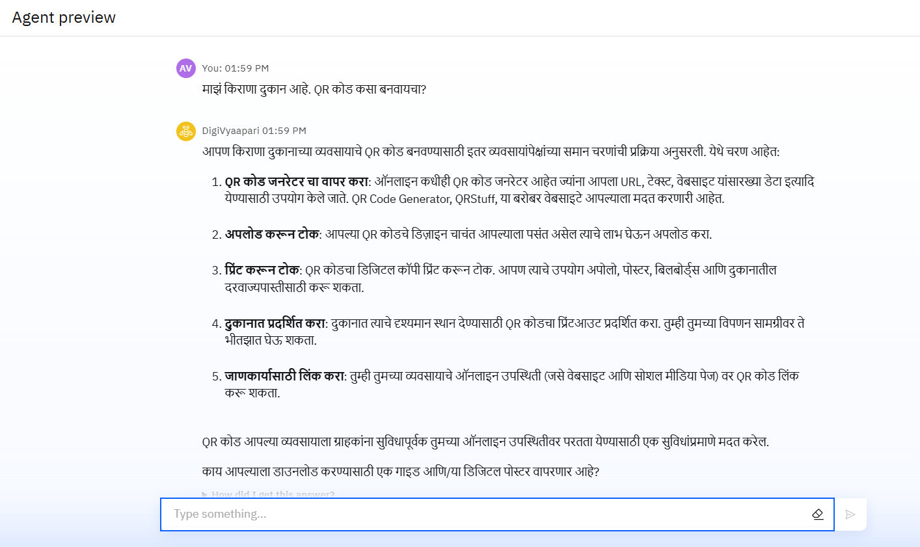
Results

Slide 12
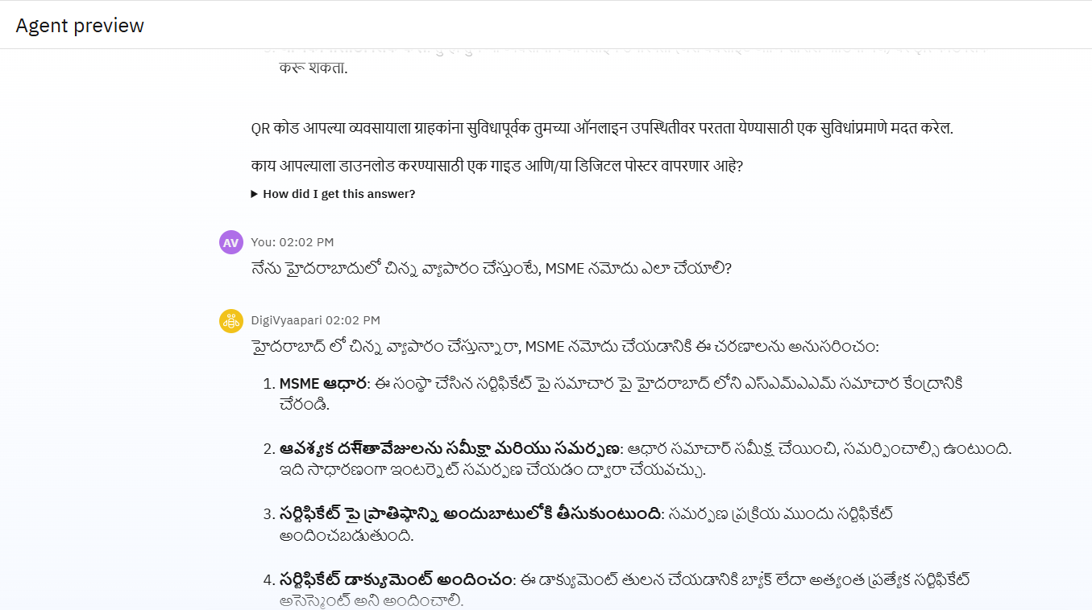
Results

Slide 13
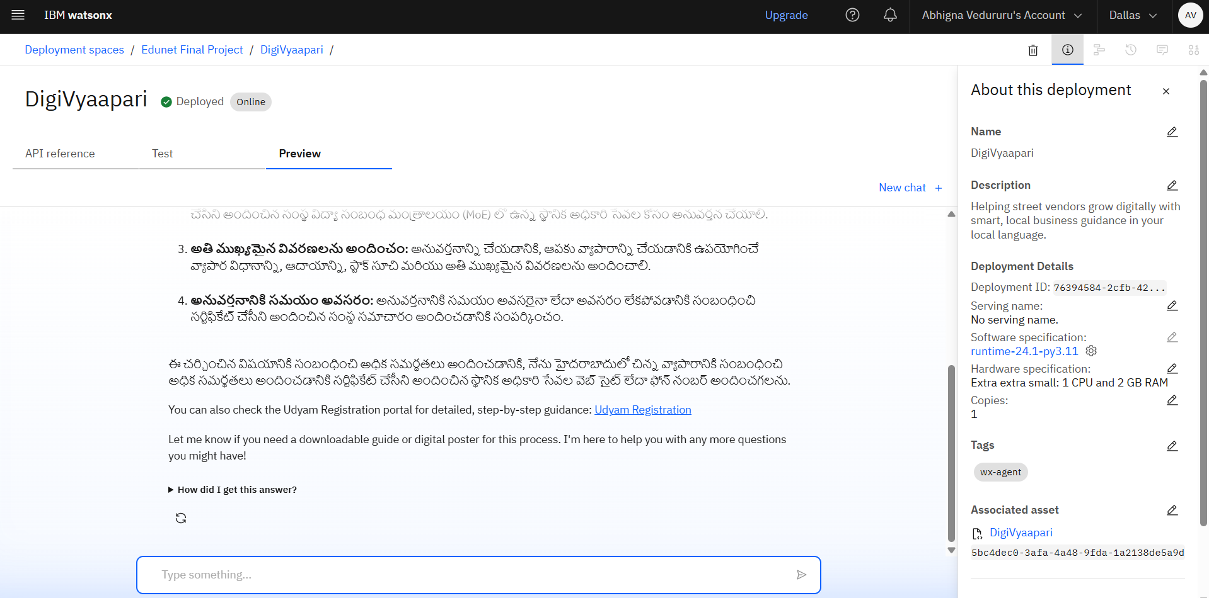
Results
Deployed AI Agent

Slide 14
Conclusion
The combination of simplicity and tailored guidance is key to making digital entrepreneurship accessible and sustainable for informal businesses.
This solution not only empowers vendors but also contributes to the growth of the hyperlocal economy, helping small businesses thrive in the digital era.
By leveraging advanced AI technologies like Retrieval-Augmented Generation (RAG) and Natural Language Processing (NLP), the agent provides localized, actionable insights for business growth, digital payments, government scheme access, and marketing strategies.

Slide 15
GitHub Link
https://github.com/Abhigna-Vedururu/DigiVyaapari

Slide 16
Future scope
WhatsApp or Mobile App Integration for easier access.
Voice-Activated Interaction (Speech-to-Text) for hands-free use.
Automated Monthly Reports on vendor performance and sales.
Integration with local payment systems and digital wallets.
Real-time updates on region-specific financial policies.
Expanded multilingual support to include more regional languages.
AI-Powered Marketing Campaigns for personalized promotions.

Slide 17
References
IBM Cloud Lite
IBM Watsonx.ai
UPI Information
MSME Registration process
MSME Schemes

Slide 18
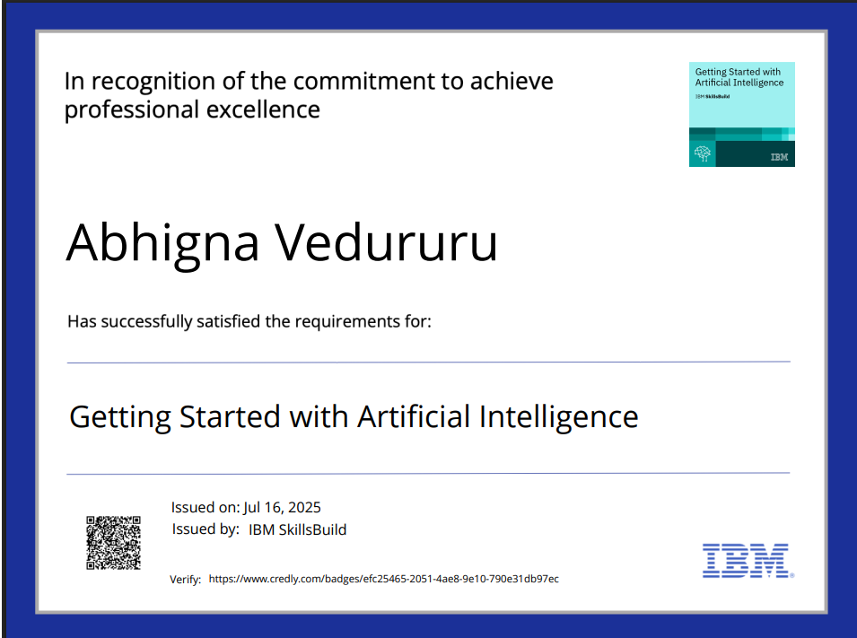
IBM Certifications

Slide 19

IBM Certifications

Slide 20
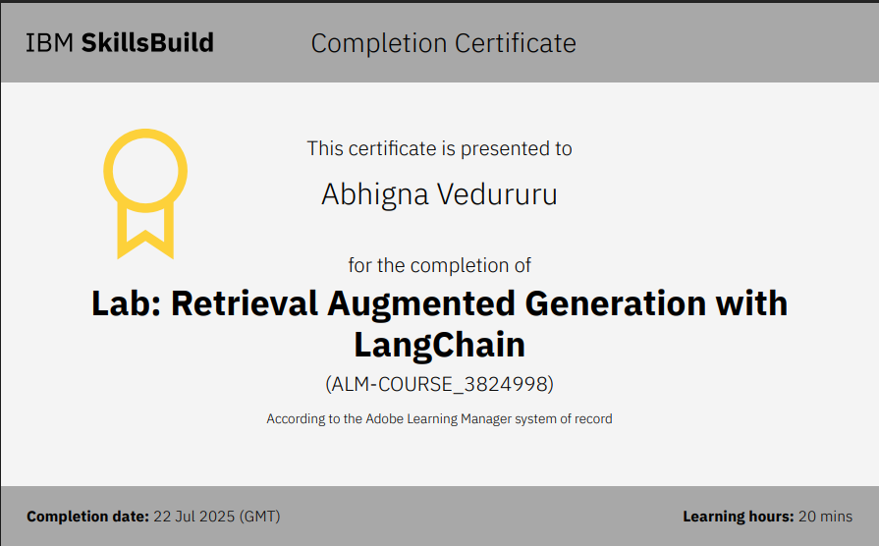
IBM Certifications

Slide 21
THANK YOU

