Slide 1
SOLID STATE DEVICES
Ultra-compact SRAM design using TFETs for low power low voltage applications
Teammates:
Abhigna Police
Rohan Ramgopal

Slide 2
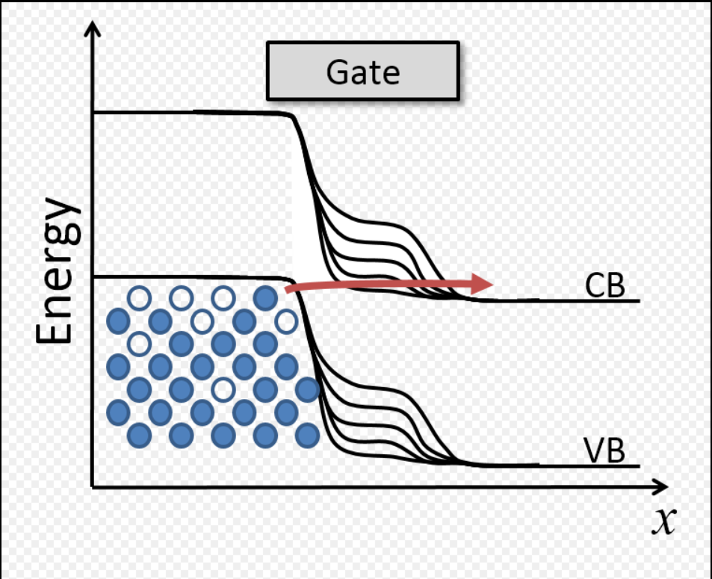
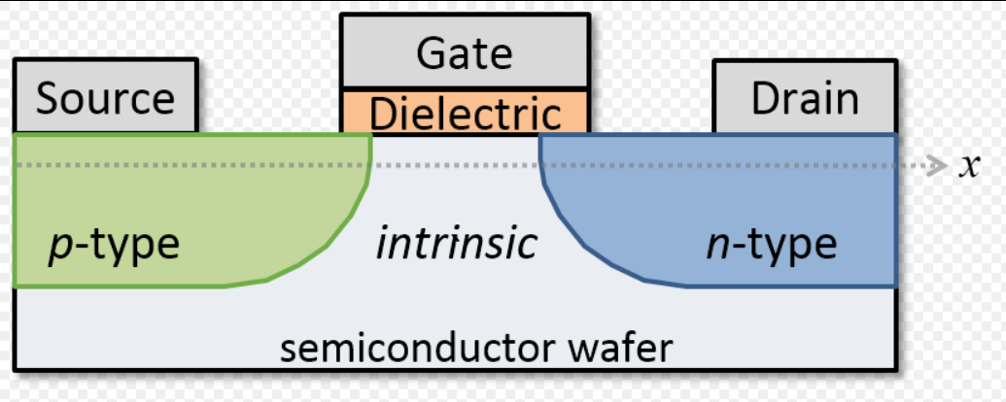
Introduction and History
CMOS: faces leakage, voltage limits.
SRAM dominates area and leakage in SoCs
IoT devices require ultra-low power memory
TFET offers low-leakage alternative to CMOS
TFETs: use tunneling for <60mV/dec SS.
Targets: ultra-low power SRAM.

Slide 3
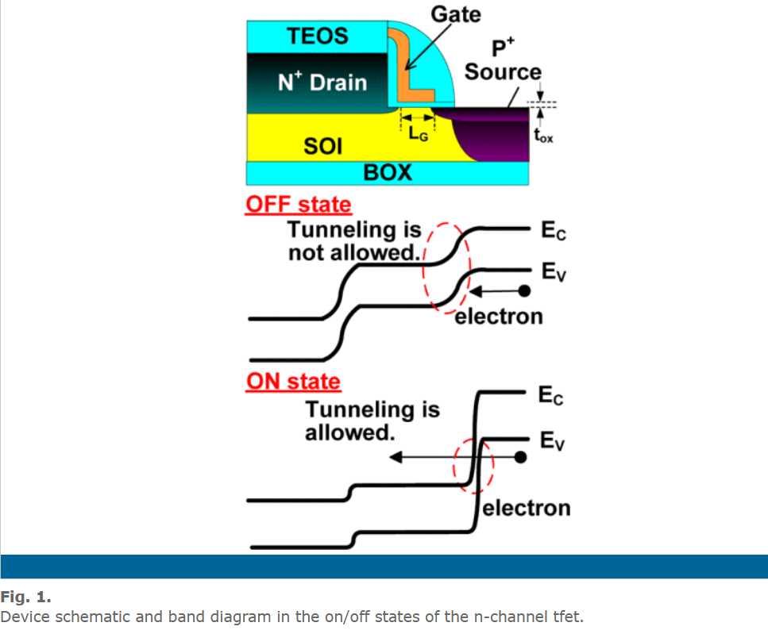
DEVICE STRUCTURE AND MATERIAL PROPERTIES
Operates via band-to-band tunneling
Achieves subthreshold slopes < 60 mV/dec
Enables operation at low supply voltages
Novel 3-Transistor TFET SRAM bitcell
3T-TFET SRAM: Compact, low leakage.

Slide 4
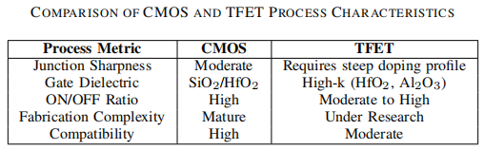
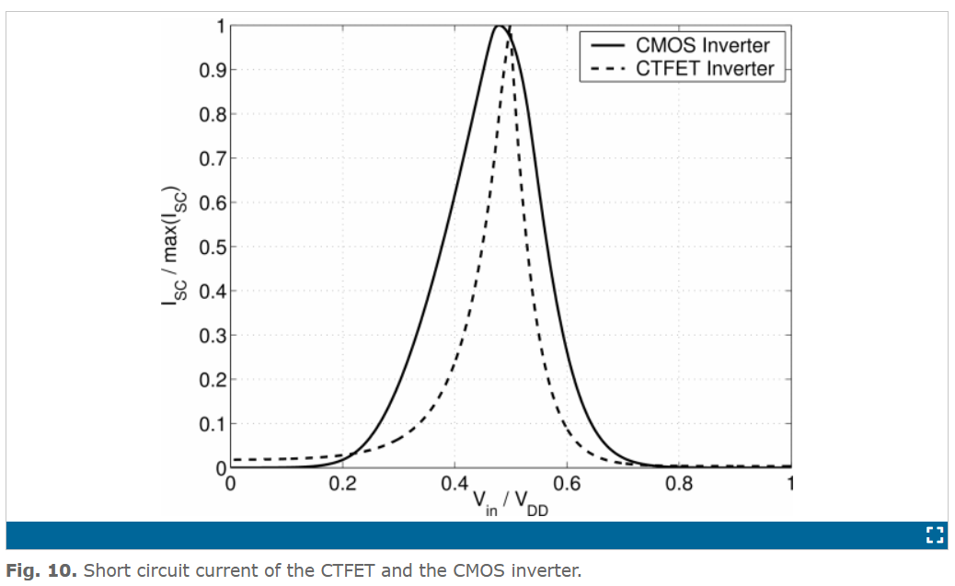
FABRICATION AND PRODUCTION
Process: SOI, ion implant, ALD, metal gate.
Challenge: doping profile control.
Goal: minimize parasitic capacitance.

Slide 5
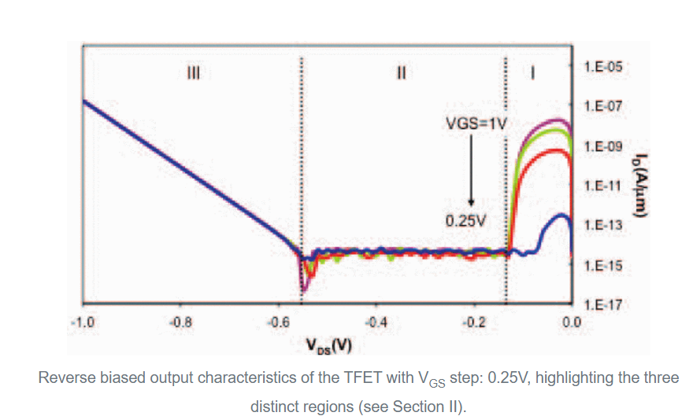
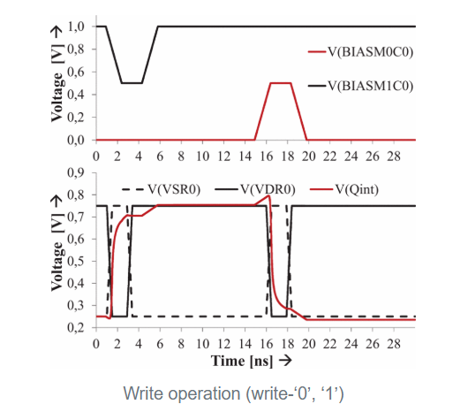
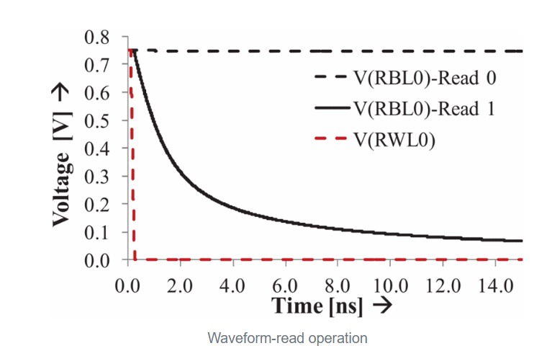
DEVICE OPERATION PRINCIPLE AND PHYSICS
Retention: Reverse-biased M0, M1 (low leakage)
Write: Swapping VDD and VSS
Read: Single-ended sense amp with precharged RBL
Kane's Model: I ∝ E²exp(-B/E).

Slide 6
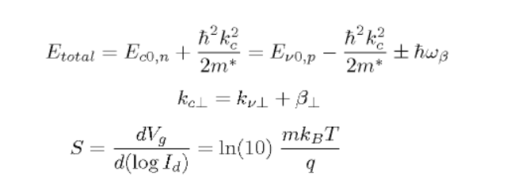
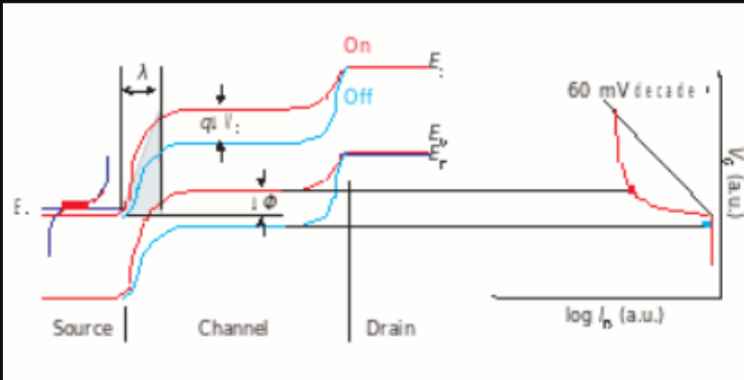
SCALING LAWS FOR THE DEVICE
Tunneling junction, not channel length.
Gate dielectric: thin, high-k for control.
CGS: low, reduces power.
CGD: optimize for switching speed.

Slide 7
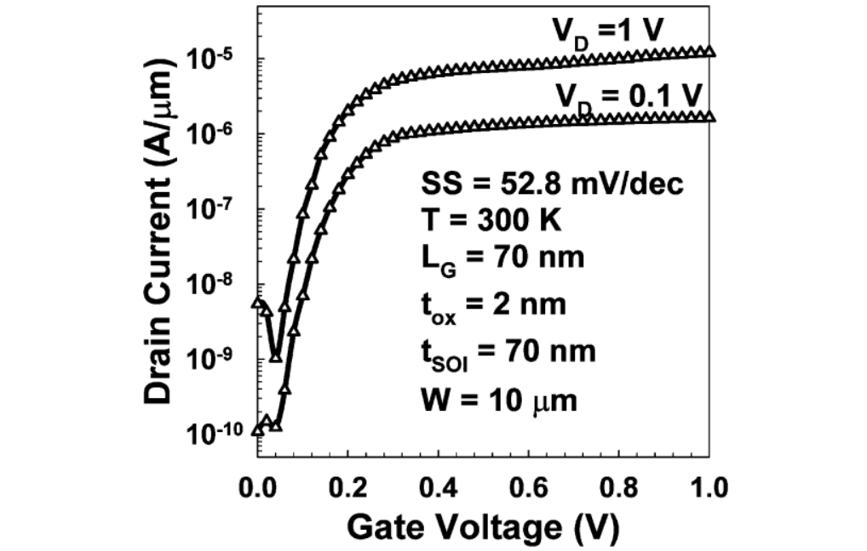
Noise and Limitations
TAT: trap-assisted tunneling noise.
Ambipolar: unwanted drain current.
Mitigation: abrupt doping, design.
Challenge: lower ION than CMOS.

Slide 8

Current Applications
IoT sensor nodes
Wearable electronics
Edge computing
Always-on SoC memory blocks

Slide 9
Discussion and Conclusion
Advantage: lower leakage.
Challenge: fabrication complexity.
TFET-SRAM shows promise for energy-constrained systems
Supports deep voltage scaling
Suitable for next-gen embedded and IoT platforms

Slide 10
References
http://large.stanford.edu/courses/2012/ph250/esfandyarpour1/
https://ieeexplore.ieee.org/document/7459337
https://ieeexplore.ieee.org/document/4278352
https://ieeexplore.ieee.org/document/10396357
https://www.sciencedirect.com/science/article/abs/pii/S0038110104001121
THANK YOU

