Slide 1


Slide 2
PROJECT TITLE
SMART BUILDING WITH IBM WATSON
Submitted by
Team: The Elite
Abhigna Ogirala, Chandra Mileeni Chowdary,
Movva Sai Laxmi, Katikam Vishali and Chandana Poorvaja Challa

Slide 3

INTRODUCTION
The main aim of the project is to reduce electrical energy consumption.
This energy saving systems employs the concept of Green Building.
It achieves this concept through three modes of operation: Eco, Away and Manual mode.

Slide 4
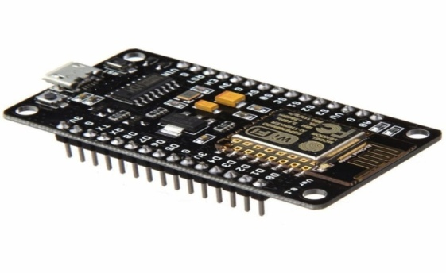
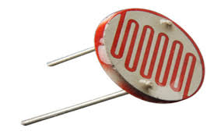
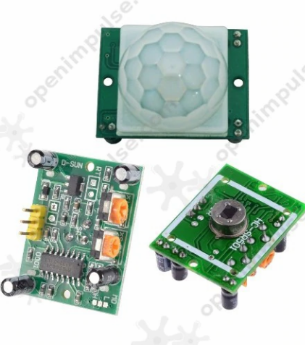
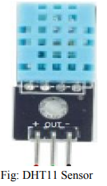
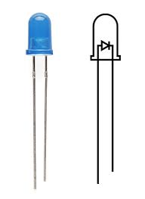
COMPONENTS
Hardware
NODEMCU
DHT11
LDR
PIR sensor
LEDs

Slide 5
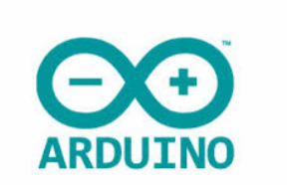


COMPONENTS
Softwares
Arduino IDE
MIT App Inventor
IBM Watson

Slide 6
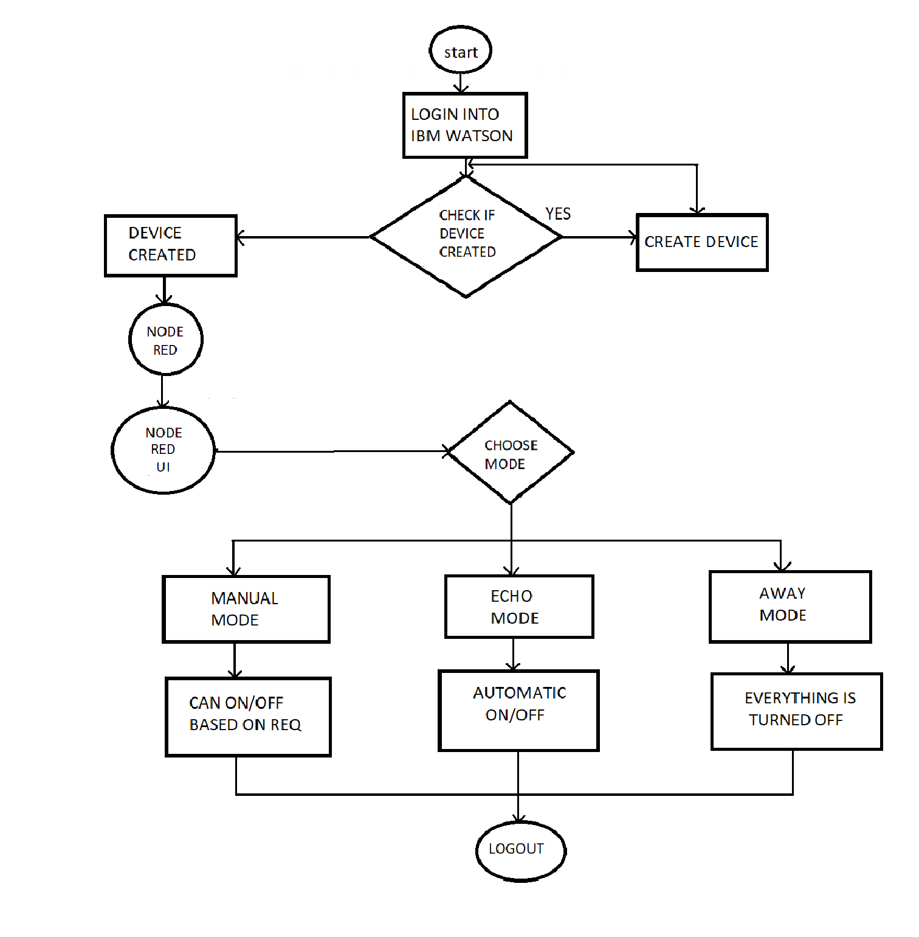
WORKING & FLOW CHART

Slide 7
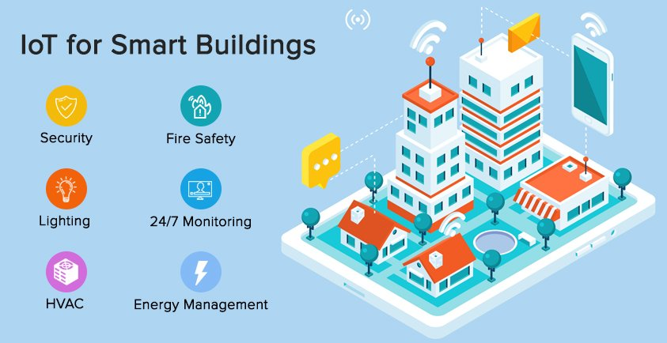
ADVANTAGES
Power consumption is minimized.
Wireless access
Environment of the room can be analyzed
Helps in decreasing the release of harmful pollutants from appliances.
Saves time and energy
Reduces electricity bills

Slide 8
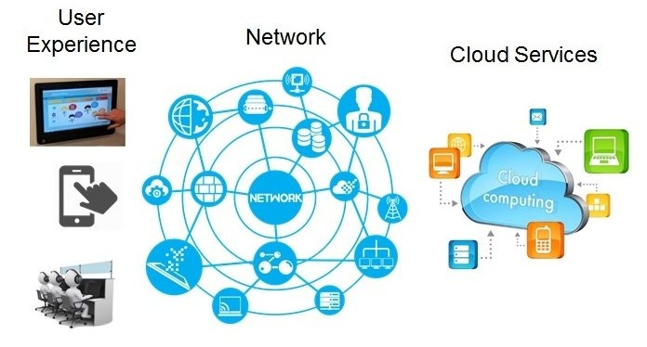
DISADVANTAGES
The appliances cannot be operated without wireless connectivity
Failure of the appliances cannot be detected
Repeated monitoring of sensors is needed to ensure they are in working condition
Privacy of data stored is not guaranteed

Slide 9
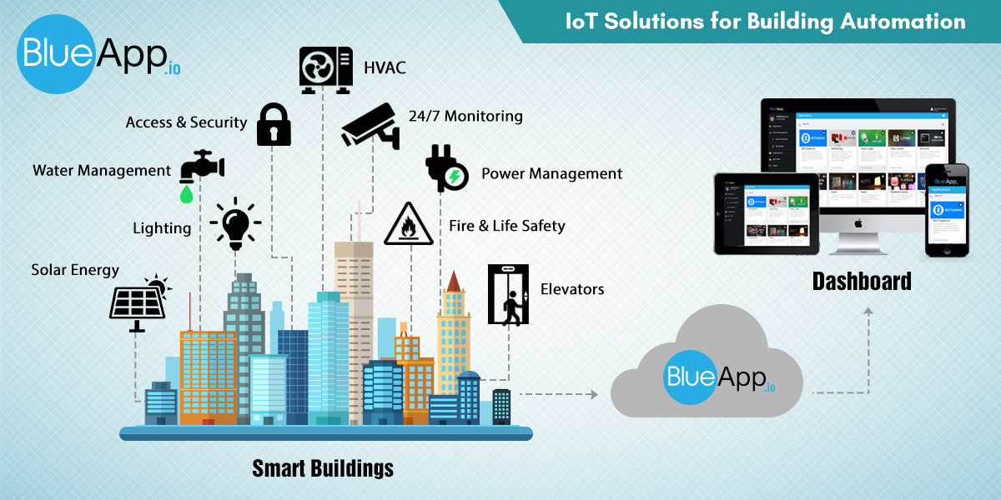
APPLICATIONS
Smart Lighting Control
The energy saving system can be employed in new land development projects
Gated Communities can make use of this system
Can make your appliances smart
Security systems can be developed
cloud

Slide 10

CONCLUSION
The Smart Building Project is an energy saving system.
Arduino IDE, NodeRed, MIT App Inventor 2 and IBM
Watson platform have been augmeted together to develop the project.
This project can be enhanced by further by integrating other features for extended uses.

Slide 11
REFERENCES
https://www.buildings.com/news/industry-news/articleid/21603/title/iot-smart-building-technology
https://smartify.in/knowledgebase/iot-based-home-automation-system/
https://www.electronicslovers.com
http://www.iotgyan.com/iot-projects/smart-buildings-with-ibm-watson
https://www.elprocus.com

Slide 12
THANK YOU !

