Slide 1

Outcome Prediction for
Shelter Dogs and Cats
Abhigna Sowgandhika Vadlamudi Ahmed Hussain Syed

Slide 2
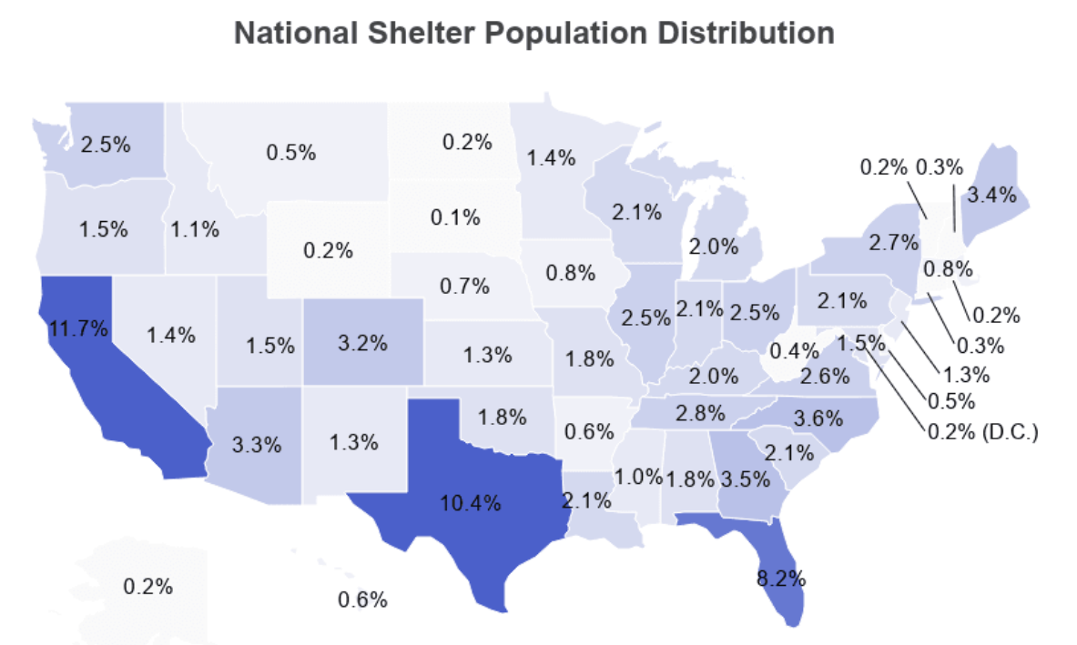
Outcome Prediction
According to the national database by the Shelter Animals Count organization, an estimated 6.5 million cats and dogs entered shelters and rescues across America in 2023. Of these, 4.8 million were adopted, 690,000 were euthanized and the rest were still waiting for an outcome.
Animal shelters nationwide house these cats and dogs in over 3,500 different facilities.
spots.com/animal-shelter-statistics/2022

Slide 3
Outcome Prediction
Our goal is to analyze these vast amounts of data across the shelters and develop a framework to predict the outcome of a new cat/dog intake.
How are we doing this?
We will run the datasets through machine learning algorithms and determine which method is beneficial to identify the features affecting the adoption speed. The rate at which an animal gets adopted /euthanised /fostered depends on various classifications (including age, health, breed, color, etc).
Why are we doing this?
This will enable shelters and rescues to understand their data and therefore provide solutions to any resource/ space constraints they could be facing. We hope our analysis will allow for quicker outcome speeds (based on which characteristics of the animal relate to a higher likelihood for adoption) for a new intake animal, improve partnerships with fosters, and reduce the rate of euthanasia.

Slide 4
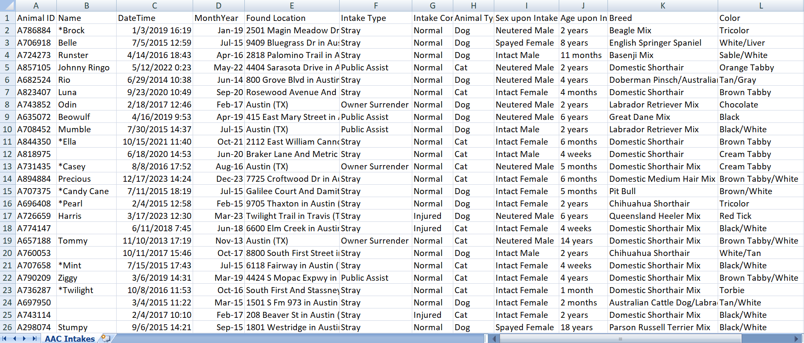
Datasets Used
Intake Dataset: 160k rows, 12 columns

Slide 5
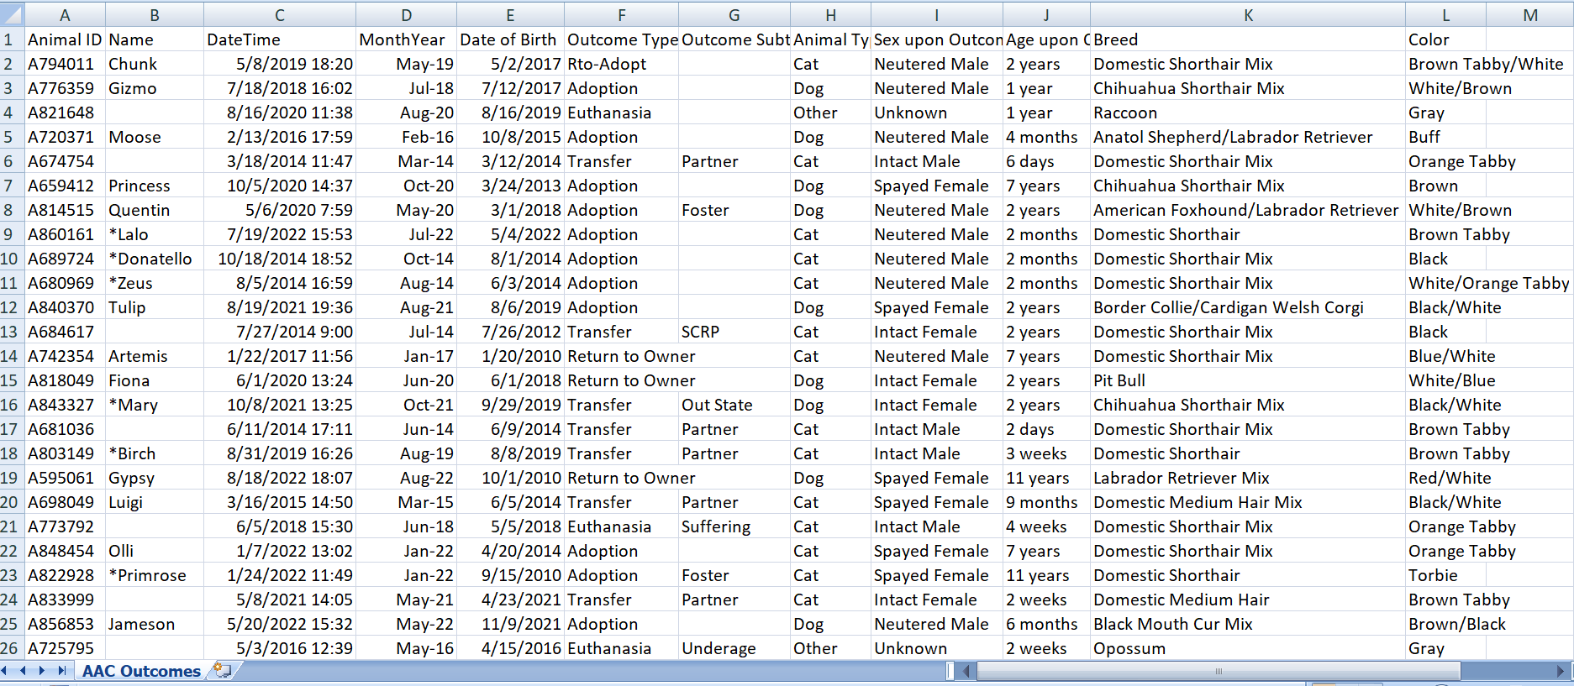
Datasets Used
Outcome Dataset: 160k rows, 12 columns

Slide 6
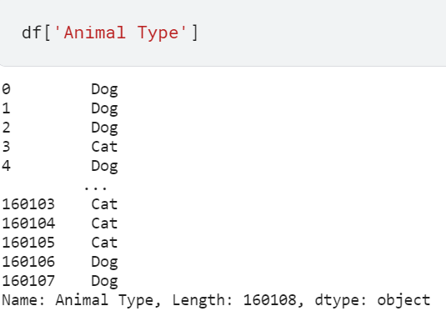
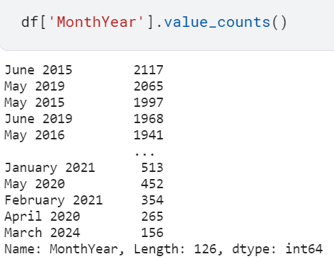
A Few Insights
Understanding the statistics of high intake rates over the years
Removing other categories of ‘Animal Type’ from the database

Slide 7
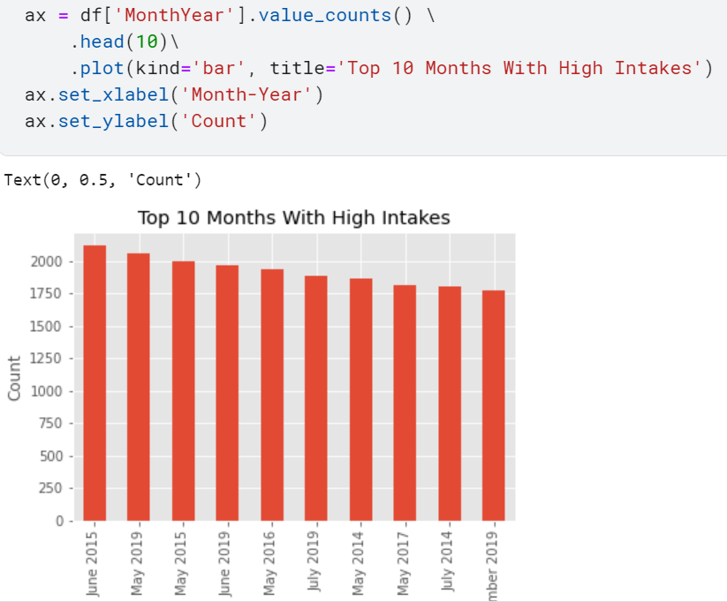
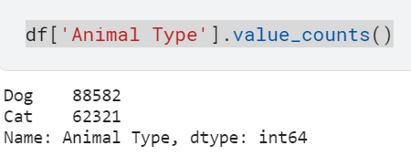
A Few Insights
Categorizing and counting the number of cats and dogs in the dataset after removing other categories
Plotting ten months with the highest number of intakes into the shelters

Slide 8
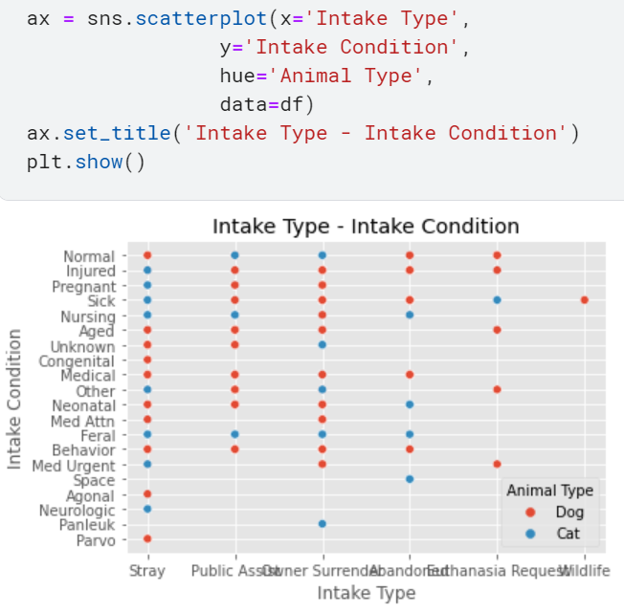
A Few Insights
A scatter plot which shows the relation between the intake type and intake condition of each cat/dog.

Slide 9
Implementation of Machine Learning
We propose to explore novel directions in predictive modeling for shelter animal outcomes by integrating a wide range of features including not only demographic information but also behavioral traits, health status, and historical shelter data.
Additionally, we aim to leverage advanced machine learning algorithms such as classification trees, random forests, etc., to capture complex relationships among predictors and predict adoption likelihood more accurately.
We will use four main predictive models: k-nearest neighbours, naive bayes, classification tree, random forest. Then, will then determine the baseline prediction accuracy and decide upon which method works best to achieve the necessary results. Then, if time permits, we plan on scaling the method to work on larger datasets, covering more parts of the country.

Slide 10
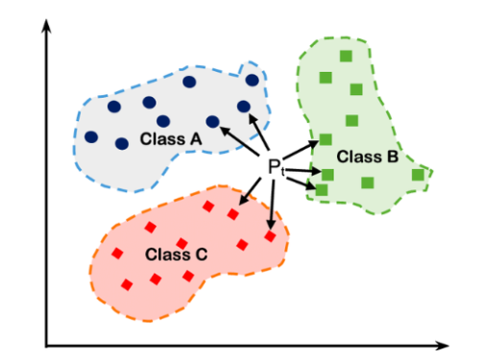
K-Nearest Neighbours
Non-parametric, supervised learning classifier, which uses proximity to make classifications or predictions about the grouping of an individual data point
Simple, popular
Can be used for classification or regression
Uses 'feature similarity' to predict the values of any new data points
Can determine the outcome of an animal after grouping it as a cat or a dog, based on the average result of each class.

Slide 11
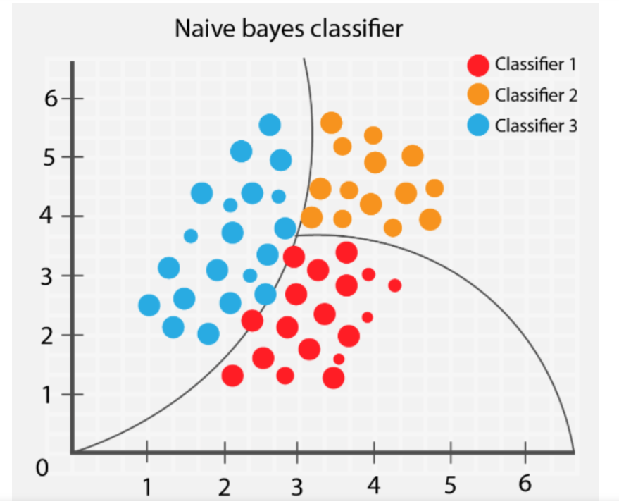
Naive Bayes
Simple technique for constructing classifiers: models that assign class labels to problem instances, represented as vectors of feature values, where the class labels are drawn from some finite set
Highly scalable
Probabilistic machine learning model
Since most of the features of our dataset are independent, this can be used to predict the target class.

Slide 12
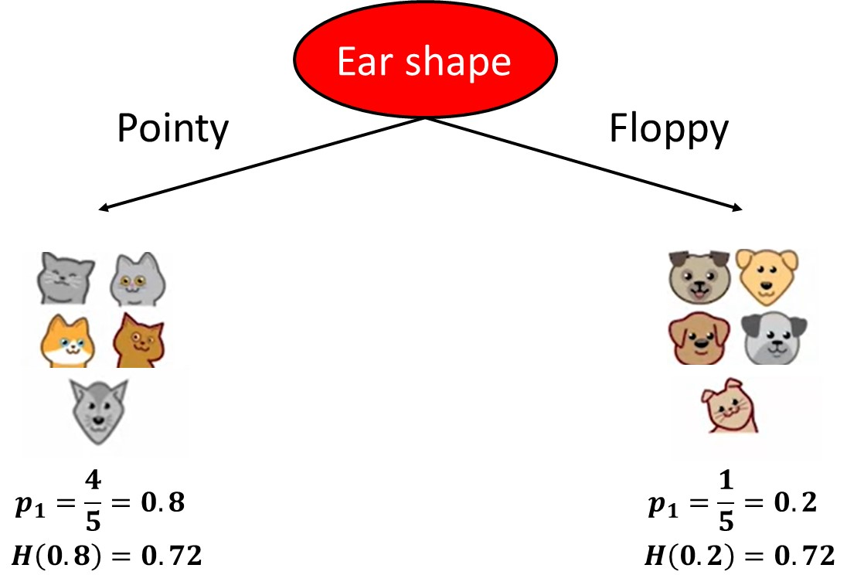
Classification Tree
Used as a predictive model to draw conclusions about a set of observations
Hierarchical way of partitioning the space
Provides a measure of confidence that the classification is correct
One of the simpler ways to understand the dataset, identify patterns if any and classify it into categories.

Slide 13
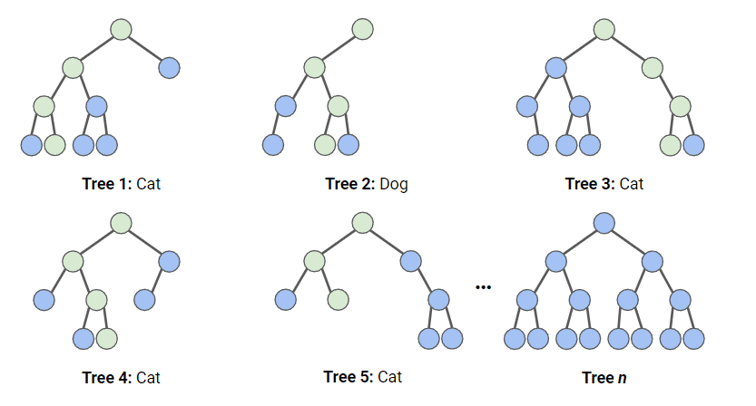
Random Forest
Combines the output of multiple decision trees to reach a single result
Can be used for both classification and regression
Powerful, versatile
Multiple questions can be used to form decision trees
This enables us to split the data based on simple questions and arrive on a final decision.

Slide 14
Conclusion
Using a data-driven approach to predicting shelter animal outcomes, we aim to improve resource allocation, enhance animal welfare, and reduce euthanasia rates. By leveraging predictive modeling techniques and integrating diverse sets of features, we seek to provide shelters and rescues with insights to optimize their operations and improve outcomes for animals in their care.
What we learned:
How outcome prediction works and why it is important for shelter animals
Preprocessing and cleaning large datasets
The different machine learning approaches that can be applied
Future work on the project
Link to Exploratory Data Analysis

