Slide 1

Assessment of Customer Booking

Slide 2
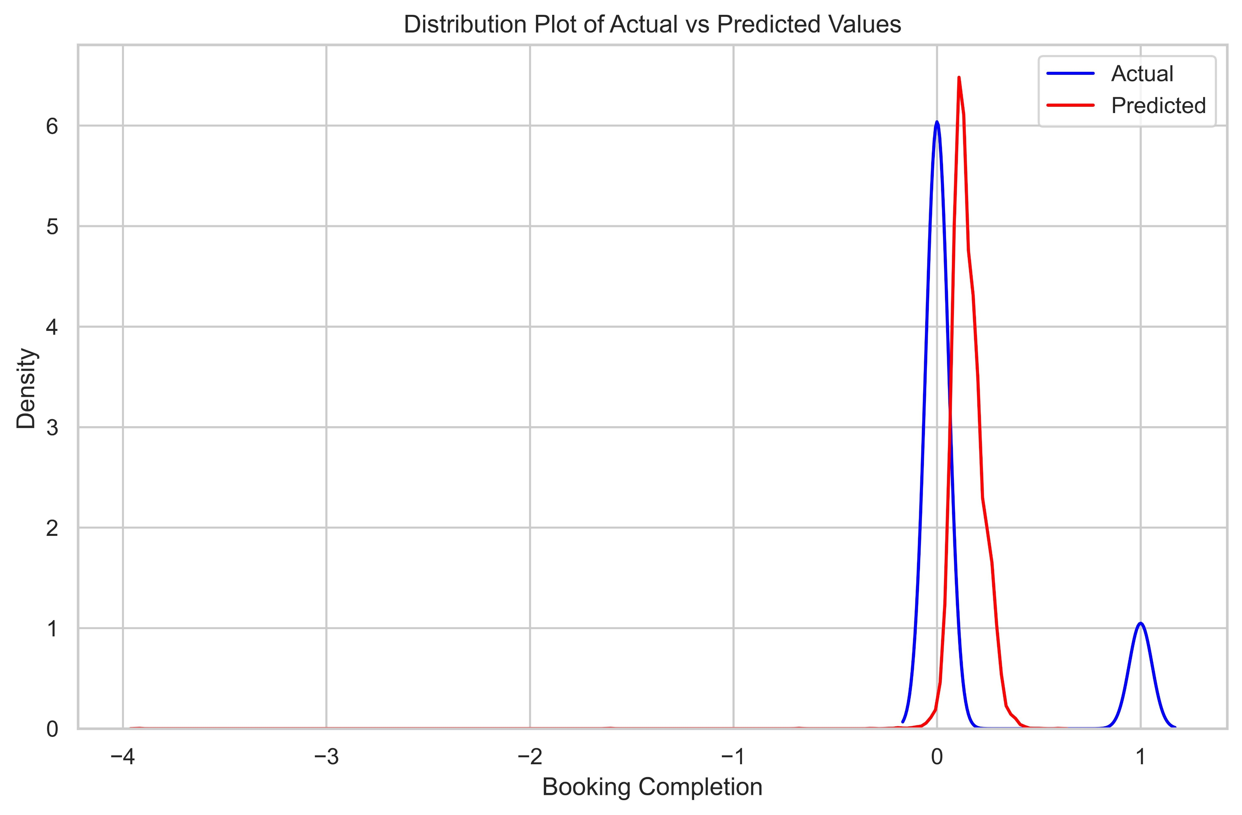
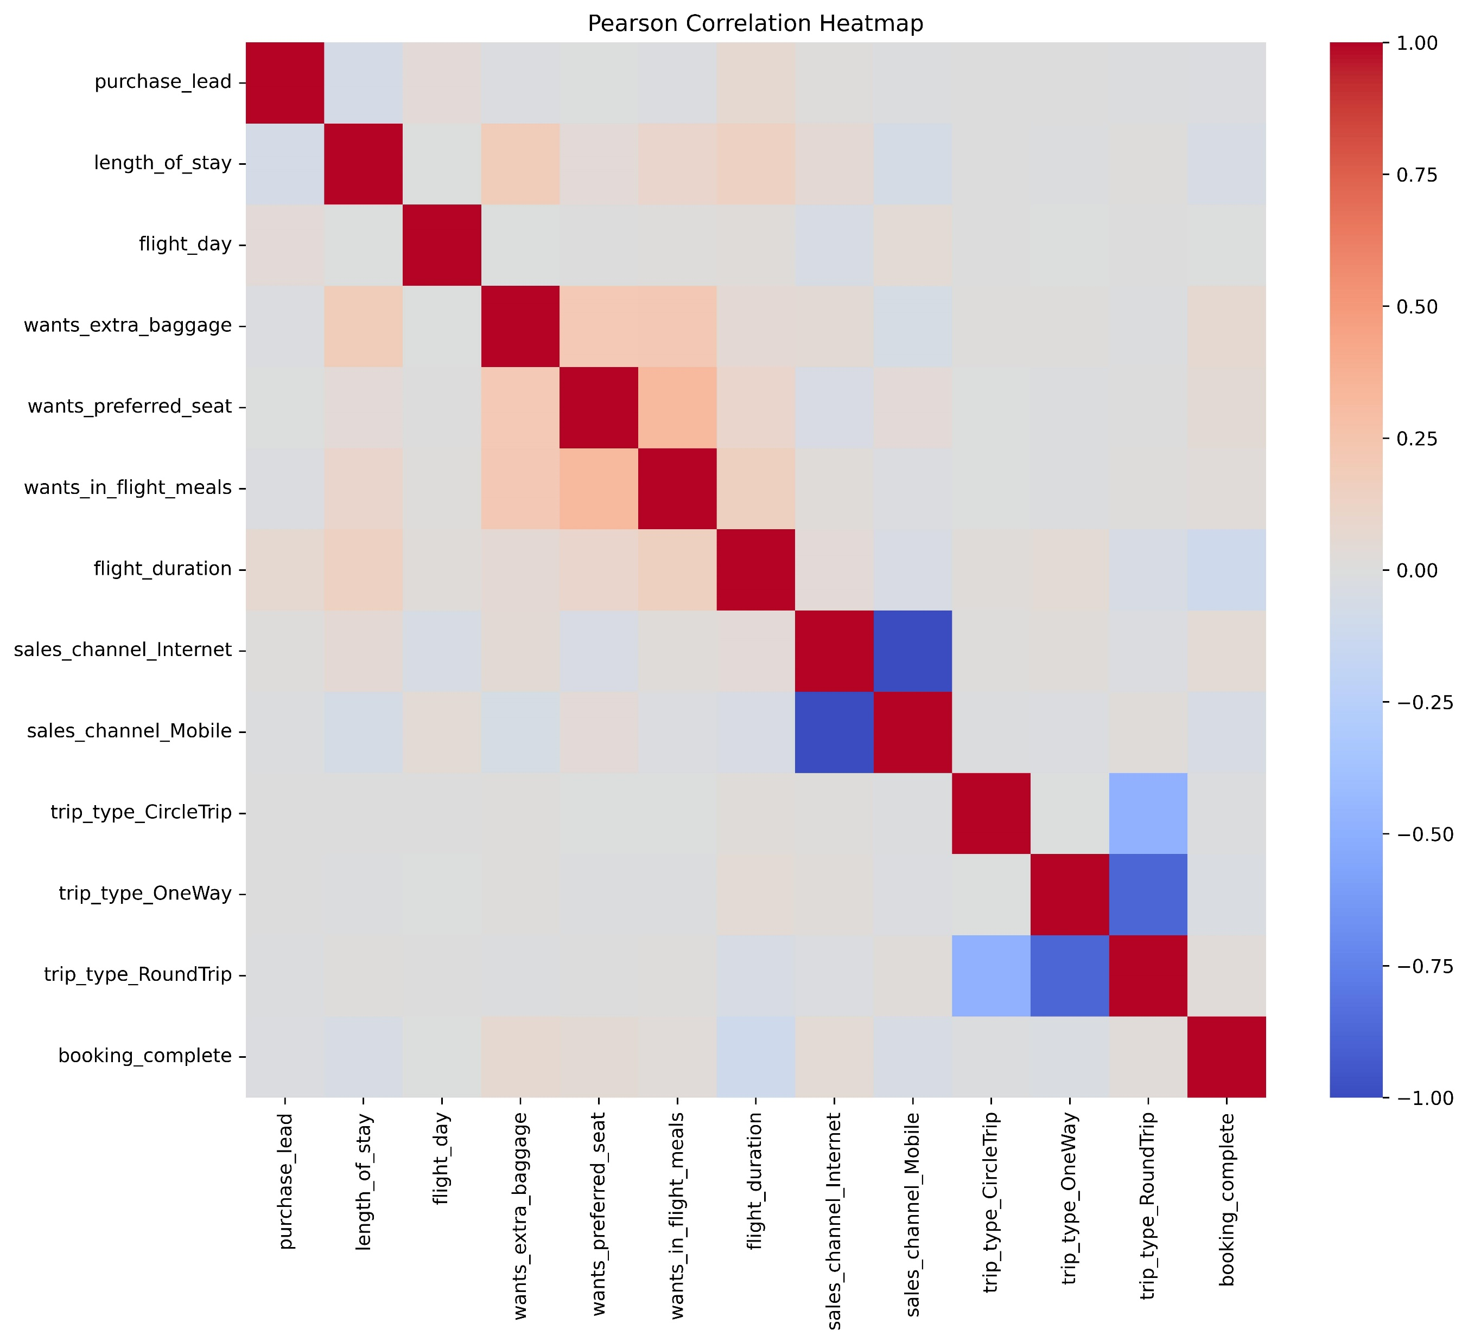
Model-Development-Eval
2) Based on the heat map we can see that the correlation of features are not very good to that of booking confirmation,
Still we make a Polynomial Regression model to make predictions and evaluate model with help for distribution plot
1) We first converted necessary categorical data into numerical data and than checked correlations through a pearson-correlation heat map as you can see below
3)As you can see we can predict when someone will not book with us but cannot predict when someone will book with us

