Slide 1

Assessment of Customer Review

Slide 2
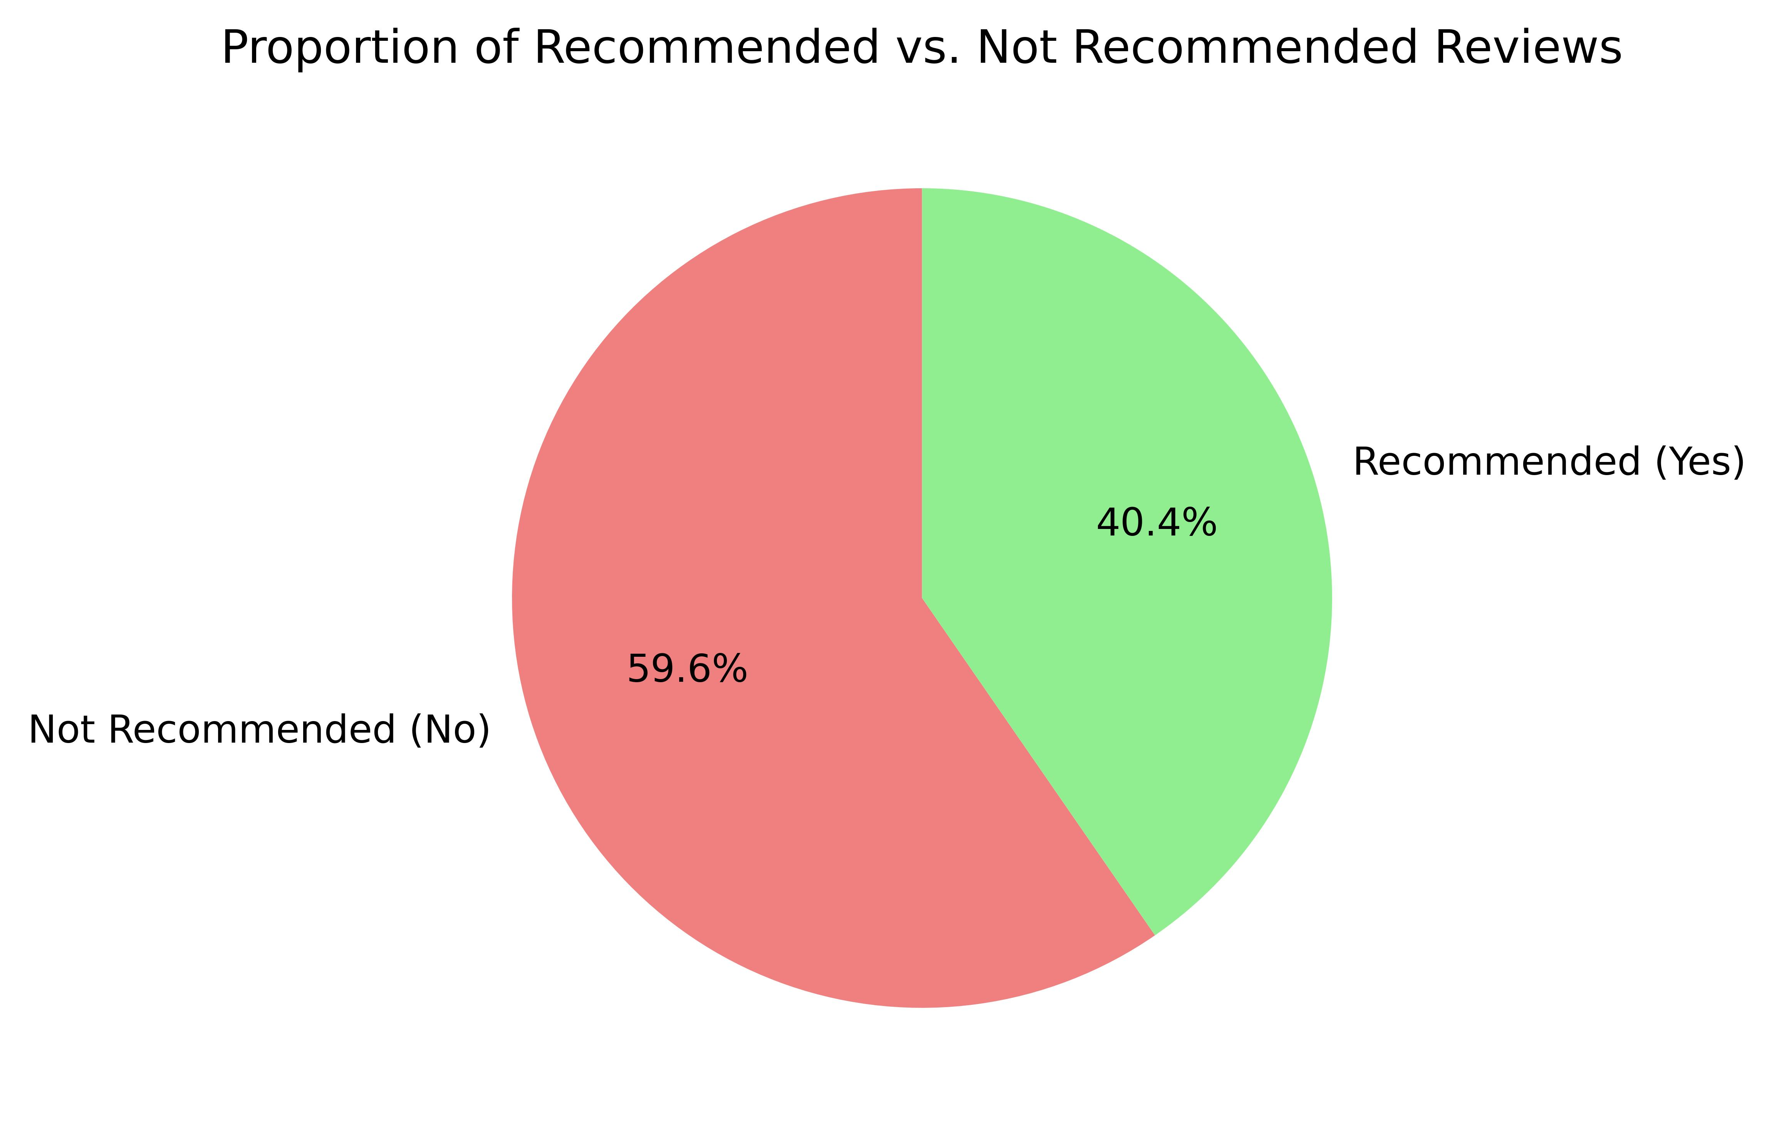
Recommendation Rate
From 3740 reviews by our valuable customers, we have found that 59.6% that is about 2229 customers have not recommended our service as you can see in the Pie-Chart, it means we need some significant improvement

Slide 3
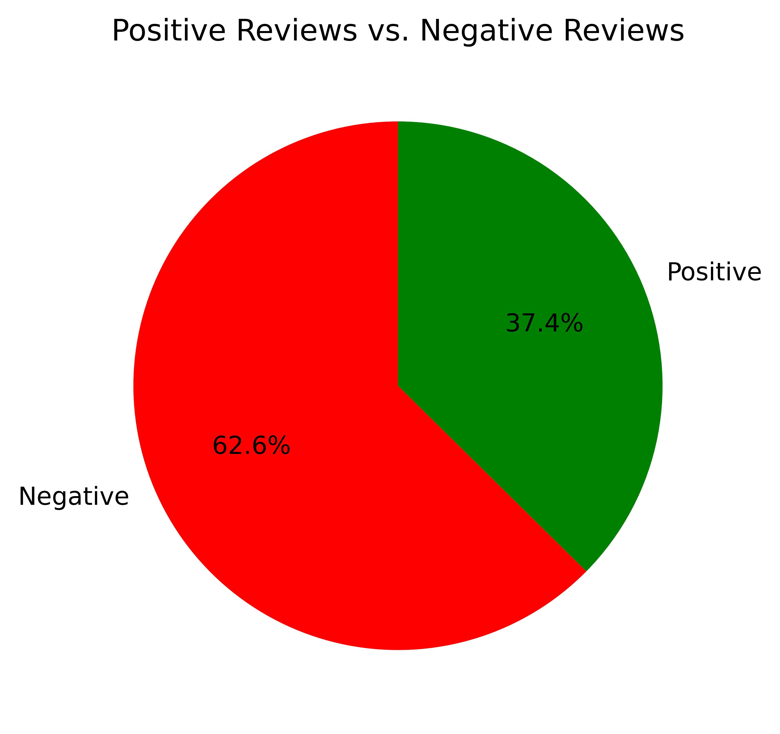
Sentiment Amongst Customer
From the below Pie-Chart we can discovered that there are total 2341 negative reviews about our service that is about 62.6% of total

Slide 4
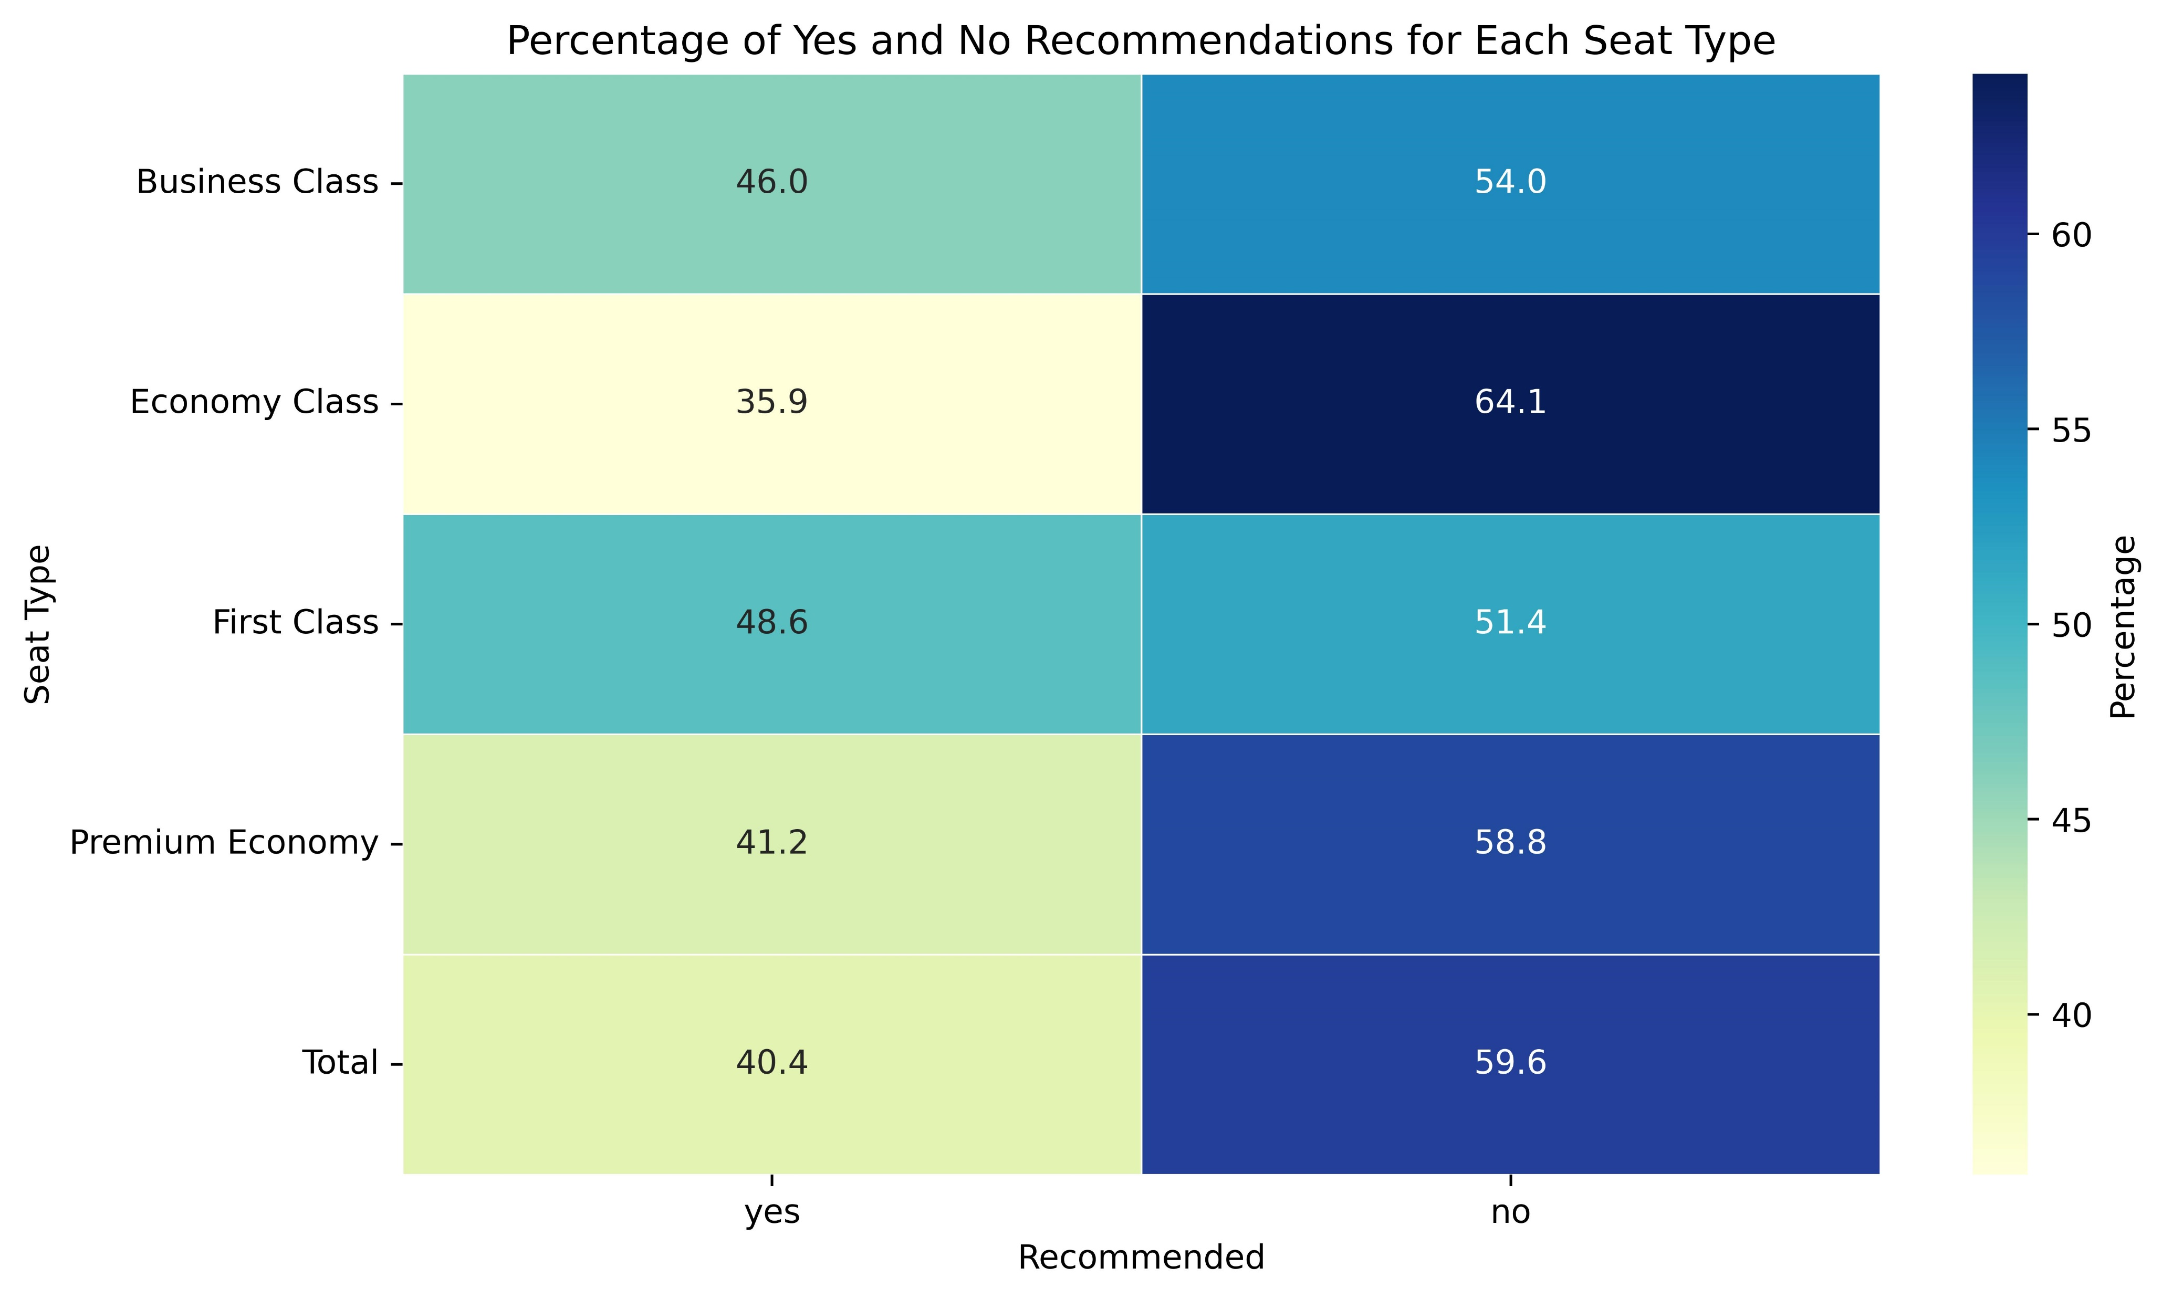
Seat Type Impact on Recommendation Decisions
As we can see from the heatmap that all of the seat type have more than 50% ‘NO’ recommendations but
Economy Class and Premium Economy
need more significant improvements than the rest as they have more amount of ‘NO’ recommendations than the other seat types and also that they combine represent 61.9% of our customers

Slide 5
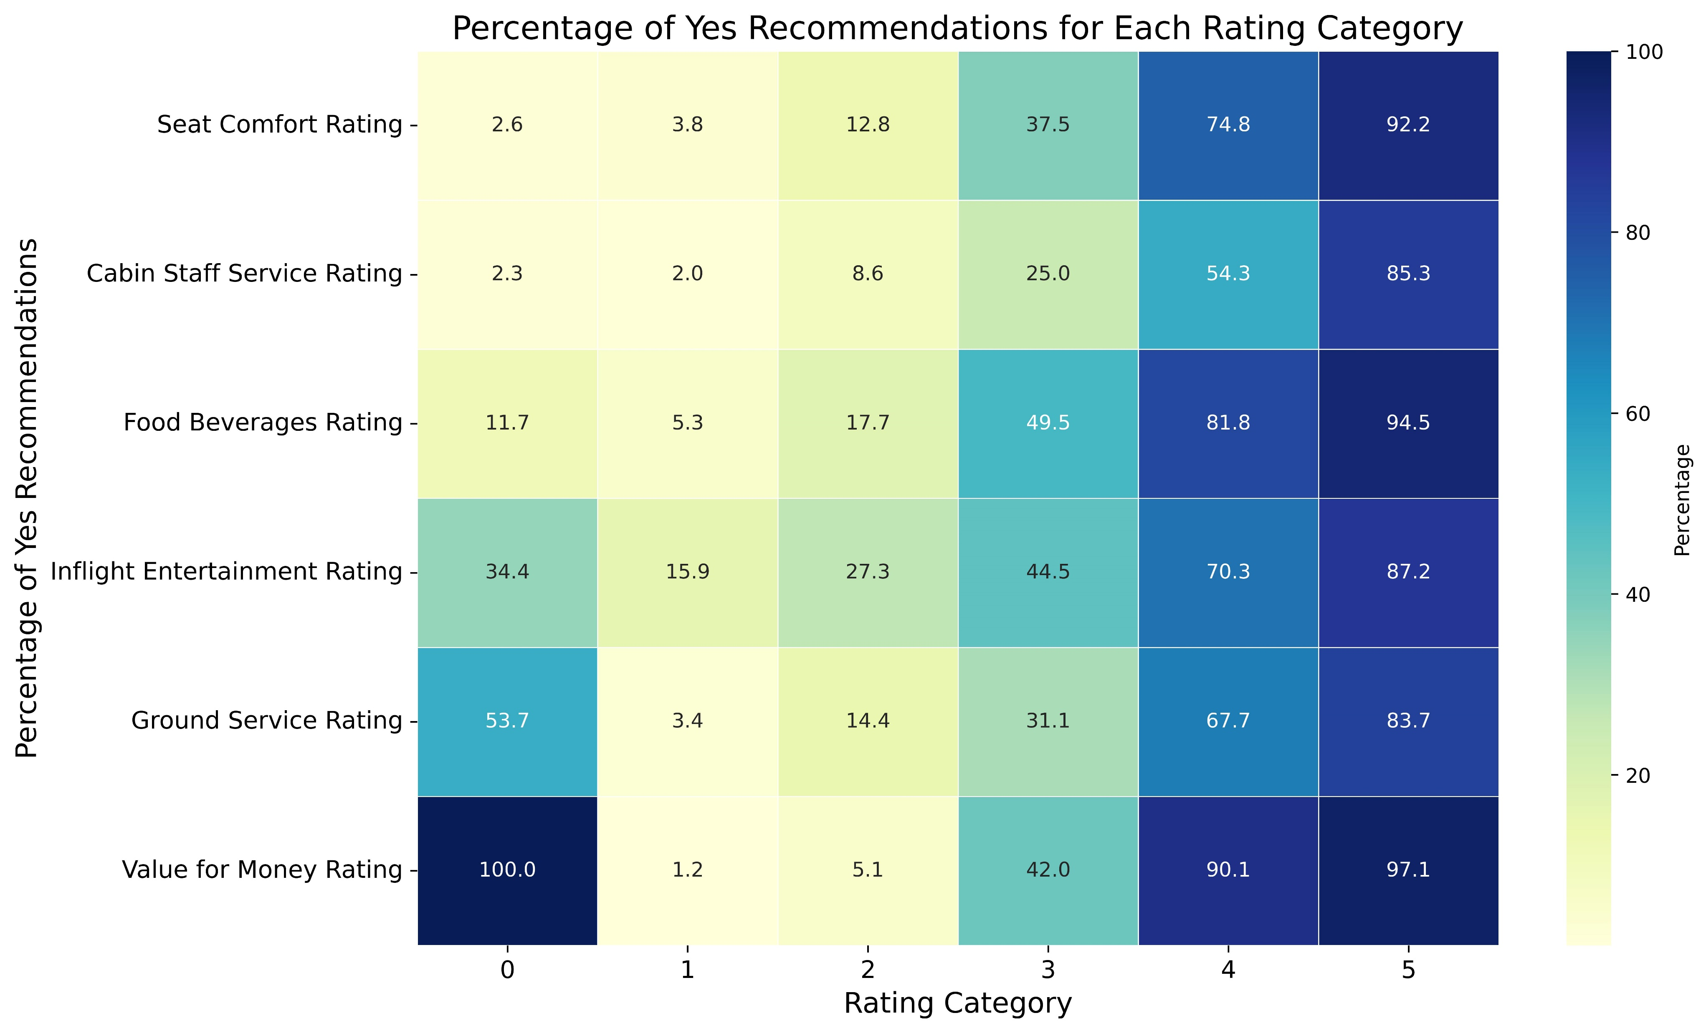
Impact of Rating on Recommendations

Slide 6
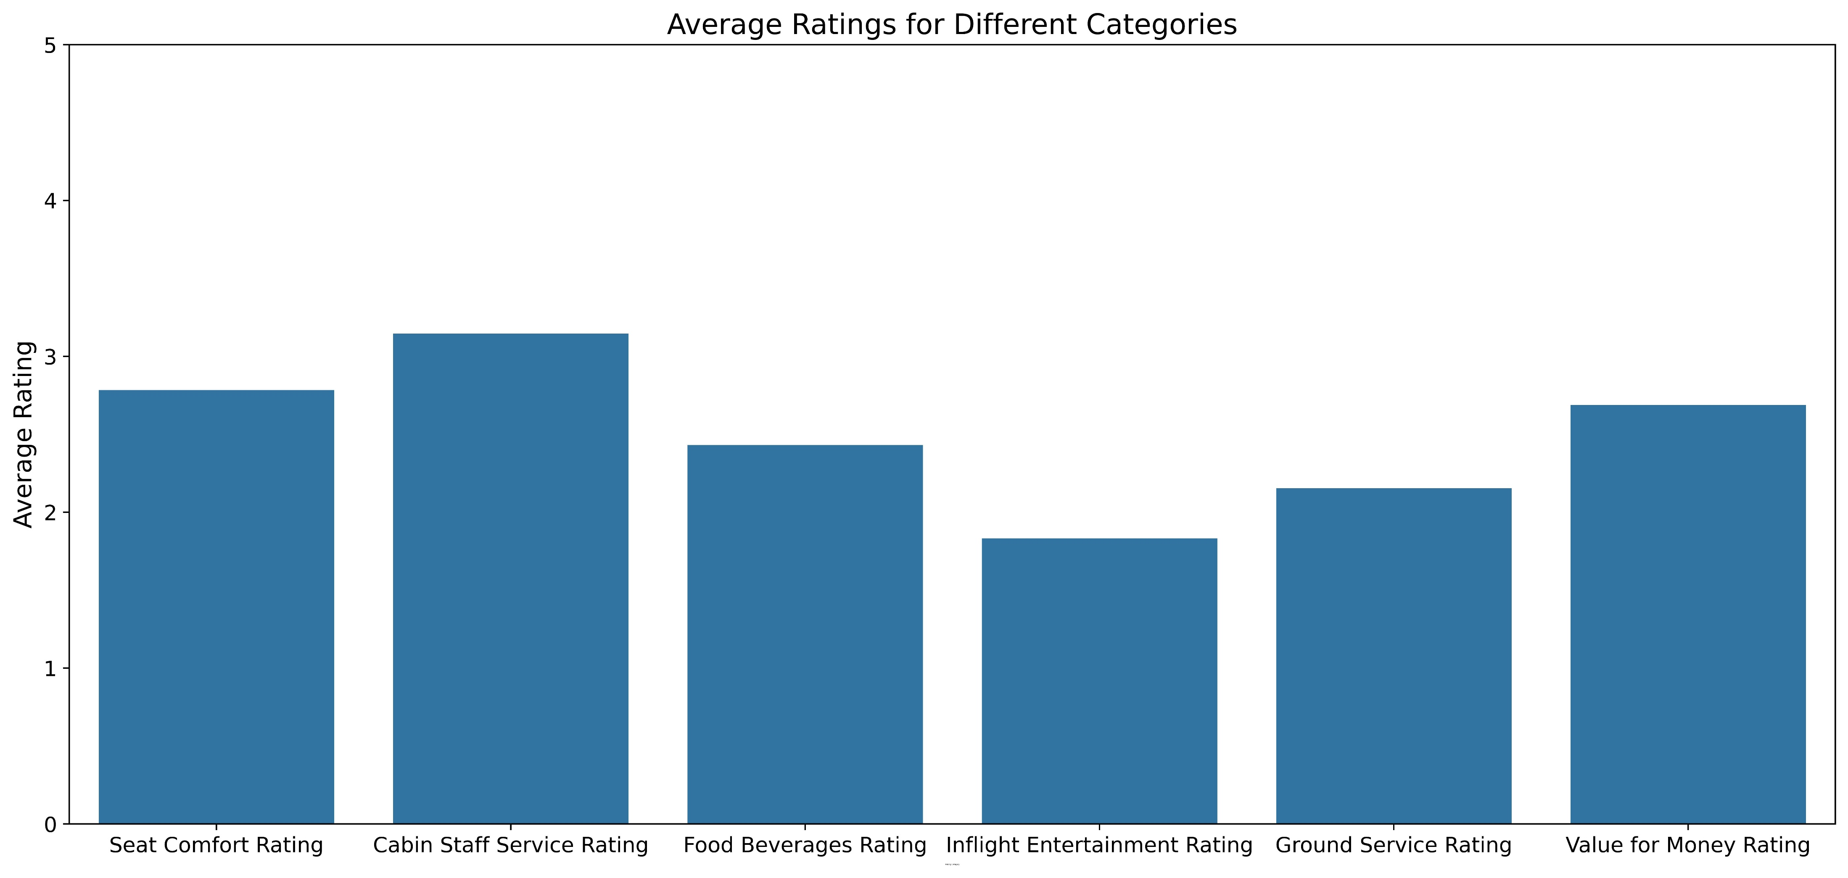
From the Heatmap in the previous slide we can observe that the comfort of seat, the quality of food and beverages and the feeling of getting value of money have more influence in getting positive reviews and recommendations from customers.
Now, How much we are lacking behind in all the rating sector can be seen in the Bar graph below.

Slide 7
After analysing the Reviews and Ratings we conclude that we need to take serious decisions to improve our service especially for Economy class and Premium Economy as they have gotten more ‘NO’ recommendations than other seat type and they also represent 61.9% of our total customers
To improve positive reviews and recommendations we need to give special focus to the comfort of seat, the quality of food and beverages and the feeling of getting value of money as they have more impact on the recommendations and reviews in comparison to other ratings
But we also need to improve in all the other sectors such as Inflight entertainment rating and Ground Service rating is worst in comparison to other ratings

